Slide 1
CORNETO: unifying multi-sample network inference from prior knowledge and omics
Rodriguez-Mier, Garrido-Rodriguez, Gabor & Saez-Rodriguez
Nature Machine Intelligence 7, 1168–1186 (2025) · doi:10.1038/s42256-025-01069-9
Notes:
CORNETO = Constrained Optimisation for the Recovery of NETworks from Omics. Saez-Rodriguez lab, Nature Machine Intelligence, July 2025. Theme of today: multi-omics integration and network inference.

Slide 2
Outline
1
Why network inference from prior knowledge?
2
The methods CORNETO unifies
3
CORNETO: one optimisation problem
4
Results in the paper
5
Our test: the PMS iNSC data
6
Discussion
Rodriguez-Mier, Garrido-Rodriguez, Gabor & Saez-Rodriguez, Nat Mach Intell 7:1168 (2025)
2
Notes:
Six parts: the problem, the methods CORNETO unifies, its formulation, the paper's results, our own test on progressive-MS stem-cell data, and a discussion.

Slide 3
Omics give lists of changes; we want mechanisms
Data-driven
Knowledge-driven
• Correlation, machine learning
• Associations
• Start from a prior knowledge network (PKN)
• Map omics data onto it
• Keep the subnetwork that explains the data
Network inference = choosing a context-specific subnetwork of the PKN
Rodriguez-Mier, Garrido-Rodriguez, Gabor & Saez-Rodriguez, Nat Mach Intell 7:1168 (2025)
3
Notes:
Data-driven network inference (correlation, ML) needs many samples and only gives associations. Knowledge-driven inference starts from a prior knowledge network (PKN) and keeps the part of it that explains the data. This is what CARNIVAL, iMAT, Steiner trees etc. all do.

Slide 4
But every method lives in its own silo
Signalling
Metabolism
Protein interactions
CARNIVAL
FBA, iMAT
Steiner trees
• Own data type, own code, one sample at a time
• Shared vs sample-specific mechanisms are hard to separate
Question
Can one optimisation problem express all of them, and fit many samples jointly?
Rodriguez-Mier, Garrido-Rodriguez, Gabor & Saez-Rodriguez, Nat Mach Intell 7:1168 (2025)
4
Notes:
Signalling, metabolism and PPI each have their own tools, data types and code. Most analyse one sample at a time, so they cannot separate shared mechanisms from sample-specific ones, and several networks often explain the data equally well (non-identifiability).

Slide 5
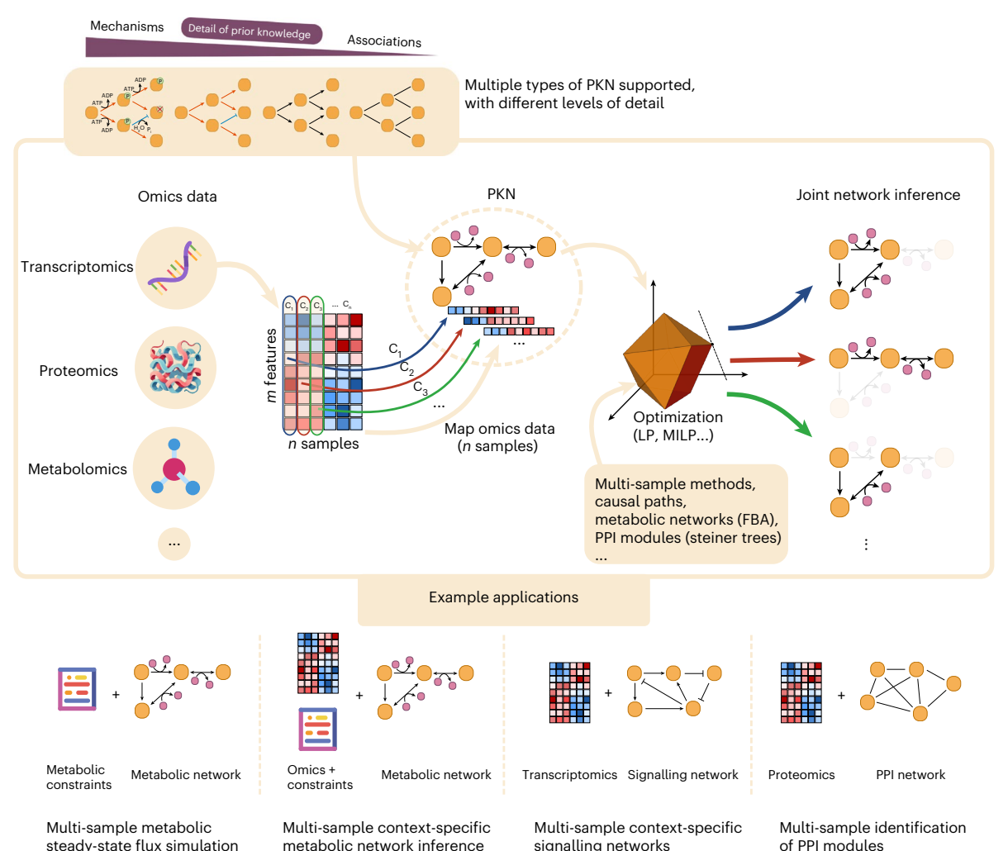
CORNETO: map data onto a PKN, solve one optimisation problem
• Any PKN: graphs to hypergraphs
• Any omics layer, mapped onto nodes or edges
• All samples solved together
• Exact solvers: LP / MILP
• Python library, solver-agnostic
Fig. 1, CC BY 4.0
Rodriguez-Mier, Garrido-Rodriguez, Gabor & Saez-Rodriguez, Nat Mach Intell 7:1168 (2025)
5
Notes:
Figure 1. Any PKN type (top), any omics layer mapped onto it, one optimisation problem (LP/MILP), and n context-specific networks out, inferred jointly. Bottom row: the four applications in the paper.

Slide 6
Outline
1
Why network inference from prior knowledge?
2
The methods CORNETO unifies
3
CORNETO: one optimisation problem
4
Results in the paper
5
Our test: the PMS iNSC data
6
Discussion
Rodriguez-Mier, Garrido-Rodriguez, Gabor & Saez-Rodriguez, Nat Mach Intell 7:1168 (2025)
6
Notes:
Before the framework: the ingredients it unifies.

Slide 7
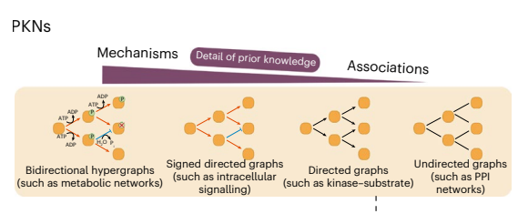
Prior knowledge networks come in four shapes
Left: more mechanistic detail
Right: more coverage, fewer assumptions
Fig. 2 (PKNs), CC BY 4.0
Hypergraph
genome-scale metabolic models
Signed directed
signalling, e.g. OmniPath
Directed
kinase–substrate
Undirected
protein–protein interactions
Rodriguez-Mier, Garrido-Rodriguez, Gabor & Saez-Rodriguez, Nat Mach Intell 7:1168 (2025)
7
Notes:
From mechanistic to associative. Metabolic networks are hypergraphs because a reaction links several metabolites with stoichiometry. Signalling PKNs (e.g. OmniPath) are signed and directed. Kinase-substrate networks are directed, PPI networks undirected. TF regulons (CollecTRI) are also signed directed graphs.

Slide 8
Step 0 — decoupler: transcription factor activity from its targets
TF
Regulon: signed TF → target edges (CollecTRI, DoRothEA)
Score: fit target gene statistics on regulon weights (e.g. univariate linear model)
Output: one activity per TF per sample
Used as: the measured nodes for CARNIVAL
g1
g2
g3
g4
g5
red activation / up blue repression / down
target changes → TF score
Badia-i-Mompel et al., Bioinform Adv 2022
Rodriguez-Mier, Garrido-Rodriguez, Gabor & Saez-Rodriguez, Nat Mach Intell 7:1168 (2025)
8
Notes:
A regulon is a signed TF -> target network (CollecTRI, DoRothEA). decoupler scores each TF from the changes of its targets, e.g. the univariate linear model (ULM): regress gene-level statistics on the signed regulon weights and use the t-value as activity. Result: one TF activity per sample. These are the 'measured' nodes CARNIVAL tries to explain. In the paper decoupler is used on CPTAC transcriptomics.

Slide 9
CARNIVAL: sign-consistent paths from inputs to TFs
In
Node state: up, down or off
Edge rule: child = edge sign × parent
Fit: match TF activities with few edges
Solver: integer linear program
Inverse CARNIVAL: inputs unknown, so any root node may start a signal
K1
K2
K3
K4
TF1
TF2
TF3
red activation / up blue inhibition / down
Liu et al., NPJ Syst Biol Appl 2019; dashed = PKN edge not selected
Rodriguez-Mier, Garrido-Rodriguez, Gabor & Saez-Rodriguez, Nat Mach Intell 7:1168 (2025)
9
Notes:
Signed directed PKN. Each node gets a state up/down/off. A selected edge passes the parent's state times the edge sign to the child. The ILP finds the smallest subnetwork whose TF states best match the decoupler activities (mismatch weighted by |activity|). Grey dashed edges are in the PKN but not selected; e.g. K2->K4 would make K4 up, contradicting TF2. Inverse CARNIVAL: if the perturbation is unknown, every root node of the PKN may start a signal.

Slide 10
FBA: fluxes through a metabolic network at steady state
Steady state: S v = 0
Bounds: lb ≤ v ≤ ub
Objective: maximise biomass flux (LP)
Sparse FBA: fewest active reactions with biomass ≥ x% of max (MILP)
B
v1
v3
v0
bio
A
C
v2
v4
D
dark = one optimal flux route
Orth, Thiele & Palsson, Nat Biotechnol 2010
Rodriguez-Mier, Garrido-Rodriguez, Gabor & Saez-Rodriguez, Nat Mach Intell 7:1168 (2025)
10
Notes:
Stoichiometric matrix S (metabolites x reactions). Steady state S v = 0: every metabolite is produced as fast as it is consumed. Flux bounds encode reversibility, nutrients, knockouts. Objective: maximise biomass, an LP. Sparse FBA: the fewest active reactions that still give at least x% of the optimal biomass, a MILP. Here A->B->C is the minimal route; A->D->C is an equivalent alternative (FBA solutions are often not unique).

Slide 11
iMAT: a metabolic network that agrees with expression
Map: expression → reaction score via gene–protein–reaction rules
Classes: high, low, uncertain
Maximise: high reactions on + low reactions off
Subject to: FBA constraints (MILP)
B
v1
v3
v0
bio
A
C
v2
v4
D
high low uncertain
Shlomi et al., Nat Biotechnol 2008
Rodriguez-Mier, Garrido-Rodriguez, Gabor & Saez-Rodriguez, Nat Mach Intell 7:1168 (2025)
11
Notes:
Gene-protein-reaction (GPR) rules turn gene expression into reaction scores: highly expressed, lowly expressed, or uncertain. iMAT maximises the number of high reactions that carry flux plus low reactions that are blocked, subject to the FBA constraints. Here v2 is lowly expressed, so the solution routes flux through B instead of D. MILP; one sample at a time in the original method.

Slide 12
Steiner trees: connect the measured proteins
Terminals: proteins with a signal
Steiner tree: cheapest tree linking all terminals
PCST: prizes on nodes, costs on edges; minimise costs − prizes
Hidden nodes: candidate mediators
Tuncbag et al., J Comput Biol 2013
Rodriguez-Mier, Garrido-Rodriguez, Gabor & Saez-Rodriguez, Nat Mach Intell 7:1168 (2025)
12
Notes:
Undirected PPI network. Terminals = proteins with a signal (e.g. differentially abundant). Steiner tree: the cheapest tree connecting all terminals; the extra nodes it needs (Steiner nodes) are candidate mediators. Prize-collecting Steiner tree (PCST): terminals are optional, each has a prize, each edge a cost; minimise edge costs minus collected prizes.

Slide 13
Different biology, same question: which edges to keep?
Method | PKN | Data | Selects
CARNIVAL | signed directed graph | TF activities | sign-consistent paths
FBA / sparse FBA | hypergraph (reactions) | flux constraints | flux distribution
iMAT | hypergraph (reactions) | expression | active reactions
Steiner / PCST | undirected graph | protein signals | a tree
All choose edges under constraints → all are (mixed-integer) linear programs
Rodriguez-Mier, Garrido-Rodriguez, Gabor & Saez-Rodriguez, Nat Mach Intell 7:1168 (2025)
13
Notes:
All four select a subset of edges (or reactions) of a PKN under constraints, scored against data. That shared structure is what CORNETO exploits: all can be written as (mixed-integer) linear programs.

Slide 14
Outline
1
Why network inference from prior knowledge?
2
The methods CORNETO unifies
3
CORNETO: one optimisation problem
4
Results in the paper
5
Our test: the PMS iNSC data
6
Discussion
Rodriguez-Mier, Garrido-Rodriguez, Gabor & Saez-Rodriguez, Nat Mach Intell 7:1168 (2025)
14
Notes:
Three ideas: flows, hypergraphs, and one template with a shared sparsity penalty.

Slide 15
Idea 1: an edge is selected if it carries flow
Source / sink edges inject and remove flow
Conservation: in = out at every node
A x = 0
Edge switch: flow only if the edge is on
0 ≤ x ≤ u · y, y ∈ {0, 1} u = capacity
Shortest path = cheapest unit of flow from s to t
a
1
1
+1
−1
s
1
t
3
1
b
numbers = edge costs; blue = flow
Rodriguez-Mier, Garrido-Rodriguez, Gabor & Saez-Rodriguez, Nat Mach Intell 7:1168 (2025)
15
Notes:
Network flows: a source edge injects flow, a sink edge removes it, and every internal node conserves flow (A x = 0 with A the incidence matrix). A binary indicator y_e switches each edge on or off; flow is allowed only on edges that are on. The selected edges are the inferred network. Example: shortest path = send one unit of flow from s to t at minimum cost (here s-a-t, cost 2). Paths, trees and DAGs all come from extra constraints on the same variables.

Slide 16
Idea 2: one incidence matrix describes every PKN
Graph edge
Reaction (hyperedge)
Source / sink
M1
u
v
∅
v
∅
M3
M2
2
u −1
v +1
empty tail or head
(exchange reactions)
M1 −1 M2 −2 M3 +1
For metabolism the incidence matrix is the stoichiometric matrix: A = S
so FBA is just a flow on the hypergraph, and graphs are the special case of one tail and one head
Rodriguez-Mier, Garrido-Rodriguez, Gabor & Saez-Rodriguez, Nat Mach Intell 7:1168 (2025)
16
Notes:
CORNETO works on directed hypergraphs: each hyperedge has a tail set and a head set, and each vertex has a signed coefficient in the incidence matrix. A graph edge is the special case with one tail (-1) and one head (+1). A reaction M1 + 2 M2 -> M3 has coefficients -1, -2, +1, so the incidence matrix IS the stoichiometric matrix and A x = 0 is the FBA steady state. Sources and sinks are hyperedges with an empty tail or head (like exchange reactions). This is why one flow formulation covers signalling, PPI and metabolism.

Slide 17
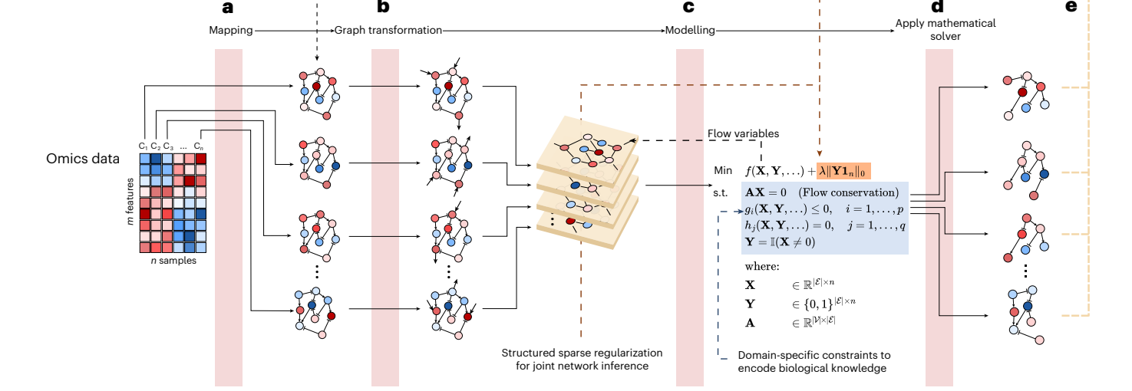
Every method = map data, edit the graph, constrain, solve
φ map
omics onto the PKN
ψ edit
add sources, sinks; prune
f, Ω model
objective + constraints
Solve
optimal networks + proof
Rodriguez-Mier, Garrido-Rodriguez, Gabor & Saez-Rodriguez, Nat Mach Intell 7:1168 (2025)
17
Notes:
Figure 2a-d. (a) phi maps omics data onto the PKN, giving one annotated graph per sample. (b) psi edits the graph: adds source and sink edges where flow should enter and leave, prunes unreachable parts. (c) The graphs are merged into one union graph; CORNETO creates flow variables X and indicator variables Y, adds method-specific constraints and the structured sparsity term (orange). (d) Any supported solver (HiGHS, Gurobi, SCIP, CPLEX...) returns the n networks with a certificate of optimality.

Slide 18
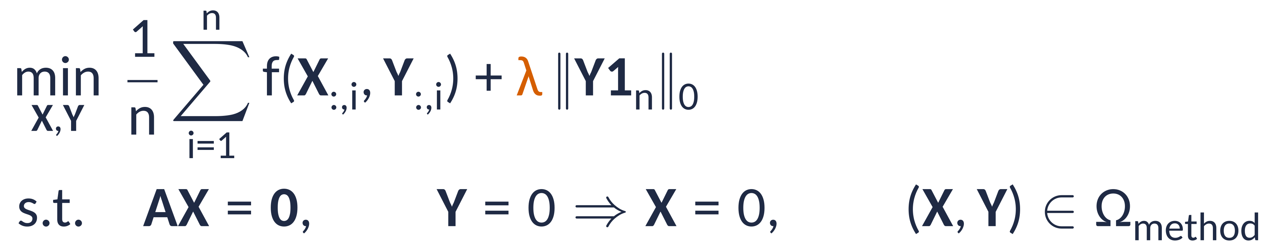
Idea 3: one template for every method and every sample
X, Y: flows and on/off indicators, edges × samples
f: the original method's objective, per sample
‖Y 1ₙ‖₀: number of edges used in any sample
λ: trade-off between data fit and one shared, sparse network
Rodriguez-Mier, Garrido-Rodriguez, Gabor & Saez-Rodriguez, Nat Mach Intell 7:1168 (2025)
18
Notes:
Equation 13. X: flows, one row per edge of the union graph, one column per sample. Y: binary edge indicators of the same shape. f is the method's own objective per sample, averaged over samples. The new term lambda * ||Y 1_n||_0 counts the edges that are used in at least one sample. Penalising that pushes samples to reuse the same edges, while still allowing sample-specific ones if the data demand it. lambda = 0 gives n independent single-sample problems.

Slide 19
Each method is a choice of graph edits, constraints and objective
Method | Graph edits (ψ) | Constraints (Ω) | Objective (f)
FBA | none: exchange reactions | flux bounds | max biomass
Sparse FBA | none | biomass ≥ x% of max | fewest reactions
iMAT | none (data via GPR rules) | flux on/off links | high on, low off
CARNIVAL | sources at inputs, sinks at TFs | tree + sign rules | match TF activities
Steiner / PCST | source at root, sinks at terminals | tree | edge costs (− prizes)
Plug into the template → the multi-sample version comes for free
Rodriguez-Mier, Garrido-Rodriguez, Gabor & Saez-Rodriguez, Nat Mach Intell 7:1168 (2025)
19
Notes:
From the Methods section. FBA needs no data mapping or graph edits (exchange reactions already exist); f = -c'x, lambda = 0. sFBA: biomass >= x% of optimum and lambda > 0, so lambda just switches sparsity on. iMAT: data mapped via GPR rules; objective penalises high reactions off and low reactions on. CARNIVAL: source edges at the perturbed nodes (all roots in inverse CARNIVAL), sink edges at TFs; tree constraint plus sign-consistency constraints on activation/inhibition variables. Steiner: source at the root, sinks at the other terminals, tree constraint, minimise edge costs; PCST also subtracts prizes.

Slide 20
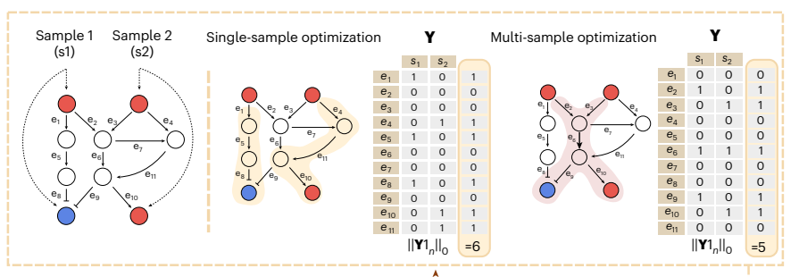
Single-sample vs Multi-samples
Rodriguez-Mier, Garrido-Rodriguez, Gabor & Saez-Rodriguez, Nat Mach Intell 7:1168 (2025)
20
Notes:
Figure 2e. Two samples share a PKN; we only know receptors (top) and TF states (bottom; red up, blue down). Fitted independently, the two networks share no edge: 6 distinct edges in the union. Fitted jointly with the structured penalty, both networks reuse e6 and the union has only 5 edges, while explaining the same TF states. Assumption: samples share structure, e.g. related patients or perturbations in one cell type.
Independent fits: 6 distinct edges, none shared Joint fit: 5 edges, one shared
λ = 0 → independent fits; larger λ → more shared structure

Slide 21
Merging optimization prbolems together
f = α f₁ + β f₂
Ω = Ω₁ ∩ Ω₂
Shared variables are merged
Signalling: signed graph
Gene regulation: TF → genes
Metabolism: reaction hypergraph
Caveat
The paper solves each layer on its own; multi-layer inference is proposed as future work
one union hypergraph, one MILP
cf. COSMOS: Dugourd et al., Mol Syst Biol 2021
Rodriguez-Mier, Garrido-Rodriguez, Gabor & Saez-Rodriguez, Nat Mach Intell 7:1168 (2025)
21
Notes:
Problem composition (Methods): weighted sum of objectives, intersection of feasible sets; variables that appear in both problems are identified, i.e. shared. Because signalling, gene regulation and metabolism are all flows on one (hyper)graph, they could in principle be stacked into one union hypergraph and one MILP. Caveat: the paper applies each layer separately; joint multi-layer inference (signalling + metabolism, as in COSMOS) is named in the Discussion as future work.

Slide 22
Outline
1
Why network inference from prior knowledge?
2
The methods CORNETO unifies
3
CORNETO: one optimisation problem
4
Results in the paper
5
Our test: the PMS iNSC data
6
Discussion
Rodriguez-Mier, Garrido-Rodriguez, Gabor & Saez-Rodriguez, Nat Mach Intell 7:1168 (2025)
22
Notes:
Three re-implemented methods, each single- vs multi-sample.

Slide 23
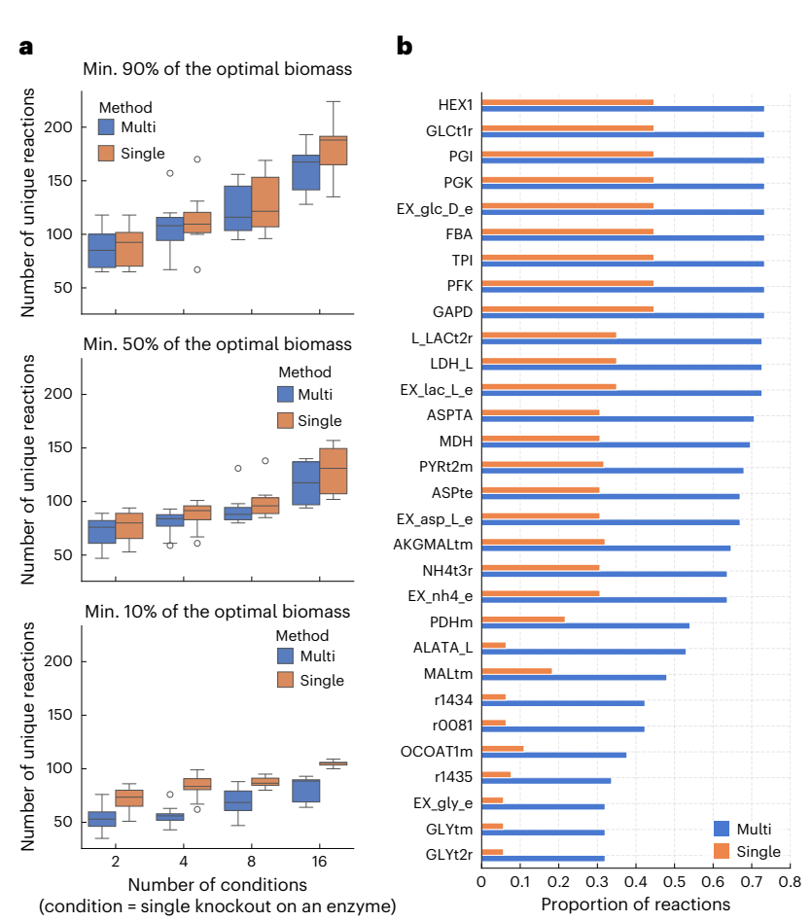
Multi-sample sparse FBA: smaller networks, canonical routes
Model: MitoCore, 555 reactions
Samples: simulated enzyme knockouts
Fewer distinct reactions: median −6% (≥90% biomass), −7% (≥50%), up to −30% (≥10%)
Joint fit keeps canonical glycolysis (HEX1, PGI, PFK)
Fig. 3a,b; blue = multi-sample, orange = single-sample
Rodriguez-Mier, Garrido-Rodriguez, Gabor & Saez-Rodriguez, Nat Mach Intell 7:1168 (2025)
23
Notes:
MitoCore model (555 reactions, 441 metabolites). Samples = simulated single-enzyme knockouts; 2, 4, 8 or 16 samples, 10 random subsets each. Joint sFBA gives fewer distinct reactions; median reduction 6.02% at >=90% biomass, 7.21% at >=50%, up to 30% at >=10% (looser constraint = more alternative routes). (b) The joint fit picks canonical glycolysis (HEX1, PGI, PFK...) more consistently; single-sample fits wander to alternative, equally optimal routes, exaggerating differences between samples.
(We are minimizing the total reactions across samples, so the total number of unique reactions are decreased across samples,
This means we will capture the canonical pathways and find the miniam set of reactions, but we’ll potentially miss sample-specific metabolic athwaays)

Slide 24
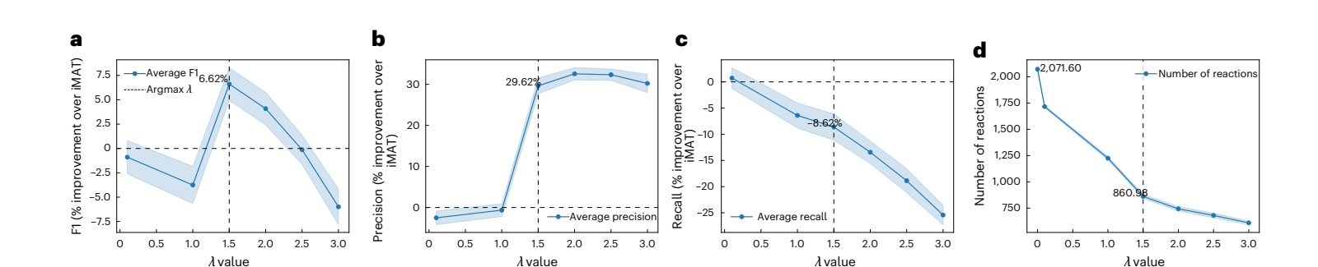
Multi-sample iMAT: more precise context-specific models
Yeast: 12 enzyme knockouts · λ = 1.5 chosen by 5-fold cross-validation
F1
+6.6%
Precision
+29.6%
Recall
−8.6%
Reactions
≈2,070 → 861
Fig. 4a–d; change relative to single-sample iMAT (λ = 0)
Rodriguez-Mier, Garrido-Rodriguez, Gabor & Saez-Rodriguez, Nat Mach Intell 7:1168 (2025)
24
Notes:
Yeast deletion microarrays (Kemmeren 2014), 12 enzyme knockouts with metabolic rewiring, Yeast-GEM. lambda chosen by 5-fold cross-validation on held-out reaction scores; best F1 at lambda = 1.5 (lambda = 0 is the original iMAT). F1 +6.62%, precision +29.62%, recall -8.62%; reactions ~2,072 -> ~861 on average; false positives -38.8%. Trade-off: fewer false positives, slightly lower recall.

Slide 25
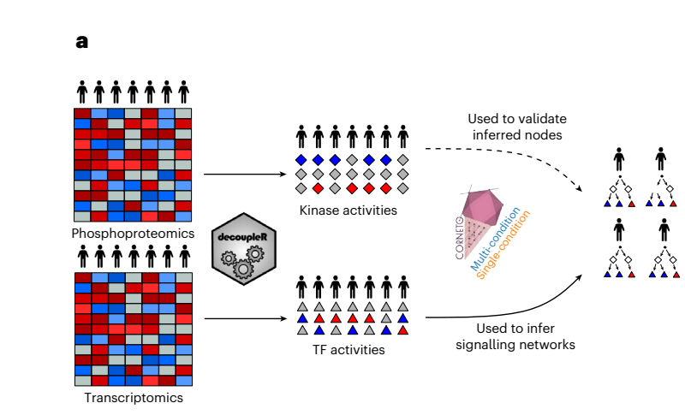
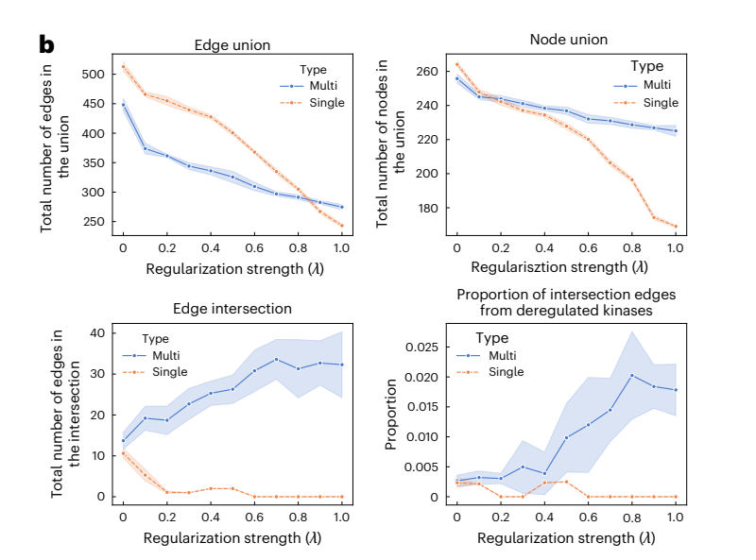
Multi-patient CARNIVAL: more shared, kinase-supported edges
Fit: TF activities from RNA
Check: kinase activities from phosphoproteomics
Fig. 5a,b; CPTAC lung adenocarcinoma; blue = multi-sample, orange = single-sample
Rodriguez-Mier, Garrido-Rodriguez, Gabor & Saez-Rodriguez, Nat Mach Intell 7:1168 (2025)
25
Notes:
CPTAC lung adenocarcinoma. TF activities from transcriptomics with decoupler; inverse CARNIVAL (inputs unknown) single vs multi-sample. Validation set: kinases deregulated (top quartile |activity|) in >=50% of patients, from phosphoproteomics, which was not used for fitting. Multi-sample: the union shrinks less in nodes, the intersection across patients grows (single-sample intersection collapses to ~0), and a larger share of intersection edges comes from deregulated kinases. Error bands: 10 seeds.

Slide 26
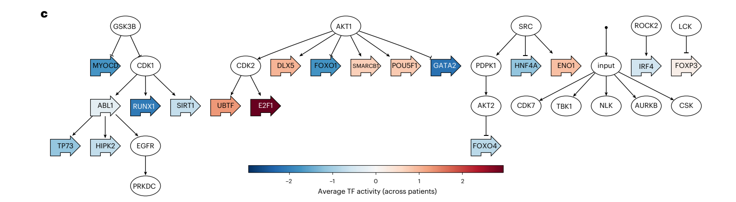
A shared core: GSK3B, AKT1 and SRC drive TF activity
Edges shared by all patients at λ = 0.8
kept if present in ≥ 50% of 30 alternative solutions
Fig. 5c; colour = mean TF activity across patients
Rodriguez-Mier, Garrido-Rodriguez, Gabor & Saez-Rodriguez, Nat Mach Intell 7:1168 (2025)
26
Notes:
Figure 5c: edges in the intersection of all patient networks at lambda = 0.8. Because optimal solutions are not unique, the joint inference was repeated 30 times with different seeds and an edge was kept if it appeared in at least 50% of the alternative solutions. Colour = mean TF activity across patients.

Slide 27
Outline
1
Why network inference from prior knowledge?
2
The methods CORNETO unifies
3
CORNETO: one optimisation problem
4
Results in the paper
5
Our test: the PMS iNSC data
6
Discussion
Rodriguez-Mier, Garrido-Rodriguez, Gabor & Saez-Rodriguez, Nat Mach Intell 7:1168 (2025)
27
Notes:
We applied CORNETO to public multi-omics data from progressive-MS induced neural stem cells, with a published mechanism as the test.

Slide 28
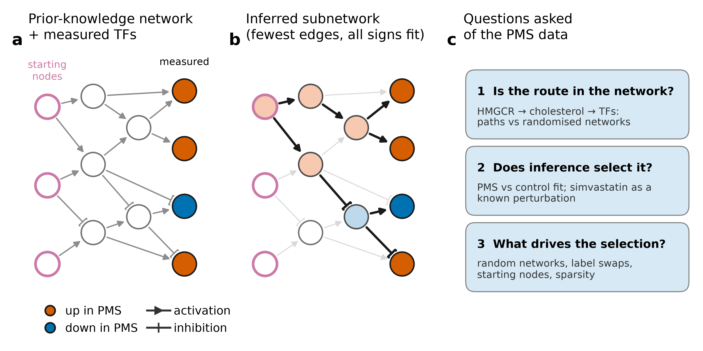
Our test: a published mechanism in PMS
HMGCR
cholesterol
SP1 · JUN · JUNB
EGR1 · E2F1 · WT1
senescence
Hypothesis: Ionescu et al., Cell Stem Cell 2024. Data: RNA-seq GSE297192 (Park et al. 2025); metabolomics ST003331/2, lipidomics ST003328
This work: networkbio project report (Oct 2026) · data: Ionescu et al. 2024; Park et al. 2025
28
Notes:
Ionescu et al. found a senescent, neurotoxic state in iNSCs from people with progressive MS, reduced by simvastatin, and proposed HMGCR -> cholesterol -> cholesterol-responsive TFs. We asked three network questions: (1) is that route in the prior-knowledge network, (2) does CORNETO select it when it is not given as a starting node, and (3) how much of the selected network comes from the data versus the network itself.

Slide 29
Set-up: choices fixed before any fit
1
Data
2
Measured nodes
3
Networks
4
CORNETO
RNA-seq: 3 vs 3 lines
Metabolites: 3 vs 4
n = cell lines
50 top TFs, stable when a line is left out
+ 36 metabolites
OmniPath: 9,870 edges
COSMOS: 54,571 edges, with metabolism
Any root may start a signal; route nodes never
λ: largest within 10% of best fit
Not circular: HMGCR, the sterol regulators and the six TFs may never start a signal
TFs: decoupler ULM on moderated t, CollecTRI. Solver HiGHS, 1% gap, 30–60 min. Plans: doc/decisions/2026-10-10-stage04-inference-plan.md
This work: networkbio project report (Oct 2026) · data: Ionescu et al. 2024; Park et al. 2025
29
Notes:
Each cell line is one observation; replicates were averaged. TF activities: moderated t statistic PMS vs control, then decoupler ULM with CollecTRI; the 50 most changed TFs that keep their sign when any line is left out are the measured nodes. In the joint fit 36 metabolite contrasts mapped to COSMOS were added, including free cholesterol. Any PKN node without incoming edges may start a signal with a free sign, except the hypothesis nodes, so recovering the route would not be circular. Lambda: the largest value whose fitting error stays within 10% of the unpenalised fit, fixed before inspecting any network.

Slide 30
How we built it: plan, run, audit, rerun
29 Sep
6 Oct
9 Oct
10 Oct
11–12 Oct
13–14 Oct
Plan + data inventory
Toy problem passes
TF activities, PKNs
Route test, inference
Robustness controls
Next: iMAT / FBA
Audit: COSMOS IDs mislabelled → rerun
Audit: ID-mapping artefact → fixed
First run invalid → fixed
Each step: a written plan, then code, then an independent audit
doc/decisions/ (14 plans), doc/reviews/ (5 audits), prompts/ (provenance)
This work: networkbio project report (Oct 2026) · data: Ionescu et al. 2024; Park et al. 2025
30
Notes:
The project history from the decision log. Every stage started from a written plan, was implemented, and was audited by a separate agent against the plan. The audits caught real errors: the first COSMOS parser treated reaction indices as gene IDs, and the first route test reported missing sterol steps that were an identifier-mapping artefact. Both were fixed and rerun; failed outputs are archived, not overwritten. The stoichiometric follow-up (iMAT/FBA on Recon3D) is in progress: its first run was invalid because of a gene-rule parsing problem and has been fixed but not yet rerun, so no results from it are shown.

Slide 31
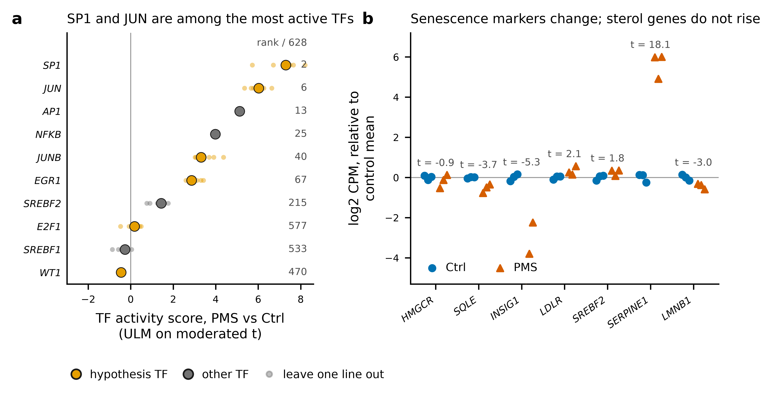
Measured nodes: AP-1 and SP1 up, sterol genes flat
Report Fig. 2. TF activity: ULM on moderated t (CollecTRI), 3 vs 3 lines; small dots leave one line out
This work: networkbio project report (Oct 2026) · data: Ionescu et al. 2024; Park et al. 2025
31
Notes:
SP1 and JUN are the 2nd and 6th most activated of 628 TFs in PMS lines; AP-1 and NF-kB rank 13th and 25th. JUNB and EGR1 are moderately up, E2F1 unchanged, WT1 not expressed. Senescence markers change (SERPINE1 up, LMNB1 down), but sterol-synthesis genes such as HMGCR are not induced.

Slide 32
Q1: the route is in the network, but not unique
56 / 58
2
2 edges
pathway reactions present in COSMOS
missing (FDFT1 halves) break it; we added them back
from cholesterol to SP1, JUN, E2F1
But cholesterol is a hub
Top 0.1% of COSMOS metabolites by betweenness
~480 metabolites are as close to SP1
33–66% of degree-preserving random networks connect it as closely
results/ionescu_corneto/03_pkn/aim5_route; KEGG cholesterol-synthesis enzymes; hub-penalised shortest paths
This work: networkbio project report (Oct 2026) · data: Ionescu et al. 2024; Park et al. 2025
32
Notes:
The cholesterol pathway is almost complete in COSMOS: 56 of 58 reactions. The two missing ones are halves of the squalene-synthase step and disconnect the pathway; after restoring them from Recon3D the weighted shortest HMGCR -> cholesterol path is the textbook pathway. Cholesterol is two edges from SP1, JUN and E2F1, but it is itself a hub, and about 480 other metabolites are as close to SP1. Short paths alone do not support the route.

Slide 33
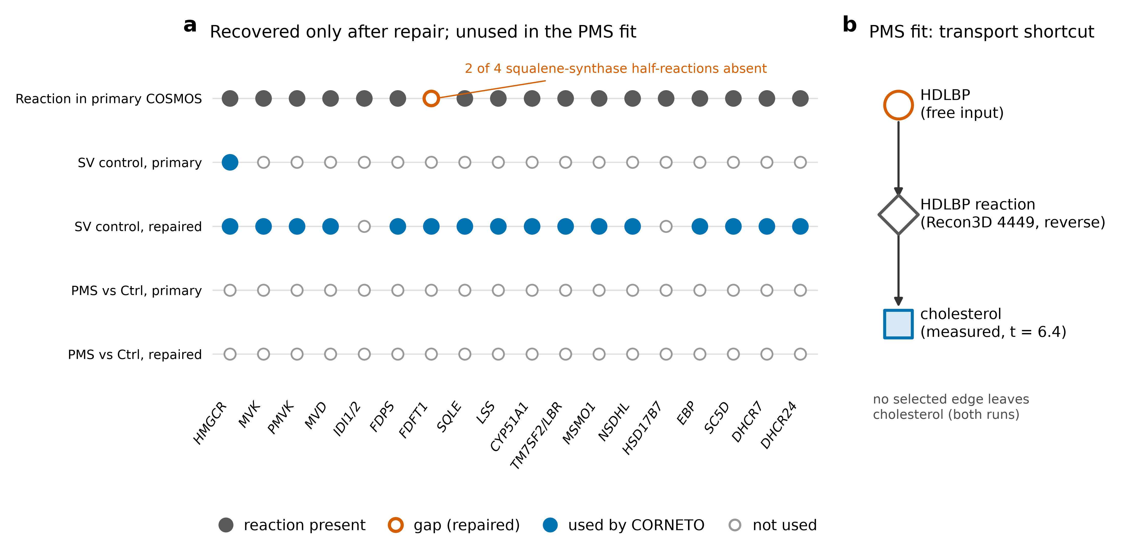
Q2: inference skips the pathway
PMS fit
HMGCR off; cholesterol via one transport step
HMGCR ↓ given
16 of 20 enzymes in order, only after repair
Report Fig. 3. SV = simvastatin control: HMGCR inhibited, cholesterol falls
This work: networkbio project report (Oct 2026) · data: Ionescu et al. 2024; Park et al. 2025
33
Notes:
Neither PMS fit used the pathway: HMGCR stayed inactive and the measured rise in cholesterol was explained by a single transport reaction. As a positive control we told CORNETO that HMGCR is inhibited and cholesterol falls (simvastatin). It then recovered the pathway through mevalonate, 16 of 20 enzymes in order, but only in the repaired network; in the original COSMOS it reached cholesterol by a 32-edge detour through unrelated mitochondrial reactions, sign-consistent but biochemically meaningless.

Slide 34
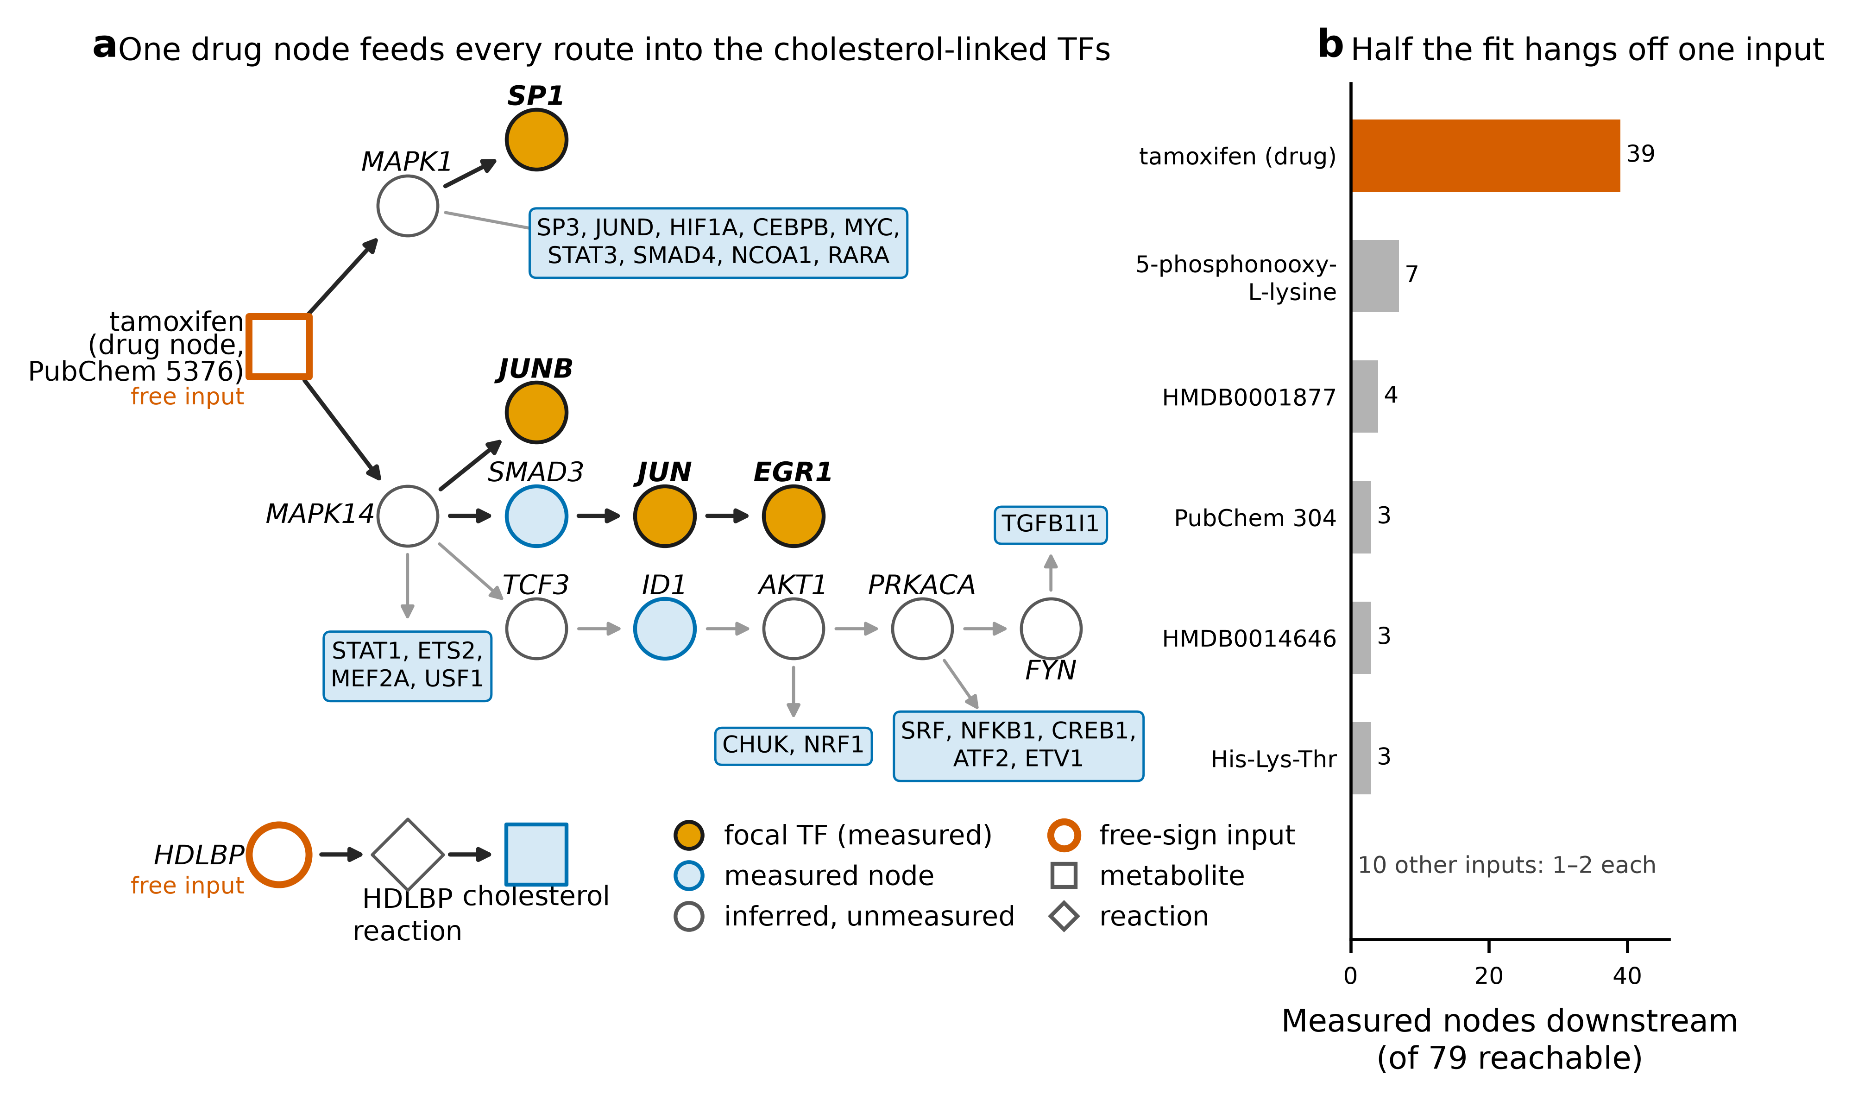
One drug node feeds the joint network
39 / 79
measurements downstream of one tamoxifen node
Routes into SP1, JUN, JUNB, EGR1 all start there
Recurring kinases: MAPK1, MAPK14, AKT1
Report Fig. 4. COSMOS, TFs + metabolites, λ = 0.1
This work: networkbio project report (Oct 2026) · data: Ionescu et al. 2024; Park et al. 2025
34
Notes:
The joint TF-plus-metabolite network on COSMOS. Every route into SP1, JUN, JUNB and EGR1 starts from one unmeasured starting node, a tamoxifen compound, which alone sits upstream of 39 of the 79 explained measurements, and passes through MAPK1 or MAPK14. The three networks (OmniPath TFs, COSMOS TFs, COSMOS joint) shared 50-71% of protein nodes but only 7-21% of edges; MAPK1, MAPK14, PRKACA, FYN and AKT1 were in all of them.

Slide 35
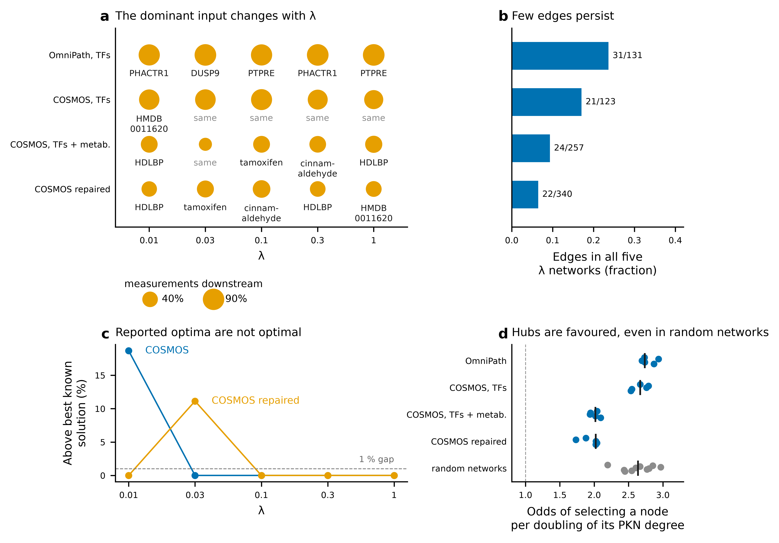
Q3: much of the network comes from the network
6 / 10
random networks fit every TF exactly
p = 2/20
only the true split fits
×1.7–3
selection odds per degree doubling
≤ 19%
"optimal" worse than best known
Report Fig. 5; results/ionescu_corneto/05_robustness
This work: networkbio project report (Oct 2026) · data: Ionescu et al. 2024; Park et al. 2025
35
Notes:
Controls on the OmniPath fit. (a) One starting node sits upstream of 24-92% of the explained measurements at every lambda, and its identity changes with lambda and PKN. (b) Only 6-24% of edges survive across all lambda values. Six of ten degree-preserving random networks explained every TF exactly while sharing only 7-18% of inferred nodes with the real network. Only the true split of the lines (and its mirror) fitted exactly: p = 2/20. Selection favours hubs: odds of selecting an unmeasured node rise 1.7- to 3-fold per doubling of its degree, also in random networks. (c) Some networks the solver reported as optimal scored up to 19% worse than other known solutions.

Slide 36
What our test shows
Robust
Kinase layer above AP-1 / SP1 (MAPK1, MAPK14, PRKACA, FYN), but these are PKN hubs
Textbook sterol pathway, for a known perturbation, after a two-reaction repair
Not identifiable
Where the signal starts: thousands of roots collapse onto one arbitrary hub
Signs are not chemistry: transport “explains” cholesterol
The solver’s optimum is approximate
Hypothesis-generating: 3 vs 3–4 lines, unmatched experiments, donor background confounded
This work: networkbio project report (Oct 2026) · data: Ionescu et al. 2024; Park et al. 2025
36
Notes:
Two results were robust: a kinase layer directly upstream of the activated AP-1 and SP1 targets, and the textbook cholesterol pathway under a known perturbation once two missing edges were restored. Because the kinases are also the main PKN hubs, their stability is necessary but not sufficient evidence. The upstream part, where the proposed mechanism would sit, was not identifiable: too much freedom at the start, signed edges without mass balance, and approximate optimisation. Next steps: restrict starting nodes to measured perturbations, use stoichiometric models (iMAT/FBA on Recon3D, in progress), and use a line-matched cohort.

Slide 37
Outline
1
Why network inference from prior knowledge?
2
The methods CORNETO unifies
3
CORNETO: one optimisation problem
4
Results in the paper
5
Our test: the PMS iNSC data
6
Discussion
Rodriguez-Mier, Garrido-Rodriguez, Gabor & Saez-Rodriguez, Nat Mach Intell 7:1168 (2025)
37
Notes:
Strengths and limitations, from the paper and from our test.

Slide 38
Strengths
1
One formulation
2
Multi-sample for free
3
Exact solvers
Signalling, metabolism and PPI as flows plus constraints
One λ term; λ = 0 gives the original method
MILP with an optimality certificate; any solver
4
Measured gains
5
Hypergraphs
6
Open, composable
iMAT precision +30%; sparser, more shared networks
A = S: stoichiometry in the same matrix
Python library; problems add up: f = αf₁ + βf₂
Rodriguez-Mier, Garrido-Rodriguez, Gabor & Saez-Rodriguez, Nat Mach Intell 7:1168 (2025)
38
Notes:
From the paper: one mathematical language and API for metabolic, signalling and PPI methods; the structured sparsity term gives every method a multi-sample version, with lambda = 0 as the original; exact MILP solvers with optimality certificates, decoupled from the solver; measured gains such as iMAT precision +29.6% and F1 +6.6%, sparser sFBA networks and a larger shared CARNIVAL core; hypergraphs make the incidence matrix the stoichiometric matrix; problems compose by adding objectives and intersecting feasible sets; open code and notebooks.

Slide 39
Limitations: what the authors say, what we saw
 | Authors | Our test
Scale | NP-hard; slow for many samples | "Optimal" up to 19% off; 6-line fit failed
λ and sharing | tune λ; assumes shared structure | dominant hub changes with λ
Uniqueness | many equally good networks | random PKNs fit just as well
Prior knowledge | only edges in the PKN | two missing reactions hid the route
Metabolism | steady state only | signs ≠ mass balance: transport shortcut
Left: paper Discussion. Right: networkbio report (results/ionescu_corneto/04–05)
Rodriguez-Mier, Garrido-Rodriguez, Gabor & Saez-Rodriguez, Nat Mach Intell 7:1168 (2025)
39
Notes:
Authors (Discussion): NP-hard problems whose cost grows with samples and PKN size; lambda is problem specific and the penalty assumes shared structure; several networks fit equally well (they sample 30 solutions and keep frequent edges); only PKN edges can be selected; steady state only. What we saw on the PMS iNSC data: solutions reported as optimal were up to 19% worse than other known ones, and a joint fit of all six lines found no solution with lambda > 0; the dominant starting hub changed with lambda; six of ten degree-preserving random PKNs fitted every TF exactly; two missing reactions were enough to hide the cholesterol pathway; and signed edges without mass balance let transport explain cholesterol.

Slide 40
Take-home
CORNETO gives
One language for many network methods
Joint, multi-sample fits for free
A sharp tool for testing hypotheses
Use it with
Starting nodes you can justify
Null models: random PKNs, label swaps
Edge frequencies and solver checks, not one network
Rodriguez-Mier, Garrido-Rodriguez, Gabor & Saez-Rodriguez, Nat Mach Intell 7:1168 (2025)
40
Notes:
CORNETO is a clean, general formulation and makes multi-sample inference easy. Our test shows what it cannot settle by itself: with free starting nodes the upstream network is not identifiable, and selection follows PKN hubs. Use justified starting nodes (measured perturbations), compare against null models, and report edge frequencies with solver gaps rather than one network.

Slide 41
For discussion
1
How should λ be chosen without ground truth?
2
Free starting nodes, or only known perturbations?
3
Signed graphs or stoichiometry for metabolism?
Rodriguez-Mier, Garrido-Rodriguez, Gabor & Saez-Rodriguez, Nat Mach Intell 7:1168 (2025)
41
Notes:
Open questions. (1) Lambda selection without ground truth: our rule (largest lambda within 10% of the best fit) still changed the dominant hub. (2) With thousands of free roots the upstream network was arbitrary; should starting nodes be restricted to measured perturbations? (3) Signed metabolite edges allowed a transport shortcut; are stoichiometric models (iMAT/FBA) needed, or a combination?

Slide 42
References
Rodriguez-Mier P, Garrido-Rodriguez M, Gabor A, Saez-Rodriguez J. Unifying multi-sample network inference from prior knowledge and omics data with CORNETO. Nat Mach Intell 7, 1168–1186 (2025). Figures reused under CC BY 4.0.
Liu A et al. From expression footprints to causal pathways: contextualizing large signaling networks with CARNIVAL. NPJ Syst Biol Appl 5, 40 (2019).
Badia-i-Mompel P et al. decoupleR: ensemble of computational methods to infer biological activities from omics data. Bioinform Adv 2, vbac016 (2022).
Türei D, Korcsmáros T, Saez-Rodriguez J. OmniPath: guidelines and gateway for literature-curated signaling pathway resources. Nat Methods 13, 966–967 (2016).
Orth JD, Thiele I, Palsson BØ. What is flux balance analysis? Nat Biotechnol 28, 245–248 (2010).
Shlomi T et al. Network-based prediction of human tissue-specific metabolism. Nat Biotechnol 26, 1003–1010 (2008).
Tuncbag N et al. Simultaneous reconstruction of multiple signaling pathways via the prize-collecting Steiner forest problem. J Comput Biol 20, 124–136 (2013).
Dugourd A et al. Causal integration of multi-omics data with prior knowledge to generate mechanistic hypotheses. Mol Syst Biol 17, e9730 (2021).
Gillette MA et al. Proteogenomic characterization reveals therapeutic vulnerabilities in lung adenocarcinoma. Cell 182, 200–225 (2020).
Kemmeren P et al. Large-scale genetic perturbations reveal regulatory networks and an abundance of gene-specific repressors. Cell 157, 740–752 (2014).
Diosdi A, Theis FJ, Horvath P. Towards 3D-oid models that integrate molecular, morphological and spatial cellular features. Nat Rev Mol Cell Biol (2026), doi:10.1038/s41580-026-01025-4 (appendix).
Ionescu A et al. Increased cholesterol synthesis drives neurotoxicity in patient stem cell-derived model of multiple sclerosis. Cell Stem Cell 31, 1574–1590 (2024).
Park J et al. Integrated omics reveals disease-associated radial glia-like cells with epigenetically dysregulated interferon response in multiple sclerosis. Neuron 113, 4158–4177 (2025).
Müller-Dott S et al. Expanding the coverage of regulons from high-confidence prior knowledge for accurate estimation of transcription factor activities. Nucleic Acids Res 51, 10934–10949 (2023).
Smyth GK. Linear models and empirical Bayes methods for assessing differential expression in microarray experiments. Stat Appl Genet Mol Biol 3, 3 (2004).
Brunk E et al. Recon3D enables a three-dimensional view of gene variation in human metabolism. Nat Biotechnol 36, 272–281 (2018).
Rodriguez-Mier, Garrido-Rodriguez, Gabor & Saez-Rodriguez, Nat Mach Intell 7:1168 (2025)
42

Slide 43
Backup
The math behind each method and building block
43
Notes:
Backup slides with the formulas, for questions.

Slide 44

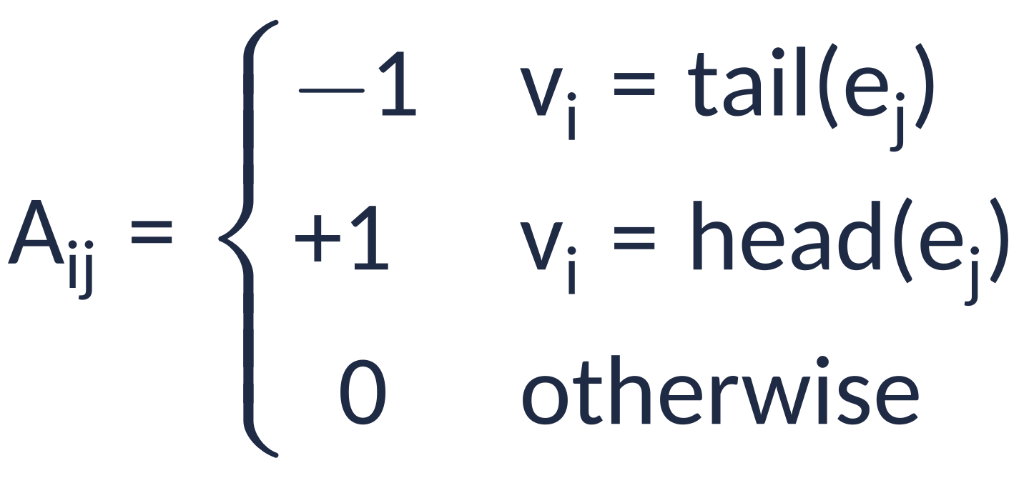
Flows: from an LP to an inference MILP
BACKUP · MATH
Flow LP
conservation, capacity
Inference
flow only on selected edges
Example
shortest path: s to t
Incidence
−1 tail, +1 head
Paper Methods, eqs. 1, 2, 14
Rodriguez-Mier, Garrido-Rodriguez, Gabor & Saez-Rodriguez, Nat Mach Intell 7:1168 (2025)
44
Notes:
Methods, Mathematical background. A x = b with the incidence matrix and capacity bounds is an LP. A binary y per edge with x <= x_max * y turns flow into structure: an edge is in the network iff it can carry flow. Shortest path is the simplest example.

Slide 45
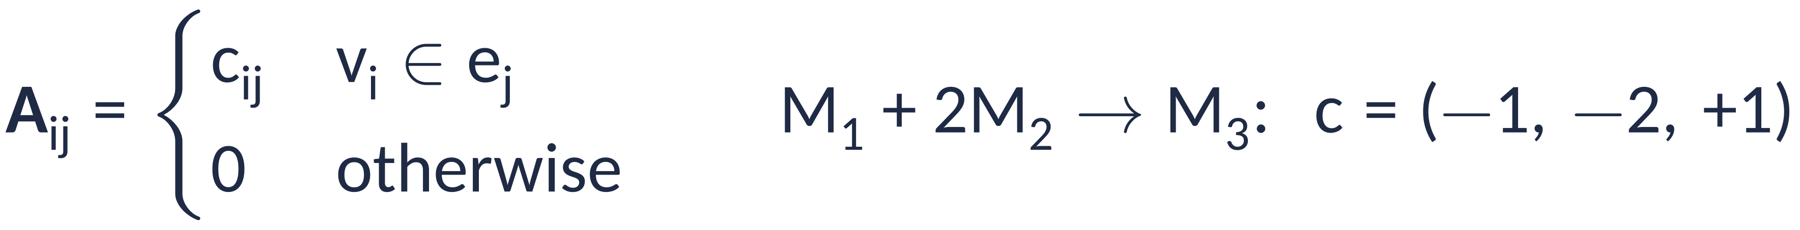
Hypergraphs and many samples
BACKUP · MATH
Incidence
for metabolism A = S
Sources, sinks
external demands become edges
Multi-flow
one column per sample
Shared capacity
optional, linearised
Paper Methods, eqs. 3, 5, 8
Rodriguez-Mier, Garrido-Rodriguez, Gabor & Saez-Rodriguez, Nat Mach Intell 7:1168 (2025)
45
Notes:
Each hyperedge has a tail set and a head set with signed coefficients, so the incidence matrix is the stoichiometric matrix. Sources and sinks are hyperedges with an empty tail or head, so b disappears. With n samples the flow becomes a matrix X; shared capacities use |X| 1_n <= x_max, linearised by splitting X into positive and negative parts.

Slide 46
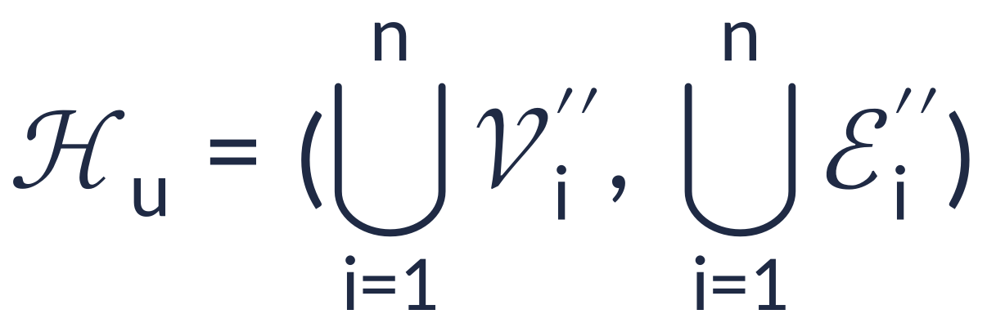
Map, edit, merge
BACKUP · MATH
Map
values per sample
Edit
prune; add sources, sinks
Merge
one union graph
Method
map, edit, problem
Paper Methods, eq. 4 and method definition
Rodriguez-Mier, Garrido-Rodriguez, Gabor & Saez-Rodriguez, Nat Mach Intell 7:1168 (2025)
46
Notes:
phi attaches n values per vertex or edge; psi edits each annotated graph; the n edited graphs merge into one union hypergraph on which X and Y are defined; a method is (phi, psi, P_M) with P_M = (f, Omega_M).

Slide 47
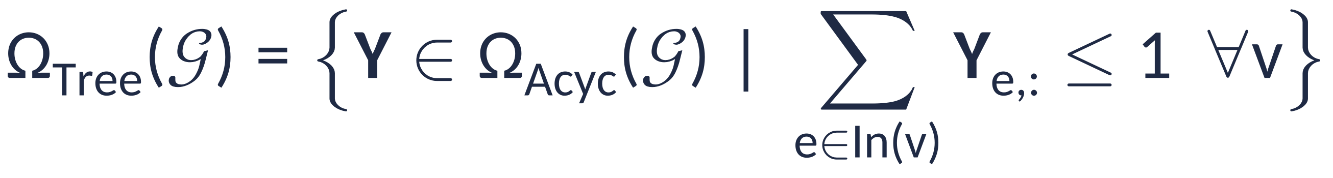
Building blocks for Ω
BACKUP · MATH
Off ⇒ no flow
eq. 9
On ⇒ flow ≠ 0
Y⁺, Y⁻ pick direction
Acyclic
L: topological order
Tree
one incoming edge
Paper Methods, eqs. 9–12
Rodriguez-Mier, Garrido-Rodriguez, Gabor & Saez-Rodriguez, Nat Mach Intell 7:1168 (2025)
47
Notes:
Omega_Free links flow to indicators; Omega_!=0 makes "selected" mean "active"; acyclicity uses a continuous order variable L with a big-M switch; a tree is acyclic with at most one incoming selected edge per vertex.

Slide 48
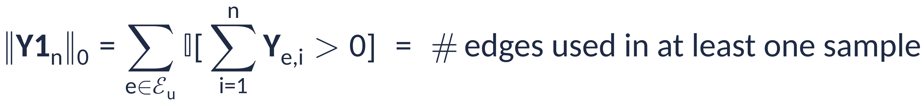
One penalty couples all samples
BACKUP · MATH
ℓ0 count
paid once per edge
As a MILP
one standard linearisation
Example
shortest paths (eq. 15)
Paper Methods, eq. 13 and 15; linearisation shown is ours
Rodriguez-Mier, Garrido-Rodriguez, Gabor & Saez-Rodriguez, Nat Mach Intell 7:1168 (2025)
48
Notes:
The structured sparsity term counts edges used in at least one sample. With one binary z_e per edge that must be 1 whenever the edge is used, lambda * sum z_e equals the penalty at the optimum (one standard linearisation; the paper gives its own in the Supplementary Information). lambda = 0 gives n independent problems.

Slide 49
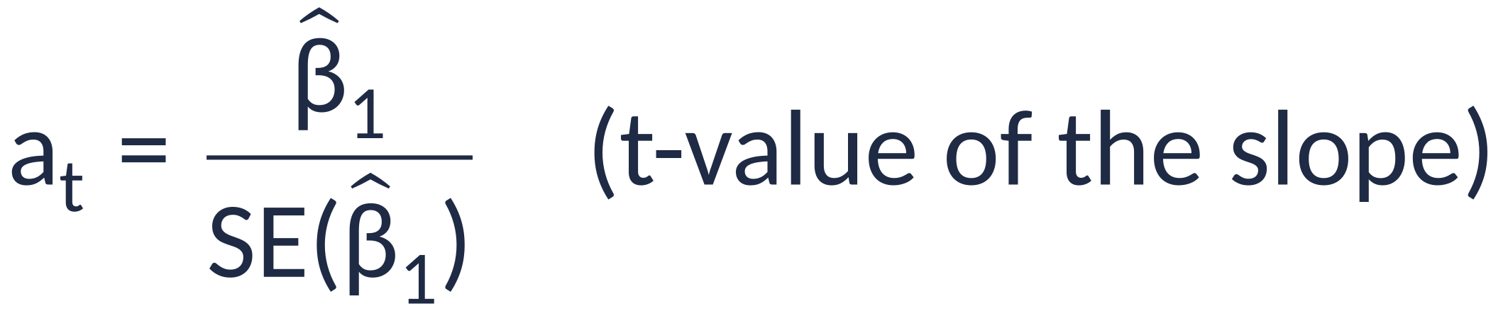
Measured nodes: TF activity from decoupler
BACKUP · MATH
Model
y on regulon weights w
Activity
> 0: TF active
Badia-i-Mompel et al., Bioinform Adv 2022
Rodriguez-Mier, Garrido-Rodriguez, Gabor & Saez-Rodriguez, Nat Mach Intell 7:1168 (2025)
49
Notes:
decoupler ULM: for one sample, regress gene statistics on the signed regulon weights of a TF; the t-value of the slope is its activity. Not part of the CORNETO Methods, but it produces the measured nodes for CARNIVAL, in the paper and in our test.

Slide 50
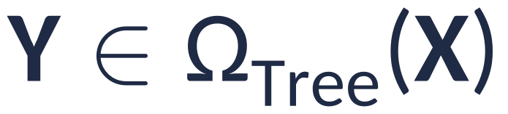
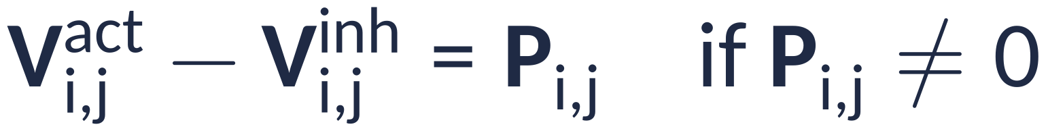
CARNIVAL as sign constraints
BACKUP · MATH
Tree
nodes up, down or off
Sign rules
state × edge sign
Inputs
perturbations fixed
Objective
0 match, |d| off, 2|d| wrong
Paper Methods, CARNIVAL
Rodriguez-Mier, Garrido-Rodriguez, Gabor & Saez-Rodriguez, Nat Mach Intell 7:1168 (2025)
50
Notes:
CORNETO version of CARNIVAL (Methods). Source edges at perturbed nodes (all roots in inverse CARNIVAL), sink edges at TFs. Sign-consistency constraints link edge activation/inhibition to the state of the tail and the edge sign; the objective penalises sign mismatches weighted by |activity|.

Slide 51
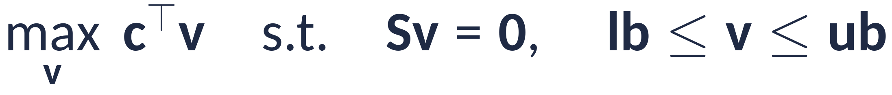
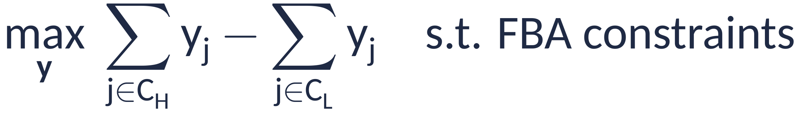
FBA, sparse FBA and iMAT
BACKUP · MATH
FBA
LP, steady state
Sparse FBA
fewest reactions
Multi-sample
λ on or off
iMAT
high on, low off
Paper Methods, FBA, sFBA, iMAT
Rodriguez-Mier, Garrido-Rodriguez, Gabor & Saez-Rodriguez, Nat Mach Intell 7:1168 (2025)
51
Notes:
All share S v = 0 with bounds (Omega_Flow with A = S). Sparse FBA keeps biomass at >= 95% of its optimum (example used in the Methods). Multi-sample sFBA has only the sparsity term, so lambda is on or off. iMAT maximises agreement between reaction activity and expression classes via GPR rules.

Slide 52
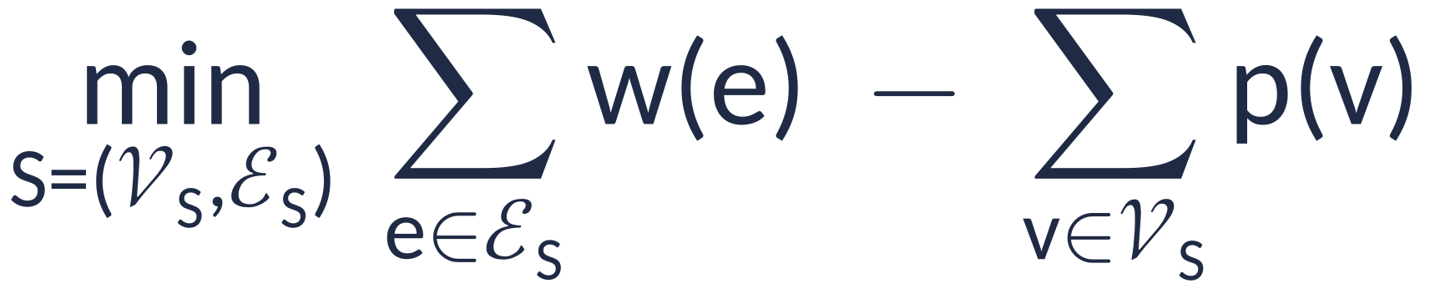
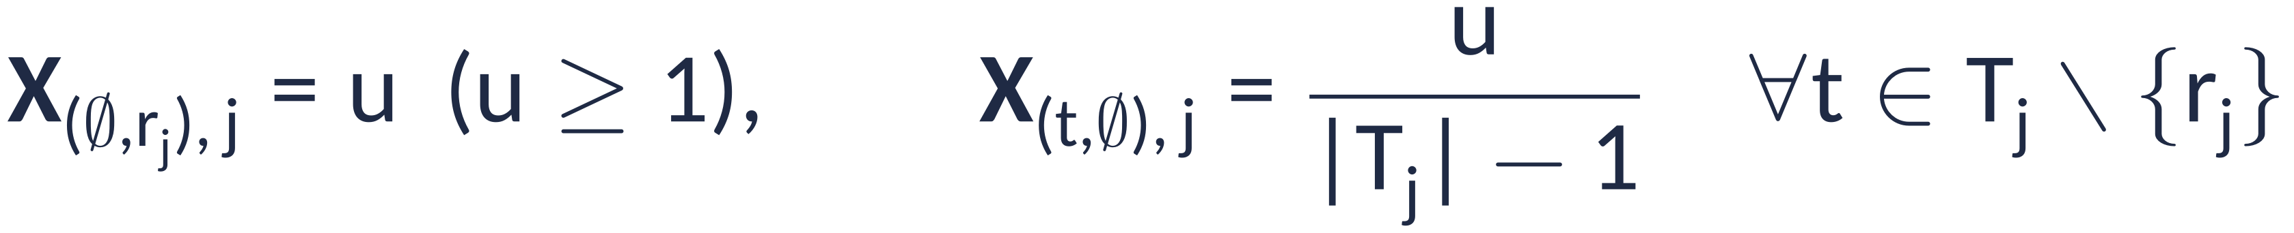
Steiner trees as rooted flows
BACKUP · MATH
PCST
costs minus prizes
CORNETO
tree constraint
Flows
root feeds every terminal
Paper Methods, Steiner tree and PCST
Rodriguez-Mier, Garrido-Rodriguez, Gabor & Saez-Rodriguez, Nat Mach Intell 7:1168 (2025)
52
Notes:
PCST minimises edge weights minus node prizes. In CORNETO the root injects u units and every other terminal receives u/(|T|-1), which forces connectivity; Omega_Tree removes cycles. Steiner tree = PCST with all terminals forced in.

Slide 53
Appendix
Towards 3D-oid models that integrate molecular, morphological and spatial cellular features
Diosdi, Theis & Horvath
Nat Rev Mol Cell Biol, Comment, 4 Sep 2026
A two-page opinion piece: no new data
53
Notes:
Appendix: a short Comment by Diosdi, Theis and Horvath arguing for integrating omics, morphology and spatial context in 3D cell culture models. Opinion piece, no new data. doi:10.1038/s41580-026-01025-4

Slide 54
A cell = omics + morphology + microenvironment
Omics profile
Morphology
Micro-
environment
molecules, interactions, dynamics
3D shape from imaging
neighbours and space
Problem: measured by siloed technologies and communities
Claim: integrating them beats any single modality
Diosdi, Theis & Horvath, Nat Rev Mol Cell Biol (2026) · doi:10.1038/s41580-026-01025-4
54
Notes:
Each cell is defined by three cornerstones: omics profile, morphology and microenvironment. The technologies probing each developed separately; the authors cite work showing that combining modalities beats single modalities, and propose next-generation 3D-oids that capture all three.

Slide 55
Three pathways towards integrated 3D-oids
1
Model systems
2
Imaging, analysis
3
Data integration
Spheroids, organoids, assembloids
Reproducible reference 3D-oids
Fewer patient-specific models
Micromanipulation of single cells
3D high-content screens + omics
AI for images
Tools for multimodal data are missing
Generalisable AI models
Connect, not replace, pipelines
Diosdi, Theis & Horvath, Nat Rev Mol Cell Biol (2026) · doi:10.1038/s41580-026-01025-4
55
Notes:
Three parallel pathways. Model systems: 3D-oids are more physiological than 2D culture; reproducible keystone 3D-oids as references, partly stepping away from patient-specific models, adding complexity only per hypothesis. Imaging and analysis: micromanipulation of single cells in 3D, high-content screening combined with omics, AI analysis. Data integration: comprehensive tools are missing; aim for generalisable AI models that connect existing domain pipelines.

Slide 56
What it means for CORNETO (our reading)
Common ground
Integration beats single views
Reproducible 3D-oids fit the “shared structure” assumption
Precise perturbations = justified starting nodes
Tensions
Prior knowledge vs generalisable AI
A PKN has no node for shape or space
Patient lines (our 3 vs 4) bring variability
Our interpretation; the Comment itself does not discuss CORNETO
Diosdi, Theis & Horvath, Nat Rev Mol Cell Biol (2026) · doi:10.1038/s41580-026-01025-4
56
Notes:
Our reading, not the authors'. Common ground: both argue that integration beats single views. Reproducible 3D-oids would satisfy CORNETO's shared-structure assumption, and precise perturbations would give justified starting nodes, the main gap in our test. Tensions: the Comment bets on generalisable AI, CORNETO on mechanistic prior knowledge; PKNs have no representation of morphology or space; and many disease studies, including our PMS iNSC lines, are patient-derived and few.

