Slide 1
CORNETO: unifying multi-sample network inference from prior knowledge and omics
Rodriguez-Mier, Garrido-Rodriguez, Gabor & Saez-Rodriguez
Nature Machine Intelligence 7, 1168–1186 (2025) · doi:10.1038/s42256-025-01069-9
Journal club · multi-omics integration and network inference · Sadegh Seyedhashemirizi
Notes:
CORNETO = Constrained Optimisation for the Recovery of NETworks from Omics. Saez-Rodriguez lab, Nature Machine Intelligence, July 2025. Theme of today: multi-omics integration and network inference.

Slide 2
Outline
1
Why network inference from prior knowledge?
2
The methods CORNETO unifies
3
CORNETO: one optimisation problem
4
Results and take-home
Rodriguez-Mier, Garrido-Rodriguez, Gabor & Saez-Rodriguez, Nat Mach Intell 7:1168 (2025)
2
Notes:
Four parts: the problem, the building blocks, CORNETO's formulation, then results.

Slide 3
Omics give lists of changes; we want mechanisms
Data-driven
Knowledge-driven
• Correlation, machine learning
• Associations
• Start from a prior knowledge network (PKN)
• Map omics data onto it
• Keep the subnetwork that explains the data
Network inference = choosing a context-specific subnetwork of the PKN
Rodriguez-Mier, Garrido-Rodriguez, Gabor & Saez-Rodriguez, Nat Mach Intell 7:1168 (2025)
3
Notes:
Data-driven network inference (correlation, ML) needs many samples and only gives associations. Knowledge-driven inference starts from a prior knowledge network (PKN) and keeps the part of it that explains the data. This is what CARNIVAL, iMAT, Steiner trees etc. all do.

Slide 4
But every method lives in its own silo
Signalling
Metabolism
Protein interactions
CARNIVAL
FBA, iMAT
Steiner trees
• Own data type, own code, one sample at a time
• Shared vs sample-specific mechanisms are hard to separate
Question
Can one optimisation problem express all of them, and fit many samples jointly?
Rodriguez-Mier, Garrido-Rodriguez, Gabor & Saez-Rodriguez, Nat Mach Intell 7:1168 (2025)
4
Notes:
Signalling, metabolism and PPI each have their own tools, data types and code. Most analyse one sample at a time, so they cannot separate shared mechanisms from sample-specific ones, and several networks often explain the data equally well (non-identifiability).

Slide 5
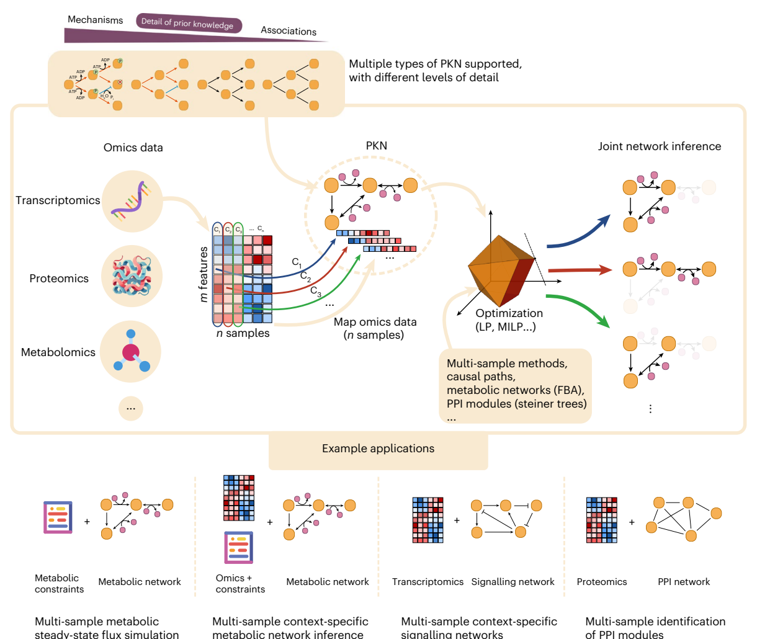
CORNETO: map data onto a PKN, solve one optimisation problem
• Any PKN: graphs to hypergraphs
• Any omics layer, mapped onto nodes or edges
• All samples solved together
• Exact solvers: LP / MILP
• Python library, solver-agnostic
Fig. 1, CC BY 4.0
Rodriguez-Mier, Garrido-Rodriguez, Gabor & Saez-Rodriguez, Nat Mach Intell 7:1168 (2025)
5
Notes:
Figure 1. Any PKN type (top), any omics layer mapped onto it, one optimisation problem (LP/MILP), and n context-specific networks out, inferred jointly. Bottom row: the four applications in the paper.

Slide 6
Outline
1
Why network inference from prior knowledge?
2
The methods CORNETO unifies
3
CORNETO: one optimisation problem
4
Results and take-home
Rodriguez-Mier, Garrido-Rodriguez, Gabor & Saez-Rodriguez, Nat Mach Intell 7:1168 (2025)
6
Notes:
Before the framework: the ingredients it unifies.

Slide 7
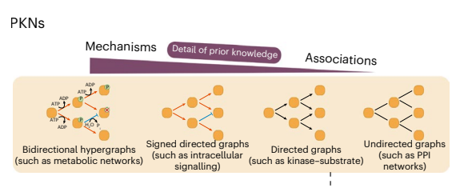
Prior knowledge networks come in four shapes
Left: more mechanistic detail
Right: more coverage, fewer assumptions
Fig. 2 (PKNs), CC BY 4.0
Hypergraph
genome-scale metabolic models
Signed directed
signalling, e.g. OmniPath
Directed
kinase–substrate
Undirected
protein–protein interactions
Rodriguez-Mier, Garrido-Rodriguez, Gabor & Saez-Rodriguez, Nat Mach Intell 7:1168 (2025)
7
Notes:
From mechanistic to associative. Metabolic networks are hypergraphs because a reaction links several metabolites with stoichiometry. Signalling PKNs (e.g. OmniPath) are signed and directed. Kinase-substrate networks are directed, PPI networks undirected. TF regulons (CollecTRI) are also signed directed graphs.

Slide 8
Step 0 — decoupler: transcription factor activity from its targets
TF
Regulon: signed TF → target edges (CollecTRI, DoRothEA)
Score: fit target gene statistics on regulon weights (e.g. univariate linear model)
Output: one activity per TF per sample
Used as: the measured nodes for CARNIVAL
g1
g2
g3
g4
g5
red activation / up blue repression / down
target changes → TF score
Badia-i-Mompel et al., Bioinform Adv 2022
Rodriguez-Mier, Garrido-Rodriguez, Gabor & Saez-Rodriguez, Nat Mach Intell 7:1168 (2025)
8
Notes:
A regulon is a signed TF -> target network (CollecTRI, DoRothEA). decoupler scores each TF from the changes of its targets, e.g. the univariate linear model (ULM): regress gene-level statistics on the signed regulon weights and use the t-value as activity. Result: one TF activity per sample. These are the 'measured' nodes CARNIVAL tries to explain. In the paper decoupler is used on CPTAC transcriptomics.

Slide 9
CARNIVAL: sign-consistent paths from inputs to TFs
In
Node state: up, down or off
Edge rule: child = edge sign × parent
Fit: match TF activities with few edges
Solver: integer linear program
Inverse CARNIVAL: inputs unknown, so any root node may start a signal
K1
K2
K3
K4
TF1
TF2
TF3
red activation / up blue inhibition / down
Liu et al., NPJ Syst Biol Appl 2019; dashed = PKN edge not selected
Rodriguez-Mier, Garrido-Rodriguez, Gabor & Saez-Rodriguez, Nat Mach Intell 7:1168 (2025)
9
Notes:
Signed directed PKN. Each node gets a state up/down/off. A selected edge passes the parent's state times the edge sign to the child. The ILP finds the smallest subnetwork whose TF states best match the decoupler activities (mismatch weighted by |activity|). Grey dashed edges are in the PKN but not selected; e.g. K2->K4 would make K4 up, contradicting TF2. Inverse CARNIVAL: if the perturbation is unknown, every root node of the PKN may start a signal.

Slide 10
FBA: fluxes through a metabolic network at steady state
Steady state: S v = 0
Bounds: lb ≤ v ≤ ub
Objective: maximise biomass flux (LP)
Sparse FBA: fewest active reactions with biomass ≥ x% of max (MILP)
B
v1
v3
v0
bio
A
C
v2
v4
D
dark = one optimal flux route
Orth, Thiele & Palsson, Nat Biotechnol 2010
Rodriguez-Mier, Garrido-Rodriguez, Gabor & Saez-Rodriguez, Nat Mach Intell 7:1168 (2025)
10
Notes:
Stoichiometric matrix S (metabolites x reactions). Steady state S v = 0: every metabolite is produced as fast as it is consumed. Flux bounds encode reversibility, nutrients, knockouts. Objective: maximise biomass, an LP. Sparse FBA: the fewest active reactions that still give at least x% of the optimal biomass, a MILP. Here A->B->C is the minimal route; A->D->C is an equivalent alternative (FBA solutions are often not unique).

Slide 11
iMAT: a metabolic network that agrees with expression
Map: expression → reaction score via gene–protein–reaction rules
Classes: high, low, uncertain
Maximise: high reactions on + low reactions off
Subject to: FBA constraints (MILP)
B
v1
v3
v0
bio
A
C
v2
v4
D
high low uncertain
Shlomi et al., Nat Biotechnol 2008
Rodriguez-Mier, Garrido-Rodriguez, Gabor & Saez-Rodriguez, Nat Mach Intell 7:1168 (2025)
11
Notes:
Gene-protein-reaction (GPR) rules turn gene expression into reaction scores: highly expressed, lowly expressed, or uncertain. iMAT maximises the number of high reactions that carry flux plus low reactions that are blocked, subject to the FBA constraints. Here v2 is lowly expressed, so the solution routes flux through B instead of D. MILP; one sample at a time in the original method.

Slide 12
Steiner trees: connect the measured proteins
Terminals: proteins with a signal
Steiner tree: cheapest tree linking all terminals
PCST: prizes on nodes, costs on edges; minimise costs − prizes
Hidden nodes: candidate mediators
Tuncbag et al., J Comput Biol 2013
Rodriguez-Mier, Garrido-Rodriguez, Gabor & Saez-Rodriguez, Nat Mach Intell 7:1168 (2025)
12
Notes:
Undirected PPI network. Terminals = proteins with a signal (e.g. differentially abundant). Steiner tree: the cheapest tree connecting all terminals; the extra nodes it needs (Steiner nodes) are candidate mediators. Prize-collecting Steiner tree (PCST): terminals are optional, each has a prize, each edge a cost; minimise edge costs minus collected prizes.

Slide 13
Different biology, same question: which edges to keep?
Method | PKN | Data | Selects
CARNIVAL | signed directed graph | TF activities | sign-consistent paths
FBA / sparse FBA | hypergraph (reactions) | flux constraints | flux distribution
iMAT | hypergraph (reactions) | expression | active reactions
Steiner / PCST | undirected graph | protein signals | a tree
All choose edges under constraints → all are (mixed-integer) linear programs
Rodriguez-Mier, Garrido-Rodriguez, Gabor & Saez-Rodriguez, Nat Mach Intell 7:1168 (2025)
13
Notes:
All four select a subset of edges (or reactions) of a PKN under constraints, scored against data. That shared structure is what CORNETO exploits: all can be written as (mixed-integer) linear programs.

Slide 14
Outline
1
Why network inference from prior knowledge?
2
The methods CORNETO unifies
3
CORNETO: one optimisation problem
4
Results and take-home
Rodriguez-Mier, Garrido-Rodriguez, Gabor & Saez-Rodriguez, Nat Mach Intell 7:1168 (2025)
14
Notes:
Three ideas: flows, hypergraphs, and one template with a shared sparsity penalty.

Slide 15
Idea 1: an edge is selected if it carries flow
Source / sink edges inject and remove flow
Conservation: in = out at every node
A x = 0
Edge switch: flow only if the edge is on
0 ≤ xₑ ≤ uₑ yₑ , yₑ ∈ {0, 1} u = capacity
Shortest path = cheapest unit of flow from s to t
a
1
1
+1
−1
s
1
t
3
1
b
numbers = edge costs; blue = flow
Rodriguez-Mier, Garrido-Rodriguez, Gabor & Saez-Rodriguez, Nat Mach Intell 7:1168 (2025)
15
Notes:
Network flows: a source edge injects flow, a sink edge removes it, and every internal node conserves flow (A x = 0 with A the incidence matrix). A binary indicator y_e switches each edge on or off; flow is allowed only on edges that are on. The selected edges are the inferred network. Example: shortest path = send one unit of flow from s to t at minimum cost (here s-a-t, cost 2). Paths, trees and DAGs all come from extra constraints on the same variables.

Slide 16
Idea 2: one incidence matrix describes every PKN
Graph edge
Reaction (hyperedge)
Source / sink
M1
u
v
∅
v
∅
M3
M2
2
u −1
v +1
empty tail or head
(exchange reactions)
M1 −1 M2 −2 M3 +1
For metabolism the incidence matrix is the stoichiometric matrix: A = S
so FBA is just a flow on the hypergraph, and graphs are the special case of one tail and one head
Rodriguez-Mier, Garrido-Rodriguez, Gabor & Saez-Rodriguez, Nat Mach Intell 7:1168 (2025)
16
Notes:
CORNETO works on directed hypergraphs: each hyperedge has a tail set and a head set, and each vertex has a signed coefficient in the incidence matrix. A graph edge is the special case with one tail (-1) and one head (+1). A reaction M1 + 2 M2 -> M3 has coefficients -1, -2, +1, so the incidence matrix IS the stoichiometric matrix and A x = 0 is the FBA steady state. Sources and sinks are hyperedges with an empty tail or head (like exchange reactions). This is why one flow formulation covers signalling, PPI and metabolism.

Slide 17
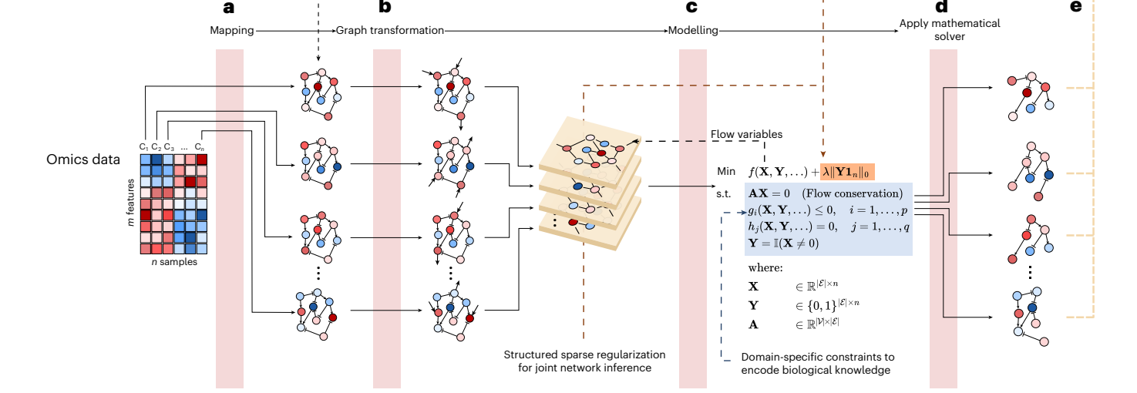
Every method = map data, edit the graph, constrain, solve
φ map
omics onto the PKN
ψ edit
add sources, sinks; prune
f, Ω model
objective + constraints
Solve
optimal networks + proof
Rodriguez-Mier, Garrido-Rodriguez, Gabor & Saez-Rodriguez, Nat Mach Intell 7:1168 (2025)
17
Notes:
Figure 2a-d. (a) phi maps omics data onto the PKN, giving one annotated graph per sample. (b) psi edits the graph: adds source and sink edges where flow should enter and leave, prunes unreachable parts. (c) The graphs are merged into one union graph; CORNETO creates flow variables X and indicator variables Y, adds method-specific constraints and the structured sparsity term (orange). (d) Any supported solver (HiGHS, Gurobi, SCIP, CPLEX...) returns the n networks with a certificate of optimality.

Slide 18
Idea 3: one template for every method and every sample
min (1/n) Σᵢ f(X:,ᵢ , Y:,ᵢ) + λ ‖Y 1ₙ‖₀
s.t. A X = 0 flow conservation in every sample
Y = 0 ⇒ X = 0 edges off carry no flow
(X, Y) ∈ Ω(method) paths, trees, signs, FBA bounds …
X, Y: flows and on/off indicators, edges × samples
f: the original method's objective, per sample
‖Y 1ₙ‖₀: number of edges used in any sample
λ: trade-off between data fit and one shared, sparse network
Rodriguez-Mier, Garrido-Rodriguez, Gabor & Saez-Rodriguez, Nat Mach Intell 7:1168 (2025)
18
Notes:
Equation 13. X: flows, one row per edge of the union graph, one column per sample. Y: binary edge indicators of the same shape. f is the method's own objective per sample, averaged over samples. The new term lambda * ||Y 1_n||_0 counts the edges that are used in at least one sample. Penalising that pushes samples to reuse the same edges, while still allowing sample-specific ones if the data demand it. lambda = 0 gives n independent single-sample problems.

Slide 19
Each method is a choice of graph edits, constraints and objective
Method | Graph edits (ψ) | Constraints (Ω) | Objective (f)
FBA | none: exchange reactions | flux bounds | max biomass
Sparse FBA | none | biomass ≥ x% of max | fewest reactions
iMAT | none (data via GPR rules) | flux on/off links | high on, low off
CARNIVAL | sources at inputs, sinks at TFs | tree + sign rules | match TF activities
Steiner / PCST | source at root, sinks at terminals | tree | edge costs (− prizes)
Plug into the template → the multi-sample version comes for free
Rodriguez-Mier, Garrido-Rodriguez, Gabor & Saez-Rodriguez, Nat Mach Intell 7:1168 (2025)
19
Notes:
From the Methods section. FBA needs no data mapping or graph edits (exchange reactions already exist); f = -c'x, lambda = 0. sFBA: biomass >= x% of optimum and lambda > 0, so lambda just switches sparsity on. iMAT: data mapped via GPR rules; objective penalises high reactions off and low reactions on. CARNIVAL: source edges at the perturbed nodes (all roots in inverse CARNIVAL), sink edges at TFs; tree constraint plus sign-consistency constraints on activation/inhibition variables. Steiner: source at the root, sinks at the other terminals, tree constraint, minimise edge costs; PCST also subtracts prizes.

Slide 20
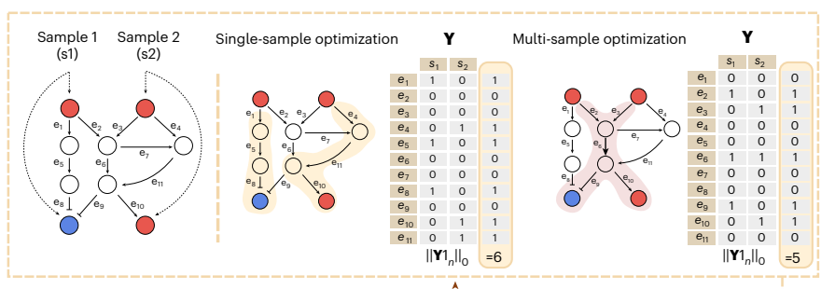
Joint inference: shared edges are cheaper
Independent fits: 6 distinct edges, none shared Joint fit: 5 edges, one shared
λ = 0 → independent fits; larger λ → more shared structure
Rodriguez-Mier, Garrido-Rodriguez, Gabor & Saez-Rodriguez, Nat Mach Intell 7:1168 (2025)
20
Notes:
Figure 2e. Two samples share a PKN; we only know receptors (top) and TF states (bottom; red up, blue down). Fitted independently, the two networks share no edge: 6 distinct edges in the union. Fitted jointly with the structured penalty, both networks reuse e6 and the union has only 5 edges, while explaining the same TF states. Assumption: samples share structure, e.g. related patients or perturbations in one cell type.

Slide 21
Same template, so problems can be composed
f = α f₁ + β f₂
Ω = Ω₁ ∩ Ω₂
Shared variables are merged
Signalling: signed graph
Gene regulation: TF → genes
Metabolism: reaction hypergraph
Caveat
The paper solves each layer on its own; multi-layer inference is proposed as future work
one union hypergraph, one MILP
cf. COSMOS: Dugourd et al., Mol Syst Biol 2021
Rodriguez-Mier, Garrido-Rodriguez, Gabor & Saez-Rodriguez, Nat Mach Intell 7:1168 (2025)
21
Notes:
Problem composition (Methods): weighted sum of objectives, intersection of feasible sets; variables that appear in both problems are identified, i.e. shared. Because signalling, gene regulation and metabolism are all flows on one (hyper)graph, they could in principle be stacked into one union hypergraph and one MILP. Caveat: the paper applies each layer separately; joint multi-layer inference (signalling + metabolism, as in COSMOS) is named in the Discussion as future work.

Slide 22
Outline
1
Why network inference from prior knowledge?
2
The methods CORNETO unifies
3
CORNETO: one optimisation problem
4
Results and take-home
Rodriguez-Mier, Garrido-Rodriguez, Gabor & Saez-Rodriguez, Nat Mach Intell 7:1168 (2025)
22
Notes:
Three re-implemented methods, each single- vs multi-sample.

Slide 23
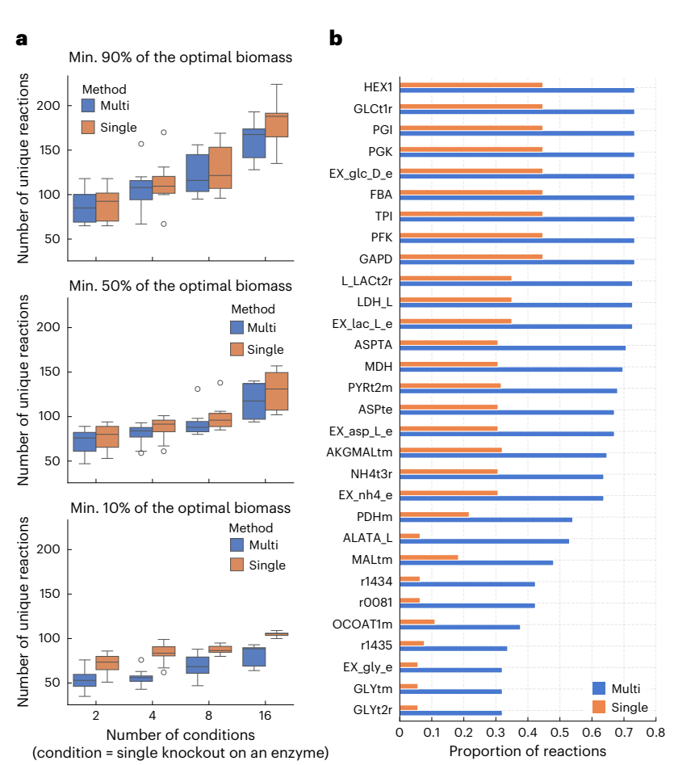
Multi-sample sparse FBA: smaller networks, canonical routes
Model: MitoCore, 555 reactions
Samples: simulated enzyme knockouts
Fewer distinct reactions: median −6% (≥90% biomass), −7% (≥50%), up to −30% (≥10%)
Joint fit keeps canonical glycolysis (HEX1, PGI, PFK)
Fig. 3a,b; blue = multi-sample, orange = single-sample
Rodriguez-Mier, Garrido-Rodriguez, Gabor & Saez-Rodriguez, Nat Mach Intell 7:1168 (2025)
23
Notes:
MitoCore model (555 reactions, 441 metabolites). Samples = simulated single-enzyme knockouts; 2, 4, 8 or 16 samples, 10 random subsets each. Joint sFBA gives fewer distinct reactions; median reduction 6.02% at >=90% biomass, 7.21% at >=50%, up to 30% at >=10% (looser constraint = more alternative routes). (b) The joint fit picks canonical glycolysis (HEX1, PGI, PFK...) more consistently; single-sample fits wander to alternative, equally optimal routes, exaggerating differences between samples.

Slide 24
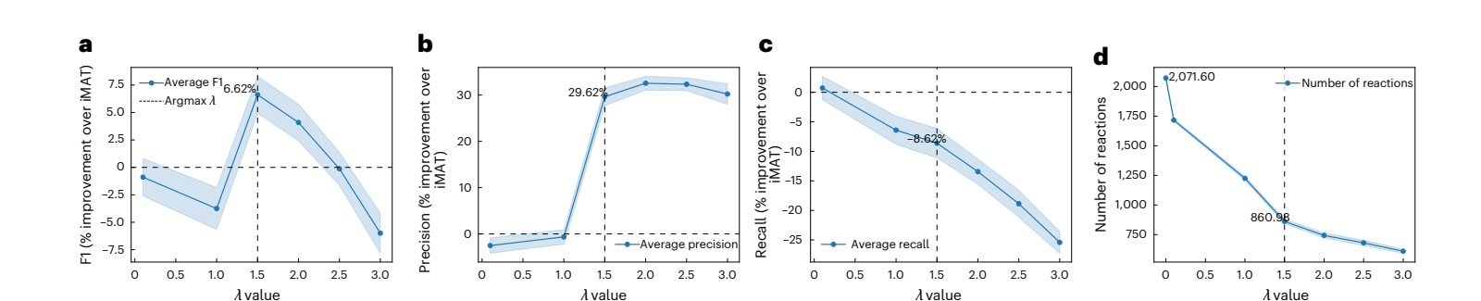
Multi-sample iMAT: more precise context-specific models
Yeast: 12 enzyme knockouts · λ = 1.5 chosen by 5-fold cross-validation
F1
+6.6%
Precision
+29.6%
Recall
−8.6%
Reactions
≈2,070 → 861
Fig. 4a–d; change relative to single-sample iMAT (λ = 0)
Rodriguez-Mier, Garrido-Rodriguez, Gabor & Saez-Rodriguez, Nat Mach Intell 7:1168 (2025)
24
Notes:
Yeast deletion microarrays (Kemmeren 2014), 12 enzyme knockouts with metabolic rewiring, Yeast-GEM. lambda chosen by 5-fold cross-validation on held-out reaction scores; best F1 at lambda = 1.5 (lambda = 0 is the original iMAT). F1 +6.62%, precision +29.62%, recall -8.62%; reactions ~2,072 -> ~861 on average; false positives -38.8%. Trade-off: fewer false positives, slightly lower recall.

Slide 25
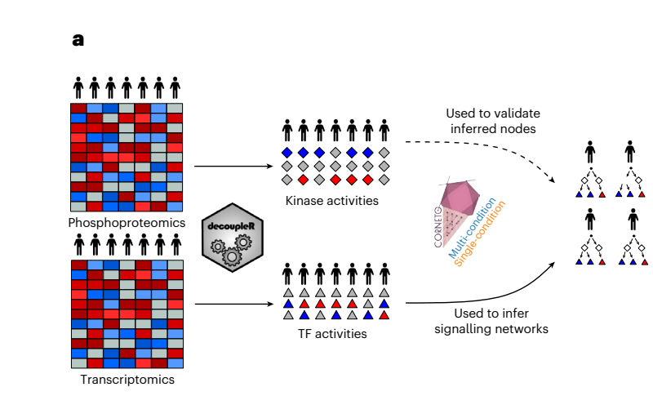
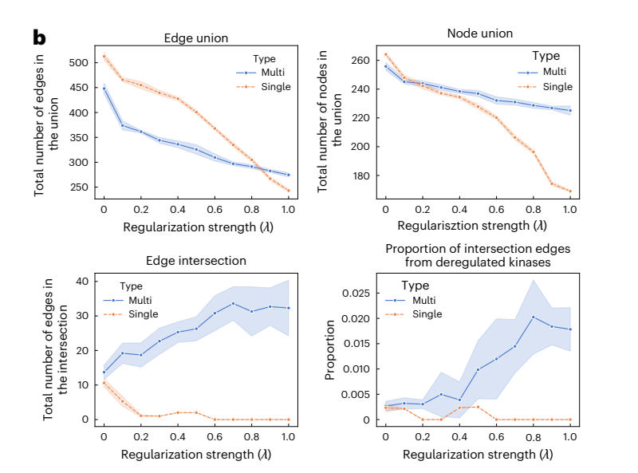
Multi-patient CARNIVAL: more shared, kinase-supported edges
Fit: TF activities from RNA
Check: kinase activities from phosphoproteomics
Fig. 5a,b; CPTAC lung adenocarcinoma; blue = multi-sample, orange = single-sample
Rodriguez-Mier, Garrido-Rodriguez, Gabor & Saez-Rodriguez, Nat Mach Intell 7:1168 (2025)
25
Notes:
CPTAC lung adenocarcinoma. TF activities from transcriptomics with decoupler; inverse CARNIVAL (inputs unknown) single vs multi-sample. Validation set: kinases deregulated (top quartile |activity|) in >=50% of patients, from phosphoproteomics, which was not used for fitting. Multi-sample: the union shrinks less in nodes, the intersection across patients grows (single-sample intersection collapses to ~0), and a larger share of intersection edges comes from deregulated kinases. Error bands: 10 seeds.

Slide 26
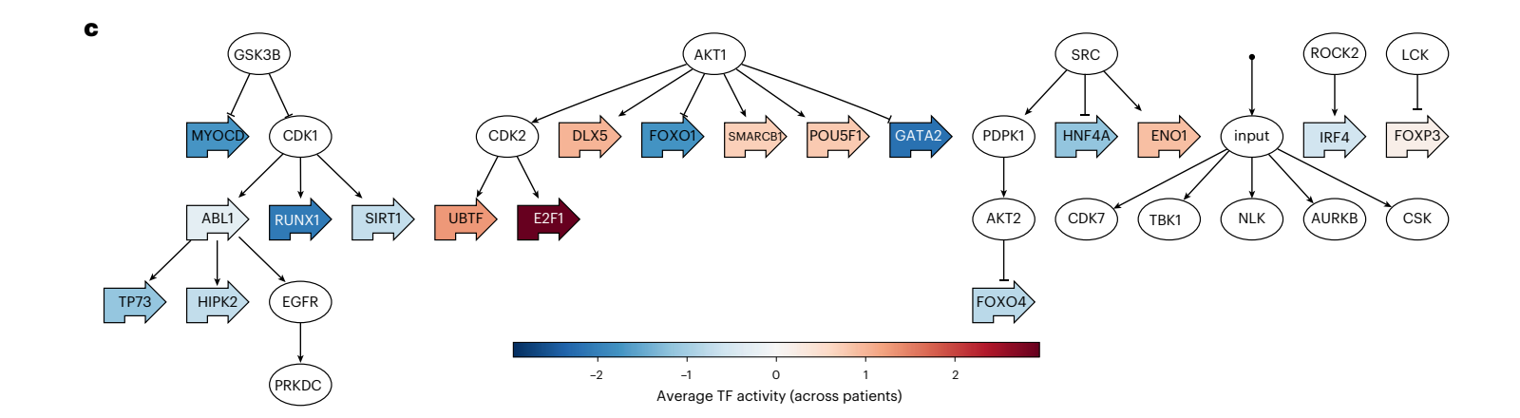
A shared core: GSK3B, AKT1 and SRC drive TF activity
Edges shared by all patients at λ = 0.8
kept if present in ≥ 50% of 30 alternative solutions
Fig. 5c; colour = mean TF activity across patients
Rodriguez-Mier, Garrido-Rodriguez, Gabor & Saez-Rodriguez, Nat Mach Intell 7:1168 (2025)
26
Notes:
Figure 5c: edges in the intersection of all patient networks at lambda = 0.8. Because optimal solutions are not unique, the joint inference was repeated 30 times with different seeds and an edge was kept if it appeared in at least 50% of the alternative solutions. Colour = mean TF activity across patients.

Slide 27
Take-home
What CORNETO gives
• One formulation for signalling, metabolism, PPI
• Exact solvers, proof of optimality
• Joint fits: sparser, more precise
• Open Python library (corneto.org)
What it does not solve
• NP-hard: slow for many samples or large PKNs
• λ must be tuned; assumes shared structure
• Steady state only
• Only edges already in the PKN
• Several optimal networks: sample them
Rodriguez-Mier, Garrido-Rodriguez, Gabor & Saez-Rodriguez, Nat Mach Intell 7:1168 (2025)
27
Notes:
Strengths: one formulation and API for signalling, metabolism and PPI; exact solvers with optimality certificates; joint fits give sparser, more precise, more consistent networks. Limitations from the Discussion: NP-hard, cost grows with samples and PKN size; lambda is problem-specific and must be tuned, and the penalty assumes samples share structure; steady state only; only edges already in the PKN can be selected; several optimal networks exist, so sample alternatives and report edge frequencies.

Slide 28
For discussion
1
How should λ be chosen when there is no ground truth?
2
When is 'samples share structure' wrong, e.g. heterogeneous patients?
3
Can signalling, gene regulation and metabolism be solved as one joint problem?
Rodriguez-Mier, Garrido-Rodriguez, Gabor & Saez-Rodriguez, Nat Mach Intell 7:1168 (2025)
28
Notes:
Open questions for the group.

Slide 29
References
Rodriguez-Mier P, Garrido-Rodriguez M, Gabor A, Saez-Rodriguez J. Unifying multi-sample network inference from prior knowledge and omics data with CORNETO. Nat Mach Intell 7, 1168–1186 (2025). Figures reused under CC BY 4.0.
Liu A et al. From expression footprints to causal pathways: contextualizing large signaling networks with CARNIVAL. NPJ Syst Biol Appl 5, 40 (2019).
Badia-i-Mompel P et al. decoupleR: ensemble of computational methods to infer biological activities from omics data. Bioinform Adv 2, vbac016 (2022).
Türei D, Korcsmáros T, Saez-Rodriguez J. OmniPath: guidelines and gateway for literature-curated signaling pathway resources. Nat Methods 13, 966–967 (2016).
Orth JD, Thiele I, Palsson BØ. What is flux balance analysis? Nat Biotechnol 28, 245–248 (2010).
Shlomi T et al. Network-based prediction of human tissue-specific metabolism. Nat Biotechnol 26, 1003–1010 (2008).
Tuncbag N et al. Simultaneous reconstruction of multiple signaling pathways via the prize-collecting Steiner forest problem. J Comput Biol 20, 124–136 (2013).
Dugourd A et al. Causal integration of multi-omics data with prior knowledge to generate mechanistic hypotheses. Mol Syst Biol 17, e9730 (2021).
Gillette MA et al. Proteogenomic characterization reveals therapeutic vulnerabilities in lung adenocarcinoma. Cell 182, 200–225 (2020).
Kemmeren P et al. Large-scale genetic perturbations reveal regulatory networks and an abundance of gene-specific repressors. Cell 157, 740–752 (2014).
Rodriguez-Mier, Garrido-Rodriguez, Gabor & Saez-Rodriguez, Nat Mach Intell 7:1168 (2025)
29

