Slide 1
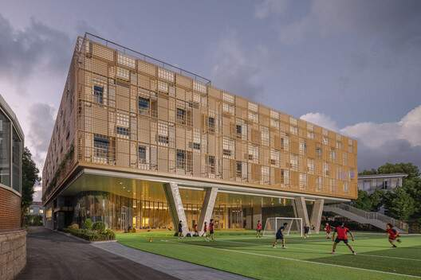
ARCHITECTURE STUDIO · DESIGN 4 · PRECEDENT ANALYSIS
HOW ARE SPORT,
LEARNING AND
SERVICE ORGANISED?
Spatial analysis of two precedents for a Faculty of Physical Education
CASE 01 — PRIMARY
Anna Pao Sohmen Centre, YK Pao School, Shanghai
Scenic Architecture Office
Photo: Anna Pao Sohmen Centre — uploaded set (p. 28)
CASE 02
Faculty of Physical Education and Sport, Charles University, Prague
Key question: why are these spaces organised this way, and what can a faculty design learn from it?

Slide 2
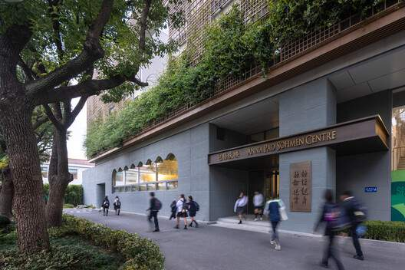
Plans first: every reading is tagged VERIFIED or INTERPRETATION
00 — CASE STUDIES + METHOD
01
02
03
04
05
COLLECT
READ PLANS
OVERLAY
RELATE
EXTRACT
Uploaded drawings & photos (Case 01) are the primary source; publications fill gaps.
Identify levels, rooms (translated from drawing legends), entrances, cores.
Colour-coded zoning + circulation drawn over the original plans.
Adjacency, public → private gradient, section stacking.
Design principles → lessons for a PE Faculty.
ZONE COLOURS (used on every slide)
Public
Documentation gap —
no plans published
Semi-public / education
Controlled / private
Sports
Service
CIRCULATION
CASE 01 · PRIMARY
CASE 02
Public / students
Anna Pao Sohmen Centre
FTVS, Charles University
Sports users
Service
Shanghai, China · Scenic Architecture Office · 2025
Prague 6 – Veleslavín, Czech Republic
Full drawing set available: 6 plans, 3 sections, 2 axonometrics, site plan.
No published floor plans or sections could be obtained → analysis limited to campus & programme level.
VERIFIED
from drawings or a cited publication
ARCHITECTURAL INTERPRETATION
reading of the plan

Slide 3
A six-level 'vertical campus' of sport, making and gathering on a tight school site
CASE 01 — ANNA PAO SOHMEN CENTRE · PROJECT
Project | Anna Pao Sohmen Centre at YK Pao School | AD
Architect | Scenic Architecture Office (SAO) | AD
Location | Shanghai, China — school campus on Hongqiao Road (虹桥路, site plan) | AD + drawing
Completed | 2025 | AD
Area | 2,473 m² (ArchDaily) · GFA 7,911.8 m² = 6,945.5 above + 966.3 basement (gooood) | SOURCES DIFFER
Levels | B1 · GF · 2F mezzanine · 3F · 4F · roof court = 6 levels | drawings
Programme | Indoor pool, multi-purpose basketball hall, table tennis, roof sports court; STEAM classrooms (art, music, ICT, wood, robotics, fashion, photography); teacher-training centre; collective hub / lecture space | AD / gooood
Institution | YK Pao School — school campus (age groups not verified) | AD
CONCEPT (as published)
“The upper mass floats above the synthetic turf field, with angled concrete columns carrying the load while keeping the ground level open” — building upward to add six levels of programme while increasing usable outdoor area.
Area: the two published figures cannot both be gross floor area; 2,473 m² likely refers to a footprint/site figure — NOT VERIFIED. Use GFA only with its source.
Entrance façade (p. 1) · lifted volume over the field (p. 28)
SOURCE ArchDaily, 'Anna Pao Sohmen Centre at YK Pao School / Scenic Architecture Office' (2025) — archdaily.com/1041795 · gooood, 'Anna Pao Sohmen Centre at Shanghai YK Pao School by Scenic Architecture Office' — gooood.cn · Drawings: Scenic Architecture Office, as published (uploaded set, pp. 33–48)

Slide 4
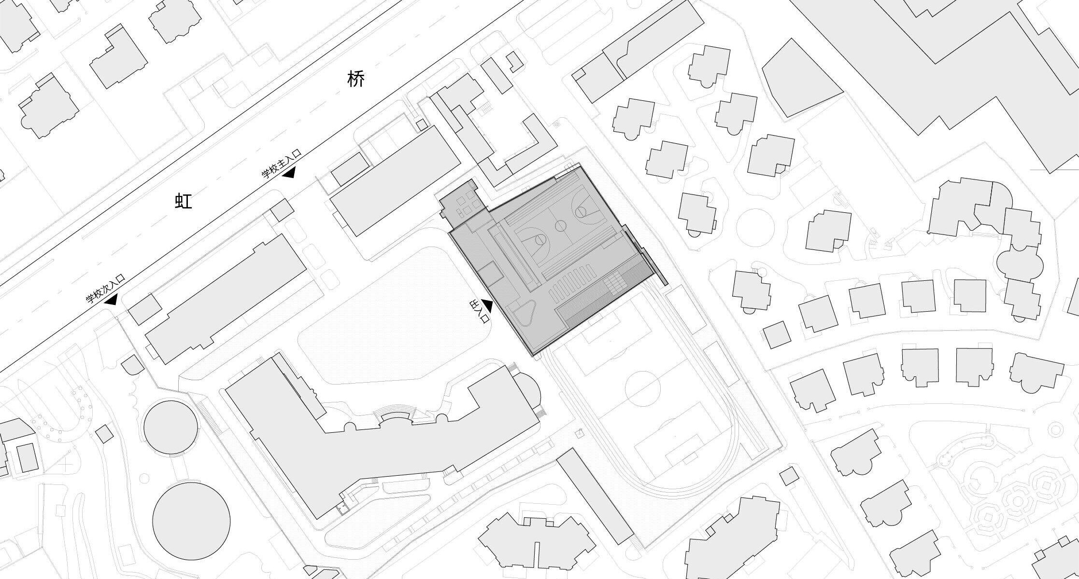
Placed at the hinge between campus lawn and sports field, close to the main gate
CASE 01 — SITE + CONTEXT
VERIFIED
Road (Hongqiao Rd.), school main & secondary entrances and the building's main entrance are labelled on the site plan. North arrow and 0–30 m scale on drawing. Building sits between the school buildings, the lawn and the field with 400 m-type track (drawn).
HONGQIAO ROAD (虹桥路)
ANNA PAO SOHMEN CENTRE
school main entrance
ARCHITECTURAL INTERPRETATION
The centre is the 'turn' of the campus: entered from the lawn side, it opens on the other side to the field — a hinge, not an object.
Short walk from the main gate → doubles as a public/event building without crossing the teaching campus.
Tight footprint between existing buildings and the field explains the vertical stacking and the lift-up over the track.
Vehicular / service access: NOT VERIFIED from the site plan.
Orientation / solar strategy: NOT VERIFIED from published sources.
CENTRAL LAWN
low-rise residential
secondary entrance
building entrance
SPORTS FIELD + TRACK
Site plan (uploaded p. 46) — annotations translated from the Chinese labels: 学校主入口 main school entrance · 学校次入口 secondary entrance · 主入口 building entrance.
SOURCE Drawings: Scenic Architecture Office, as published (uploaded set, pp. 33–48) — site plan; ArchDaily, 'Anna Pao Sohmen Centre at YK Pao School / Scenic Architecture Office' (2025) — archdaily.com/1041795

Slide 5
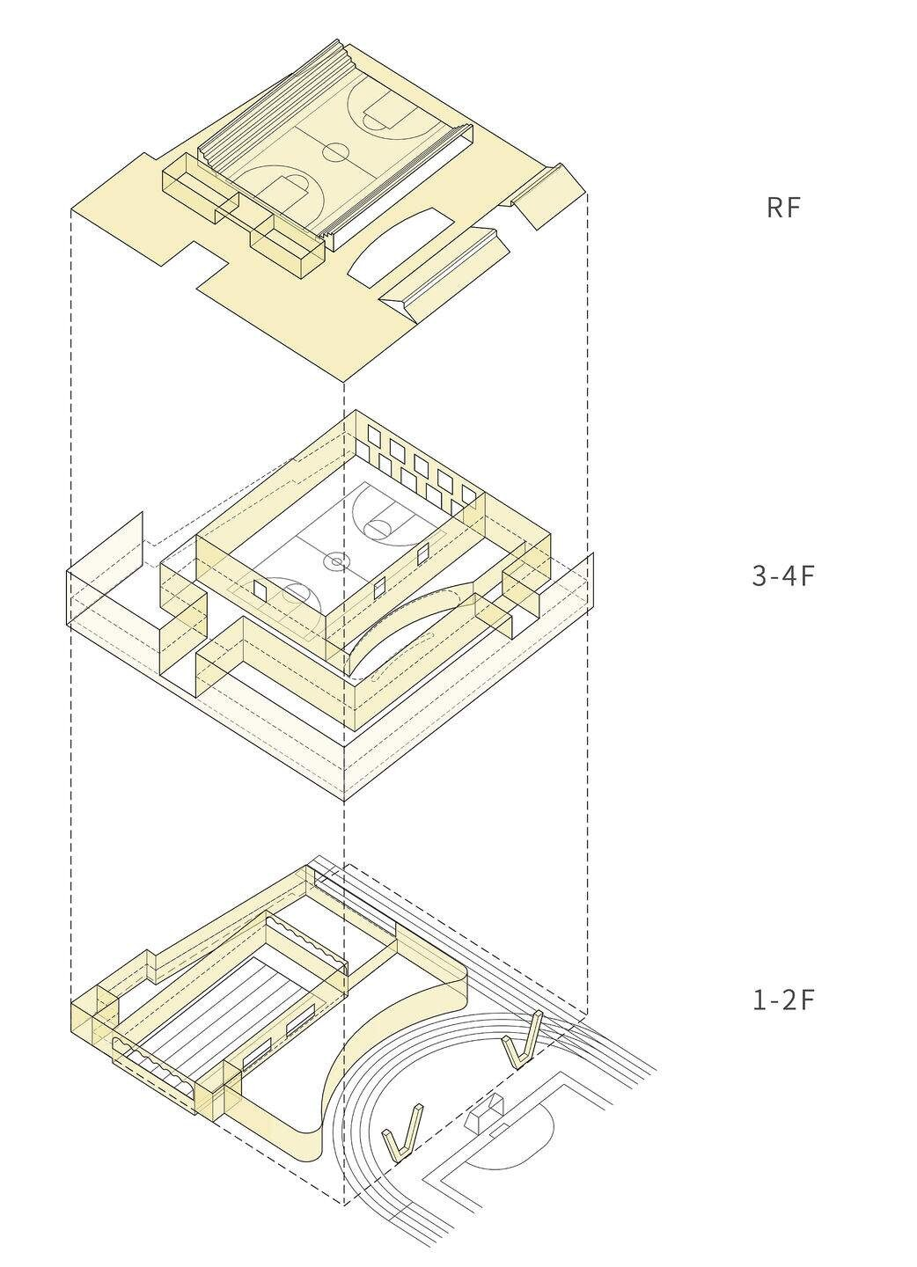
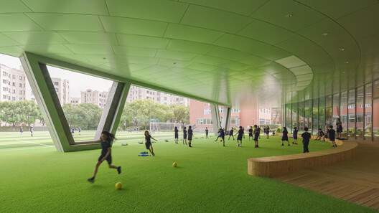
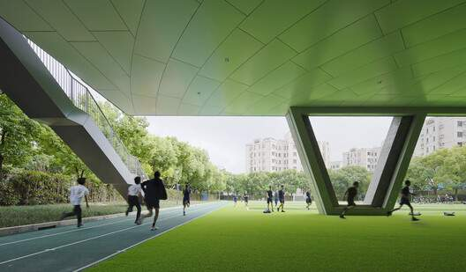
Build up, free the ground: the field continues under the building
CASE 01 — ARCHITECTURAL CONCEPT
CONCEPT DIAGRAM
A · object beside the field
B · stacked + lifted: field runs under, roof becomes a court
ARCHITECTURAL INTERPRETATION
Upper floors (3F–4F) cantilever south over the track — dashed outline on the GF plan matches the 3F footprint.
Sports volumes stacked: pool (GF/B1) → gym (3F–4F) → roof court.
Learning wraps the gym on three sides → daylight + views (ArchDaily).
Covered field under the 3F–4F volume; angled concrete columns at the track edge (pp. 26, 5)
SOURCE ArchDaily, 'Anna Pao Sohmen Centre at YK Pao School / Scenic Architecture Office' (2025) — archdaily.com/1041795 (quoted concept); Drawings: Scenic Architecture Office, as published (uploaded set, pp. 33–48); Photographs: uploaded set (pp. 1–32), as published with the project
Exploded axonometric — architects' drawing (p. 39)

Slide 6
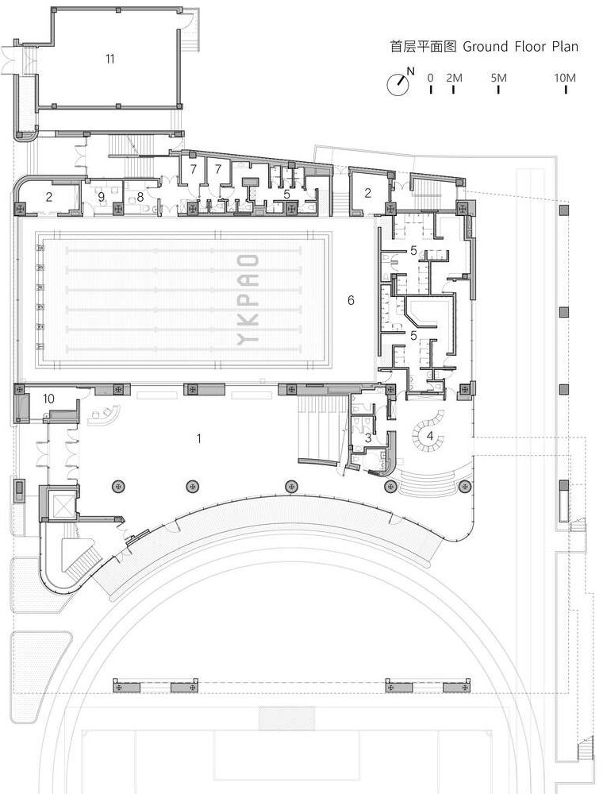
GF: an assembly lobby between pool and field; wet + service behind
CASE 01 — GROUND FLOOR PLAN
ROOMS (drawing legend, translated)
VERIFIED
1 Assembly lobby · 2 Storage · 3 Toilet · 4 Pool foyer · 5 Change rooms · 6 Swimming pool · 7 Equipment · 8 Emergency clinic · 9 Office · 10 Staff lounge · 11 Power distribution
Pool hall is the largest GF space; change rooms sit between pool and pool foyer; clinic, office, storage and equipment line the north edge; a staircase rises from the lobby to the 2F mezzanine.
ARCHITECTURAL INTERPRETATION
Public
WHY the lobby here: it is the threshold between campus (entrance) and field (south) — gathering space that also distributes to the pool and upper floors.
Direct access: pool foyer → change rooms → pool (wet sequence never re-enters the dry lobby).
Controlled: clinic & staff rooms at the back edge, near the north stair.
Service: plant + storage stacked on the north strip, power room detached — away from public frontage.
Acoustic / humidity: pool enclosed by service & change rooms rather than by classrooms.
Semi-public / education
Controlled / private
Sports
Service
E
Public / students
Sports users
Service
F
SOURCE Drawings: Scenic Architecture Office, as published (uploaded set, pp. 33–48) — Ground Floor Plan (p. 40). Zones, arrows and pins added by author.
E entrance (from site plan) · F opens to field under the cantilever · ▭ cores

Slide 7
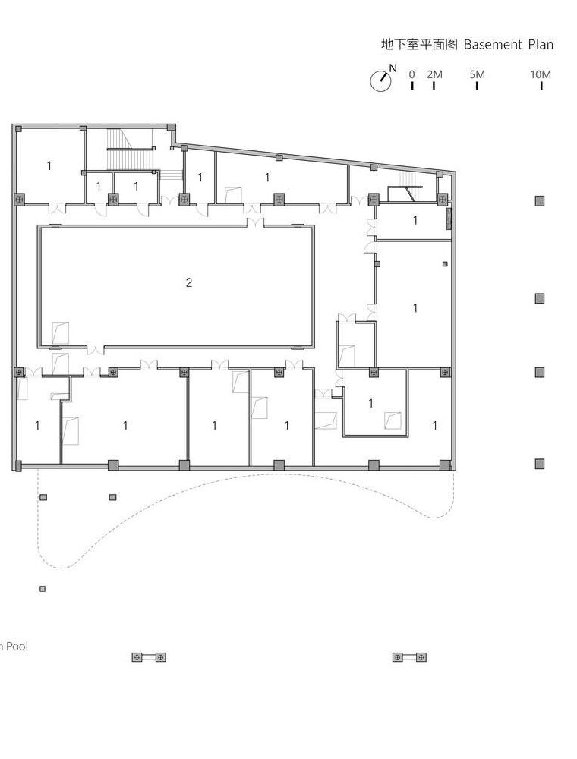
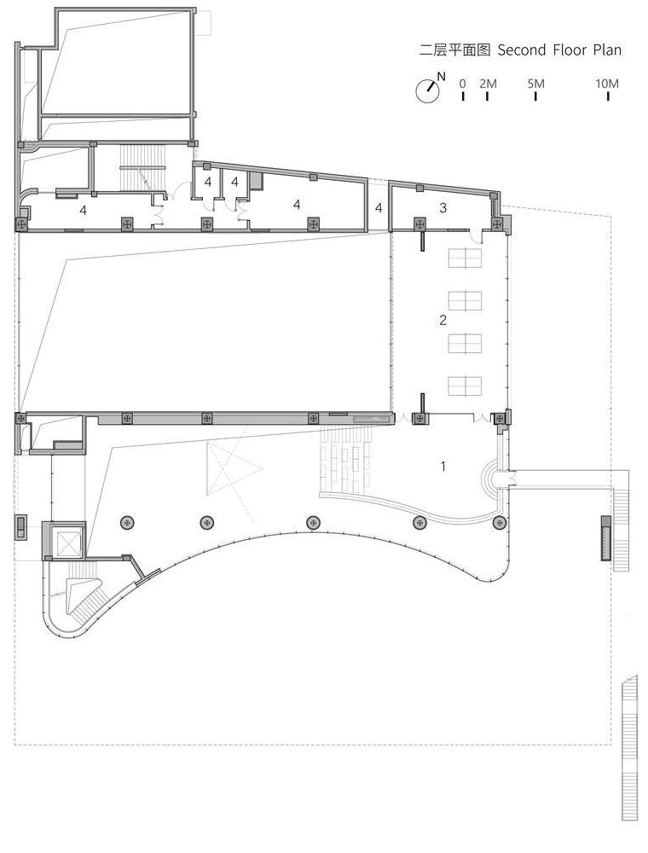
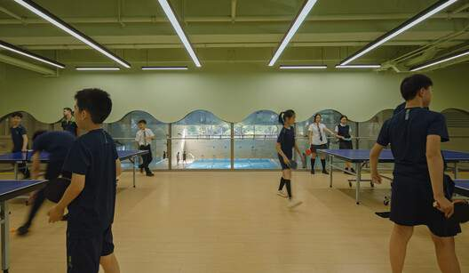
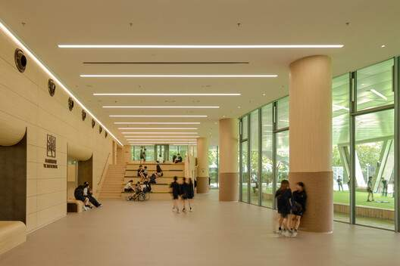
Below: plant under the pool. Above: a mezzanine that watches the pool and the field
CASE 01 — BASEMENT + SECOND FLOOR
Table tennis looks into the pool through the wave windows (p. 10) · lobby stair-seating to mezzanine (p. 25)
VERIFIED
B1 contains only equipment rooms and the pipe void beneath the pool. 2F: mezzanine over the lobby, table-tennis room above the change rooms, equipment strip along the north; an external bridge/stair leaves the east side.
ARCHITECTURAL INTERPRETATION
Service stacked under service: B1 plant directly below the pool → shortest pipe runs, no plant on public levels.
Visual connection: table tennis overlooks the pool; mezzanine overlooks lobby + field → sport is displayed, not hidden.
The lobby stair is also seating (photo) → circulation doubles as spectator space.
BASEMENT — equipment rooms (设备间) all round the void under the pool (泳池下方管道空腔)
2F — 1 Activity mezzanine · 2 Table tennis · 3 Storage · 4 Equipment; dashed = pool void below
Note: drawing's English legend reads 'Activity mezzanine' for item 1; the Chinese 设备间 = equipment room → used here.
SOURCE Drawings: Scenic Architecture Office, as published (uploaded set, pp. 33–48) — Basement (p. 42) & Second Floor (p. 35) plans; Photographs: uploaded set (pp. 1–32), as published with the project

Slide 8
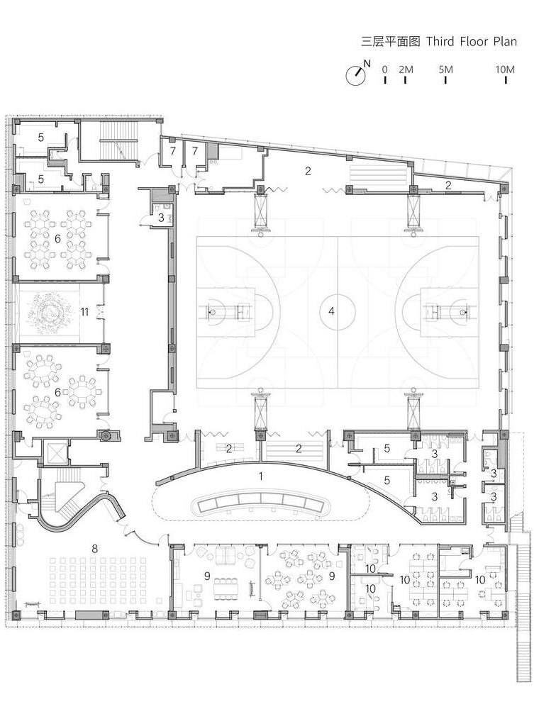
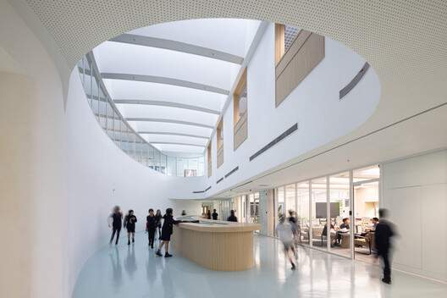
3F: the gym as the centre, wrapped by classrooms, offices and an atrium ring
CASE 01 — THIRD FLOOR PLAN
ROOMS (drawing legend)
VERIFIED
1 Atrium · 2 Storage · 3 Toilet · 4 Indoor gym · 5 Change room · 6 Classroom · 7 Equipment · 8 Multi-function room · 9 Seminar · 10 Office · 11 Pomelo courtyard
Gym (4) occupies the centre-north; classrooms + courtyard on the west; multi-function, seminar and offices on the south façade; change rooms + toilets between gym and offices; a sculptural stair + lift form the SW core.
Public
ARCHITECTURAL INTERPRETATION
Semi-public / education
Gym = organising mass; every other room is a 'liner' along a façade → daylight for learning, gym lit from roof/high windows.
Change rooms (5) sit on the atrium side of the gym → sports users enter the gym without crossing classrooms.
Atrium ring = public spine: links core, multi-function hall (event use), seminars and gym doors.
Courtyard splits the classroom wing → light, air and a quiet outdoor pause.
Offices at the SE corner: controlled, next to the external stair rather than the public core.
Controlled / private
C
Sports
Service
Public / students
Sports users
Service
A
Atrium + oval roof light (p. 21)
SOURCE Drawings: Scenic Architecture Office, as published (uploaded set, pp. 33–48) — Third Floor Plan (p. 33). Overlay by author.
A atrium void with roof light · C pomelo courtyard (open) · ▭ cores

Slide 9
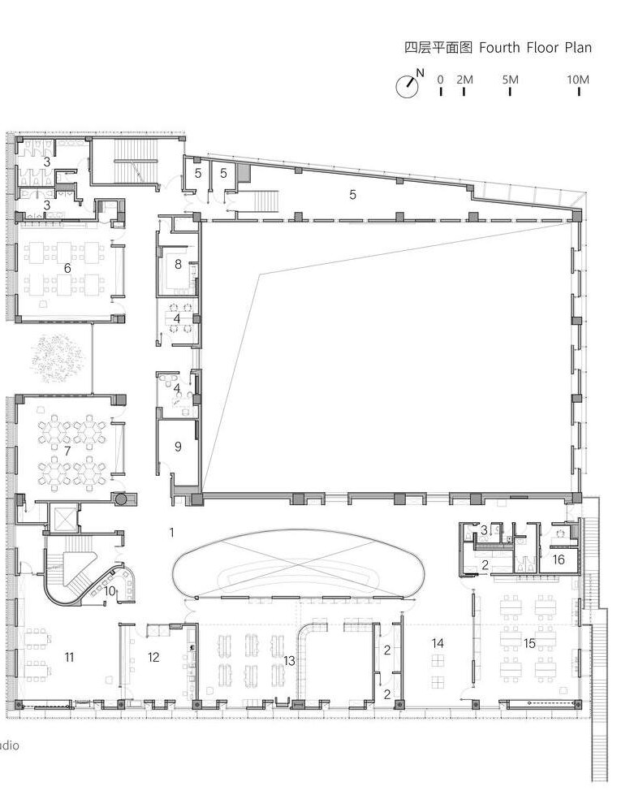
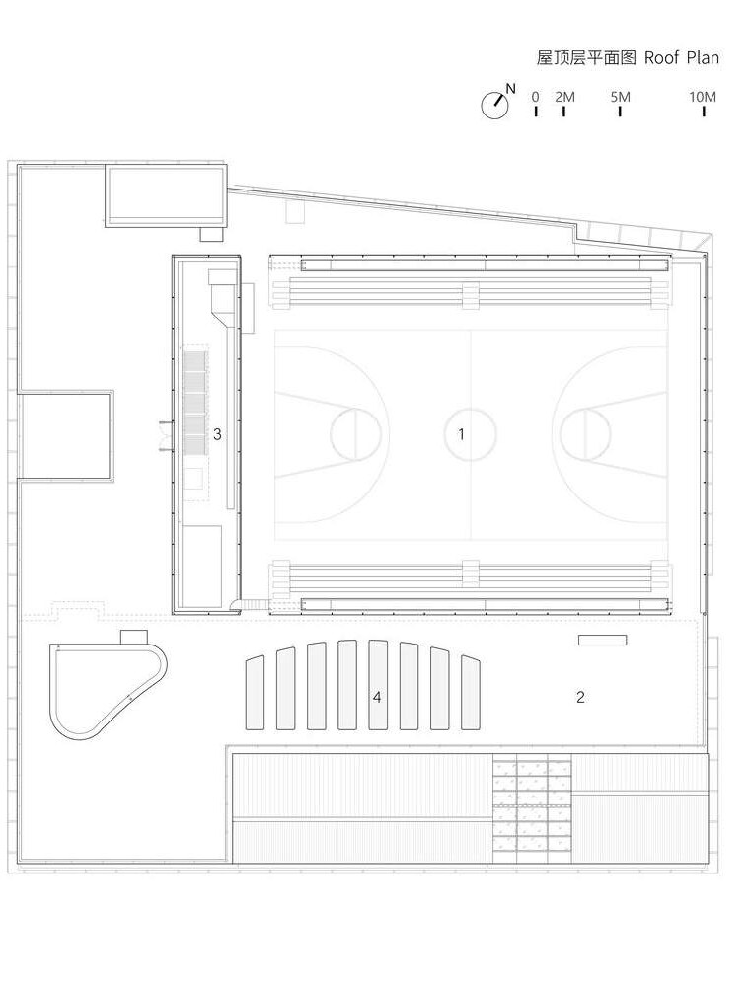
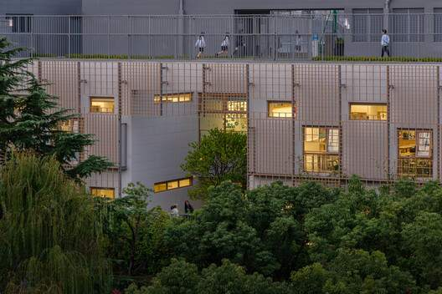
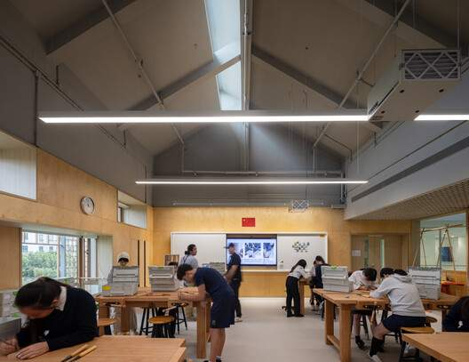
4F studios ring the gym void; the roof is a second, open-air court
CASE 01 — FOURTH FLOOR + ROOF
Roof court above the studio façade (p. 3) · pitched-roof wood studio (p. 16)
VERIFIED
4F studios line west and south façades; offices/dark room/photo studio line the gym's west wall. Roof: full court with stepped seating on both long sides, solar plant platform, and 'clerestory desks' over the atrium.
ARCHITECTURAL INTERPRETATION
Noise/mess-tolerant making studios grouped on one floor, above quieter classrooms.
Roof court reuses the gym's footprint → the long-span structure carries play twice.
Stepped seats make the roof a small outdoor arena; clerestory desks = skylights that are also furniture.
Plant (solar) kept to a strip beside the court, away from the play edge.
4F — studios: visual art, ICT, robotics, maker, wood, greenhouse, fashion, photography, dark room, 3D print, recording; dashed = gym void
ROOF — 1 roof playground (court + stepped seats N & S) · 2 activity space · 3 solar equipment platform · 4 clerestory desks
SOURCE Drawings: Scenic Architecture Office, as published (uploaded set, pp. 33–48) — Fourth Floor (p. 41) & Roof plans (p. 37); Photographs: uploaded set (pp. 1–32), as published with the project

Slide 10
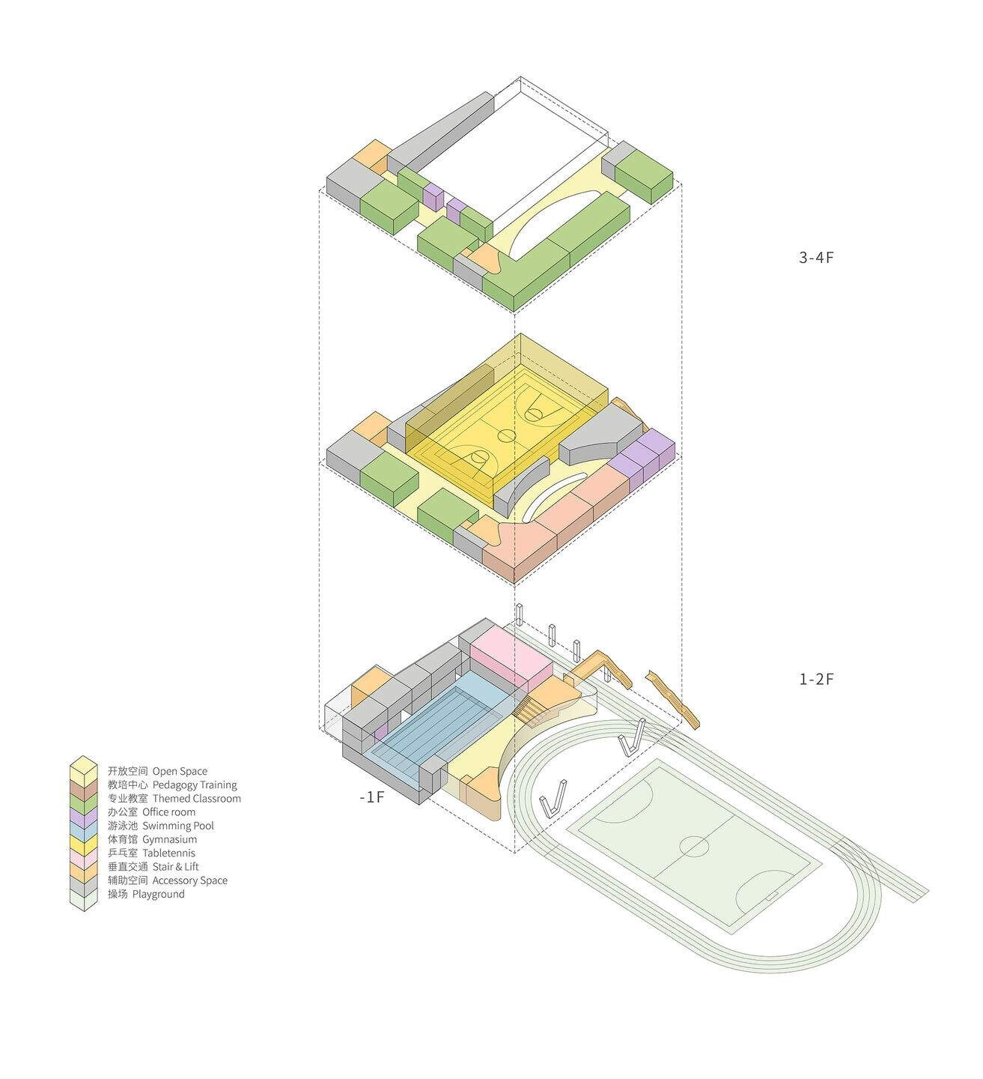
Zoning is vertical: wet sport low, dry sport high, learning around, service below
CASE 01 — FUNCTIONAL ZONING
PUBLIC
SEMI-PUBLIC / EDU
CONTROLLED
SPORTS
SERVICE
roof court + seats
solar platform
ROOF
atrium
studios, ICT, art
offices, dark room
(gym void)
equipment, WC
4F
atrium, multi-function
classrooms, seminar
offices, change
indoor gym
storage, WC
3F
mezzanine
table tennis
equipment
2F
assembly lobby
pool foyer
clinic, staff
pool
storage, power
GF
plant under pool
B1
VERIFIED ROOMS · ZONE ASSIGNMENT = INTERPRETATION
SOURCE Drawings: Scenic Architecture Office, as published (uploaded set, pp. 33–48) — all plans + programme axonometric (p. 38).
Programme axonometric — architects' drawing and colours (p. 38)

Slide 11
Two hearts — the lobby (GF) and the atrium (3F) — connected by one core
CASE 01 — SPATIAL RELATIONSHIPS / ADJACENCY
CAMPUS LAWN / ENTRANCE
LINE TYPES
direct / required (plan-verified)
sports sequence
ASSEMBLY LOBBY
POOL FOYER
CHANGE ROOMS
POOL
near / shared corridor
visual connection
service (vertical)
FIELD + TRACK
(under building)
MEZZANINE (2F)
TABLE TENNIS (2F)
PLANT (B1)
ARCHITECTURAL INTERPRETATION
Pool ↔ change ↔ foyer: linear wet sequence on GF (plan).
Gym ↔ change (3F): change rooms open off the atrium beside gym doors.
Lobby ↔ field: lobby glazed + stepped to the track (section p. 34).
Atrium ↔ multi-function / seminar: event rooms on the public ring.
Plant directly below pool: vertical service adjacency.
Table tennis ↔ pool: visual only (wave windows, photo p. 10).
WEST CORE: LIFT + STAIR
ATRIUM (3F–4F)
CHANGE (3F)
MULTI-FUNCTION / SEMINAR
COURTYARD
CLASSROOMS / STUDIOS
INDOOR GYM
OFFICES
ROOF COURT
SOURCE Drawings: Scenic Architecture Office, as published (uploaded set, pp. 33–48) (plans pp. 33–42, section p. 34); Photographs: uploaded set (pp. 1–32), as published with the project

Slide 12
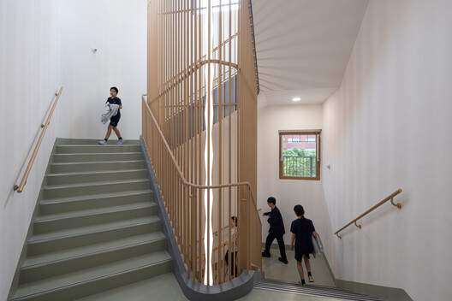
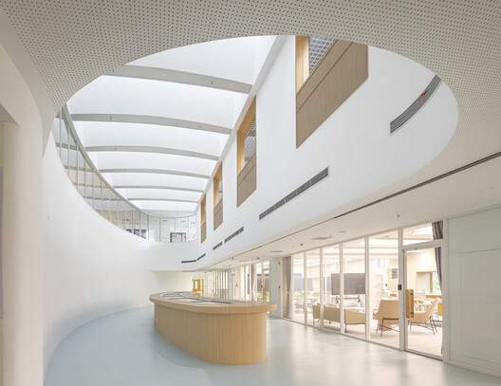
One public core, one back stair, one external stair — and stairs that are also seats
CASE 01 — CIRCULATION
WEST CORE
lift + sculptural stair
NORTH STAIR
(back of house)
ROOF
Stair with timber screen (p. 23) · atrium stair landing (p. 20)
4F
VERIFIED
Cores in plans: lift + curved stair (SW, all levels GF–4F), north stair (B1–roof), straight stair lobby→2F, east external stair/bridge (2F–3F).
3F atrium ring (public spine)
EAST EXTERNAL STAIR
3F
ARCHITECTURAL INTERPRETATION
Students / visitors: lobby → west core or stair-seating → atrium ring → rooms.
Sports users: field/lobby → change rooms → pool or gym without passing studios.
Staff: offices next to the east external stair; north stair as back route.
Service: north stair + equipment strip connect B1 plant to every level.
User-separation by schedule is likely, not by fully separate routes — NOT VERIFIED.
2F
GF
GF lobby
lobby stair-seating
B1
Schematic vertical-circulation diagram, based on cores identified in all plans (not to scale).
SOURCE Drawings: Scenic Architecture Office, as published (uploaded set, pp. 33–48); Photographs: uploaded set (pp. 1–32), as published with the project

Slide 13
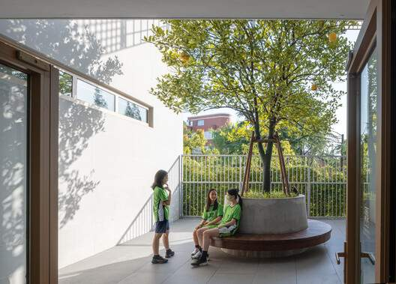
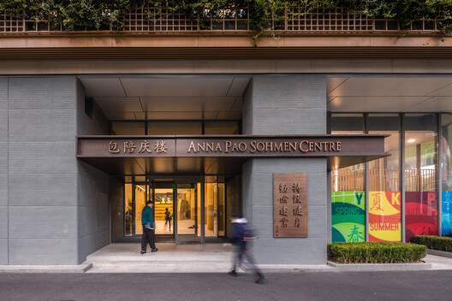
Control increases with height and with distance from the lobby
CASE 01 — PUBLIC → PRIVATE GRADIENT
PUBLIC
Field under the building · lobby · stair-seating · mezzanine
open edge to field; lobby doubles as assembly
SEMI-PUBLIC
Atrium ring · multi-function hall · seminars · pool foyer
Courtyard threshold (p. 29) · entrance (p. 31)
reached via the public core; event-capable rooms
ARCHITECTURAL INTERPRETATION
Control is architectural, not only by doors: height (GF open → 4F studios), depth (front lobby → back offices) and sequence (change rooms before courts).
The lobby can open for events while upper teaching floors stay closed — the core is the single checkpoint.
Pool access is gated twice: pool foyer → change rooms.
Service zones never face the lobby: north strip, basement, roof edge.
CONTROLLED
Classrooms · studios · change rooms · clinic
doors off the ring; change rooms gate the sports volumes
PRIVATE / SERVICE
Offices · staff lounge · equipment · plant (B1) · solar platform
edges, back stair, basement and roof strip
↓ increasing control
SOURCE Derived from Drawings: Scenic Architecture Office, as published (uploaded set, pp. 33–48); Photographs: uploaded set (pp. 1–32), as published with the project

Slide 14
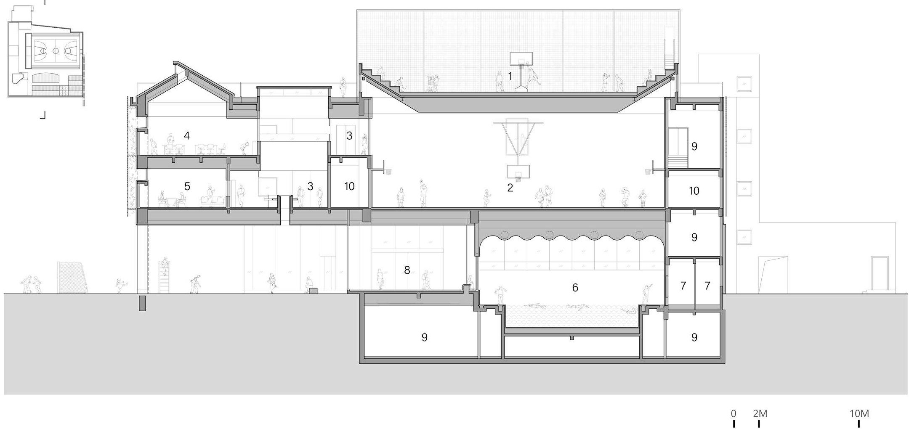
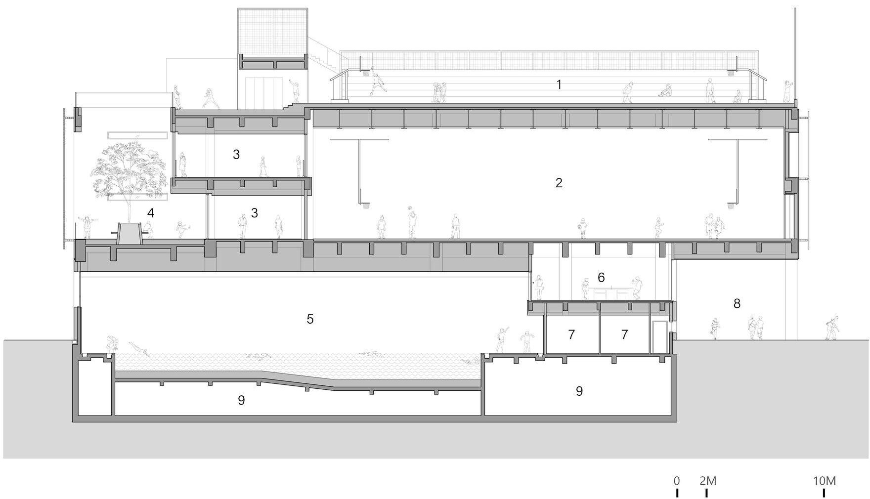
Three long spans stacked: pool → gym → roof court
CASE 01 — SECTIONAL ORGANISATION
VERIFIED
ROOF COURT + seats
Sections show the pool at grade/below grade with plant beneath, the indoor gym as a double-height volume on 3F–4F directly above, and the roof court with stepped seating on top. The assembly lobby + mezzanine sit beside the pool and open to the track.
STUDIOS
INDOOR GYM
ARCHITECTURAL INTERPRETATION
Double-height gym sits on a deep transfer floor over the pool → the most demanding spans are stacked, so loads travel straight down.
Wave-shaped pool clerestory: daylight under the gym floor (ArchDaily: arched clerestory windows).
Learning floors (≈ 2 storeys) wrap the gym height → classrooms share the gym's section, not its noise.
The 3F courtyard (with tree) is cut into the stack — outdoor space at upper level.
Floor-to-floor heights NOT dimensioned here: not stated in sources; scaling the drawings would be approximate.
LOBBY
POOL
PLANT
N–S section (p. 36) — overlay by author
E–W section through pool, table tennis, change rooms & courtyard (p. 48) — overlay by author
SOURCE Drawings: Scenic Architecture Office, as published (uploaded set, pp. 33–48) — sections pp. 34, 36, 48; ArchDaily, 'Anna Pao Sohmen Centre at YK Pao School / Scenic Architecture Office' (2025) — archdaily.com/1041795

Slide 15
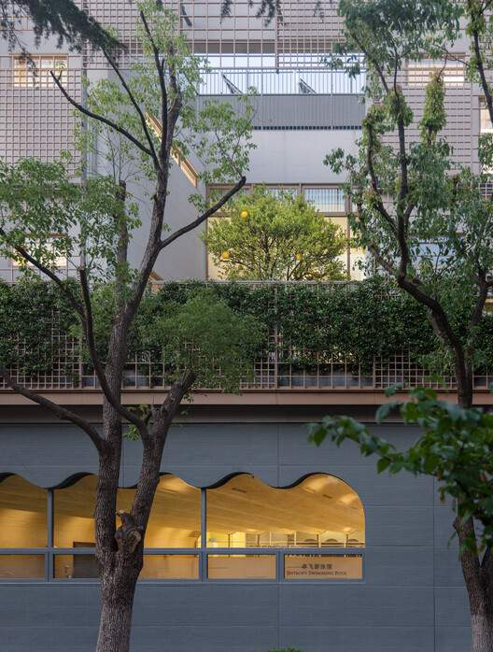
Outdoor space at three levels: under, inside and on top of the building
CASE 01 — INDOOR / OUTDOOR + ENVIRONMENT
UNDER — covered field
INSIDE — pomelo courtyard (3F)
ON TOP — roof court
EDGE — pool clerestory
sport + recreation + shelter
social + landscape + light
sport + spectators
daylight + visual link to street
Photos: uploaded set pp. 26, 29, 3, 2
Strategy | Evidence | Status
Daylight to learning spaces | Classrooms 'profit from natural daylighting and scenic views' (ArchDaily); rooms line façades on plans | VERIFIED
Pool daylight | Arched clerestory windows along the pool; timber beams diffuse light (ArchDaily); wave windows in photos/section | VERIFIED
Atrium roof light | Oval atrium + 'clerestory desks' on roof plan; photos p. 20–21 | VERIFIED (drawings)
Green façade / shading | Planted screens and timber-colour grid on façades (photos p. 1–6) | VISIBLE — performance not verified
Solar energy | 'Solar equipment platform' on roof plan | VERIFIED (drawing) — capacity unknown
Natural ventilation / orientation | No published statement | NOT VERIFIED
SOURCE ArchDaily, 'Anna Pao Sohmen Centre at YK Pao School / Scenic Architecture Office' (2025) — archdaily.com/1041795; Drawings: Scenic Architecture Office, as published (uploaded set, pp. 33–48); Photographs: uploaded set (pp. 1–32), as published with the project

Slide 16
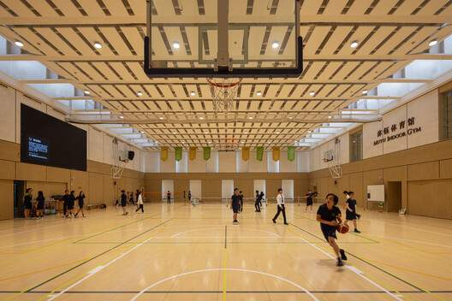
Long spans stacked on one footprint; angled columns release the ground
CASE 01 — STRUCTURAL / ARCHITECTURAL LOGIC
VERIFIED
Angled concrete columns carry the upper mass over the turf (ArchDaily). Plans show a regular column grid around the gym and pool; sections show a deep structural zone under the gym floor and under the roof court.
ROOF COURT
ARCHITECTURAL INTERPRETATION
The gym is column-free; its roof is also a playground → a deep, stiff roof structure (visible joists/beams in section).
Pool directly below the gym → the transfer floor between them is the key structural element.
Perimeter rooms are on a smaller grid → structure follows the 'big room + liner' plan.
Material, span and member sizes: NOT VERIFIED (no structural data published).
GYM span (3F–4F)
V / angled
columns
POOL span
lobby / mezzanine
Schematic section — interpretation, not to scale
SOURCE ArchDaily, 'Anna Pao Sohmen Centre at YK Pao School / Scenic Architecture Office' (2025) — archdaily.com/1041795; Drawings: Scenic Architecture Office, as published (uploaded set, pp. 33–48); Photographs: uploaded set (pp. 1–32), as published with the project
Angled columns at the field edge (p. 5) · gym roof structure with skylights (p. 12)

Slide 17
Seven principles extracted from the Anna Pao Sohmen Centre
CASE 01 — KEY DESIGN PRINCIPLES
01
02
03
04
Stack the long spans
Lift to give back ground
Big room + liner
Thresholds that gather
Pool → gym → roof court on one footprint frees the site.
Upper floors cantilever; the field continues under the building.
Gym in the centre; classrooms / studios line the façades for daylight.
Lobby and atrium are distribution AND event spaces (stair-seating).
05
06
07
Wet sequence is linear
Show the sport
Service stacked out of sight
Foyer → change → pool; dry users never cross wet floors.
Visual links: table tennis → pool, mezzanine → field, roof seats → court.
Plant under the pool, equipment strip at the back, solar on the roof edge.
PRINCIPLES = INTERPRETATION OF VERIFIED PLANS
Programme axo (p. 38)

Slide 18
A faculty inside a converted 1950s complex, with sport spread across a campus
CASE 02 — FTVS, CHARLES UNIVERSITY · PROJECT + CONTEXT
Institution | Faculty of Physical Education and Sport (FTVS / 'CU SPORT'), Charles University | FTVS / CUNI
Address | José Martího 269/31, Praha 6 – Veleslavín, Czech Republic | FTVS contacts
Original building | Built 1949–1956 for the Communist Party's political college (VŠP ÚV KSČ, 'Vokovická Sorbonna') | slavnevily.cz · cs.wikipedia
Use as faculty | Faculty moved here after 1989 (VŠP dissolved 1990); faculty part of Charles University since 1959 | cs.wikipedia
Architecture | 'Strict, originally symmetrical' composition on a functionalist basis | slavnevily.cz
Blocks | Lettered blocks A–H (A–D insulation, E–H façade renewal in a university tender) | zakazky.cuni.cz
Architect | NOT VERIFIED
Area / plans | NOT VERIFIED — no published floor plans, sections or areas found
CONTEXT — RELATIONAL DIAGRAM
PRAGUE CENTRE
NOVÝ VELESLAVÍN
metro + city district
≈ 25 min by
public transport
FTVS COMPLEX
blocks A–H
STADIUM + PITCHES
tennis · beach volley
SITE / CONTEXT READING
SPORTS HALL
+ gym rooms
A suburban campus in Prague 6, served by the Nový Veleslavín transport hub — the faculty is a destination, not part of the historic university core (verified: location; interpretation: role).
Teaching occupies a building designed for a different institution → sport facilities were added around it rather than integrated in one volume (interpretation).
ARCHITECTURAL INTERPRETATION — relational, not a map
Positions are not geographic. Exact site layout, access points and orientation could not be verified from available documentation.
SOURCE ftvs.cuni.cz (contacts; 'Jak se vyznat na fakultě'); cs.wikipedia.org — VŠP ÚV KSČ & FTVS UK; slavnevily.cz — 'Škola ve Veleslavíně'; zakazky.cuni.cz — FTVS tender; cuni.cz.

Slide 19
Verified facilities, organised as a campus of separate sports elements
CASE 02 — FUNCTIONAL PROGRAMME, ZONING + STANDARDS CHECK
VERIFIED FACILITIES
SPORTS HALL 32 × 22 m — STANDARDS FIT (to scale)
ADJACENCY (programme)
Sports hall 22 × 32 m (704 m²), Taraflex floor, multi-court markings
32 m
iscus.cz #19361
ENTRANCE / ADMIN
Gym + gymnastics room
iscus.cz #19361
TEACHING BLOCKS
Stadium: football 100 × 65 m + 400 m track, 6 lanes, jump sectors
iscus.cz #19360
Tennis courts · beach-volleyball court
ftvs.cuni.cz
CHANGING ?
22 m
CU SPORT Gym — basement of block H: reception, weights, stretching, TRX, shooting range + cardio, athletic tunnel, warm-up
ftvs.cuni.cz
HALL · GYM
'Creative Hub' study room above the gym (block H)
ftvs.cuni.cz
Teaching, departments, administration in blocks A–H
STADIUM · COURTS
ftvs.cuni.cz
— basketball 28 × 15 + 2 m lane = 32 × 19 m → fits exactly in length
- - volleyball 18 × 9 + 3 m = 24 × 15 m → fits; FIVB official (31 × 19 m) fits in plan
BLOCK H — VERIFIED STACKING
INTERPRETATION
CREATIVE HUB (study)
Study above training — a small-scale version of APSC's 'learning over sport'.
CALCULATION FROM CITED VALUES
Dashed = relationship not verifiable without plans (location of changing rooms, routes between blocks and outdoor facilities).
Hall clear height: NOT VERIFIED → official FIVB use (12.5 m) cannot be confirmed.
CU SPORT GYM (basement)
SOURCE iscus.cz — Haly sportovního centra UK Veleslavín (#19361) & Stadion a venkovní hřiště (#19360); ftvs.cuni.cz — sports facilities, 'CU SPORT Gym'. Court values: FIBA OBR 2024 Art. 2; FIVB Rules 2025–28 Rule 1.

Slide 20
What can be learned — and what must be obtained before analysing further
CASE 02 — CIRCULATION, SECTION + PRINCIPLES
NOT VERIFIED FROM AVAILABLE DOCUMENTATION
PRINCIPLES THAT CAN BE EXTRACTED (programme level)
Floor plans
room layout, entrances, cores, changing-room position
01
Campus of parts
Teaching blocks + separate hall + outdoor stadium: each sport element sized to its own standard (hall exactly fits a FIBA court + lane).
Sections
hall clear height, vertical stacking, basement gym depth
Circulation
routes between blocks, sports hall and stadium; athlete vs. public separation
02
Outdoor sport as a field, not a roof
100 × 65 m pitch with 400 m track needs land — opposite of APSC's vertical strategy.
Structure
grid, hall roof span and system
Environment
orientation, daylight, ventilation strategy
03
Adaptive reuse
A 1950s symmetrical college re-programmed for sport education; renovation by blocks (A–H).
HOW TO CLOSE THE GAP
Request plans from the faculty's building-management office (FTVS UK).
Prague 6 building archive — building-permit drawings of José Martího 31.
Site visit: photograph entrances, changing rooms, hall section; pace distances.
04
Training under study
Basement gym beneath a study hub in block H — vertical mix at small scale.
INTERPRETATION OF VERIFIED FACTS
SOURCE As previous two slides.

Slide 21
Vertical compression vs. horizontal campus — two answers to the same programme
COMPARATIVE ANALYSIS
Category | Anna Pao Sohmen Centre (Shanghai) | FTVS Charles University (Prague)
Site organisation | Compact infill between lawn and field; ground freed by lifting | Suburban campus; buildings + separate outdoor sports land
Main entrance | From the lawn into an assembly lobby (site plan) | Not verified
Functional zoning | Vertical: wet sport low, dry sport high, learning wraps | Horizontal (interp.): teaching blocks, hall, stadium as separate parts
Public / private | Height + depth + sequence; lobby = only public threshold | Not verifiable without plans
Circulation | One public core + atrium ring; stairs as seating | Between blocks and outdoors — not verified
Sports spaces | Pool, gym, table tennis, roof court — stacked | Hall 32 × 22 m, gym rooms, stadium 100 × 65 m + track, courts
Educational spaces | STEAM classrooms & studios lining façades | Teaching in converted 1950s blocks A–H
Social spaces | Lobby, mezzanine, atrium, courtyard, roof seats | Creative Hub study room (block H)
Service spaces | Basement plant, north equipment strip, roof solar | Not verified
Indoor / outdoor | Under, inside and on top (field, courtyard, roof) | Outdoor sport on grade beside buildings
Structural logic | Stacked long spans + angled columns | Not verified
Main strategy | Compress & stack → maximise outdoor ground | Distribute & reuse → land-based campus
Not a ranking: APSC shows how to fit a sports-learning programme on scarce land; FTVS shows the land and buildings a full PE faculty with outdoor athletics actually needs.

Slide 22
Twelve transferable principles — not copies of either building
DESIGN LESSONS FOR A FACULTY OF PHYSICAL EDUCATION
01
FUNCTIONAL ZONING
02
EDUCATION ↔ SPORT
03
STUDENT SOCIAL SPACE
Zone in section as well as plan: wet sport + plant low, dry halls above, learning on the daylit perimeter.
Wrap halls with teaching rooms that look in (glazed screens) but are acoustically separated.
Make the lobby/atrium the social core: stair-seating, mezzanines, courtyard.
from: APSC
from: APSC
from: APSC
04
CIRCULATION
05
SPECTATOR / USER SEPARATION
06
CHANGING ROOMS
One legible public spine + separate back-of-house stair/lift for service and staff.
Spectators via lobby & seating; athletes via change rooms that open directly onto courts.
Place them between entrance and every court/pool: foyer → change → sport, wet never crossing dry.
from: APSC
from: APSC + standards
from: APSC
07
HALL ADJACENCY
08
SERVICE ACCESS
09
OUTDOOR SPORT
Hall ↔ change ↔ store at the same level; size hall to FIBA 32 × 19 m min. footprint.
Plant and storage stacked behind or below; a service yard away from the public front.
Reserve land for a 400 m track & pitch if athletics is taught; otherwise use roofs/undercrofts.
from: FTVS + FIBA
from: APSC
from: FTVS vs APSC
10
PUBLIC / PRIVATE
11
COURTYARDS + LANDSCAPE
12
FLEXIBLE + LARGE-SPAN
Grade control by height and depth; let the ground floor open for events.
Cut courtyards into upper floors to light deep plans and give quiet outdoor rooms.
Stack long spans on one footprint; multi-court halls; reuse existing buildings where possible.
from: APSC
from: APSC
from: APSC + FTVS
All lessons are architectural interpretations derived from the analysed plans, sections and verified facts; dimensional rules come from the standards study (FIBA / FIVB / Sport England / INBR).

Slide 23
Sources used in the case-study analysis
REFERENCES
CASE 01 — ANNA PAO SOHMEN CENTRE
Uploaded drawing & photo set (CamScanner PDF, 64 pp.): plans GF, 2F, 3F, 4F, roof, basement; sections; axonometrics; site plan — Scenic Architecture Office.
ArchDaily — Anna Pao Sohmen Centre at YK Pao School / Scenic Architecture Office (2025).
https://www.archdaily.com/1041795/anna-pao-sohmen-centre-at-yk-pao-school-scenic-architecture-office
gooood — Anna Pao Sohmen Centre at Shanghai YK Pao School by Scenic Architecture Office.
https://www.gooood.cn/anna-pao-sohmen-centre-at-shanghai-yk-pao-school-by-scenic-architecture-office.htm
CASE 02 — FTVS, CHARLES UNIVERSITY
FTVS UK — Contacts / faculty pages; sports facilities; CU SPORT Gym.
https://www.ftvs.cuni.cz/en/faculty/contacts
iscus.cz — Haly sportovního centra UK Veleslavín (#19361).
https://iscus.cz/kraje/praha/pasport/19361
iscus.cz — Stadion a venkovní hřiště sportovního centra UK Veleslavín (#19360).
https://iscus.cz/kraje/praha/pasport/19360
Wikipedia (cs) — Vysoká škola politická ÚV KSČ; Fakulta tělesné výchovy a sportu UK.
https://cs.wikipedia.org/wiki/Fakulta_t%C4%9Blesn%C3%A9_v%C3%BDchovy_a_sportu_Univerzity_Karlovy
SlavneVily.cz — Škola ve Veleslavíně (Stavby Prahy 6).
https://www.slavnevily.cz/stavby-/-unesco/stavby-prahy-6/skola-ve-veleslavine
Charles University tenders — UK FTVS block renovation.
https://zakazky.cuni.cz/contract_display_7294.html
STANDARDS USED FOR CHECKS
FIBA Official Basketball Rules 2024.
https://assets.fiba.basketball/image/upload/documents-corporate-fiba-official-rules-2024-v10a.pdf
FIVB Official Volleyball Rules 2025–2028.
https://www.fivb.com/wp-content/uploads/2025/01/FIVB-Volleyball_Rules2025_2028-EN-v05.pdf

