Slide 1
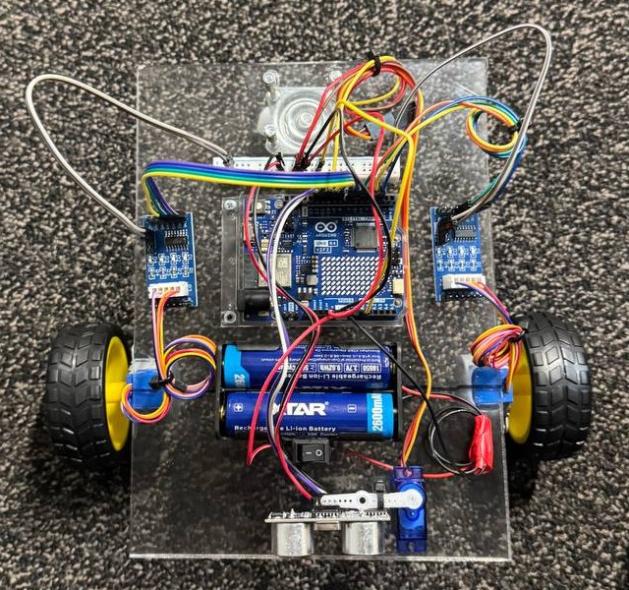
LUTES Deep Tech Hackathon 2026 · Challenge 1
Obstacle-Avoiding Rover
A 2WD robot that measures the distance to obstacles and drives around them on its own
Caspian Mavericks
Mohammadsadegh Shoushtaridehshal
Amirmohammad Shariatkhah

Slide 2
1 Challenge and what we built
Our rover
The brief
Measures the distance ahead every 60 ms
Stops at 20 cm, reverses, scans 7 directions
Curves towards the clearer side
Remembers where it has already driven
Detects when it is stuck on something it cannot see
Live dashboard over WiFi: radar, map, manual control
“Design and construct a mobile two-wheel drive (2WD) robotic rover capable of navigating dynamic environments autonomously by measuring distances to surrounding obstacles and executing avoidance maneuvers to prevent collisions.”

Slide 3
2 Hardware
Part | Why
Arduino UNO R4 WiFi | Controller with built-in WiFi for the dashboard
2 × 28BYJ-48 steppers + ULN2003 | Every step is counted: exact distance and turn angle. The kit had no driver for DC motors
HC-SR04 on SG-90 servo | One sensor scans from 60° to 120°
2 × 18650 + switch → VIN | 7.4 V; the board's regulator feeds the 5 V rail

Slide 4
3 Obstacle avoidance
Drive
Detect
Back off
Scan
Turn
Measure ahead every 60 ms
Under 20 cm, confirmed by a second reading
Reverse 15 cm
7 directions, 60° to 120°, median of 3 readings
45° curve, 25 cm radius, to the better side
Better side = free space measured on that side − 20 cm for every already-visited cell the curve leads into
Both sides blocked → reverse along a curve and scan again; no spinning in place
Motors run from a 10 kHz timer interrupt → measuring and WiFi never pause the wheels

Slide 5
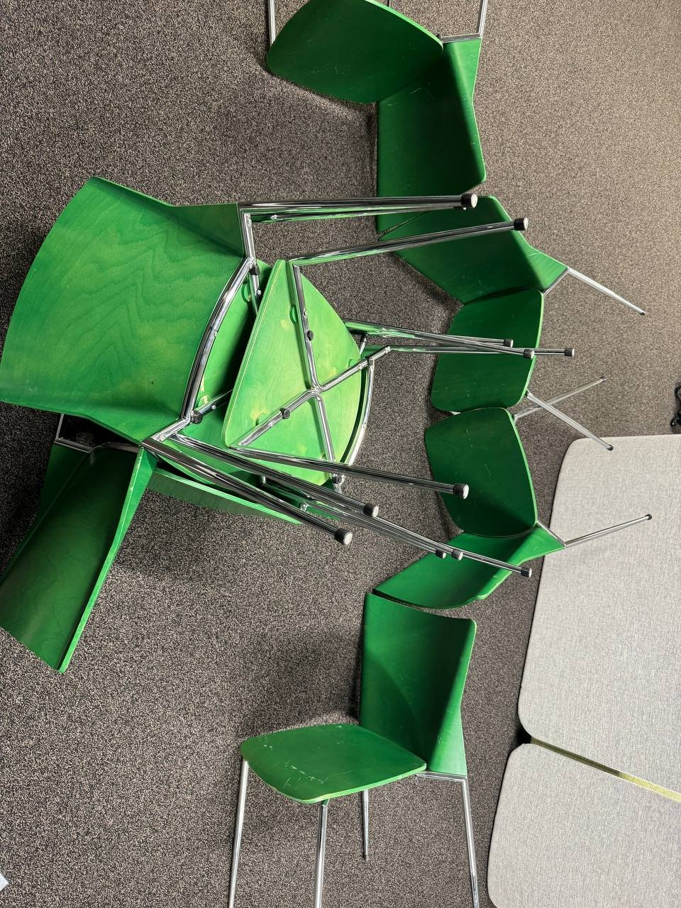
4 Position, memory and stuck detection
Position from the steps
x, y and heading from the step counts of both wheels (4096 half-steps per wheel turn). No extra sensor needed.
Memory of visited places
10 cm grid over 6 × 6 m. On the chair track the robot kept turning back to the entrance; now turns that lead into visited cells lose points.
Stuck detection
Steppers give no feedback. If the steps say 10 cm but the distance ahead changed less than 3 cm, something the sensor missed (a thin chair leg) is blocking it: back off and turn.
Our chair test track

Slide 6
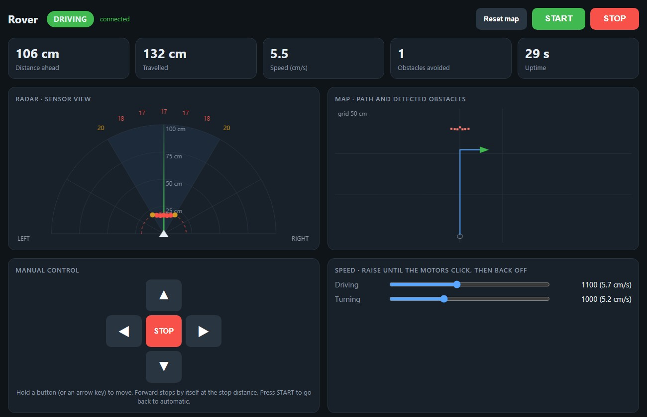
5 Dashboard
Served by the robot itself: http://192.168.137.50
START / STOP and hold-to-drive arrows
Speed sliders, applied live
Radar: the last 7-point scan
Map: path and detected obstacles
Distance graph and event log
Manual drive stops by itself at 20 cm and when the signal is lost
Shown with test data

Slide 7
6 Testing and calibration
Calibration
Problems found and fixed
Test | Result
Drive 30 cm | Drove 34 cm → wheel diameter 6.8 cm
Spin 360° | Turned 340° → wheel distance 21.6 cm
Speed steps 900 to 1700 | 1500 skips steps → 1100 (5.7 cm/s)
Servo sweep | 60° to 120° free, 90° straight ahead
Problem | Fix
Battery wired to the 5 V rail | Battery to VIN only
Robot never stopped | 30 ms pause before the confirming reading
Motors clicking | Lower speed, smooth acceleration
Hotspot gave no address | Fixed IP 192.168.137.50
Went back out of the U-track | Memory of visited cells
Thin chair legs not seen | Stuck detection

Slide 8
Live demo
START from the dashboard
Obstacle ahead: stop, back off, scan, curve away
Radar and map update while it drives
Manual drive with the arrow keys, then STOP

Slide 9
7 Limitations and next steps
Limitations
Next steps
Sees only ahead while driving (about ±15°)
Very thin or steeply angled objects can be missed
Map drifts when the wheels slip
Slow: about 5.7 cm/s with 5 V steppers
Bumper switches on the front corners
Side sensors to follow walls
Geared DC motors with encoders for speed
Use the stored map to plan a route
Code: github.com/sadeghshoushtari/obstacle-avoiding-rover
Libraries used: AccelStepper, Servo, WiFiS3

