Slide 1

Presented by:
Momodu Sadiq Favour
Test Accuracy
ROC-AUC
Best Model
88%
0.94
Random Forest
Hotel Booking
Cancellation Risk Prediction
Machine Learning Analytics for Revenue and Occupancy Planning
Presented by:
Momodu Sadiq Favour

Slide 2
Business Problem: Cancellations Erode Revenue Certainty
Cancelled bookings reduce revenue visibility, leave rooms unsold, and make daily hotel planning harder.
High cancellation exposure
Late demand shocks
Weak occupancy forecasts
Uncertain staffing needs
Revenue leakage
Unsold room nights
Operational inefficiency
Riskier overbooking decisions
32.8%
Nearly 1 in 3 bookings were cancelled, creating material risk for occupancy and expected revenue.

Slide 3
Project Objective: Predict Risk Early Enough to Act
Build a model that flags likely cancellations and turns booking data into practical revenue decisions.
Predict cancellation risk
Explain risk drivers
Support hotel actions
Flag bookings most likely to cancel before arrival.
Identify which booking signals influence cancellation behavior.
Improve occupancy planning, interventions, and overbooking choices.
Booking Data
->
EDA
->
ML Model
->
Risk Score
->
Business Action

Slide 4
Dataset Overview: 36,248 Cleaned Booking Records
The dataset supports customer cancellation-risk prediction using customer, booking, pricing, and room-related variables.
36,248
19
32.8%
13
3
Cleaned Bookings
Model Inputs
Cancellation Rate
Numerical Signals
Categorical Signals
Customer
->
Booking
->
Pricing
->
Room
->
Outcome
Raw booking data was cleaned and engineered into 19 model-ready features; the 32.8% rate means nearly 1 in 3 bookings cancelled.

Slide 5
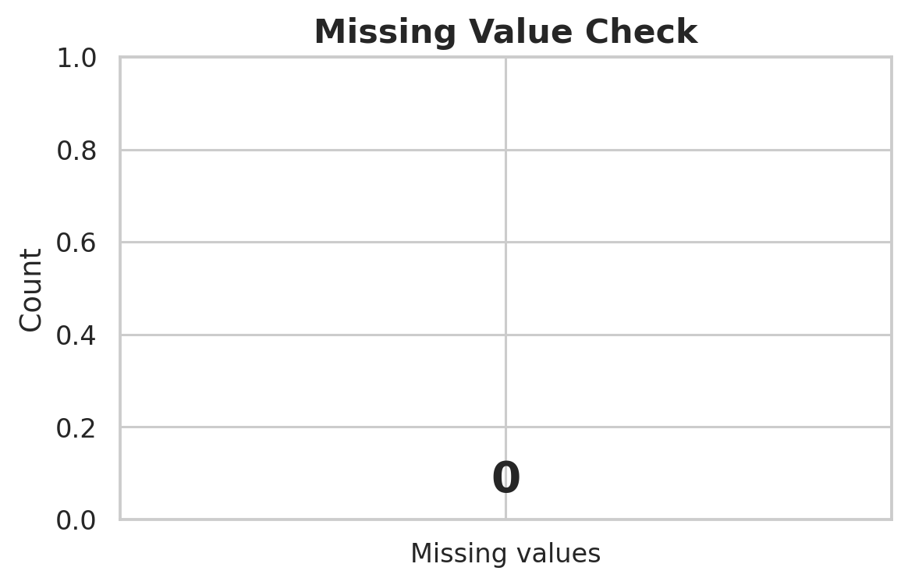
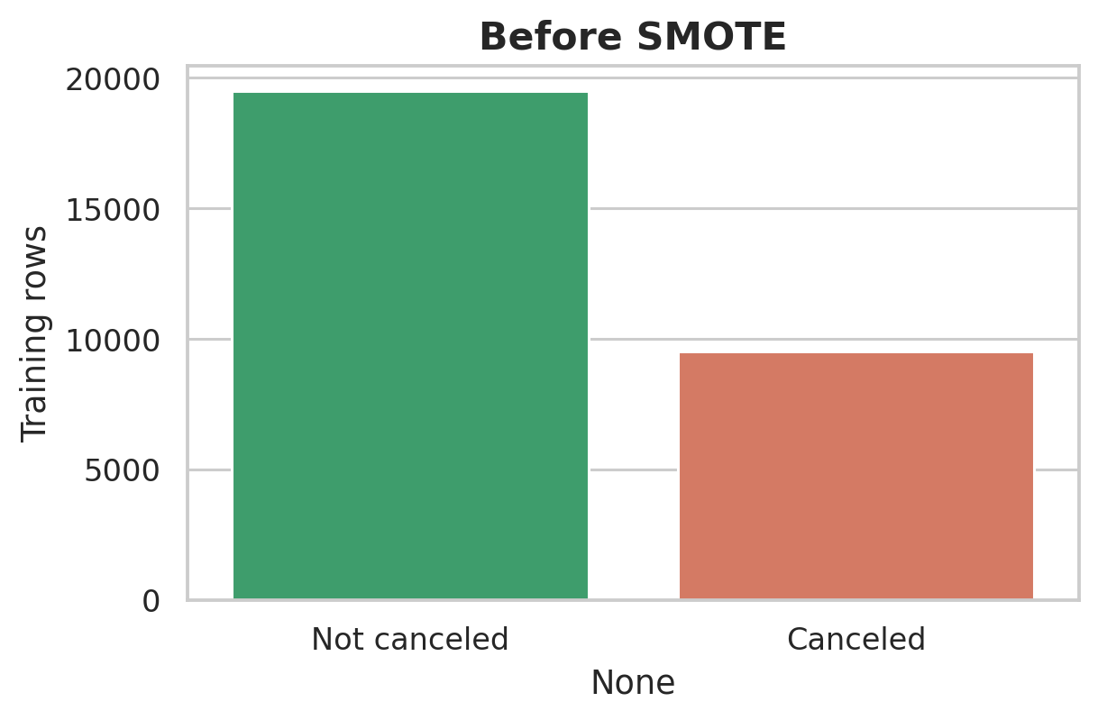
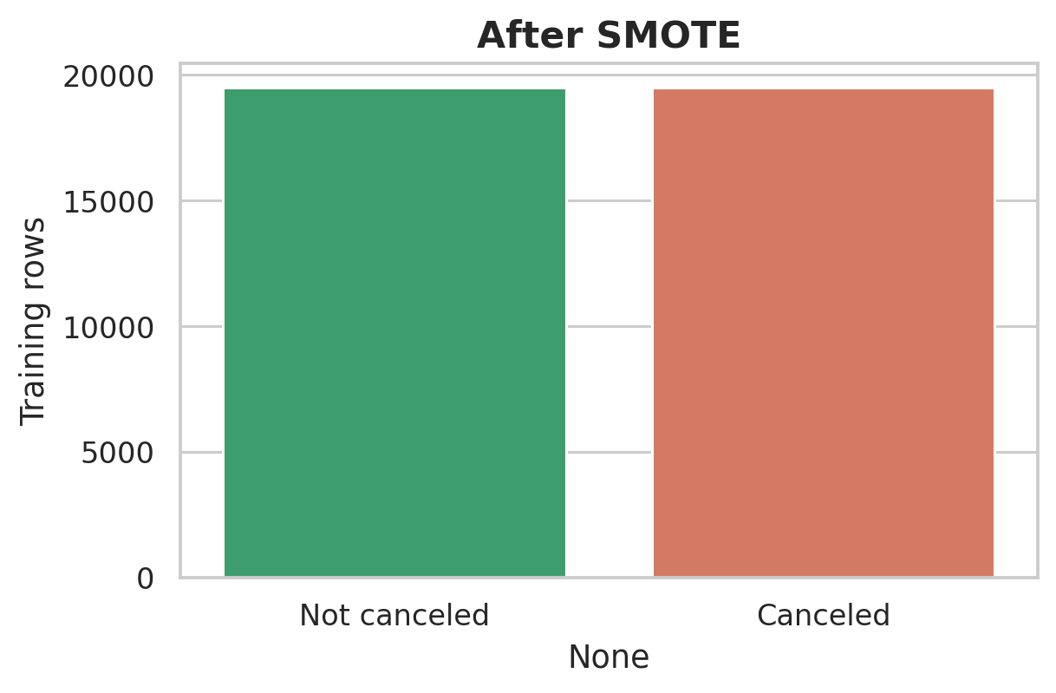
Data Cleaning & Preprocessing: Build a Reliable Modeling Base
Cleaning converted raw reservation data into consistent, leakage-aware inputs for fair model training.
Raw Data
->
Missing Values
->
Duplicates
->
Encoding
->
Scaling
->
Train/Test Split
->
SMOTE
Clean dates and booking fields improved data reliability.
The cancellation class was balanced only within training data.
This protects test-set evaluation from artificial performance inflation.

Slide 6
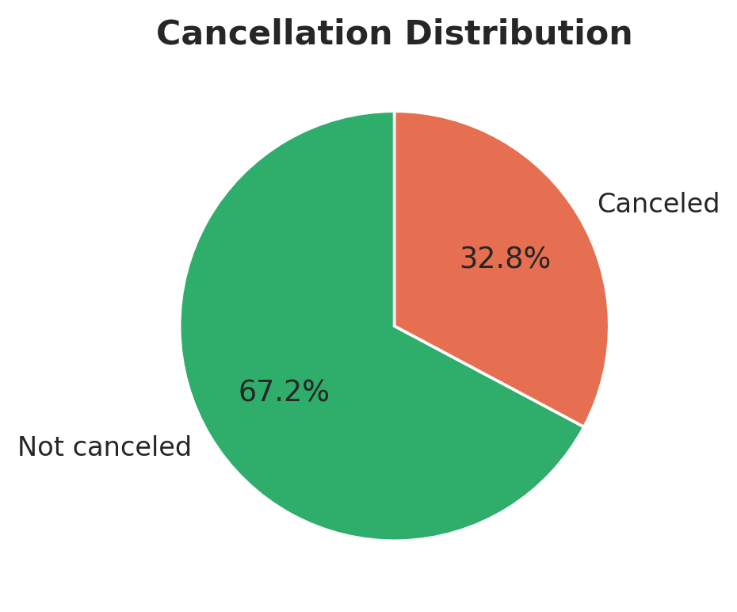
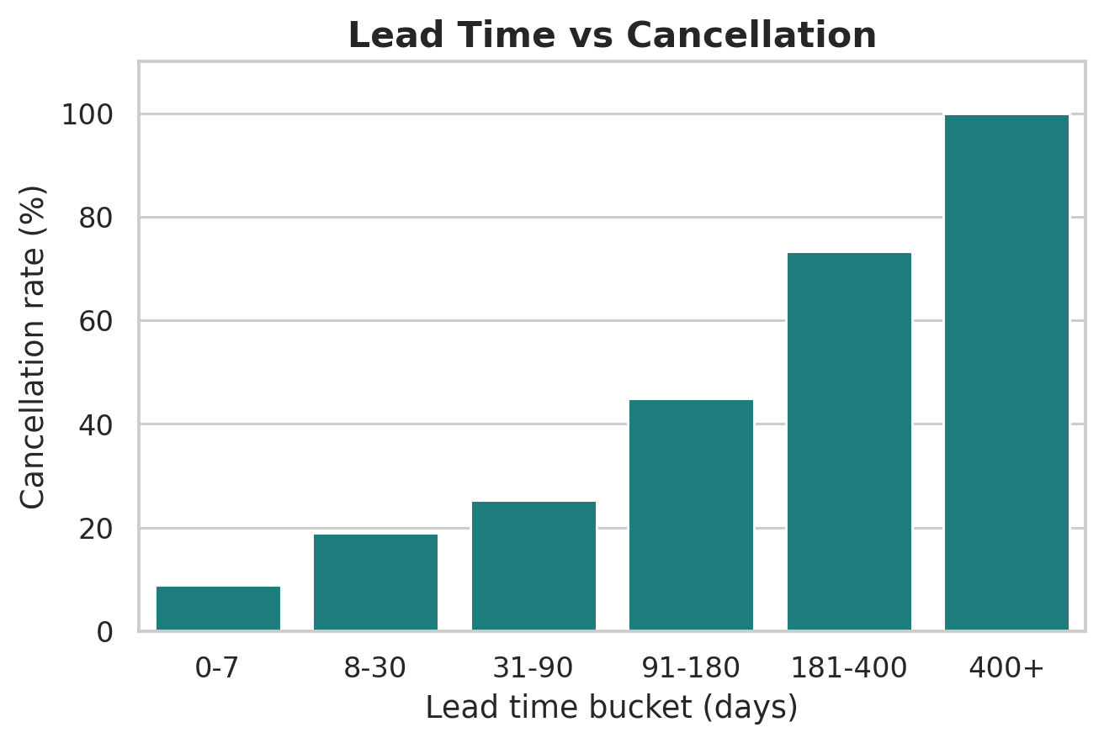
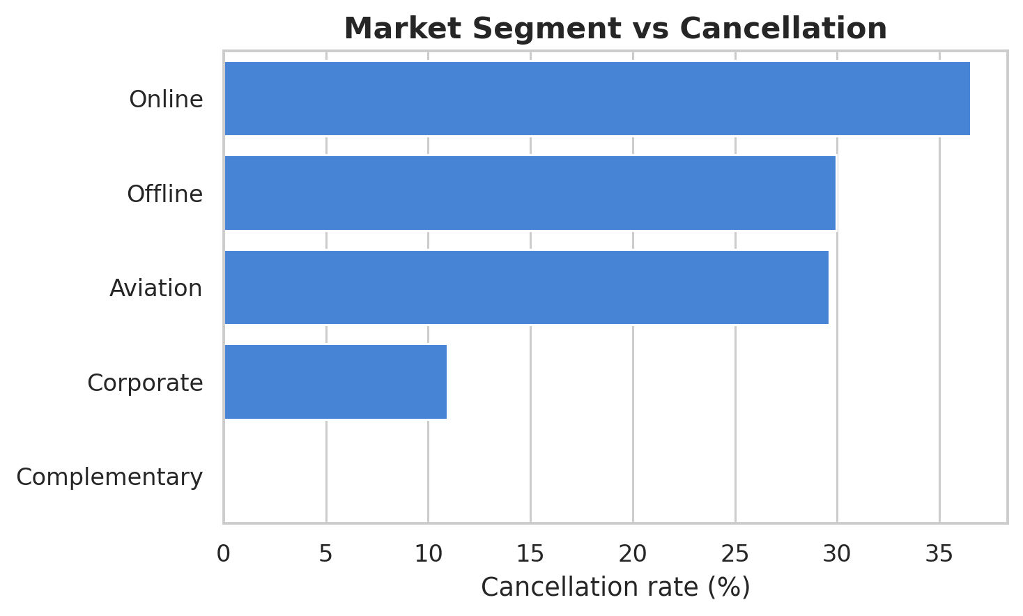
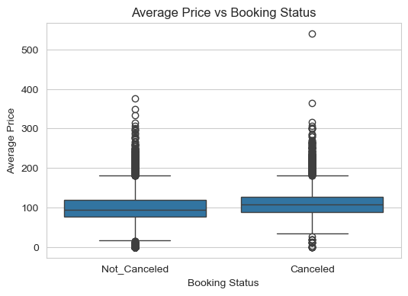
Exploratory Analysis: Where Cancellation Risk Shows Up
EDA connected booking patterns to revenue, occupancy, and demand-planning risk.
Nearly one-third of bookings cancelled, affecting expected occupancy and revenue.
Long lead times may signal weaker commitment and need earlier follow-up.
Online and high-risk channels may need closer monitoring.
Higher price profiles may reflect price sensitivity and cancellation behaviour.

Slide 7
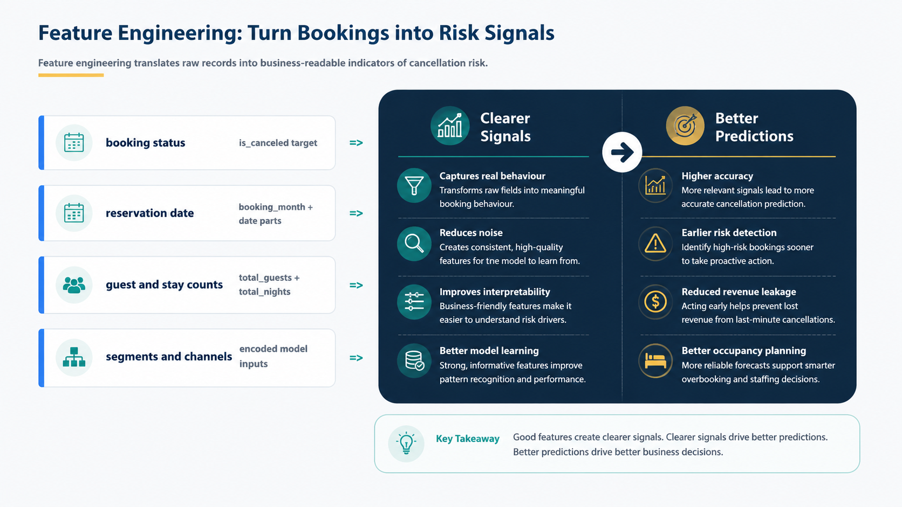
Feature Engineering: Turn Bookings into Risk Signals
Feature engineering translates raw records into business-readable indicators of cancellation risk.
booking status
=>
is_canceled target
reservation date
=>
Clearer Signals
->
Better Predictions
booking_month + date parts
guest and stay counts
=>
total_guests + total_nights
segments and channels
encoded model inputs
=>

Slide 8
Model Training: Compare Algorithms for Decision Support
Multiple models were tested to select the most reliable option for operational hotel decisions.
Logistic Regression
Decision Tree
Transparent baseline
Simple decision rules
Random Forest
Gradient Boosting
Best balance of accuracy and separation
Strong ranked-risk model
Train
->
Evaluate
->
Compare
->
Select

Slide 9
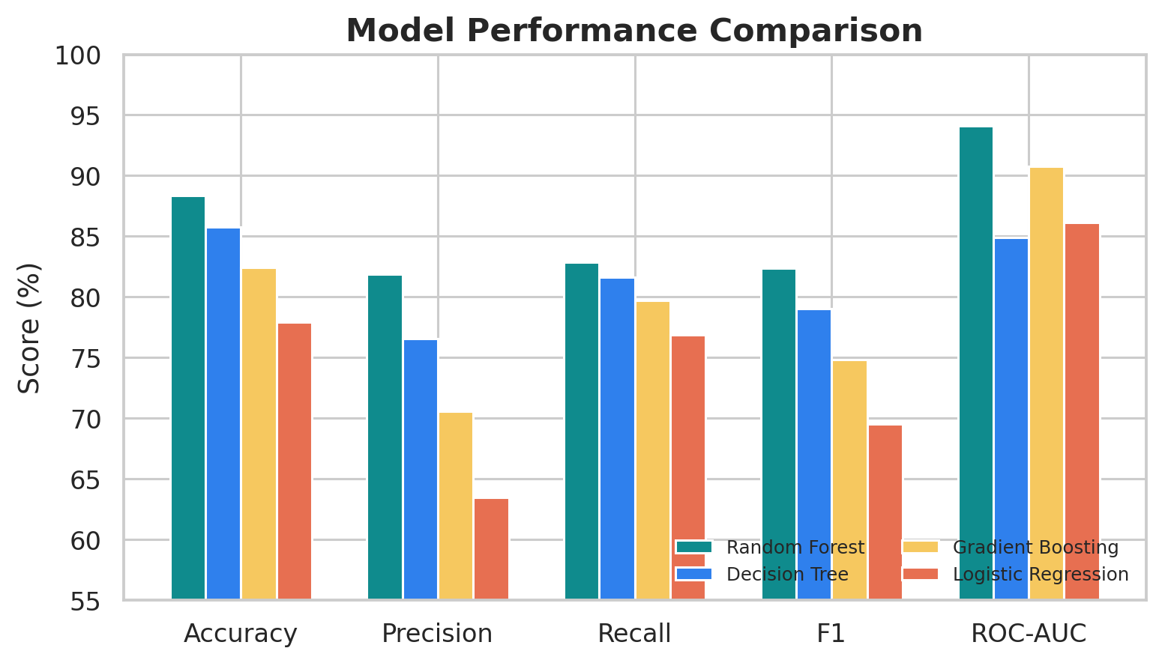
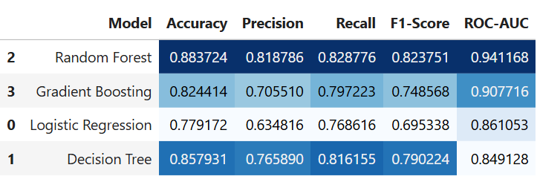
Model Evaluation: Random Forest Leads Overall
Random Forest offered the best mix of accuracy and cancellation-risk separation on the untouched test set.
Model Accuracy ROC-AUC
Random Forest 88% 0.94
Decision Tree 86% 0.85
Gradient Boosting 82% 0.91
Logistic Regression 78% 0.86
Recommended model: Random Forest
Business view: higher ROC-AUC means better ranking of risky bookings before check-in.
Model Strengths
Highest overall accuracy
Strong cancellation separation
Balanced predictive performance
Stable across evaluation metrics
Operational Value
Earlier cancellation detection
Better overbooking decisions
Improved staffing forecasts
Reduced revenue leakage

Slide 10
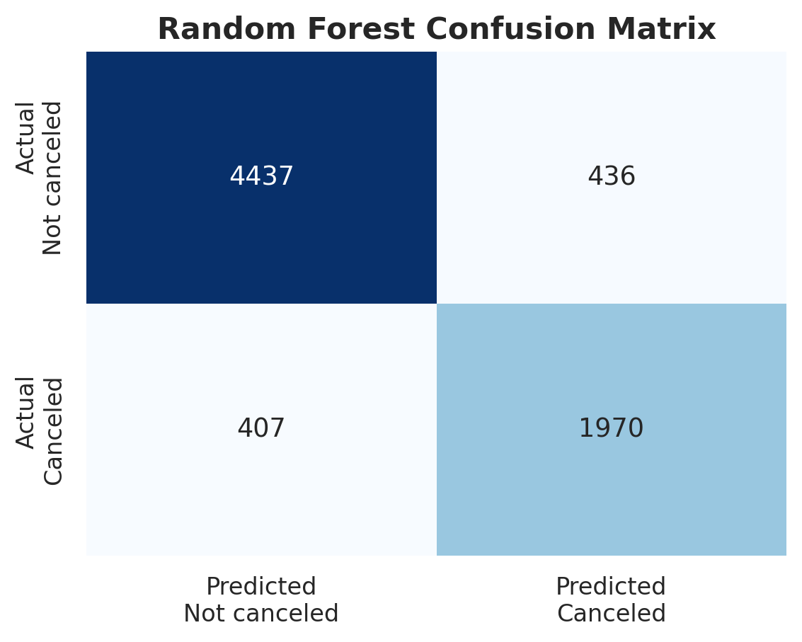
Confusion Matrix: Predictions Translated into Hotel Actions
The matrix shows where the model supports action and where business risk remains.
True Negatives
Guests likely to stay no extra intervention needed.
True Positives
Likely cancellations identified early enough to act.
False Positives
Unnecessary intervention risk for guests who would stay.
False Negatives
Missed cancellations may still create empty rooms.
Test set: TN=4,437 | FP=436 | FN=407 | TP=1,970
Business takeaway: use predictions to prioritize outreach, protect revenue, and tune overbooking decisions.

Slide 11
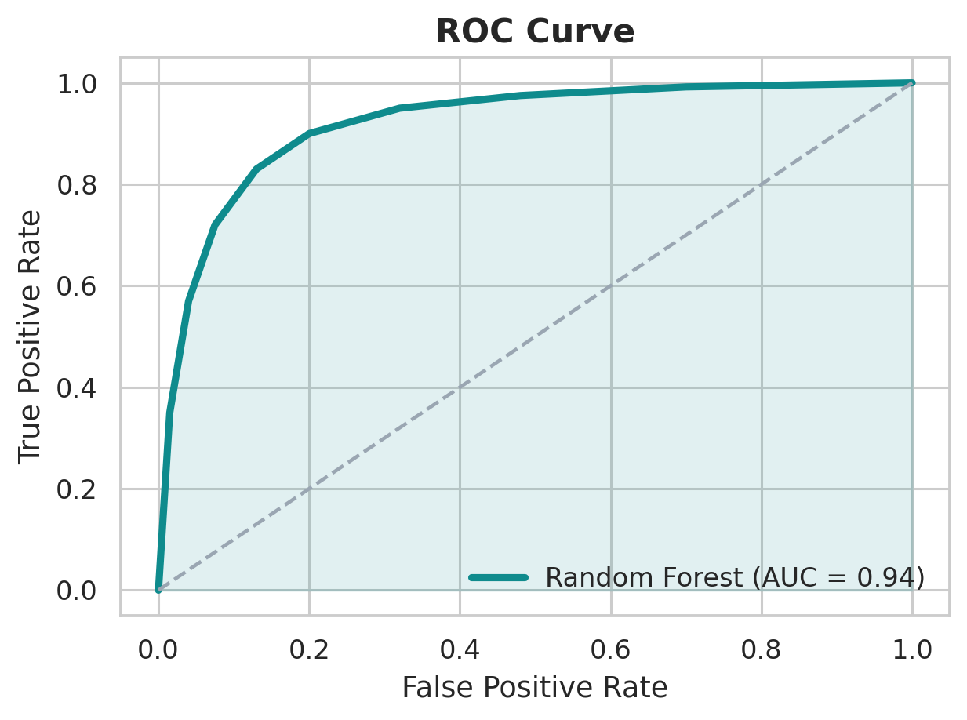
ROC-AUC: Strong Separation of Cancellation Risk
ROC-AUC measures how well the model ranks risky bookings ahead of lower-risk bookings.
ROC-AUC = 0.94
Strong discrimination supports earlier intervention and more confident occupancy forecasting.
Selected model: Random Forest

Slide 12
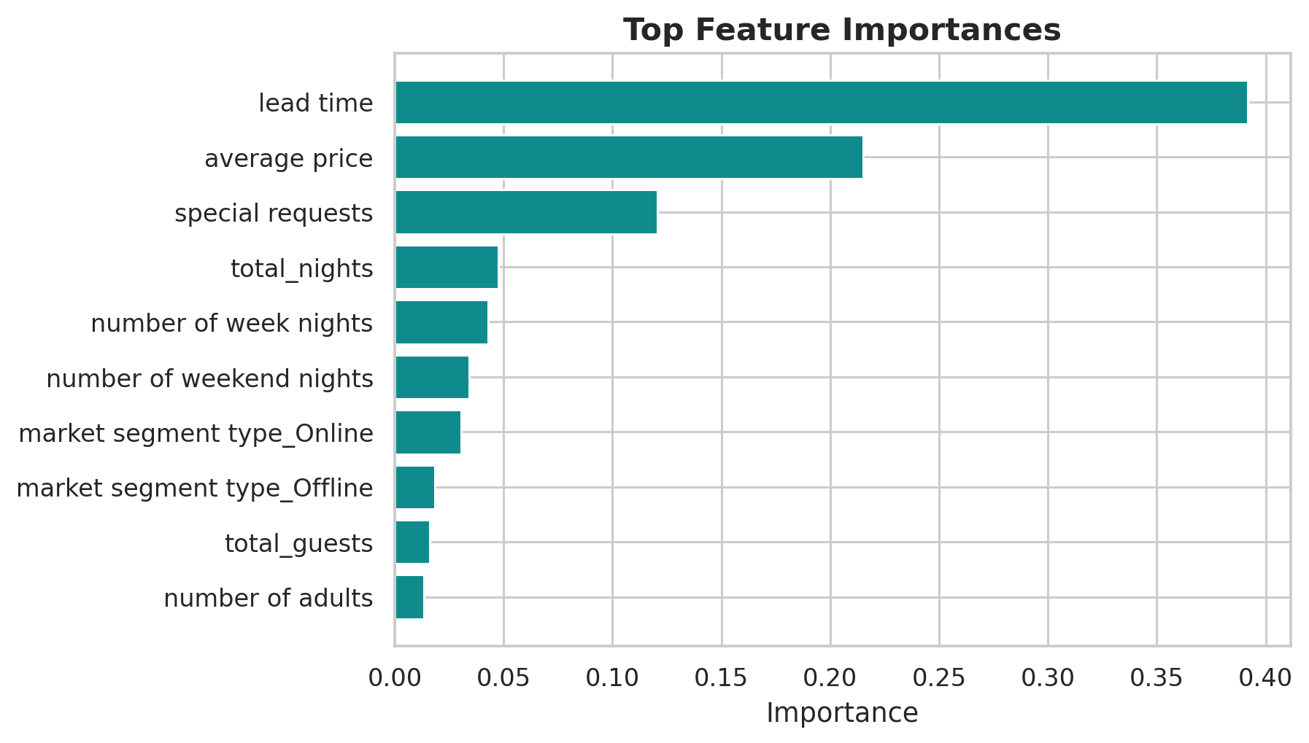
Feature Importance: What Drives Cancellation Risk
Important features show which booking signals should inform policy, outreach, and revenue management.
Business Interpretation
Lead time is a key risk signal; average price may reflect price sensitivity; special requests can indicate stronger guest commitment.
Random Forest top feature importances

Slide 13
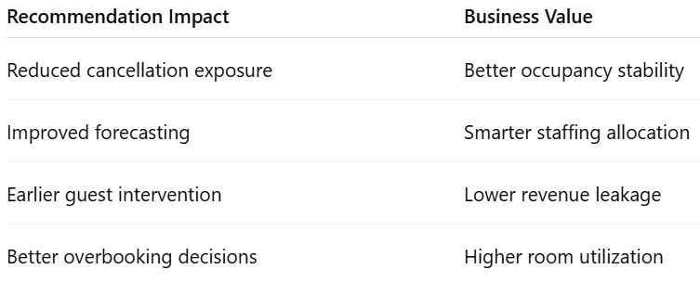
Business Recommendations: Turn Risk Scores into Action
Use model outputs to reduce revenue leakage, improve occupancy planning, and guide guest engagement.
Long-lead bookings
Policy by risk level
Channel monitoring
Long lead times increase cancellation risk.
Action
Send reminder emails or WhatsApp confirmations and offer small commitment incentives.
Risk varies by guest signals, price, and commitment.
Action
Use flexible deposit or cancellation policies based on predicted risk level.
Some market segments and booking channels show higher cancellation patterns.
Action
Monitor high-risk channels and use risk scores to support revenue management and overbooking decisions.

Slide 14
Final Conclusion: Predictive Analytics for Better Hotel Planning
Built an end-to-end machine learning pipeline
Best Model
Evaluated multiple models on the test set
Random
Forest
Random Forest achieved 88% accuracy
ROC-AUC of 0.94 showed strong risk separation
Model can improve forecasting, reduce revenue leakage, and support staffing and overbooking decisions

