Slide 1

Safety
Analysis of Road Accident Data
Improving Road Safety Through Data Analysis Tools: Pivot Tables & Dashboards
Presented by Pod Titan C25 - 11

Slide 2

Objectives and Data Cleaning
Key Factors and Data Preparation
Objective
Data Cleaning
The primary aim of this analysis is to identify key factors affecting casualty severity in road accidents, informing targeted interventions to improve safety outcomes.
Proper data cleaning involves handling missing data effectively, filtering relevant columns, and validating entries to ensure the analysis yields accurate and reliable insights on road safety.

Slide 3

417,883
Total Casualties
In the analysis of road accident data, a staggering 417,883 total casualties were recorded, highlighting the urgent need for improved safety measures across all road users.

Slide 4
Vehicle and Road Analysis
Vehicle Involvement
Cars account for 79.8% of casualties, highlighting the need for focused safety interventions on this vehicle type.
Road Type Distribution
Single carriageways experience the highest casualty rates, necessitating targeted improvements for safety in urban areas.

Slide 5
Road Conditions
Analysis of Surface and Light Conditions
Surface Conditions
Light Conditions
Monthly Trends
Road surface conditions significantly affect accident occurrences, with dry surfaces contributing to the highest casualty numbers, totalling 279,445 accidents attributed to optimal driving conditions in this dataset.
The analysis reveals that daylight conditions prevail in most accidents, accounting for 72.98% of incidents, which highlights the importance of visibility in accident prevention strategies.
There was a slight casualty reduction from 2021 to 2022, decreasing from 222,146 to 195,737 total casualties, indicating potential improvements in road safety measures over this period.

Slide 6




Statistical Analysis
Key Statistical Metrics Overview
This dataset contains 307,973 entries, revealing critical insights into casualty trends and distributions.
Mean: 1.36
Median: 1
Mode: 1, indicating low casualties
Distribution Visualization and Analysis
Data Skewness
Key Insights from Analysis
The distribution shows a significant long tail of high casualty events.
5.69
Casualty Concentration
High skewness factor
Median and mode at 1 indicate most incidents have low casualties.

Slide 7
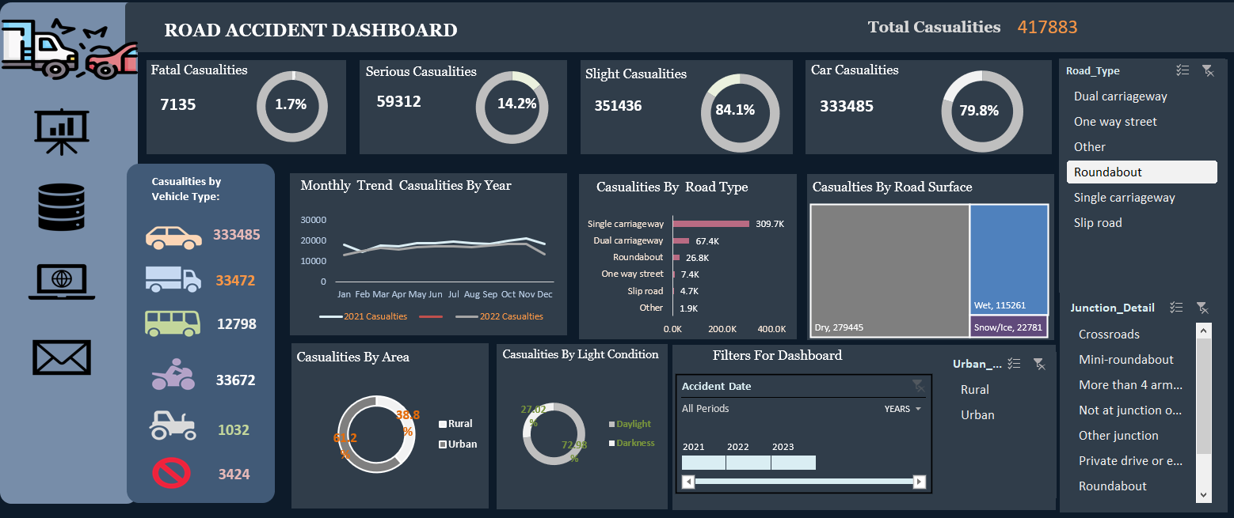

Introduction to Road Safety Insights
This presentation highlights critical data-driven recommendations for road safety improvements, emphasizing the urgent need to address accident hotspots and enhance public awareness through actionable policies and infrastructure upgrades.

Slide 8
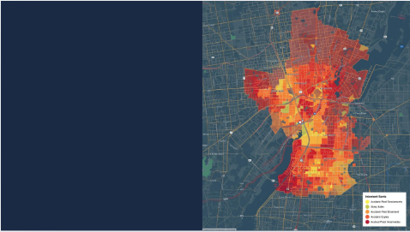
Identification of Accident Hotspots
Urban areas experience high casualty rates due to congestion
Single carriageways pose risks from traffic separation issues
Dry road conditions contribute to unexpected accident risks

Slide 9

Targeted Policy Measures
Implement stricter speed limits in urban zones and highways
Mandate advanced safety features in all commercial vehicles
Deploy speed cameras in identified high-risk accident zones

Slide 10

Infrastructure Enhancements for Safety
Upgrade single carriageways to dual carriageways for safety.
Improve junction designs to reduce congestion and risks.
Add pedestrian crossings and cycle lanes in urban areas.

Slide 11

Community Engagement Strategies
Seasonal campaigns to promote road safety awareness
Education focusing on pedestrian and cyclist interactions
Reporting initiatives for near-miss incidents in communities

Slide 12

Continuous Monitoring for Road Safety
Real-time accident monitoring integrates data from police, hospitals, and traffic, enabling efficient evaluation of safety interventions. This proactive approach ensures ongoing improvements in road safety and supports data-driven decision-making.

Slide 13

Thank you!

