Slide 1
AI SecOps: Noise Into Insight
Samson Adewale
November 2025
Notes:
Alright, quick show of hands — how many people here have not used any AI or LLM tool — like ChatGPT, Claude, Copilot, Gemini, anything like that?”
Okay, good — if your hands up, i was gonna say please see me after the session so we can fix that asap.
Seriously though, it’s everywhere — and whether we like it or not, it’s creeping into every part of how we work — including security.
—--------------------------------------------------
Now, just so I know who’s in the room — another quick pulse check.
Who here is currently working in cybersecurity or related IT field?
Awesome. How about students or folks trying to break into cybersecurity?
And how many of you would say you’re just curious about how AI is changing security?
Perfect. Looks like we have a goods mix or learners. Which is perfect.
In this session, we’re going to explore how AI — and especially AI agents — can move us from all that noise we deal with every day, to actual, actionable intel.

Slide 2
Who dis??
BSides ATL newbie presenter 🎤
Threat Response Engineer @ Klaviyo 🛡️
Notes:
So, quick intro — I’m Samson, and this is actually my first time presenting at BSides Atlanta.”
By day, I’m a Threat Response Engineer at Klaviyo — working on detection, incident response, and, lately, exploring how AI can make threat analysis a little less painful.

Slide 3
Problem
Thousands of daily signals
Repetitive manual triage
Context switching & fatigue
Too Many Alerts. Too Little Time

Slide 4
Opportunity
Alert triage / analysis
Incident summarization
Context enrichment
Response actions (Approval)
Cognitive Augmentation for Defenders.
🧠 Assist, not replace.

Slide 5

Designing the System
Agent Frameworks 🧩
Model Selection 🤖
Prompt & Context Design ✍️
Token & Cost Management 💰
Workflow Orchestration ⚙️
Notes:
Everything starts with choosing the right agent framework.
There are lots of ways to do this — open-source and commercial.
On the open-source side, you’ll see tools like LangChain, CrewAI, or AutoGPT that let you build your own logic, connect data, and create task-driven agents.
Then there are security-specific AI agent platforms — Prophet Security, Torq, and Tines — that already integrate with your SOC tools and workflows.
For today’s demo, I’ll be using Tines, which lets me build and trigger an agent workflow directly from a security alert — no custom code required.”
—-------------------------------------------------------------------------------------

Slide 6
Agent Framework

Slide 7
Model Selection

Slide 8
Prompt & Context Design

Slide 9
Token & Cost Management

Slide 10
Workflow Orchestration

Slide 11
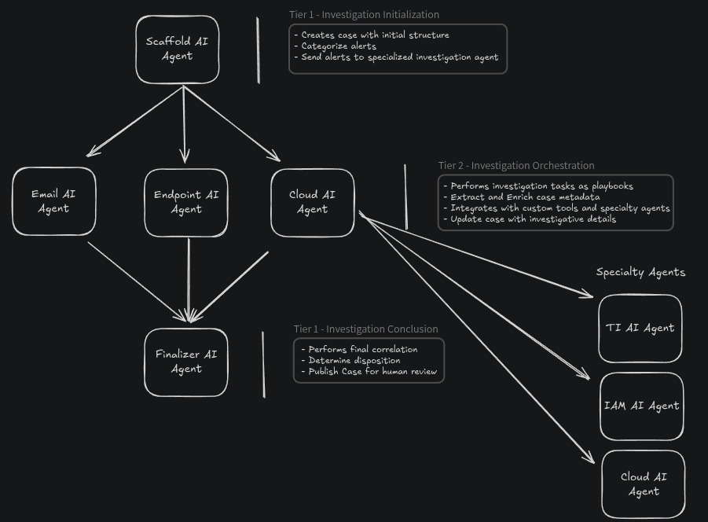
Excalidraw

Slide 12
Demo

Slide 13

Key takeaways
Start small — pilot AI on low-risk, repetitive tasks
Keep humans in the loop — AI assists, not replaces
Prioritize context & safety over speed
Share learnings — community-driven defense wins
Notes:
“If you remember just a few things from today — make it these:
Start small. Don’t try to automate your whole SOC overnight. Pick a repetitive, low-risk task — like summarizing alerts — and learn from it.
Keep humans in the loop. AI is powerful, but it lacks judgment. Let it assist, not replace.
Prioritize context and safety. It’s easy to get wowed by speed — but data exposure or wrong conclusions can cost more.
And finally, share what works. This community thrives when we learn from each other. Such is the motivation for this talk.

Slide 14
Getting in touch
Code and slides on github.com/sadewale4
Email via samwale008@gmail.com
Notes:
So, quick intro — I’m Samson, and this is actually my first time presenting at BSides Atlanta.”
By day, I’m a Threat Response Engineer at Klaviyo — working on detection, incident response, and, lately, exploring how AI can make threat analysis a little less painful.

Slide 15
Thank you
This content is for general informational purposes only and should not be considered a substitute for professional advice. Please credit Samson Adewale when using this content.
samsonadewale.com
Notes:
Alright, quick show of hands — how many people here have not used any AI or LLM tool — like ChatGPT, Claude, Copilot, Gemini, anything like that?”
Okay, good — if your hands up, i was gonna say please see me after the session so we can fix that asap.
Seriously though, it’s everywhere — and whether we like it or not, it’s creeping into every part of how we work — including security.
—--------------------------------------------------
Now, just so I know who’s in the room — another quick pulse check.
Who here is currently working in cybersecurity or related IT field?
Awesome. How about students or folks trying to break into cybersecurity?
And how many of you would say you’re just curious about how AI is changing security?
Perfect. Looks like we have a goods mix or learners. Which is perfect.
In this session, we’re going to explore how AI — and especially AI agents — can move us from all that noise we deal with every day, to actual, actionable intel.

