Slide 1
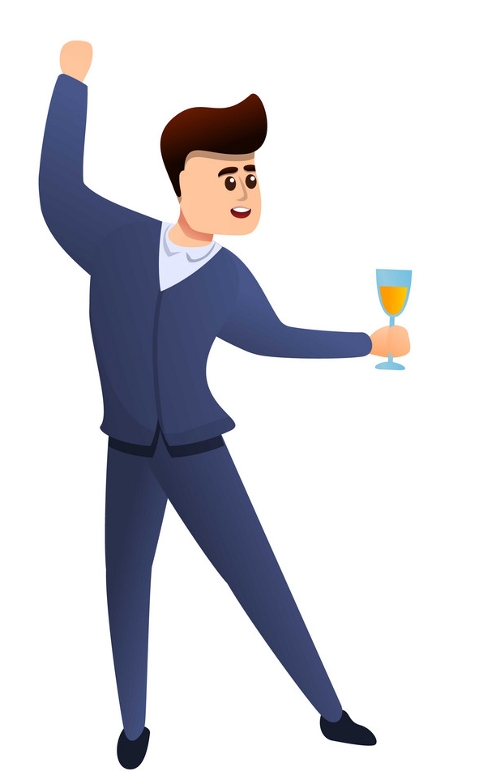


Lengfeld, Würzburg

Slide 2

And customer satisfaction comes from hospitality
If I focus on the customer satisfaction from the first day itself, that would be BEST !!

Slide 3
But HOW to check it ?????

Slide 4

Let‘s make an employee feebdack form using SIMPLIFIER to check the behavior of my employees towards the customers

Slide 5
