Slide 1
project IOT BASED ACCURATE THERMAL SCREENING AND ALERT FOR COVID SITUATION USING BEAGLEBONE task interfacing Wi-Fi router with beaglebone black.

Slide 2
Content
Introduction
Interfacing Wi-Fi router with Beagle bone black
Router specifications
Hardware connection

Slide 3
Cont…
Connection to beaglebone
Coding
References

Slide 4
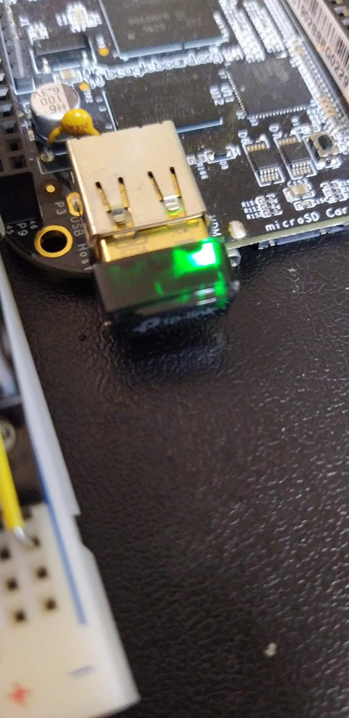
Introduction
In our project design, camera needs WI-FI for cloud uploading, so we are using a router for example tp-link Wi-Fi adapter.
This router goes to the USB port of the Beagle bone Black.

Slide 5

Router Specifications
Going to use WI-FI adapter for connectivity purpose.
Many USB adapters are available.
For example- TP-Link AC1300 USB 3.0 Wi-Fi Adapter
Following adapter is dual band.
Needs 5 V DC.

Slide 6
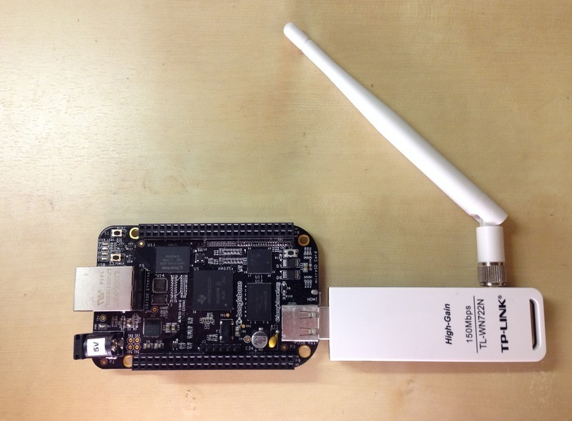
Hardware connection

Slide 7
Connection to beaglebone
Interfacing the router to Beagle bone black is another important task in project.
Connect WI-FI router to USB port available.

Slide 8
Coding
Steps: 1. Connect to the BBW.
2. Run the network manager
debian@beaglebone:~$ sudo connmanctl
[sudo] password for debian:
Error getting VPN connections: The name
net.connman.vpn was not provided by any
Enter password if requested: temppwd
Ignore the VPN error.
3. Enable Wifi:
connmanctl> enable wifi
Error wifi: Already enabled

Slide 9
Coding
4. Scan for Wifi networks:
connmanctl> scan wifi
Scan completed for wifi
5. Show available Wifi services:
connmanctl> servicesFIS wifi_f45eab2e3825_464953_managed_psk
Gtother wifi_f45eab2e3825_47546f74686572_managed_psk
GTRI-Device wifi_f45eab2e3825_475452492d446576696365_managed_psk
If no services are displayed, disable the WiFi tether and run services:
connmanctl> tether wifi
offconnmanctl> services

Slide 10
Coding
5b. Remove auto-connect:
If *AO or *AR are next to a service, remove auto-connect:
connmanctl> config <id of the network> auto-connect off
<id of the network> is the value shown next to *AO or *AR starting with wifi_ … (e.g.wifi_8030dcea18e4_464953_managed_psk)
6. Turn on the agent:
connmanctl> agent on
Agent registered
7. Connect to the service of interest:
Copy network ID of interest from step 5 and paste after ‘connect’.
connmanctl>connect wifi_f45eab2e3825_47546f74686572_managed_psk

Slide 11
Coding
8. Enter Wifi password:
Passphrase?
Connected to wifi_8030dcea18e4_464953_managed_psk
9. Check auto-connect:
connmanctl> services
*AO or *AR should be next to the desired network ID.
10. Quit:
connmanctl> quit
11. Test:
The wireless network is ready after about 30 seconds.

Slide 12
Coding
View IP addresses:
debian@beaglebone:~$ ifconfig
Test the network connection by pinging Google:
debian@beaglebone:~$ ping google.com
PING google.com (172.217.164.78) 56(84) bytes of data.64 bytes from 172.217.164.78 (172.217.164.78): icmp_seq=1 ttl=56 time=5.02 ms

Slide 13
References
(https://www.amazon.ca/TP-Link-Archer-T3U-Adapter-Wireless/dp/B07P6N2TZH/ref=asc_df_B07P6N2TZH/?tag=googleshopc0c-20&linkCode=df0&hvadid=335526236542&hvpos=&hvnetw=g&hvrand=12910649570092329209&hvpone=&hvptwo=&hvqmt=&hvdev=c&hvdvcmdl=&hvlocint=&hvlocphy=90, n.d.)
BeagleBoard.org. (2019, September 6). BeagleBoard.org - black. Retrieved June 5, 2020, from https://beagleboard.org/black

