Slide 1
IOT BASED ACCURATE THERMAL SCREENING AND ALERT FOR COVID SITUATION USING BEAGLEBONE

Slide 2
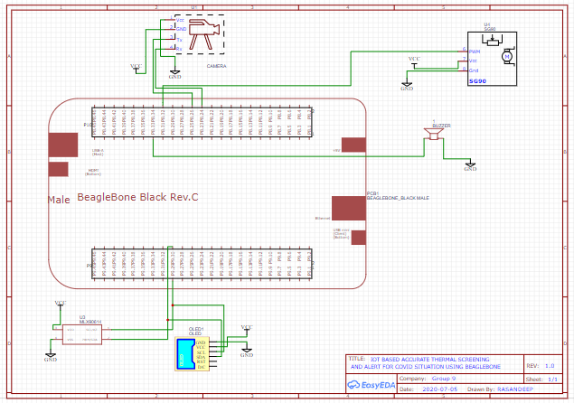
SCHEMATICS

Slide 3
COMPONENTS
BEAGLEBONE BLACK
MLX90614
OLED
CAMERA
SERVO MOTOR
BUZZER

Slide 4
Beagle bone black
BEAGLE BONE is the micro controller unit we are using for this project
Various components which are required for this project are connected to the beagle bone black
Considering the schematic diagram all the connections of various components are explained in the following slides.

Slide 5
MLX90614
We are using MLX90614 which is a contact less IR temperature sensor.
This temperature sensor has 4 different pins to make connections with the beagle bone.(VCC,GND,SCL,SDA)
VCC and GND of the temperature sensor are connected to VCC and GND of beagle bone respectively.
SCL(clock line) is connected to the pin P9.29.
SDA(data line) is connected to the pin P9.30

Slide 6
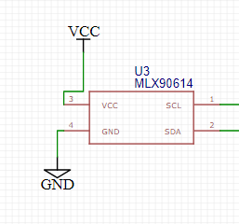
The scl and sda pins are the serial clock line and data line pins of MLX90614
Serial clock line is used to synchronise digital circuits,
Serial data line is used to transmit synchronise data between microcontroller and their peripheral devices

Slide 7
OLED
We are using OLED SCREEN which is used to display the temperature.
VCC and GND of the OLED are connected to VCC and GND of beagle bone respectively.
SCL(clock line) is connected to the pin P9.29.
SDA(data line) is connected to the pin P9.30

Slide 8
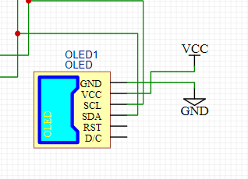
The vcc and gnd pins are the input sources
The Rst pin used for reset purpose
The scl and sda is used for serial communication between the Beagle bone and the OLED screen
This is Data/Command control pin(D/C). When it is pulled HIGH , the data at is treated as data. When it is pulled LOW, the data at will be transferred to the command register

Slide 9
CAMERA
We are using camera module for live monitoring and future references.
This Camera module has 4 different pins to make connections with the beagle bone.(VCC,GND,TX,RX)
VCC and GND of the camera module are connected to VCC and GND of beagle bone respectively.
Tx(Transmission line) is connected to the pin P8.26.
Rx(Receiver line) is connected to the pin P8.24

Slide 10
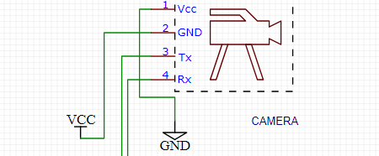
The Tx and Rx pins are used to transmit and receive data from beagle bone
Vcc and gnd are the input source to the camera module

Slide 11
SERVO MOTOR
We are using servo motor which is used in the servo door mechanism
This servo door mechanism has 3 different pins to make connections with the beagle bone.(VCC,GND,PWM)
VCC and GND pins are connected to VCC and GND of beagle bone respectively.
PWM pin is connected to the pin number p8.32

Slide 12
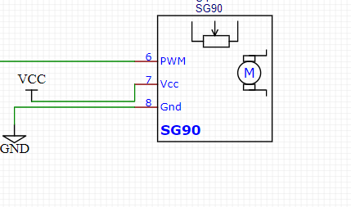
The vcc and gnd pins are the input source to the servo motor
PWM stands for Pulse Width Modulation, It is used to convert the digital signal into an analog by varying the width of the Pulse

Slide 13
BUZZER
The buzzer is connected to p8.33 pin in beagle bone the Gnd pin is connected to Gnd.
We are using 0.5w speaker for the buzzer.

