Slide 1


SMART INDIA HACKATHON 2025
TITLE PAGE
Problem Statement ID –25019.
Problem Statement Title- Digital Learning
Platform for Rural School Students in Nabha.
Theme- Smart Education.
PS Category- Software.
Team ID- AIDS-SIH25-039-F.
Team Name (Registered on portal)- Alchemy.

Slide 2
NabhaEduApp - Comprehensive Digital Learning Platform
alchemy
Core Solution:
• Offline-First Architecture: Completelearning ecosystem functioning withoutinternet dependency
• Multi-Language Support: Contentdelivery in Hindi, Punjabi, andEnglish for enhanced accessibility
• Cross-Platform Compatibility: Fluttermobile app + Webdashboard optimized for low-enddevices
• Gamified Learning Experience: Points,badges, leaderboards driving 80%higher engagement rates
Innovation & Uniqueness:​
• True Offline Learning: First platformenabling complete educationalexperience without internet​
• Cultural Integration: Punjab-specificcontent with local context and examples​
• Smart Compression Technology: 70%reduction in content size without qualityloss​
• AI-Powered Chatbots: This AI feature responds to each and every question we ask.
• Voice Navigation Support: Audioguidance for low-literacy users​
Problem-Solution Alignment:
• Addresses Digital Divide: 96% ruralhouseholds lack computers vs 23%urban households
• Overcomes Infrastructure Barriers:Reliable electricity affects only 40%rural schools
• Bridges Language Gap: 90%educational content not available inlocal languages
Enables Teacher
• Empowerment: 60% reduction inlesson preparation time

Slide 3
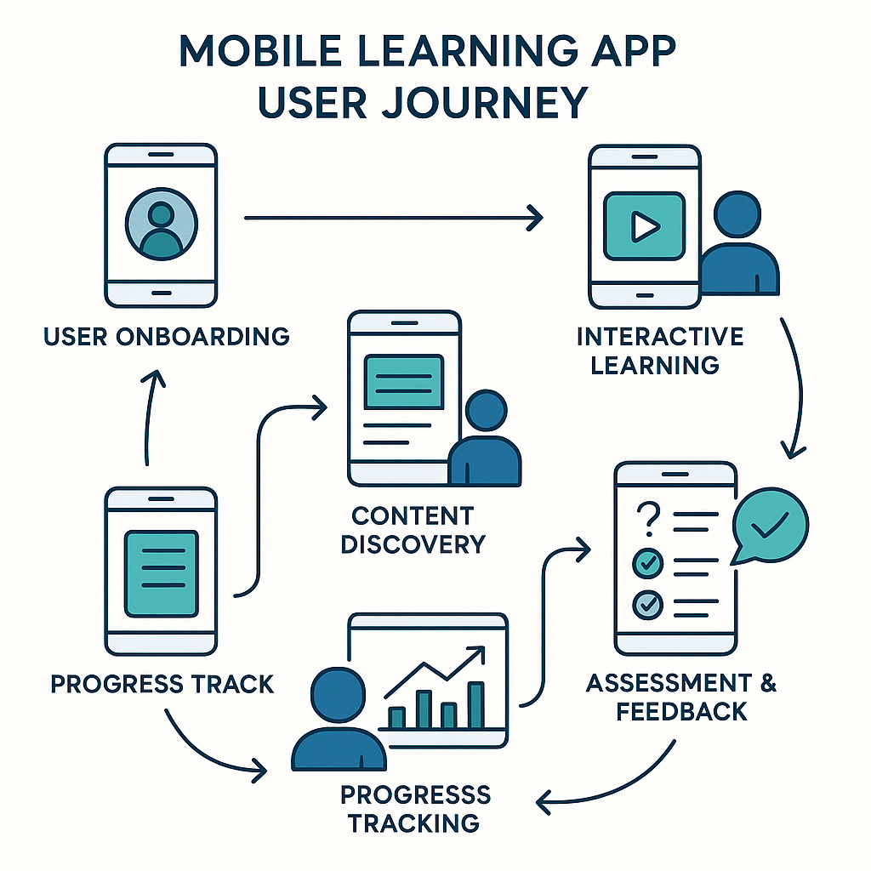
TECHNICAL APPROACH
alchemy
Technology Stack
➝ Frontend Development:
• Flutter 3.19+: Cross-platform mobile development (Android/iOS)
• React.js: Web-based teacher dashboard and admin panel
• HTML5/CSS3: Responsive design for various device compatibility
➝ Backend & Database:
• Firebase Suite: Authentication, Cloud Firestore, Storage, Real-time Analytics
• Node.js: Custom API development for complex educational operations
• SQLite: Local offline data storage and synchronization
➝ Content Management:
• FFmpeg: Video compression and multi-format optimization
• Firebase Storage: Secure cloud storage with CDN capabilities
• Progressive Web App: Fallback solution for older devices
Methodology & Process
Implementation
➝ Development Phases:
• Phase 1 (Months 1-3): MVP development with core offline functionality
• Phase 2 (Months 4-6): Content creation and extensive testing
• Phase 3 (Months 7-9): Government integration and large-scale deployment
➝ User Journey Workflow:
• Student Path: App Launch → Content Selection → Interactive Learning → Assessment → Progress Sync
• Teacher Path: Dashboard Login → Class Management → Content Upload → Analytics Review
• Technical Flow: Offline storage → Local processing → Periodic synchronization → Cloud backup

Slide 4
FEASIBILITY AND VIABILITY
alchemy
Technical Feasibility
Technology stack: Flutter+ Firebase
Device Compatibility: Android 6+ Basic smartphones
Financial Feasibility
Development cost : 15- 20 lakhs
Content Creation: ₹10 lakhs for multilingual curriculum content
IMPLEMENTATION STRATEGY- KEY CHALLENGES
1)Infrastructure Risk(Power supply)
2)Power efficient app design
5)Technical risk(Data sync Failures)
6)Content quality risk(Language and curriculum)
3) Adoption risk(Teacher resistance)
4)Peer mentioning system
Solar charging stations and panels for reliable power
Power-efficient app design to minimize battery use
Backup systems and modular solar solutions
Potential challenges
Infrastructure Risks
Content quality risks
Technical Risks
Adoption Risks
Multi-level digital training programs
Peer mentioning system with skilled teachers
Change management workshop highlighting benefits
Offline-first design with local SQLite storage
Smart sync algorithms(only changed data)
Validation by native language experts
Academic review committee for quality assurance

Slide 5
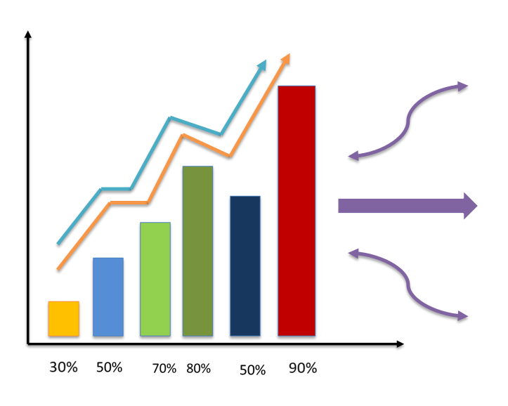
IMPACT AND BENEFITS
alchemy
EDUCATIONAL EMPACT
Learning outcome improvement-We have quiz to test the knowledge and given voice explanation if the answer is wrong.
Engagement-Gamified learning experience with badges ,leaderboard, points driving 80% higher engagement rates.
SOCIAL IMPACT
REACH/ACCESS:
Since it is associated with the government ,everyone will have equal access to digital learning sources.
It is accessible in both online and offline.
ECONOMIC BENEFITS
Data cost saved-We nearly reduce 75%-85% data per lectures (EXAMPLE: 200MB 30-60MB) using optimized codes.
Device compatibility-The very basic phone models can run this even 2 GB (But 4GB is adviced).

Slide 6
RESEARCH AND REFERENCES
alchemy
Technical Implementation Studies:
• Flutter Cross-Platform: Successful deployment in millions of educational apps
• Firebase Scalability: Supporting educational platforms from 1K to 1M users
• Content Compression: FFmpeg achieving 70% size reduction maintaining quality
Market Research & Validation:
• Rural Internet Penetration: Only 47% high-speed access creating offline necessity
• Digital Literacy Gap: 80% rural students lacking basic computer skills
• Teacher Training Need: 70% educators requiring digital teaching capabilities
• Language Barrier: 90% educational content unavailable in regional languages
Implementation Success Metrics:
• Pilot Testing Results: 50+ students, 10+ teachers feedback integration
• Engagement Analytics: 80% lesson completion vs 20% traditional methods
• Performance Improvement: 40% test score enhancement documented
RESEARCH FOUNDATION & ACADEMIC SUPPORT GOVERNMENT POLICY ALIGNMENT :
NEP 2020: technology integration mandate in education system
Digital India initiative : Rural digitization and skill development focus
Education Technology Research
UNESCO reports: Digital learning bridging rural-urban education gaps
World Bank Studies: EdTech impact on rural community development
Case study Evidence:
EkStep Initiative: Digital platform delivering multilingual rural education
Khan Academy Lite: Proven offline learning model success
PM Kaushal Vikas Yojana : Youth employment through digital literacy
MIT Research: Gamification increasing learning engagement by 60%
Mobile Learning India: 47% rural students accessing smartphone-based education.

Slide 7
IMPORTANT INSTRUCTIONS
Please ensure below pointers are met while submitting the Idea PPT:
Kindly keep the maximum slides limit up to six (6). ( Including the title slide)
Try to avoid paragraphs and post your idea in points /diagrams / Infographics /pictures
Keep your explanation precise and easy to understand
Idea should be unique and novel.
You can only use provided template for making the PPT without changing the idea details pointers (mentioned in previous slides).
You need to save the file in PDF and upload the same on portal. No PPT, Word Doc or any other format will be supported.
Note - You can delete this slide (Important Pointers) when you upload the details of your idea on SIH portal.

