Slide 1

Better world
Microloan by Kiva Analysis
UT Data analytics Bootcamp, 2018
Min Kim
Subhashini
Tania
Sadhana

Slide 2
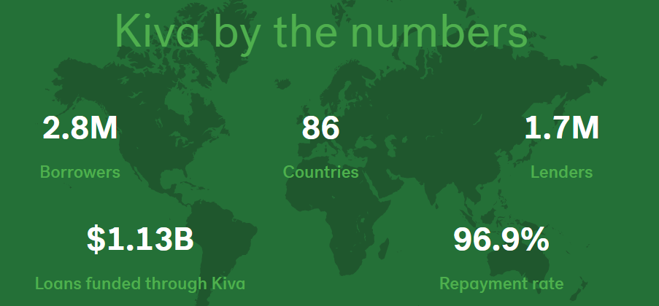
Why Kiva
Kiva is an international nonprofit, founded in 2005 and based in San Francisco,
By lending as little as $25 on Kiva, anyone can help a borrower start or grow a business, go to school, access clean energy or realize their potential
Total donation goes to the borrower
Data is public

Slide 3

Data
Used Kiva public data from Builtkiva.com
Kaggle.com
MPI data from Worldbank
Data cleaning challenge

Slide 4

Visualization
Created interactive maps for loan summary , sector information by country
Gender distribution
Sectors of loan funded

Slide 5


Storytelling
Looked deeper into top three most funded country (Philippines, Peru, )
Three most poorest country in three continent ( Mongolia, Honduras, DRC), what kiva can do to help them better

Slide 6

Prediction
Used K means cluster method

