Slide 1
Hypothesis Testing Exercise
A F&B manager wants to determine whether there is any significant difference in the diameter of the cutlet between two units. A randomly selected sample of cutlets was collected from both units and measured? Analyze the data and draw inferences at 5% significance level. Please state the assumptions and tests that you carried out to check validity of the assumptions.
Minitab File : Cutlets.mtw
Ans) H0- size of cutlet is same
H1- size of cutlets is different
After doing 2 tail test since it is type 1 hypothesis ,we get p value as 0.4 so null hypothesis is rejected.

Slide 2
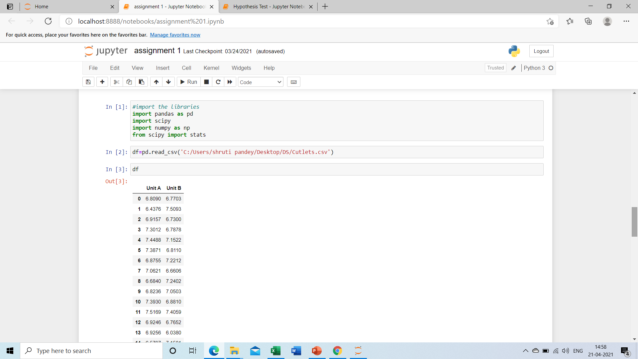
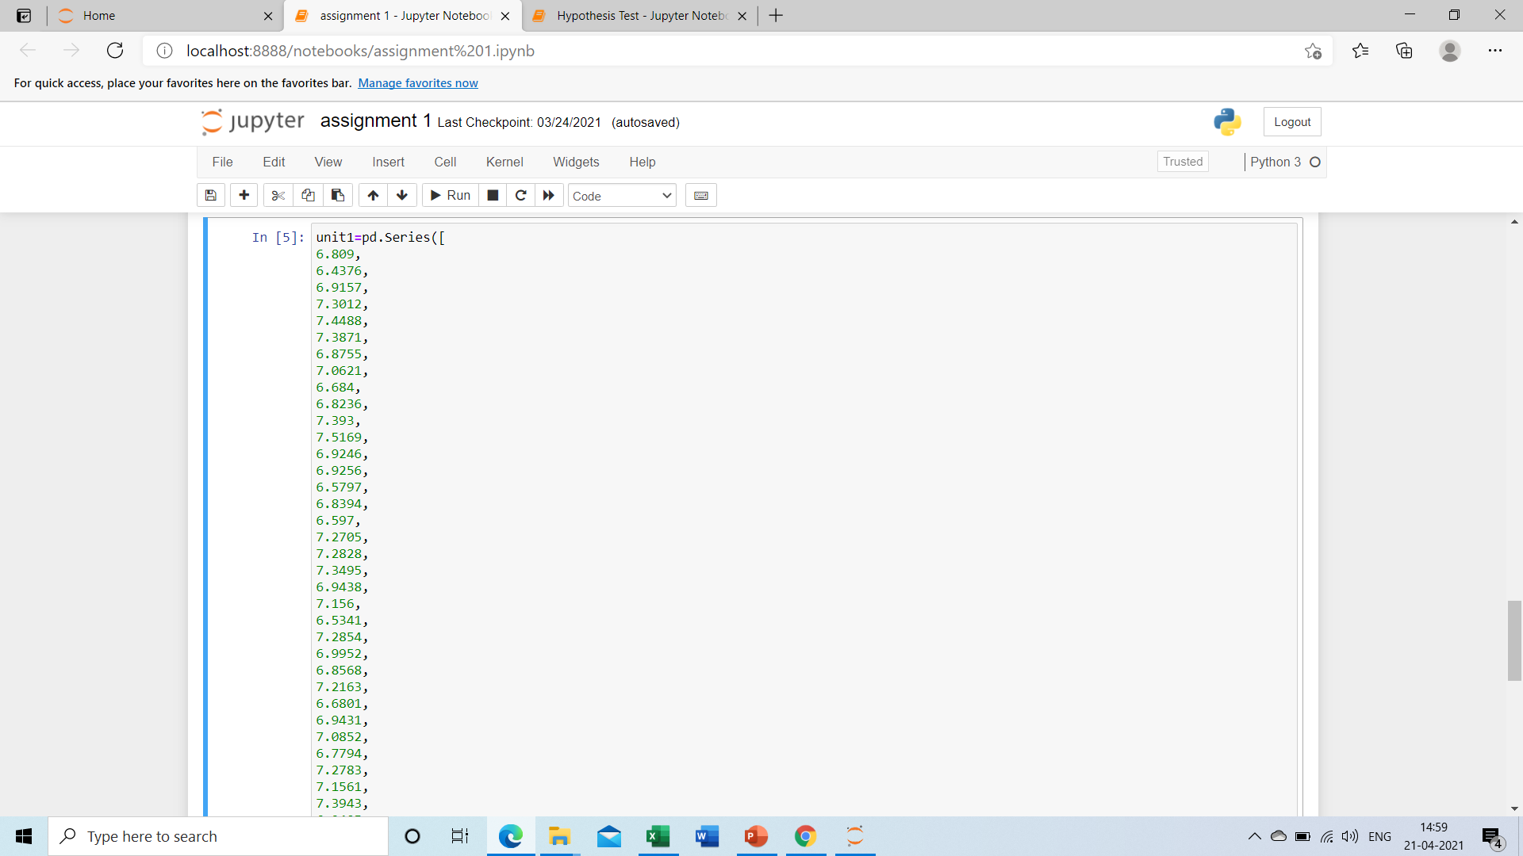

Slide 3
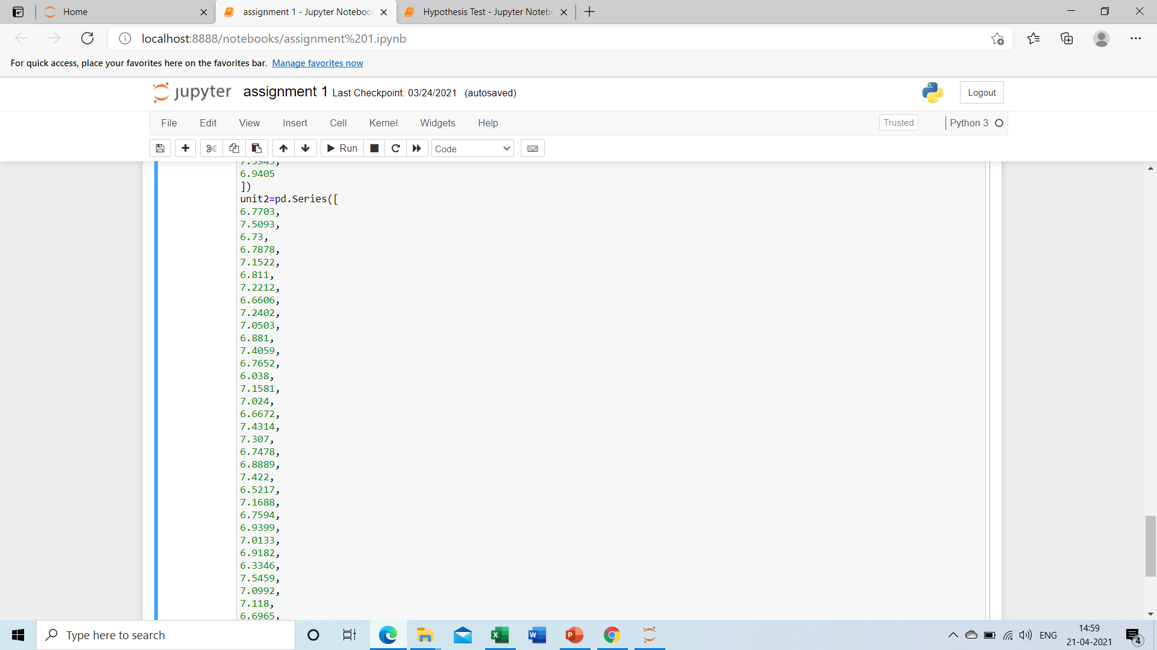
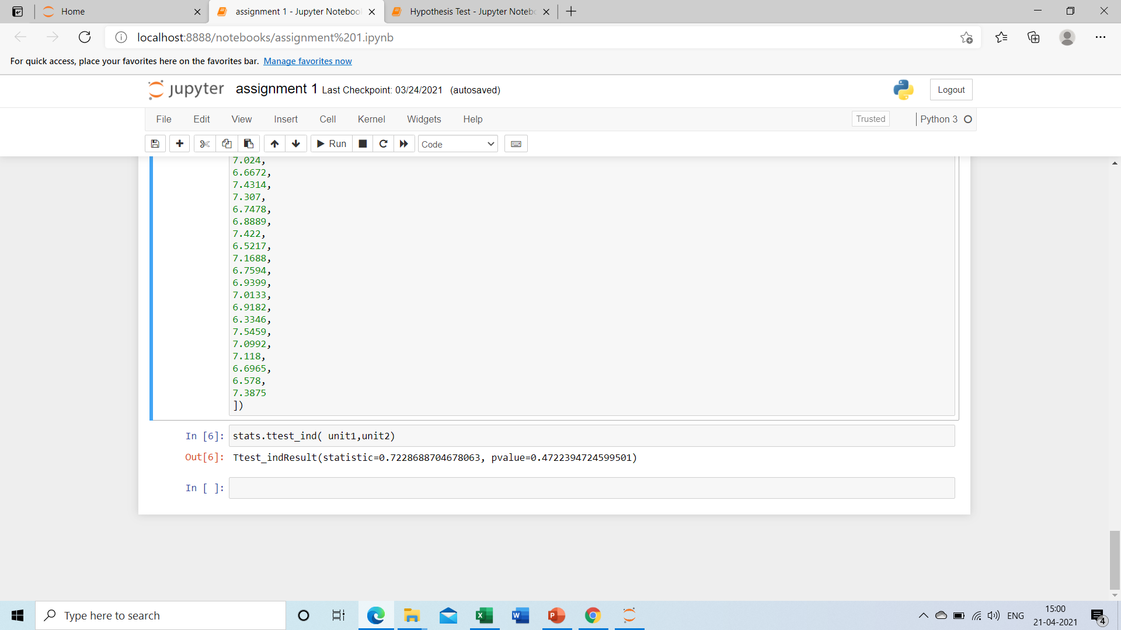

Slide 4
Hypothesis Testing Exercise
A hospital wants to determine whether there is any difference in the average Turn Around Time (TAT) of reports of the laboratories on their preferred list. They collected a random sample and recorded TAT for reports of 4 laboratories. TAT is defined as sample collected to report dispatch.
Analyze the data and determine whether there is any difference in average TAT among the different laboratories at 5% significance level.
Minitab File: LabTAT.mtw
Ans) H0– there is no difference in tat
H1-there is difference in tat
Here we get p value< 0 so null hypo is rejected ,so there is difference

Slide 5
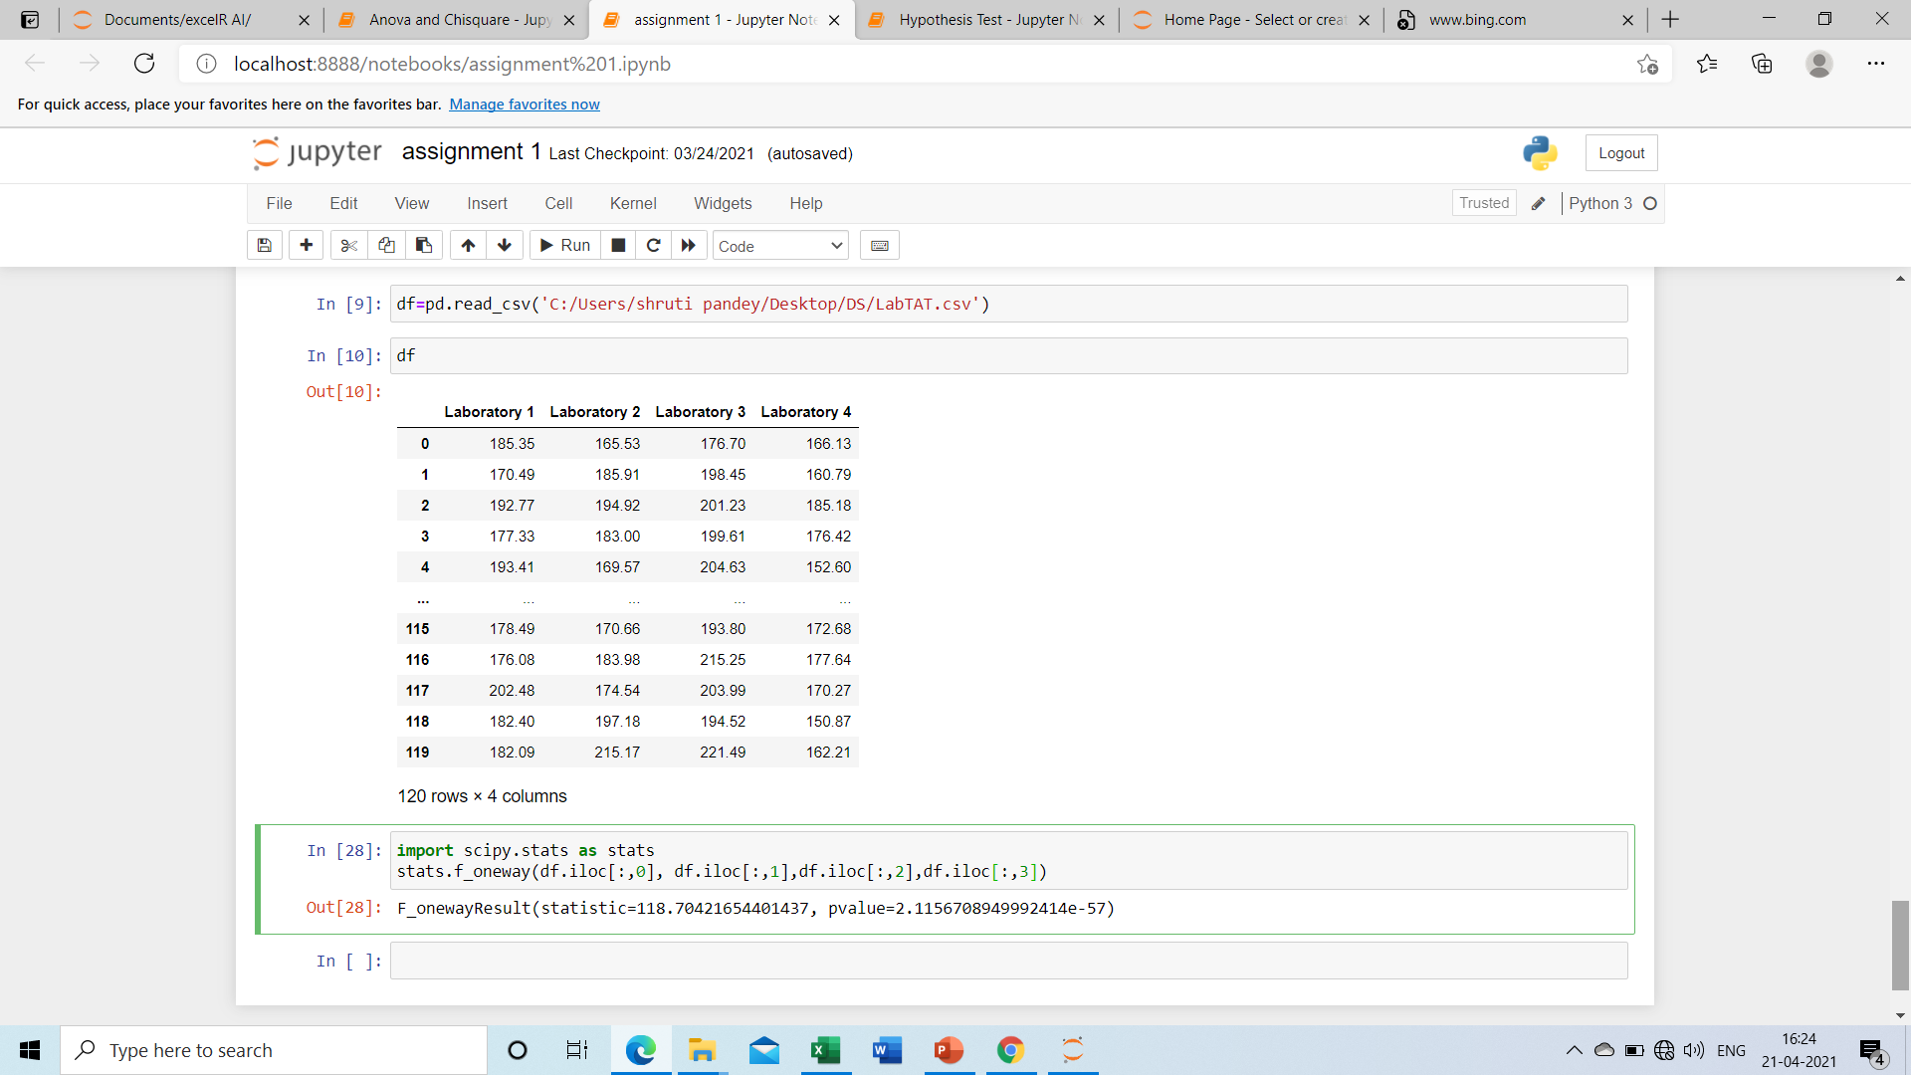

Slide 6
Hypothesis Testing Exercise
Sales of products in four different regions is tabulated for males and females. Find if male-female buyer rations are similar across regions.
 | East | West | North | South
Males | 50 | 142 | 131 | 70
Females | 550 | 351 | 480 | 350
Check p-value
If p-Value < alpha, we reject Null Hypothesis
H0
All proportions are equal
Ha
Not all Proportions are equal
Buyer Ratio.mtw

Slide 7
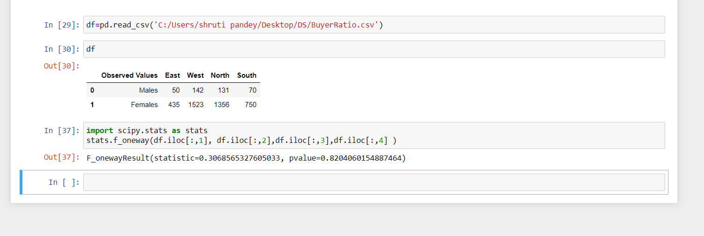
Ans: Here p value is greater so null hypothesis is accepted

Slide 8
Hypothesis Testing Exercise
TeleCall uses 4 centers around the globe to process customer order forms. They audit a certain % of the customer order forms. Any error in order form renders it defective and has to be reworked before processing. The manager wants to check whether the defective % varies by centre. Please analyze the data at 5% significance level and help the manager draw appropriate inferences
Minitab File: CustomerOrderForm.mtw
Ans: Here we use Chi square test because question contain more than 2 character columns.

Slide 9
