Slide 1

Ligand Interaction with Flagellar Motor Protein MotS : A Molecular Docking Approach
Name :- Km. Sadhana
Enrollment no. :- MBI2024011
Under the supervision of:-
Dr. Nidhi Mishra

Slide 2
Introduction
Bacillus subtillis is a gram positive bacterium that cause nosocomial infections and in some research paper and clinical reports show its role in serious infections.
It’s survival and infection capability are linked to flagellar motility, which is driven by the stator proteins MotS.
It is also known for its ability to form spores.
MotS undergoes a sodium – dependent conformational change that is essential for anchoring the motor to the peptidoglycan layer, helps it to move.

Slide 3
Motivation
MotS from Bacillus subtilis infections are increasingly recognized, especially in patients with weak immune system.
This bacterium can survive on hospital surface, form biofilms and contribute to hospital-acquired infections (HAIs). By targeting its movement, we can reduce its ability to spread infections.
It is often seen as a simple contaminant, but it can cause significant risk, especially in vulnerable patients, it can cause infections such as Oesophageal infection, Bacteraemia (bloodstream infection).
It has been reported in numerous studies as being isolated from samples including blood, cerebrospinal fluid, liver and spleen abscesses and vitreous fluid.
Focusing on its motility could lead to new antimicrobial treatment.

Slide 4
Research Gap and Problem
MotS protein is activated by sodium, molecule inhibitors are not much explored against this protein to reduce flagellar movement.
The goal of this research is to screen molecules to find inhibitors that target the MotS periplasmic domain.
This approach aims to interrupt the function of the flagellar stator, which could help to reduce the ability of Bacillus subtilis to cause infections.

Slide 5
Software for Molecular Docking
AutoDock4
SwissDock
Schrodinger Molecular Operating Environment (MOE)
Dock6
AutoDock Vina

Slide 6
Methodology
workflow
PubChem, Zinc database,ChEMBL,DrugBank
Target
protein
Ligand selection
PDB, UniProt
Chimera, Pymol, Autodock Tools
Protein preparation
Ligand preparation
Avogadro, MarvinSketch, OpenBabel
Molecular docking
* *.pdbqt
* *.gpf
* *.glg
* *.pdbqt
* *.dpf
* *.dlg
Best pose selection
Visualization

Slide 7
Standard drugs
Ampicillin (CID: 6249)
Ceftriaxone (CID: 5479530)
Benzylpenicillin (CID: 5904)
Levofloxacin (CID: 149096)
2-Hydroxyquinoline (CID: 6038)
Methicillin (CID: 6087)
Selected Phytochemicals
Theaflavin (CID: 114777)
Kaempferol (CID: 5280863)
Luteolin (CID: 5280445)
Quercetin (CID: 5280343)
Daidzein (CID: 5281708)
Ligand Selection

Slide 8
Docking analysis of Phytochemicals with cavity1
PDB ID | Cavity 1 | Compound | Binding energy | Run | Hydrogen bond | Residues | Inhibition Constant (Ki)
9LJL | Cavity 1 | Theaflavin | -11.35 kcal/mol | 2 | 7 | Ser171A,Glu142B, Thr172A,Glu180A,Arg174B,Tyr175B | 0.0048 µM
9LJL | Cavity 1 | Daidzein | -6.95 kcal/mol | 5 | 4 | Ser195B,Val137B, Tyr175B, Arg174B | 8.09 µM
9LJL | Cavity 1 | Quercetin | -6.84 kcal/mol | 6 | 5 | Glu180A,Tyr173A, Glu142B,Lys136B, Gly188B | 9.76 µM
9LJL | Cavity 1 | Luteolin | -6.79 kcal/mol | 8 | 3 | Val137B,Tyr173A, Tyr175B | 10.49 µM
9LJL | Cavity 1 | Kaempferol | -6.67 kcal/mol | 9 | 5 | Gln191B,Ala135B, Val137B,Tyr175B, Arg174B | 13.01 µM

Slide 9
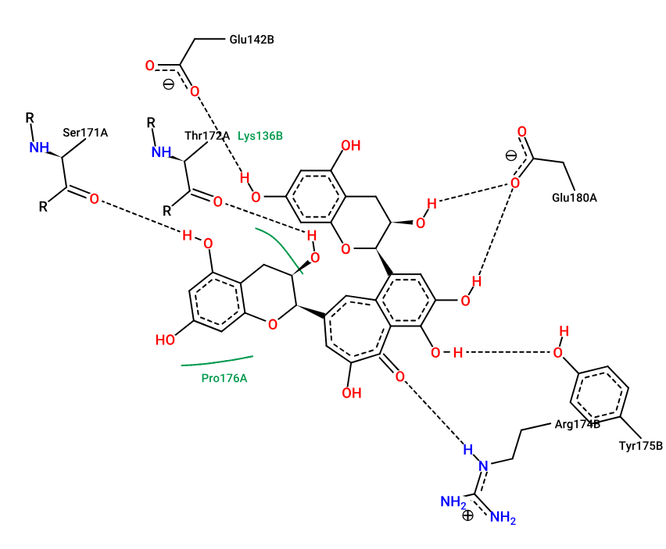
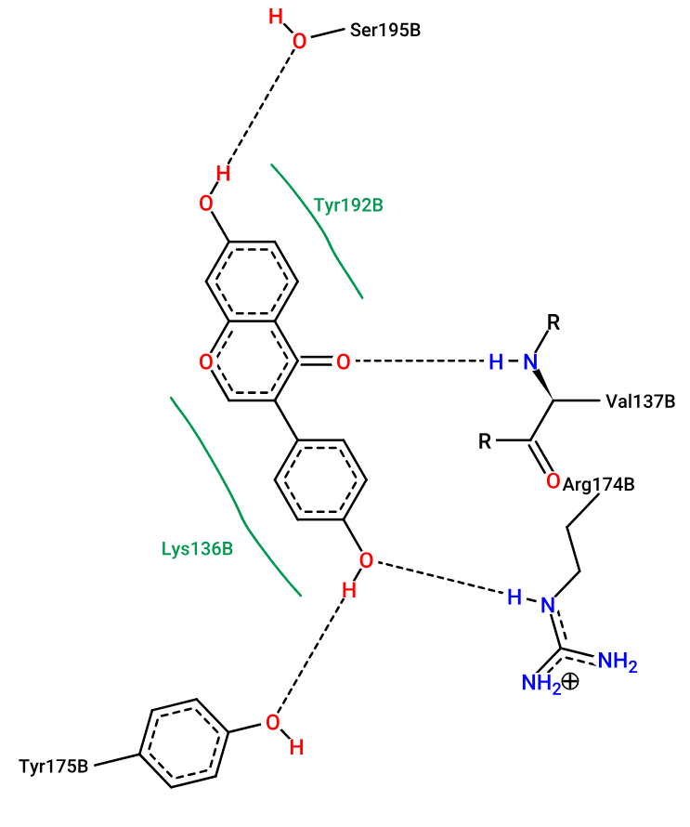
(a)
(b)
Figure: Show 2D interaction of 9LJL protein with compound (a) Theaflavin and (b) Daidzein

Slide 10
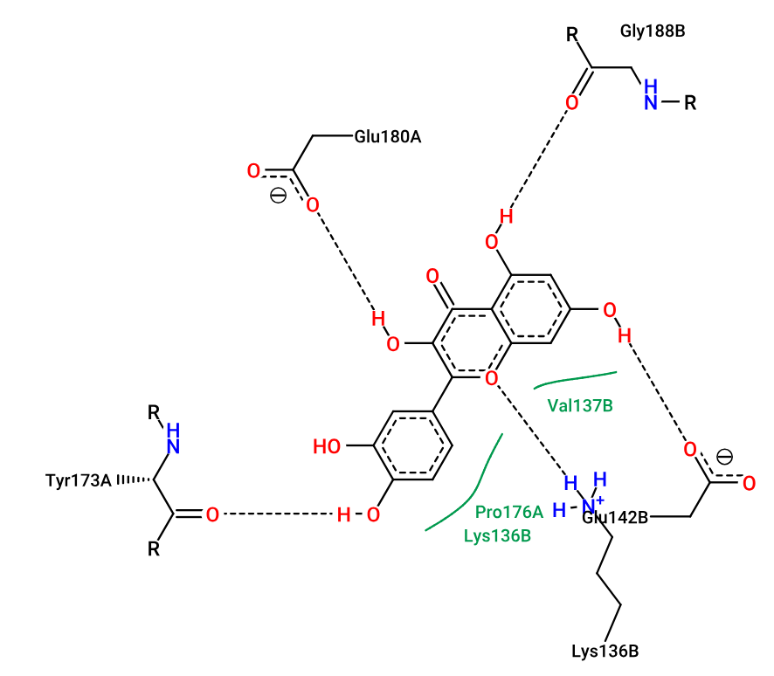
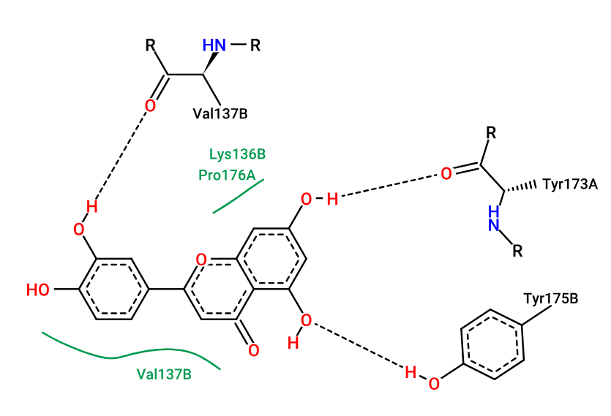
(c)
(d)
Figure: Show 2D interaction of 9LJL protein with compound (c) Quercetin and (d) Luteolin

Slide 11
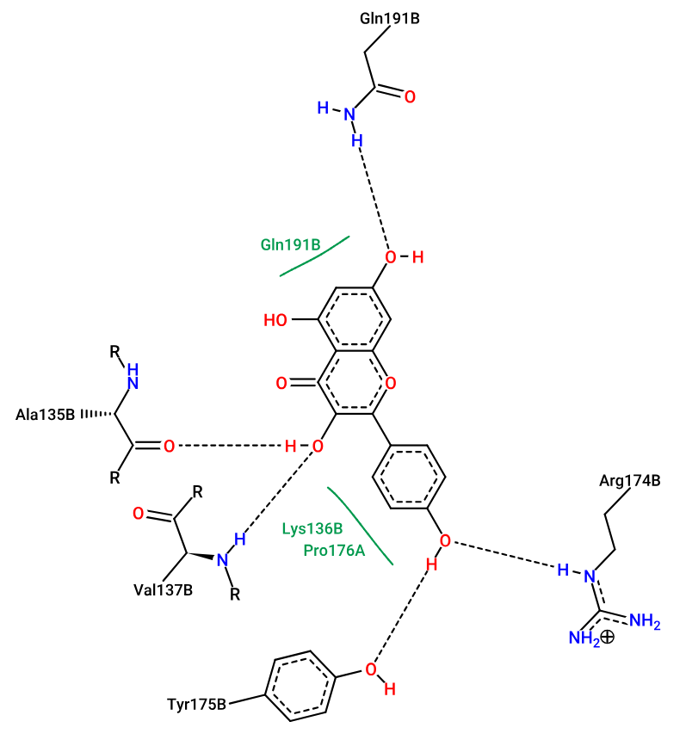
(e)
Figure: Show 2D interaction of 9LJL protein with compound (e) Kaempferol

Slide 12
Standard Drugs with cavity1
PDB ID | Cavity 1 | Drugs | Binding energy | Run | Hydrogen bond | Residues | Inhibition Constant(Ki)
9LJL | Cavity 1 | Ceftriaxone | -7.01 kcal/mol | 10 | 7 | Arg174B, Glu134B, Tyr175B, Ala135B, Lys136B, Gln191B | 7.23 μM
9LJL | Cavity 1 | Methicillin | -6.97 kcal/mol | 7 | 3 | Lys136B, Val137B | 7.72 μM
9LJL | Cavity 1 | Ampicillin | -6.39 kcal/mol | 10 | 4 | Glu134B, Lys139B, Asp131B | 20.55 μM
9LJL | Cavity 1 | Levofloxacin | -6.24 kcal/mol | 1 | 3 | Lys196B, Lys198B | 26.86 μM
9LJL | Cavity 1 | Benzylpenicillin | -5.99 kcal/mol | 7 | 2 | Ser195B, Gln191B | 40.67 μM
9LJL | Cavity 1 | 2-Hydroxyquinoline | -5.31 kcal/mol | 7 | 4 | Arg174B, Glu134B, Tyr175B, Ala135B | 127.12 μM

Slide 13
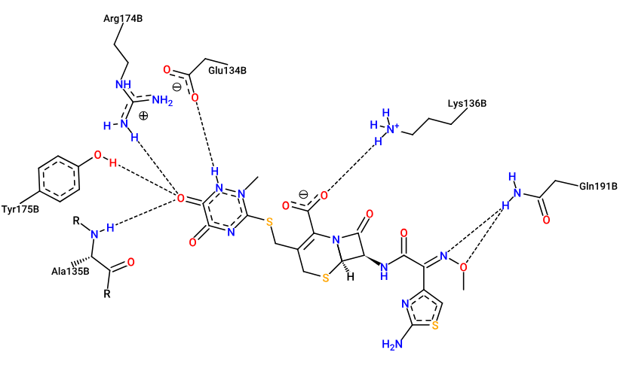
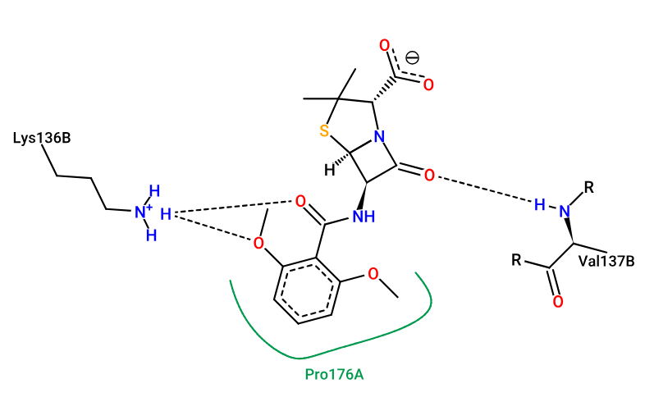
(a)
(b)
Figure: Show 2D interaction of 9LJL protein with drug (a) Ceftriaxone and (b) Methicillin

Slide 14
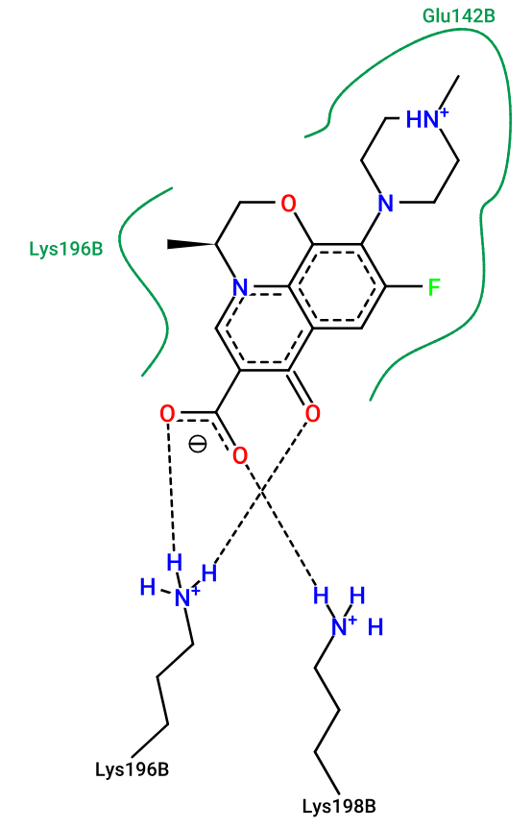
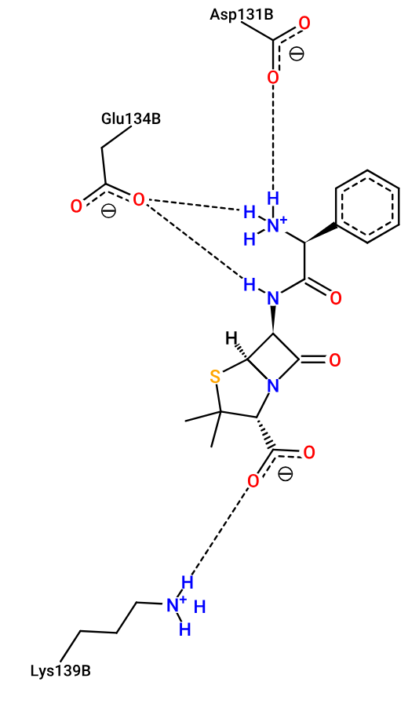
(c)
(d)
Figure: Show 2D interaction of 9LJL protein with drug (c) Ampicillin and (d) Levofloxacin

Slide 15
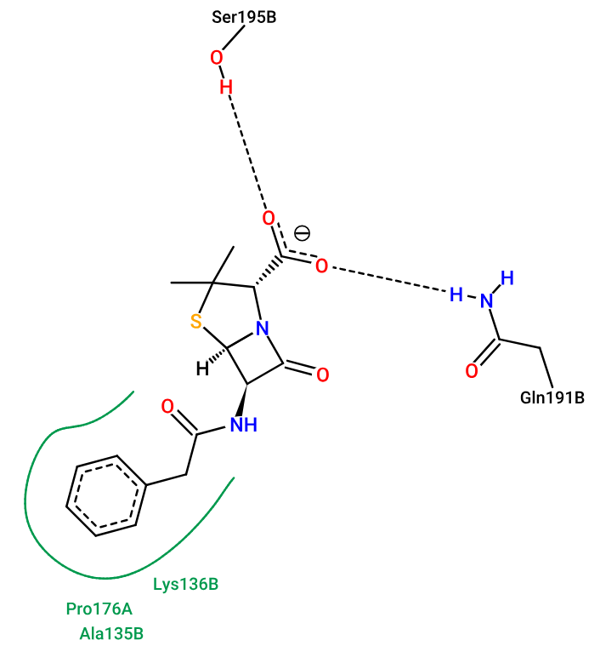
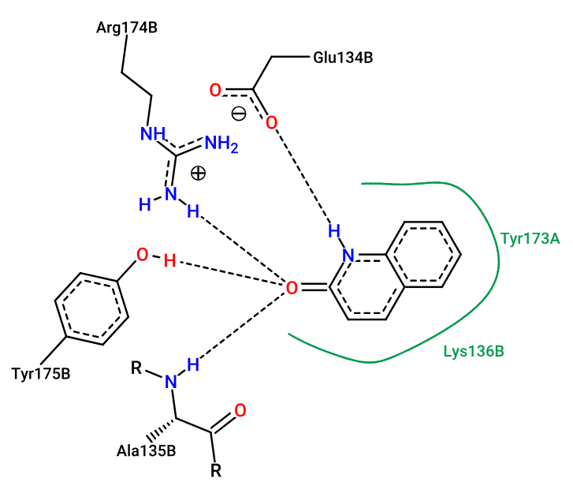
(e)
(f)
Figure: Show 2D interaction of 9LJL protein with drug (c) Benzylpenicillin and (f) 2-Hydroxyquinoline

Slide 16
Phytochemicals with cavity4
PDB ID | Cavity 4 | Compound | Binding energy | Run | Hydrogen bond | Residues | Inhibition Constant(Ki)
9LJL | Cavity 4 | Theaflavin | -8.39 kcal/mol | 1 | 7 | Gly188A, Lys196A, Thr172B, Val137A, Ser171B, Tyr175A, Arg174A | 0.70405 µM
9LJL | Cavity 4 | Luteolin | -7.21 kcal/mol | 3 | 3 | Tyr173B, Val137A, Lys196A | 5.21 µM
9LJL | Cavity 4 | Daidzein | -7.13 kcal/mol | 8 | 2 | Lys196A, Arg174B | 5.90 µM
9LJL | Cavity 4 | Kaempferol | -6.91 kcal/mol | 4 | 3 | Glu180B, Tyr173B, Lys196A | 8.64 µM
9LJL | Cavity 4 | Quercetin | -6.86 kcal/mol | 8 | 5 | Tyr175A, Ala135A, Gly188A, Tyr173B, Lys196A | 9.39 µM

Slide 17
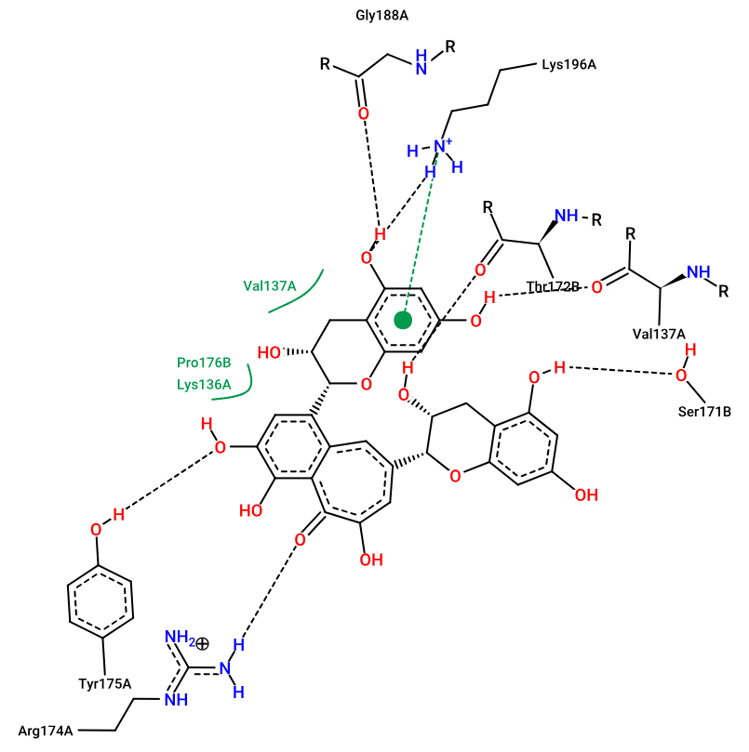
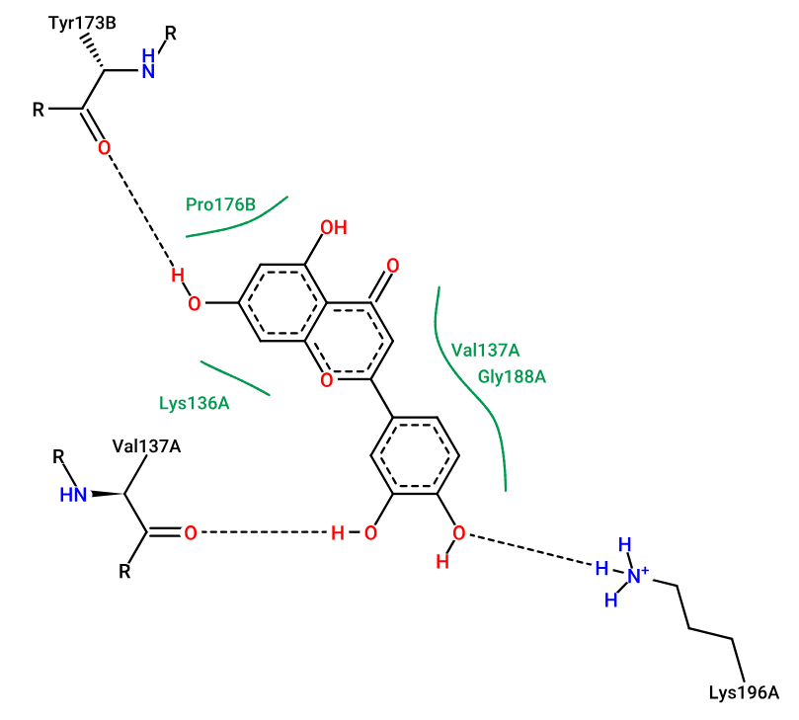
(a)
(b)
Figure: Show 2D interaction of 9LJL protein with compound (a) Theaflavin and (b) Luteolin

Slide 18
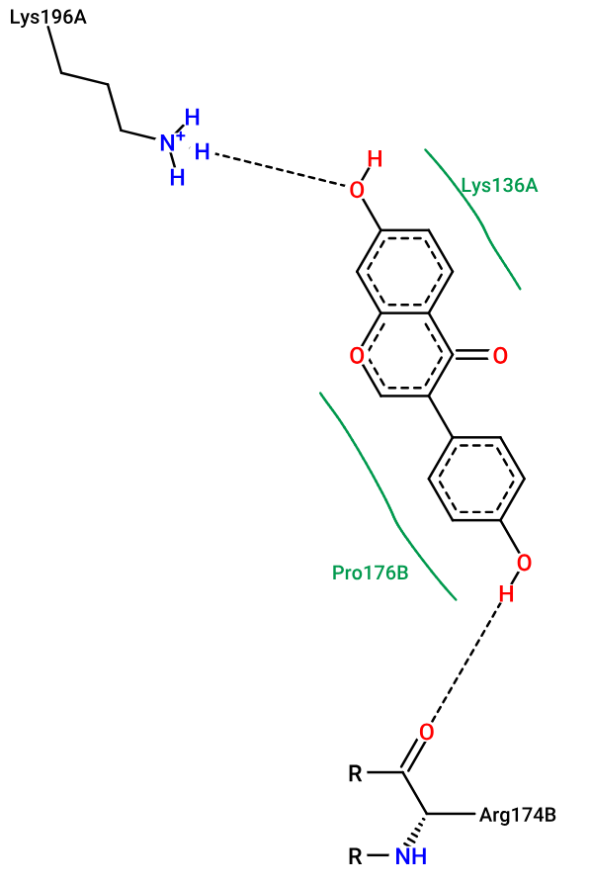
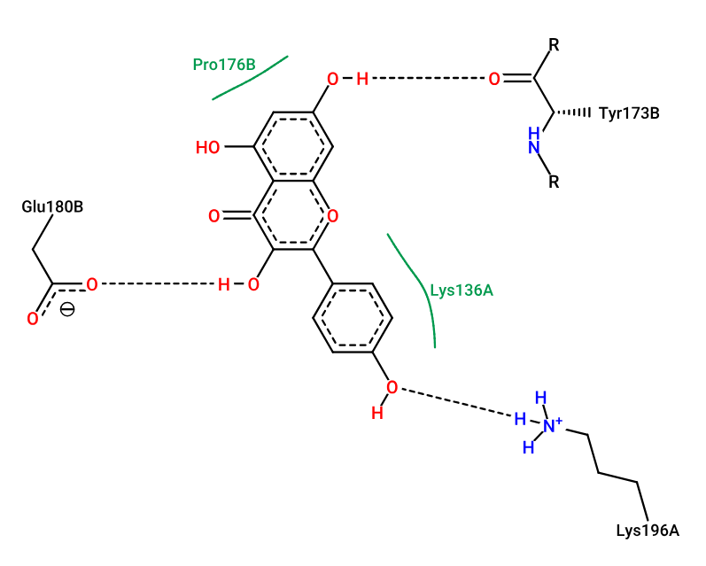
(c)
(d)
Figure: Show 2D interaction of 9LJL protein with compound (c) Daidzein and (d) Kaempferol

Slide 19
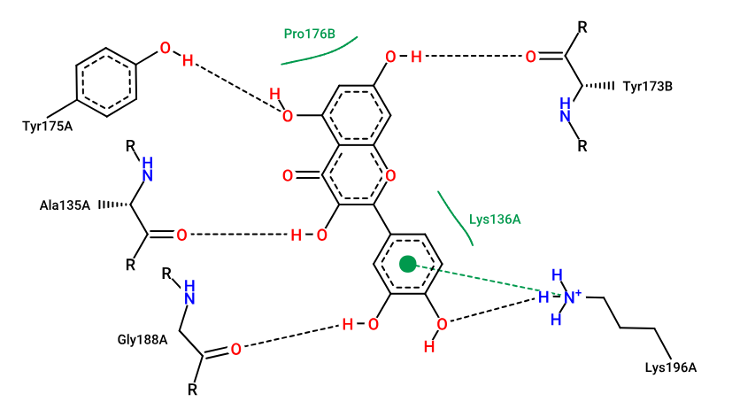
(e)
Figure: Show 2D interaction of 9LJL protein with compound (e) Quercetin

Slide 20
Standard Drugs with cavity 4
PDB ID | Cavity 4 | Drugs | Binding energy | Run | Hydrogen bond | Residues | Inhibition Constant(Ki)
9LJL | Cavity 4 | Benzylpenicillin | -7.43 kcal/mol | 4 | 2 | Lys196A, Val137A | 3.58 μM
9LJL | Cavity 4 | Methicillin | -7.05 kcal/mol | 5 | 3 | Lys196A,Val137A, Tyr175A | 6.81 μM
9LJL | Cavity 4 | Levofloxacin | -6.82 kcal/mol | 1 | 2 | Lys196A, Tyr175A | 9.94 μM
9LJL | Cavity 4 | Ceftriaxone | -6.37 kcal/mol | 4 | 4 | Lys196A, Val137A, Tyr175A | 21.42 μM
9LJL | Cavity 4 | Ampicillin | -5.84 kcal/mol | 9 | 3 | Ala135A, Glu180B, Lys196A | 52.24 μM
9LJL | Cavity 4 | 2-Hydroxyquinoline | -5.09 kcal/mol | 6 | 1 | Tyr173B | 185.26 μM

Slide 21
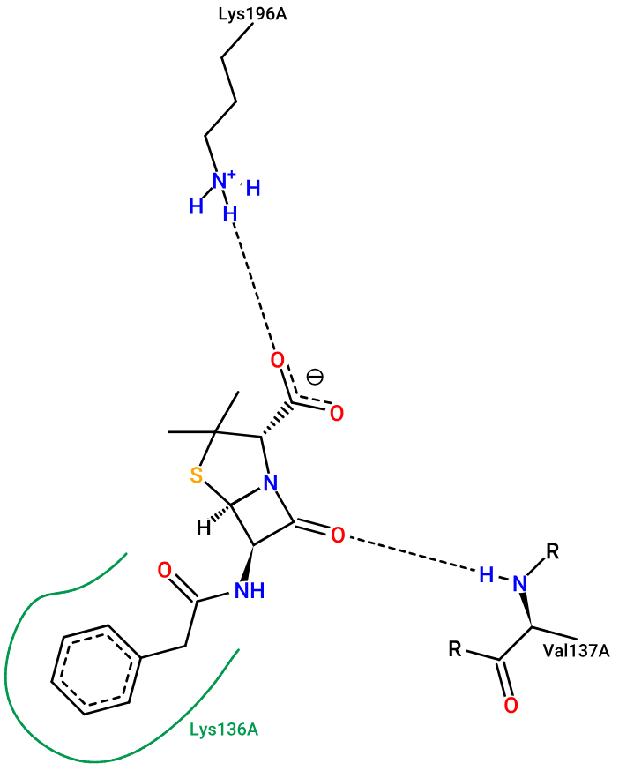
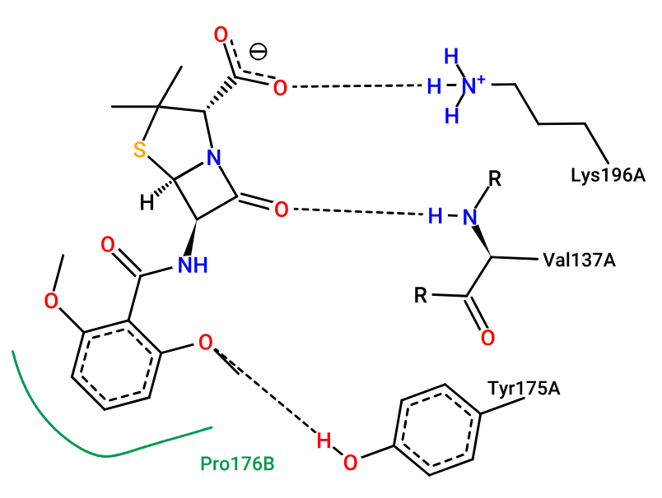
(a)
(b)
Figure: Show 2D interaction of 9LJL protein with drug (a) Benzylpenicillin and (b) Methicillin

Slide 22
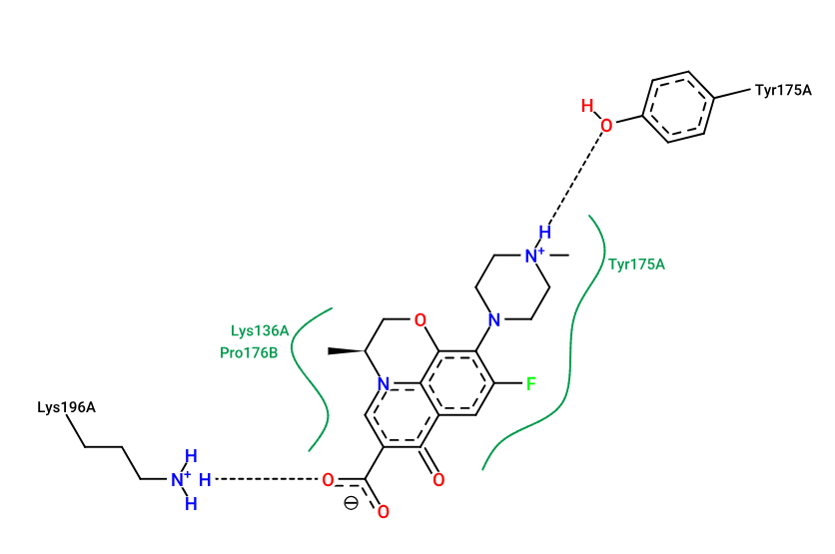
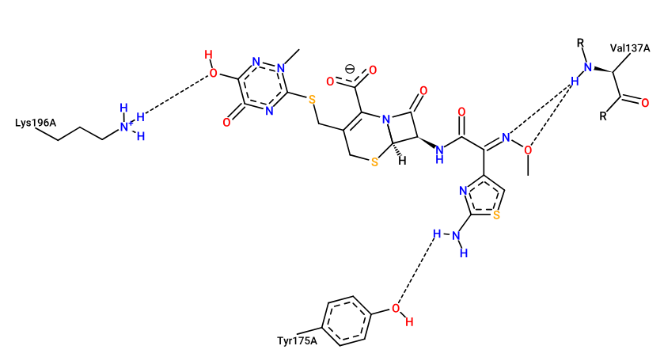
(c)
(d)
Figure: Show 2D interaction of 9LJL protein with drug (a) Levofloxacin and (d) Ceftriaxone

Slide 23
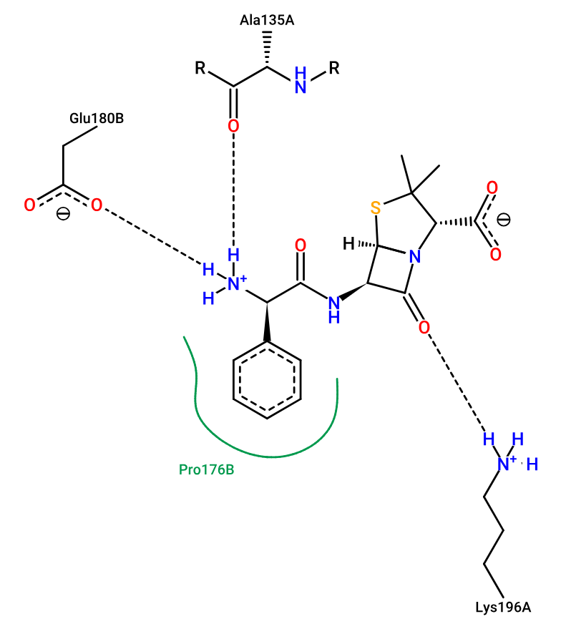
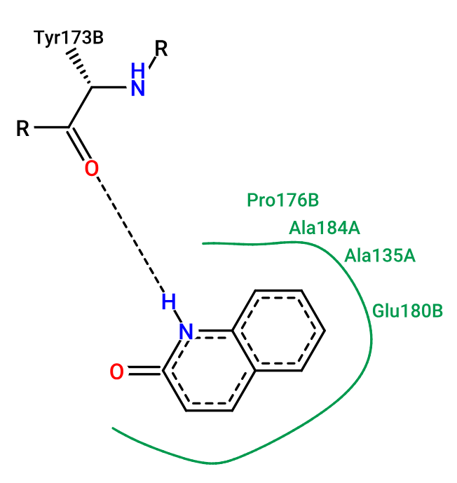
(e)
(f)
Figure: Show 2D interaction of 9LJL protein with drug (e) Ampicillin and (f) 2-Hydroxyquinoline

Slide 24
Outcomes
Successfully docked 11 Phytochemicals and standard drugs against the protein MotS periplasmic domain (PDB ID: 9LJL).
Theaflavin showed strong binding affinity compared to standard antibiotics such as Benzylpenicillin, Ceftriaxone in both cavity 1 and cavity4.
In future, Molecular Dynamics(MD) simulation can be performed to observe the stability and realistic time interaction of Theaflavin (CID:114777) with protein in a dynamic biological environment.
This compound helps to reduce or block the target site of bacterial movement.
By using this compound we can target the motility of Bacillus subtilis which could be a new treatment approach.

Slide 25
Refference
Takekawa, N.; Kojima, S.; Homma, M. Contribution of many charged residues at the stator-rotor interface of the Na+-driven flagellar motor to torque generation in Vibrio Alginolyticus. J. Bacteriol. 2014, 196, 1377–1385.
Koca, Özlem. "Microbiological Characteristics of Bacillus subtilis Species and their Relationship with Hospital Infections." Bacterial, Viral, Fungal and Parasitic Coinfections. IntechOpen, 2024.
La Jeon, You, et al. "Combined Bacillus licheniformis and Bacillus subtilis infection in a patient with oesophageal perforation." Journal of medical microbiology 61.12 (2012): 1766-1769.
Takekawa, N., Yamaguchi, A., Nishiuchi, K., Uehori, M., Kinoshita, M., Minamino, T., & Imada, K. (2025). Sodium-Dependent Conformational Change in Flagellar Stator Protein MotS from Bacillus subtilis. Biomolecules, 15(2), 302.

Slide 26
THANK YOU

