Slide 1

PRISM ENGINE
Multi-Dimensional STEAM Career Guidance & Hyper-Local Innovation Platform
Team Members
Sadhasivam S — 26BAI1019
Anantha Krishna S R — 26BAI1320
Rupeesh Kumar N — 26BAI1144
Sai Venkatesh M — 26BRS1343
S Abhinav — 26BAI1352
Hanish Naren — 26BAI1324
TEAM
Byte Busters
Notes:
Opening slide.

Slide 2

WHAT WE BUILT
A unified platform that turns student responses into clear, personalised guidance.
01
02
03
04
Assessment
Analysis
Prediction
Result / Profile
Students complete structured questions across key dimensions.
Responses are evaluated to uncover strengths, preferences and patterns.
Our model predicts best-fit paths and future outcomes.
Students receive a clear, personalised profile with recommended next steps.

Slide 3

ASSESSMENT
Eight factors. Two timing modes.
One fair, consistent experience.
TIMING & BEHAVIOR
Mathematics
01
Timed
Family
Feasibility
Logical
Reasoning
15 seconds per question
02
Untimed
Career
Interests
EIGHT
FACTORS
Technical
Interest
Career Interests
Family Feasibility
Leadership
Creative
Problem
Solving
03
Timeout
Communication
Unanswered timed question
scores 0 and auto-advances

Slide 4

ANALYSIS
Four signals that guide personalised decisions.
STUDENT FIT
STUDENT FIT
How well options align with strengths and preferences.
FAMILY FEASIBILITY
Practicality based on time, resources and constraints.
MARKET
OPPORTUNITY
FAMILY
FEASIBILITY
MARKET OPPORTUNITY
Demand and momentum in relevant pathways.
CONFLICT INDEX
Potential clashes that may impact the path forward.
CONFLICT INDEX

Slide 5

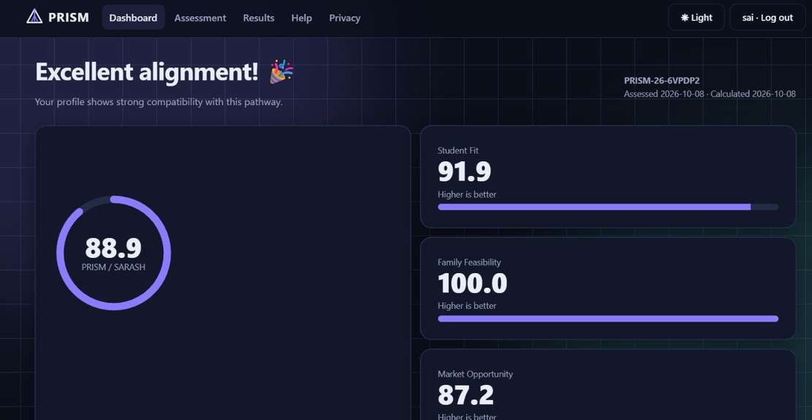
RESULTS
01
ML prediction output
Our model generates clear, actionable predictions.
02
Downloadable result
Students can download their personalised results instantly.
03
Excellent-score celebration
High achievers are celebrated with a confetti success state.

Slide 6

APPLICANT FLOW
A clear path from identification to personalised guidance, with a separate admin access.
APPLICANT JOURNEY
ADMIN ACCESS
01
02
03
04
05
A1
Applicant
ID issued
Return login
with ID + DOB
Profile
unlocked
Applicant
ID visible
logout
Admin
login
A unique Applicant ID is generated and shared securely.
Use Applicant ID and DOB (DDMMYYYY) to sign in.
Personalised profile and guidance become available.
Your Applicant ID remains visible inside your profile.
End session securely when you’re finished.
A separate admin login provides secure system acces.

Slide 7

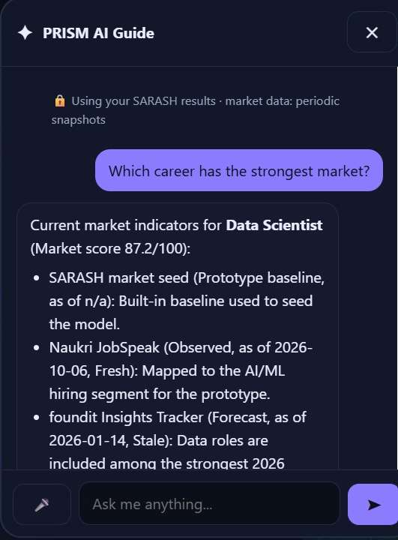
AI GUIDE
Our built-in assistant delivers fast, clear guidance, in the way students choose.
Multiple ways to ask
Type, upload, or speak.
Helpful by default
Smart suggestions and next steps.
Built for action
Edit, refine, and regenerate with ease.
Transparent and trustworthy
Code you can review, copy, and learn from.

Slide 8

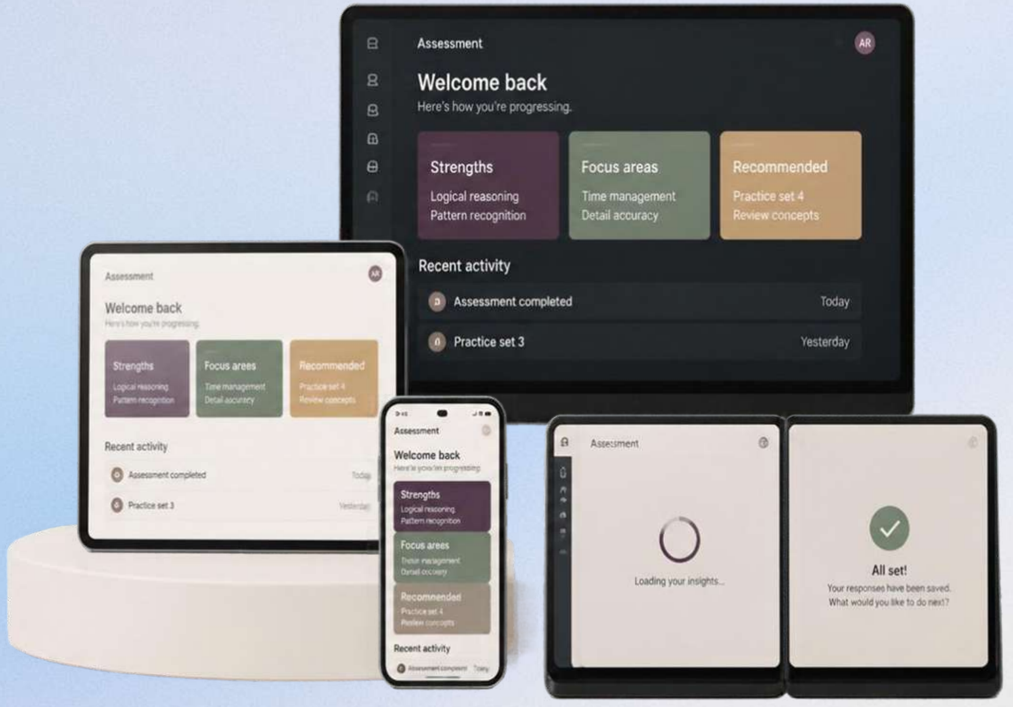
UI / INTERACTION
A responsive interface that feels consistent,
clear, and effortless across
every context.
ADAPTIVE BY DESIGN
One experience, perfectly tuned from mobile to dual-screen.
FEELS IN EVERY STATE
Thoughtful loading, empty, success, error and confirmation states.
SMOOTH & REFINED
Subtle transitions and microinteractions that guide without distraction.
LIGHT OR DARK
Seamless theming to match any environment and reduce fatigue.

Slide 9

SYSTEM FLOW
How responses move through PRISM from input to guidance.
01
02
03
04
05
06
UI
Assessment
+ Scoring
Analysis
+ Radar
ML
Prediction
Result
/ Profile
AI
Guide
Students answer structured questions.
Responses are evaluated and scored.
Patterns are analysed and visualised.
Our model predicts best-fit paths and outcomes.
Students receive a clear, personalised profile.
Guidance and next steps are tailored by the AI.
Local Persistence
Browser localStorage keeps progress and responses stored on device.

Slide 10

TAKEAWAYS
8
assessment
factors
ASSESS
ANALYZE
gather clear, structured responses.
identify strengths, preferences and patterns.
4
decision
signals
1
connected
result flow
GUIDE
PREDICT
deliver personalised guidance and next steps.
forecast best-fit paths and future outcomes.

