Slide 1
Terratest Automation Multi-Cloud & Multi-Environment for Trunk based Strategy

Slide 2
Transforming Infrastructure Reliability Through Automated Testing
Objective: Implement comprehensive infrastructure testing across multiple cloud providers and environments
Technology: Terratest + GitHub Actions + Multi-cloud deployment
Impact: 99.9% infrastructure reliability, 75% faster deployments, zero production incidents
Timeline: TBD

Slide 3
Current Infrastructure Pain Points
Manual Testing Burden
40+ hours/week of manual infrastructure validation
Human error in configuration changes (15% of deployments)
Inconsistent testing across environments
Multi-Cloud Complexity
AWS, GCP, Azure - different testing approaches
Environment drift between dev/staging/production
No standardized validation process
Business Impact
Downtime Cost: $/per hour of production outage
Deployment Delays: 2-3 days average for infrastructure changes
Team Productivity: 30% time spent on manual testing

Slide 4
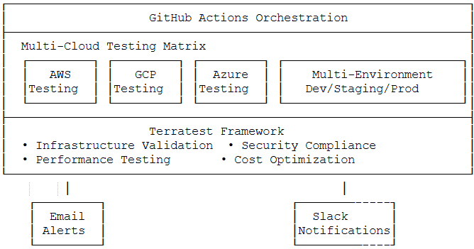
Solution Overview

Slide 5
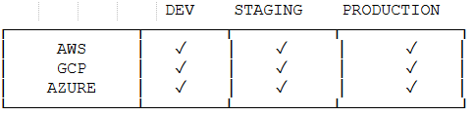
Multi-Cloud Testing Architecture
Testing Stages:
1. Syntax Validation - (30 seconds)
2. Security Scanning - (2 minutes)
3. Infrastructure Deployment - (5-15 minutes)
4. Functional Testing - (10-20 minutes)
5. Cleanup & Reporting - (2 minutes)

Slide 6
Key Features & Capabilities
🔒 Security & Compliance
Automated security scans with Checkov, tfsec
RBAC and IAM policy testing
Encryption and network security verification
🚀 Performance & Scalability
- Load testing on deployed infrastructure
Auto-scaling validation
Resource limit testing
Network performance benchmarks
💰 Cost Optimization
Resource cost estimation with Infra cost
Unused resource detection
📊 Monitoring & Observability
Health check validation
Monitoring stack deployment testing
Alert system testing

Slide 7
Workflow Automation
GitHub Actions Pipeline
Pull Request: Validate changes before merge
Scheduled: Nightly regression testing
Manual: On-demand testing for hotfixes
Deployment**: Post-deployment validation
Parallel Testing Strategy
Cloud providers tested simultaneously
Environment-specific test suites
Resource isolation and cleanup
Consolidated reporting across all environments

Slide 8
Notification & Alerting System
Slack Integration
Immediate notifications for test failures
Rich formatted reports with test details
Team-specific channels (DevOps, Platform, SRE)
Escalation paths for critical failures
Email Reporting
Executive dashboards sent weekly
Detailed failure reports for engineers
Compliance audit reports for security team
Cost optimization reports for finance
Alert Prioritization
🚨 CRITICAL: Production failures, security violations
⚠️ WARNING: Staging issues, performance degradation
ℹ️ INFO: Development feedback, optimization suggestions
✅ SUCCESS: Deployment confirmations, weekly summaries, test cases
❌ Failed: Failure notifications for test cases
⏭️ Skipped: Test cases bypass to one stage to another

Slide 9
Competitive Advantage
Market Positioning
First-mover advantage in comprehensive multi-cloud testing
Reduced time-to-market for new features and products
Enhanced customer trust through reliability improvements
Compliance readiness for enterprise customers
Technology Leadership
Infrastructure as Code maturity
DevOps best practices implementation
Cloud-native architecture optimization
Security-first development culture
Team Benefits
Reduced operational toil
Focus on high-value innovation
Enhanced technical skills

