Slide 1
Digital Portfolio
STUDENT NAME: P.Sadhasivam
REGISTER NO :20924U18146
NMID: 17846B1D6A73E37B686409426942CEE9
DEPARTMENT: B.sc, computer science
COLLEGE: shanmuga industries arts & science College
UNIVERSITY: Thiruvallur University

Slide 2
PROJECT TITLE
Responsive Portfolio Design

Slide 3


AGENDA
Problem Statement
Project Overview
End Users
Tools and Technologies
Portfolio design and Layout
Features and Functionality
Results and Screenshots
Conclusion
Github Link
3/21/2024 Annual Review

Slide 4

PROBLEM STATEMENT
In today’s digital world, professionals need a strong online presence to showcase their skills, experience, and projects. A personal portfolio website helps developers, designers, and freelancers present their work effectively and attract potential clients or employers.

Slide 5

PROJECT OVERVIEW
This project is a responsive personal portfolio website that highlights an individual’s profile, skills, services, and projects. The design is simple yet professional, with smooth navigation and a user-friendly layout. It ensures accessibility on both desktop and mobile devices.

Slide 6

WHO ARE THE END USERS?
Job seekers who want to showcase skills to recruiters. Freelancers to display services and connect with clients. Students/learners for presenting academic and project work. General audience to learn more about the portfolio owner.

Slide 7

TOOLS AND TECHNIQUES
Frontend: HTML5, CSS3, JavaScript Responsive Design: Media Queries (CSS) Version Control: Git & GitHub Browser Support: Chrome, Edge, Firefox, Safari

Slide 8
POTFOLIO DESIGN AND LAYOUT
Navigation Bar: Fixed top navbar with smooth scrolling and active section highlighting. Home Section: Full-screen background image with introduction text. About Section: Details about skills and background. Services Section: List of offered services. Projects Section: Display of recent works. Contact Section: Email, phone, and social media links. Responsive Design: Hamburger menu for mobile devices.
8

Slide 9
FEATURES AND FUNCTIONALITY
Smooth scrolling navigation. Highlighting active menu links on scroll. Responsive mobile-friendly design. Modern UI with background images, shadows, and hover effects. Organized sections for better readability

Slide 10
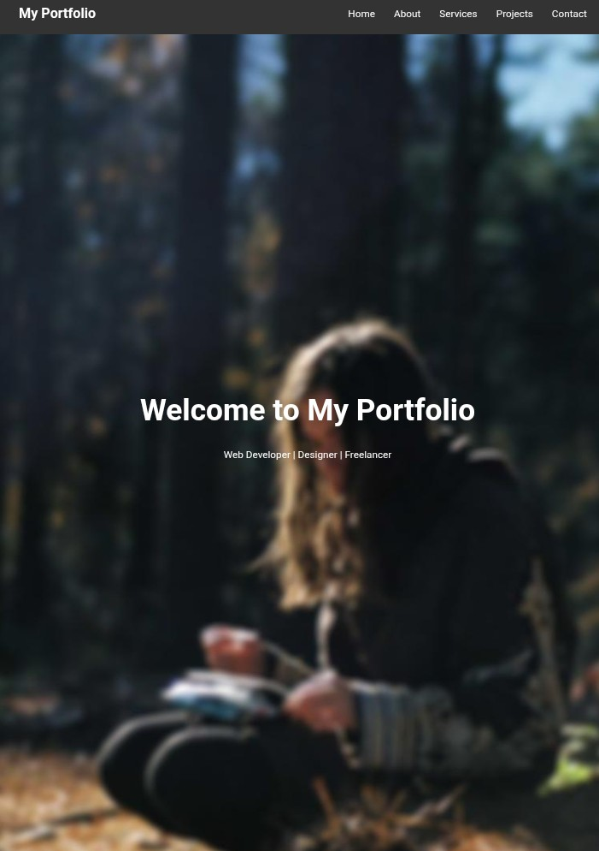
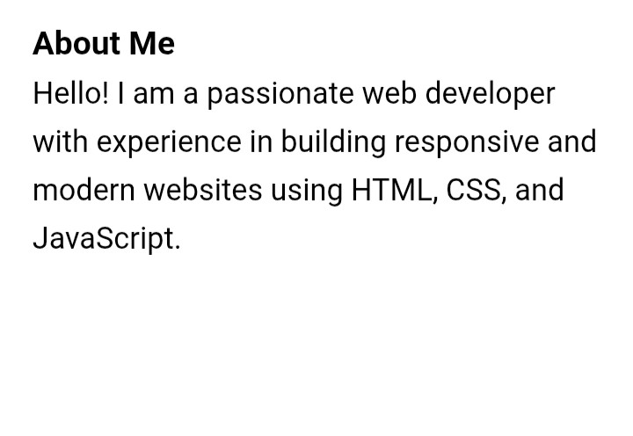

RESULTS AND SCREENSHOTS
3/21/2024 Annual Review
10

Slide 11
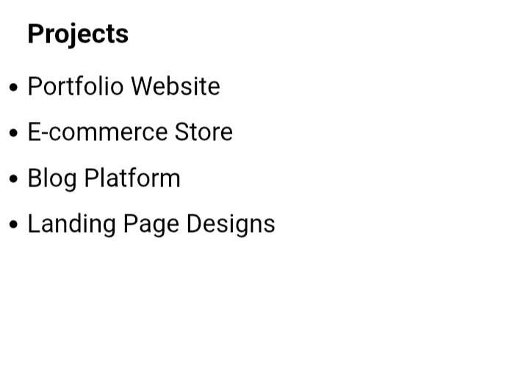
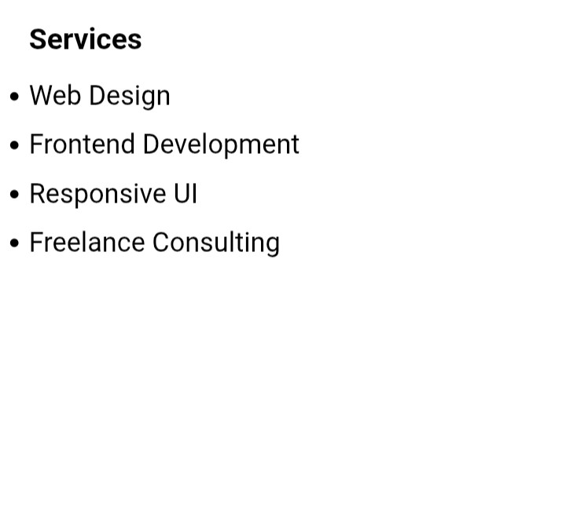
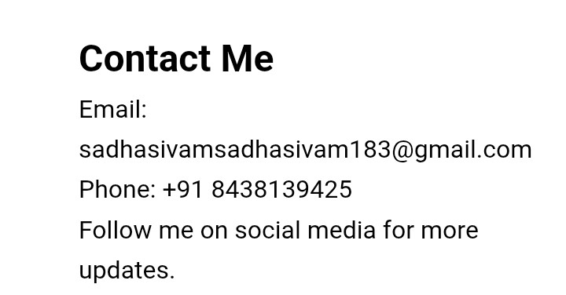


Slide 12
CONCLUSION
The portfolio website provides a professional way to showcase skills, services, and projects. It is lightweight, responsive, and easy to maintain. With future improvements (like adding animations, a contact form, or a blog), it can become a complete personal branding platform.
12

