Slide 1
Credit Card Fraud Detection using Machine Learning & Big Data Concepts
Sadhvi Chandragiri
Course: Certificate of Advanced Studies in Machine Intelligence
Module: Machine Learning & Big Data
Professor(s): Dr. Philipp Denzel & Dr. Pavel Sulimov
Date: 28. Oct. 2024

Slide 2
Credit Card Fraud Detection
Objective:
To showcase our learnings, I have chosen Credit Card Fraud detection as the focus, aligning with my role in the Business Intelligence department within the Finance domain.
Project Highlights:
ML Models for Fraud Detection: Multiple machine learning models have been implemented, optimizing accuracy through hyperparameter tuning.
Feature Engineering: Developed essential features, such as transaction patterns and behavioral indicators, to improve fraud detection.
Graph Analysis: Used Networkx for relationship analysis within transaction data, uncovering complex fraud-related patterns.
Big Data Processing: Implemented multiprocessing and dask for scalable and efficient handling of large datasets.
Github Repository Link: https://github.com/sadhchanGitHub/ML_BigData_Repo_1
Learning Alignment:
This project reflects essential Big Data & ML concepts from the CAS syllabus, sowcasing thier practical applications in relevant to real-world fraud detection scenarios.

Slide 3
Dataset Details
Source: Kaggle Credit Card Fraud Detection https://www.kaggle.com/code/hamzasafwan/credit-card-fraud-detection/input
fraudTrain.csv: ~1.2 million records
fraudTest.csv: ~550k records
Class Imbalance: Majority of transactions are non-fraudulent, challenging fraud detection.
Key Features:
Transaction Attributes: TransactionAmount, LogTransactionAmount, HighValueTransactionFlag, TransactionCountLast7/14/30Days, AverageTransactionAmountLast7/14/30Days.
Temporal Features: Hour, HighRiskHour, DayOfWeek, IsWeekend.
Behavioral & Geolocation: Transaction Frequency, Distance between cardholder and merchant, City population.
Network Metrics: Betweenness Centrality, Degree, Community.

Slide 4
Graph Processing for Fraud Detection
Leveraged Python’s multiprocessing library to parallelize data processing tasks, significantly reducing feature engineering time.
Objective
To uncover network-based fraud patterns using graph processing techniques.
Model transactions as a network where nodes represent credit cards and merchants, and edges represent transactions with transaction amounts as edge attributes.
Graph Construction - Tool Used: NetworkX library in Python.
Node Types:
Credit Card Nodes: Represent cardholders.
Merchant Nodes: Represent merchants involved in transactions.
Edges: Transaction amounts stored as edge attributes.
Impact
This structure allowed detailed analysis of transaction relationships, helping detect hidden patterns in fraud behavior.

Slide 5
Graph Metrics and Network Insights
Graph Metrics Applied
Degree Calculation: Computed degrees for credit card and merchant nodes to identify high-activity accounts or merchants.
Degree Distribution: Fraud and non-fraud nodes showed similar degree ranges, with non-fraud nodes dominating due to class imbalance.
Betweenness Centrality: Used to identify nodes that frequently act as intermediaries in the network.
Betweenness centrality distribution varied significantly, with fraud nodes showing unique patterns that could indicate higher-risk transactions.
Clustering Coefficient: Zero for all nodes, indicating low interconnectedness, which aligns with typical transaction networks where merchants rarely interact directly.
Graph Density: 0.2513
Moderate density, suggesting some level of connectedness but not enough to form highly clustered communities.
Average Degree: 406.18
High degree suggests extensive interactions between credit cards and merchants without forming closed loops, typical in transactional fraud networks.

Slide 6
Graph Metrics and Network Insights
Community Detection and Key Insights
Community Detection with Louvain Method
Identified clusters with high fraud rates, particularly among "net" (e-commerce) transactions.
Highlighted potential fraud rings and patterns in high-risk communities.
Abandoning Low Betweenness Centrality Nodes
Disconnected, low-betweenness nodes were found to be peripheral and insignificant for fraud analysis.
Excluded from further analysis due to low relevance to network’s main fraud patterns.
PageRank for Influence Analysis
PageRank used to pinpoint influential nodes, likely key fraudster accounts or high-risk merchants.
Nodes with high PageRank values highlight potential focal points for fraud activities.

Slide 7
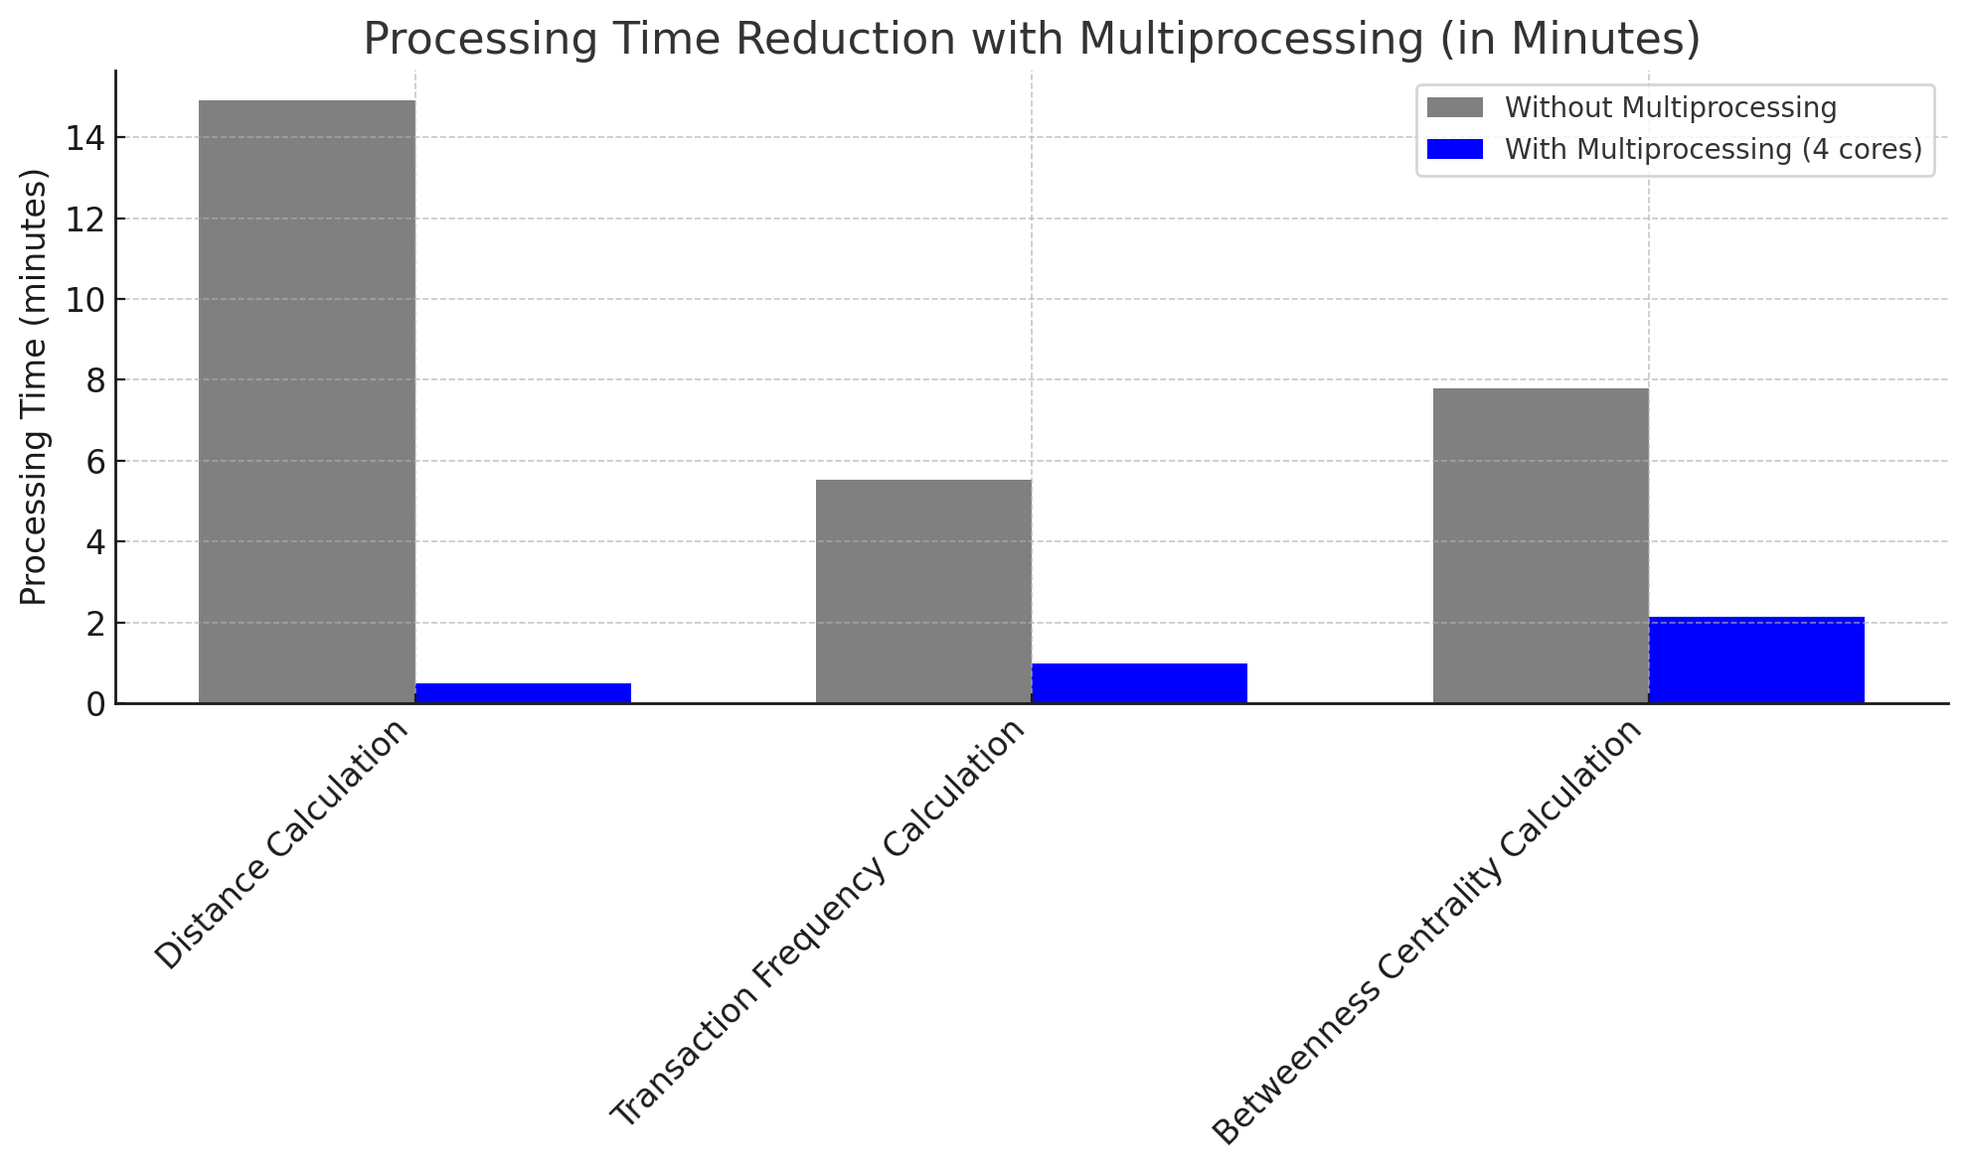
Credit Card Fraud Detection
Multiprocessing and Parallel Processing
Leveraged Python’s multiprocessing library to parallelize data processing tasks, significantly reducing feature engineering time.
Impact of Multiprocessing
Distance Calculation
Without Multiprocessing: 14 minutes 55 seconds
With Multiprocessing (4 cores): 30 seconds
Improvement: ~97% reduction in processing time
Transaction Frequency Calculation
Without Multiprocessing: 5 minutes 32 seconds
With Multiprocessing (4 cores): 59 seconds
Improvement: ~82% reduction in processing time
Betweenness Centrality Calculation
Without Multiprocessing: 7 minutes 47 seconds
With Multiprocessing (4 cores): 2 minutes 8 seconds
Improvement: ~72% reduction in processing time
DecisionTrees_Train_logfile_20241103_004328.txt

Slide 8
Machine Learning at Scale with Dask
Objective:
Scale up model training for large datasets using Dask to reduce runtime and improve efficiency.
Why Dask?
Supports single-machine parallelism, making it ideal for scaling tasks without a full Spark cluster.
Seamless integration with Python, allowing for easy use with existing workflows and libraries.
My attempts to use DASK to train the model and compare it against the time taken against model trained without DASK is NOT successful.
Challenges with Dask Integration:
Data Compatibility: Converting large categorical and string data to numerical formats caused unexpected errors and prolonged troubleshooting.
Resource Management: Managing memory and computation overhead became complex with Dask's large graph structures.
Error Handling: Difficulty in tracing errors with Dask's distributed computation model impacted development speed.

Slide 9
Final Model Performance Summary
Model Comparision :
Logistic Regression: Strong on non-fraud detection but weak on fraud cases.
Decision Tree: High precision and recall for fraud, even without tuning.
Random Forest & XGBoost: Tested but added complexity without significant improvement over Decision Tree.
Why Decision Tree Wins:
Scalable & Efficient: Low computational cost; fits well in Big Data setups (e.g., Dask for data loading).
Interpretable: Clear decision paths, useful for explainable fraud detection.
Handles Imbalance: Adapted well to class imbalance, focusing on key fraud indicators.
Key Takeaway:
Decision Tree offers a balanced, efficient solution for Big Data fraud detection, making it suitable for real-world deployment, while Random Forest and XGBoost added complexity without clear performance gains.

Slide 10
Future Extensions:
Graph-Based Analysis: Expand community detection and centrality metrics for deeper fraud insights.
Real-Time Detection: Integrate data streaming for real-time fraud detection, aligning with machine learning at scale concepts.
Dask for Feature Engineering & Hyperparameter Tuning: Use Dask to efficiently scale feature engineering and accelerate model tuning.
Exploring Further: Random Forest, XGBoost with refined hyperparameters and enhanced feature engineering to further improve fraud detection performance.
Async I/O for Production: Explore async I/O for non-blocking data processing in real-world deployments.
Learning Alignment:
These extensions leverage advanced machine learning techniques and real-time data handling from the CAS in Machine Intelligence, reinforcing the theoretical and practical skills acquired.

