Slide 1
EuroSAT Image Classification: Identifying Land Cover Types
Sadhvi Chandragiri
Course: Certificate of Advanced Studies in Machine Intelligence
Module: Deep Learning
Professor(s): Dr. FRANK-PETER SCHILLING
Date: 14. Jan. 2025

Slide 2
EuroSAT Image Classification: Identifying Land Cover Types
Objective:
Develop a robust image classification model to identify land cover types using EuroSAT satellite images, supporting sustainable urban planning and land use analysis
Dataset: EuroSAT (RGB images only).
Approach:
Start with a simple CNN model to establish a baseline.
Progress to using pre-trained models like ResNet for transfer learning to enhance performance.
Achieve strong classification results and explore extending the project to segmentation in future phases.
Learning Alignment:
The project aligns with key topics from the Deep Learning syllabus, such as Convolutional Neural Networks for image classification, data augmentation, transfer learning, and model evaluation techniques

Slide 3
EuroSAT Image Classification: Identifying Land Cover Types
Data Set Preparation:
Step 1: Download EuroSAT RGB images from the "EuroSAT" folder.
Step 2: Resize images to 256 * 256 using DASK for efficient processing.
Step 3: Convert resized images into category-specific .npy files (e.g., AnnualCrop.npy).
Step 4: Split .npy files into Train, Validation, and Test sets for model training and evaluation.
Additional Step: Verify the consistency of data splits to ensure alignment with corresponding labels.

Slide 4
EuroSAT Image Classification: Identifying Land Cover Types
Baseline CNN Results:
Test Loss: 3.8675
Test Accuracy: 29.06%
Classification Report Highlights:
Forest: Precision = 0.00, Recall = 0.00
HerbaceousVegetation: F1-Score = 0.40 (best-performing class)
Industrial: Recall = 0.90, but low precision.
Key Observations:
Struggles with highly imbalanced recall across classes.

Slide 5
EuroSAT Image Classification: Identifying Land Cover Types
Data Loading Challenges and Solutions
Faced challenges with large image datasets:
High memory usage during preprocessing and training.
Inefficient data loading slowed down model training.
Solution:
Utilized data generators for efficient loading and preprocessing.
Enabled batch-wise image loading to reduce memory usage.
Improved training speed and scalability.

Slide 6
EuroSAT Image Classification: Identifying Land Cover Types
Challenges with Multi-Class Classification
Test accuracy remained low (~24%) despite applying data augmentation.
Significant precision-recall imbalance across classes.
Overlapping features between Residential and AnnualCrop complicated classification.
Outcome:
Motivated the shift to binary classification for clearer results.
Simplified the task to focus on clearer decision boundaries.

Slide 7
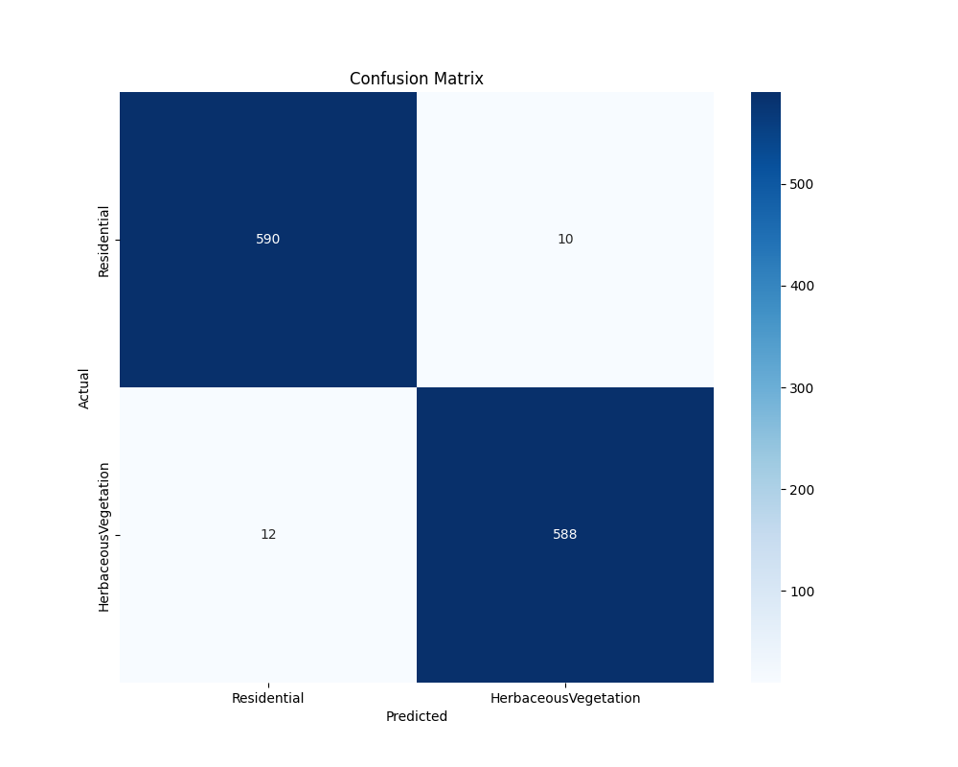
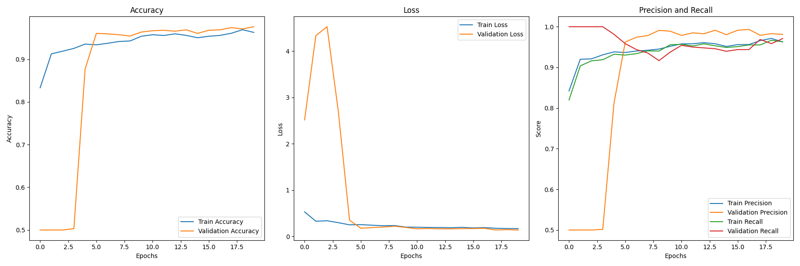
EuroSAT Image Classification: Identifying Land Cover Types
Binary Classification Results:
Achieved ~97% accuracy with minimal misclassifications (confusion matrix shows only 22 errors out of ~1200 predictions).
Precision and recall stabilized over training, showing strong generalization (see rightmost graph).

Slide 8
EuroSAT Image Classification: Identifying Land Cover Types
Learning from ResNet and Segmentation Attempts
ResNet Transfer Learning:
Efforts: Used pre-trained ResNet to improve multi-class classification.
Outcome: No significant improvement compared to the baseline CNN.
Learning: Complex models require better feature separation in data to yield meaningful results.
Segmentation with DeepLabV3:
Efforts: Generated segmentation masks to explore greenery detection.
Outcome: Segmentation masks were largely black, indicating poor pixel-wise classification.
Learning: Challenges in adapting pre-trained segmentation models without labeled ground truth.
Key Takeaway:
Significant insights gained, despite limited success.
Simplified tasks (e.g., binary classification) yield more actionable results at this stage.

Slide 9
EuroSAT Image Classification: Identifying Land Cover Types
Rebuilding Multi-Category Classification
Explore VGG or similar architectures for clearer feature extraction.
Use class weights or balanced datasets to address class imbalance.
Experiment with better augmentation strategies (e.g., color jitter, blur).
Segmentation (Optional Future Work):
Revisit segmentation only after achieving stable classification performance.
Consider labeling a small subset of data manually to fine-tune models effectively.
Goal:
Achieve strong performance on multi-category classification, addressing challenges faced in earlier attempts.

Slide 10
EuroSAT Image Classification: Identifying Land Cover Types
Code can be found at: https://github.com/sadhchanGitHub/data_science_projects/tree/main/cas_deepL_project
Thank you

