Slide 1
NLP for Smarter Dining: Turning Reviews into Tailored Recommendations
Sadhvi Chandragiri
Course: Certificate of Advanced Studies in Machine Intelligence
Module: Text Analytics
Professor(s): Dr. Don Tuggener
Date: 14. Jan. 2025

Slide 2
NLP for Smarter Dining: Turning Reviews into Tailored Recommendations
Objective: Transform restaurant reviews in New York into actionable, sentiment-based recommendations.
Dataset: Kaggle dataset with 509,612 reviews (preprocessed to exclude restaurant names).
Methods: TF-IDF and GloVe embeddings, Logistic Regression, and CNN models for sentiment classification.
Output: Tailored restaurant rankings based on positive sentiment scores.
Learning Alignment:
The project aligns with key syllabus topics such as text representations, sentiment classification, word embeddings, CNNs, and practical NLP with large language models
Notes:
Pre-processing used DASK for cleaning etc..

Slide 3
NLP for Smarter Dining: Turning Reviews into Tailored Recommendations
Data Preprocessing & Feature Engineering:
Steps Taken:
Removed restaurant names to focus on sentiment-related terms.
Applied TF-IDF (5,000 features) and GloVe embeddings (300 dimensions).
Embedding Validation:
Missing significant words: 37.74%.
Domain-specific words like "taste," "quality," and "service" validated.
Cosine similarities confirmed embedding coherence.
Insights:
Prepared robust input features for sentiment classification.
Notes:
TfidfVectorizer(max_features=5000) is used to create .npy files and then did LogisticRegression on them. Top Domain specific words were also obtained. As missing significant words were 37.7% missing words were reterived and found mote of them were in fact part of restaurant names etc, hence no action taken.

Slide 4
NLP for Smarter Dining: Turning Reviews into Tailored Recommendations
Models and Training
Models Used:
Logistic Regression (with and without class balancing).
CNN with pre-trained GloVe embeddings.
Training Results:
CNN achieved high accuracy (>90%).
Early stopping and dropout layers prevented overfitting.
Evaluation Metrics:
Precision, Recall, F1-Score, and Confusion Matrix (82,048 true positives).

Slide 5
NLP for Smarter Dining: Turning Reviews into Tailored Recommendations
Evaluation and Insights
Confusion Matrix Analysis:
Strong in detecting positive sentiment.
Needs improvement in identifying negative reviews.
Key Metrics:
Precision: High for positive sentiments.
Areas of Improvement: False positives and false negatives.
Visualization:
Embedding space shows clustering of sentiment-related terms (PCA visualizations).

Slide 6
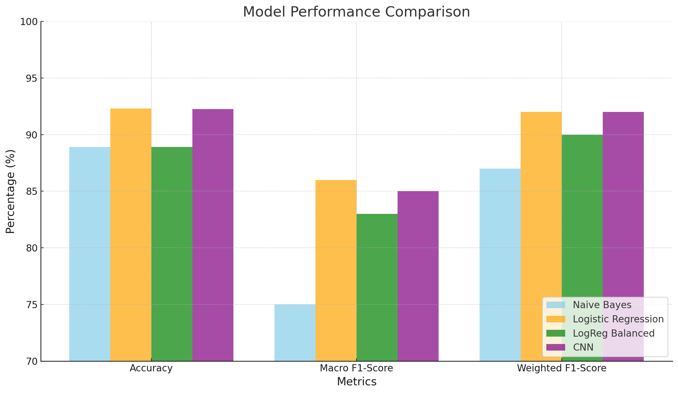
NLP for Smarter Dining: Turning Reviews into Tailored Recommendations

Slide 7
NLP for Smarter Dining: Turning Reviews into Tailored Recommendations
Next Steps for Improvement
Model Tuning:
Adjust thresholds for better recall on negative reviews.
Experiment with class weighting to balance sentiment detection.
Additional Preprocessing:
Refine exclusion criteria to reduce missing critical vocabulary.
Data Augmentation:
Generate synthetic reviews for underrepresented sentiments.
Model Exploration:
Try advanced transformers like BERT or DistilBERT for sentiment analysis.

Slide 8
NLP for Smarter Dining: Turning Reviews into Tailored Recommendations
Chatbot Demonstration
Highlights:
Interface:
Supports both CLI and GUI modes for user interaction.
Core Functionality:
Detects cuisines from user input (e.g., "Italian food").
Recommends restaurants based on keyword or cuisine matches.
Fallback mechanism provides top-rated restaurants when no direct matches are found.
Debugging Mechanism:
Ensures cuisine-specific or keyword-based matches are accurate.
Review snippets can be displayed to validate recommendations.

Slide 9
NLP for Smarter Dining: Turning Reviews into Tailored Recommendations
Future Extensions
Potential Enhancements:
Advanced Model Training: - Leverage transformer-based models like BERT or DistilBERT for improved sentiment analysis and contextual understanding.
Support Multi-Turn Conversations: - Enable the chatbot to maintain context across multiple user interactions, improving its conversational depth.
Include Review Snippets: - Provide relevant review excerpts alongside recommendations to enhance transparency and user trust.
Price Range Filtering: - Integrate price-related data for more refined filtering, helping users select restaurants within their budget.
Real-Time Data Integration: - Incorporate live restaurant reviews and ratings for up-to-date recommendations.

Slide 10
NLP for Smarter Dining: Turning Reviews into Tailored Recommendations
Code can be found at:
https://github.com/sadhchanGitHub/data_science_projects/tree/main/cas_textanalytics_project_2
THANK YOU

