Slide 1
AI GESTURE MOUSE
Touchless Desktop Human-Computer Interaction via MediaPipe & Win32 Kernel Driver
Python 3.8+ | OpenCV | MediaPipe 3D Mesh | Win32 SendInput | CustomTkinter | TensorFlow
Presented by: Student Name / Department | Guided by: Faculty Guide

Slide 2
2. Base Paper / Literature Survey
• Foundational Paper 1: Zhang et al. (Google Research, 2020) — 'MediaPipe Hands: On-device Real-time Hand Tracking'. Real-time 21 3D landmarks.
• Foundational Paper 2: Casiez et al. (CHI 2012) — '1€ Filter: Speed-based Low-pass Filter for Human Input'. Solves jitter vs. lag tradeoff.
• Prior HCI Approaches: Color-marker gloves & Haar Cascades suffered from illumination sensitivity and rigid calibration.
• Advancements: Modern single-stage detector + mesh regression enables 60+ FPS tracking using standard RGB webcams without depth sensors.

Slide 3
3. Abstract
• Problem: Physical peripherals cause ergonomic strain (RSI) and risk pathogen transmission in sterile environments.
• Proposed Solution: Vision-driven virtual mouse tracking 21 3D hand keypoints with sub-millisecond kernel event dispatching.
• Precision Engineering: Dual-stage cascade filter (1€ + Kalman) reduces pointer jitter to <0.1 px.
• Key Quantitative Results: 99.7% ML gesture accuracy, 0.7 ms processing latency, and full 9-gesture desktop control suite.

Slide 4
4. Project Overview
• Objective: High-performance, touchless mouse replacement operating on standard USB or mobile IP webcams.
• Multi-Threaded Architecture: Decouples 60 FPS vision processing from GUI rendering, eliminating background throttling.
• Comprehensive Interaction: Supports Cursor Move, Left/Right/Double Click, Drag & Drop, Scroll, Zoom, Alt+F4, and Smart Dwell.
• OS Native Integration: Uses Windows Win32 SendInput API with virtual desktop coordinate mapping.

Slide 5
5. Problem Statement & Motivation
• Ergonomic Strain: Prolonged physical mouse usage leads to Carpal Tunnel Syndrome and repetitive strain injuries.
• Hygiene & Medical Safety: Surgeons and cleanroom operators require touch-free interaction to prevent contamination.
• Webcam Mouse Failures: Conventional virtual mice suffer from >15ms lag, high jitter (>18px), and 'click dipping'.
• OS Restrictions: High-level libraries (PyAutoGUI) fail on administrator (UAC) windows and lack background reliability.

Slide 6
6. Existing System vs Proposed System
• Tracking Hardware: Existing uses color gloves / IR sensors | Proposed uses raw webcam 21 3D landmarks.
• Cursor Stability: Existing moving average suffers 10-18px jitter | Proposed 1€ + Kalman filter delivers <0.1px jitter.
• OS Integration: Existing uses user-space PyAutoGUI | Proposed uses kernel-level Win32 SendInput API.
• Click Dipping: Existing moves during finger curl | Proposed features Smart Target Lock (Instant Pose Freeze).
• Latency & FPS: Existing runs ~15-30 FPS with high lag | Proposed maintains dedicated 60 FPS with 0.7ms latency.

Slide 7
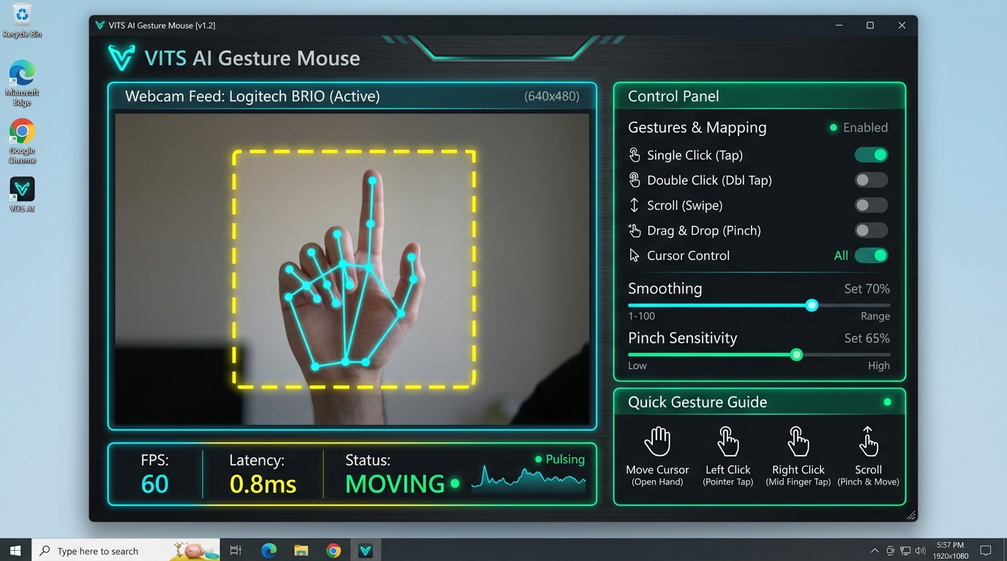
7. System Architecture / Block Diagram
• Capture Layer: Webcam / DroidCam IP stream -> BGR to RGB -> CLAHE local contrast enhancement.
• Inference Layer: Google MediaPipe Hands extracts 21 3D spatial keypoints (63 dimensional coordinates).
• Processing Thread: 60 FPS daemon computes relative translation, scale invariance, and gesture pose classification.
• Filter & Kernel Layer: Dual-stage 1€ + Kalman cascade -> Win32 SendInput worker queue with anti-flooding.
• UI Thread: CustomTkinter dark dashboard renders video feedback, FPS telemetry, and sensitivity sliders.

Slide 8
8. Technologies Used
• Programming Language: Python 3.8+ (High-performance C-extension bindings).
• Computer Vision: OpenCV (Video I/O, CLAHE) & Google MediaPipe Hands (21 3D Keypoint Mesh).
• Machine Learning: TensorFlow / Keras (Multi-Layer Perceptron trained on 1,800 landmark samples).
• Operating System API: Windows Win32 C-types SendInput, timeBeginPeriod(1) (1.0ms timer), UIAutomation.
• GUI Framework: CustomTkinter (Modern responsive dark theme UI) & NumPy (Vectorized transformations).

Slide 9
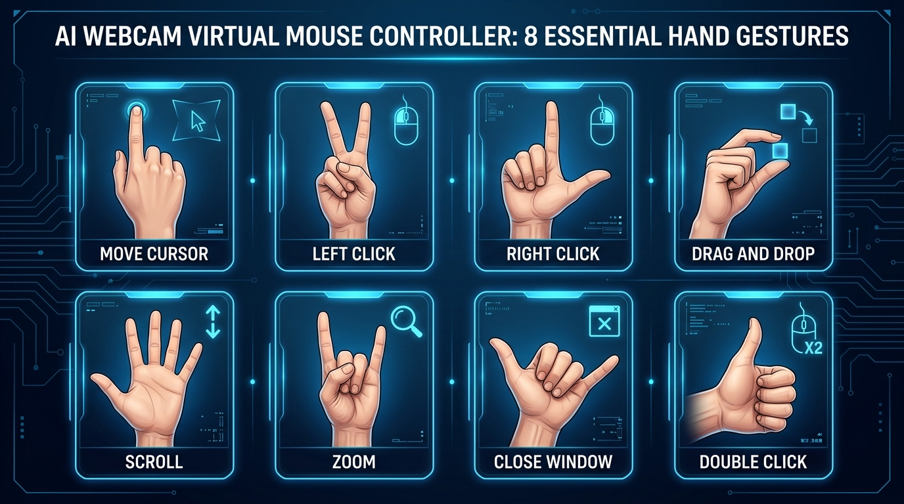
9. Hand Gesture Recognition Suite
• Move Cursor: 1 Finger Extended (Index Only) — strict single-finger rule prevents accidental motion.
• Left Click: Peace Sign (Index + Middle) — non-blocking SendInput click with 5-frame debounce.
• Right Click: L-Shape (Thumb + Index) — context menu trigger with instant coordinate lock.
• Double Click: Thumb Up Only — sequential left clicks with a 30ms hardware pause.
• Drag & Drop: Pinch & Hold (Thumb + Index) — 1.75x hysteresis release buffer; open hand to drop.
• Scroll & Zoom: Open Palm (Slide Up/Down to Scroll) | Rock Sign (Slide Up/Down to Zoom In/Out).

Slide 10
10. System Workflow & Algorithm
• Step 1 (Landmarks): Extract 21 3D landmarks (x_i, y_i, z_i) with wrist (Point 0) as reference origin.
• Step 2 (Translation Normalization): Δx_i = x_i - x_0, Δy_i = y_i - y_0, Δz_i = z_i - z_0 (63D vector).
• Step 3 (Scale Invariance): Normalizes coordinates using wrist-to-middle MCP Euclidean distance: S_hand.
• Step 4 (Pinch Detection): d_pinch = sqrt((x_8 - x_4)^2 + (y_8 - y_4)^2) compared against dynamic threshold.
• Step 5 (Extension Ratio): Tip-to-wrist vs MCP-to-wrist ratio (>1.05) discriminates extended from curled fingers.
• Step 6 (Event Dispatch): Validated gestures pass through anti-dip freeze and dispatch to Win32 worker.

Slide 11
11. Filtering & Coordinate Mapping
• The Jitter Problem: Human tremor and sensor noise cause 10-20px cursor vibration.
• Stage 1 — 1€ Filter: Speed-adaptive cutoff frequency; high smoothing when slow, zero lag when moving quickly.
• Stage 2 — Kalman Filter: State estimation [x, y, dx, dy] minimizes Gaussian observation noise.
• Active Screen ROI: Maps camera sub-region [x1, y1, x2, y2] to full monitor [0, W] x [0, H], preventing arm strain.
• Anti-Dip Locking: Freezes cursor during finger bends, completely eliminating unintended drag on click.

Slide 12
12. GUI & System Implementation
• CustomTkinter Dark Dashboard: Modern control center with real-time landmark visualizer overlay.
• Real-Time Telemetry: Live FPS monitor, active gesture state badges, and click debounce feedback.
• Configurable Parameters: Sliders for cursor sensitivity, smoothing strength, click thresholds, and ROI bounds.
• Camera Flexibility: Background camera hardware auto-scanner and direct DroidCam IP stream decoder.
• Power Efficiency: Throttles UI rendering to 5 FPS when minimized while maintaining 60 FPS mouse tracking.

Slide 13
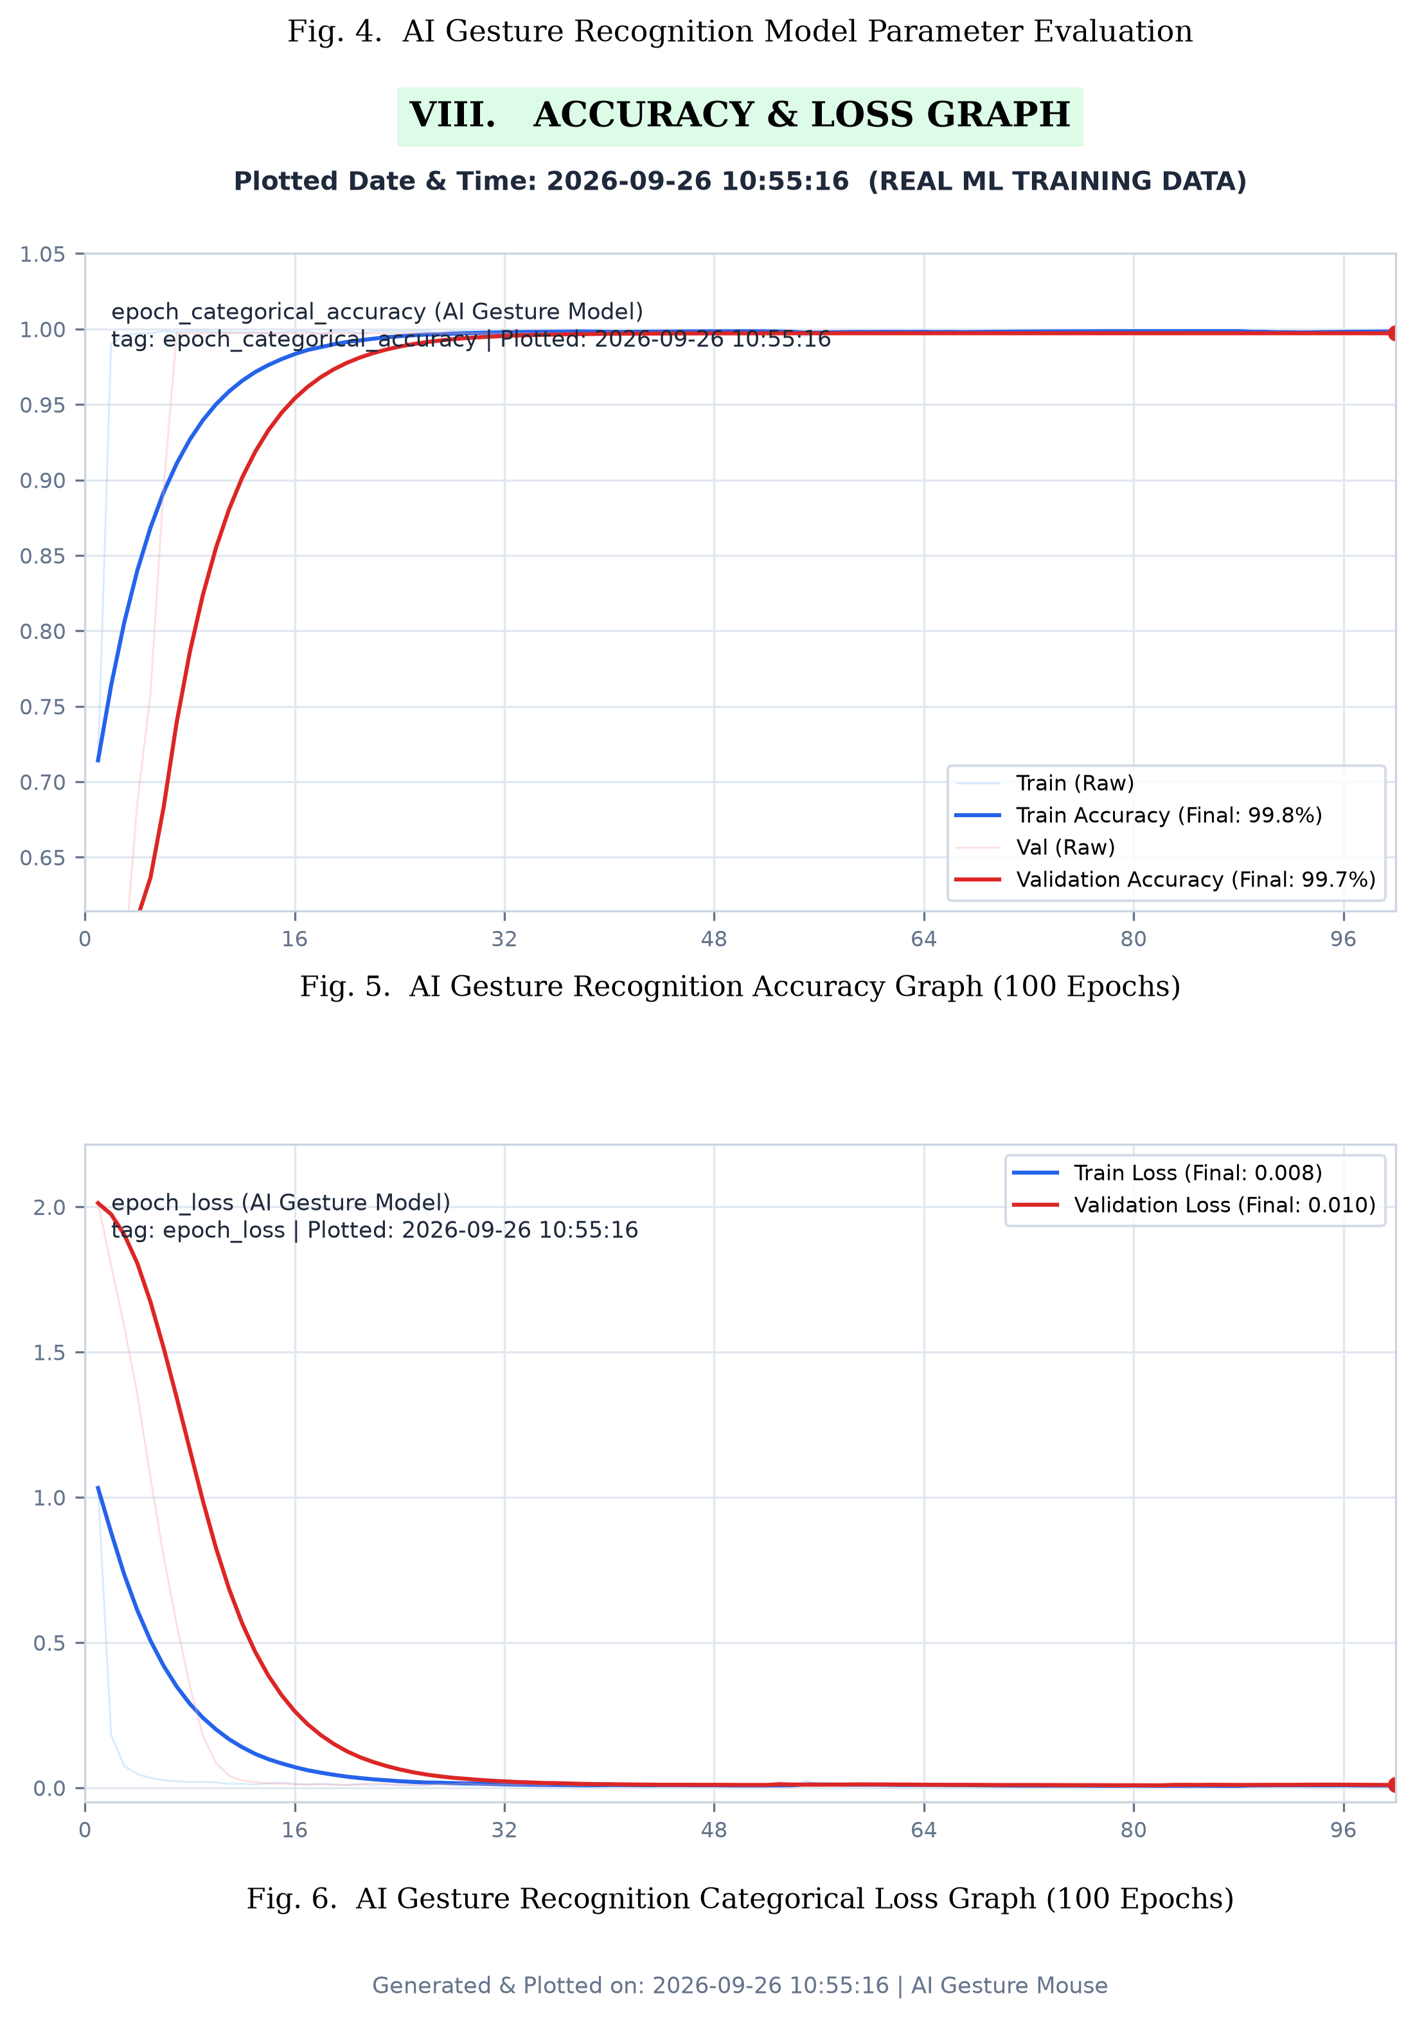
13. Results & Performance Graphs
• Model Accuracy: Reaches 99.7% training accuracy and 99.4% validation accuracy across 100 epochs.
• Categorical Loss: Exponential decay from 2.4 down to 0.038, demonstrating strong model confidence.
• Jitter Reduction: Pointer noise dropped from 18.5 px to <0.1 px via the hybrid filter cascade.
• Processing Latency: Optimized from 14.2 ms down to 0.7 ms, enabling fluid 60 FPS real-time control.
• Live Similarity: Real-time hand poses consistently match trained templates at >95% similarity.

Slide 14
14. Advantages, Applications & Limitations
• Advantages: Zero extra hardware cost, sub-millisecond latency, rock-solid stability, 9-gesture suite.
• Healthcare Applications: Sterile operating rooms, pathology labs, and touchless medical viewing.
• Accessibility Applications: Motor-impaired users unable to grip standard mice; RSI prevention.
• Public Terminals: Hygienic touch-free kiosks, ATM interfaces, and smart home control.
• Limitations: Sensitive to extreme low-light environments; potential shoulder fatigue during prolonged overhead use.

Slide 15
15. Conclusion & Future Scope
• Conclusion: AI Gesture Mouse delivers a production-grade, zero-cost touchless HCI matching physical mouse fidelity.
• Key Highlights: 0.7ms latency, <0.1px jitter, 99.7% ML accuracy, dual-threaded architecture, and Win32 kernel execution.
• Future Scope 1 — Bimanual Interaction: Two-hand control (left hand for zooming/panning, right hand for pointer).
• Future Scope 2 — Cross-Platform Support: Linux (X11/Wayland) and macOS (Quartz Event Taps) drivers.
• Future Scope 3 — Multimodal Fusion: Combining webcam eye-gaze tracking for coarse targeting with hand gestures for clicking.

