Slide 1
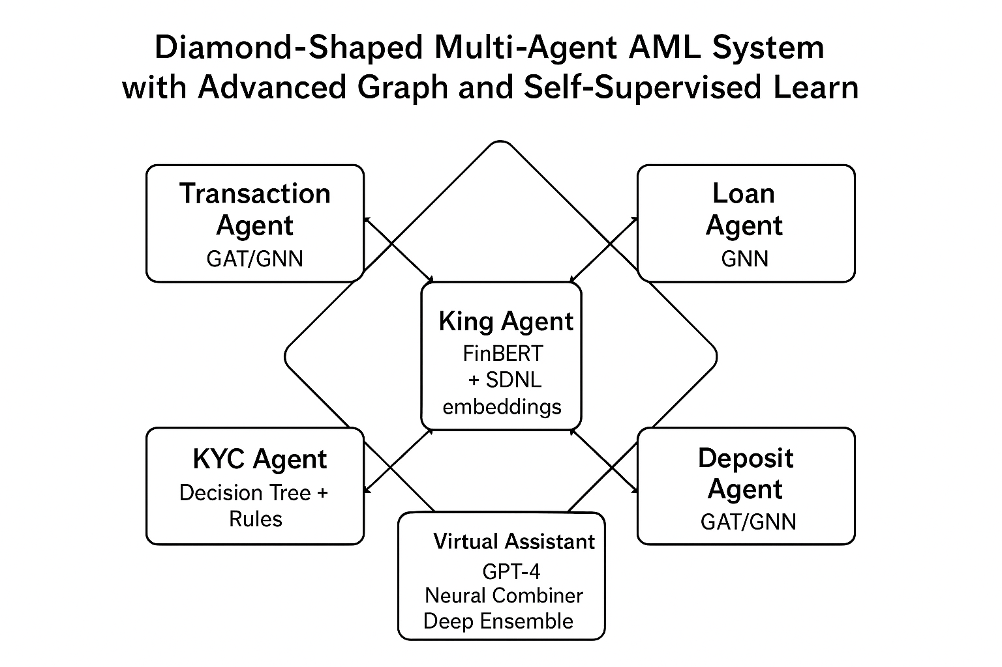
Diamond-Shaped Multi-Agent AML System
Advanced Graph and Self-Supervised Learning for Financial Crime Detection
Submitted by
Sadhna Mall
Pranav Srihas Allu
FinSynapse
GenAI Team

Slide 2

THE Challenge
Limited Detection
Traditional rule-based systems fail to capture sophisticated fraud patterns and complex relational structures.
High False Positives
Static threshold approaches generate excessive alerts, overwhelming compliance teams.
Fragmented Analysis
Transaction, loan, KYC, and deposit datasets analyzed in isolation, missing cross-domain relationships.
Poor Transparency
Customers and investigators lack clear insights into flagged activities and risk decisions.

Slide 3
Our Solution
A diamond-shaped multi-agent architecture integrating cutting-edge AI techniques for intelligent AML detection.
01
02
King Agent Routes Tasks
Sub-Agents Analyze Domains
FinBERT + SDNL embeddings analyze datasets and direct to specialized sub-agents.
Four specialized agents use GAT/GNN and decision trees for deep domain analysis.
03
04
Risk Decision Aggregates
Virtual Assistant Explains
Neural Combiner synthesizes outputs into unified AML risk score.
GPT-4 provides real-time, interpretable insights to users.

Slide 4
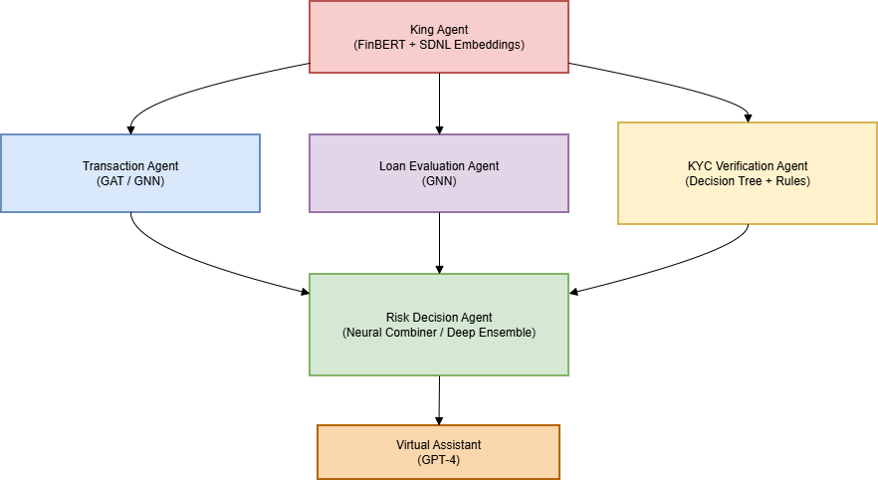
System Architecture
Central Intelligence
Unified Risk Scoring
The King Agent uses FinBERT and SDNL embeddings for contextual understanding and intelligent task routing across all domains.
The Risk Decision Agent employs Deep Ensemble techniques to aggregate insights and generate comprehensive AML scores.

Slide 5




Four Specialized Sub-Agents
Transaction Agent
Loan Agent
Uses GAT/GNN to detect fraudulent patterns in account transaction networks and suspicious relational structures.
Employs GNN to identify suspicious loans, linked applications, and potential collusion or synthetic identities.
KYC Agent
Deposit Agent
Leverages Decision Trees and rule-based systems to verify customer identity and ensure compliance.
Applies GAT/GNN to detect anomalous deposit patterns, circular transactions, and temporal irregularities.

Slide 6




Advanced AI Techniques
Self-Supervised Learning
Graph Neural Networks
Natural Language AI
BYOL and SDNL generate robust embeddings without labeled data, enabling the King Agent to understand complex financial contexts.
GAT and GNN model relational patterns between accounts, loans, and deposits to detect networked fraud.
GPT-4 Virtual Assistant provides explainable insights, bridging AI reasoning with human understanding.

Slide 7

Data Integration
Four Kaggle Datasets
AML Transaction Dataset: Transactions with fraud labels
KYC Dataset: Customer verification and identity attributes
Loan Dataset: Loan applications with risk indicators
Deposit Dataset: Deposit records with temporal and network attributes
Preprocessing Pipeline
Data cleaning, feature engineering, graph construction, self-supervised embeddings, and train-test splits ensure high-quality inputs.

Slide 8

Expected Business Impact
85%
60%
100%
Detection Rate
Fewer False Positives
Transparency
Improved capture of complex, multi-domain fraud patterns through relational analysis.
Reduced alert fatigue compared to traditional rule-based AML systems.
Virtual Assistant enhances customer trust and regulatory compliance through explainability.

Slide 9




Future Enhancements
Multi-Modal Data
Real-Time Processing
Integration of emails and documents for comprehensive fraud detection.
Streaming implementation of transaction graphs for instant risk assessment.
Multi-Lingual Assistant
Explainable AI
Context-aware Virtual Assistant supporting multiple languages.
Enhanced interpretability techniques for regulatory review and audit.

Slide 10
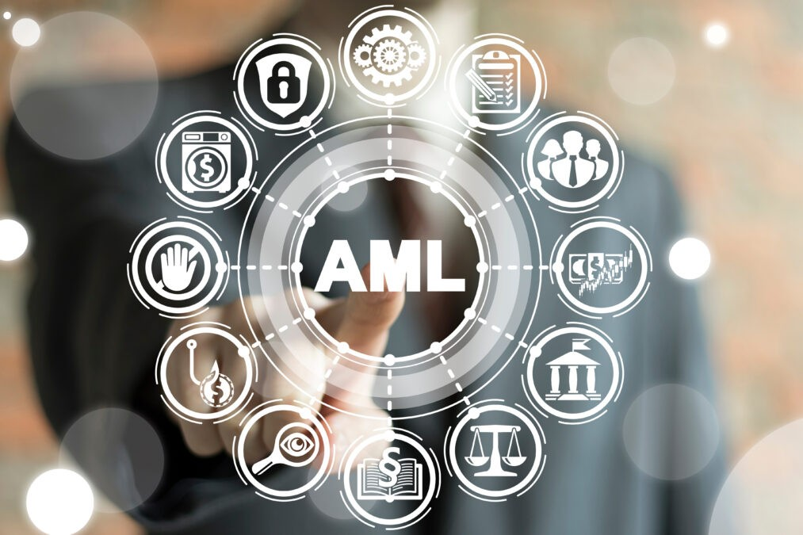
The Future of AML
This diamond-shaped multi-agent system demonstrates the transformative potential of modern AI in anti-money laundering. By combining self-supervised learning, graph neural networks, and intelligent virtual assistance, we enable financial institutions to detect sophisticated fraud patterns, reduce false positives, and provide transparent, explainable risk assessments.
"Capturing complex relational patterns through cutting-edge AI to protect the financial ecosystem."

