Slide 1



SPIDERBOT
Problem Statement ID –SIH1533
Problem Statement Title-Student Innovation
Theme-Robotics and Drones
PS Category- Software/Hardware
Team ID-12879
Team Name -KAIZEN

Slide 2
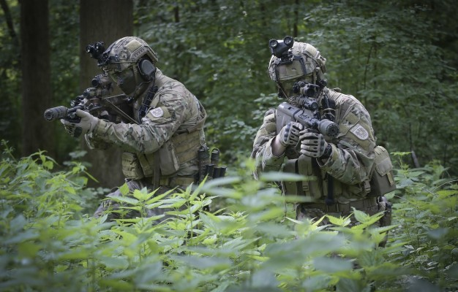

SPIDERBOT
Your Team Name
PROBLEMS
The indian army faces many challenges while working in forests and in cold mountain areas during combat against terrorists.
In hostage situations our army needs quick detection of hidden terrorists.
SOLUTIONS
Our spiderbot will detect the hidden terrorists via body heat using thermal imaging technolgy.
Dending upon the area we will send 50k-100k spiderbots , they all will be connected to each other so that we will get maximum information.
On a hostage situation our spiderbot will tell us the exact location .
Our spiderbot will self destruct on our terrorists, so that it will spare some time to the forces.
@SIH Idea submission- Template
2

Slide 3
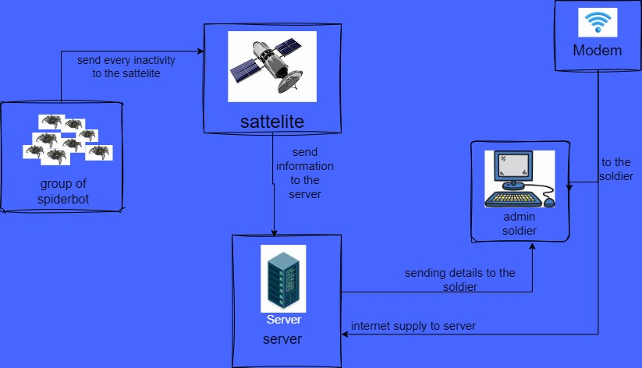
TECHNICAL APPROACH
Your Team Name
Group of spiderbots -Every action of them will be send to sattellite.
Sattelite- It will send information to the server.
Server- It will send details to the admin(soldier).
Modem-Give internet supply to the server.
@SIH Idea submission- Template
3

Slide 4
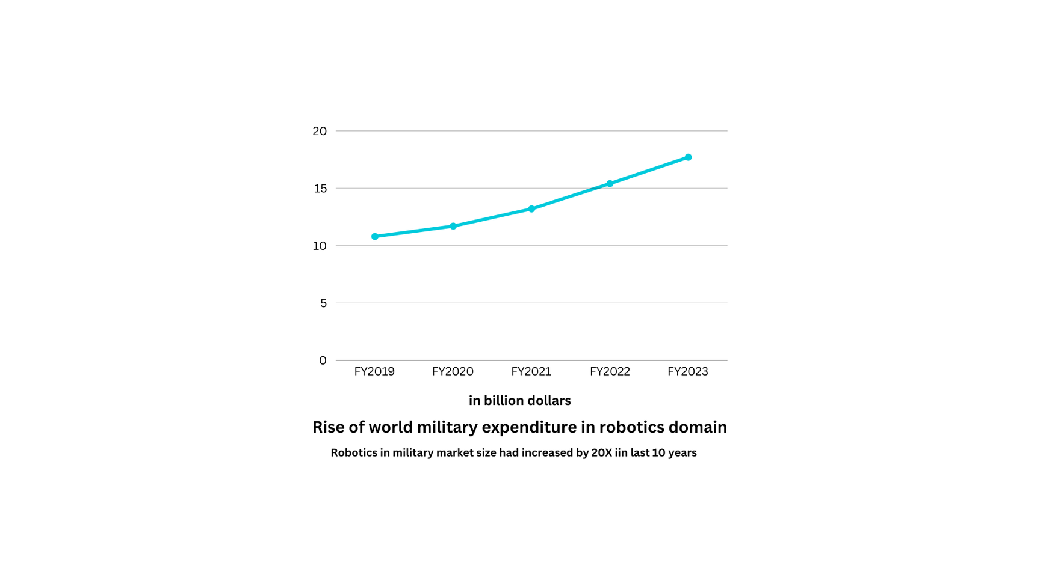
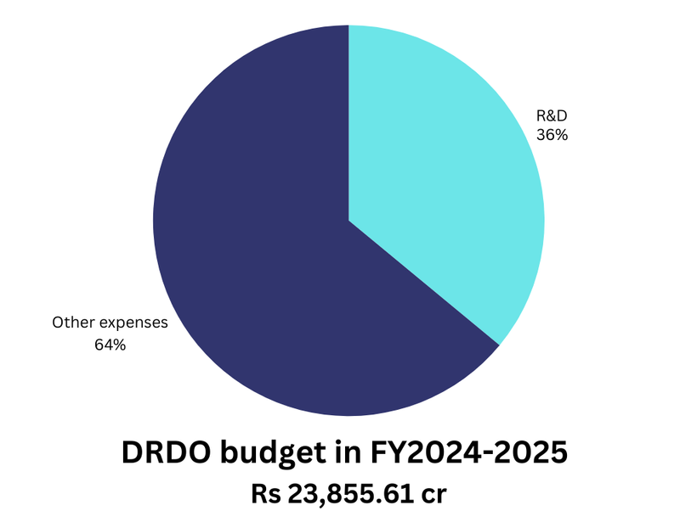
FEASIBILITY AND VIABILITY
Your Team Name
Global military expenditure in robotics hav increased by 20x in last 10 years.
Global military robot market size is 19bilion dollars in fy2023. It will be 43 billion dollar by 2031.
Our market size globally in fy 2023 is 5 billion dollar and it will grow exponentially in next few years.
The total expenditure of DRDO in robotics segment is Rs 23,855.61 cr in FY 2024-2025.
DRDO annual budget have increased by 13.55% in last 10 years
Our market size in India only is approximately 1-2 billion INR.
@SIH Idea submission- Template
4

Slide 5
IMPACT AND BENEFITS
Your Team Name
IMPACT
Gives the army an advantage in tough situations.
Helps protect borders from intruders.
Shows the army uses latest technology.
Helps finish missions like rescue and combats more quickly.
BENEFITS
Spiderbot makes the army’s work eaiser and faster.
Find peoples in needs like natural disasters.
Spiderbot makes the army’s work more efficent.
Collects information in hard -to-reach places or dangerous place.
@SIH Idea submission- Template
5

Slide 6
RESEARCH AND REFERENCES
Your Team Name
Details / Links of the reference and research work
@SIH Idea submission- Template
6

