Slide 1



Credit Card Fraud Detection
Submitted to:
SAMARTH AMRUTE
Presented by:
SADHVI KESARWANI
UU ID-UU252000006

Slide 2

Introduction
Credit card fraud is a major challenge in digital payments.
Millions of transactions occur daily; manual detection is impossible.
Fraudsters use advanced methods to hide fraudulent activity.
Machine Learning helps detect unusual patterns automatically.
This project builds a hybrid ML model for accurate fraud detection.
2

Slide 3
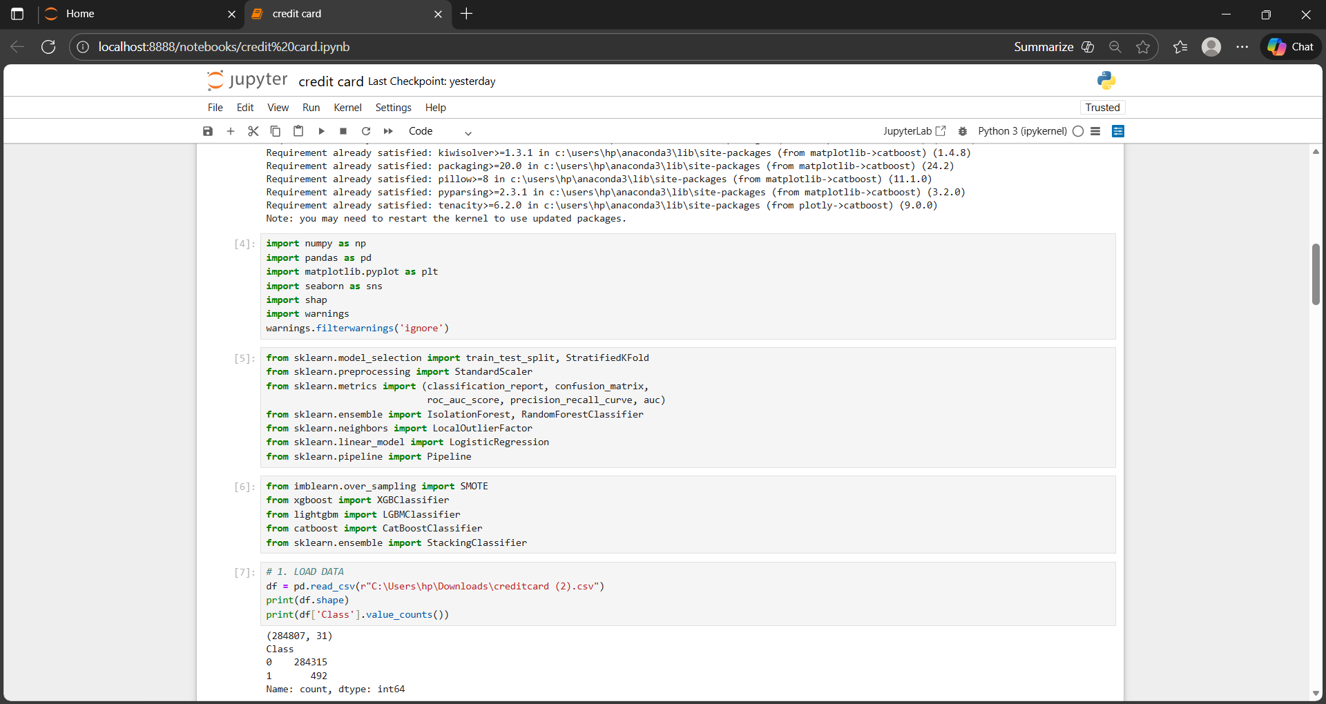
IMPORTING LIBRARIES
Imported essential ML and visualization libraries.
Used Seaborn/Matplotlib for plots.
Used SHAP for explainability.

Slide 4
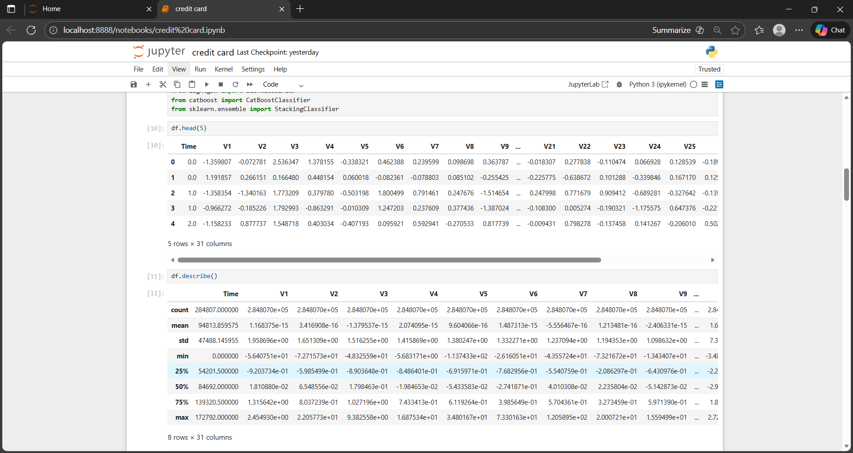
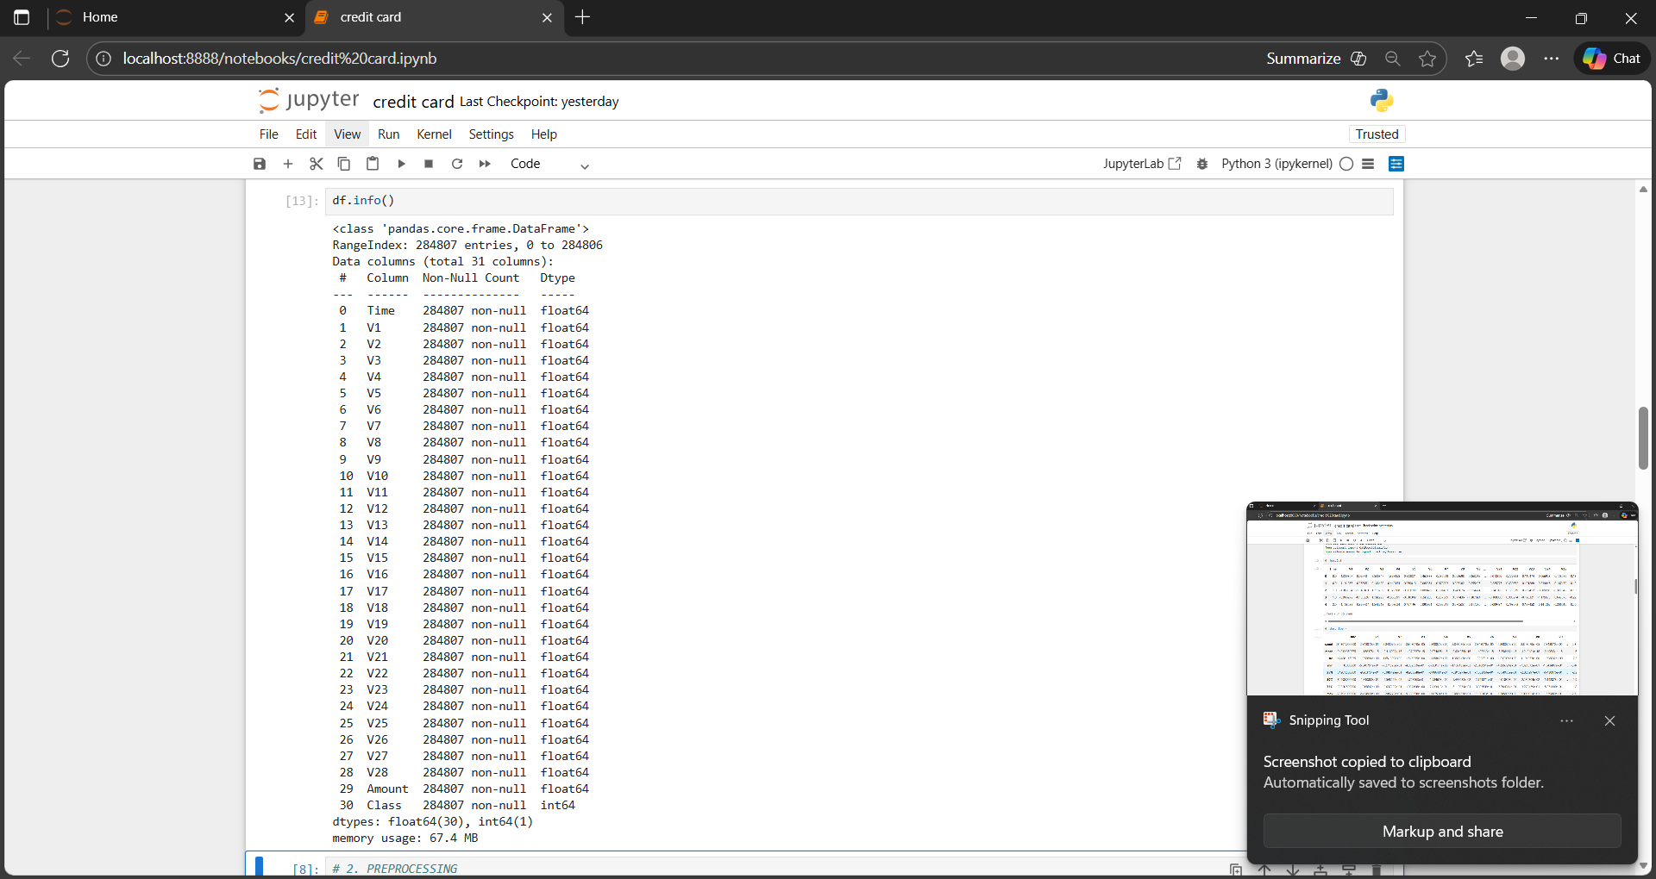
READ CSV FILE AND OVERVIEW OF DATASET

Slide 5
MODELS USED
Random Forest
Hybrid Ensemble Model
Logistic Regression
XGBoost
LightGBM

Slide 6
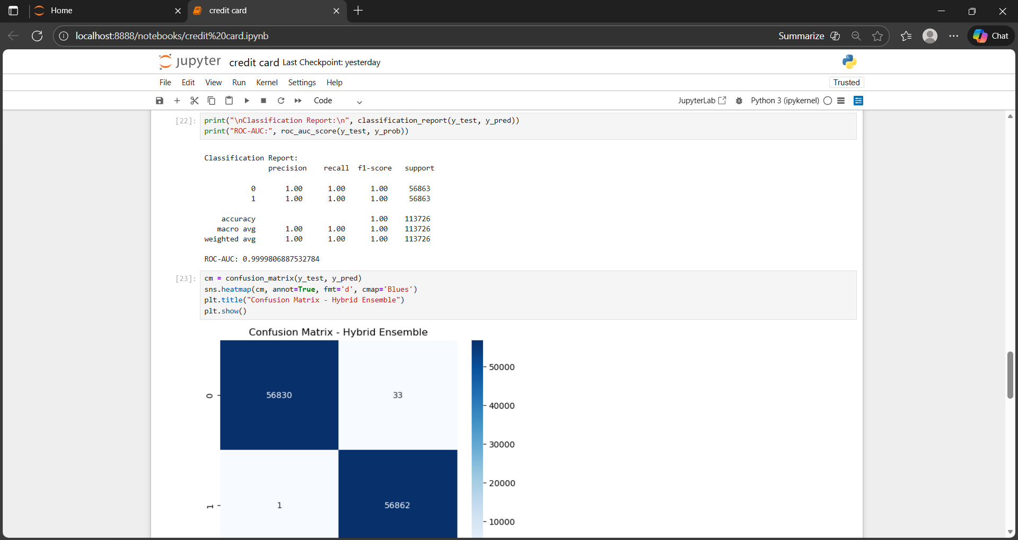
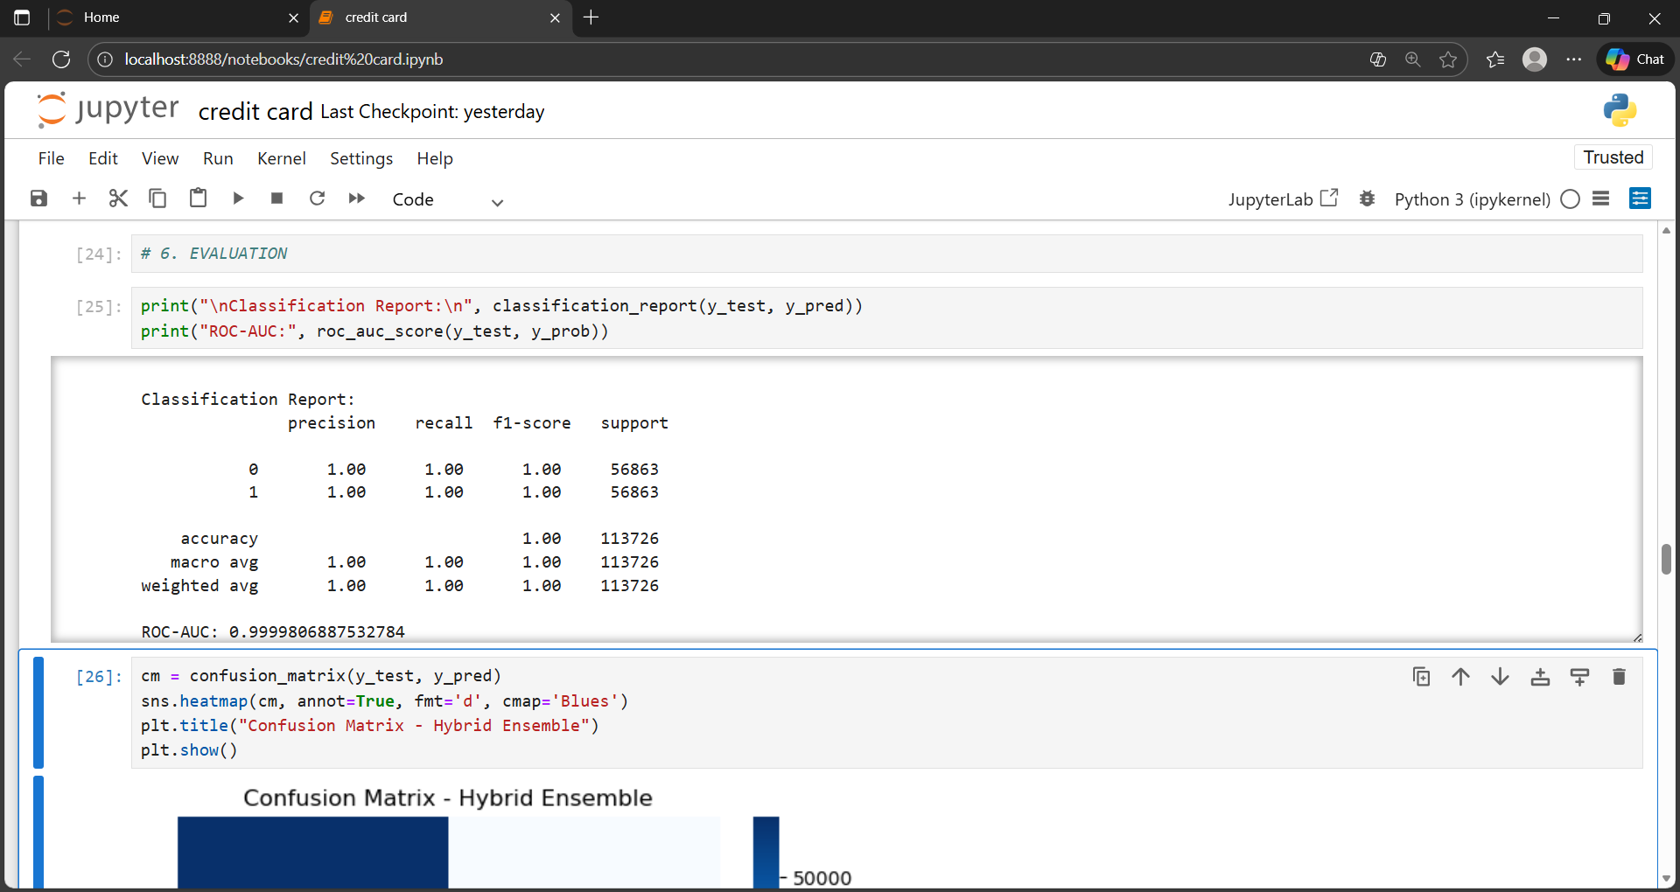
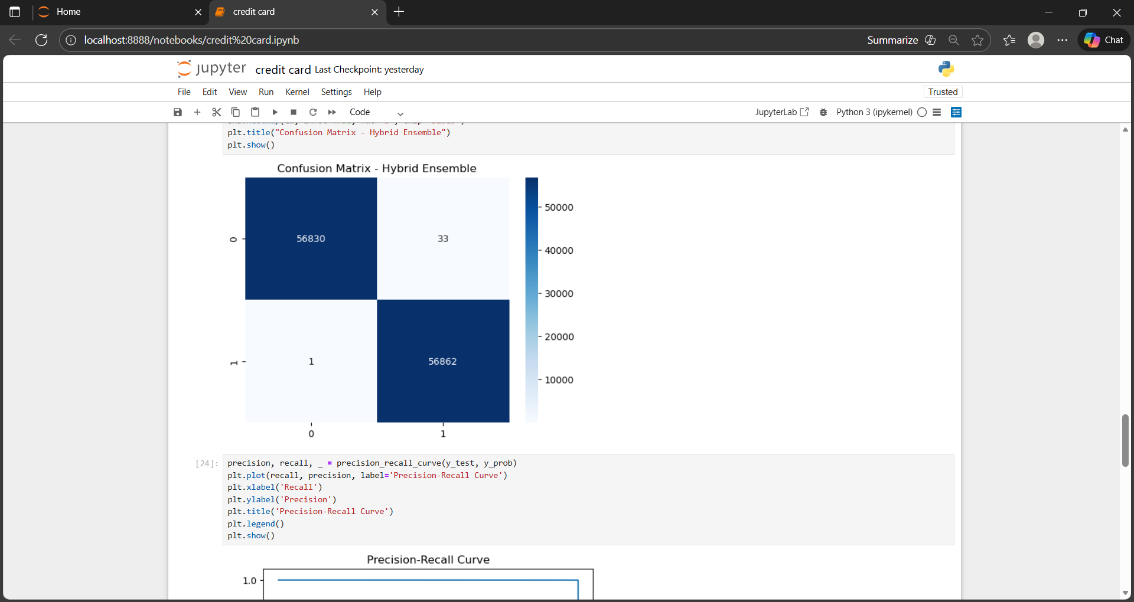
CONFUSION MATRIX
Shows how well the model classifies fraud and non-fraud.
Contains TP, FP, TN, FN to measure errors.
Helps identify false negatives, which are critical in fraud detection.
A good model should have high TP and very low FN for fraud cases.

Slide 7
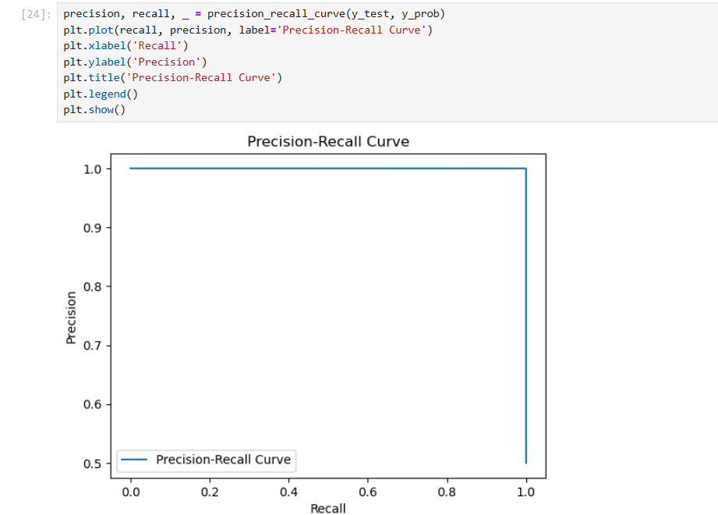
PRECISION RECALL
Shows how many predicted frauds are actually fraud.
High precision = fewer false alarms.
Important for reducing unnecessary customer verification calls.

Slide 8
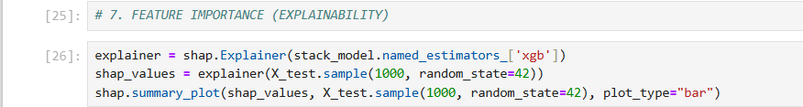
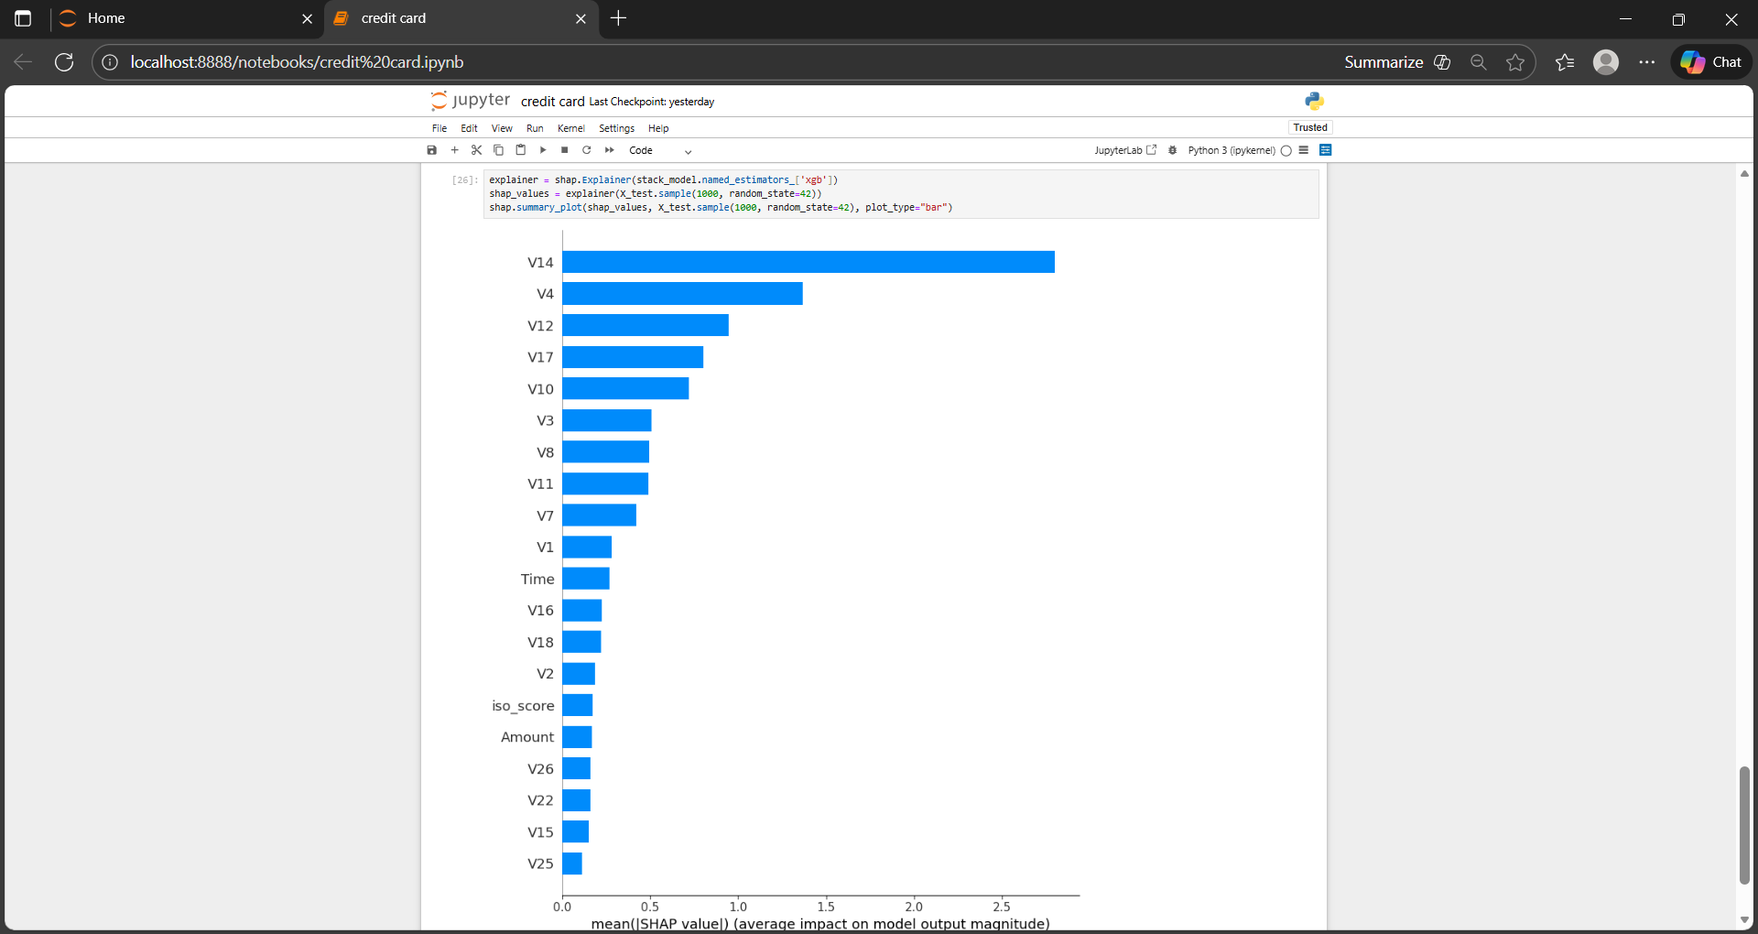
FEATURE IMPORTANCE
Shows which features have the highest impact on detecting fraud.
Helps explain why the model classifies a transaction as fraud or non-fraud.
Improves model transparency and helps identify key risk factors.

Slide 9
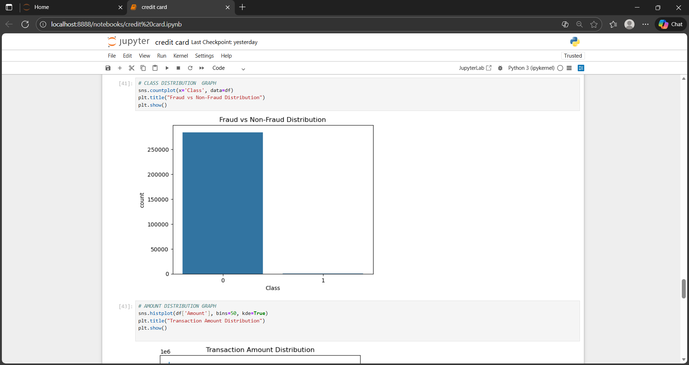
CLASS DISTRIBUTION: FRAUD VS NON-FRAUD
Shows the extreme imbalance between fraud and non-fraud cases.
Fraud cases are very few compared to normal transactions.
Imbalance can make the model biased toward Class 0 (normal).
Highlights the need for resampling techniques like SMOTE.

Slide 10
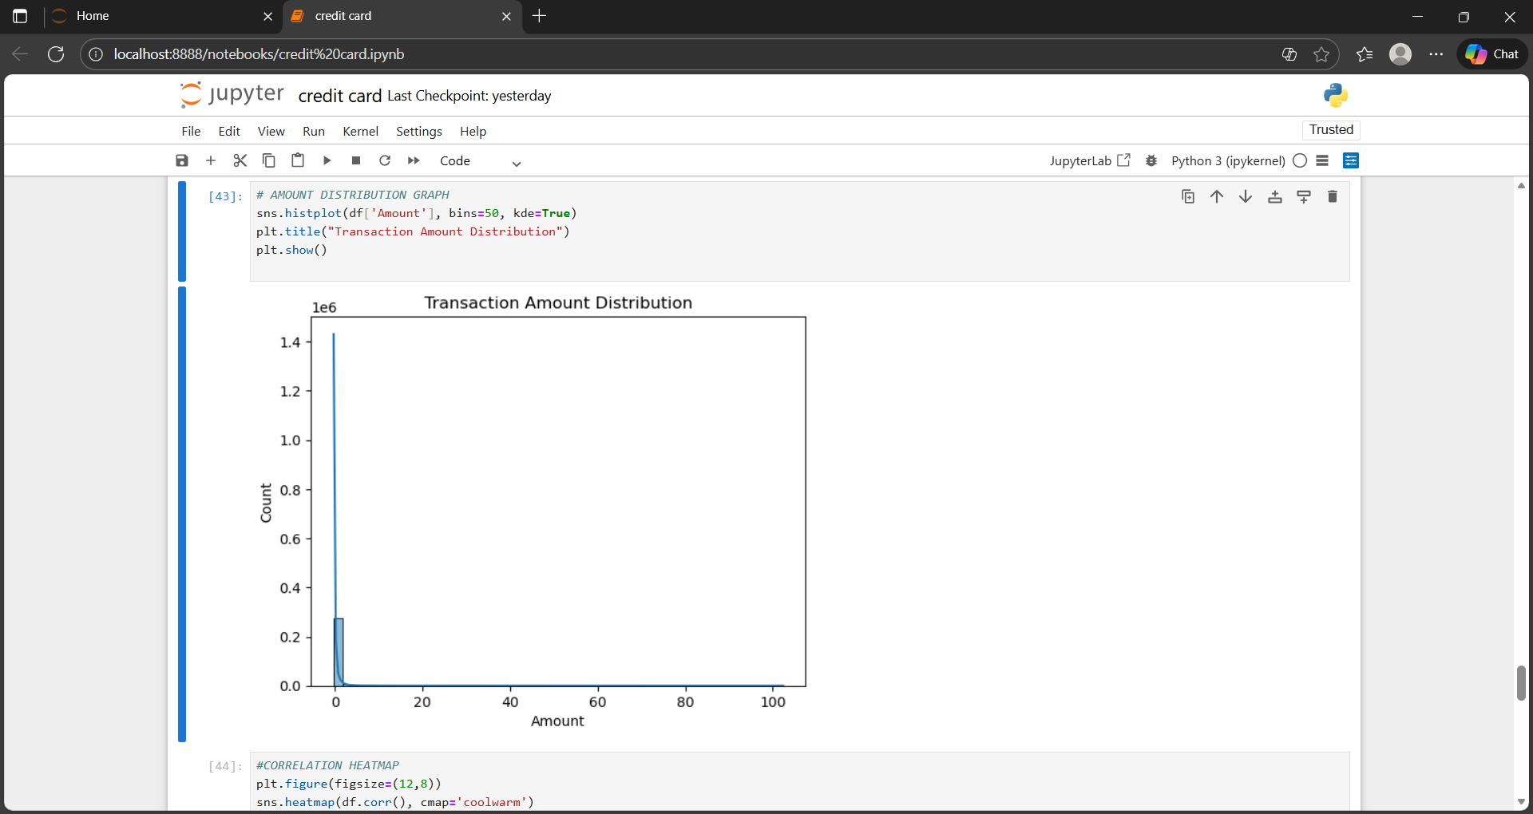
AMOUNT DISTRIBUTION
Shows how transaction amounts vary across the dataset.
Majority of transactions are of low amounts; few are very high.
Helps detect outliers and understand spending behavior.
Amount must be scaled for better model performance.

Slide 11
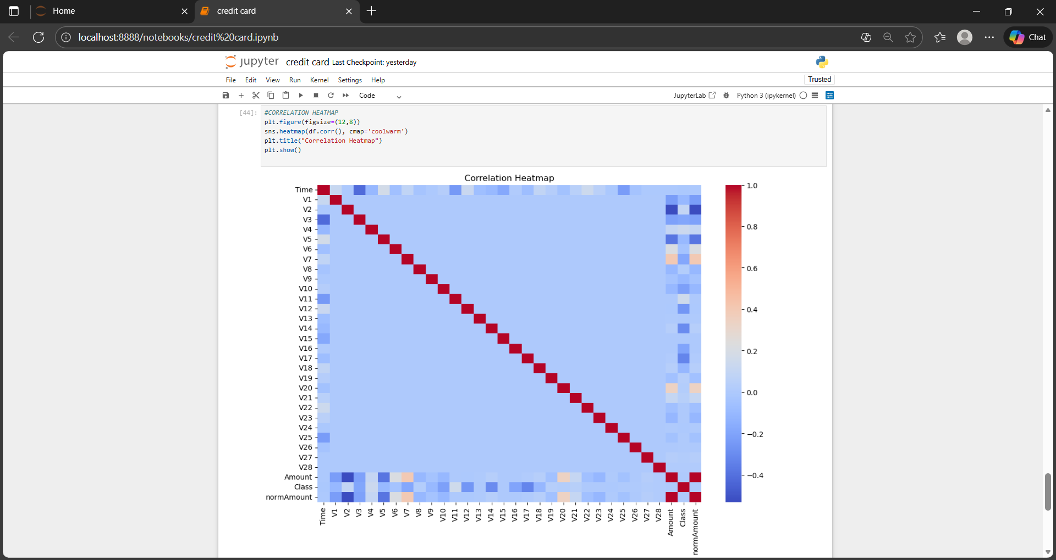
CORRELATION
Shows correlation between all PCA features (V1–V28) and Class.
PCA-transformed features have very low correlation with each other.
Helps understand feature relationships and patterns.
Useful to see if any features strongly influence fraud detection.

Slide 12
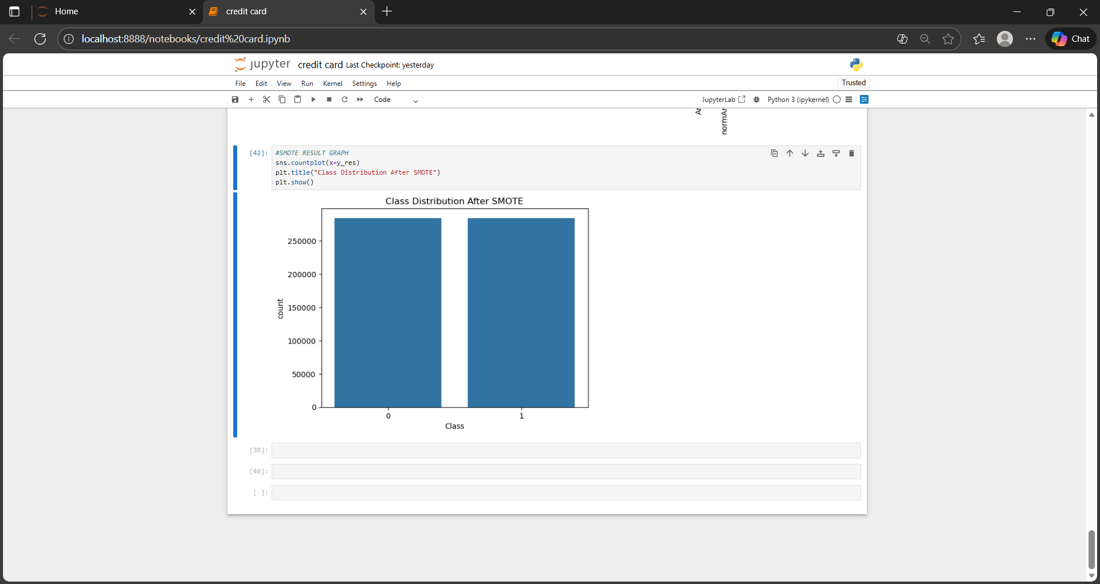
SMOTE RESULT: CLASS DISTRIBUTION
SMOTE creates synthetic fraud samples to balance the classes.
After SMOTE, both fraud and non-fraud classes have equal counts.
Helps the model learn fraud patterns more effectively.
Reduces false negatives, improving fraud detection performance.

Slide 13

RESULT
Best performing model: XGBoost
Achieved 99.9% accuracy in detecting fraud vs non-fraud
Indicates the model is highly reliable
Supported by strong precision, recall, and F1-score

