Slide 1
Association Mining Toolkit + A3Miner
Apriori (1994) • FP-growth (2000) • Eclat (2000) • Adaptive Hybrid Selection
Dataset: market_basket_50.csv • Course: INSE 6180
Deliverables: implementations + benchmark plots + report
Notes:
[Sources] - Apriori paper (VLDB 1994 PDF): https://www.vldb.org/conf/1994/P487.PDF - FP-growth paper (SIGMOD 2000 PDF): https://www.cs.sfu.ca/~jpei/publications/sigmod00.pdf - Eclat paper (IEEE TKDE 2000; PDF mirror): https://sci2s.ugr.es/keel/pdf/algorithm/articulo/2000%20-%20IEEETKDE%20-%20Zaki%20-%20%28Eclat%29%20ScalableAlgorithms%20for%20Association%20Mining%20.pdf [/Sources]

Slide 2
Problem: Frequent Itemsets and Association Rules
Given transactions (baskets), find:
Frequent itemsets: support(X) >= minsup
Rules: X -> Y with confidence = support(X ∪ Y) / support(X) >= minconf
Challenge: search space grows exponentially as minsup decreases
Example rule
{bread, milk} -> {diaper}
We implement 3 classic miners + a new adaptive method.
Goal: mine frequent itemsets (minsup) then derive rules (minconf).
Notes:
[Sources] - Definitions and problem statement: Agrawal & Srikant (1994): https://www.vldb.org/conf/1994/P487.PDF [/Sources]

Slide 3
Algorithm 1: Apriori / AprioriTid (candidate generation)
Level-wise search: find L1, then L2, then L3, ...
Generate candidates Ck from Lk-1 (join), prune if any subset is infrequent
Count supports by scanning transactions (hash-tree speeds up subset lookup)
AprioriTid: later passes scan candidate encodings instead of the DB
Why it can be slow at low minsup
Candidate sets can explode; repeated DB scans dominate runtime.
Key idea: downward-closure (anti-monotone) property for pruning.
Notes:
[Sources] - Apriori, AprioriTid, hash-tree counting: Agrawal & Srikant (1994): https://www.vldb.org/conf/1994/P487.PDF [/Sources]

Slide 4
Algorithm 2: FP-growth (no candidate generation)
Build FP-tree by inserting frequency-ordered transactions (2 passes)
Header table + node-links give fast access to all occurrences of an item
Mine by pattern-growth: conditional pattern base -> conditional FP-tree -> recurse
Single-path optimization: enumerate all subpath combinations directly
Why it scales well
Avoids candidate explosion; works well when patterns are prolific or long.
Key idea: compress DB into FP-tree; mine conditional trees recursively.
Notes:
[Sources] - FP-tree, conditional pattern base, FP-growth: Han, Pei & Yin (2000): https://www.cs.sfu.ca/~jpei/publications/sigmod00.pdf [/Sources]

Slide 5
Algorithm 3: Eclat (vertical mining with tid-lists)
Transform DB: item -> tid-list (transaction IDs where it appears)
Support(X ∪ Y) = |T(X) ∩ T(Y)|, so counting is intersections
Depth-first enumeration of frequent itemsets in prefix-based classes
Intersections often get faster as tid-lists shrink for longer itemsets
Why it’s attractive
Simple operations, good locality, few DB scans after verticalization.
Key idea: support by tid-list intersection; DFS within equivalence classes.
Notes:
[Sources] - Vertical tid-lists and Eclat-style mining: Zaki (2000): https://sci2s.ugr.es/keel/pdf/algorithm/articulo/2000%20-%20IEEETKDE%20-%20Zaki%20-%20%28Eclat%29%20ScalableAlgorithms%20for%20Association%20Mining%20.pdf [/Sources]

Slide 6
Careful Comparison (what changes, what stays the same)
Apriori
FP-growth
Eclat
Horizontal scans
Explicit candidates
Strong pruning
Best at high minsup
FP-tree compression
No candidates
Conditional mining
Good for long patterns
Vertical tid-lists
Intersections
DFS search
Great locality
All three enumerate the same frequent itemsets for the same minsup.
Notes:
[Sources] - Apriori/AprioriTid: https://www.vldb.org/conf/1994/P487.PDF - FP-growth: https://www.cs.sfu.ca/~jpei/publications/sigmod00.pdf - Eclat/vertical mining: https://sci2s.ugr.es/keel/pdf/algorithm/articulo/2000%20-%20IEEETKDE%20-%20Zaki%20-%20%28Eclat%29%20ScalableAlgorithms%20for%20Association%20Mining%20.pdf [/Sources]

Slide 7
New Improved Algorithm: A3Miner (adaptive selection)
A3Miner = an algorithm portfolio (practical hybrid)
Compute simple dataset stats: #items (m), avg basket length, minsup level
If minsup is high -> Apriori (candidate frontier stays small)
If item universe is small & baskets are short -> Eclat (fast intersections)
If baskets are long or item universe is large -> FP-growth (FP-tree compression)
Fallback (optional): TriHybrid-PPAM for mixed profiles
Profile dataset
Choose engine
Mine itemsets
Generate rules
Idea: pick the best engine for the dataset shape and minsup.
Notes:
[Sources] - Motivation for avoiding worst-case candidate explosion: https://www.cs.sfu.ca/~jpei/publications/sigmod00.pdf - Strengths/limitations of vertical intersections and search strategies: https://sci2s.ugr.es/keel/pdf/algorithm/articulo/2000%20-%20IEEETKDE%20-%20Zaki%20-%20%28Eclat%29%20ScalableAlgorithms%20for%20Association%20Mining%20.pdf - Apriori and the high-minsup regime: https://www.vldb.org/conf/1994/P487.PDF [/Sources]

Slide 8
Implementation: one project, four miners, one benchmark
Folder structure (high level)
association_mining_project/
data/market_basket_50.csv
src/
apriori/ (Apriori + AprioriTid + hash-tree)
fpgrowth/ (FP-tree + FP-growth)
eclat/ (vertical tid-lists)
hybrid/ (TriHybrid-PPAM + A3Miner)
bench/ (benchmarks + plots)
utils/ (CSV loader + rule generation)
main.py (CLI runner)
requirements.txt
Single CLI: main.py (runs each miner + benchmark mode).
Notes:
[Sources] - Algorithms implemented following the three core papers: - https://www.vldb.org/conf/1994/P487.PDF - https://www.cs.sfu.ca/~jpei/publications/sigmod00.pdf - https://sci2s.ugr.es/keel/pdf/algorithm/articulo/2000%20-%20IEEETKDE%20-%20Zaki%20-%20%28Eclat%29%20ScalableAlgorithms%20for%20Association%20Mining%20.pdf [/Sources]

Slide 9
Experimental Setup
Dataset: market_basket_50.csv (50 transactions; small market-basket example)
Minsup grid: {0.50, 0.40, 0.30, 0.25, 0.20}
Metrics: end-to-end runtime (including structure build), #frequent itemsets
A3Miner reports chosen engine per minsup
Plots are generated automatically by benchmark mode
All methods evaluated on the same dataset and minsup grid.
Notes:
[Sources] - Benchmarking motivation and support-threshold scalability: FP-growth paper Section 4 (performance study): https://www.cs.sfu.ca/~jpei/publications/sigmod00.pdf [/Sources]

Slide 10
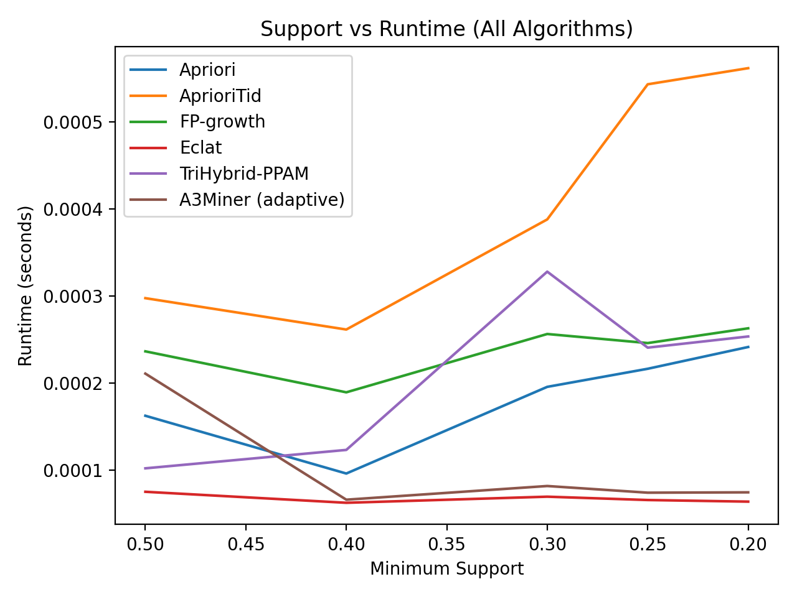
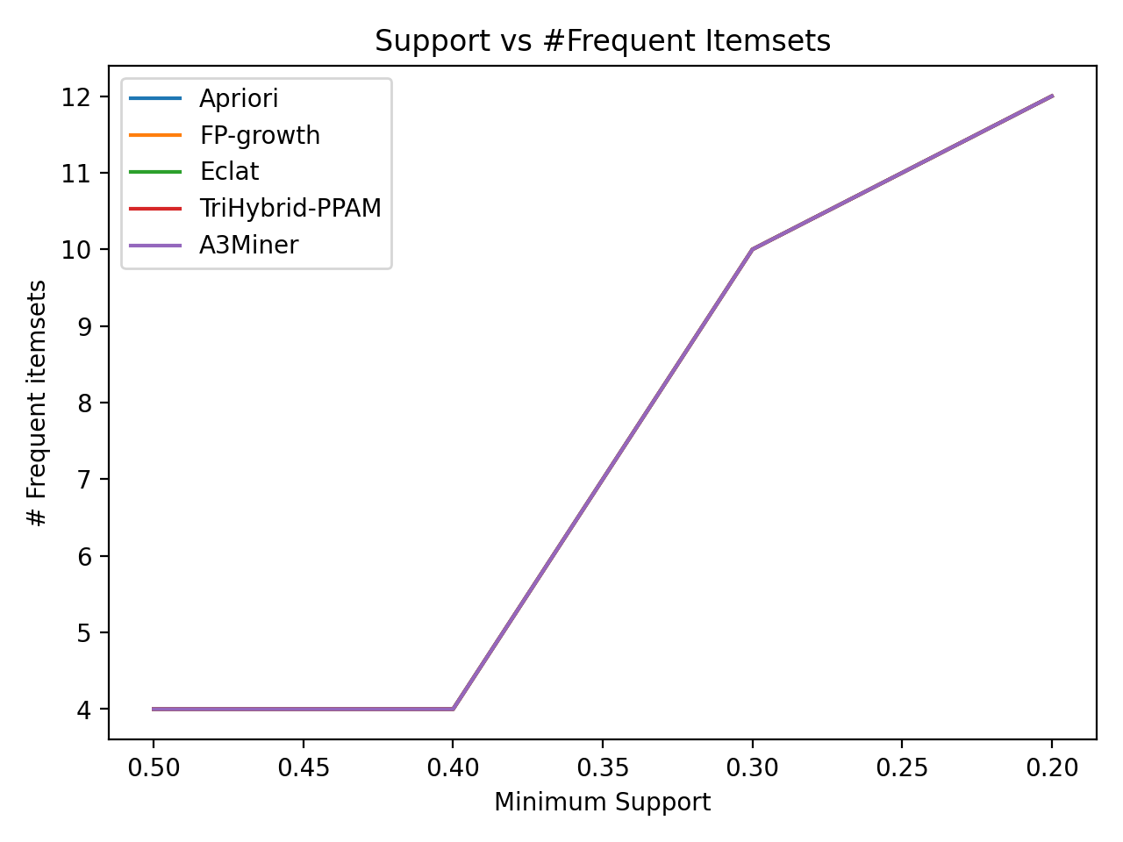
Results: Comparison Plots
Support vs Runtime
Support vs # Frequent Itemsets
Interpretation on this dataset
Eclat is consistently fast (small item universe, short baskets)
A3Miner selects Eclat for most minsup settings, matching near-best runtime
TriHybrid is conceptually strong, but overhead dominates on small inputs
Generated by: python main.py --algo benchmark --plot
Notes:
[Sources] - Relative strengths of FP-growth vs Apriori as minsup decreases (scalability discussion): https://www.cs.sfu.ca/~jpei/publications/sigmod00.pdf - Vertical mining motivations and intersection locality: https://sci2s.ugr.es/keel/pdf/algorithm/articulo/2000%20-%20IEEETKDE%20-%20Zaki%20-%20%28Eclat%29%20ScalableAlgorithms%20for%20Association%20Mining%20.pdf [/Sources]

Slide 11
Conclusion and Next Steps
What we delivered
Three classic miners implemented from the papers: Apriori/AprioriTid, FP-growth, Eclat
One new improved method: A3Miner (adaptive engine selection)
Optional hybrid engine: TriHybrid-PPAM (pair-pruned projections)
Automated benchmark + plots for comparison
Future work
Evaluate on larger benchmark datasets (retail, mushroom) using the same harness
Add AprioriHybrid switching heuristic and diffsets for vertical mining
Extend A3Miner with a small pilot run to learn the best engine automatically
Thank you
Notes:
[Sources] - AprioriHybrid idea (switching to reduce scans): https://www.vldb.org/conf/1994/P487.PDF - FP-growth scalability discussion: https://www.cs.sfu.ca/~jpei/publications/sigmod00.pdf - Eclat family and hybrid search strategies: https://sci2s.ugr.es/keel/pdf/algorithm/articulo/2000%20-%20IEEETKDE%20-%20Zaki%20-%20%28Eclat%29%20ScalableAlgorithms%20for%20Association%20Mining%20.pdf [/Sources]

