Slide 1
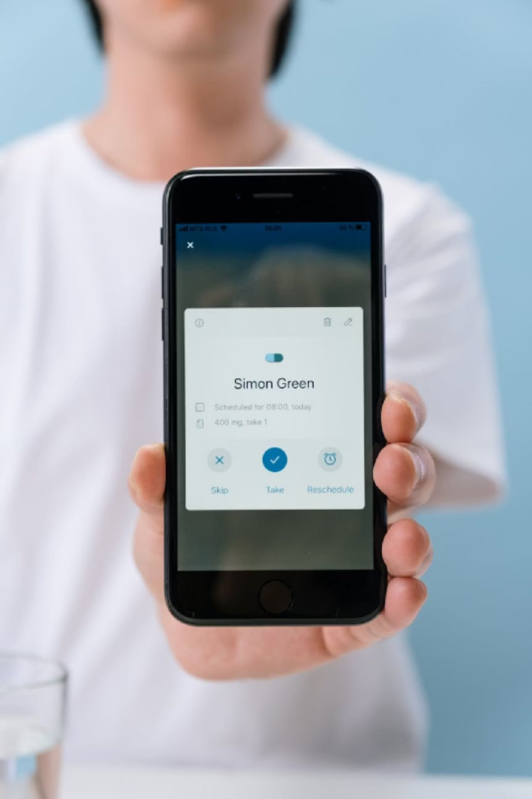
AmarCure
An AI-Powered Comprehensive Healthcare Management System

Slide 2

The Challenge
Bangladesh's healthcare system relies on fragmented, paper-based records — making medical information difficult to access, organize, and interpret.

Slide 3







Core Problems
1
Paper Records Easily lost, damaged, or misplaced
2
Emergency Gaps
Blood group, allergies, medications unavailable
3
Medication Mismanagement
Missed doses, forgotten follow-ups
4
Fragmented Family Care
Records spread across hospitals and homes
5
Report Confusion
Patients can't interpret lab results
6
Repeated Tests
No shared platform — rising costs, delays

Slide 4

AI-Powered Report Analysis
SOLUTION
Complex medical reports translated into clear, patient-friendly insights — identifying whether key indicators like blood sugar, cholesterol, and kidney function are within normal range.

Slide 5
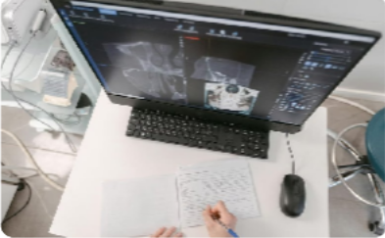



Centralized Medical Records
Secure Upload
Prescriptions, lab reports, X-rays, MRI/CT scans, vaccination records — all in one place.
OCR Scanning
Snap a photo — Optical Character Recognition extracts and stores key info automatically.
Cloud Backup
Automatic backup reduces risk of losing important healthcare documents.
Download & Share
Print or securely share documents with doctors, hospitals, or family anytime.

Slide 6





Smart Health Management
Medicine Reminders Timely notifications, missed-dose tracking, completion history
Appointment Alerts Doctor visits, follow-ups, vaccinations, lab tests
Health Timeline All medical activity organized chronologically
Intelligent Search Find records by doctor, hospital, disease, date, or medicine

Slide 7

Family & Caregiver Dashboard
FAMILY CARE
Securely share access with trusted family members. Monitor medication schedules, appointments, and health updates — especially helpful for elderly patients and children.

Slide 8
Emergency & Intelligence Features
One-Click Emergency Profile
Health Risk Alerts
AI flags abnormal values and recommends consulting a professional
Personalized Tips
Lifestyle guidance: hydration, diet, exercise, routine checkups
Blood group
Allergies
Chronic diseases
Current medications
Emergency contacts
Doctor Visit Notes
Save advice, symptoms, treatment plans after each consultation

Slide 9
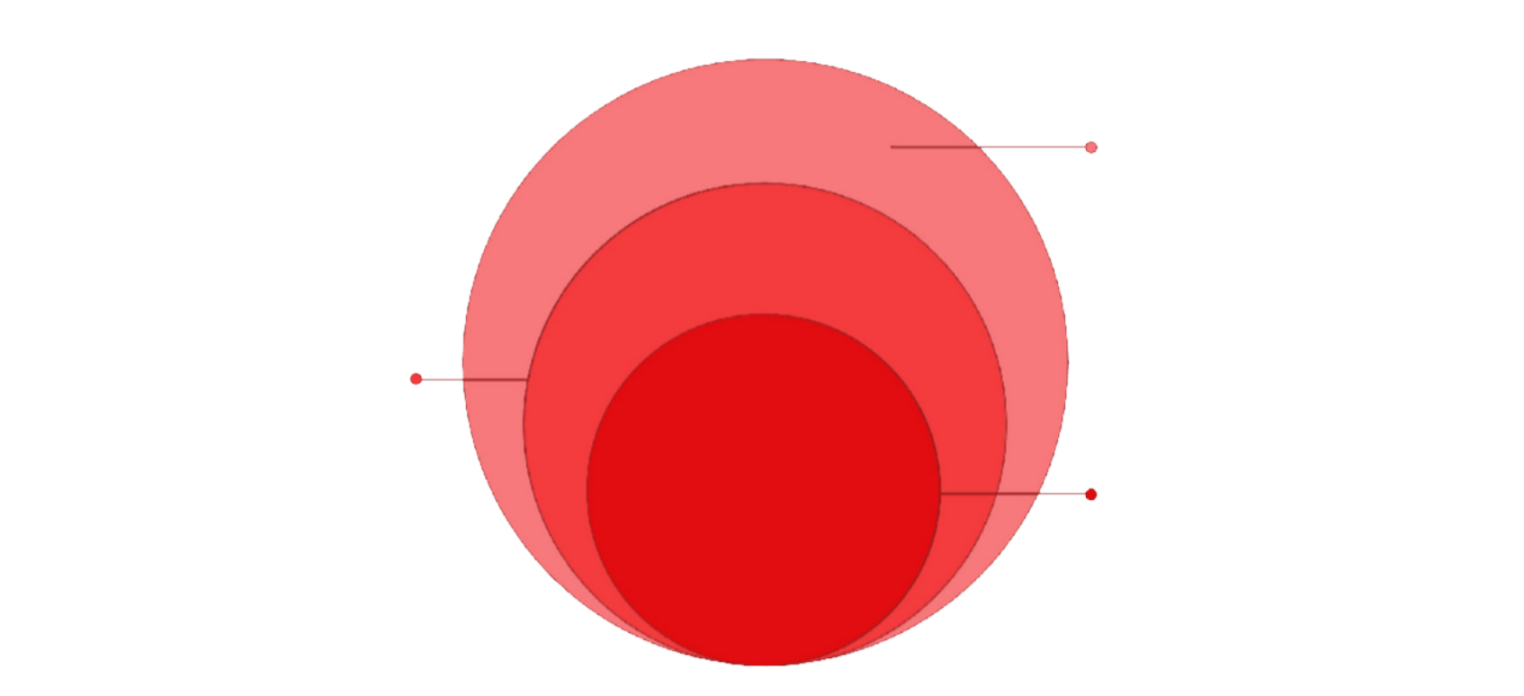
Technology Stack
Frontend & Data
React UI with Supabase auth and DB
Backend Services
Node.js processing and
reminders
Core AI
Medical report analysis and insights
Modern technologies ensuring a secure, fast, and user-friendly healthcare experience.

Slide 10

The Road Ahead
FUTURE SCOPE
Telemedicine
Online appointments & AI chatbot support
Wearable Integration
Smartwatches & fitness bands synced
Pharmacy & Insurance
Medicine ordering and insurance records
National Integration
Connect with national digital health systems

Slide 11
Thank You
Any Questions?

