Slide 1


Comparative Analysis of ANN and CNN Models
Exploring the performance of Artificial Neural Networks (ANN) and Convolutional Neural Networks (CNN) for regression and classification tasks using PyTorch and Keras.
by Sadia Shakoor

Slide 2
Datasets
California Housing
Customer Churn
CIFAR-10
Regression, 20,640 records, 8 features, median house value target.
Classification, 7,043 records, 20 features, binary churn target.
Classification, 60,000 images, 32x32 RGB, 10 classes.

Slide 3
Model Architectures
1
PyTorch ANN (Regression)
2
PyTorch ANN (Classification)
3
Keras CNN (Classification)
32-16-8-1 layers, ReLU activation.
16-8-1 layers, ReLU activation, sigmoid output.
3 Conv2D layers, Dense layers, dropout regularization.

Slide 4
Training Configurations
Regression
Classification
CNN
SGD optimizer, learning rates 0.01, 0.1, epochs 30, 50, batch sizes len(X_train)/10, len(X_train)/5 and len(X_train).
Adam optimizer, learning rates 0.01, 0.1, epochs 30, 100, batch sizes len(X_train)/10, len(X_train)/5 and len(X_train).
Adam optimizer, learning rate 0.001, epochs 10, 15, 20, batch size 32 and 64.

Slide 5
Performance Metrics
1.31
83%
MSE
Accuracy
Regression, epoch 30, learning rate 0.01.
Classification, epoch 100, learning rate 0.01.
0.90
74%
MAE
Accuracy
Regression, epoch 30, learning rate 0.01.
CNN Model 2, epoch 20, learning rate 0.001.

Slide 6


Visualizations
Learning Curves
Confusion Matrices
Training and validation loss, accuracy over epochs.
Class-wise performance for classification tasks.

Slide 7
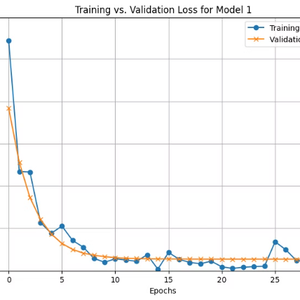
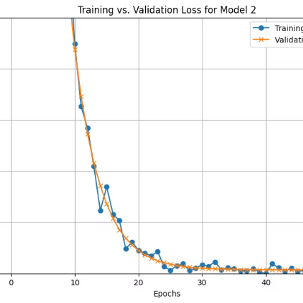
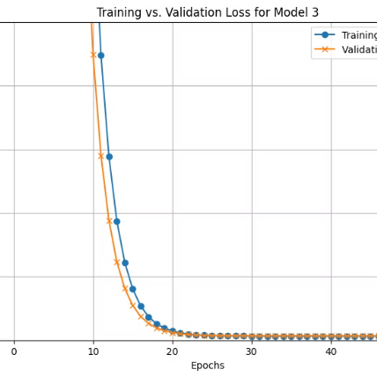
Learning Curves for Regression Models
Model 1
Model 2
Model 3
Optimizer =SGD
Optimizer =SGD
Optimizer =SGD
Learning Rate =0.01
Learning Rate =0.01
Learning Rate =0.01
Loss Fun = MSELoss
Loss Fun = MSELoss
Loss Fun = MSELoss
Epoch=30
Epoch=100
Epoch=100
Batch Size=int(len(X_train)/10)
Batch Size=int(len(X_train)/5)
Batch Size=int(len(X_train))
Mean Squared Error: 1.3105
Mean Squared Error: 1.3218
Mean Squared Error: 1.3218
Mean Absolute Error:0.90097
Mean Absolute Error: 0.9261
Mean Absolute Error: 0.92607

Slide 8
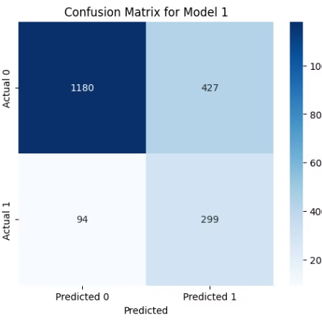
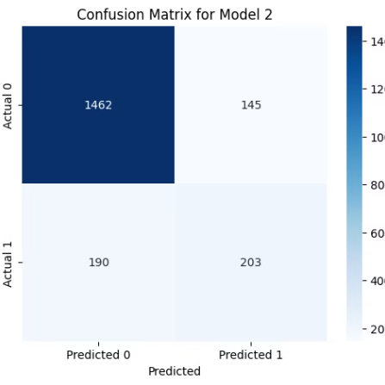
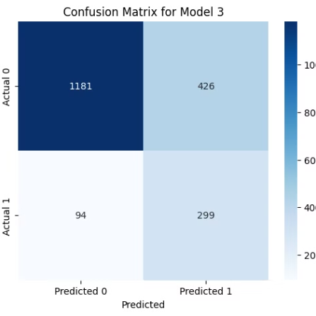
Confusion Matrices for Classification Model
Model 1
Model 2
Model 3
Optimizer = Adam
Optimizer = Adam
Optimizer = Adam
Learning Rate =0.01
Learning Rate =0.01
Learning Rate =0.1
Loss Fun = BCELoss
Loss Fun = BCELoss
Loss Fun = BCELoss
Epoch= 30
Epoch= 100
Epoch= 100
Batch Size=int(len(X_train)/10)
Batch Size=int(len(X_train)/5)
Batch Size=int(len(X_train))
Accuracy: 0.7395
Accuracy: 0.8325
Accuracy: 0.74

Slide 9
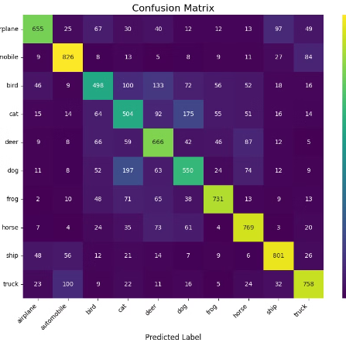
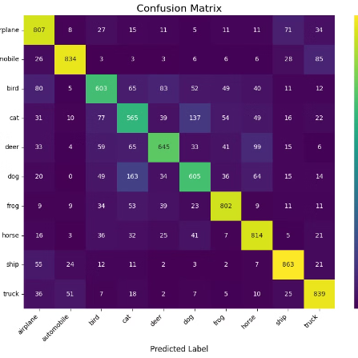
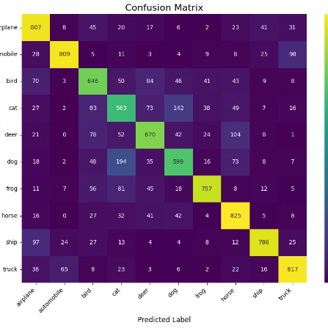
Confusion Matrices for CNN Models
Model 1
Model 2
Model 3
Optimizer = Adam
Optimizer = Adam
Optimizer = Adam
Learning Rate =0.01
Learning Rate =0.01
Learning Rate =0.001
Loss Fun = BCELoss
Loss Fun = BCELoss
Loss Fun = BCELoss
Epoch=10
Epoch= 20
Epoch= 15
Batch Size=32
Batch Size= 64
Batch Size= 32
Accuracy= 0.68 10000
Accuracy= 0.74
Accuracy= 0.73

Slide 10
Comparative Table
Model
Dataset / Task
Key Hyperparams
Final Metric
Training Time
PyTorch ANN (Reg)
California Housing
LR=0.01, Epoch=30
MSE=1.31, MAE=0.90
~1 min
PyTorch ANN (Class)
Customer Churn
LR=0.01, Epoch=100
Accuracy=83%, Recall=52%
~1 min
Keras CNN (Model 2)
CIFAR-10
LR=0.001, Epoch=20
Accuracy=74%
~1 min (GPU)

Slide 11




Key Takeaways
Strengths
PyTorch ANN: Simple architectures, decent results for regression and binary classification.
Strengths
Keras CNN: Improved accuracy with deeper architectures and dropout regularization.
Weaknesses
PyTorch ANN: Limited recall for imbalanced datasets.
Weaknesses
Keras CNN: Performance plateaued with increased complexity.

