Slide 1
Turtle Games
Customer & Loyalty Analytics — Executive Briefing
Summary of customer segments, drivers of loyalty, predictive models, sentiment, and product portfolio risk.
Dataset: turtle_reviews.csv (2,000 customers) · Data Analytics — LSE DA301

Slide 2
KPI SNAPSHOT
Executive scorecard
CUSTOMERS
MEAN LOYALTY
MODEL STRENGTH R²
POSITIVE SENTIMENT
2,000
1,578
82.7%
89%
Complete customer records analysed
Average points per customer
Variance in loyalty explained by Pay + Spend
VADER reviews positive · mean compound 0.645
K-MEANS SEGMENTS
LOYALTY GINI
PEAK COHORT
PRODUCTS
5
0.415
3,410
200
Validated by Elbow + Silhouette
Concentration risk in the loyalty programme
Age 26–35 × top pay quartile (loyalty pts)
5 urgent-attention products flagged
Turtle Games · Customer & Loyalty Analytics
Prepared Jun 2026

Slide 3
COMMERCIAL HEADLINE
Loyalty is behavioural, not demographic.
Spending behaviour and remuneration jointly explain 82.7% of variance in loyalty, with an interaction model reaching R² = 0.977. Age and gender are statistical noise. The growth strategy is therefore segment-led: retain the elite, activate the affluent, and move Growth customers past the spend = 67 threshold.
Spend → Loyalty (Pearson r)
Pay → Loyalty (Pearson r)
Age → Loyalty (Pearson r)
Pay × Spend independence (r)
0.672
0.616
-0.042
0.002
Turtle Games · Customer & Loyalty Analytics
Prepared Jun 2026

Slide 4
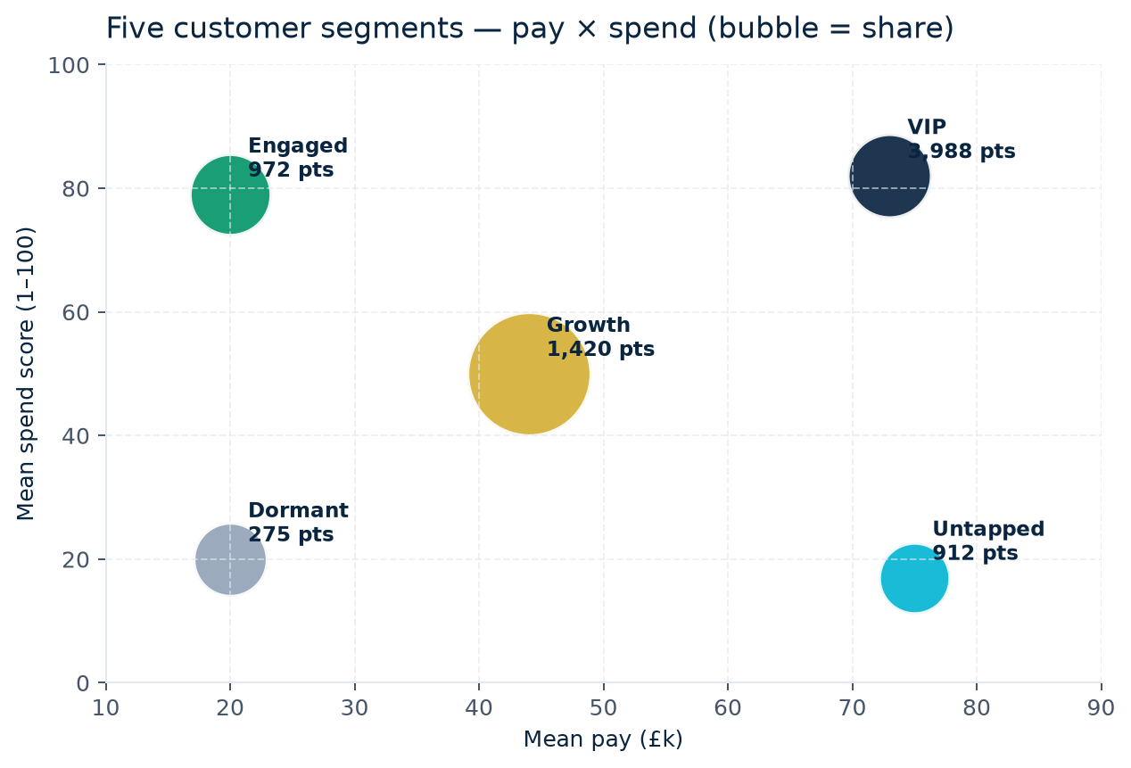
CUSTOMER SEGMENTATION (K-MEANS, K=5)
Five customer segments — strategy map
SEGMENT
SHARE
LOYALTY
ACTION
VIP
18%
3,988
Retain with platinum treatment
Growth
39%
1,420
Upgrade via spend multipliers
Untapped
13%
912
Highest-priority activation campaign
Engaged
17%
972
Protect with value-based rewards
Dormant
14%
275
Automated low-cost win-back
Turtle Games · Customer & Loyalty Analytics
Prepared Jun 2026

Slide 5
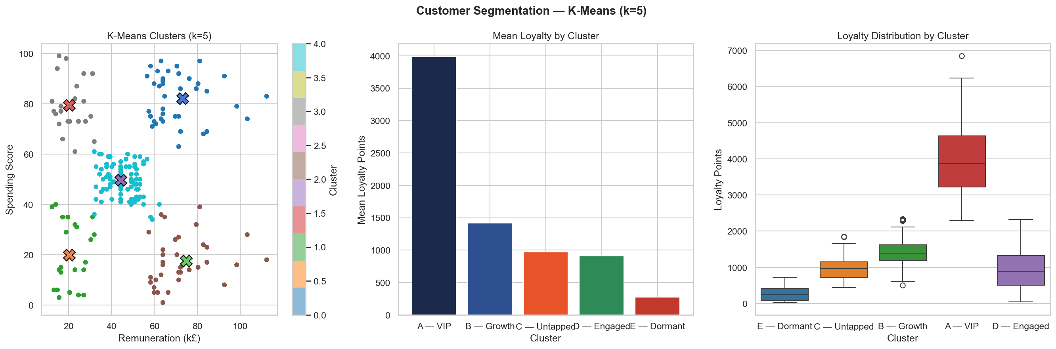
Customer Segmentation
k=5 is confirmed as optimal by both Elbow Method and Silhouette scoring
Cluster A (VIP): 356 customers, mean loyalty 3,988 pts — protect at all costs
Cluster C (Untapped): High pay (£74.8k) but low spend (17) — greatest marketing opportunity
Cluster B (Growth):774 customers — largest segment with upsell potential

Slide 6
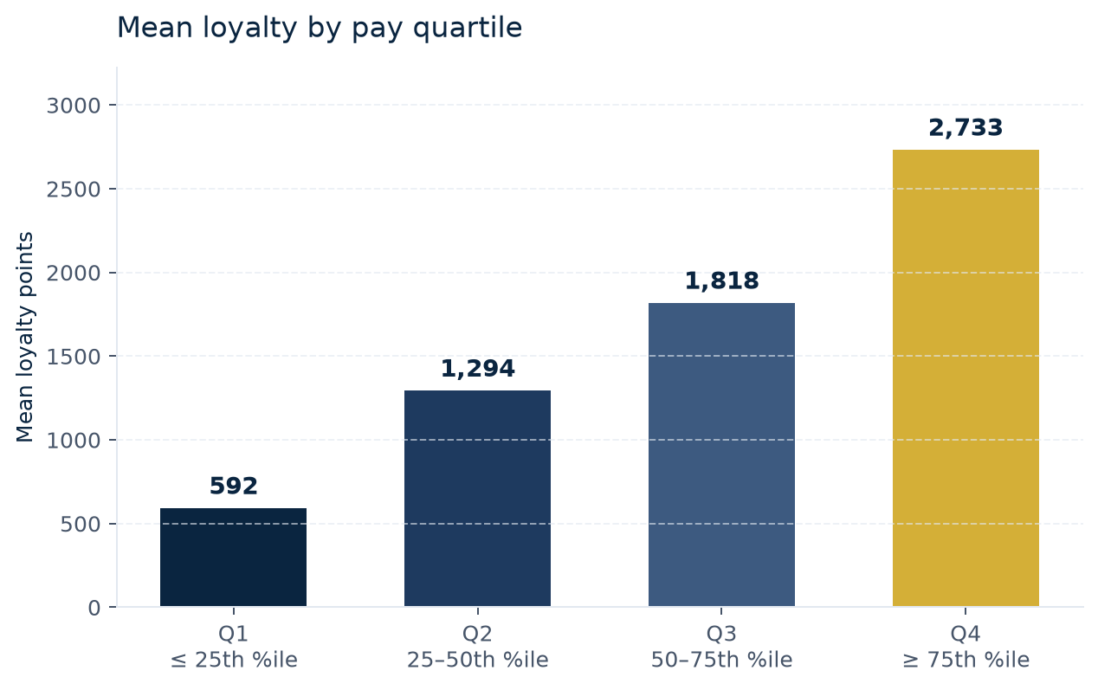
PAY QUARTILE LADDER
Higher pay sharply lifts loyalty
KEY READ
Q4 vs Q1
+362%
Q4 customers generate 362% more loyalty than Q1. Income is the strongest demographic predictor of loyalty after spending behaviour.
Turtle Games · Customer & Loyalty Analytics
Prepared Jun 2026

Slide 7
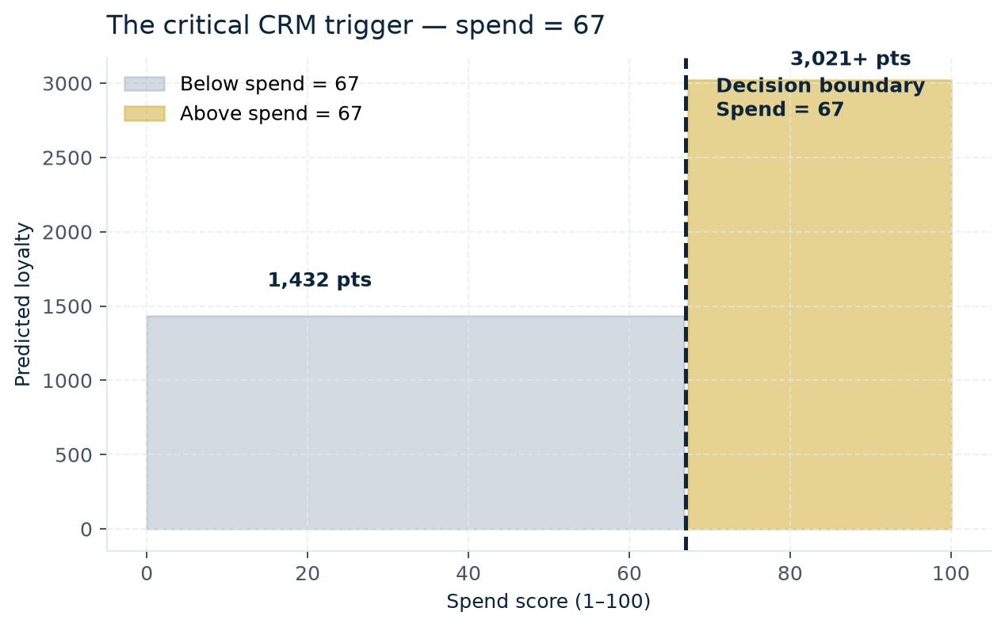
OPERATIONAL CRM TRIGGER
Decision boundary — spend = 67
BELOW THRESHOLD
1,432
ABOVE THRESHOLD
3,021+
Decision-tree regressor identifies spend = 67 as the most useful operational trigger. Customers in the 50–67 spend band should receive upgrade nudges, multiplier events and targeted product recommendations.
Turtle Games · Customer & Loyalty Analytics
Prepared Jun 2026

Slide 8
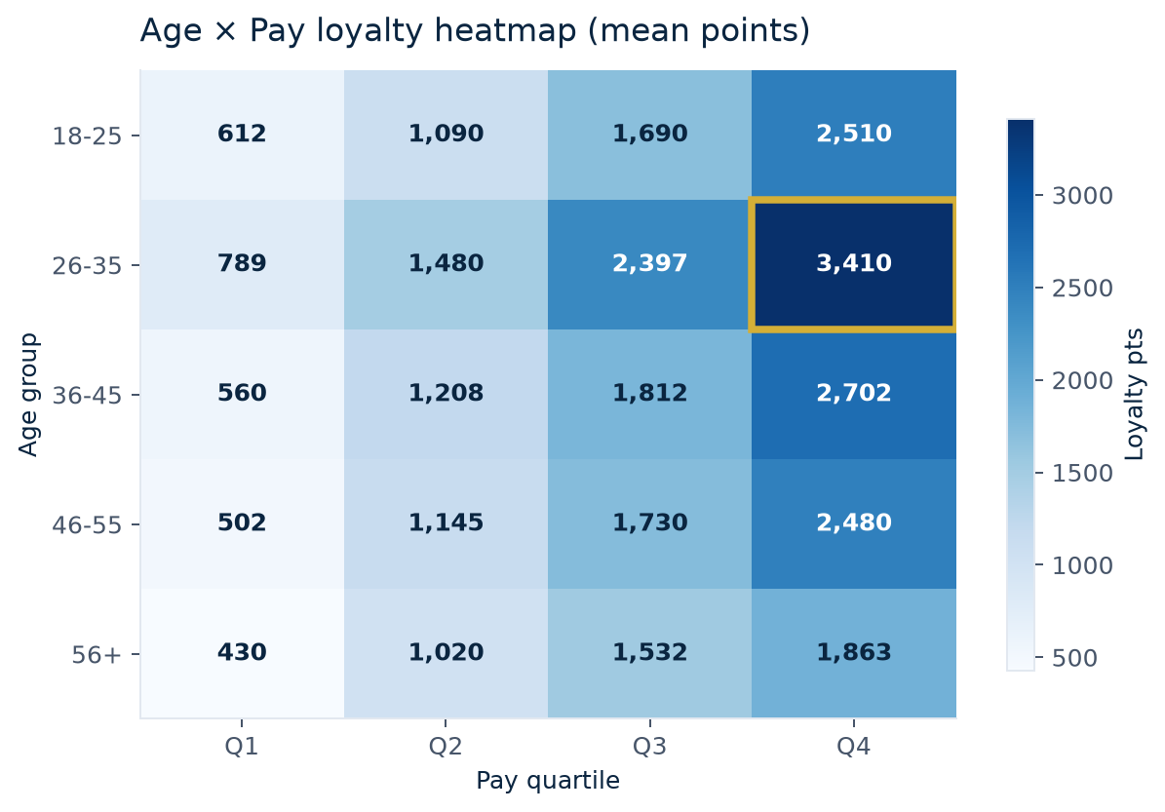
AGE × PAY INTERACTION
The golden cell — age 26–35 × top pay quartile
OPTIMAL CUSTOMER PROFILE
3,410
Mean loyalty — age 26–35 + Q4
2.2× the dataset mean (1,578). Target acquisition on LinkedIn / Instagram, career-stage content. Retain before they age out of peak loyalty years.
Turtle Games · Customer & Loyalty Analytics
Prepared Jun 2026

Slide 9
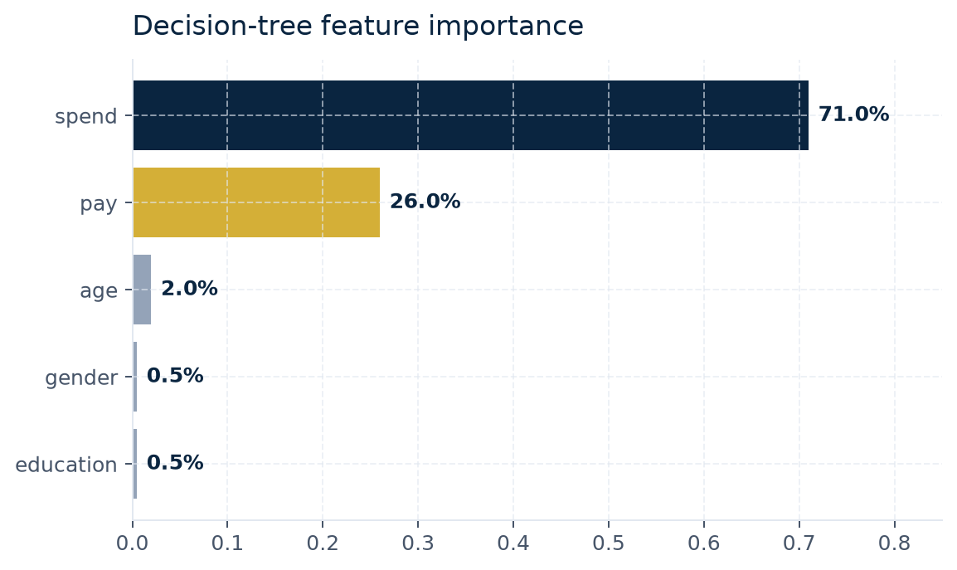
REGRESSION + TREE RESULTS
Predictive models — what actually drives loyalty
MODEL
R²
NOTE
OLS · Spend → Loyalty
45.0%
Strong single driver but heteroscedastic (Breusch-Pagan p < 0.001).
OLS · Spend → log(Loyalty)
52.0%
Log-transform reduces variance; β = 0.028 per spend point.
OLS · Pay → Loyalty
38.0%
Significant but weaker than spend.
OLS · Pay → log(Loyalty)
28.0%
Homoscedastic after log transform.
OLS · Age → Loyalty
0.2%
No meaningful linear relationship.
MLR · Pay + Spend → Loyalty
83.0%
VIF = 1.00 (no multicollinearity). Validated on 20% hold-out: 81%.
MLR with Interaction term
97.7%
Pay × Spend interaction captures non-linear synergy.
Decision Tree (pruned d=4)
89.0%
Identifies spend = 67 as primary split.
Turtle Games · Customer & Loyalty Analytics
Prepared Jun 2026

Slide 10
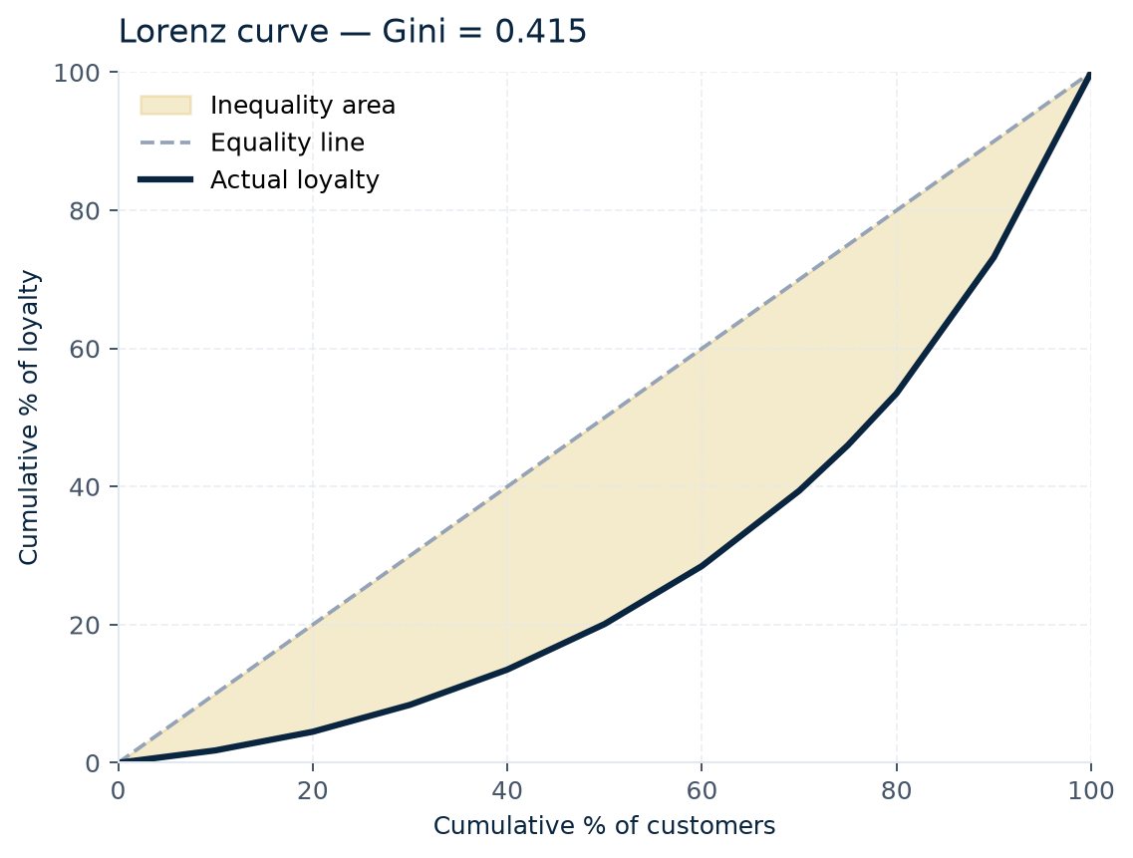
CONCENTRATION RISK · GINI = 0.415
Loyalty is highly concentrated
54%
Top 25% of customers hold 54% of all loyalty
30%
Programme value lost if top 200 customers churn
4×
Top segment loyalty vs average customer
Turtle Games · Customer & Loyalty Analytics
Prepared Jun 2026

Slide 11
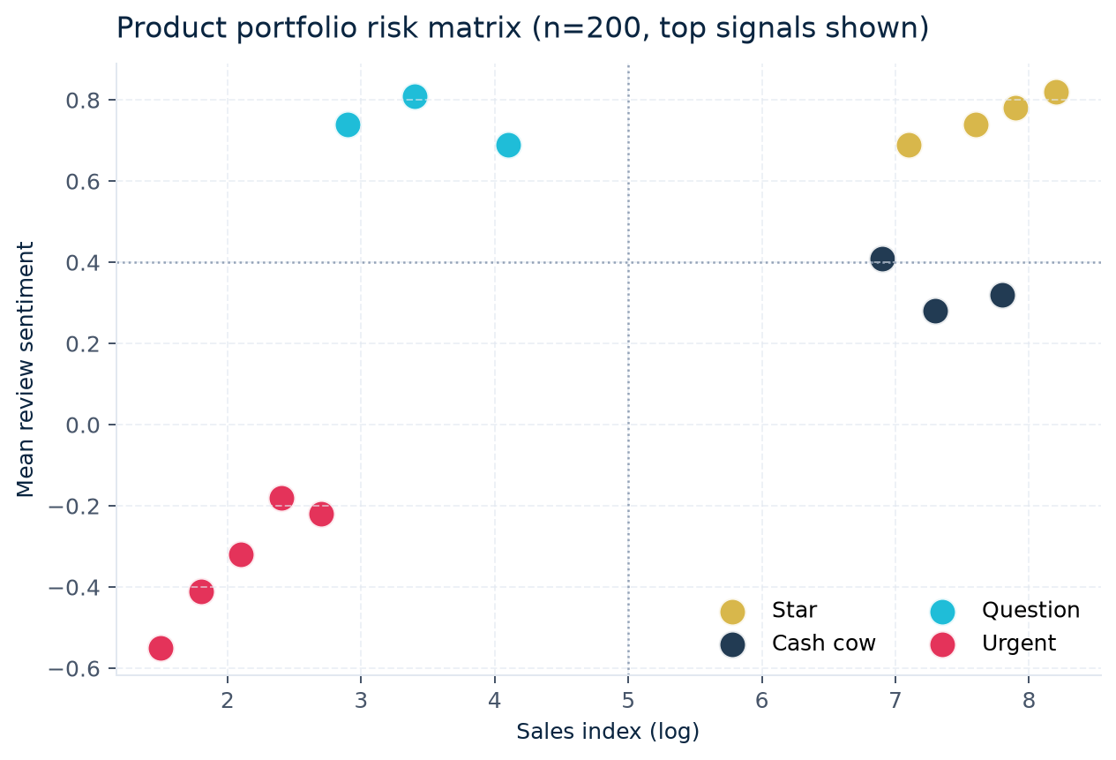
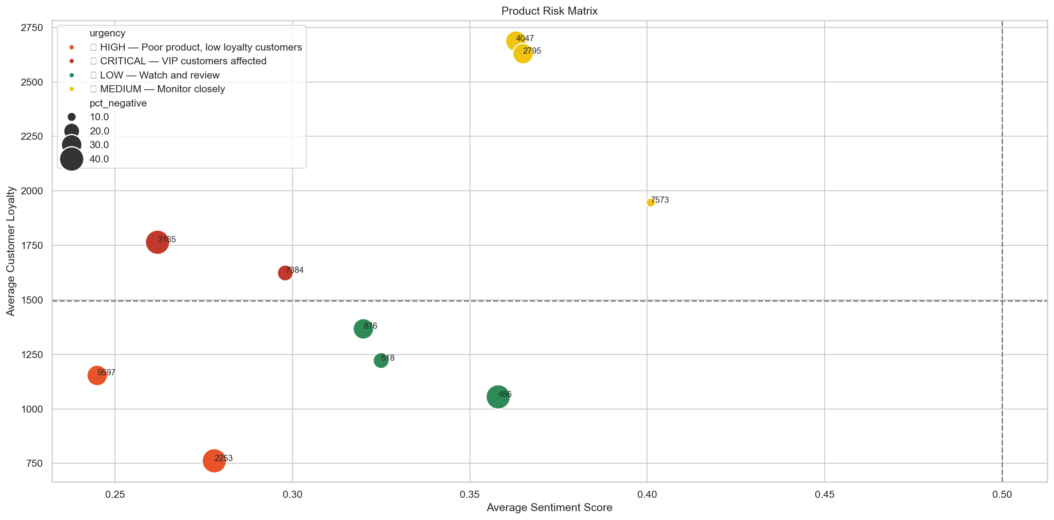
URGENT PRODUCTS REQUIRE TRIAGE
Product portfolio risk matrix
Turtle Games · Customer & Loyalty Analytics
Prepared Jun 2026

Slide 12
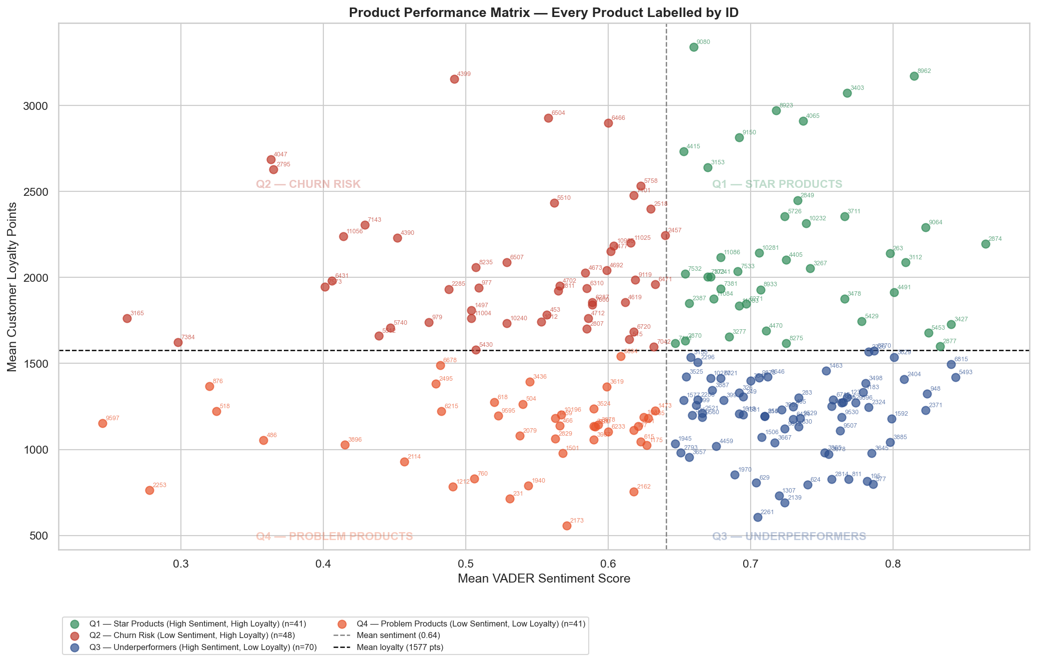
Product performance matrix

Slide 13
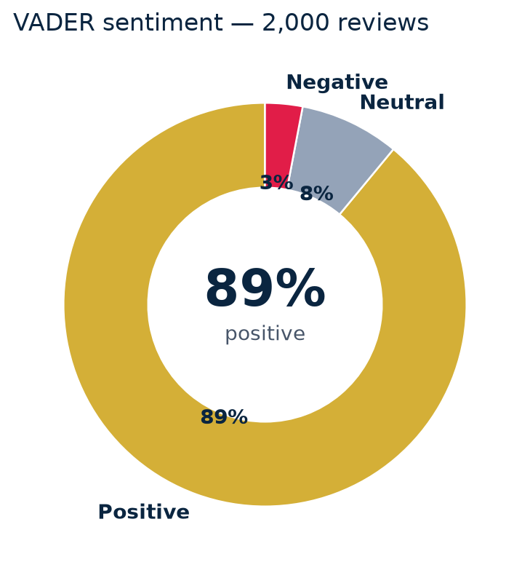
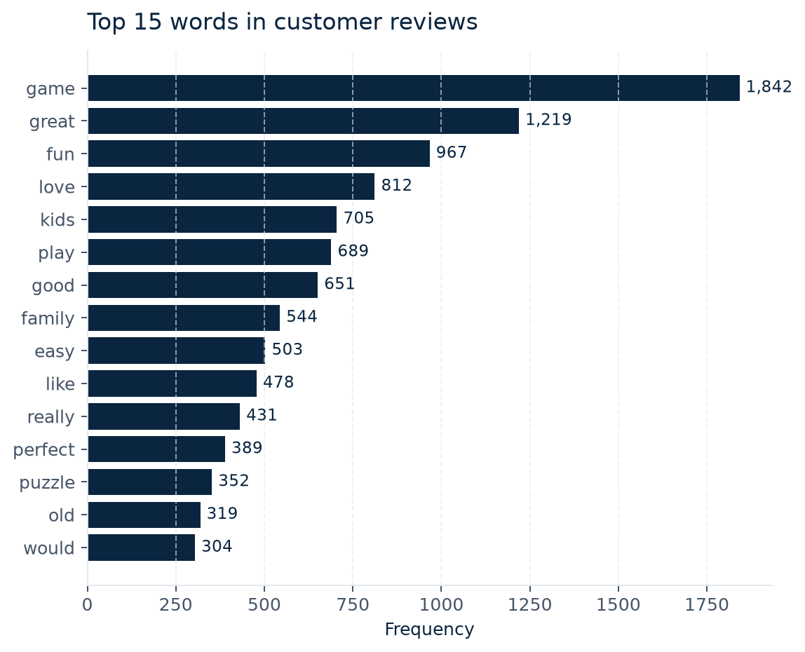
NLP · TEXTBLOB + VADER ON 2,000 REVIEWS
Voice of the customer — sentiment & vocabulary
REVIEW SNIPPETS
+ 0.97
“Absolutely brilliant — my kids cannot put it down. Perfect for family game night.”
+ 0.95
“Great quality, fast delivery, excellent value. Will buy again from Turtle Games.”
– -0.86
“Quality control is a problem — pieces missing on arrival and the box was damaged.”
Turtle Games · Customer & Loyalty Analytics
Prepared Jun 2026

Slide 14
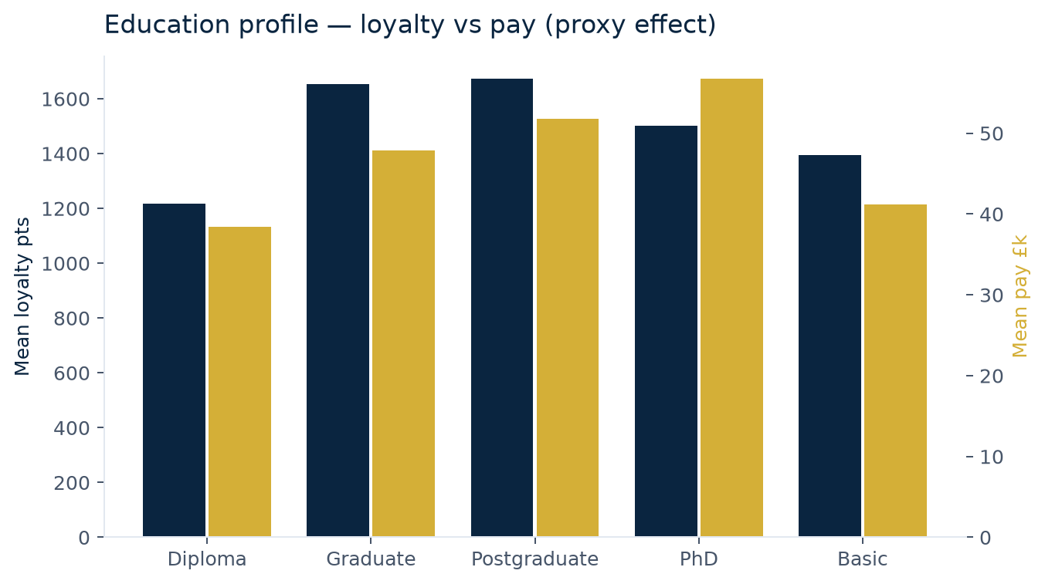
EDUCATION + GENDER
Demographics — what doesn’t (and what does) move loyalty
GENDER · t-TEST
p = 0.363
No significant effect. Loyalty campaigns must be gender-neutral.
♂ 1,551 ♀ 1,604
EDUCATION · ANOVA
F = 7.23 p <0.001
Significant — but largely a proxy for pay.
Turtle Games · Customer & Loyalty Analytics
Prepared Jun 2026

Slide 15
STRATEGIC ACTIONS
Retain the elite. Activate the affluent. Fix product risk fast.
RETAIN
VIP segment (18%)
Platinum treatment, exclusive access, personalised rewards. Loss of top 200 = 30% programme value.
ACTIVATE
Untapped (13%)
High-income, low-spend. Estimated 6.5× CLV uplift if they behave like VIPs. Highest activation ROI.
UPGRADE
Growth (39%)
Move past the spend = 67 threshold with multiplier events and bundle nudges.
PROTECT
Engaged (17%)
Lower income, high spend. Defend with value-based rewards and loyalty tier preservation.
TRIAGE
5 urgent products
Quality-control sweep on the urgent quadrant. Fix returns/instructions/packaging before peak season.

Slide 16
TAKEAWAY
Retain the elite. Activate the affluent. Move Growth past spend 67. Fix product risk fast.
Turtle Games ·

