Slide 1
SHENZHEN FINTECHATHON 2026
BorderProof AI
Evidence-consistent student tuition assistance | International AI Topic C
Verify the evidence.
Protect the authorization.
Team FinVeritas • English defense • 10 minutes
DEMONSTRATION SOFTWARE — NOT A BANK OR LIVE PAYMENT PRODUCT
FINVERITAS • BORDERPROOF AI • INTERNAL SYNTHETIC SANDBOX
01/12
Notes:
Introduce team FinVeritas and explicitly state that all transfers and beneficiaries shown are synthetic; real settlement is not supported.

Slide 2
01 / PROBLEM
Tuition payments fail at evidence boundaries
A student can receive a plausible invoice that contains changed beneficiary details.
Evidence can conflict
Approval can become stale
Agent output can mislead
Invoice, recipient and university banking instructions may contradict one another.
A quote or beneficiary can change after the student approves a transfer.
An LLM explanation or forged tool response must not count as payment proof.
Core design principle: untrusted content must never become execution authority.
FINVERITAS • BORDERPROOF AI • INTERNAL SYNTHETIC SANDBOX
02/12
Notes:
Real payment providers already exist; this project addresses verifying changing evidence and ensuring authorization remains bound to the intended payment.

Slide 3
02 / COMPETITION FIT
Why Topic C and why an AI participant?
International students need understandable, auditable cross-border tuition workflows.
TASK COMPLETION · 40%
SECURITY · 30%
INNOVATION · 30%
Working case → invoice → synthetic beneficiary match → quote → approval → simulated transfer → receipt.
Role/tenant guards, consent binding, fresh evidence checks, negative tests and audit chain.
Student-specific BPCE dependency checks and a reproducible synthetic fault benchmark.
Scope: Bangladesh → UK / USA / Canada *demo corridors*; legal eligibility unverified.
FINVERITAS • BORDERPROOF AI • INTERNAL SYNTHETIC SANDBOX
03/12
Notes:
Scoring percentages and topic are taken from the provided international rules. Do not describe the demo corridor list as authorized real-bank routes.

Slide 4
03 / WORKFLOW
One auditable tuition-payment journey
The backend enforces control points; the UI cannot bypass them.
1
2
3
4
5
6
7
Intent
→
Invoice
→
Evidence
→
Quote
→
Approval
→
Sandbox
→
Receipt
Fail closed on missing evidence, tampering, recipient conflict or expired authorization.
FINVERITAS • BORDERPROOF AI • INTERNAL SYNTHETIC SANDBOX
04/12
Notes:
Walk through a single example from the prepared synthetic invoice. Emphasize that approval is case-and-quote specific, not a global permission.

Slide 5
04 / ARCHITECTURE
Real app state, independently enforced security
Frontend is a Next.js source project plus verified FastAPI standalone preview.
USER UI
API / BPCE
DATA / AUDIT
Next.js source
Standalone browser preview
EN · 简体中文 · বাংলা
FastAPI validation
Policy and ownership checks
Quote and consent binding
SQLite local demo
Double-entry sim ledger
Hash-linked local audit
No financial-provider credentials. No bank settlement. No external identity verification.
FINVERITAS • BORDERPROOF AI • INTERNAL SYNTHETIC SANDBOX
05/12
Notes:
The standalone preview has been exercised with real API requests. The Next.js production build has not been verified because npm registry access was unavailable.

Slide 6
05 / BPCE
The BorderProof Consistency Engine
An execution-time recheck, not an assertion from model text.
BOUND DEPENDENCIES
NEGATIVE CONTROLS
Document SHA-256 and parser values
Case amount / currency
Beneficiary from synthetic registry
Provider quote and expiry
Authorization scope / evidence-set version
Changed amount or recipient → block
Uploaded new evidence → invalidate
Stale quote → reject
Forged simulator response → reject
Untrusted instructions → flag / stop
Security claims are limited to the tested internal simulator and local threat model.
FINVERITAS • BORDERPROOF AI • INTERNAL SYNTHETIC SANDBOX
06/12
Notes:
BPCE is not cryptographic payment mandate verification. Existing protocols such as AP2 already cover related mandate/authorization ideas.

Slide 7
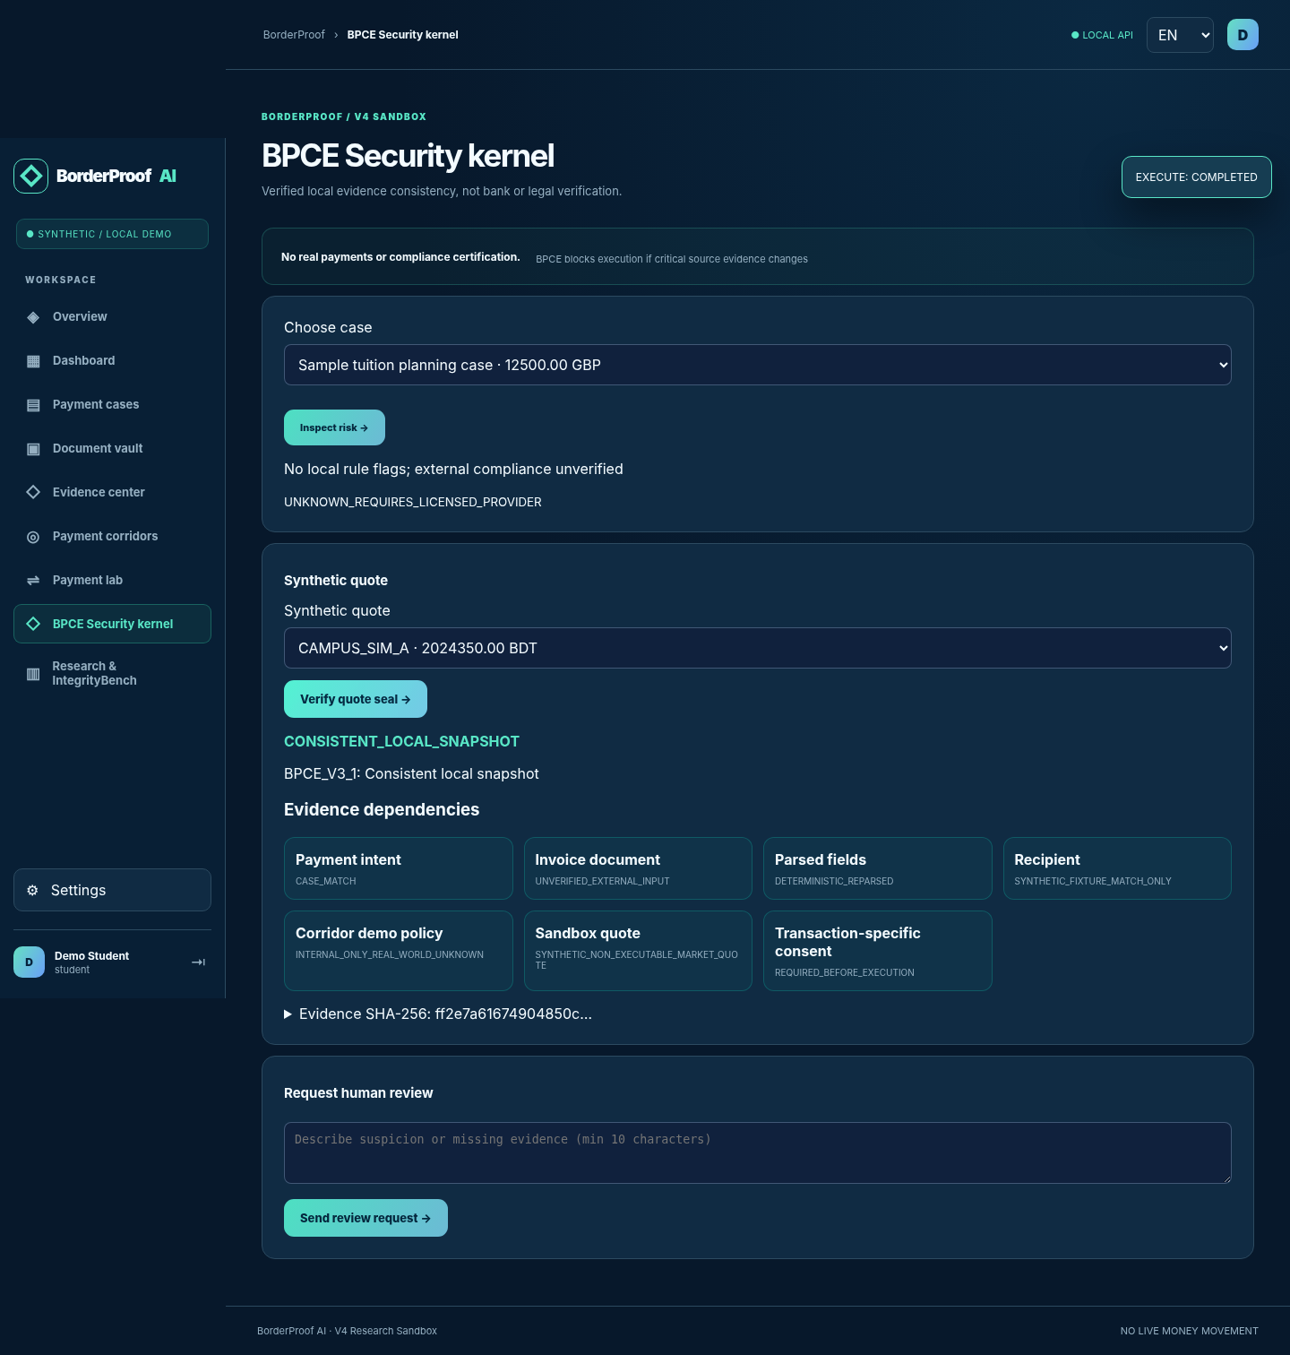
06 / DEMONSTRATION
Show one safe completion and one deliberate block
Demonstrate observable backend state and explain failed outcomes.
PASS
Synthetic correct fixture → explicit approval → COMPLETED simulation.
BLOCK
Changed beneficiary or expired quote → HTTP 409 / no debit.
Evidence comes from generated DB receipts and reproducible test cases.
FINVERITAS • BORDERPROOF AI • INTERNAL SYNTHETIC SANDBOX
07/12
Notes:
Switch between Payment Lab and BPCE inspector. Never say the example university or bank account has been externally authenticated.

Slide 8
07 / STUPAY-INTEGRITYBENCH
300 authored synthetic scenarios
The holdout set is 60 examples; labels and heuristics are project-authored, not blind expert-validated.
60
40
50
50
Legitimate
Incomplete
Recipient conflict
Prompt injection
40
40
20
Approval changes
Failure & recovery
Corridor conflict
Split: 240 development + 60 stratified holdout · 8 hand-coded policy variants.
FINVERITAS • BORDERPROOF AI • INTERNAL SYNTHETIC SANDBOX
08/12
Notes:
The generated benchmark is reproducible, not a random sample of real payments. Held-out labels are not independently audited.

Slide 9
08 / MEASURED RESULTS
Unsafe scenarios accepted in 60-case holdout
Lower is better · 48 unsafe-labelled cases · policy proxies are NOT LLMs or AP2.
Heuristic proxy
38/48
AP2-inspired proxy
20/48
BPCE core proxy
5/48
BPCE also rejected 3/12 legitimate cases (25% false rejection in this synthetic holdout).
FINVERITAS • BORDERPROOF AI • INTERNAL SYNTHETIC SANDBOX
09/12
Notes:
These numbers come from benchmark results JSON in the ZIP. They are not statistical evidence of real-world finance safety.

Slide 10
09 / FAILURE ANALYSIS
Where the current system fails
Measuring faults is more useful than claiming perfect accuracy.
50% evasion
25% false rejects
External trust gap
Held-out prompt-injection family evaded the heuristic BPCE proxy.
Three of 12 legitimate synthetic cases were not completed by the BPCE proxy.
No real beneficiary attestations, provider settlement or regulatory clearance.
Most important next experiment: independently labelled tasks with real comparable agent baselines.
FINVERITAS • BORDERPROOF AI • INTERNAL SYNTHETIC SANDBOX
10/12
Notes:
Explicitly acknowledge the inability to generalize. This project is not fraud detection software validated on human cases.

Slide 11
10 / EVALUATION EVIDENCE
Implementation checks and limitations
Evidence categories must not be conflated.
REPRODUCIBLE
STILL UNVERIFIED
Pytest API/security suite
Chromium browser interactions
Local DB upgrade path
Benchmark corpus and CSV traces
Demo export with SHA-256 digest
Next.js production build
Docker image deployment
Provider sandbox integrations
Independent benchmark labels
Production auth / step-up / KYC
FINVERITAS • BORDERPROOF AI • INTERNAL SYNTHETIC SANDBOX
11/12
Notes:
Do not give a test count unless the release report is final; show the exact count from current verification. If asked whether the project is deployable, explain the limitations.

Slide 12
11 / CLOSING
Evidence before execution. Accountability after.
A measurable student-finance simulator with a defined path to real validation.
What we delivered
A working synthetic workflow • BPCE checks • replayable test cases • decision receipts
Not an operational payment provider. Not a verified bank integration.
FinVeritas | BorderProof AI | Source and reproducible artifacts in submission ZIP
FINVERITAS • BORDERPROOF AI • INTERNAL SYNTHETIC SANDBOX
12/12
Notes:
Invite questions about BPCE failure modes, baselines, authorization binding and the path to independent data. End in under 10 minutes.

