Slide 1
BorderProof AI
FinVeritas
Evidence-consistent assistance for international-student tuition payments
V5.3 implementation and execution evidence
INTERNAL SIMULATION. NO REAL PAYMENTS.
01
Notes:
45 seconds. Team FinVeritas, International AI Topic C. This is a real internal simulator demonstration, not a live payment product. No external partner or bank ownership verification is claimed. Source: AUDIT/FINAL_RELEASE_VERDICT.md.

Slide 2
The payment decision depends on evidence
An invoice can name one account while the payment plan uses another.
A quote can expire after the student reviews it.
A later document can change the evidence.
A retry can create a duplicate debit.
The tested kernel rechecks these conditions before internal execution.
02
Notes:
60 seconds. Explain the concrete problem using this system: source invoice, payee, fee quote and student consent must agree. Different upstream facts can invalidate a previously reasonable plan. No invented market-size or fraud-savings statistic is used.

Slide 3
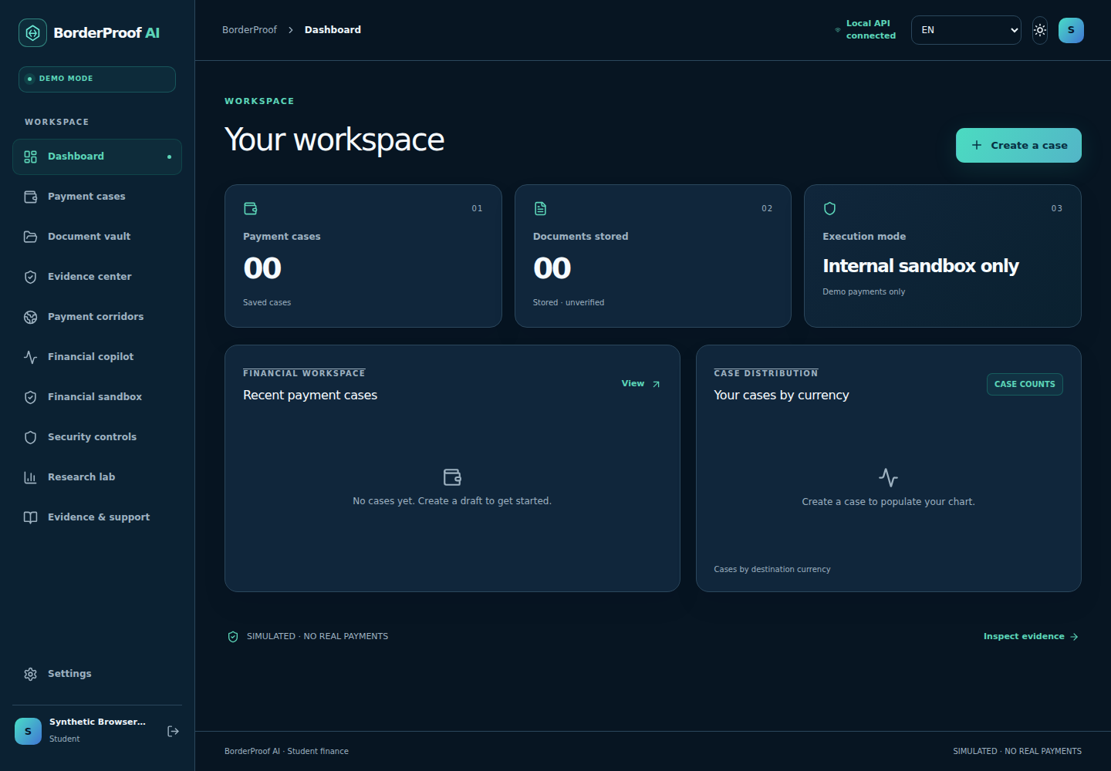
A new account starts with empty records
Native browser requests
Zero records before case creation
Same backend for both UIs
03
Notes:
55 seconds. Screenshot from actual native Next.js production server. New synthetic user account before case creation; zero counts are read from backend cases/documents, not marketing counters. The same account API powers /demo. Sources: AUDIT/evidence/native_final/report.json and next_dashboard.png.

Slide 4
The financial safety kernel
Control | Implemented behavior
Evidence binding | Stored bytes, hashes, source reparse and latest-document checks
Human consent | Exact quote and evidence snapshot, single-use approval
Financial writes | Serialized updates, strict idempotency, balanced ledger
Model boundary | Six read-only tools, no approval or payment tool
Audit boundary | Local hash chain, no external signature or anchoring
All financial execution remains inside the labelled synthetic simulator.
04
Notes:
75 seconds. Read-only model tools cannot grant transaction consent. BPCE re-parses original bytes and compares source-set, case, payee, quote and approval. Database transactions/idempotency protect retries. These are established security techniques adapted to this scenario, not a new cryptographic protocol. Sources: services/api/app/finance.py, bpce.py, audit.py, security.py and AUDIT/FINANCIAL_SECURITY_TESTS.md.

Slide 5

Actual internal execution and receipt
659.50 GBP
Recorded debit: 107136.24 BDT
Two ledger postings balance to zero.
SIM references identify local software execution.
05
Notes:
60 seconds. The displayed result is generated by the application and stored in SQLite. This is no bank or provider sandbox connection. The API acceptance also restarts Uvicorn and reads back receipt and balance. Source: native_final/FRESH-GBP_receipt.json and report.json.

Slide 6
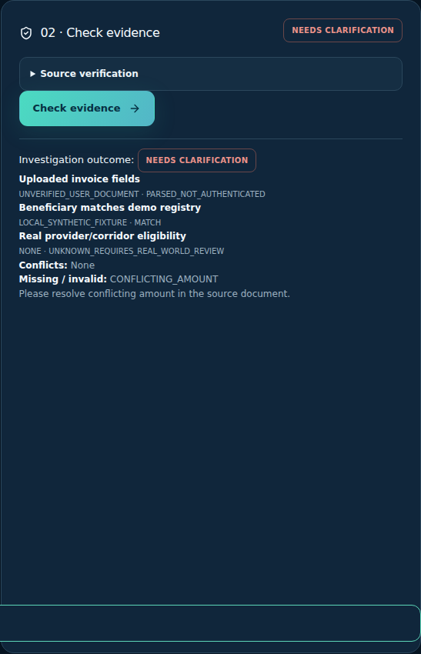
A conflicting invoice stays blocked
Conflicting source values
Explicit clarification
No quote or approval shortcut
06
Notes:
60 seconds. A separate new case receives a fresh invoice with conflicting amount labels. The parser asks for clarification and quote creation stays disabled. This screenshot is an actual browser state; no success UI was fabricated. Source: native_final/next_conflict_details.png, report.json, inputs/fresh_contradiction.txt.

Slide 7
Research results expose remaining failures
Original holdout policy proxy | Unsafe cases accepted / 48
Heuristic assistant proxy | 38
Static approval proxy | 28
AP2-inspired proxy (not AP2) | 20
BPCE core proxy | 5
BPCE also rejects 3 of 12 safe cases. True LLM baselines remain unmeasured.
07
Notes:
80 seconds. These are authored synthetic offline policy proxies, not real LLM or AP2 implementations. Original 300 cases, 60 holdout; BPCE accepts 5/48 unsafe cases and rejects 3/12 legitimate cases. Added 96 frozen rows have 24 holdout. Same generator templates limit generalization, IDs expose families, labels are not independently adjudicated. Sources: research/original_reproduction/holdout_results.json and methodology_and_results.json. Prior art reviewed at abstract/README level: https://arxiv.org/abs/2609.00060 , https://arxiv.org/abs/2604.15367 , https://arxiv.org/abs/2406.13352 , https://aclanthology.org/2024.findings-acl.624/ , https://github.com/google-agentic-commerce/AP2 .

Slide 8
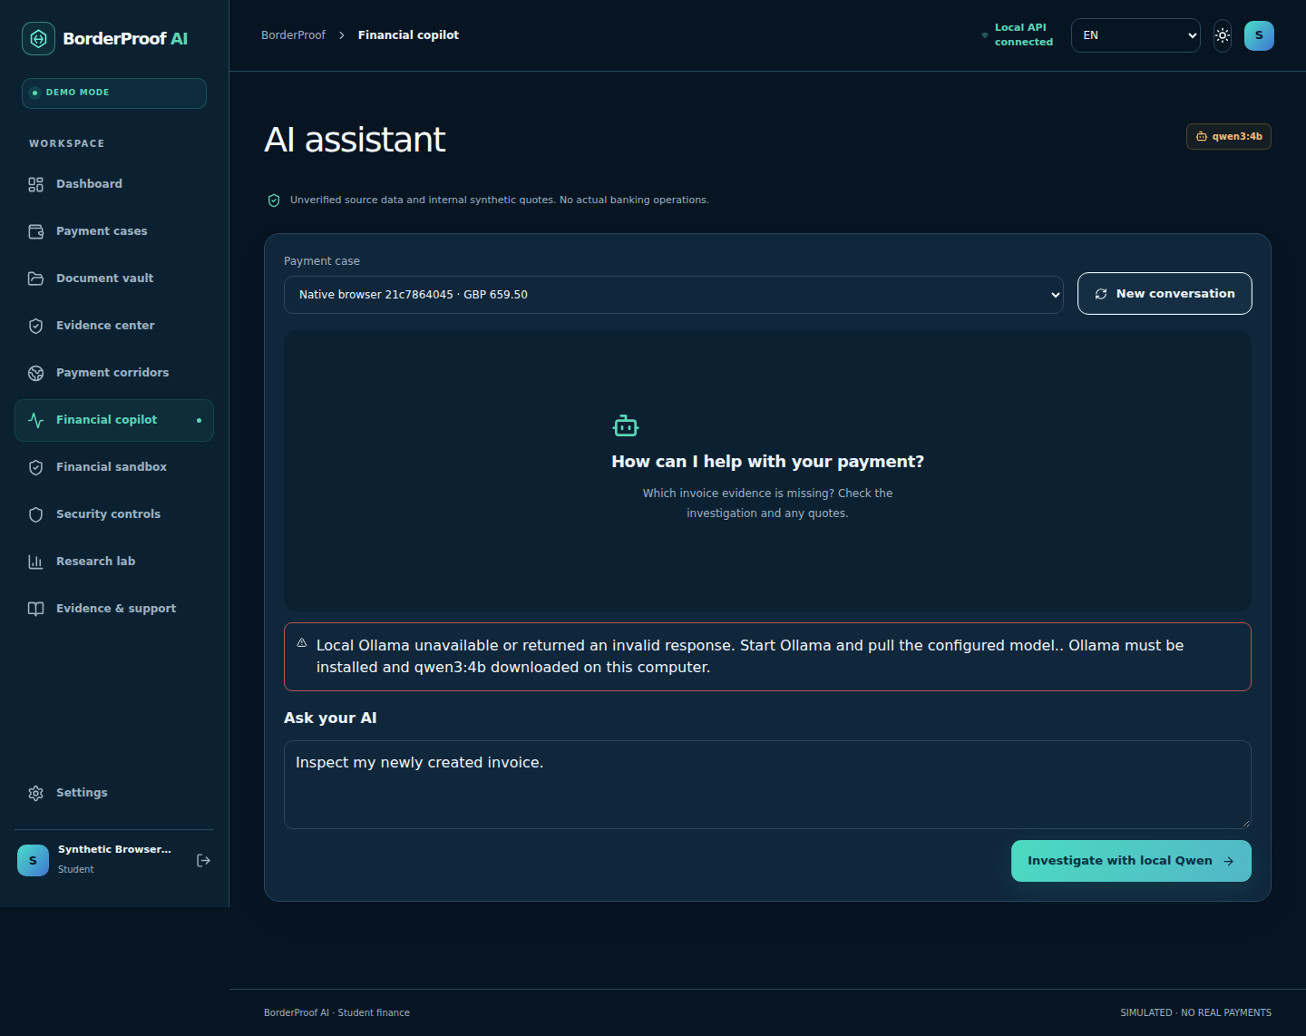
Local Qwen validation is still pending
Mock contracts verify tool boundaries.
Real inference requires the local laptop.
The model cannot approve or execute.
08
Notes:
60 seconds. Actual Work localhost model probe returned connection refused. UI reports 503. We do not replace that with a canned answer. The included local script creates synthetic input and captures 8 actual Qwen requests, read-only tool traces, model identity and latency. Human answer/citation scoring is not automatic. The user laptop can run it with Ollama qwen3:4b. Sources: live_model_preflight.json and scripts/validate_local_agent.py.

Slide 9
Release status and next validation
130 backend tests passed
Production Next.js build and native browser journeys verified
Original 300-case corpus reproduced, plus 96 frozen challenge cases
READY FOR LOCAL SIMULATION DEMO
Production finance and unqualified live-agent claims remain unready.
09
Notes:
65 seconds. Readiness applies to the internal local demo. No deployment, GitHub push, organizer message, real transfer or charge occurred. Production is blocked by absent external financial/legal evidence, durable cloud document storage, executed PostgreSQL/Docker checks and live Qwen validation. Lint has 11 retained performance/dependency warnings, no lint errors. The clean evidence should be rechecked if numbers change. Sources: AUDIT/FINAL_RELEASE_VERDICT.md, FRONTEND_PRODUCTION_BUILD.md, RENDER_READINESS.md and clean logs.

