Slide 1
✳
FOODRECALL AI
Evidence first.
Decisions reviewed.
Agent investigations · Traceable sources · Scout Intent contracts
V0.8 | 24 OCT 2026 | LOCAL TRAINING CANDIDATE — NOT FINAL

Slide 2
V0.8 · LOCAL DEVELOPMENT CANDIDATE
The operational problem
Recall evidence can be incomplete or contradictory.
Text similarity is not proof that a warehouse lot is affected.
An earlier decision can become unsafe when supplier evidence changes.
Food safety decisions need source visibility and a qualified reviewer.
FoodRecall AI | Synthetic training demo | NOT production authorized
02

Slide 3
V0.8 · LOCAL DEVELOPMENT CANDIDATE
What the agent actually does
User asks a recall question in the Investigation workspace.
Scout Intent scopes the task and issues signed, time-limited tool contracts.
Read-only tools inspect case, lots, supplier records and optional approved sources.
Agent reports citations, ambiguity, missing sources and observed steps.
Any proposed training hold goes to separate QA approval.
FoodRecall AI | Synthetic training demo | NOT production authorized
03

Slide 4
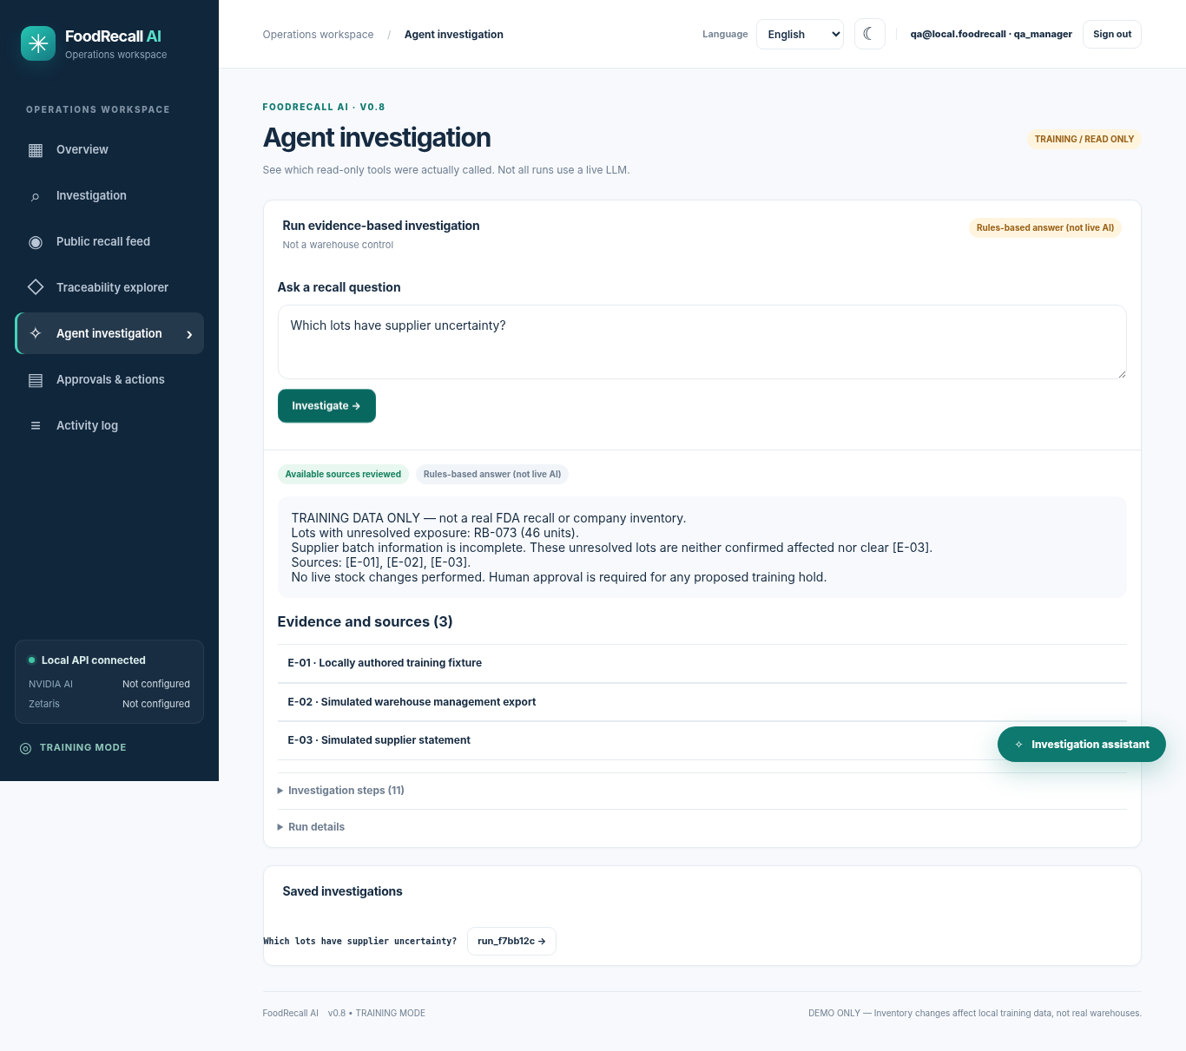
V0.8 · LOCAL DEVELOPMENT CANDIDATE
Real UI: investigation with cited evidence
Prior V0.7 UI screenshot
V0.8 keeps the compact UI and adds signed Scout tool contracts to its execution trace.
TRAINING DATA ONLY
FoodRecall AI | Synthetic training demo | NOT production authorized
04

Slide 5
V0.8 · LOCAL DEVELOPMENT CANDIDATE
Meterless Scout Intent is in the execution path
Implemented: Sense → Interpret → Guard → Route → Recommend.
Eight FoodRecall-specific intents; default to local read-only sources.
5-minute HMAC execution contracts checked before every tool call.
Forged, expired and out-of-scope tool calls are refused.
Official upstream Meterless npm eval: NOT RUN in this environment.
FoodRecall AI | Synthetic training demo | NOT production authorized
05

Slide 6
V0.8 · LOCAL DEVELOPMENT CANDIDATE
A decision becomes stale when evidence changes
Training case: RB-071 / RB-072 affected; RB-073 initially uncertain.
QA manager approves a synthetic hold proposal.
Supplier evidence is updated; earlier decision snapshot no longer matches.
Stale execution is blocked; reviewer inspects Decision Diff.
New proposal and fresh approval are required before training readback.
FoodRecall AI | Synthetic training demo | NOT production authorized
06

Slide 7
V0.8 · LOCAL DEVELOPMENT CANDIDATE
Sponsor integrations: honest readiness
METERLESS
Scoped Scout Intent works locally; upstream eval not run.
NVIDIA
Nemotron client + output guards; live API not verified.
ZETARIS
Read-only SQL adapter; tenant connection not verified.
FDA
Historical source versioning; live archive sync not verified here.
FoodRecall AI | Synthetic training demo | NOT production authorized
07

Slide 8
V0.8 · LOCAL DEVELOPMENT CANDIDATE
Local executed verification
85/85
50
65/65
Backend tests
Authored Scout test cases
Synthetic dependency checks
Also checked: TCP localhost auth/CSRF/QA flow, Chromium UI, 8 locale dictionaries, and signed-contract tampering/expiry.
Also checked: TCP localhost auth/CSRF/QA flow, Chromium UI, 8 locale dictionaries, and signed-contract tampering/expiry.
Also checked: TCP localhost auth/CSRF/QA flow, Chromium UI, 8 locale dictionaries, and signed-contract tampering/expiry.
These are LOCAL training checks, not real-world model accuracy or sponsor compliance.
These are LOCAL training checks, not real-world model accuracy or sponsor compliance.
These are LOCAL training checks, not real-world model accuracy or sponsor compliance.
FoodRecall AI | Synthetic training demo | NOT production authorized
08

Slide 9
V0.8 · LOCAL DEVELOPMENT CANDIDATE
Architecture: bounded and inspectable
USER QUESTION
→
SCOUT CONTRACT
→
READ-ONLY TOOLS
→
EVIDENCE REPORT
→
QA REVIEW
Explicit boundaries: no real warehouse action, no automatic FDA-to-inventory join, no unverified citations, and stale approvals cannot be reused.
FoodRecall AI | Synthetic training demo | NOT production authorized
09

Slide 10
V0.8 · LOCAL DEVELOPMENT CANDIDATE
What remains before any final submission
Run real NVIDIA model/tool-call and Zetaris tenant SQL verification.
Run upstream Meterless acceptance tests or obtain organizer confirmation.
Install and exercise genuine LangGraph on an internet-enabled machine.
Verify FDA live sync and test any HTTPS-hosted synthetic demo.
Record authentic <=4-minute demo, publish secret-free GitHub, submit.
FoodRecall AI | Synthetic training demo | NOT production authorized
10

