Slide 1
A Brighter Future
INCOME BASED SOCIAL EQUITY PLAN
Xiaowei Jin, Sadia Nasir, Kashyap Patel, Johnny Li, Parshan Bahrami
Notes:
lkfdslfnss

Slide 2
Business Problem and Social Equity Goals
Business Problem
Goals
Government of Canada wants to fund construction and renovation projects but don’t know which geographic areas need more attention to increase social equity.
Social Equity
1
Targeted Development
2
Employment Opportunities
3
4
Economic Prosperity
Notes:
cdcdscsddcs

Slide 3



Our Strategy
Segmentation and Income Prediction of Areas
Increase Social Equity
Better Understanding of Geographic Areas
Optimal Allocation of Public Funds For Development

Slide 4
Better Understanding of Geographic Areas
Notes:
as mentioned in our strategy plan, in order to reach our ultimate goal by segemenattion and allocating public funds for development, we would require a good understanding of the geograhic area

Slide 5
Census Data
Provided by Statistics Canada
Data contain information on census tracts with 15 main characteristics that include:
1. Population characteristics (total population)
2. Household characteristics
Total households
Households built in various time periods
Number of types of households (apartments, dwellings)
Number of houses (owned, rented)
3. Median Income
Repetitive and highly correlated variables were removed:
Total households for period of construction
Total households for tenure
Additional derived variables added:
Percentage changes in number of households constructed for each of the five time periods. (1961-80, 1981-90,…, 2005-16)
Percentage of occupation types for private dwellings.
Notes:
the census dataset provided by stats canada was used for this which contains details of census tracts. We first talk about larger areas, generally called census metropolitan areas and agglomeratuions, which have a population greater than or equal to 50k. Census tracts refer to mildly populated small sub-ares which have a population between 2.5k to 8000 people.
the data used has 15 main characteristics that include population, total houselholdds, segregation of househods based on the time period they were buid it, whether they are owned or rented and most importantly, median income.
because clustering was the technique implemented here and on general principle, it is adviced to avoid using highly correlated variables, we dropped 2 vars:
1. total households for period of construction
2. total households for tenure
we also added a few vars to aid in our analysis, which included 5 columns corresponding to period with thir % incease in number of households constructed and specifically for private dwellings, the occupation types of the owners
based on this, we clustered the geographical areas into 3 groups.

Slide 6
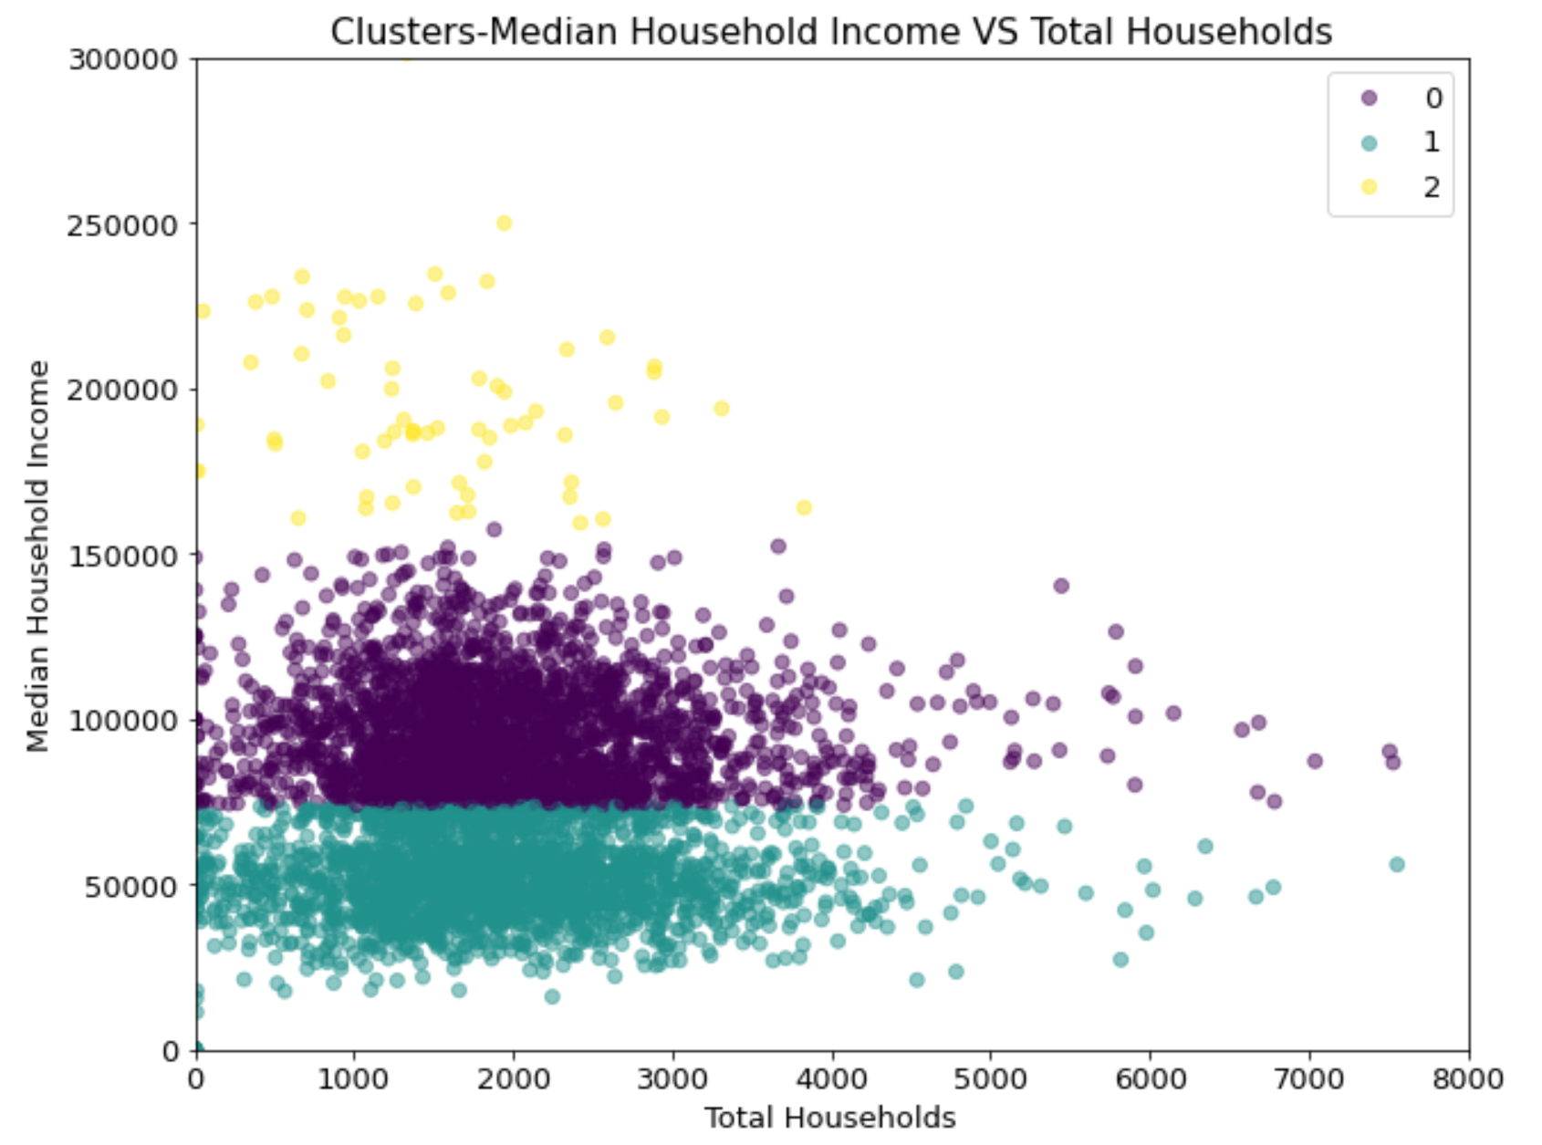
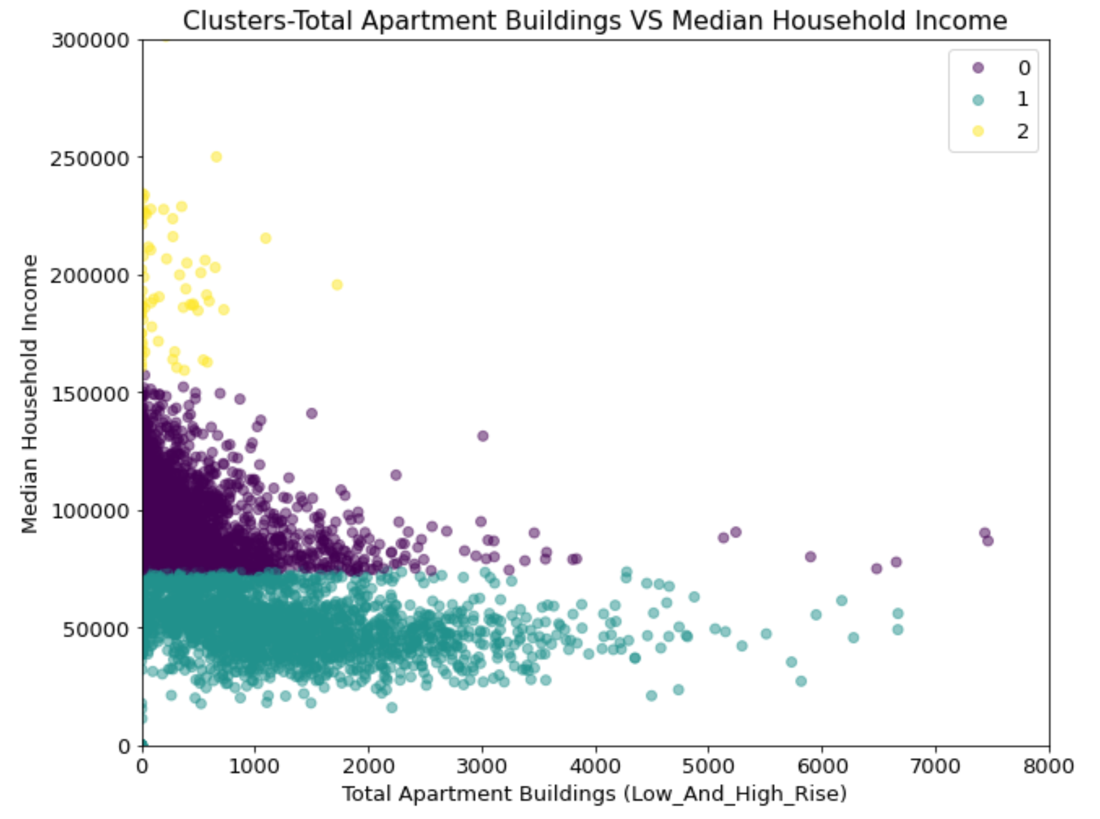
Classes of Geographic Areas
Three Classes of Geographic Areas identified:
High Income
Medium Income
Low Income
Geographic Areas differ by Median Income, as well as distribution of Households, particularly Apartment types
Notes:
Referring to all the information census data obtained, we can cluster all areas using k-means clustering algorithm. According to the silhouette score, clusters will provide the most useful and clear information when data are being segmented into three groups. From the scatterplot on the right-hand side, the first scatterplot shows the relationship b/t total household and the median income of that area, and the second scatterplot down below shows the relationship between the total apartment buildings and the median income of that area. We can observe that income clearly divides clusters horizontally regardless of the total household and the total apartment buildings in that area. Therefore, these three clusters are being identified as high-income groups (the yellow points on the top), medium income (the purple points in the middle) and low incomes (the green points down below).

Slide 7
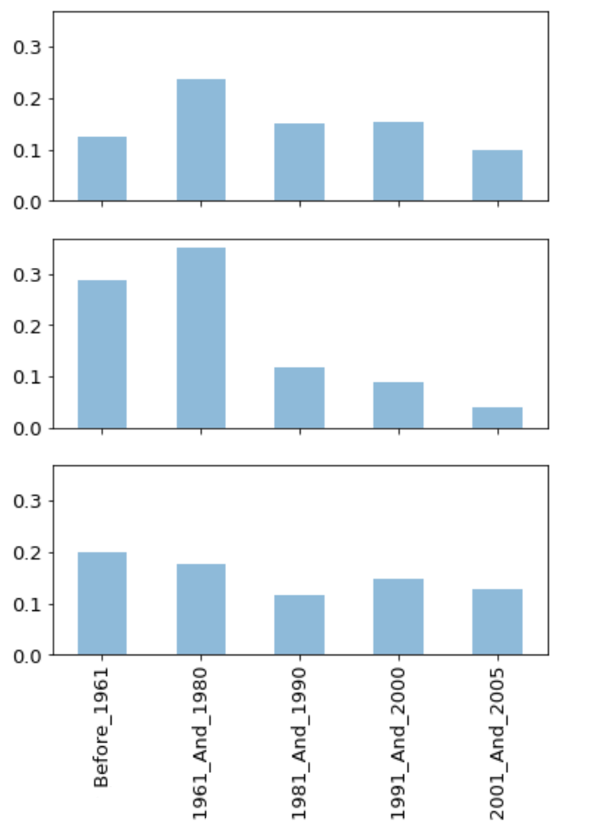
Property Age Insights
Medium Income
64% of homes in the Low-income Areas have been built before 1980 and are aging.
Low Income
High Income
Notes:
On the left-hand side, we have a histogram illustrating the percentage of homes being built in each period for different income groups. For medium and high-income groups, the proportion of home being built in each period is almost consistent since the 1980s with a minor drop on 2000s for the medium income group. However, looking into the low-income group, 64% of homes have been built before 1980, indicating that buildings or houses in these areas are facing the aging issue.

Slide 8
Prediction of Area Median Income
Notes:
Now with a good understanding of what the clustering algorithm can bring to the table, we will move onto the prediction of the median income of different census tracts.

Slide 9
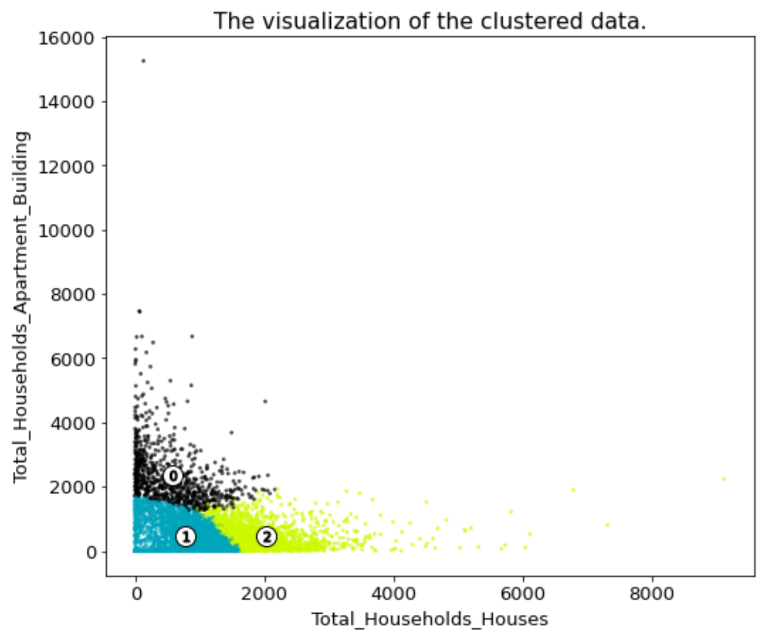
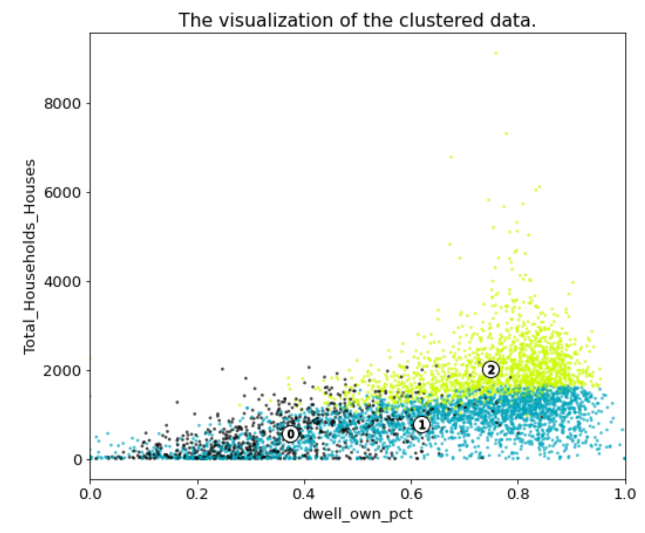
Segmentation of Geographic Areas
Segments:
Low Density Area
Medium Density Area
High Density Area
Key predictors used in segmentation include number of houses, apartments, and house ownership per geographic area
Notes:
In the prediction stage, we re-ran the clustering algorithm without including the median income variable and the two cluster plots on the right are two of the many possible perspectives to look at the three clusters. We can see here that the number of houses and the number of apartments clearly split the three clusters. So do the dwellings ownership rate along with number of houses.

Slide 10




Census Tract Segments
High Density
Low Density
Medium Density
16%
31%
53%
Cosmopolitan
Suburb
Mixed-use
0%
100%
More households
More old buildings
Lower homeownership rate
More houses
Higher homeownership rate
Stable growth and development
Least households
Less construction projects
Slower growth and development
Notes:
To understand the bigger picture, we examined the mean values of the feature variables for each cluster. Here are the main insights we derived. 16% of the census tracts can be categorized as cosmopolitan-like area. There are more households living in relatively old apartment buildings, which means the homeownership rate is low. 31% of the census tracts can be considered as suburban areas with more houses, higher ownership rate, and a stable rate of local development. Last but not least, half of the census tracts are mixed-use areas, with a combination of residential, commercial, and even industrial properties. This type of land has the least number of households and less construction projects in the last few decades probably due to saturation.

Slide 11
Predictive Model Selection
1
Linear Regression
Evaluation Criteria
Mean Absolute Deviance
2
Classification and Regression Tree (CART)
Root Mean Square Error
3
K-nearest Neighbors
R-square
4
Neural Networks
Notes:
For each of the census tract segments identified, we will now build models that will predict the median income. In order to compare the results, we will also build a model for the whole census tract data.
We have used 4 Machine Learning Models so far which includes; Linear Regression, Classification and Regression Tree, KNN and Neural Network
To assess the performance of the models, we will mainly use the Mean Absolute Deviance.
Root Mean Square Error and R-Square will also be used to verify the model performance

Slide 12
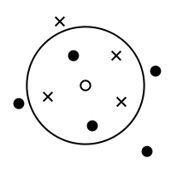
Optimal Model Per Segment (Preliminary)
All Densities
Regression Tree
High Density
Medium Density
Low Density
K-Nearest Neighbors
Notes:
For the Full Model which includes all Densities as well as for the Medium and High-Density Areas, the CART Regression Tree performed the best based on our evaluation criteria.
For the Low-Density Area however, K-Nearest Neighbors performed the best.
Segmenting these areas and then make separate prediction models for each as compared to just having one model has helped because
There are inherent differences between each area and it leads to much better prediction models according to the evaluation criteria.

Slide 13




Actions
Know Our People Well
Accurate Prediction
Look at the clusters' characteristics and understand the pain spots
Predict each area's median income
Find the Right Antidote
The Brighter Future
Optimal Fund Allocation
Customize development plans and renovation projects according to areas' pain spots
Use the predicted median income to help government with development fund allocation
Use Data and Plans to Win Support
Project Commencement
Development each geographic area accordingly and strive for social equity
Notes:
Now we will inform our future actions based on our results.
Firstly, we have firstly identified groups of census tracts with specific characteristics such as Medium Density areas, with Use areas have slower growth and development.
Then we will customize the action plan according to each area, so for Mixed-Use Areas as they have slower development, there should be higher priority for development there.
The median income predictions will help us to gauge the socio-economic level there and what sorts of development projects are needed there and what level of funding to allocate for each segment and census tract.
Lastly, our plan is to implement these projects to develop each geographic area and strive for social equity.
We hope to have your support to be able to bring these actions to life.

Slide 14
Thank You
Question Period

