Slide 1

BookWorm
Student Name & ID :
Abiha Tahsin Chowdhury 180104126
Barnana Prabene Kristi 180104127
Sadia Afsana Mumu 180104138
Arpa Alam 180104143

Slide 2

PROJECT SUMMARY
Bookworm project website used to maintain all activities of library system such as maintain books stock, issue book records, author record, publisher record, member detail.
Here is add on system for donation. User can donate according to their interest. And donation records are also stored.
Provides help and support to members through mailing system, which directly contact with the Admin. Thus admin can help as needed.

Slide 3
PROJECT REQUIREMENTS
Software: Visual Studio 2019
Languages: C#, HTML5, CSS, JavaScript
Platform: Web Application
Database: SQL
Framework: ASP.NET MVC
Architecture: MVC ( Model - View - Controller)
The Elements included in this Project

Slide 4
Context level Diagram
Data Flow Diagram
Level 1 Diagram
Level 2 Diagram

Slide 5
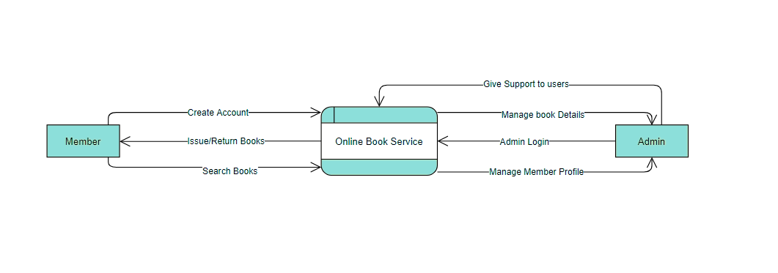

Context Level Diagram

Slide 6
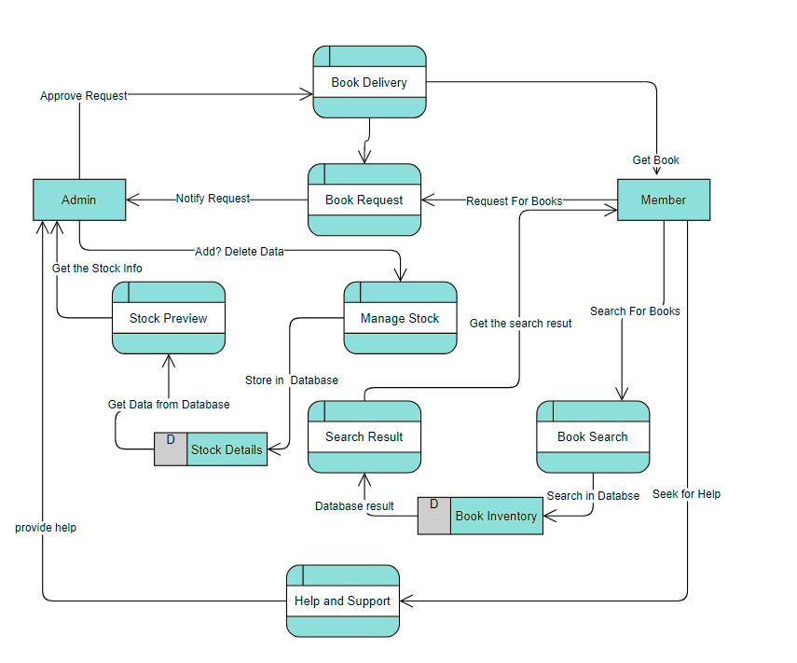
Level 1Diagram

Slide 7
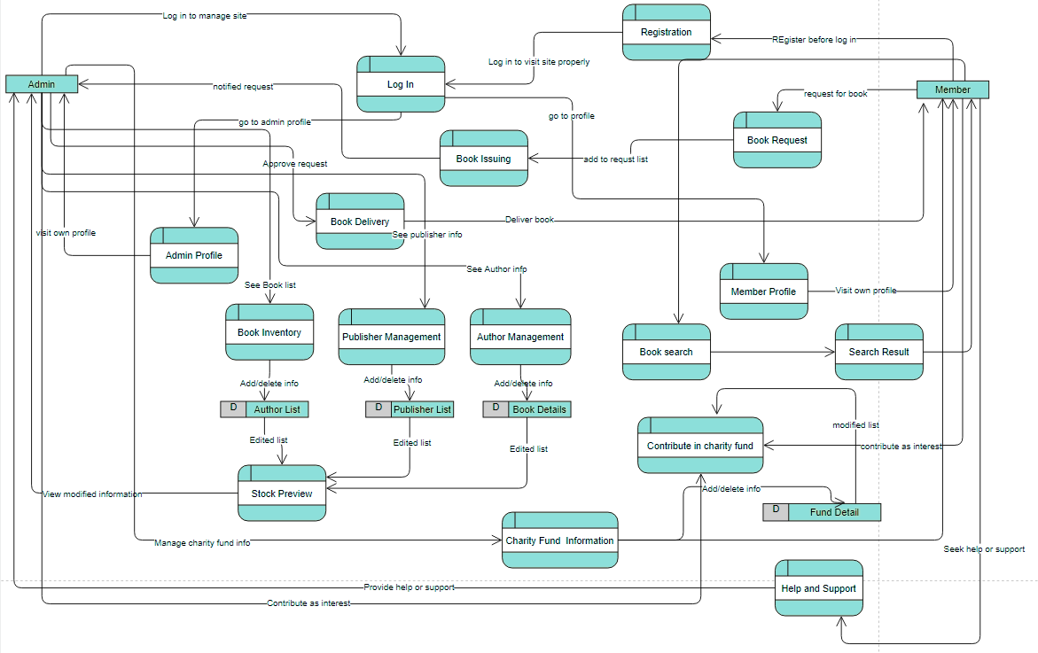
Level 2 Diagram

Slide 8
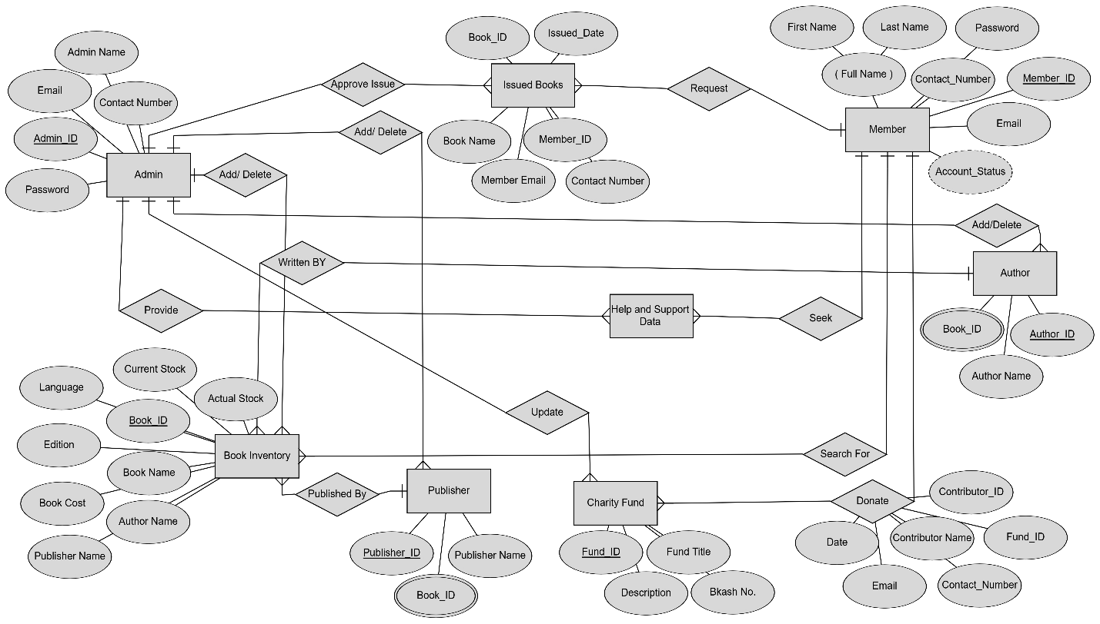
Entity Relationship Diagram

Slide 9
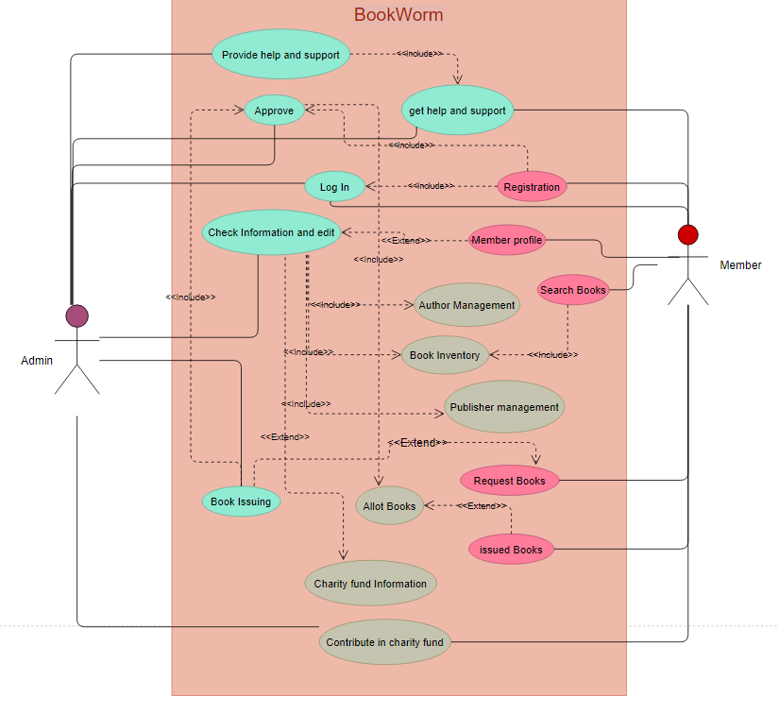
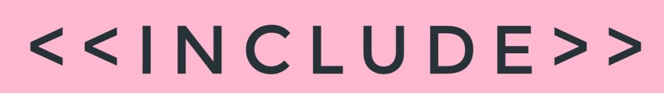
Use Case Diagram

Slide 10
Project
Demonstration

Slide 11
Future Plans
Add more features and functionality, thus it becomes more user friendly
Add more and more books in our inventory in upcoming time
Will try to Use advanced cloud based database system

Slide 12
Thank You!!

