Slide 1
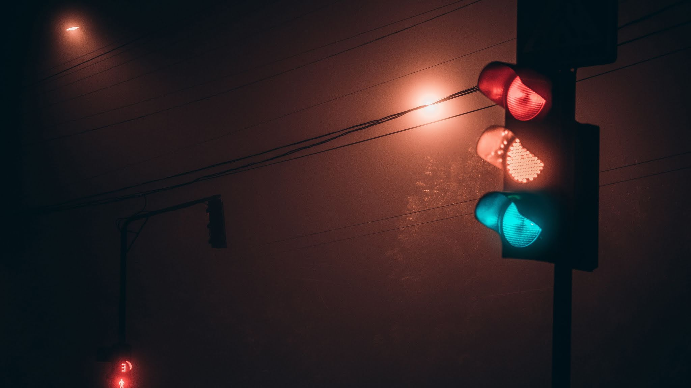
Density based Four Way Traffic System
Group no : 4 Group Members & Id :
Abiha Tahsin Chowdhury 180104126
Barnana Prabene Kristi 180104127
Sadia Afsana Mumu 180104138
Arpa Alam 180104143

Slide 2
Objective
Our Main objective is to form a four way intersection, based on Density of vehicles for each lane. Traffic Lights will be used as lights and the logic and function will be performed by the Arduino alone. The code of the Arduino will be such that it will have the knowledge of when to switch on each light with respect to density of the vehicles .

Slide 3
Social Values
With the number of vehicle users constantly increasing, the facility provided by the current system is limited and inefficient. A survey shows that an average person spends about four to six months of his/her entire life just waiting for the green light to be turned ON at a signal.
It is also been identified that this inadequate facility and irrational distribution of signal control is leading to such traffic issues.
Unnecessary waiting time in the signal can be avoided by determining in which side the green signal should stay longer during the traffic.
The saving of fuel (petrol, diesel, natural gas), reduction in time of the operation of automobile engines, reduction in the emission of the harmful gases in the atmosphere.
The proposed system aims to save the number of manhours wasted at the signals and hence making effective utilization of time.

Slide 4
Required Components
Arduino Mega 2650
Traffic Lights (4 pieces )
Pedestrian Traffic Lights (4 pieces)
Resistors: (330-1000 Ohm )
Connecting wires
Pedestrian Button
Ultrasonic Sensor

Slide 5
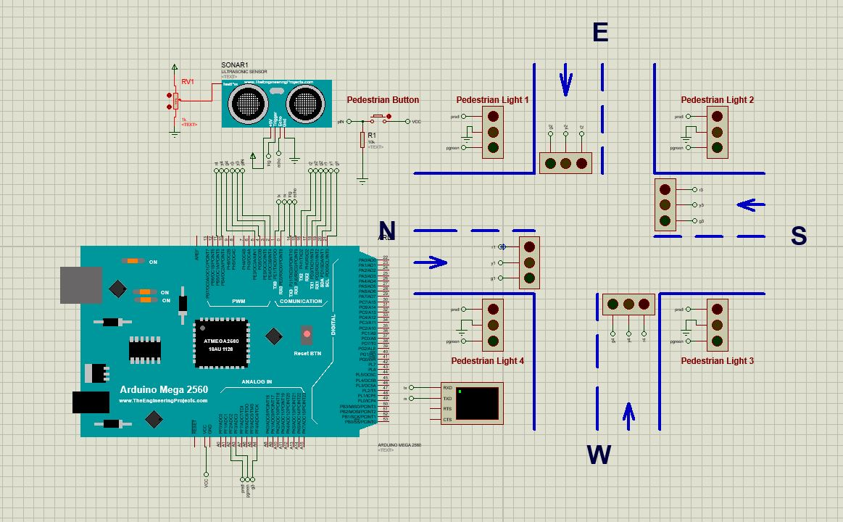
Design

Slide 6
Working Procedure
The basic components that react to the inputs are :
Resistors: (330-1000 Ohm)
Pedestrian Button
Ultrasonic Sensor
The components that receive commands :
Traffic Lights (4 pieces)
Pedestrian Traffic Lights (4 pieces)
Proteus simulation of 4-way traffic system with a pedestrian button and Ultrasonic Sensor that interrupts the normal operation of the system when required. The system automatically returns to the normal sequence after instruction from Arduino. In this model, the Ultrasonic Sensor is used to detect the presence of any vehicle in that part of the road. When detected it sends a triggered output to Arduino UNO which is the heart of the project. Then Arduino analyses the number of such triggered outputs from the set of sensors placed in the different roads at the junction and correspondingly triggers the different LED lights in the signals in order to felicitate the vehicle movement

Slide 7
Budget
Equipment | Quantity | Budget(Tk)
Arduino Mega 2650 | 1 | 920
Traffic Lights | 4 | 80
Pedestrian Traffic Lights | 4 | 80
Resistors | 24 | 500
Connecting wires | As Needed | 200
Pedestrian Button | 1 | 60
Ultrasonic Sensor | 1 | 100
Total |  | 2420 Tk

Slide 8
Code
const int g1 = 21; const int y1 = 20; const int r1 = 19; const int g2 = 18; const int y2 = 17; const int r2 = 16; const int g3 = A4; const int y3 = 3; const int r3 = 4; const int g4 = 5; const int y4 = 10; const int r4 = 11; const int pRed = A2; const int pgreen = A3; const int pIN = 2; const int TrigPin = 14; // Trigger Pin of Ultrasonic Sensor const int echoPin = 15; // Echo Pin of Ultrasonic Sensor long microsecondsToInches(long microseconds) { return (microseconds*0.034*0.3937) / 2; } long microsecondsToCentimeters(long microseconds) { return (microseconds*.034) / 2; } void setup() { pinMode (r1, OUTPUT); pinMode (y1, OUTPUT); pinMode (g1, OUTPUT); pinMode (r2, OUTPUT); pinMode (y2, OUTPUT); pinMode (g2, OUTPUT); pinMode (r3, OUTPUT); pinMode (y3, OUTPUT); pinMode (g3, OUTPUT); pinMode (r4, OUTPUT); pinMode (y4, OUTPUT); pinMode (g4, OUTPUT); pinMode (pRed, OUTPUT); pinMode (pgreen, OUTPUT); pinMode (pIN, INPUT); digitalWrite (r1, HIGH); digitalWrite (r2, HIGH); digitalWrite (r3, HIGH); digitalWrite (r4, HIGH); digitalWrite (pRed, HIGH); Serial.begin(9600); } void loop() { long duration, inches, cm; pinMode(TrigPin, OUTPUT); digitalWrite(TrigPin, LOW); delayMicroseconds(2); digitalWrite(TrigPin, HIGH); delayMicroseconds(10); digitalWrite(TrigPin, LOW); pinMode(echoPin, INPUT); duration = pulseIn(echoPin, HIGH); inches = microsecondsToInches(duration); cm = microsecondsToCentimeters(duration); Serial.print("Distance = "); Serial.print(inches); Serial.print("in, "); Serial.print(cm); Serial.print("cm"); Serial.println(); if (inches >= 200) { int crossIn = digitalRead (pIN); if (crossIn == HIGH) { WalkCycle(); } else { delay(100); digitalWrite (r1, LOW); digitalWrite(g1, HIGH); digitalWrite(r2, HIGH); digitalWrite(r3, HIGH); digitalWrite(r4, HIGH); delay(4000); } int crossIn2 = digitalRead (pIN); if (crossIn2 == HIGH) { WalkCycle(); } else { digitalWrite(g1, LOW); digitalWrite(y1, HIGH); digitalWrite(r2, HIGH); digitalWrite(r3, HIGH); digitalWrite(r4, HIGH); delay(2000); } int crossIn3 = digitalRead (pIN); if (crossIn3 == HIGH) { WalkCycle(); } else { digitalWrite(y1, LOW); digitalWrite(r2, LOW); digitalWrite(r1, HIGH); digitalWrite(g2, HIGH); //2nd light digitalWrite(r3, HIGH); digitalWrite(r4, HIGH); delay(4000); } int crossIn4 = digitalRead (pIN); if (crossIn4 == HIGH) { WalkCycle(); } else { digitalWrite(g2, LOW); digitalWrite(y2, HIGH); digitalWrite(r1, HIGH); digitalWrite(r3, HIGH); digitalWrite(r4, HIGH); delay(2000); } int crossIn5 = digitalRead (pIN); if (crossIn5 == HIGH) { WalkCycle(); } else { digitalWrite(y2, LOW); digitalWrite(r3, LOW); digitalWrite(g3, HIGH); //3rd light digitalWrite(r1, HIGH); digitalWrite(r2, HIGH); digitalWrite(r4, HIGH); delay(4000); } int crossIn6 = digitalRead (pIN); if (crossIn6 == HIGH) { WalkCycle(); } else { digitalWrite(g3, LOW); digitalWrite(y3, HIGH); digitalWrite(r1, HIGH); digitalWrite(r2, HIGH); digitalWrite(r4, HIGH); delay(2000); } int crossIn7 = digitalRead (pIN); if (crossIn7 == HIGH) { WalkCycle(); } else { digitalWrite(y3, LOW); digitalWrite(r3, LOW); digitalWrite(r4, LOW); digitalWrite(g4, HIGH); //4th light digitalWrite(r1, HIGH); digitalWrite(r2, HIGH); digitalWrite(r3, HIGH); delay(4000); } int crossIn8 = digitalRead (pIN); if (crossIn8 == HIGH) { WalkCycle(); } else { digitalWrite(g4, LOW); digitalWrite(r4, LOW); digitalWrite(y4, HIGH); digitalWrite(r1, HIGH); digitalWrite(r2, HIGH); digitalWrite(r3, HIGH); delay(2000); } digitalWrite(y4, LOW); digitalWrite(r4, LOW); digitalWrite(r1, LOW); } else if (inches >= 300 ) { int crossIn = digitalRead (pIN); if (crossIn == HIGH) { WalkCycle(); } else { delay(100); digitalWrite (r1, LOW); digitalWrite(g1, HIGH); digitalWrite(r2, HIGH); digitalWrite(r3, HIGH); digitalWrite(r4, HIGH); delay(4000); } int crossIn2 = digitalRead (pIN); if (crossIn2 == HIGH) { WalkCycle(); } else { digitalWrite(g1, LOW); digitalWrite(y1, HIGH); digitalWrite(r2, HIGH); digitalWrite(r3, HIGH); digitalWrite(r4, HIGH); delay(2000); } int crossIn3 = digitalRead (pIN); if (crossIn3 == HIGH) { WalkCycle(); } else { digitalWrite(y1, LOW); digitalWrite(r2, LOW); digitalWrite(r1, HIGH); digitalWrite(g2, HIGH); //2nd light digitalWrite(r3, HIGH); digitalWrite(r4, HIGH); delay(4000); } int crossIn4 = digitalRead (pIN); if (crossIn4 == HIGH) { WalkCycle(); } else { digitalWrite(g2, LOW); digitalWrite(y2, HIGH); digitalWrite(r1, HIGH); digitalWrite(r3, HIGH); digitalWrite(r4, HIGH); delay(2000); } int crossIn5 = digitalRead (pIN); if (crossIn5 == HIGH) { WalkCycle(); } else { digitalWrite(y2, LOW); digitalWrite(r3, LOW); digitalWrite(g3, HIGH); //3rd light digitalWrite(r1, HIGH); digitalWrite(r2, HIGH); digitalWrite(r4, HIGH); delay(4000); } int crossIn6 = digitalRead (pIN); if (crossIn6 == HIGH) { WalkCycle(); } else { digitalWrite(g3, LOW); digitalWrite(y3, HIGH); digitalWrite(r1, HIGH); digitalWrite(r2, HIGH); digitalWrite(r4, HIGH); delay(2000); } int crossIn7 = digitalRead (pIN); if (crossIn7 == HIGH) { WalkCycle(); } else { digitalWrite(y3, LOW); digitalWrite(r3, LOW); digitalWrite(r4, LOW); digitalWrite(g4, HIGH); //4th light digitalWrite(r1, HIGH); digitalWrite(r2, HIGH); digitalWrite(r3, HIGH); delay(4000); } int crossIn8 = digitalRead (pIN); if (crossIn8 == HIGH) { WalkCycle(); } else { digitalWrite(g4, LOW); digitalWrite(r4, LOW); digitalWrite(y4, HIGH); digitalWrite(r1, HIGH); digitalWrite(r2, HIGH); digitalWrite(r3, HIGH); delay(2000); } digitalWrite(y4, LOW); digitalWrite(r4, LOW); digitalWrite(r1, LOW); } else if (inches >= 500 ) { int crossIn = digitalRead (pIN); if (crossIn == HIGH) { WalkCycle(); } else { delay(100); digitalWrite (r1, LOW); digitalWrite(g1, HIGH); digitalWrite(r2, HIGH); digitalWrite(r3, HIGH); digitalWrite(r4, HIGH); delay(4000); } int crossIn2 = digitalRead (pIN); if (crossIn2 == HIGH) { WalkCycle(); } else { digitalWrite(g1, LOW); digitalWrite(y1, HIGH); digitalWrite(r2, HIGH); digitalWrite(r3, HIGH); digitalWrite(r4, HIGH); delay(2000); } int crossIn3 = digitalRead (pIN); if (crossIn3 == HIGH) { WalkCycle(); } else { digitalWrite(y1, LOW); digitalWrite(r2, LOW); digitalWrite(r1, HIGH); digitalWrite(g2, HIGH); //2nd light digitalWrite(r3, HIGH); digitalWrite(r4, HIGH); delay(4000); } int crossIn4 = digitalRead (pIN); if (crossIn4 == HIGH) { WalkCycle(); } else { digitalWrite(g2, LOW); digitalWrite(y2, HIGH); digitalWrite(r1, HIGH); digitalWrite(r3, HIGH); digitalWrite(r4, HIGH); delay(2000); } int crossIn5 = digitalRead (pIN); if (crossIn5 == HIGH) { WalkCycle(); } else { digitalWrite(y2, LOW); digitalWrite(r3, LOW); digitalWrite(g3, HIGH); //3rd light digitalWrite(r1, HIGH); digitalWrite(r2, HIGH); digitalWrite(r4, HIGH); delay(4000); } int crossIn6 = digitalRead (pIN); if (crossIn6 == HIGH) { WalkCycle(); } else { digitalWrite(g3, LOW); digitalWrite(y3, HIGH); digitalWrite(r1, HIGH); digitalWrite(r2, HIGH); digitalWrite(r4, HIGH); delay(2000); } int crossIn7 = digitalRead (pIN); if (crossIn7 == HIGH) { WalkCycle(); } else { digitalWrite(y3, LOW); digitalWrite(r3, LOW); digitalWrite(r4, LOW); digitalWrite(g4, HIGH); //4th light digitalWrite(r1, HIGH); digitalWrite(r2, HIGH); digitalWrite(r3, HIGH); delay(4000); } int crossIn8 = digitalRead (pIN); if (crossIn8 == HIGH) { WalkCycle(); } else { digitalWrite(g4, LOW); digitalWrite(r4, LOW); digitalWrite(y4, HIGH); digitalWrite(r1, HIGH); digitalWrite(r2, HIGH); digitalWrite(r3, HIGH); delay(2000); } digitalWrite(y4, LOW); digitalWrite(r4, LOW); digitalWrite(r1, LOW); } } void WalkCycle() { delay(350); digitalWrite (g1, LOW); digitalWrite (g2, LOW); digitalWrite (g3, LOW); digitalWrite (g4, LOW); digitalWrite (y1, LOW); digitalWrite (y2, LOW); digitalWrite (y3, LOW); digitalWrite (y4, LOW); digitalWrite (r1, HIGH); digitalWrite (r2, HIGH); digitalWrite (r3, HIGH); digitalWrite (r4, HIGH); digitalWrite (pgreen, HIGH); digitalWrite (pRed, LOW); delay (3000); digitalWrite (pgreen, LOW); delay(250); for (int x = 0; x < 5; x++) { digitalWrite(pgreen, HIGH); delay(250); digitalWrite(pgreen, LOW); delay(250); } digitalWrite(pRed, HIGH); }

Slide 9
Members Contribution

Slide 10
Difficulties
We had to face difficulties while trying to measure the perfect density of the vehicles for a more practical implementation.

Slide 11
Future Work
In future we will try to implement this practically using a servo-motor which will help to rotate the Ultrasonic Sensor in 90Degrees. Thus we can get the distance in perfect measure.
Also we can use the image sensor or imager for producing the image of the roads. It creates the image by converting the variable attenuation of light into signal that conveys the picture.

Slide 12
Conclusion
The proposed traffic control system is the very basic step towards achieving automation in the field of traffic control system. With various advancements taking place in today’s world, people are in search for automated systems which not only saves their time but also a lot of energy in different forms.
Thus this system helps in reducing the number of accidents that take place just because of this improper traffic control system and paving way to a better traffic control system.

Slide 13
Thank you!

