Slide 1

PRESENTATION TOPIC: HISTORY OF OPERATING SYSTEM Course Title: Basic English Course Code: ICT-1211
Presented By:
Mst. Sadia Binta Sazzad
ID:IT-25027
Department of Information and
communication Technology,
MBSTU
Supervised By:
Dr. Nazrul Islam
Associate professor;
Department of Information and
communication Technology,
MBSTU

Slide 2
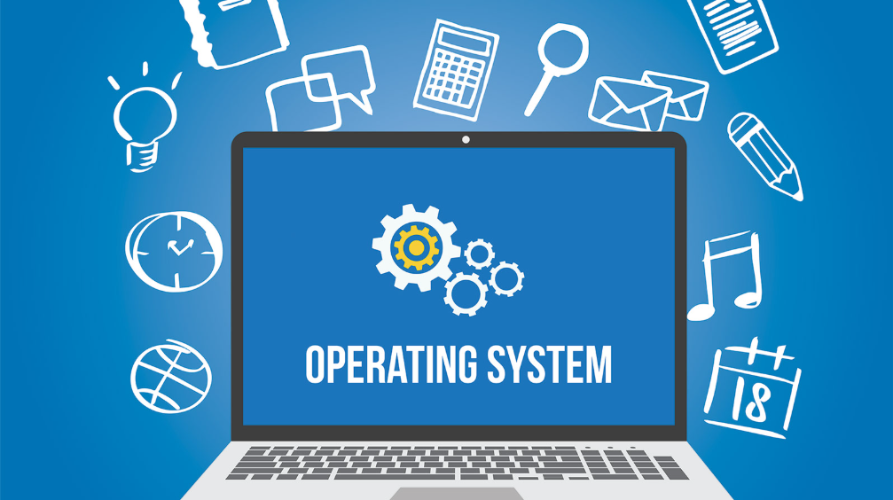
Introduction
An Operating System (OS) is the core software of a computer
Acts as a bridge between user and hardware
Without OS, a computer cannot function properly
Examples: Windows, Linux, macOS, Android

Slide 3
What is an Operating System
System software that manages hardware resources
Provides an environment to run applications
Controls CPU, memory, and input/output devices
Offers a user interface

Slide 4
Early Computers (Before OS)
1940s–1950s: No Operating System
Programs executed manually
Used punch cards
Only one program could run at a time

Slide 5
Batch Operating Systems (1950s–1960s)
Similar jobs grouped into batches
No direct user interaction
Improved efficiency but lacked flexibility
Used in early large computers

Slide 6
Multiprogramming Systems (1960s)
Multiple programs stored in memory
CPU switched between programs
Reduced idle time
Introduced job scheduling

Slide 7
Time-Sharing Systems (1970s)
Multiple users can use the system simultaneously
CPU time divided among users
Interactive computing became possible
Example: UNIX

Slide 8
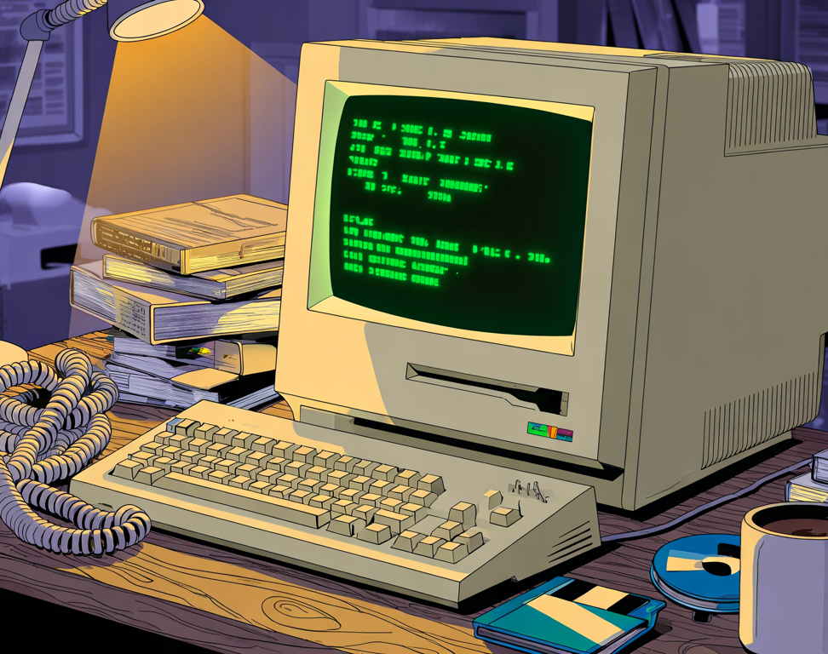
Personal Computer OS (1980s)
Rise of personal computers
Development of user-friendly systems
Examples: MS-DOS, early Windows
Introduction of Graphical User Interface (GUI)

Slide 9
Modern Operating Systems (1990s–Present)
Advanced multitasking and security
Internet integration
Examples:
Windows
macOS
Linux

Slide 10
Mobile Operating Systems
Growth of smartphones
Touch-based interfaces
Lightweight systems
Examples:
Android
iOS

Slide 11
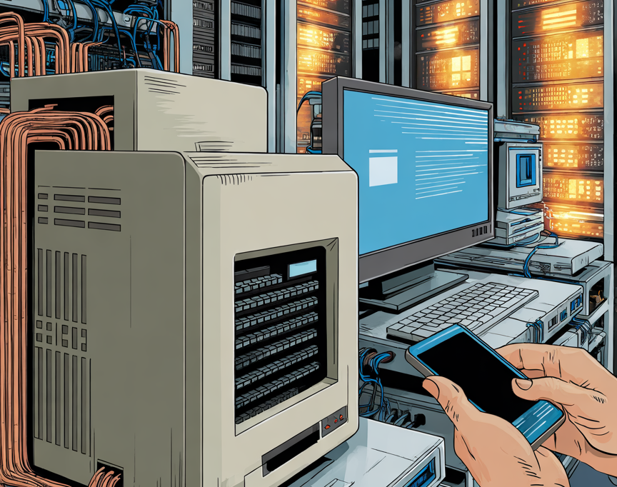
Types of Operating Systems
Batch OS
Time-sharing OS
Distributed OS
Real-time OS
Mobile OS

Slide 12
Key Functions of OS
Process Management
Memory Management
File System Management
Device Management
Security and Protection

Slide 13
Process Management
Memory Management
File System Management
Device Management
Security and Protection

Slide 14
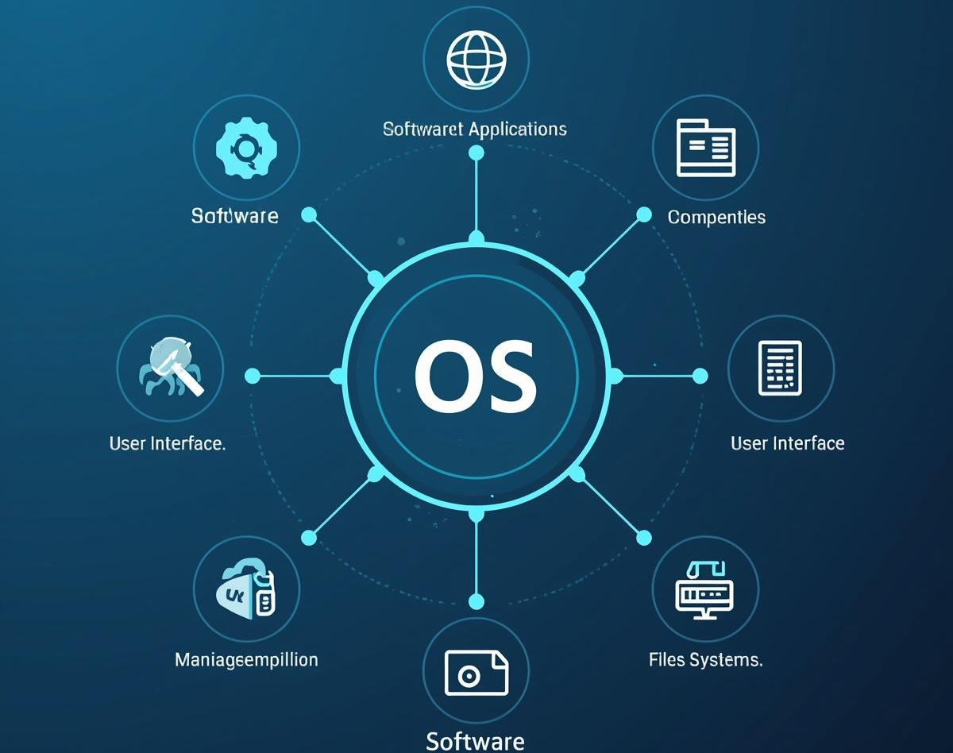
Importance of OS
Makes computers usable
Efficient use of hardware
Enables application software
Improves user experience

Slide 15
Future of Operating Systems
Integration with Artificial Intelligence
Cloud-based operating systems
Enhanced security features
Support for IoT devices

Slide 16
Conclusion
OS is essential for computer operation
It has evolved significantly over time
Future OS will be more intelligent and efficient

Slide 17
Thank You

