Slide 1



An Explainable Deep Learning Framework for Forest Wildfire Classification Using Custom CNNs and Transfer Learning
Sadia Hossain Bushra
Sadia Hossain Bushra, Sayada Zakia Afrinee, Ayan Chatterjee, Vimala Nunavath
University of South-Eastern Norway (USN) · NILU Research Lab
ICT-DM 2026 · Online · 9th November 2026
Sayada Zakia Afrinee
Notes:
Good morning/afternoon. I'm presenting our work on explainable deep learning for forest wildfire image classification, done at the University of South-Eastern Norway together with NILU. The talk covers why fair comparison matters, our unified framework, results for five models, and what saliency maps tell us about how they decide.

Slide 2


Why early, image-based wildfire detection matters
Rising risk
Traditional monitoring is slow
Deep learning helps
Climate change, prolonged droughts and land-use change are making wildfires more frequent and severe.
Lookout towers, patrols and satellites suffer from delayed response and limited temporal resolution.
CNNs on camera or UAV imagery learn fire and smoke features automatically — no hand-crafted rules.
Notes:
Wildfires are among the most destructive natural hazards. Traditional detection — towers, patrols, satellites — is slow or coarse. Vision-based systems using surveillance cameras or drones are a promising alternative, and deep learning has made them much more accurate than hand-crafted image processing.

Slide 3




Research gap and our contribution
Unified benchmark
The gap
One dataset, one preprocessing pipeline, one metric set for 5 models
Studies use different datasets, preprocessing and metrics — results are not comparable like-for-like
Few studies fix everything except the architecture
Explainability is rarely used to compare how models decide
Tuned custom CNN
Keras Tuner search; trained with Adam and with SGD
Augmentation ablation
No aug. vs geometric vs geometric + photometric
Saliency-based XAI
Gradient saliency maps to check what each model looks at
Notes:
Existing work evaluates models under different datasets and settings, so we can't tell which architecture is actually better. Our contribution: a single controlled framework comparing a tuned custom CNN against MobileNetV2, ResNet50V2 and EfficientNetB3, plus an augmentation ablation and saliency maps to inspect model reasoning.

Slide 4
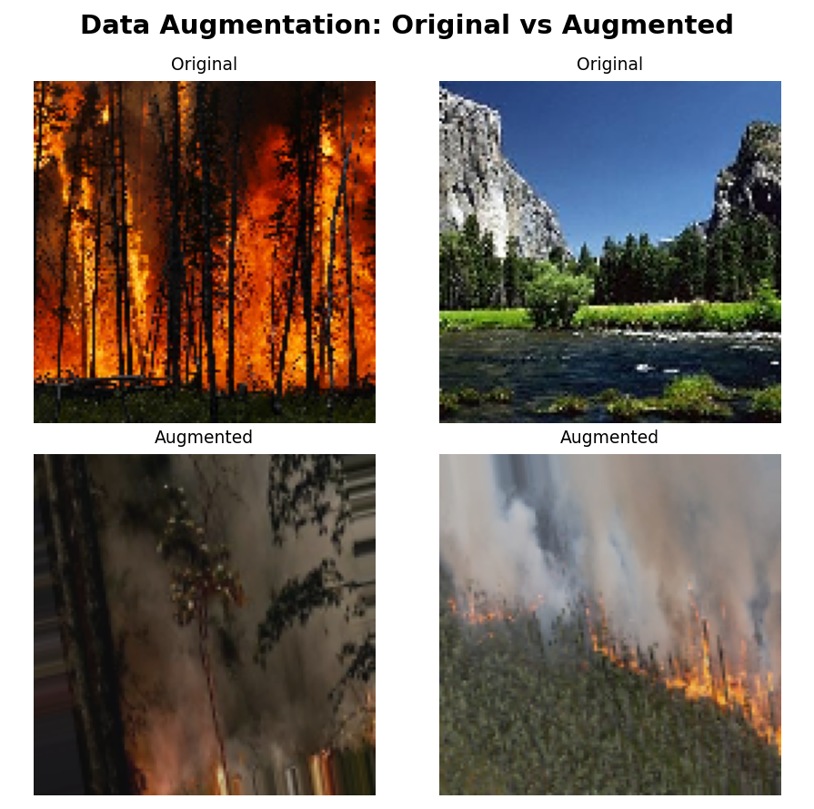
Dataset: Kaggle Forest Fire Images
5,000
389
4,611
original training images
corrupted files removed
clean images used
Class | Original | Removed | Cleaned
Fire | 2,500 | 388 | 2,112
Non-Fire | 2,500 | 1 | 2,499
Total | 5,000 | 389 | 4,611
Fire / Non-Fire samples, original (top) and augmented (bottom)
Split: 80/20 stratified → 3,689 train / 922 val; independent test set of 50 images (25 / 25). Inverse-frequency class weights; 128×128, [0,1] normalisation. 679 low-contrast or blurry frames (13.6%) kept on purpose — they reflect real smoke, dusk and UAV conditions.
Notes:
We used the Kaggle Forest Fire Images dataset: 5,000 balanced images. PIL verification found 389 corrupted files — almost all in the Fire class — leaving 4,611 images and a moderate imbalance, handled with class weights. We flagged about 14% of images as dark or blurry but deliberately kept them, because a real detector sees smoke, night-time and moving cameras. The test set is small: 50 images, which matters for interpreting results later.

Slide 5
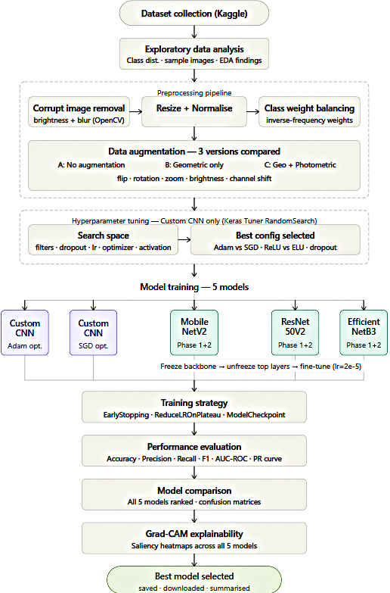
End-to-end framework
1
Clean & preprocess
Remove undecodable files, resize to 128×128, normalise, class weights
2
Augment
Three regimes compared; best (geometric + photometric) used for all models
3
Tune & train 5 models
Custom CNN (Adam, SGD) + MobileNetV2, ResNet50V2, EfficientNetB3
4
Evaluate
Accuracy, Precision, Recall, F1, AUC-ROC, PR-AUC + 95% Wilson CIs
5
Explain
Gradient-based saliency maps for all five models
Notes:
Here is the full pipeline. The key design principle: every model sees exactly the same data, preprocessing, augmentation, training callbacks and metrics. Only the architecture changes. At the end, saliency maps let us inspect what each network relies on.

Slide 6
Five models, one training protocol
Model | Params | Fine-tune from | Optimiser | LR
Custom CNN (Adam) | 489 K | Scratch | Adam | 1e-4
Custom CNN (SGD) | 489 K | Scratch | SGD + Nesterov | 1e-3
MobileNetV2 | 2.6 M | Layer 100 | Adam | 2e-5
ResNet50V2 | 24.1 M | Layer 150 | Adam | 2e-5
EfficientNetB3 | 11.2 M | Layer 200 | Adam | 2e-5
Keras Tuner (RandomSearch, 10 trials)
Best: 32 filters · ReLU · dropout 0.2 · LR 1e-4 · Adam · L2 0.001
94.8% val. accuracy
Shared training setup
Transfer models: frozen backbone → fine-tune top layers
EarlyStopping (patience 5), ReduceLROnPlateau, checkpointing
Same architecture trained with two optimisers isolates the effect of optimiser choice.
Notes:
The custom CNN is small — under half a million parameters — and trained from scratch, once with Adam and once with SGD. The three transfer-learning models use ImageNet weights with two-stage training: train the head, then fine-tune deeper layers at a low learning rate. All share early stopping, LR scheduling and checkpointing.

Slide 7
ResNet50V2 leads; custom CNN close behind
98%
ResNet50V2 accuracy
Precision 1.00 · AUC 1.00
96%
Custom CNN, from scratch
~50× fewer parameters
Notes:
Results on the 50-image test set. ResNet50V2 is best: 98% accuracy, perfect precision, AUC of 1.0. Both custom CNNs reach 96% and AUC 0.989 — matching or beating MobileNetV2 and EfficientNetB3 despite being trained from scratch with about 50 times fewer parameters than ResNet50V2. MobileNetV2 has a high AUC but lower recall; EfficientNetB3 underperforms, which I'll explain shortly.

Slide 8
With n = 50, top models are statistically tied
Custom CNN (Adam)
0.96 [0.865, 0.989]
Custom CNN (SGD)
0.96 [0.865, 0.989]
MobileNetV2
0.86 [0.738, 0.930]
ResNet50V2
0.98 [0.895, 0.996]
EfficientNetB3
0.76 [0.626, 0.857]
0.6
0.7
0.8
0.9
1.0
Test accuracy with 95% Wilson interval
Notes:
Because the test set is only 50 images, one error moves accuracy by 2 points. The 95% Wilson intervals for ResNet50V2 and both custom CNNs overlap heavily, so the 2-point gap is not statistically distinguishable. MobileNetV2 and EfficientNetB3 sit clearly lower. So: ResNet50V2 is the point-estimate leader, but the honest conclusion is that a tuned custom CNN is competitive.

Slide 9
Augmentation was the most influential component
+8 pts
accuracy, no augmentation → full augmentation
Geometric: flip, rotate ±20°, zoom 15%, shift 10% — robustness to viewpoint and framing
Photometric: brightness 70–130%, channel shift — robustness to lighting; recall reached 1.00
Single run per version: the A→C trend is clear, B vs C ordering needs repeated seeds
Notes:
We ablated augmentation on the Adam custom CNN. No augmentation gave 88%; geometric transforms raised it to 94%; adding photometric changes reached 96% with perfect recall. That 8-point gain makes augmentation the single most influential pipeline component. Caveat: one run each, so the small B-to-C difference — one or two test images — isn't separable from seed noise.

Slide 10

Two closer looks: optimiser choice and EfficientNetB3
Adam vs SGD (same CNN)
Why EfficientNetB3 lagged (76%)
 | Precision | Recall | F1
Adam | 0.926 | 1.000 | 0.962
SGD | 0.960 | 0.960 | 0.960
Keras EfficientNetB3 rescales inputs internally and expects [0, 255]
Our [0, 1] inputs were divided by 255 twice → backbone saw ≈ [0, 0.004]
A pipeline defect, not an architecture weakness — treat its score as a lower bound
Same 96% accuracy and 0.989 AUC. Adam missed no fires — preferable when a missed fire costs more than a false alarm.
Notes:
Left: Adam and SGD give identical accuracy and AUC on the same architecture, but Adam achieves perfect recall — operationally attractive since missing a fire is worse than a false alarm. Right: EfficientNetB3's poor result is most likely a preprocessing fault — its Keras implementation already rescales internally, so our normalised inputs were scaled twice. We report its score as a lower bound, not as evidence about the architecture.

Slide 11
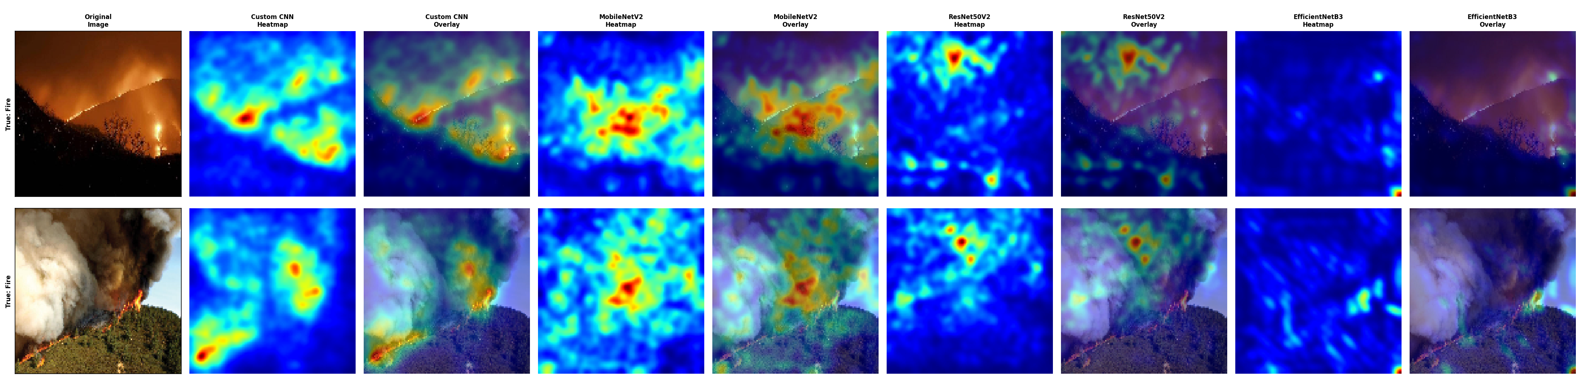
Saliency maps: do models look at the fire?
ResNet50V2
Custom CNN
MobileNetV2
EfficientNetB3
Most localised attention, tightly on flames and smoke plumes
Broader maps but centred on fire cues; one false positive from warm-coloured vegetation
Misses when flames are small or smoke-obscured — weak, scattered activation
Diffuse, background-heavy activation — consistent with its weak score
Notes:
Saliency maps show which pixels drove each prediction. The stronger models focus on flames, smoke and orange-red gradients, not background — evidence they learned meaningful wildfire features. ResNet50V2 is the most localised. The custom CNN is broader but still on fire regions; its one false positive came from warm-coloured vegetation. EfficientNetB3's maps are diffuse even on obvious fires, matching its weak result.

Slide 12



Conclusions and future work
Key takeaways
Next steps
ResNet50V2 best on point estimates: 98% acc., F1 0.980, AUC 1.000
A tuned custom CNN (96%) is competitive with pretrained backbones on a curated dataset of this scale
Geometric + photometric augmentation: +8 pts accuracy
Saliency confirms top models attend to fire, not background
Limits: one dataset, 50-image test set, single run per config
Larger multi-source test sets
Video-based detection
Edge deployment optimisation
Uncertainty estimation
Notes:
To conclude: under a fully controlled comparison, ResNet50V2 led, but a tuned custom CNN trained from scratch was statistically on par — useful for resource-constrained deployments. Augmentation mattered most, and saliency maps support that the strong models use real fire cues. These results are bounded by one dataset and a small test set. Next, we'll evaluate on larger multi-source datasets, move to video, optimise for edge hardware, and add uncertainty estimation.

Slide 13
Thank you — questions?
sadia.h.bushra@usn.no · saafr7491@usn.no
ayan@nilu.no · vimala.nunavath@usn.no
Dataset: Kaggle “Forest Fire Images” (M. S. Prasad)
Notes:
Thank you for your attention. I'm happy to take questions.

