Slide 1

Artificial Intelligence Lab
Project Proposal
KROSH
CSE 3811 | AI Lab | Section A
Group 5

Slide 2
Our Team
Sadia Islam Mim
Adham Zarif
Saber Hassan
ID: 112330329
ID: 112330721
ID: 112330870

Slide 3
Introduction
Checkers- Krosh
H a l l u c i n a t i n g o u r c h i l d h o o d

Slide 4
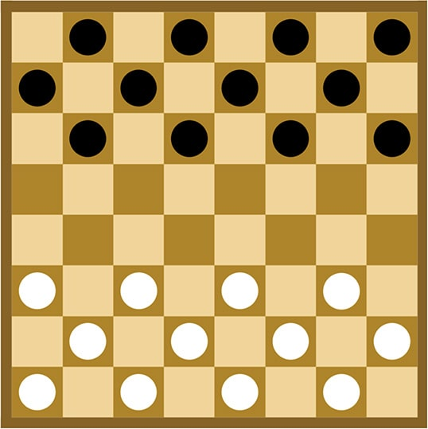
Checkers
Current scenario:
2 players
Each player starts with 12 dices
Initially, the die can only move forward in a diagonal direction.

Slide 5
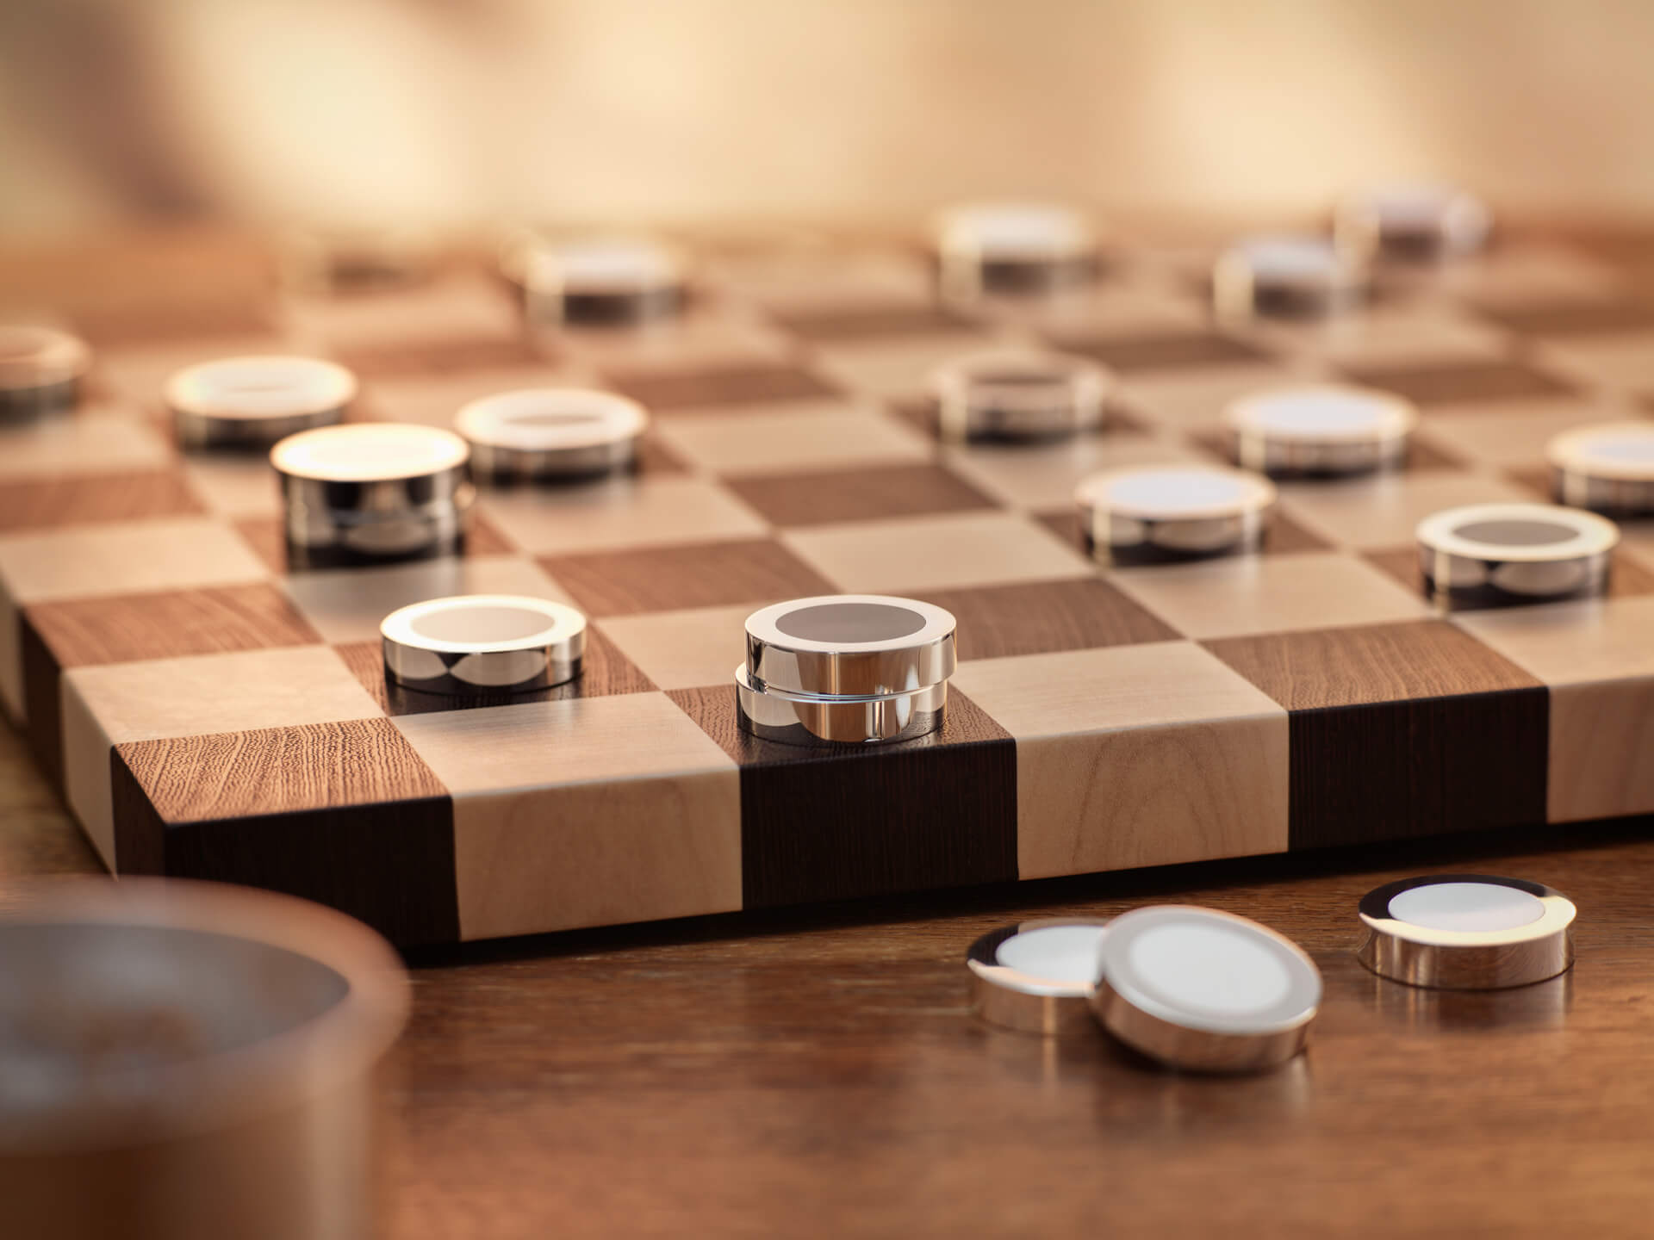
Checkers
Current scenario:
2 players
Each player starts with 12 dices
Initially, the die can only move forward in a diagonal direction.
Capture pieces by leaping over them, multiple
captures possible.

Slide 6
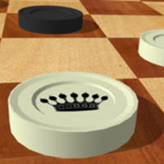
Checkers
Current scenario:
2 players
Each player starts with 12 dices
Initially, the die can only move forward in a diagonal direction.
Capture pieces by leaping over them, multiple
captures possible.
When a piece reaches the opponent's king row, it becomes a King (or gets 'crowned') and gains the ability to move both forward and backward.

Slide 7
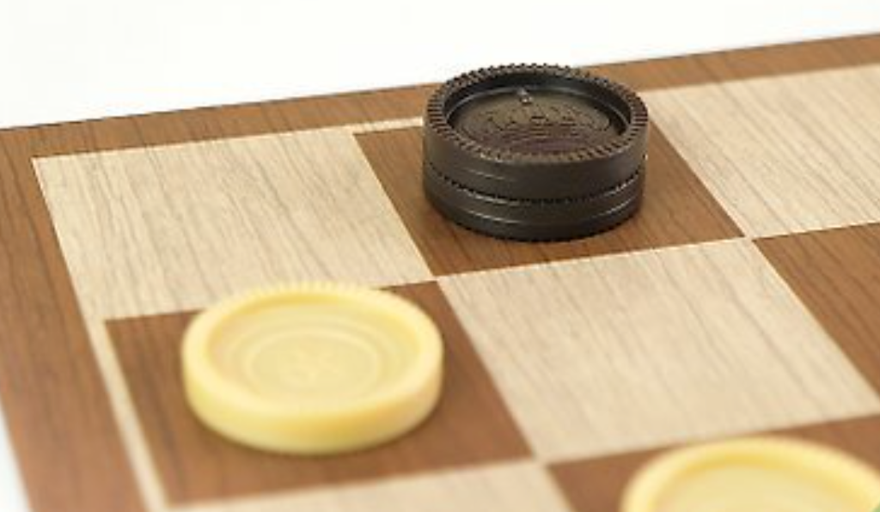
Checkers
Current scenario:
2 players
Each player starts with 12 dices
Initially, the die can only move forward in a diagonal direction.
Capture pieces by leaping over them, multiple
captures possible.
When a piece reaches the opponent's king row, it becomes a King (or gets 'crowned') and gains the ability to move both forward and backward.
Win by capturing opponent’s pieces

Slide 8
Motivation
sentimental value
simple game with simple rules
time constraint
complexity

Slide 9
Our Solution
KROSH is an offline single-player Checkers game where the human plays against four classical AI opponents — Greedy Search, full Minimax, Alpha-Beta pruning, and Monte Carlo Tree Search

Slide 10
Key Features & User Actions
4 game modes:
1. Play vs Greedy AI
- Fast, one-ply opponent — the beginner tier of the ladder
- Ideal for learning the interface and warming up
2. Play vs Minimax / Alpha-Beta
- Adjustable search depth (2 to 8 plies) with depth slider
- Full-tree adversarial reasoning with optional pruning toggle
3. Play vs MCTS
Configurable rollout budget for the MCTS opponent
User flow: pick opponent → place moves via click/drag on Pygame board → end-of-game stats screen
4. Play vs Hybrid AI
- Switches engine by game phase — Minimax/α-β in the opening & midgame, MCTS once the branching factor drops in the endgame
- Adaptive difficulty that mirrors human play: deliberate in the middle, decisive at the end

Slide 11
Methodology
3 phases:
1. Minimax Algorithm
- Full game tree expansion using minimax to maximize score and minimize opponent's gain
- Static board evaluation heuristic for non-terminal states
2. Greedy Search
- Fast, heuristic-guided state expansion for immediate optimal choices
- Local best-first evaluation prioritizing short-term gain over deep tree search
3. Monte Carlo Tree Search (MCTS)
Probabilistic tree expansion via Monte Carlo rollouts
Selection, Expansion, Simulation, and Backpropagation phases
Unbiased evaluation for deep game trees without domain heuristics

Slide 12
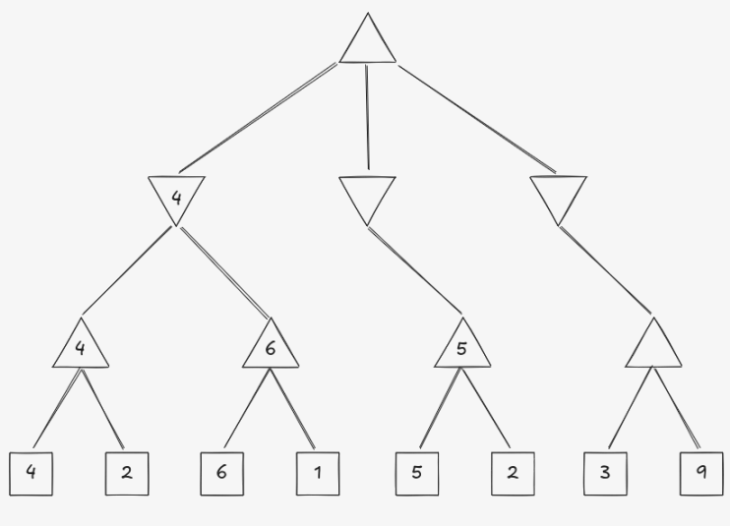
Minimax Algorithm
Full game tree expansion
Maximize score and minimize opponent's gain
Static board evaluation heuristic for non-terminal states

Slide 13
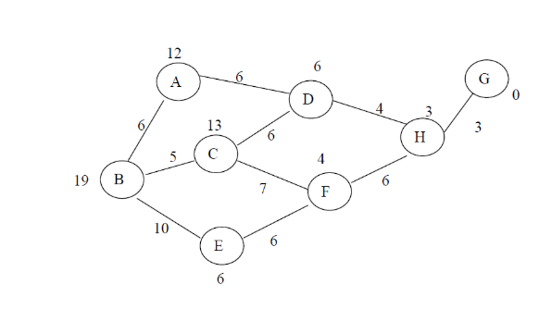
Greedy Search
Greedy search implementation
Heuristic-driven best-first expansion
Fast evaluation without full game tree expansion

Slide 14
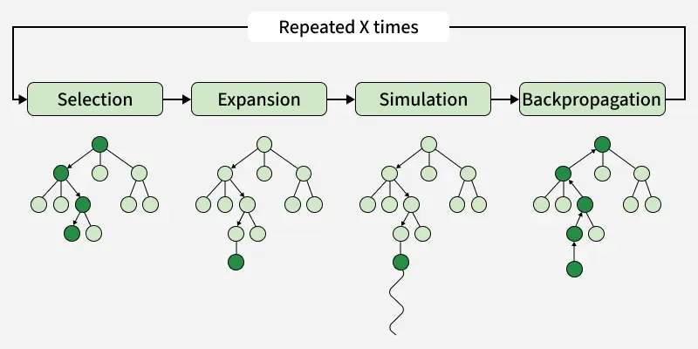
Monte Carlo Tree Search (MCTS)
Probabilistic tree expansion via Monte Carlo rollouts
Selection, Expansion, Simulation, and Backpropagation
phases
Unbiased evaluation for deep game trees without domain heuristics

Slide 15
System Architecture
Pipeline (Input → AI Processing → Output):
1. Input Layer
- Pygame captures the human move (mouse click on an 8×8 board)
- Rule validator converts the click into a legal move on the NumPy board state
2. AI Processing Layer
- Selected engine (Greedy / Minimax / Alpha-Beta / MCTS) receives the board matrix
- Engine returns the chosen move along with a search-stat payload (nodes visited, time, score)
3. Output & Feedback Layer
Pygame renders the AI move, updated board, and a live sidebar showing search stats
Pytest suite validates rules and engine behaviour on every commit
Stack: Python 3.11+, Pygame, NumPy, Pytest

Slide 16
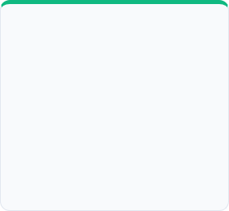
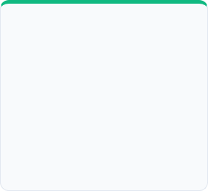
TARGET TIMELINE
Core Board & Pygame UI
Greedy & Minimax
Alpha-Beta Engine
MCTS & Tournament UI
NumPy 8x8 times 8$ board matrix, rule validator, Pygame GUI, and Pytest suite.
Implementation of 1-step Greedy Agent and full-tree Minimax decision engine.
Optimization of Minimax tree traversal using Alpha-Beta cutoffs & caching.
MCTS engine integration, Pygame AI vs AI mode, and performance benchmarking.
•
NumPy state array setup
•
Alpha-Beta pruning limits
•
Pygame render loop
•
Material & positional matrix
•
Move ordering heuristics
•
UCB1 MCTS playouts
•
Pytest rule unit tests
•
Greedy reactive agent
•
Transposition dictionary
•
Pygame match controller
•
Recursive Minimax engine
•
Algorithm comparison report

Slide 17

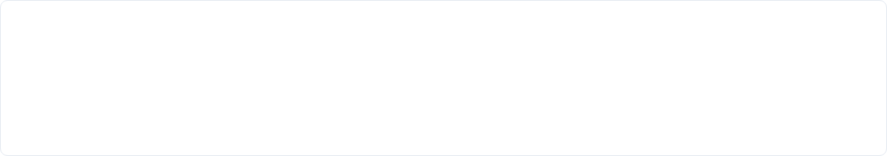
ALGORITHM BENCHMARKS
Pygame / NumPy Board
Greedy Agent
Minimax
Alpha-Beta
MCTS Engine
Algorithm | Time Complexity | Primary Focus | Key Metric / Benchmark
Greedy Search | $O(b)$ per move | Immediate score gain without depth | Baseline speed ($<1\text{ ms}$)
Minimax Engine | $O(b^d)$ full tree | Exact adversarial score minimization | Optimal path at shallow depth ($d \le 4$)
Alpha-Beta Pruning | $O(b^{d/2})$ optimal | Branch elimination for deeper search | $>60\%$ node reduction ($d \ge 7$)
MCTS | $O(N \times m)$ simulations | Statistical sampling without full depth | High win-rate in complex mid-game

Slide 18
Scope & Final Deliverable
End-of-term MVP:
1. Playable desktop app
- Full Checkers rules with king promotion and multi-capture chains
- Human-vs-AI and AI-vs-AI modes across all four engines
2. Benchmark & comparison suite
- Automated matches logging win rate, nodes searched, and move time per engine
- One-page comparison report generated from the Pytest benchmark run
3. Anticipated challenges & mitigation
Minimax blow-up at deep plies → controlled via Alpha-Beta + transposition caching
MCTS tuning of exploration constant → tracked through repeatable seeded rollouts
Time management → milestones locked to the Week-by-Week timeline shown earlier

Slide 19
Thank you

