Slide 1
Team 5
Earth Fault Detection
Physics-guided spatial fault localization using PLC telemetry
1001
1015
1030
1045
1060
1075
1085
1090
CCR
⚡
Sadia Parveen
Apu Bhowmick
Truc Do
Luis Herrera P.
FAULT
90-fixture series circuit · 3 test runs · Ranked fault zones with confidence

Slide 2
PHYSICS INSIGHT
Earth Faults Leak Communication
Signal — Not Only Power
Upstream: healthy signal
Downstream: weaker, noisier comms
CCR
⚡
signal leaks
to ground
Observable symptoms along the 90-fixture chain:
Response Rate
Repeater Depth
📡
Phase Noise
⚡
CRC / BER
drops near fault
increases beyond fault
rises around fault
errors cluster spatially

Slide 3
OUR METHOD
Spatial Anomaly Localization
Across the Fixture Chain
1
2
3
4
5
Parse CSV
Aggregate
Baseline
Normalize
Score &
Smooth
Rank
Zones
Split into COMM
RATES · EXCOMM
CORR families
One feature row
per fixture across
all message types
Compare each
fixture to its
no-fault baseline
Anomaly score
per fixture ·
Smoothed spatially
Top candidate
regions + change-
points detected
Core Idea
Spatial Patterns We Look For
Not a classifier. We build a spatial anomaly profile across the ordered 90-fixture chain and look for spatial change-points, degradation steps, or clustered anomalies that reveal where the fault sits — explainably and without needing labels.
Step / Change-Point
Sharp transition between healthy upstream and degraded downstream fixtures.
Gradient / Slope
Gradual roll-off of signal quality across a span — soft or high-impedance fault.
Clustered Degradation
Bounded group of adjacent fixtures departing together from baseline.

Slide 4
SCORING DETAIL
SCORING DETAIL
How the Anomaly Score Is Built
How the Anomaly Score Is Built
No-fault Baseline
1
No-fault Baseline
1
From raw telemetry to ranked zone
From raw telemetry to ranked zone
Per fixture + feature: baseline mean & std dev
Per fixture + feature: baseline mean & std dev
Confidence
Per-fixture · Per-feature
Confidence
Per-fixture · Per-feature
Z-score
2
Z-score
2
z = (value − mean) / std
z = (value − mean) / std
Anomaly strength
z = (value − mean) / std
Anomaly strength
z = (value − mean) / std
max(0, ±z) capped at 5
max(0, ±z) capped at 5
How far above baseline?
How far above baseline?
Direction-Aware Score
3
Direction-Aware Score
3
Spatial sharpness
High-is-worse: max(0, z) Low-is-worse: max(0, −z) Cap at 5
Spatial sharpness
High-is-worse: max(0, z) Low-is-worse: max(0, −z) Cap at 5
Sharp step vs soft gradient
Family Scores
Sharp step vs soft gradient
Family Scores
COMM
COMM
RATES
4
RATES
4
COMM · RATES · EXCOMM · CORR
COMM · RATES · EXCOMM · CORR
Family agreement
Family agreement
EXCOMM
EXCOMM
CORR
CORR
Do COMM, RATES, EXCOMM, CORR agree?
Fixture Anomaly Profile
Do COMM, RATES, EXCOMM, CORR agree?
5
Fixture Anomaly Profile
5
Combine family scores · order 1001 → 1090
Combine family scores · order 1001 → 1090
4 independent family scores
4 independent family scores
Temporal consistency
Temporal consistency
Zone Score
6
Zone Score
6
Stable across 15-min window?
Stable across 15-min window?
Smooth across neighbors · find high-scoring contiguous regions
Smooth across neighbors · find high-scoring contiguous regions
Fixture anomaly profile
Fixture anomaly profile
1001 ──────────────── 1090
1001 ──────────────── 1090
Output:
Confidence
Output:
7
Confidence
7
HIGH
HIGH
MEDIUM
MEDIUM
LOW
LOW
UNCERTAIN
Anomaly strength + spatial sharpness + family agreement
UNCERTAIN
Anomaly strength + spatial sharpness + family agreement

Slide 5
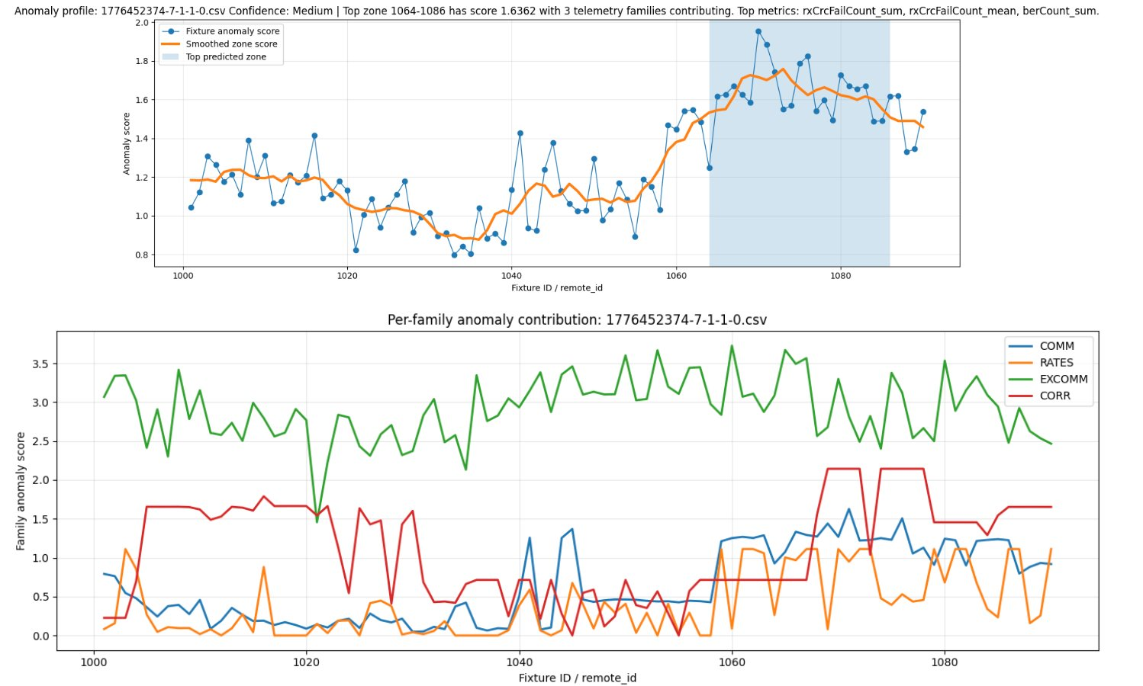
PROTOTYPE RESULTS
Example Output: Fixtures 1064–1086
Example Prediction
MEDIUM
Top zone: 1064–1086
Anomaly Score: 1.6362
Message type contribution
contributing
Evidence
rxCrcFailCount elevated
berCount rising ~1060+
EXCOMM + CORR align
Gradient rise visible

Slide 6
PROTOTYPE RESULTS
Conservative but Explainable
Fault-Zone Ranking
80
7,200
12/12
Interpretation
Safe by design
Scenarios
processed
Fixture-level rows
created
No-fault scenarios
correctly Uncertain
Model refuses to hallucinate a zone. "Uncertain" is the honest answer when signal is weak.
Physical-layer driven
Confidence Distribution — Faulted Scenarios
EXCOMM/CORR (CRC failures, BER, SNR) carry the strongest fault fingerprint.
Uncertain
20
Conservative, not wrong
High-impedance faults (30–50 kΩ) produce faint signals — wider zones or Uncertain are correct.
Low confidence
50
Medium confidence
10
No-fault: 100% correct
All 12 baseline scenarios correctly returned no localized zone.
Total faulted scenarios: 68 (80 total − 12 no-fault baselines)

Slide 7
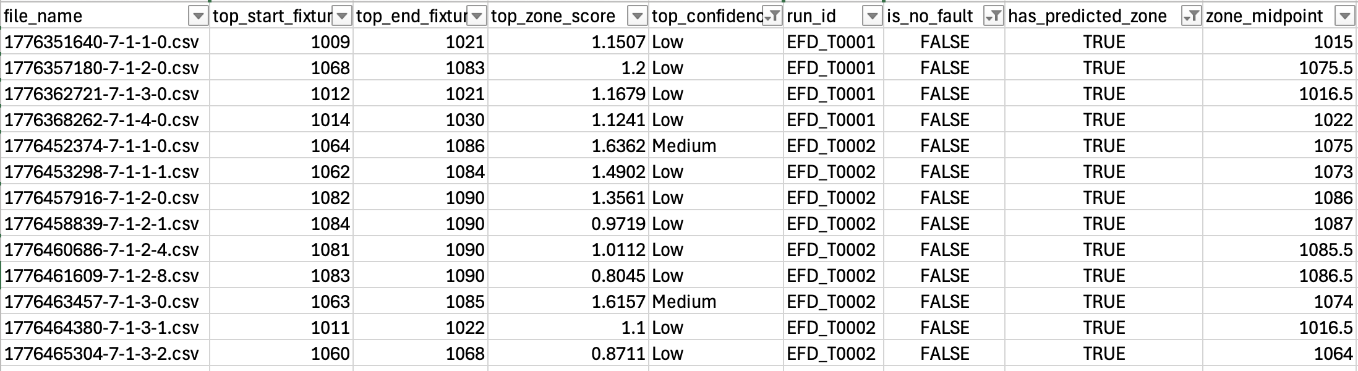
Actual Prediction

Slide 8
RECOMMENDATION
Recommendation: 3-Step Pipeline
Anomaly Detection
→
Feature Engineering
→
Classification
1
Anomaly Detection
2
Feature Engineering
3
Classification
Is there a fault?
What does the pattern look like?
Which location (1–4)?
INPUT
INPUT
INPUT
→ Raw CSV (15 min telemetry)
→ 90 fixture × raw metrics
→ 810-feature spatial vector
→ Baseline (loc=0) reference
→ Trained Random Forest (200 trees)
LOGIC
LOGIC
LOGIC
Compute BER delta per fixture
Subtract baseline per fixture
predict_proba → 4 class scores
SNR = max(BER_delta) / noise_floor
Z-score, gradient, rolling mean
Rank locations by probability
Compare against threshold tiers
Flatten to spatial signature vector
Attach confidence tier from Step 1
OUTPUT
OUTPUT
OUTPUT
✓ NONE → stop, cannot localize
✓ 810-feature vector
✓ Ranked list: loc2 68%, loc3 20%...
✓ LOW / MEDIUM / HIGH → proceed
✓ 90 fixtures × 9 spatial metrics
✓ Confidence: HIGH / MEDIUM / LOW

