Slide 1

Career Prediction based on Academic Performance and Skills using Machine Learning (CPS)
Presented By
Anujit Deb ID: UG02-49-18-012 | Sadia Anha Tonni ID: UG02-49-18-004 | Niaz Ahamed Naem ID: UG02-49-18-003
Department of Computer Science and Engineering,
State University of Bangladesh(SUB),
Dhaka, Bangladesh

Slide 2
Table Of Contents
01. Objective 07. Advantages & Disadvantages
02. Introduction 08. Literature Overview
03. Literature Overview 09. Conclusion
04. Architecture
05. Application
06. Challenges

Slide 3

Remove Student Frustration
Why CPS?

Slide 4
Solution for Confused Student
Why CPS?

Slide 5
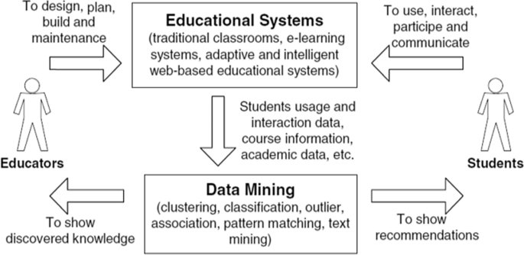
This is an unique project witch will help the students by predicting their career
It will analysis all the past data of a student and then it will predict the outcome.
It will also show the persentage of it’s prediction so that any one can judge the result given by the algorithm.
We will use python programming language and use some algorithm for the prediction.
We will train out algorithm as much we can so that it can perform well.
Introduction

Slide 6

Component Presents CPS
Python Programming language
Some algorithm
Data set
Experts for train the program

Slide 7
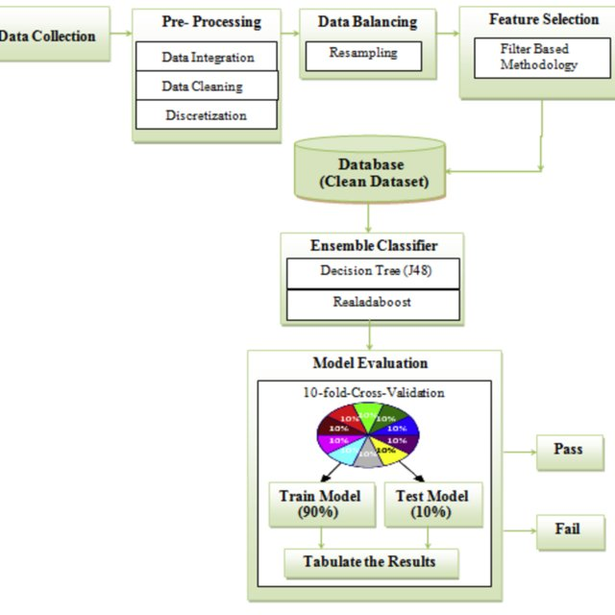
CPS Architecture

Slide 8
Application
Journal
May be a mobile app
May be a web site

Slide 9

Learning Python
Data set Handling
Collecting true information
Training Data set
Algorithm analysis
Challenges

Slide 10

Help the student by choosing their career.
It can be add on their CV.
Help the student in terms of choosing in which department he/she should study next.
Build Confidence for their job life.
Advantages

Slide 11

Can predict wrong outcome
Can manipulate students in wrong direction
The used algorithm can be more batter
For exceptional case it can’t work
Also high percentage outcome can be wrong in real life
Disadvantages

Slide 12
If we can build the program in a way that the prediction will be very near 100% then we can build a very big business with it.
On the other hand people can easily judge them self and can easily choose their right career.
Future Of CPS

Slide 13
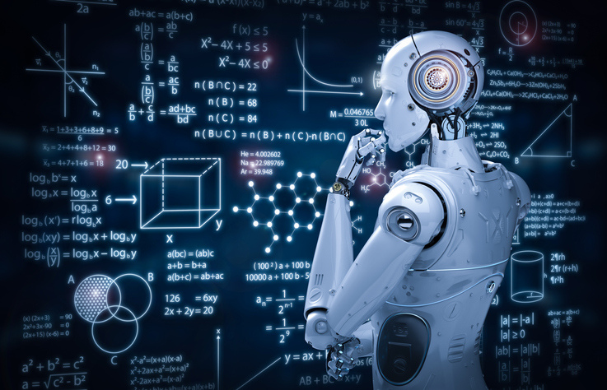
CPS can be Future.
CPS can be widely applicable over the world.
Conclusion

Slide 14
Roy, K. Sripath, K. Roopkanth, V. Uday Teja, V. Bhavana, and J. Priyanka. "Student career prediction using advanced machine learning techniques." International journal of engineering and technology 7, no. 2.20 (2018).
Casuat, Cherry D., and Enrique D. Festijo. "Predicting students' employability using machine learning approach." In 2019 IEEE 6th International Conference on Engineering Technologies and Applied Sciences (ICETAS), pp. 1-5. IEEE, 2019.
Baashar, Y., Alkawsi, G., Ali, N.A., Alhussian, H. and Bahbouh, H.T., 2021, July. Predicting student’s performance using machine learning methods: A systematic literature review. In 2021 International Conference on Computer & Information Sciences (ICCOINS) (pp. 357-362). IEEE.
Dubey, Aarushi, and Muthukumara Mani. "Using Machine Learning to Predict High School Student Employability–A Case Study." 2019 IEEE International Conference on Data Science and Advanced Analytics (DSAA). IEEE, 2019.
Literature Review

Slide 15
Thank You

