Slide 1

CS 412 MACHINE LEARNING PROJECT
FIT ME BABY ONE MORE TIME
GROUP #27
10 January 2021
SADİ ÇELİK
25542
CENK ELİGÜZELOĞLU
23925
EMİR KILKIL
23868
Link for visualization notebook: https://drive.google.com/file/d/1Feax16HfZZVSb5VK5yLsKlADLMskkbRR/view?usp=sharing
Link for training notebook: https://drive.google.com/file/d/1P2K0NnlnQmCj_0472FHLN-zpK0Fd8PBc/view?usp=sharing

Slide 2
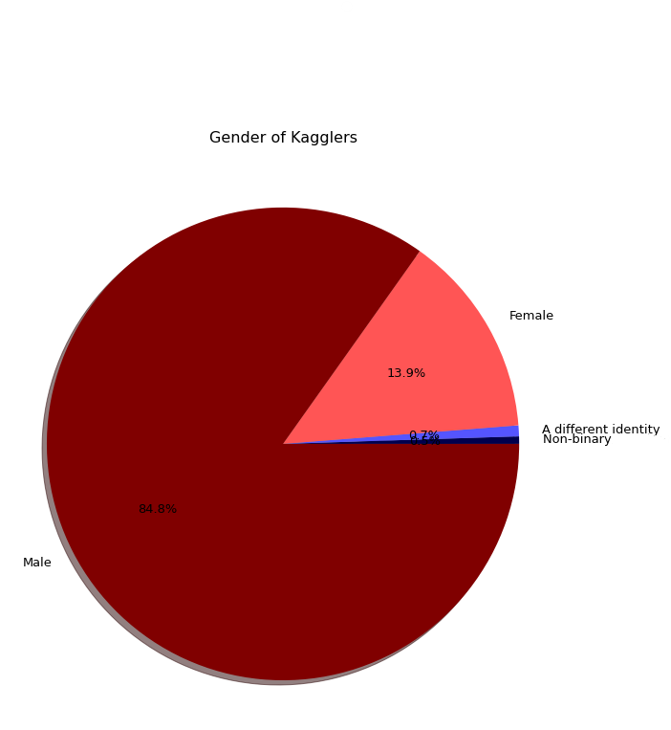
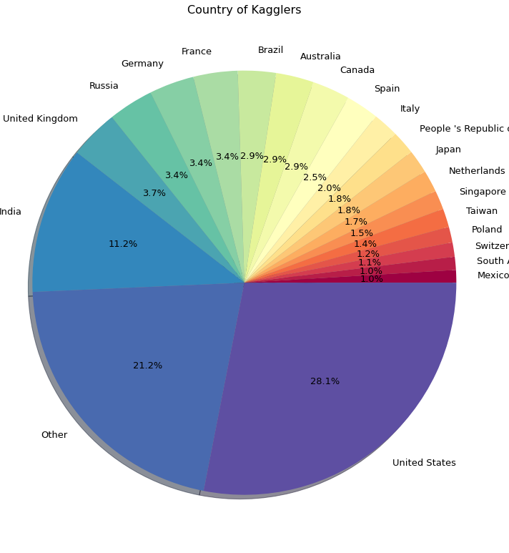

Slide 3
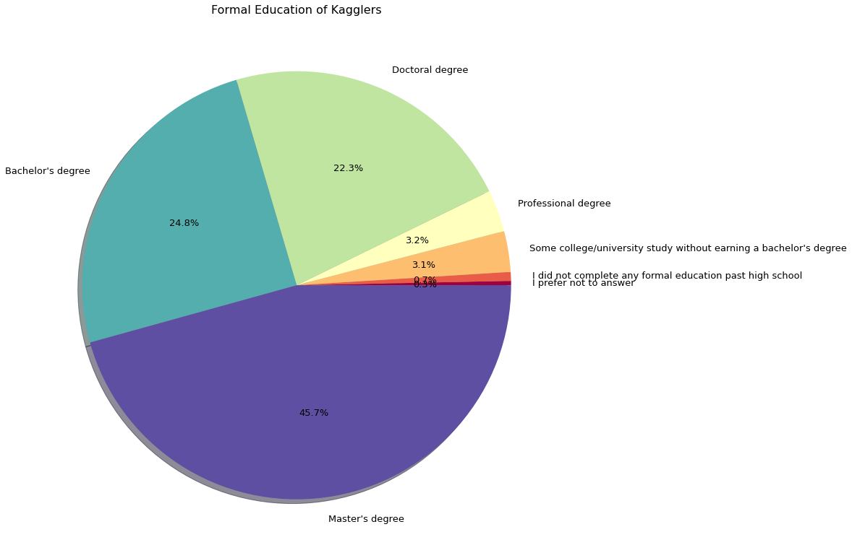

Slide 4
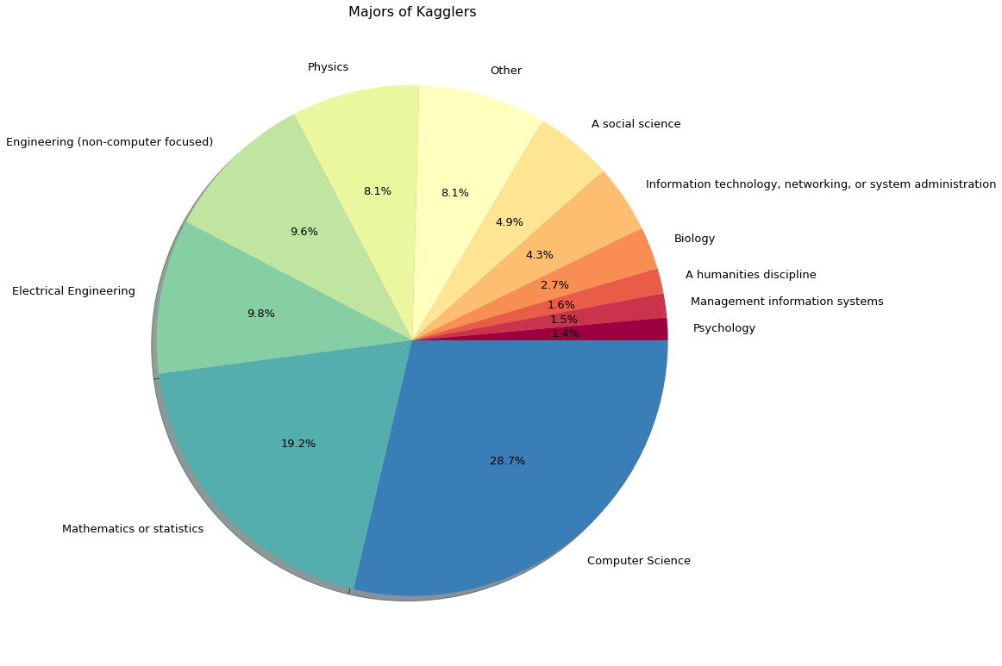

Slide 5
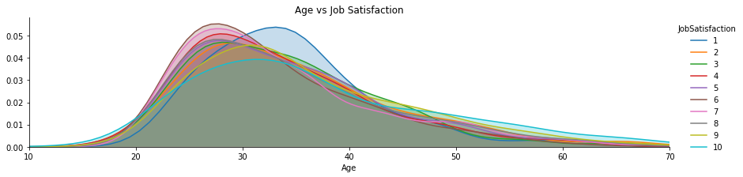
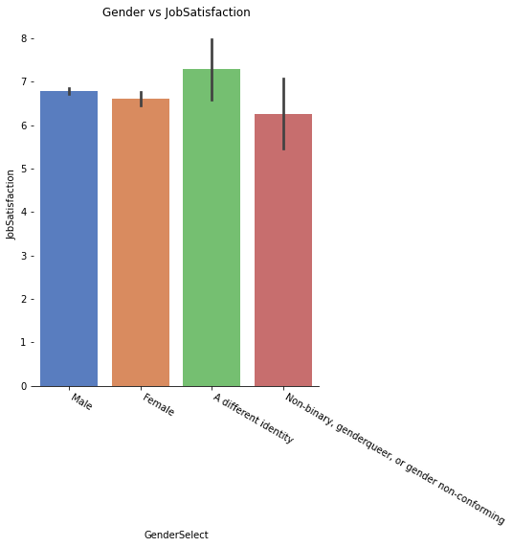
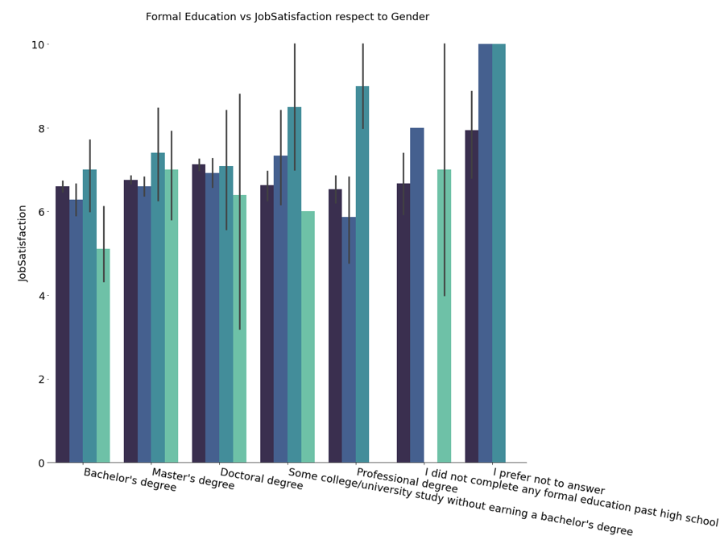
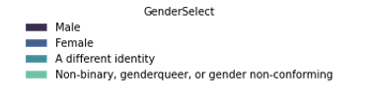

Slide 6
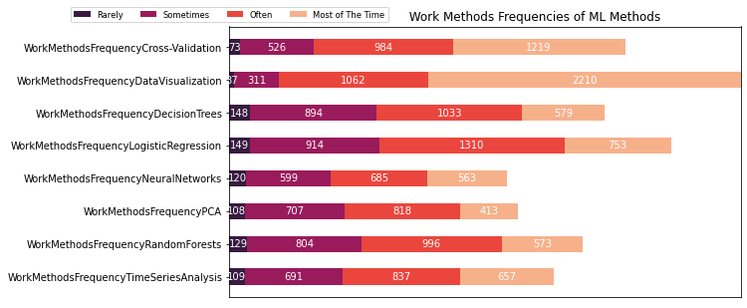
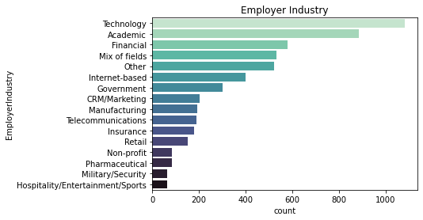
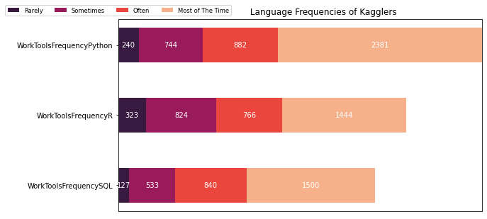

Slide 7
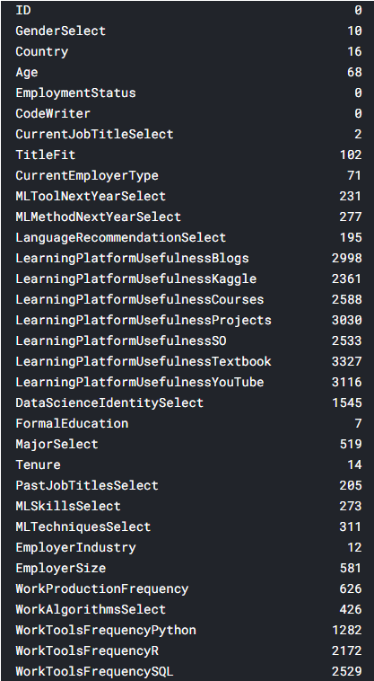
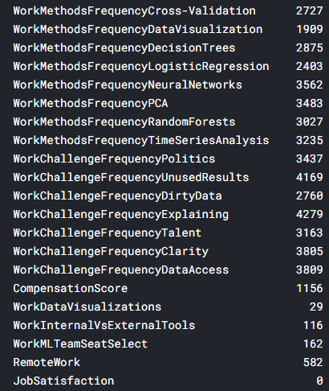
Feature Engineering
If the NaN value ratio was below 50%
Filled NaN values with their “Mode” and “Mean” values
If the NaN value ratio was above 50%
Considered as “Do not know” for categorical values and “0” for ordinal values
Test dataset also filled with Train dataset values

Slide 8
Mapped Columns
TitlesFit
FormalEducation
Tenure
EmployerSize
WorkProductionFrequency
WorkToolsFrequencies
WorkMethodsFrequencies
WorkChallengeFrequencies
LearningPlatformUsefulness
WorkDataVisualisation
RemoteWork
- Since they are ordinal and have superiorities to one another
Multi Label Binarizer
Splitting categorical variables uniquely with multiple entries in a single row separated with ",”
CurrentEmployerType
PastJobTitleSelect
MLSkillSelect
MLTechniqueSelect
WorkAlgorithmSelect
One Hot Encoding
The rest of the dataset except “ID” and “CodeWith” columns since "ID" column is irrelevant and "CodeWriter" columns only contain "Yes" answer, that is why not an effective column
- Since they are categorical and have no superiorities to one another

Slide 9

PreferredWorkMatch – Added Feature
If the ML techniques that kagglers feel most competent also match with algorithms they used the most during their daily jobs
Give a score to the kaggler according to the number of matches

Slide 10


Best Model Trained – Best RMSE Score Obtained
Ensemble Voting Regression
XGBoost Regression
Bayesian Ridge Regression
Stochastic Gradient Boosting Regression
Used “cross_val_predict” witk k-fold value “10” since we have small data
RMSE Obtained During Training in Kaggle Notebook: 1.938719
RMSE Obtained During Training in Colab Notebook: 2.091317
RMSE Obtained On Submission: 1.98274

