Slide 1

PROBLEM
Analyze education/job data about Kagglers
Imagine that you are consulting for a company (think Google or Coursera or a startup…) that wants to know more about data science professionals around the world, so as to launch a new product/business…
They have collected data about Kaggle competition participants which is given you to analyze, study and draw insights from.
You are also asked to build a machine learning model for predicting a given target variable.

Slide 2
Features
Target Variable:
JobSatisfaction: Job satisfaction level of Kaggler in a scale of 1 to 10.
Demographic Features:
Gender, Country, Age, Employment Status
Education Features:
Formal Education, MajorSelect
Data Science Experience:
Tenure: How long has the Kaggler been writing code to analyze data
MLSkillsSelect: In which areas of ML do the Kaggler consider herself/himself as competent
MLTechniquesSelect: In which techniques of ML do the person consider herself/himself as competent
CodeWriter: Whether the person writes code to analyze data

Slide 3
Features
Features Related to Workplace:
CurrentEmployerType, EmployerIndustry, EmployerSize, CurrentJobTitleSelect, PastJobTitlesSelect , CompensationScore…
WorkAlgorithmsSelect: List of algorithms/analytic methods that are being typically used
TitleFit: How adequately the title describes what employee does.
RemoteWork: Frequency of working remotely.
WorkProductionFrequency: Frequency of models building to get put into production.
WorkToolsFrequency : How frequently does the Kaggler use the related tool?
WorkInternalVsExternalTools: Degree of the Kaggler’s team use internal versus external resources for data science projects.
WorkMLTeamSeatSelect: Sitting place of ML team in the office.
WorkDataVisualizations: Proportion of analytics projects that incorporate data visualization.

Slide 4
Features
Other Features:
MLToolNextYearSelect: Tools and technologies that the Kaggler most excited about learning in the next year.
MLMethodNextYearSelect: ML/DS methods that the Kaggler most exiced about learning next year.
LanguageRecommendationSelect: Recommendation of a programming language for a new data scientist.
LearningPlatformUsefulness: Usefulness of related platforms & resources for learning data science skills.
DataScienceIdentitySelect: Is the Kaggler consider herself/himself as a data scientist?

Slide 5
Overview
You are expected to complete 2 tasks:
Task 1 (40pts): In the visualization and insight task, you are not told what to look for. You need to analyze the data and draw insights that may be used for a new business.
data to business value
Task 2 (60pts): In the prediction task (organized as a Kaggle competition), you are expected predict the JobSatisfaction of a Kaggler, given their job description, level etc.
The PPT presentation expected from you is given in the next slides. It will also outline what is expected from you.

Slide 6
TASKS and PRESENTATION
You are expected to prepare a Power Point presentationŞ
Each presentation should be a maximum of 11 slides (title + 10 slides) altogether.
Title slide of your presentation should contain your Kaggle group name and your group number and members.

Slide 7
TASKS and PRESENTATION
Task 1 – 40pts : 4-5 slides should contain visualizations that will summarize important aspects of the data and and insights that may suggest business value/potential (e.g. what courses people are taking may be used to design new course material or to see where they can find more data scientists…)
If you have multiple insights, it would be good to present them in a coherent fashion (grouped together etc) and it would be good if there is some business value of the insights
Order your insights (most important first)
Graphics should be readable (maybe max 4 graphics on a slide)

Slide 8
TASKS and PRESENTATION
Task 2 – 60pts : 4-5 slides should contain your approach to the prediction part of the problem.
You must include:
Preprocessing if any.
Feature selection/extraction if any. Which features emerged as most important and if you have found any new features that are useful
The methods/algorithms tried and the one that resulted in your best cross-validation performance and corresponding results.
Analysis of your system performance – what can you say about when/how system is working well or failing? Any critical issues or solution steps in your approach.

Slide 9
OVERALL SCORE
TASK 1 –Data Visualization & Insights – 40pts
Presentation Quality
Think that you have a short time to pitch your idea to the company
Good presentation skills: right level of detail, interesting, readable slides, good timing,…
Good visuals
Good answers to questions
Value of Insights
Importance will be measured as business or information value.
Could this information be predicted easily (e.g. “there are fewer women than men in data science”) or is it surprising/informative?
What is informative can be something you can build a business upon, or publish in a newspaper/blog about ML, etc
The company can use the information you provide to design new Data Science courses or to open a new research lab where many people may be interested in data science etc ….

Slide 10
OVERALL SCORE
TASK 2: Kaggle task – 60pts
Approach – 20pts
You will be given the maximum points as default; but flaws or shortcomings in your approach will result in points (2-5pts) subtracted from this: e.g. not trying enough suitable approaches (e.g. at least 3 separate approaches), applying an unsuitable transformation, wrong approach in model selection, incorrect handling of the missing values etc..
Note that even though your approach will also affect your test performance of your system, the two are graded separately so that your score does not depend exclusively on your test performance.
Test Performance – 40pts
Your system will be ranked/graded according to RMSE (root mean squared error)
Non-working systems or groups who don’t submit any test results will get 0 points from this category.
Best performing system will obtain the maximum score
The rest of the systems will be graded according to their performance (roughly linearly).

Slide 11
IMPLEMENTATION
Programming language: You are expected to use a Python 3 notebook.
Approach and Software:
You may make use of any available toolboxes and libraries commercial or free.
You may use any approach (any regressor including those that were not addressed during the course; and any data normalization; dimensionality reduction techniques, as you see fit.).
Make sure your preprocessing/feature extraction can be done easily on the test data; you will need to apply the same feature processing steps on the test.
Do not use any external data. The idea here is to see what you can do with the given features/data.
Computing Resources: You may use any computing resources available, including the cloud and the HPC.

Slide 12
KAGGLE DETAILS
Here is the https://www.kaggle.com/t/ae0b72b683954031a7a8404bea93e8a5
train.xlsx
5529 instances
53 regular features
1 target feature (JobSatisfaction)
test.xlsx (will be provided later)
1000 instances
53 regular features
Dataset_explanation.csv
You will find feature explanations
Remind that performance metric is RMSE (Root Mean Squared Error)
Again, we have Public (40%) / Private (60% fixed) Leaderboard (their weighted average will be considered)

Slide 13
KAGGLE SUBMISSON FILE
It should be csv file
There should be header
ID,Prediction
"ID"s should be an integer 1 to 1000 (both included)
"Prediction"s should be a real numeric value 1 to 10 (both included)
Check sampleSubmission.csv in Kaggle link
Groups can make at most 2 submissions in a day
Participants will need to wait until the next UTC day after submitting the maximum number of daily submissions.

Slide 14
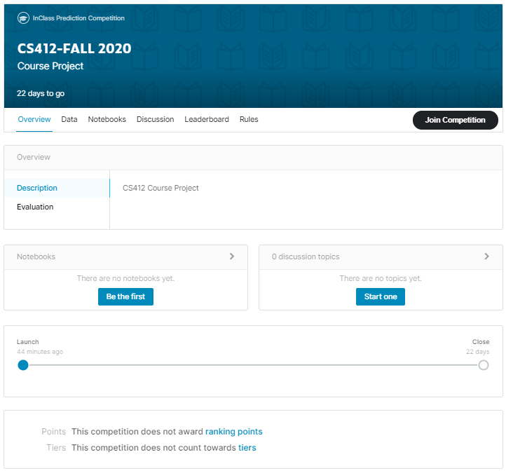

Slide 15
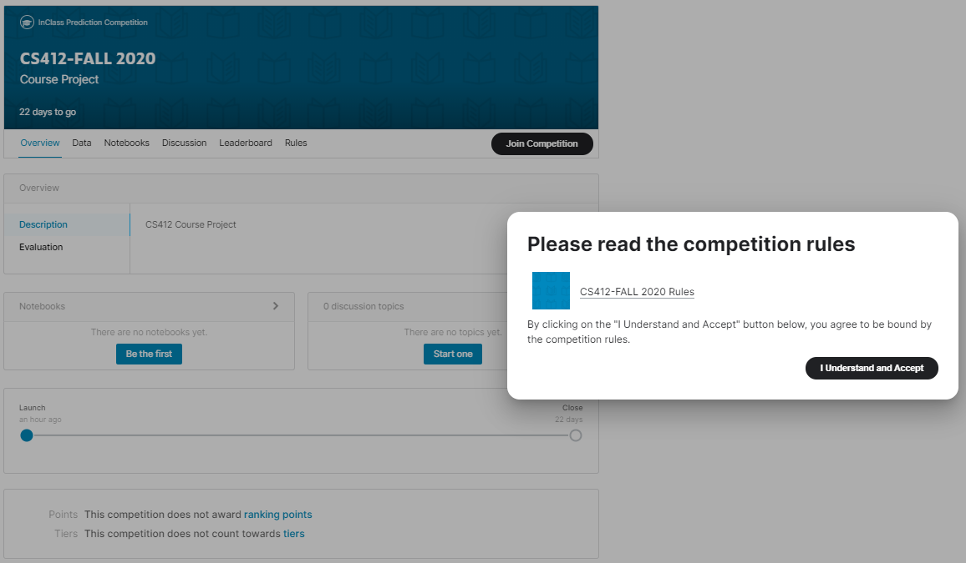

Slide 16
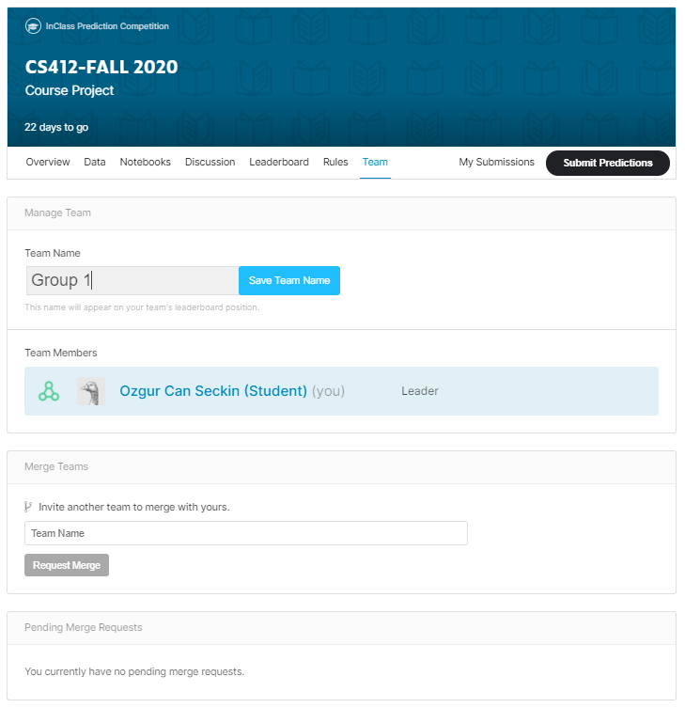

Slide 17
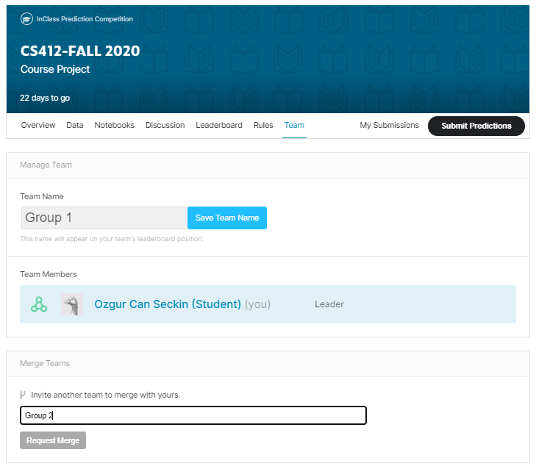

Slide 18
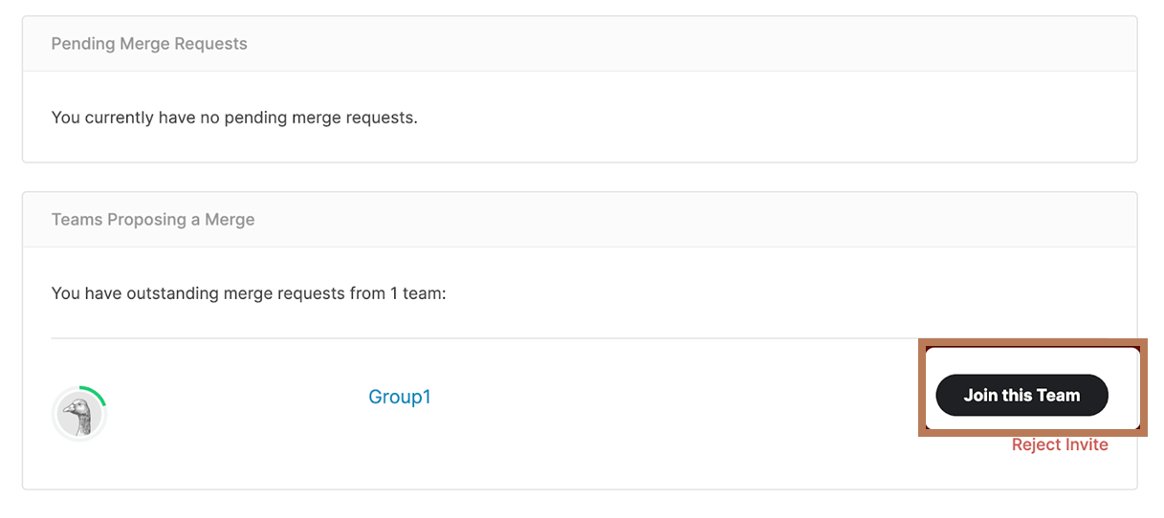

Slide 19
OVERALL SUBMISSION
What to submit:
predictions to Kaggle when test is made available
your 11 slide presentation (in ppt/pdf format)
your notebook that produced the predictions should be submitted as a Colab notebook
link in the title page of your presentation.
Do not submit code written to generate visualization or to draw insights.
Your submitted code must give the exact test results when trained with the given training data using your code.
In order to remove any randomness, please start by setting a random number seed (or random_state) to have results that you can replicate.
The first person in the group (first lastname-alphabetically) should submit the presentation file.

