Slide 1
What contributes to Higher Taxes in Single Family Homes?
Sadie Harper
DSC 530-T301
6/5/2021

Slide 2
Dataset
I used Zillow housing data from Kaggle and Zillow’s website
The dataset I analyze includes different variables for single family homes from Los Angeles County, Orange County, and Ventura County California from 2016-2017.
I am exploring the data to see if location and lot size contribute significantly to total tax amount spent on single family homes in these areas around 2015.
Sources
  Zillow prize: Zillow's home Value Prediction Zestimate. (2017). Retrieved June 05, 2021, from https://www.kaggle.com/c/zillow-prize-1/data?select=properties_2016.csv
  Zillow Research. (2021, March 25). Housing Data. Retrieved June 05, 2021, from https://www.zillow.com/research/data/

Slide 3
Variables for Analysis
Total Tax Amount
Number of Bedrooms
Number of Bathrooms
Finished Living Area Sqft.
Lot Sqft.
Percent Change of Zillow’s typical home value from Jan. 2014 to Jan. 2015
County
Variable Selection Methods:
Low numbers of missing values
Available description of what the values represented
Information relevant to my hypothesis

Slide 4
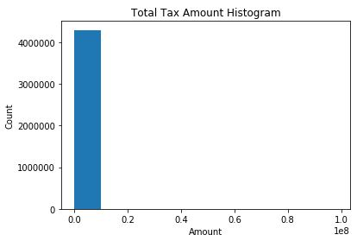
Total Tax Amount
Count | 4298258.0
Mean | 449682.0
Standard Deviation | 675874.0
Min | 1.0
25% | 183720.0
50% | 319798.0
75% | 520802.0
Max | 98428909.0
Spread | 98428908.0
Mode | 1 cluster
Tails | N/A
Outliers | Yes: Max values

Slide 5
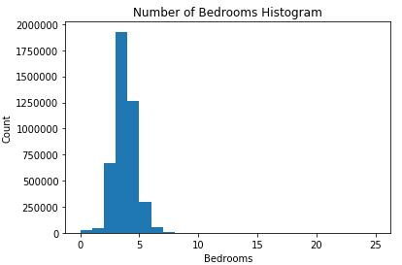
Number of Bedrooms
Count | 4299223
Mean | 3
Standard Deviation | 1
Min | 0
25% | 3
50% | 3
75% | 4
Max | 25
Spread | 25
Mode | 1 cluster
Tails | Rapid drop towards max
Outliers | Yes: Max values

Slide 6
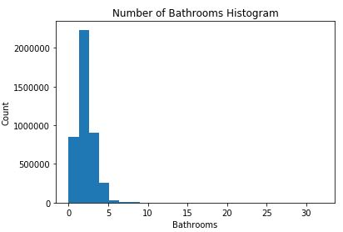
Number of Bathrooms
Count | 4299223
Mean | 2
Standard Deviation | 1
Min | 0
25% | 2
50% | 2
75% | 3
Max | 32
Spread | 32
Mode | 1 cluster
Tails | Rapid around mode and towards max
Outliers | Yes: Max values

Slide 7
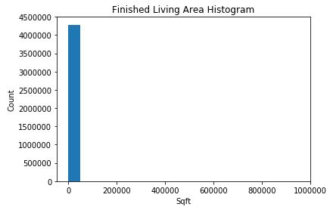
Finished Living Area Sqft.
Count | 4281255.0
Mean | 1861.0
Standard Deviation | 1219.0
Min | 1.0
25% | 1256.0
50% | 1621.0
75% | 2205.0
Max | 952576.0
Spread | 952575.0
Mode | 1 cluster
Tails | N/A
Outliers | Yes: Max values

Slide 8
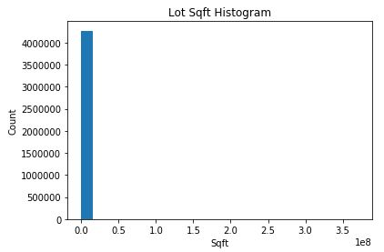
Lot Sqft.
Count | 4273470.0
Mean | 11184.0
Standard Deviation | 321108.0
Min | 100.0
25% | 5635.0
50% | 6760.0
75% | 8550.0
Max | 371000512.0
Spread | 371000412.0
Mode | 1 cluster
Tails | N/A
Outliers | Yes: Max values

Slide 9
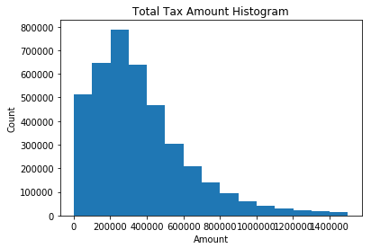
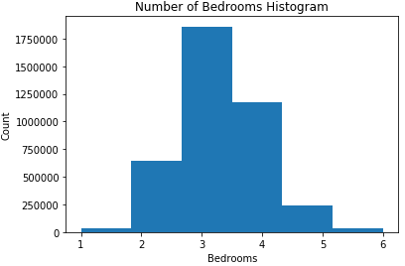
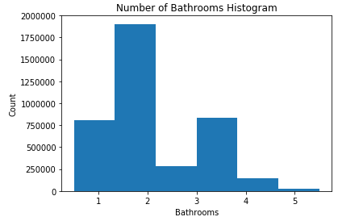
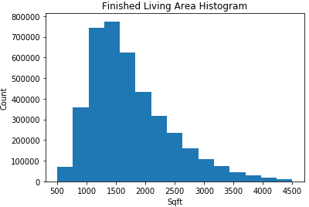
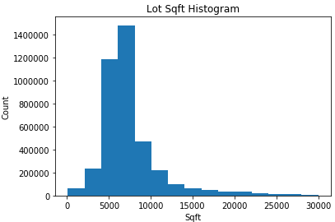
Histograms: Again
I applied to following filters to the property data to remove outliers and try to make the data fit a more typical single-family home; the visuals represent the new histograms after these changes.
Total Tax Amount | >= $1,000 | <= $1,500,000
Number of Bedrooms | > 0 | < 7
Number of Bathrooms | > 0 | < 6
Finished Living Area | >= 500 Sqft. | <= 4,500 Sqft.
Lot Sqft. | N/A | <= 30,000 Sqft.

Slide 10
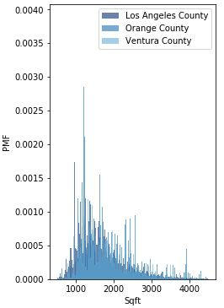
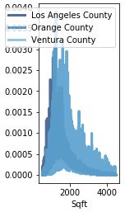
PMF: Lot Sqft by County
Part of understanding what influences total tax amount is the location of the home and the size of the lot for the property tax portion. These visuals help explain this relationship.

Slide 11
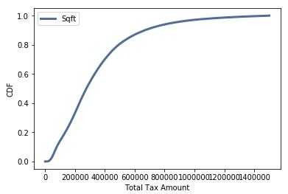
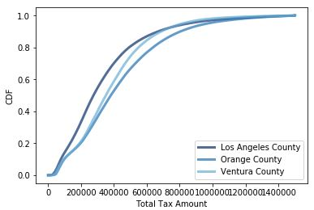
CDF: Total Tax Amount
From the top visual I can see that most of the properties fall under around $600,000 in total taxes. Only around 10% start to pay more than that with very few nearing a million. Just over 50% of the properties all fall under $300,000.
The bottom visual shows the total taxes for the three counties. This tells me that Los Angeles County has more properties with lower total taxes.

Slide 12
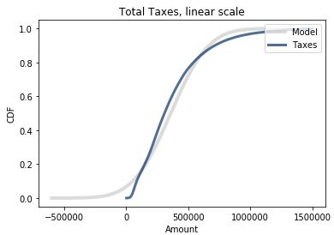
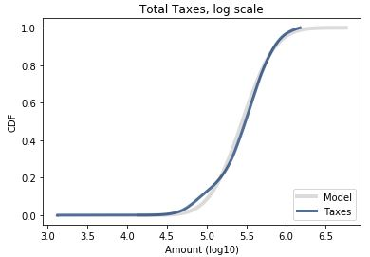
Lognormal Distribution:
Total Tax Amount
The top visual plots total taxes on a linear scale and it shows that the normal distribution is not a good fit for the data.
The bottom visual plots the log scale of total tax amount and here we get a much better fit. It’s not a perfect match but it’s not terrible. The main reason being the small portion of properties that have high total tax amounts.
Overall, the data somewhat fits a lognormal distribution

Slide 13
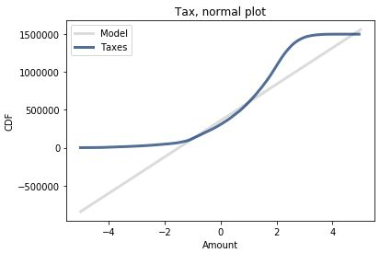
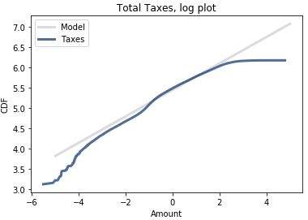
Probability Plot:
Total Tax Amount
The top visual is a normal probability plot for taxes and shows that it is not a good fit.
The bottom visual is the lognormal probability plot. This shows the data is a somewhat good fit except for the tails.

Slide 14
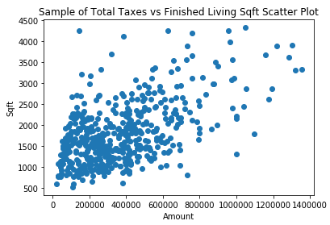
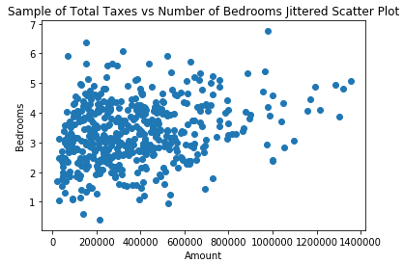
Scatter Plots
The plot of total taxes vs living sqft. show a slightly strong positive linear relationship – this is reflected in the correlation values
Taxes vs number of bedrooms shows a somewhat linear relationship, but the correlation is not strong – also reflected in correlation values listed below
The data is all clustered around the lower total tax amounts because the bulk of the data is there.
The covariance is hard to interpret and compare because the living sqft and number of bedrooms are drastically different in size of the numbers used to calculate the covariance
Metrics | Taxes vs Living | Taxes vs Bedrooms
Covariance | 100661153.81 | 72335.77
Pearson’s | 0.55 | 0.32
Spearman’s | 0.46 | 0.31
Strength | Somewhat strong | Very slightly strong

Slide 15
Hypothesis Test
Hypothesis: Location has a significant affect on total tax amount for properties in California
Null Hypothesis: Location does not have an affect on total tax amount for properties in California
I tested the difference in means for total tax amount between the three different counties.
  All tests resulted in a p-value of 0.0
  This indicates that 0% of the time we expect to see a difference as big as the observed difference between counties.

Slide 16
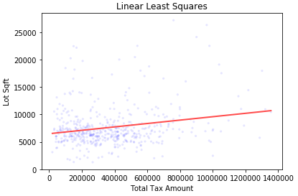
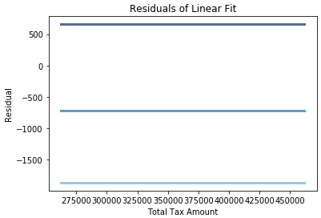
Regression Analysis
Initially, I thought this linear least squares model was an okay fit of the data based on these two visuals. The line of best fit somewhat represents the linear relationship.
The residuals are flat which indicates they have the same variance across the groups and they’re random.
Based on the R squared value though, lot size only accounts for around 4.6% of the variance in total tax amount.
  R-squared = 0.0461
  Rho = 0.215
  R = 0.215

Slide 17
Outcome
Based on my findings, I would say that location and lot size do not contribute significantly to total tax amount in single family homes from Los Angeles County, Orange County, and Ventura County.

