Slide 1

Programming Languages Final Project
OPTION A
Levi Stovall & Sadie Sublousky

Slide 2
Part 1
Remove excess code from yacc.py and lis.py in DrCannata/Python/PLY mini-lisp such that yacc.py has no unused eval code and lis.py has no unused parse code.
*seen in Part4and5 version of mini-lisp

Slide 3
Part 2 - Use of the "exec" function (in Part 3 & 4)
*inspiration* se of the "exec" function that has been added to lis.py. ml> (+ 1 (exec 'import Addition; toReturn = Addition.add(23, 34)'))
AST is: ['+', 1, ['exec', "'import Addition; toReturn = Addition.add(23, 34)'"]] 58

Slide 4
Part 3: Functional Python
Python closures involve nested functions which refer to variables in their enclosing scopes
The enclosing function returns the nested function
Provides a degree of data hiding

Slide 5
Part 3: Functional Python
Our example: Vector.py
Outer function f returns nested function cf to update or display data of a three_vector instance
Magnitude function on same level as f returns a value depending on the data
ml>(exec ‘import Vector; v = Vector.three_vector(); v.run(“$x”)(3);
v.run(“$y”)(4); toReturn = v.magnitude()’)
This command returns 5.0.

Slide 6
Part 4 - Stream Operations
*Allows developers to process data declaratively
*Makes use of multi-core processors with parallel code processing
(exec 'import Stream; Stream.streamIt(78,45,89,45,88,95,99)')
Troubles encountered:
(1) Getting mini-lisp to pass in data as opposed to just running Java file with embedded data
(2) Java file AND class file in the project

Slide 7
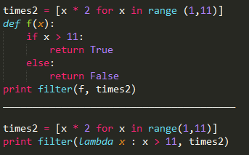
Part 5 - Lambda List Comprehension
Lambdas are functions that are declared in a way that allows us to write shorter, cleaner code
*You don’t have to search code for function definitions

Slide 8
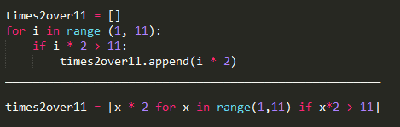
Part 5 - Lambda List Comprehension
List Comprehension is a quick way of creating a list that contains what you want

Slide 9
Part 5 – Lambda List Comprehension
>ml (mapp "lambda x: x + 1" '(1 2 3))
AST is: ['mapp', 'lambda x: x + 1', [1, 2, 3]]
(1) define tokens ‘MAPP’ and ‘LAMBDA’ to recognize & parse the statement
(2) Add ‘mapp’ EVAL function

Slide 10
Bugs
((lambda (x) (+ x x)) 4) does NOT work
ml> (define lam (lambda (x) (+ x x)))
AST is: ['define', 'lam', ['lambda', ['x'], ['+', 'x', 'x']]]
ml> (lam 4)
AST is: ['lam', 4]
8

Slide 11
Bug Fix
Previously, in mini-lisp, a variable could not be defined with a string value.
We edited the eval function in lis.py so that
ml> (define s “test”)
ml> s
returns “test”

Slide 12
Swift Subset
We wrote a parser sufficient to interpret the following:
ms> let a = 5
ms> let b = 6
ms> let b_sentence = “b is equal to \(b).”
ms> let const_sentence = “a plus b equals \(a + b).”

Slide 13
Made a lex file, a yacc file, and a file to run the command prompt, and reused lis.py with some edits to the eval function
Defined grammar rules for simple binary operations and let statements
Caused the eval function in lis to recognize \(expression) in strings, and passed the contained string back into the parser

Slide 14
Errors found from testing suite
http://norvig.com/lispy2.html (Go to section titled TESTING)

Slide 15
ILLEGAL CHARACTER ERRORS
ILLEGAL CHARACTER BUGS
(quote (testing 1 (2.0) -3.14e159)) => (testing 1 (2.0) -3.14e+159)
Illegal character ‘.’
(+ 2 2) => 4
(+ (* 2 100) (* 1 10)) => 210
(if (> 6 5) (+ 1 1) (+ 2 2)) => 2
Illegal character ‘>’
(if (< 6 5) (+ 1 1) (+ 2 2)) => 4
Illegal character ‘<’
(define x 3) => None
x => 3
(+ x x) => 6

Slide 16
SYNTAX ERROR ‘(‘ BUGS
((lambda (x) (+ x x)) 5) => 10
Syntax error right at beginning (
(define compose (lambda (f g) (lambda (x) (f (g x))))) => None
((compose list twice) 5) => (10)
Syntax error right at beginning (
(define repeat (lambda (f) (compose f f))) => None
((repeat twice) 5) => 20
Syntax error right at beginning (
((repeat (repeat twice)) 5) => 80
Syntax error right at beginning (
(define fact (lambda (n) (if (<= n 1) 1 (* n (fact (- n 1)))))) => None
(fact 3) => 6

