Slide 1
Wireless Tremor Detection
ME 505 Group 3
Sadra Hemmati, Nav Kikkeri, Carter McVeigh, Nolan Perry

Slide 2
Background
Problem at hand:
Many infants are exposed to illicit drugs during development
They may experience withdrawal
Symptoms include violent tremors which may injure the child
Task
We have to develop a device which can wirelessly monitor a child’s motion
It must alert nurses if there are any tremors
The system must be simple and easy to use

Slide 3
Completed Work
Proof of Concept
Acquired and integrated the hardware to create a testbed device
Device is able to differentiate between normal body movements and tremors
Designed a printed circuit board
Developed iOS app which would use Bluetooth Low Energy to receive data and present textual indication
Further Development
Integrate all hardware onto wireless prototype (accelerometer)
Apple Developer’s Account

Slide 4
Solution
Our Wired Design
Low power microprocessor – RFDuino, which has a Bluetooth low energy transceiver
Integrated into developer kit with USB programming dongle
Large accelerometer (easy to solder)
Why?
Simpler layout before minimizing space
Easily verify and develop Arduino code

Slide 5
Solution
Our Wireless Design
low power microprocessor – RFDuino, which has a Bluetooth low energy tranceiver
Accelerometer
All mounted on a PCB
Approximate total weight – 7 grams
Why?
Simple to use devices
Minimize size and power requirements
Accelerometer must sample at an appropriate rate

Slide 6
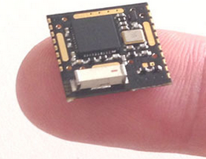
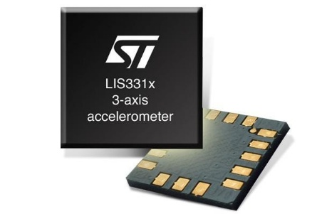
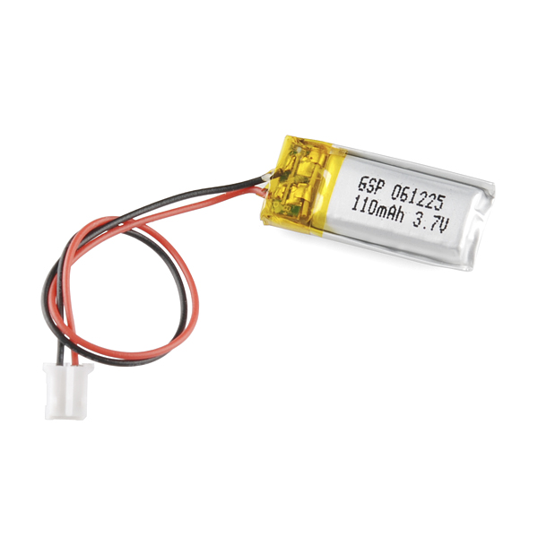
Hardware Components
Component | Why?
RFDuino developer kit, with a RFDuino and USB Programming dongle | Primary test bed for project development. Has built in RFDuino, Bluetooth transceiver, and USB port for fast programming. Used to verify concept
RFDunio Microprocessor (RFD22301) | Has an integrated Bluetooth low energy transceiver. Low power, with peak power draw at 12mA. Has range of 30 feet. Meets minimum processing speeds.
Accelerometer | Has a sampling rate of .5Hz – 1kHz, and consumes 10uA.
110mAh Li-Ion battery | Supplies power to the device for 9+ hours. Compact size. Rechargeable.

Slide 7
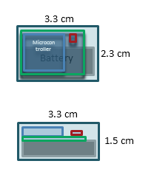
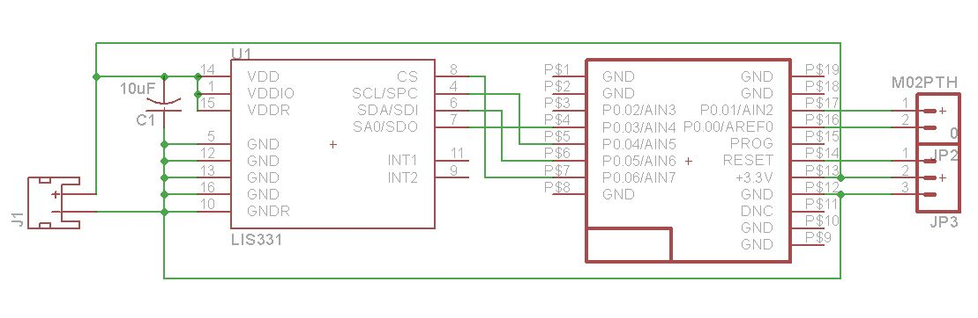
Our Design

Slide 8
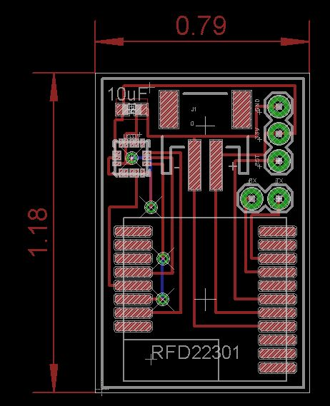
Our PCB Design

Slide 9
Tremor Detection
Differentiates between tremors and general movements
Accelerometer is sampled at 50Hz
Algorithm:
Reads 30 samples
Average is taken
Compares each successive sets of data with the average
Counts the number of times the acceleration crosses the average

Slide 10
Acceleration Data

Slide 11
Acceleration Data

Slide 12
Acceleration Data

Slide 13
UI Design
We explored different options
Android – did not have necessary OS updates to access BLE
Windows/Linux OS – did not have access to BLE hardware
Explored the use of BLE dongle – failed to properly work
iOS Application – appeared simplest to work with and pre-built shells were available

Slide 14
UI Design
iOS application
Modified existing Rfduino application code to meet our needs
Used Xcode Simulator
Ran the Simulator on a Mac
Did not have BLE hardware
Difficulties with acquiring an iOS developer account
Prevented us from uploading the app onto an iPhone/iPad

Slide 15
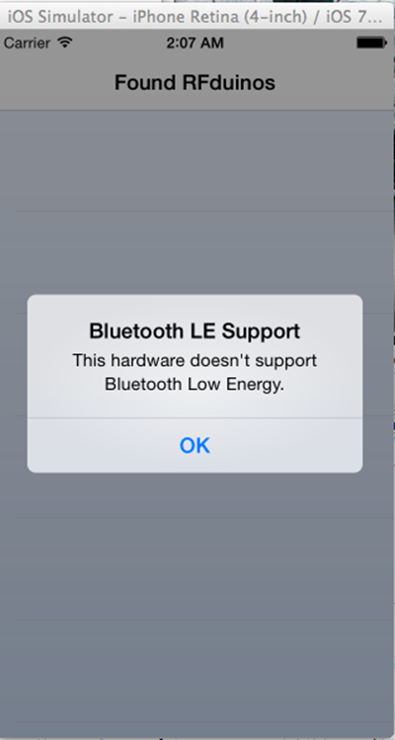

Slide 16
Conclusion
Unfinished tasks
Test application with BLE capable iOS device
Finish building and test Printed Circuit Board
Refine tremor detection algorithm for babies
Modify device for any conditions specific to individual babies
Lessons learned
Apple is difficult to work with
Ensure that you have available equipment to work with your hardware

Slide 17
Questions?

