Slide 1


SİS POWER
Sadık AKYAR İsmail ATASEVEN Sonay ULUKAYA

Slide 2

Magnetıc Desıgn
Due to discontinuous mode
$\frac{∆i_{L}}{2}=i_{L\left(avg\right)}$
${∆i}_{L}=\frac{{2∗P}_{out}}{V_{d}∗D}=\frac{2∗60W}{24V∗0.295}=16.95A {∆i}_{L}=\frac{{2∗P}_{out}}{V_{d}∗D}=\frac{2∗60W}{48V∗0.1725}=14.5A$
${∆i}_{L}=\frac{V_{s}∗D∗T_{S}}{L_{M}}→L_{M}=\frac{V_{s}∗D∗T_{S}}{{∆i}_{L}}$
$L_{M}=\frac{24∗0.295∗(1/62500)}{16.95}=6.68 µH L_{M}=\frac{48∗0.1725∗(1/62500)}{14.5}=9.13 µH$

Slide 3
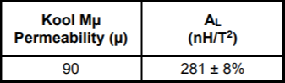
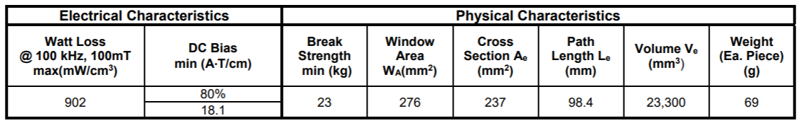

Chosen core K4022E090;
$A_{L} ∗N_{1}^{2}=L_{M}$
$281nH ∗N_{1}^{2}=6.68 µH 281nH∗N_{1}^{2}=9.13 µH$
$N_{1}=5 turns$ → $L_{M}$ $=7 µH$ $N_{1}=6 turns \text{→} L_{M} =10.11 µH$

Slide 4
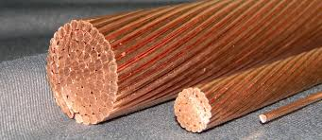

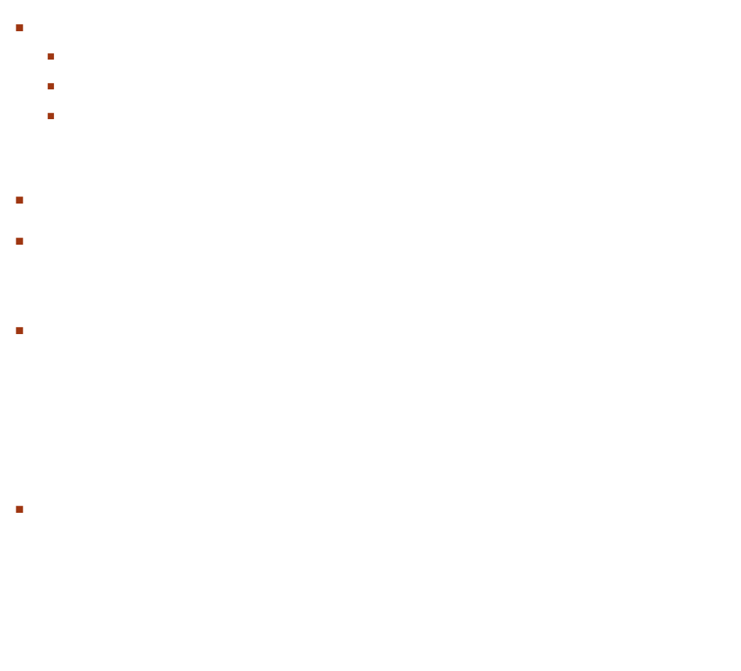
Chosen AWG-18 cable properties;
R=20.95 mΩ/m
I(max)=16A
Area=0.823 ${mm}^{2}$
Passing max. Current = 8.475A
One turn length = 63.8 mm
$Copper Loss=\left(I^{2}\right)∗R$
$={8.475A}^{2}∗\left(20.95\text{m}\text{Ω}\text{/}\text{m}\text{∗0.0638}\text{m}\text{∗}6t\right)$
$=$67.9mW
$k_{fill−factor}=\frac{N∗Cable area}{Window area}∗100$
$$=\frac{6∗\left(0.823{mm}^{2}\right)}{\left(9.27mm\right)∗\left(14.9mm\right)∗2}∗100=1.7\%$$

Slide 5

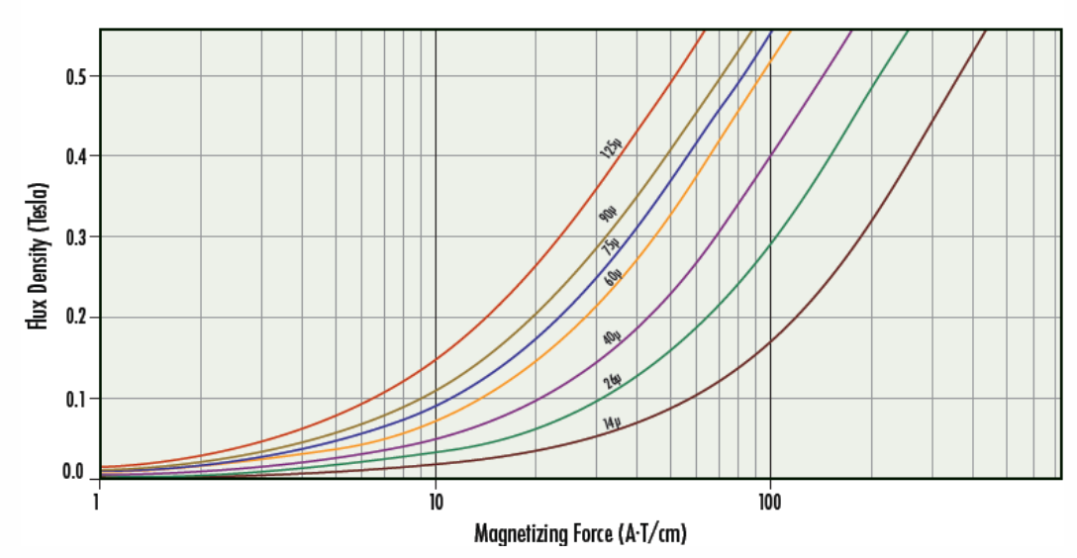

$N∗I=B∗A∗R\left(reluctance\right)$
6$∗14.5A=B∗\left(237∗{10}^{−6}{mm}^{2}\right)∗\left(3670024.515\right)$
$B=0.1T$

Slide 6
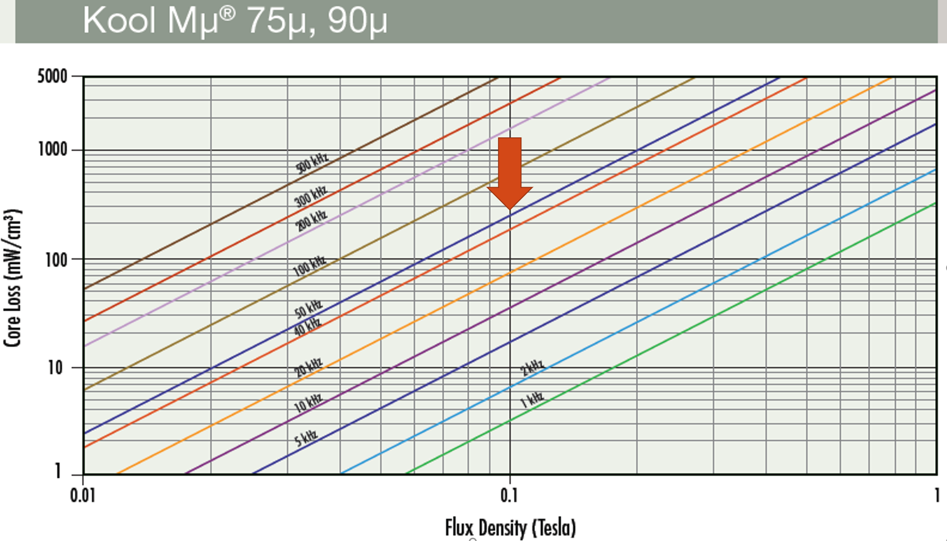
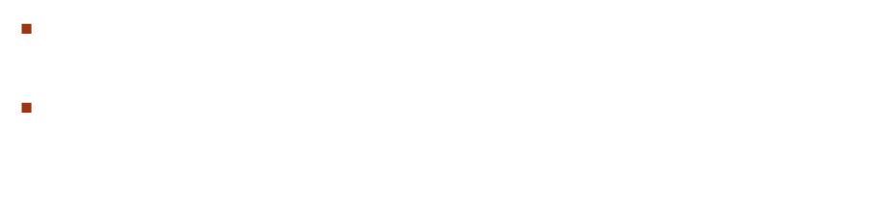
$Core Loss=Volume∗Core loss multiplier$
$Core loss=\left(23300{mm}^{3}\right)∗\left(\frac{250mw}{{cm}^{3}}\right)=5.8W$

Slide 7
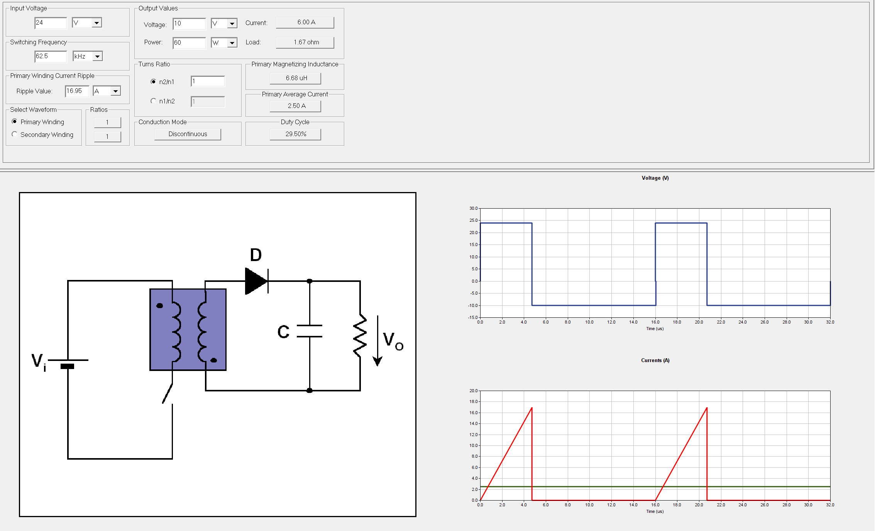
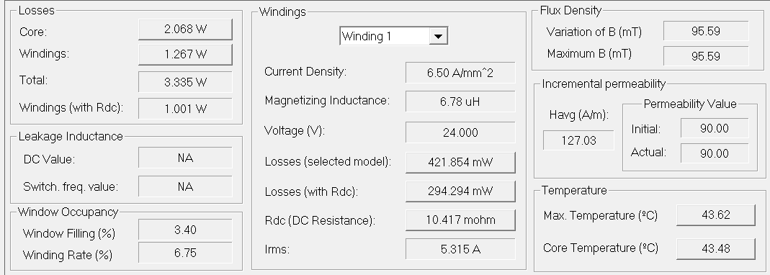
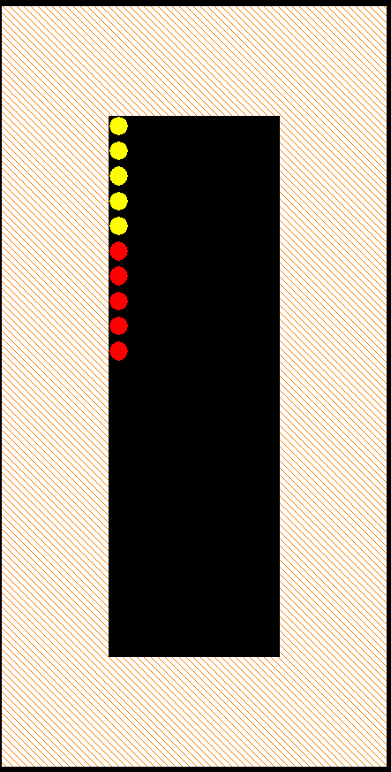
PExprt

Slide 8
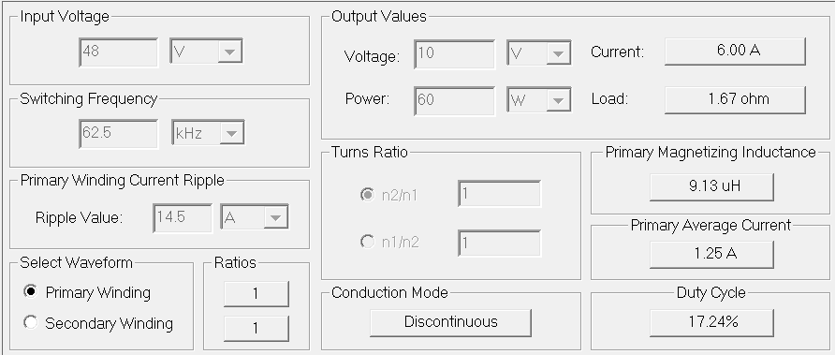
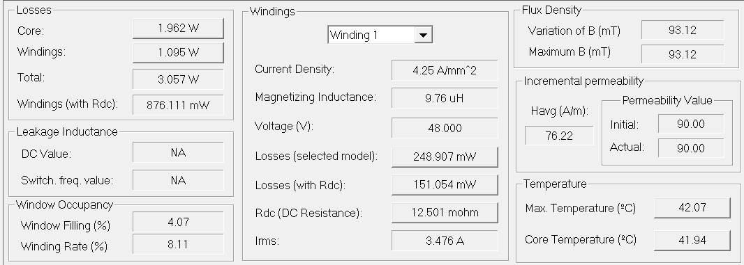
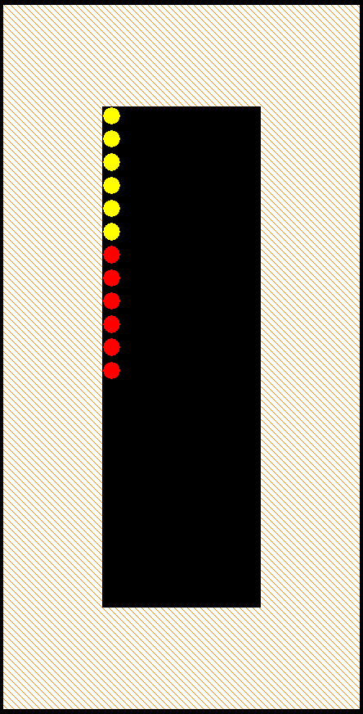
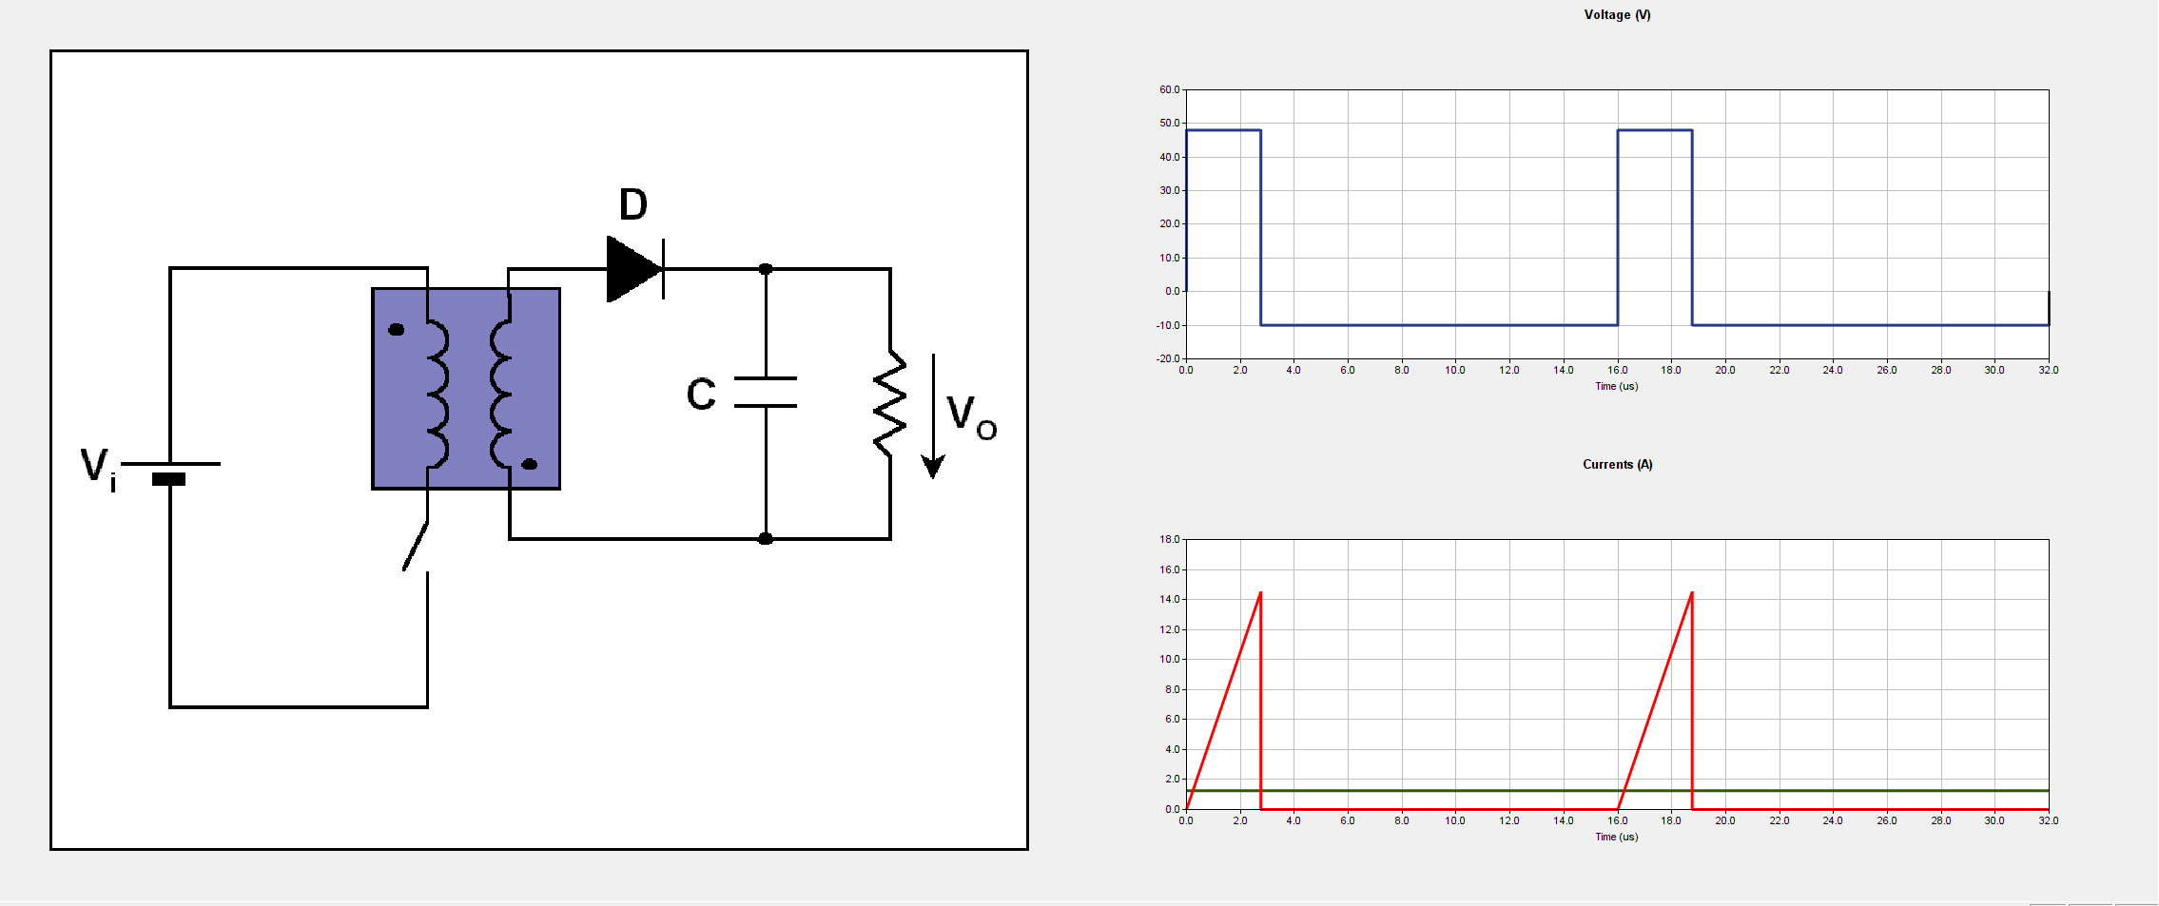
PExprt

Slide 9
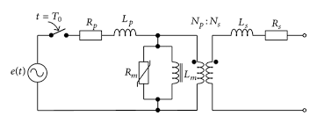
Transformer equıvalent cct model

Slide 10
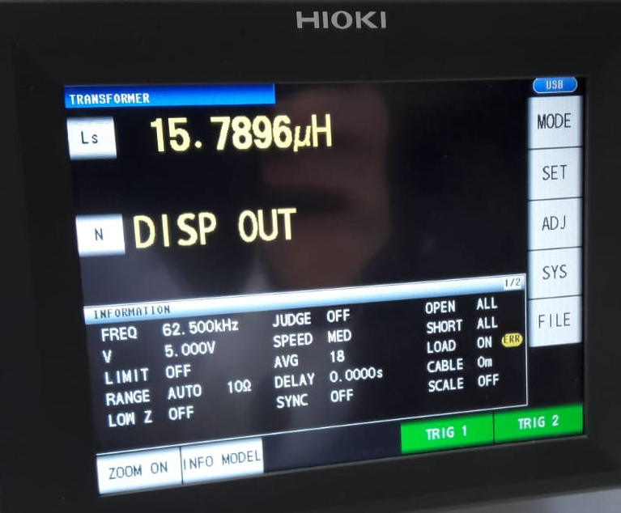
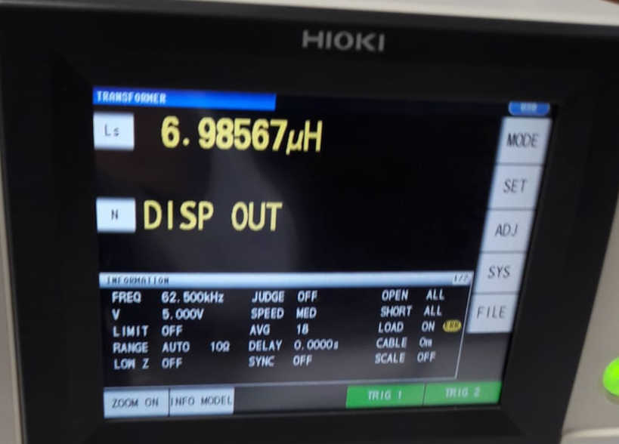

Test results
7 turns
Open Cct Short Cct
$L_{M}$ =15.79 $µH$ -(6.98 $µH$ /2)=12.3 $µH$

Slide 11
SIMULATION RESULTS

Slide 12
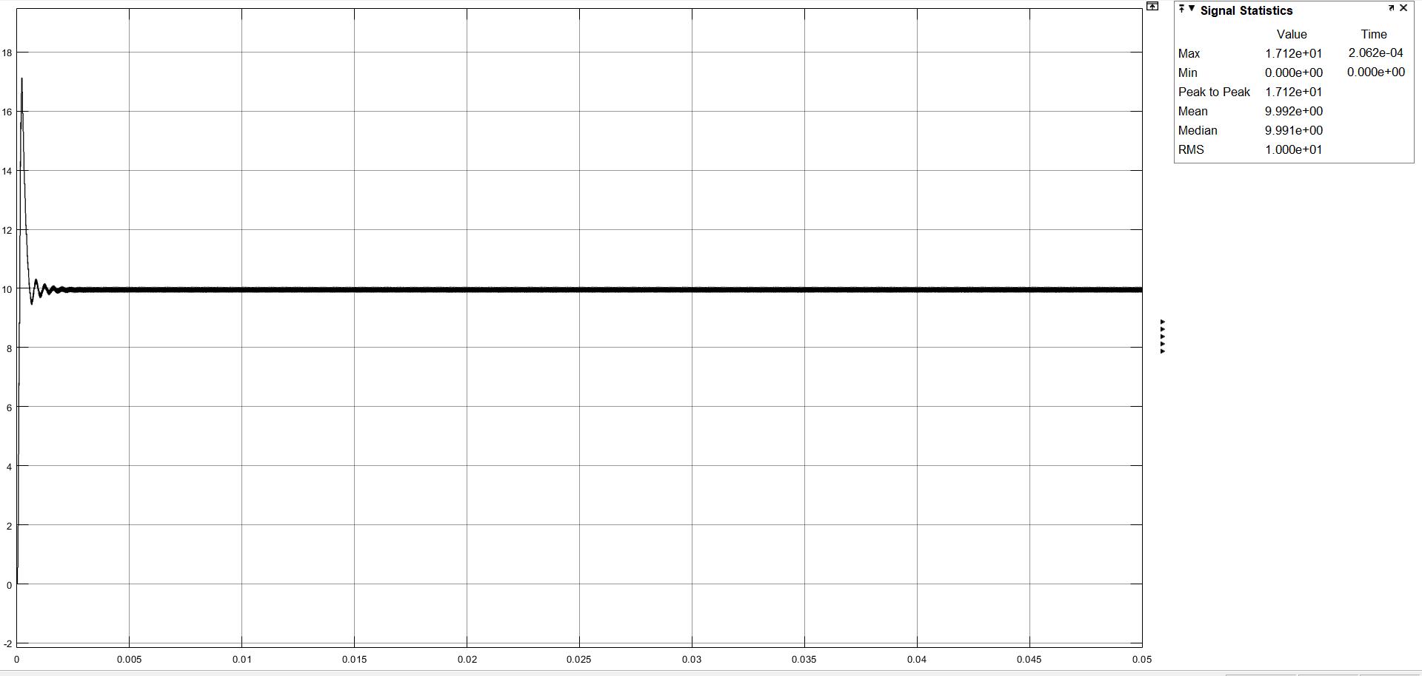
For Vın = 24 V
Output Voltage

Slide 13
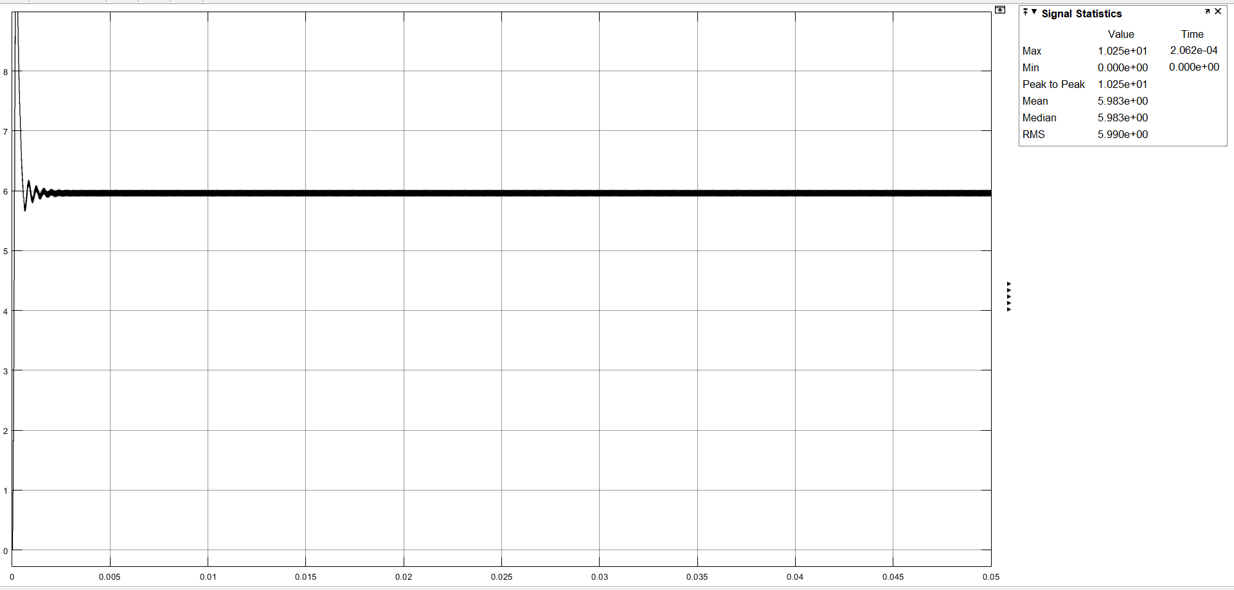
Output Current

Slide 14
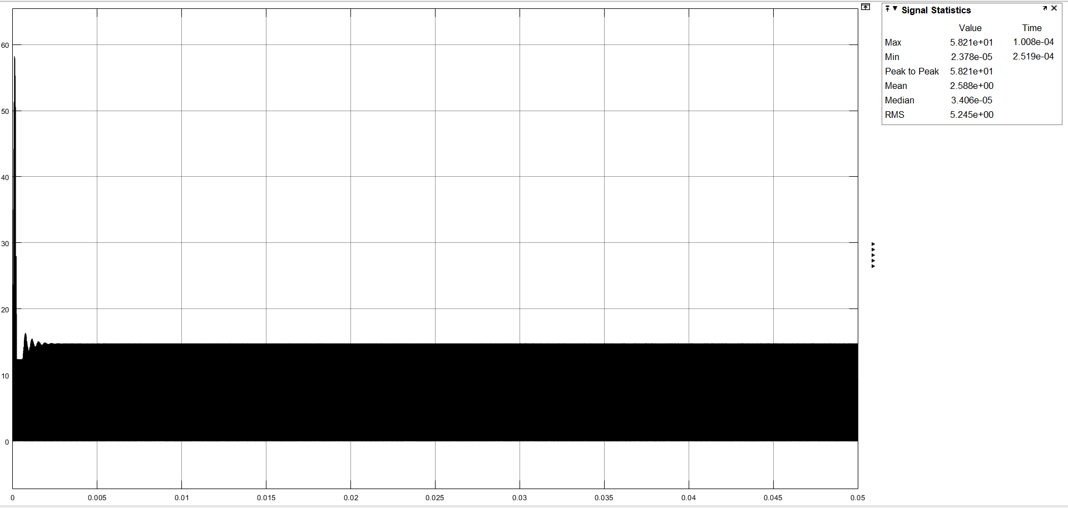
Input Current

Slide 15
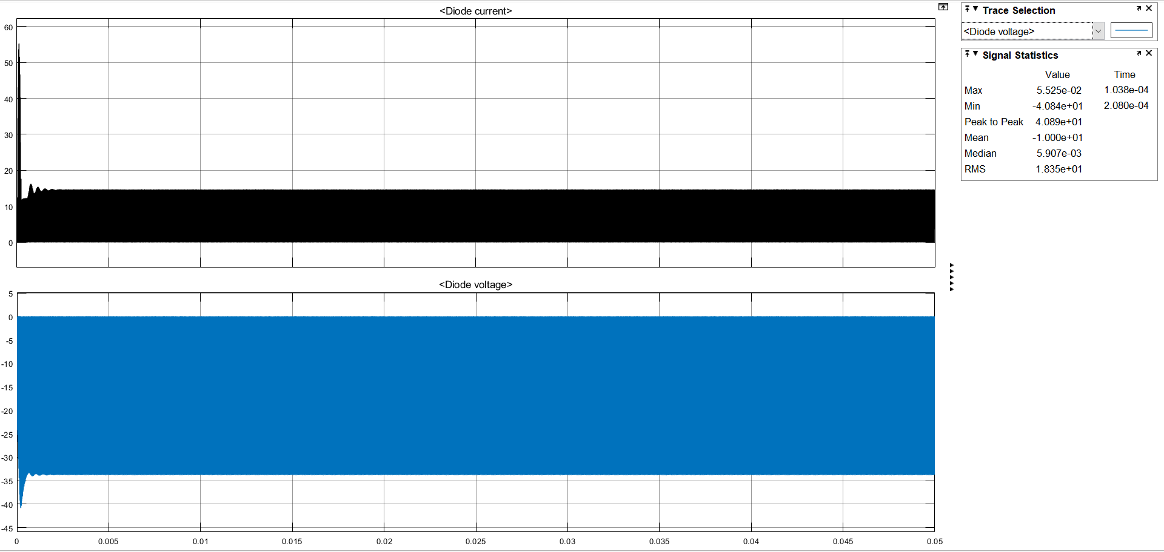
Diode Current and Voltage

Slide 16
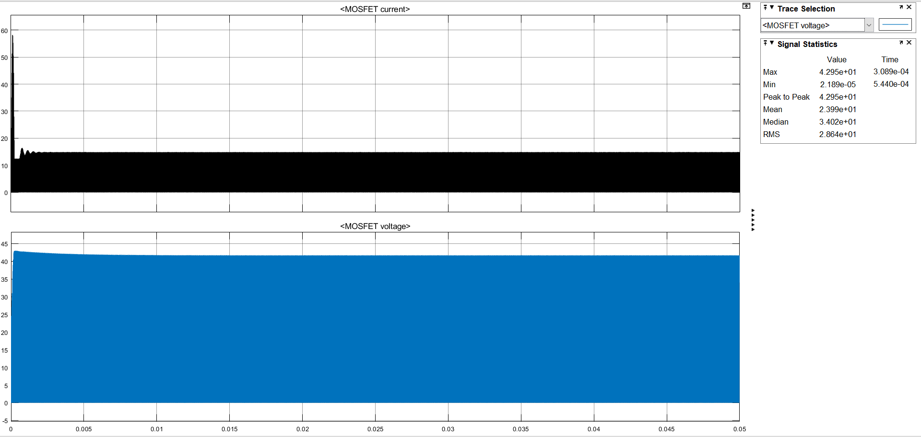
MOSFET Current and Voltage

Slide 17

For Vın = 48 V
Output Voltage

Slide 18
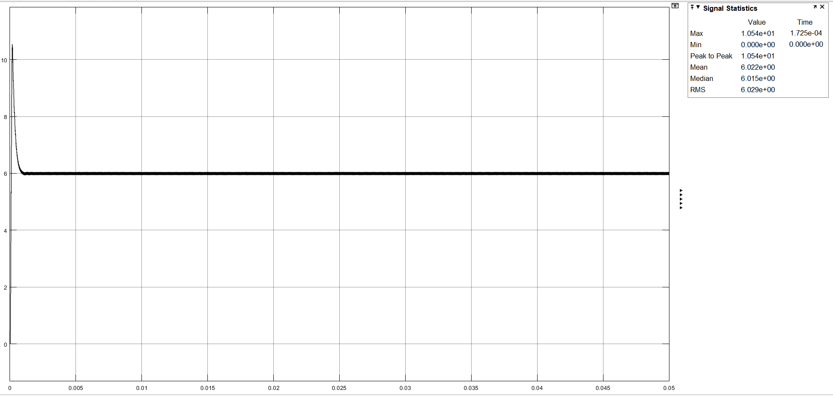
Output Current

Slide 19

Input Current

Slide 20

Diode Current and Voltage

Slide 21
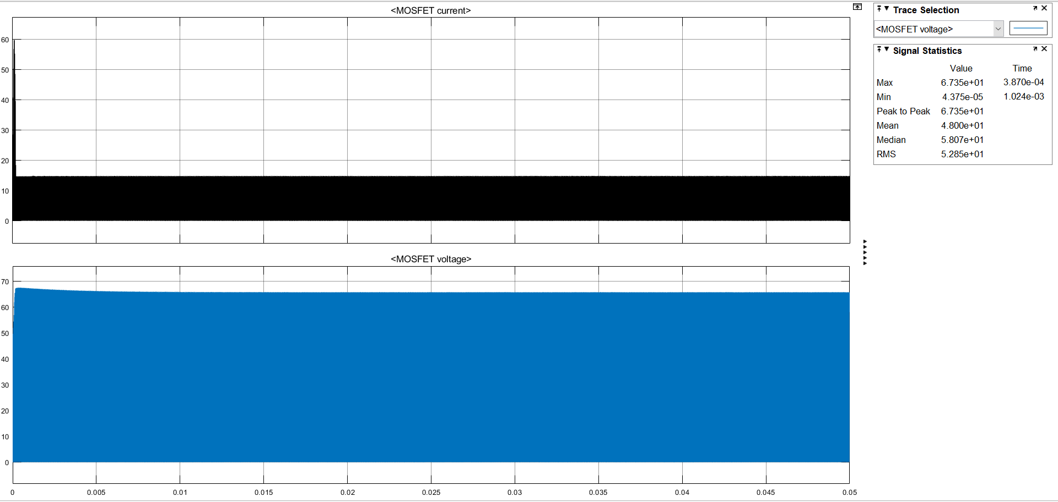
MOSFET Current and Voltage

