Slide 1

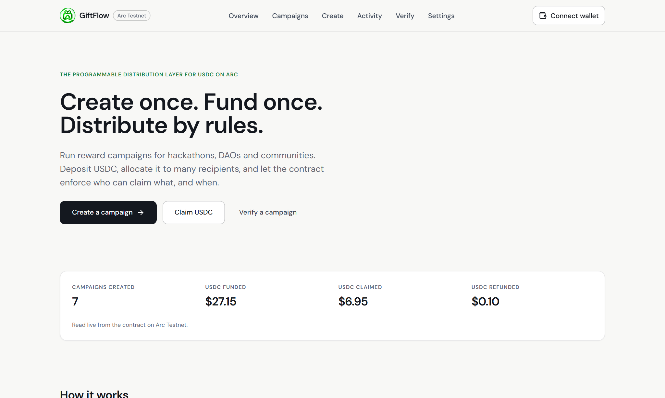
GiftFlow
Programmable USDC distribution on Arc
Create once. Fund once. Distribute by rules.
Live on Arc Testnet
Notes:
GiftFlow is a non-custodial platform for paying many people in USDC on Arc. One campaign, one funding transaction, and the contract enforces who can claim what.

Slide 2
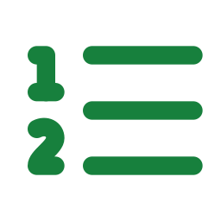

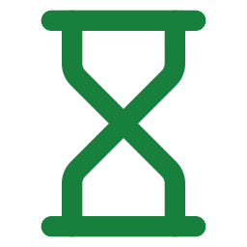
Paying many people in USDC is still manual
One transfer per person
Paying 100 people means 100 transactions, 100 addresses to check and a spreadsheet to reconcile.
50 to 100
Recipients cannot see the money is there
A promise of payment is not a funded payment. Trust is the only guarantee.
recipients in one campaign: the first launch GiftFlow is built to handle.
Leftovers need chasing
Unclaimed rewards sit in a wallet that someone has to remember to clean up.
Notes:
Today, paying a roster of people in USDC means many manual transfers and no proof of funding. Organizers also have to recover leftovers by hand.

Slide 3
Create once. Fund once. Distribute by rules
1
2
3
Create
Fund
Distribute
Name the campaign, set the claim window and choose how people get paid.
One transaction locks the full USDC total in the contract. Allocations can never exceed it.
Recipients claim with a wallet, a link or a code. Unclaimed USDC returns to you after the deadline.
Non-custodial. No database. No backend. Everything that matters lives onchain on Arc.
Notes:
The promise in three verbs. The key idea: the contract holds the money from the moment the campaign is created, so recipients can verify funding before they do anything.

Slide 4
The product at a glance
Live totals
Campaigns, USDC funded, claimed and refunded are read straight from the contract.
Three clear actions
Create a campaign, claim USDC, or verify any campaign without a wallet.
No sign-up
Connect an Arc wallet and go. No account, no backend, no stored data.
Landing page on Arc Testnet
Notes:
The landing page shows real numbers read from the contract, not marketing statistics.

Slide 5

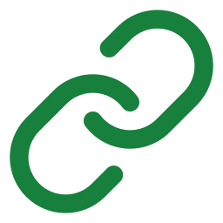

Three ways to pay people
Wallet list
One shared link
Secret codes
You know each wallet. Everyone opens one page, connects and claims, or you send to all of them.
Equal shares with one link. Anyone who has it claims one share until none are left.
Equal shares with one personal code per person. Each code works once.
Best for salaries and DAO payouts
Best for open giveaways
Best for exactly one share each
Same contract and same guarantees in every mode. Pick one per campaign.
Notes:
Salary: wallet list. 100 people at 5 USDC who have no wallet on file: shared link if you trust the audience, secret codes if each person must get exactly one share.

Slide 6
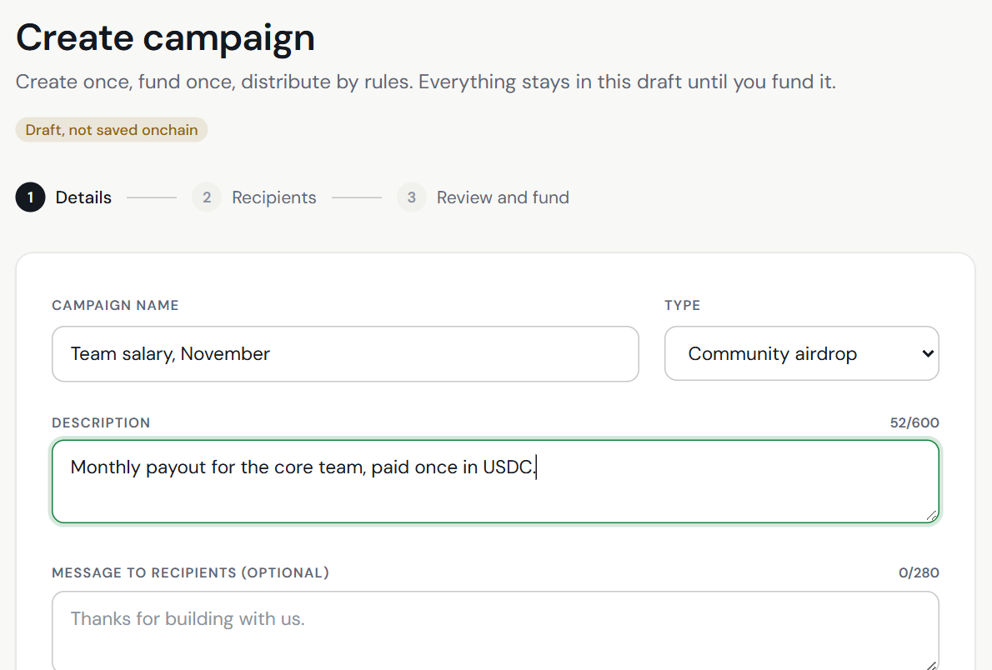
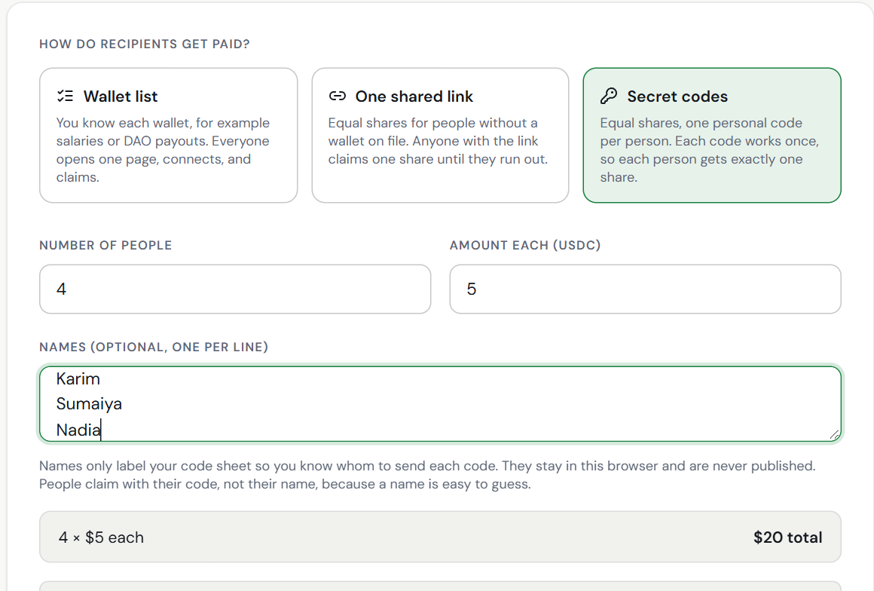
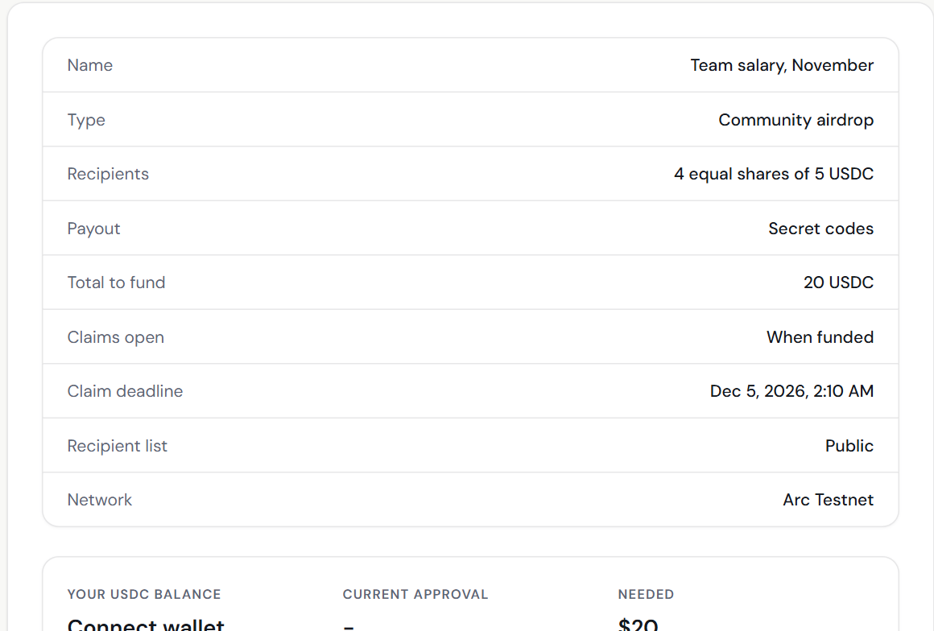
Create a campaign in three steps
1 Details
2 Recipients
3 Review and fund
Name the campaign, add a message and set the claim window. Choose a public or private recipient list.
Pick wallet list, one shared link or secret codes. Import a CSV or enter equal shares.
Check the total, balance and approval. Fund in one transaction. Success shows only after the chain confirms.
Notes:
Everything stays in an in-memory draft until the funding transaction. Nothing is saved to a server.

Slide 7
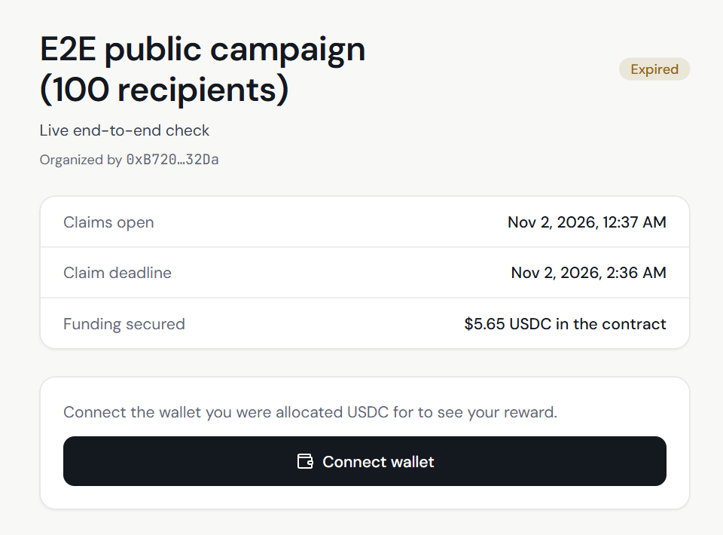
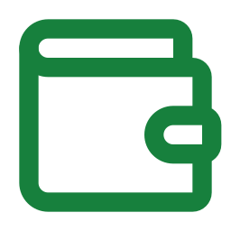



Claiming takes one wallet and one click
Connect the wallet
The page shows your reward and the deadline once your wallet is connected.
Eligibility is enforced onchain
The contract checks the proof and the wallet. A hidden button is never the only guard.
One claim per allocation
Duplicate and replayed claims are rejected by the contract.
USDC goes straight to you
Claim page of a live campaign. This one has expired, so claiming is closed.
No middleman holds funds. Success shows only after the chain confirms.
Notes:
Recipients need a small USDC balance for the network fee because Arc uses USDC for gas.

Slide 8
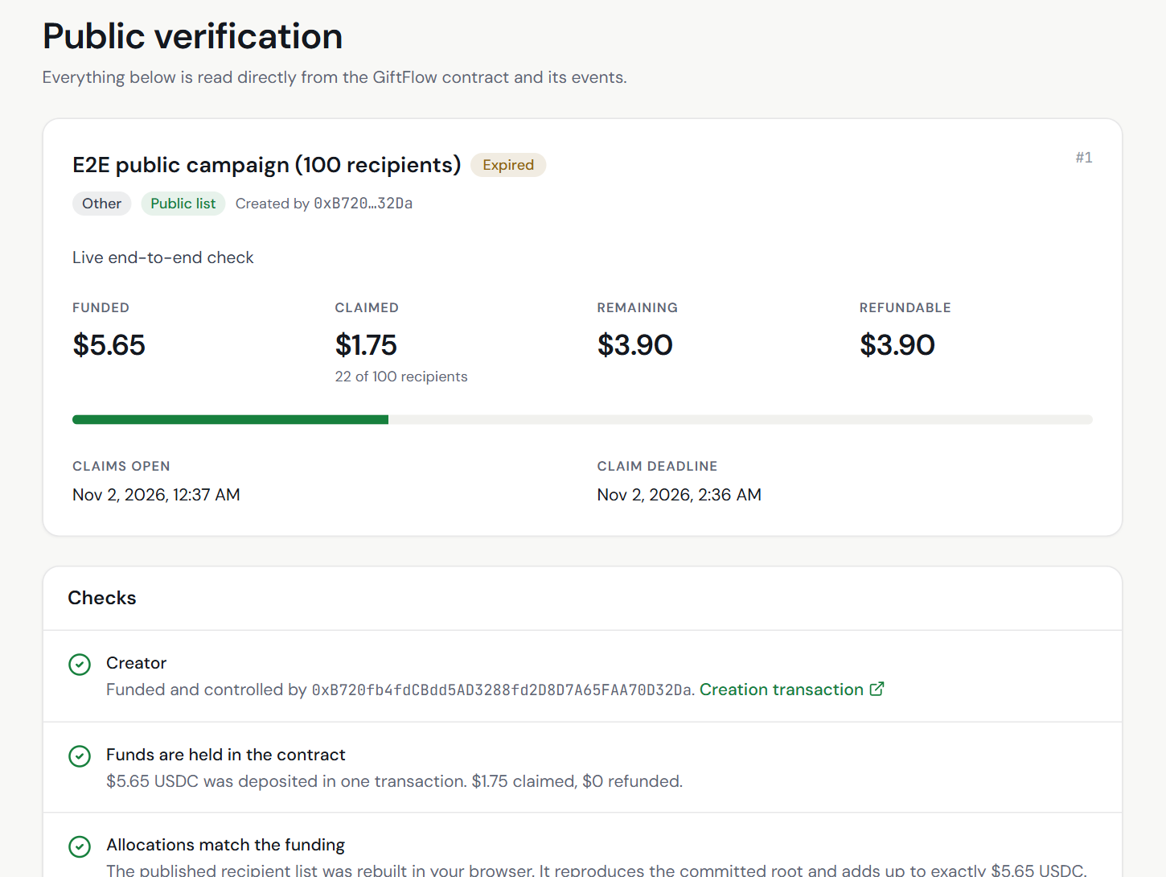
Anyone can verify a campaign
Funded, claimed, remaining
Read live from the contract, with no wallet needed.
Allocations match the funding
The recipient list is rebuilt in your browser and compared with the onchain commitment.
Every transaction is linked
Creation, claims and refunds point to the Arc block explorer.
Campaign #1: 100 recipients on Arc Testnet
Notes:
This is the page to share with recipients and auditors. The numbers come from the chain, not from us.

Slide 9
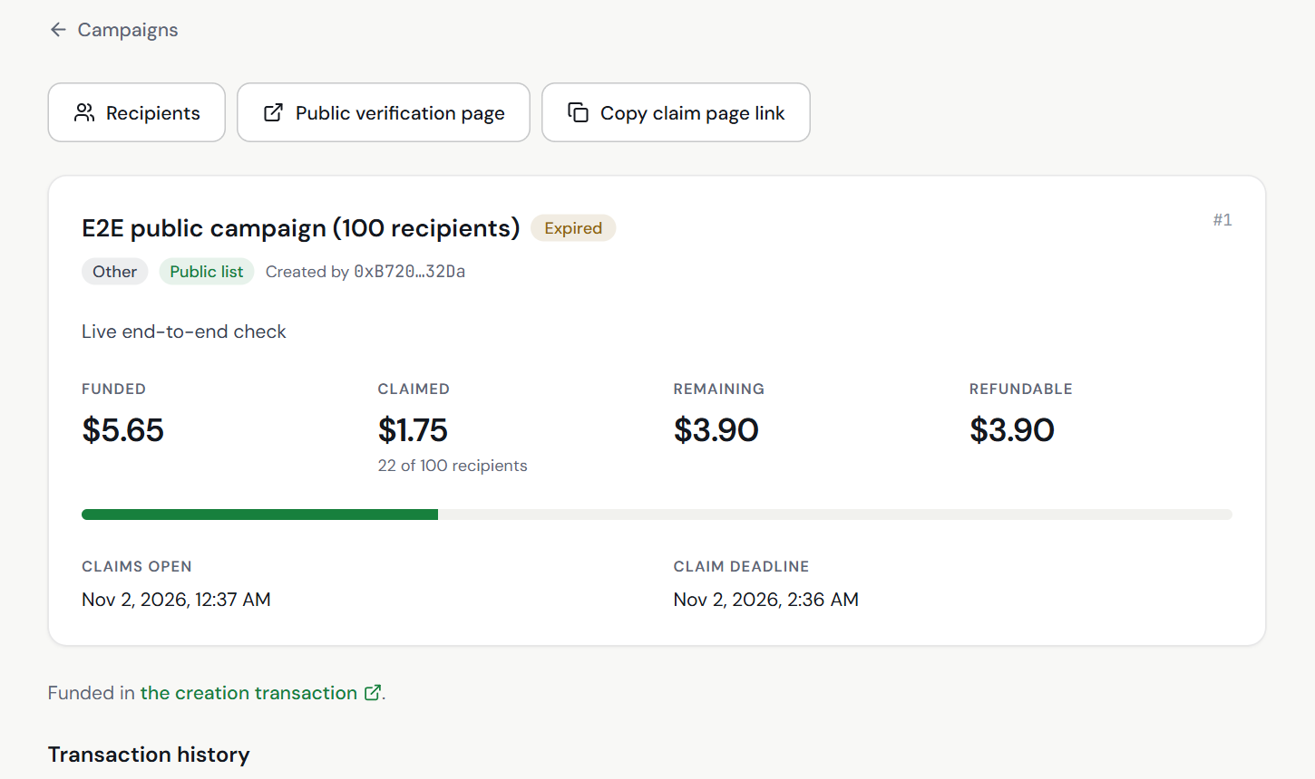



Organizers stay in control
Send directly
Push wallet-list rewards to every wallet, 50 per transaction.
Refund after the deadline
Unclaimed USDC returns to the funding wallet, once.
Cancel before it starts
Scheduled campaigns can be cancelled for a full refund.
Campaign page: funding, claimed, remaining and history
Pause never traps funds
Refunds and cancellations still work while paused.
Notes:
Refund and cancel are creator-only and keep working even if the owner pauses the contract.

Slide 10




Security is enforced by the contract
Safe transfers
Single-use claims
Wallet-bound claims
Reentrancy guards, SafeERC20 and state updated before any transfer.
A bitmap marks every claimed allocation. No duplicates, no replays.
Signatures name the receiving wallet, so a copied transaction cannot redirect funds.
Funding equals allocation
Safe refunds
No operator backdoor
A Merkle sum tree proves allocations add up to the deposited total.
Creator only, after expiry, once. Works even while paused.
The owner can pause and set a cap. It cannot withdraw funds or edit campaigns.
Notes:
Built on OpenZeppelin SafeERC20, ReentrancyGuard, Pausable, Ownable2Step and EIP-712. The contract has not had a third-party audit yet.

Slide 11
No database, no backend
React app
Arc RPC
GiftFlow contract
→
→
Static files served by nginx. Builds Merkle trees, claim keys and links in your browser.
Reads, events and receipts.
Holds the USDC. Checks proofs, enforces windows, pays claims and refunds.
Your wallet
→
→
Signs and sends transactions.
State lives in contract storage and events. The browser stores three interface preferences only.
Notes:
There is no server to trust or to take down. History is rebuilt from contract events, read in windows the public RPC allows.

Slide 12
Tested before it holds real money
123
7
100
3.5M
Foundry contract tests: unit, fuzz and invariant
frontend tests for codes, claim keys and links
recipients in live testnet campaign #1
gas to create a 1,000-recipient campaign, under the 30M block limit
Proven on Arc Testnet
A live end-to-end script created campaign #1 on the real contract; 22 of its 100 allocations were claimed.
Not yet done
An independent security audit, and any mainnet deployment.
Notes:
Be upfront: this is a testnet product. An independent audit is the next step before real value.

Slide 13
Ready to host and easy to run
Run it anywhere
Built with
Docker image: a Vite build served by nginx
Solidity
OpenZeppelin
Foundry
docker-compose.yml ready for Coolify
React 18
Vite
TypeScript
One build variable: the contract address
Tailwind CSS
wagmi
viem
Health check at /healthz and security headers
Arc Testnet, chain 5042002, USDC with 6 decimals.
Notes:
The image builds in about four minutes and needs roughly 1 GB of memory for the Vite step.

Slide 14




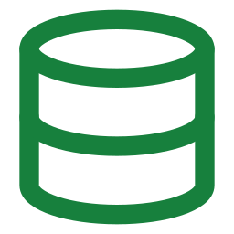

What comes next
Vesting
Milestones
Attestations
Release funds over time, with cliffs, per recipient.
Pay when a milestone is approved by the organizer.
Signed proof of external work unlocks claims.
Independent audit
Indexer
Mainnet
A third-party review before real value is held.
Faster history than public RPC log scans.
Added only after an explicit go-ahead.
A contract cannot see the real world alone, so conditional rewards need an authorized verifier or a signed attestation.
Notes:
The design already leaves room for these: leaves can carry new fields and the claim path already verifies EIP-712 signatures.

Slide 15
Create once. Fund once.
Distribute by rules.
GiftFlow: programmable USDC distribution on Arc
Full documentation is in the docs folder of the repository.
Notes:
Thank you. Questions?

