Slide 1
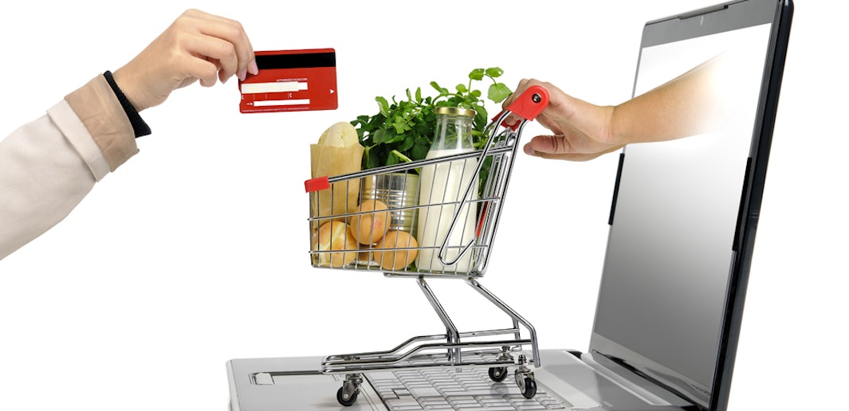
Supermarket management system
Presented By: Sadina Jarga Magar
NCC ID: 00170190
Batch : 21’A’
Subject: Computing Project

Slide 2
Introduction
This project is a self automation supermarket.
A supermarket is a self service store which provides a wide variety of products related to food, beverages and household.
Designed to make the existing system more informative, reliable, fast and easy for all the stake-holders.

Slide 3
Problems with the existing system
Lack of security of data.
Takes too much time.
Increase paper work.
Inefficiencies in manual system.
Needs manual calculations which are prone to errors.
Although manpower but it is less efficiency.

Slide 4
Project Description
first of all, adding the product along with their names and rates of the products which will be up for sale in the super-market. This authority is given only to admin.
Any modification to be done in the product name or product rate can be only done by admin.
Right to delete any product details rest with the admin too.
Admin provides a unique email and password for each employee which they can login.
All the products will be displayed by the system which customer wants to purchase.

Slide 5
Aim
To manage inventories from the system.
To generate bill for customers.
To make management system automated.
Paper work can be reduced by implementing this system.

Slide 6
Objective
To always be the first choice of customers.
To manage the supermarket activities.
To maintain the records of the sales done.
To maintain the stock details.
To reduce paper work; so that users can spend more time on monitoring their requirements.
To reduce time in calculation of sales activities.
To store huge amount of data in the database which will reduce clumsiness.

Slide 7
Features of the Project
Login by admin and User.
There is login feature which will allow admin to access the system and provides a unique email and password for each users which they can login.
Add product category
We can add different types of product category to our stock on the basis of customers requirements.
Display product
Admin can display all the products for the customers.
Modify product category
Update the product category in case wrong input is done.

Slide 8
Features of the Project
Delete product
Product can be deleted if incase product is expired or something gone wrong.
Navigation
Navigation allows admin and customers to navigate around the interface.
Create and print bill
Automatic bill is created once customer buys the product and check out from the supermarket. Created bill can be printed.
Search engine
It allows searchers to find a products, with search results featuring product information, Rate and description.

Slide 9
Features of the Project
Add product
We can add different types of product to our stock on the basis of customers requirements and trend as well.
Modify product
Update the product in case wrong input is done or if we have to upgrade the certain price of product .
View order
Admin can view customers order along with their specific details.
Contact page
It is a standard web page on a website to allow the visitor to contact the website owner or people who are responsible for the maintenance of the site.

Slide 10
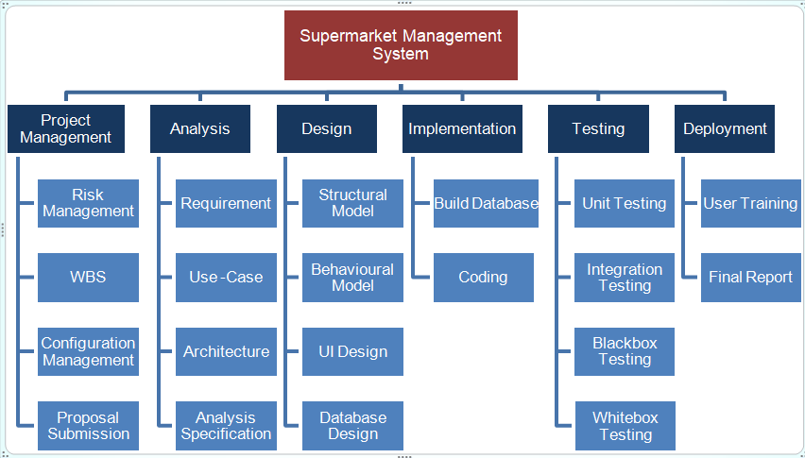
Work Breakdown Structure

Slide 11
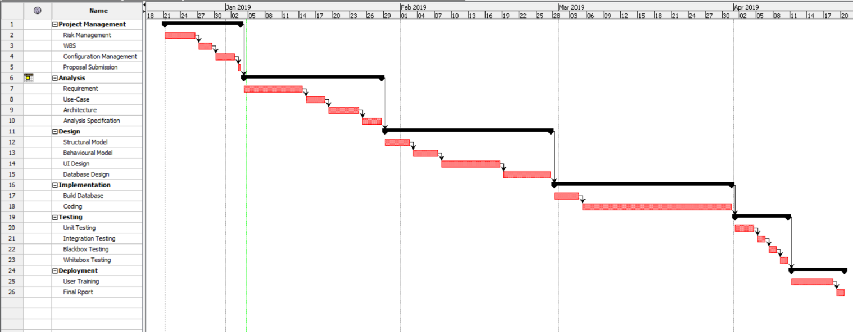
Gantt Chart

Slide 12
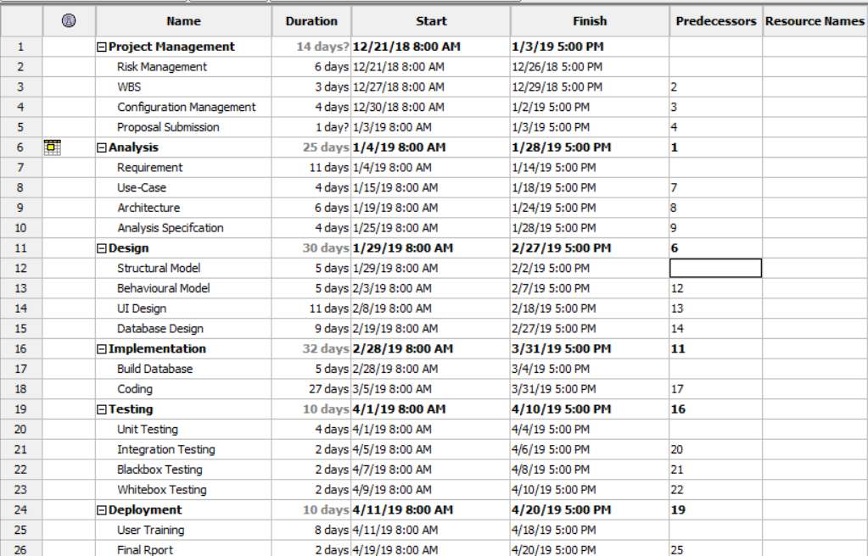
Scheduling

Slide 13
MoSCoW prioritization
MoSCoW prioritization is a technique for helping to understand and manage priorities.
The letter stand for:
Must Have
Should Have
Could Have
Won’t Have

Slide 14
Waterfall Methodology
I have used waterfall methodology in my supermarket management system project which helps to manage my project on a sequential design process; it finishes on stage before another stage can begin.
I have used this methodology for the following reasons:
It is simple and easy to understand.
It enables to find error early in the requirement analysis stage.
It is easier to keep on budget.
Due to the rigidity of the model each stage has certain deliverables and a review process which make easier to manage.
In this model, stages do not overlap. There stages are processed and completed one at a time.
Developers and customers agree on what will be delivered early in the development lifecycle. This makes planning and designing more straightforward.

Slide 15
Architecture
I have used MVC architectural pattern which contains three folders i.e. model, view and controller that is used to separate application’s regard.
M(Model) – It shows the functionality of the application.
V(View) - Deals with the interface. User can view the interface of the system.
C(Controller) – It handles the user interaction.

Slide 16
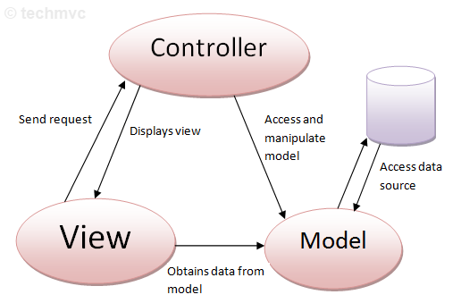
MVC Architecture

Slide 17
Risk Management
Risk management should always be pro-active.
Risk management is the process to avoid or minimize the adverse effects of unforeseen events.
Should applied to all projects.

Slide 18
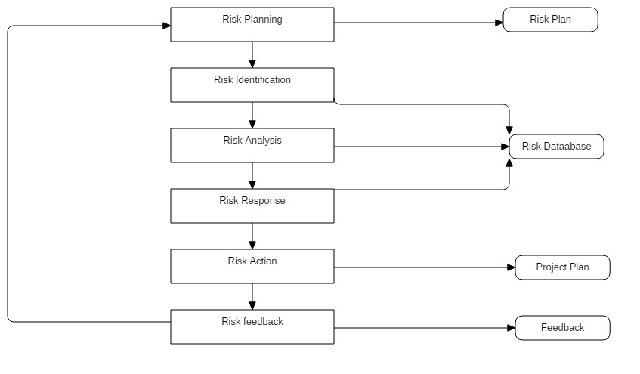
Risk Management Process

Slide 19
Configuration Management
Configuration management is the preserver of the quality of the emerging solution, controlling the elements of the solution as it is developed.
It is a version controller.
Why configuration management?
It manage the code.
It is used for rollback.
It is used for change implementation.

Slide 20
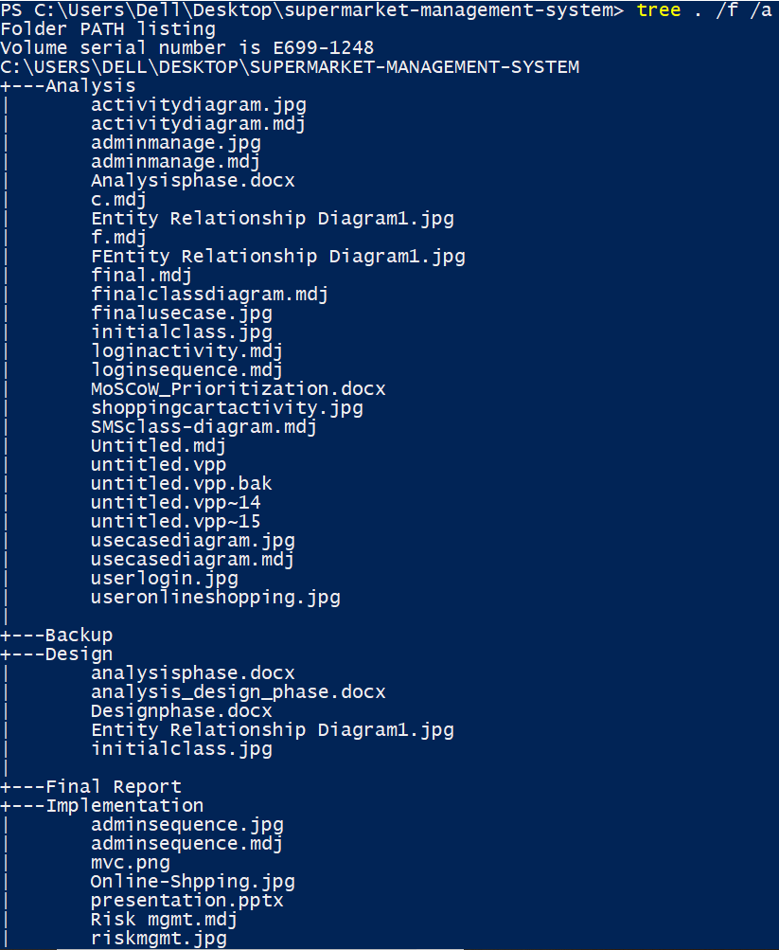
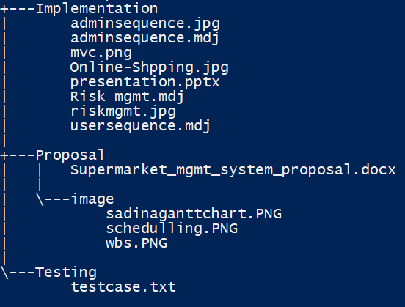

Slide 21
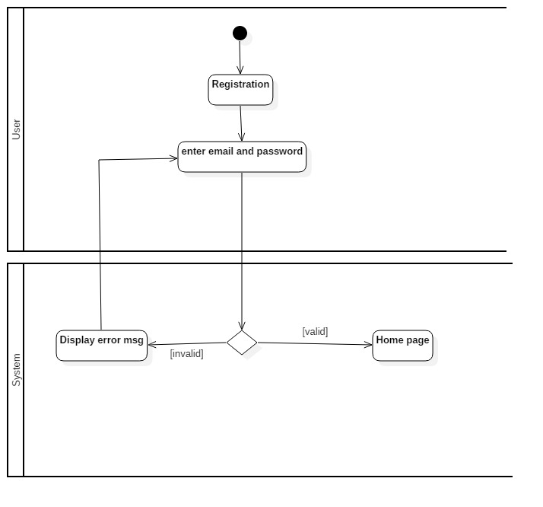
Diagram
1) Behavioral Diagram
Activity Diagram of login

Slide 22
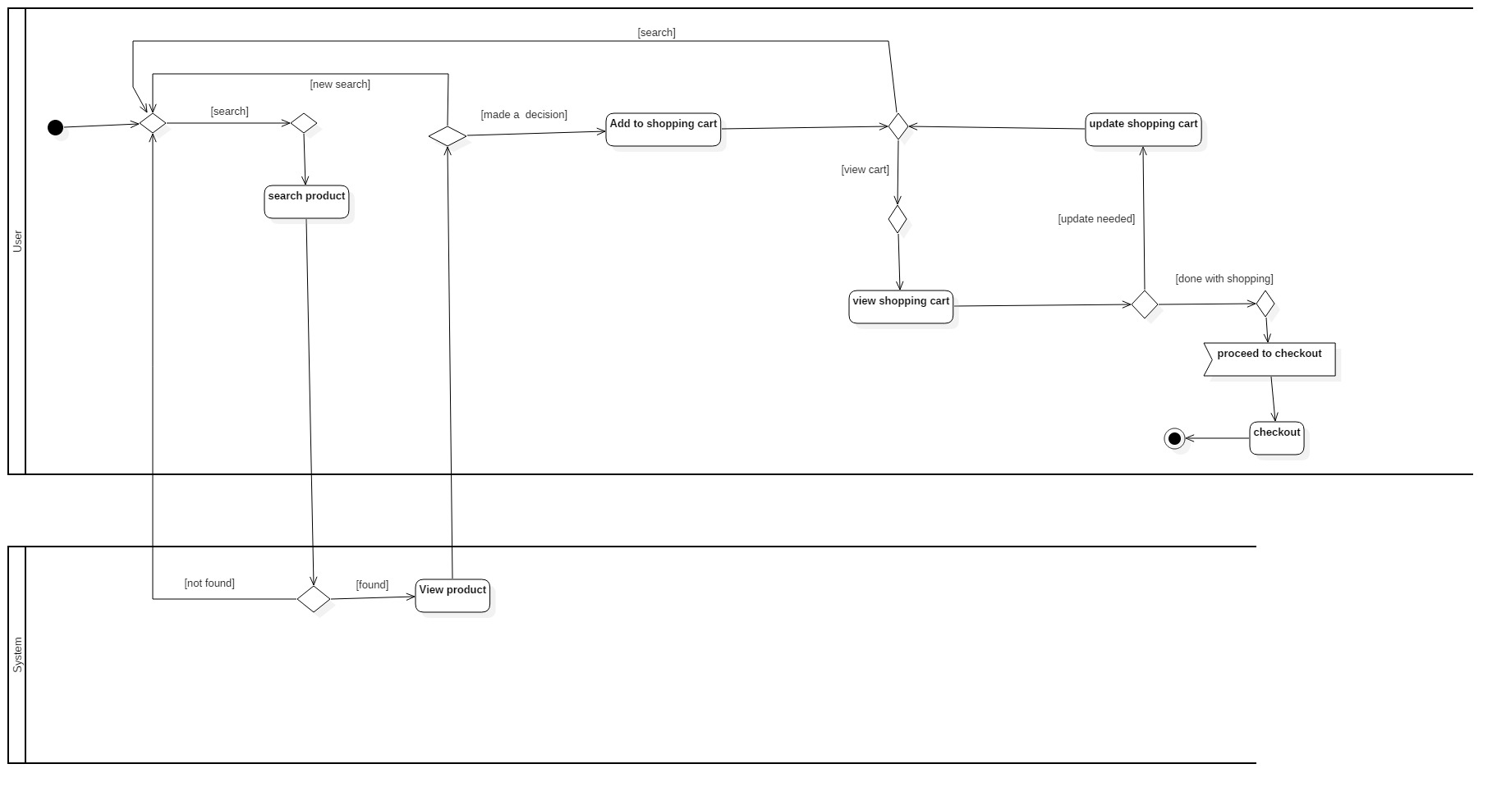
1) Behavioral Diagram
2) Activity Diagram of online shopping

Slide 23
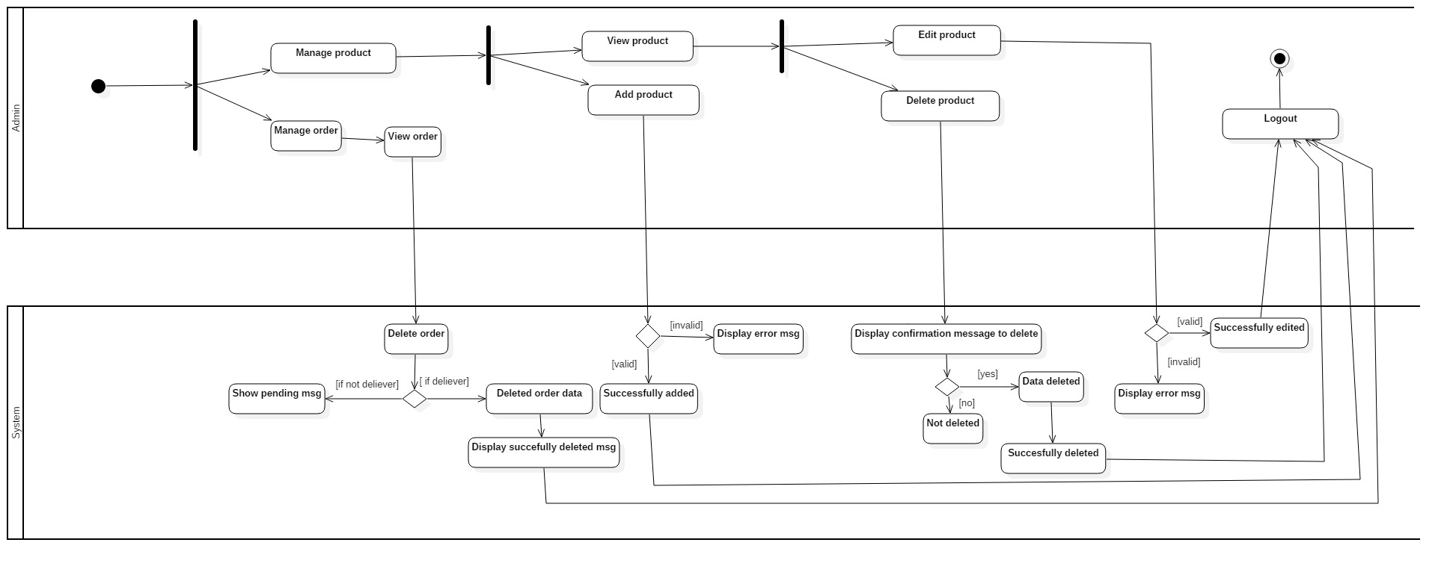
1) Behavioral Diagram
3) Activity Diagram of admin

Slide 24
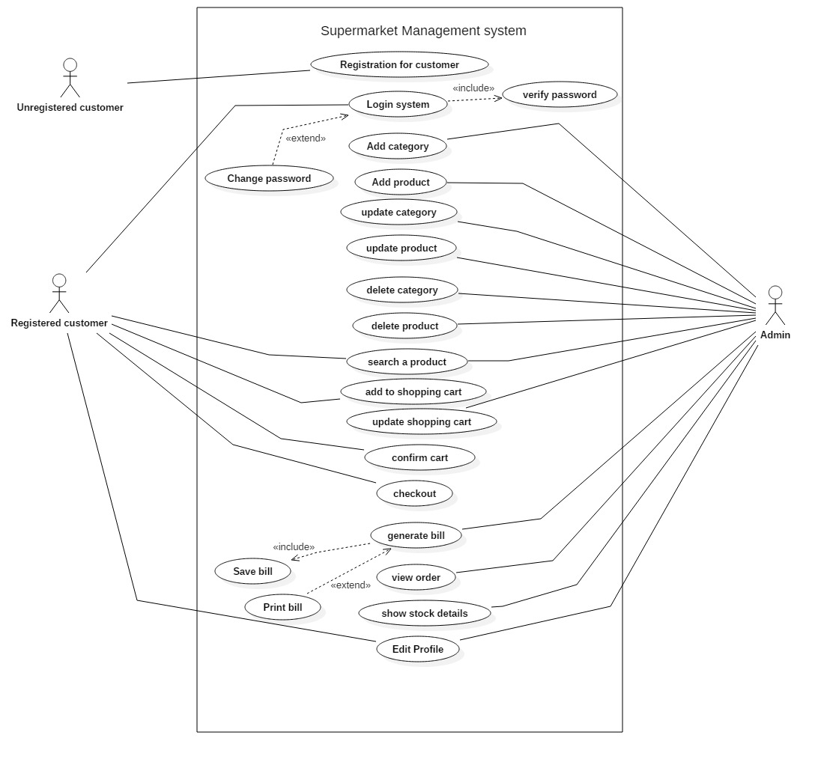
2) Use Case Diagram

Slide 25
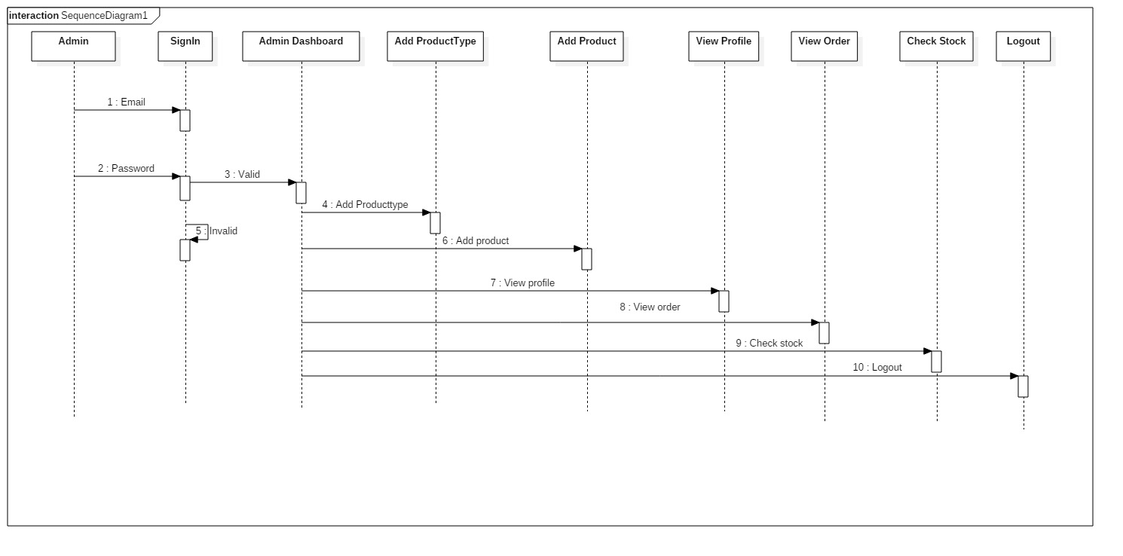
3) Sequence Diagram

Slide 26
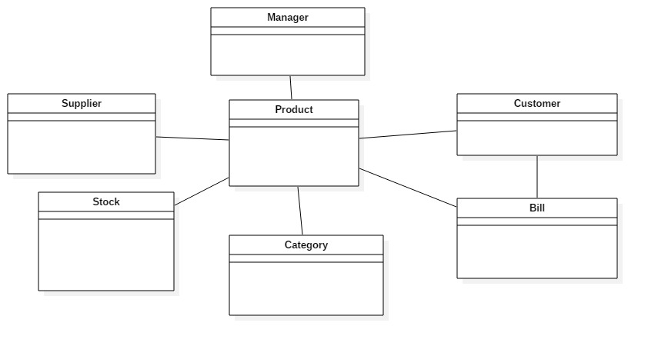
2) Structural Diagram
4) Initial Class Diagram

Slide 27
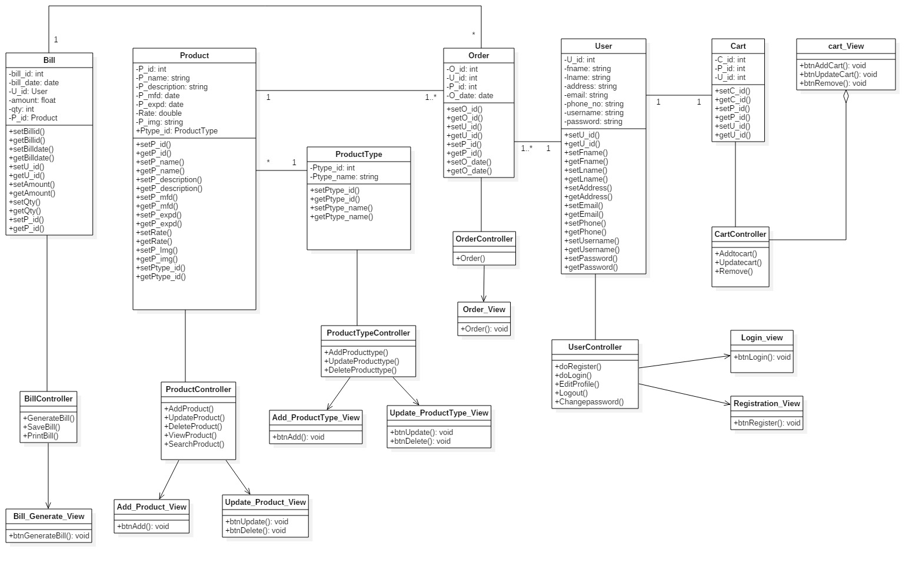
5) Final Class Diagram

Slide 28
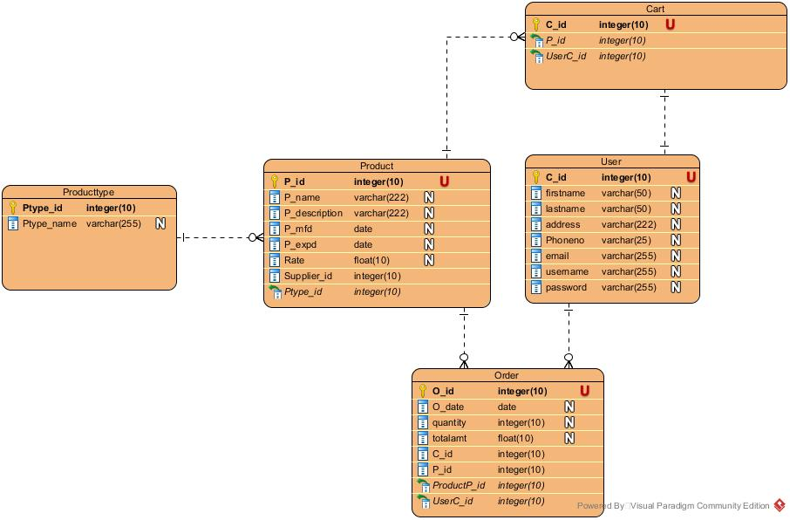
6) ER-Diagram

Slide 29
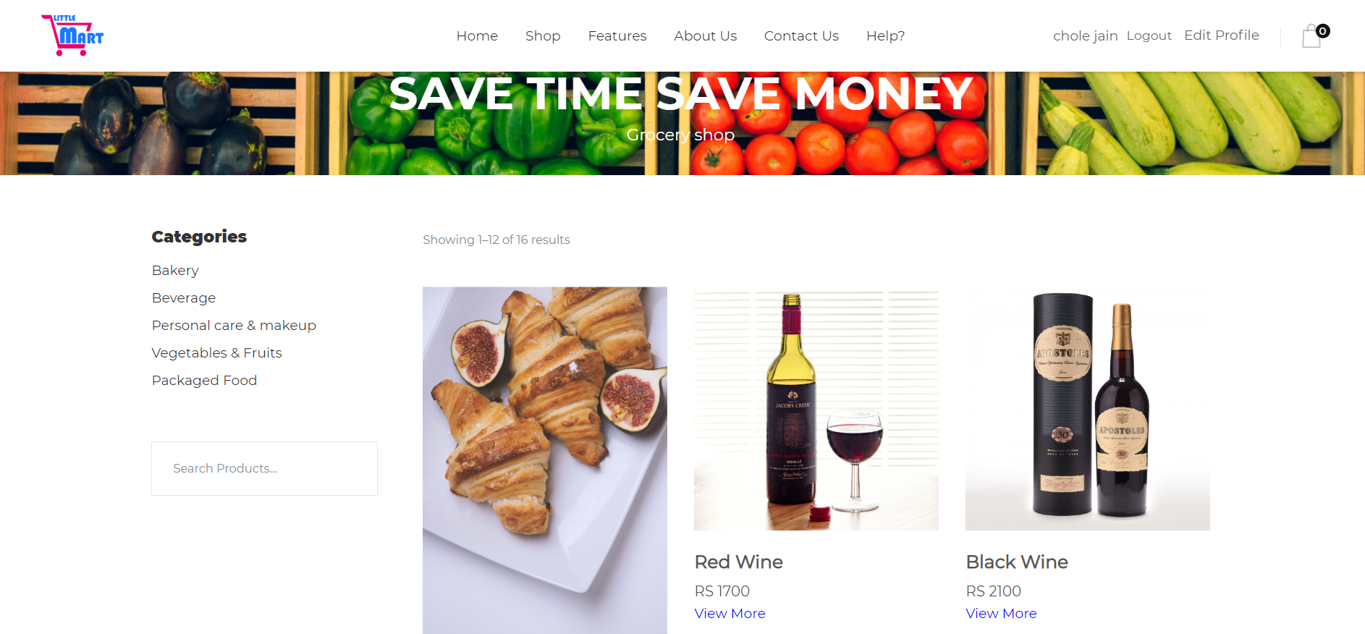
Coding and UI design
1) UI design and code of add to cart

Slide 30
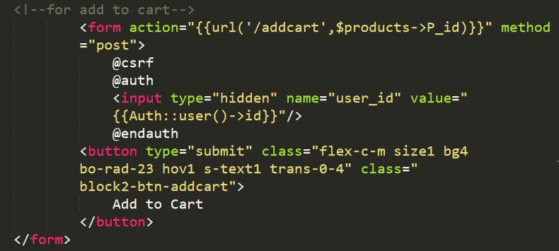
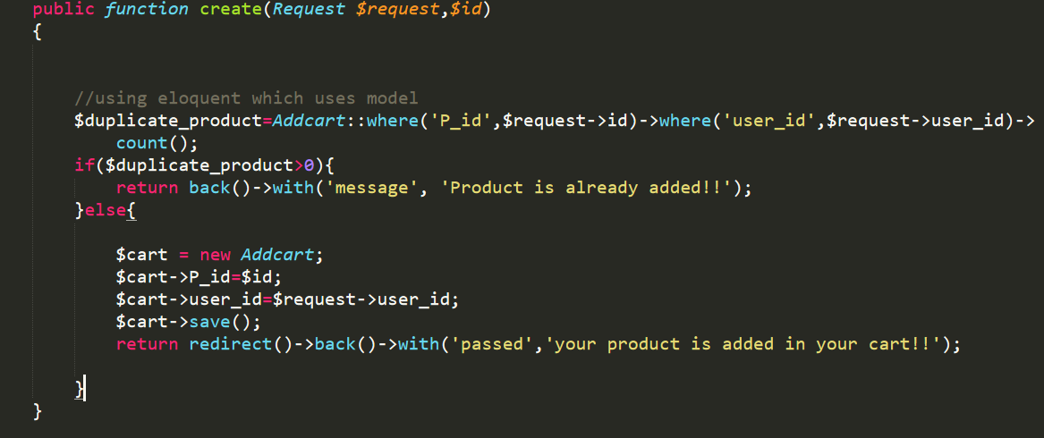

Slide 31
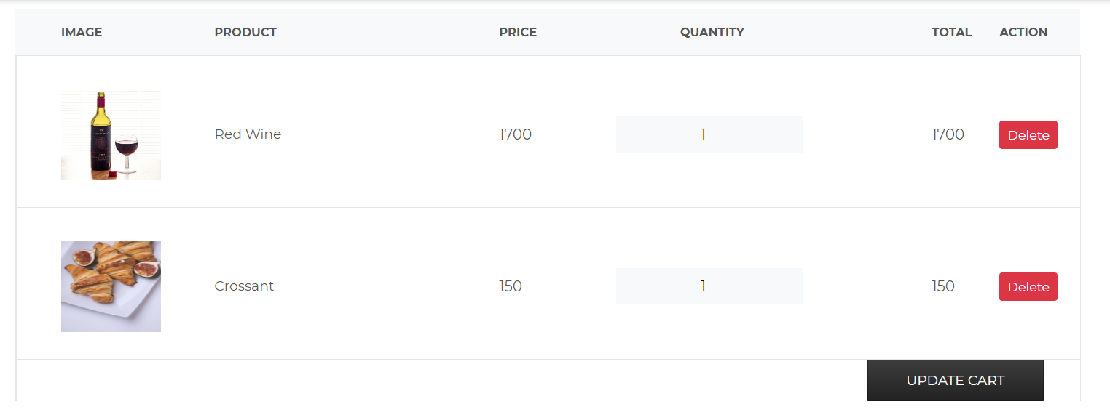
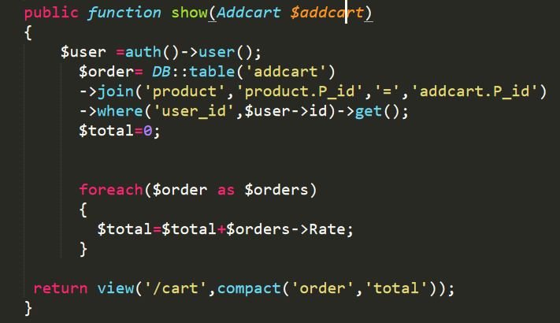

Slide 32
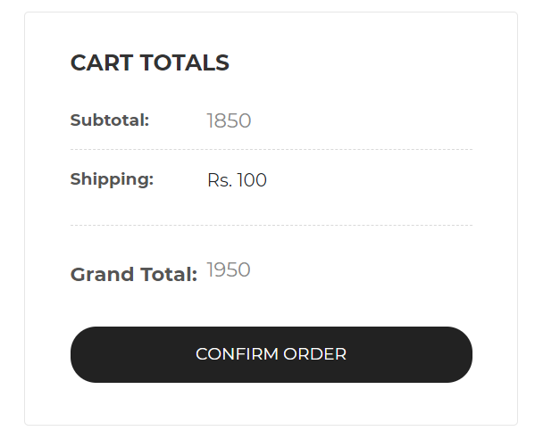

Slide 33
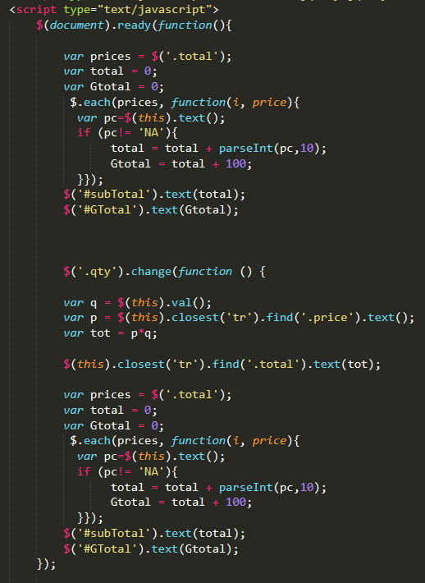
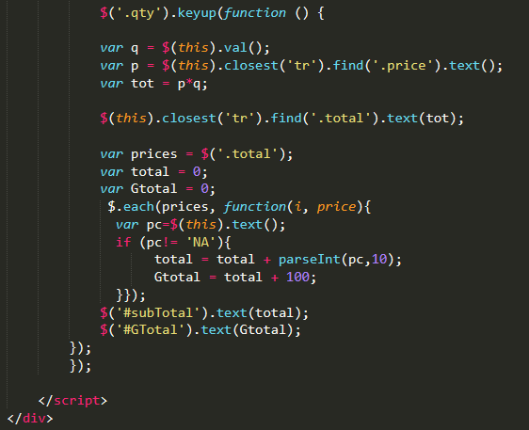

Slide 34
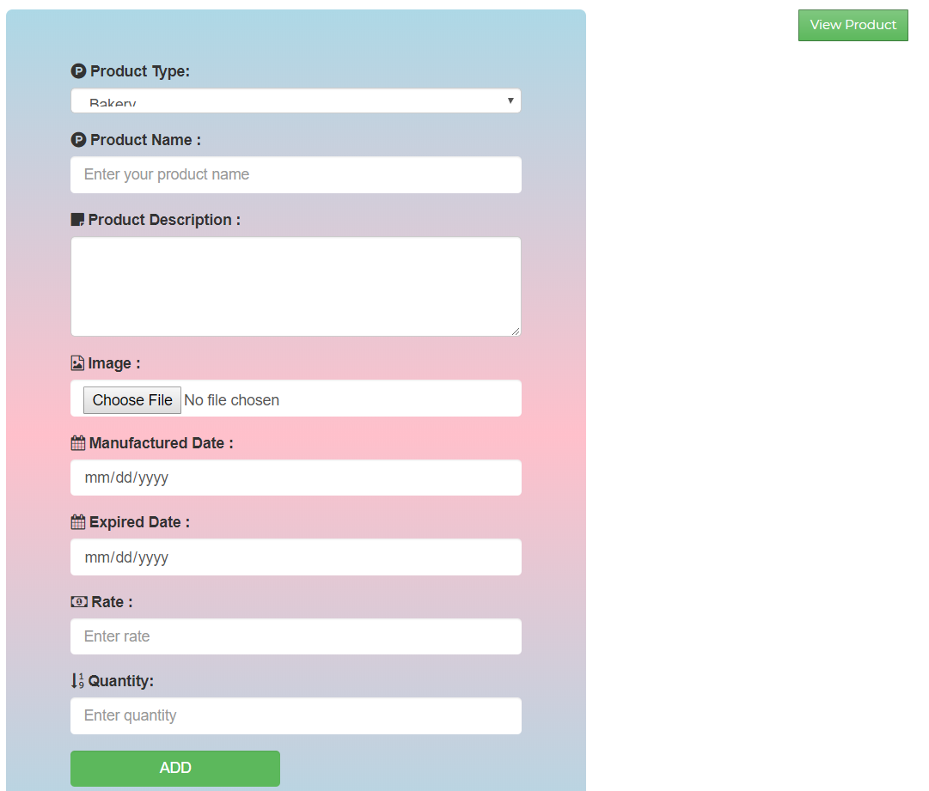
2) UI design and code of add product

Slide 35
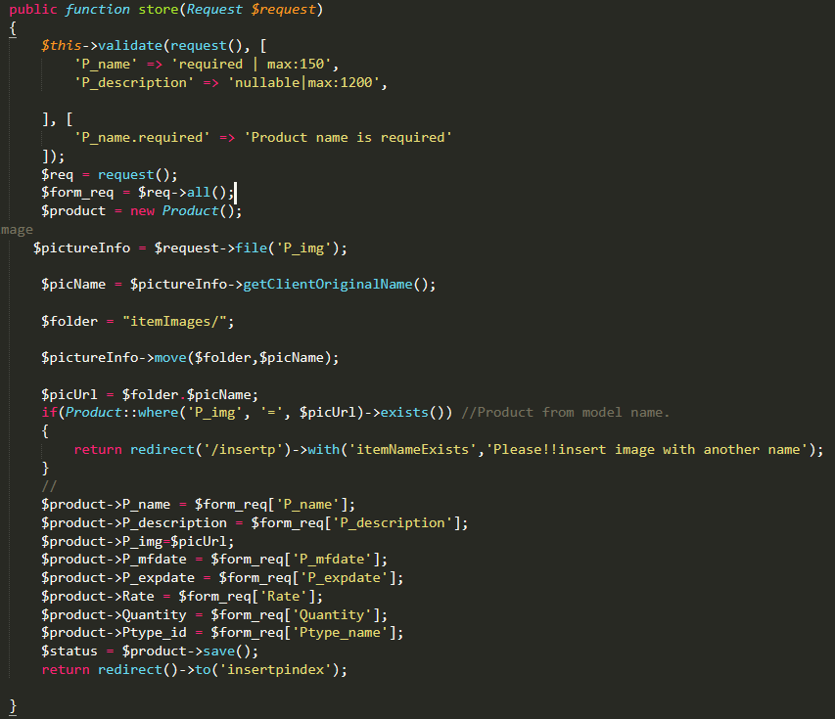

Slide 36
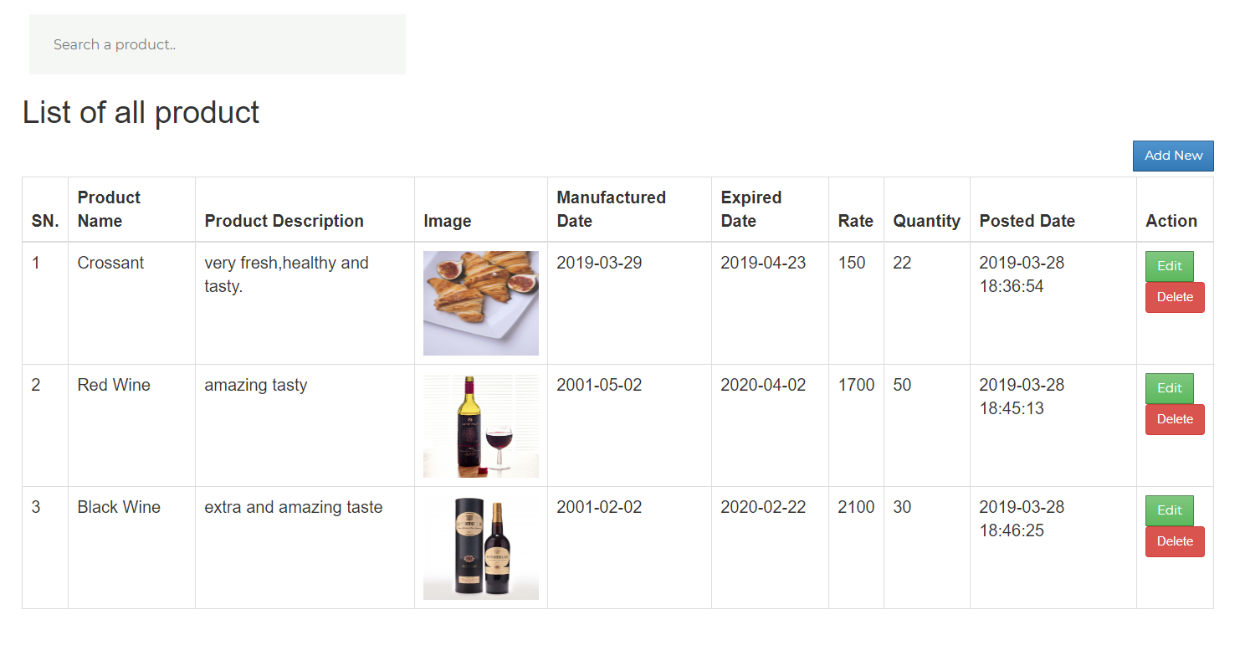

Slide 37
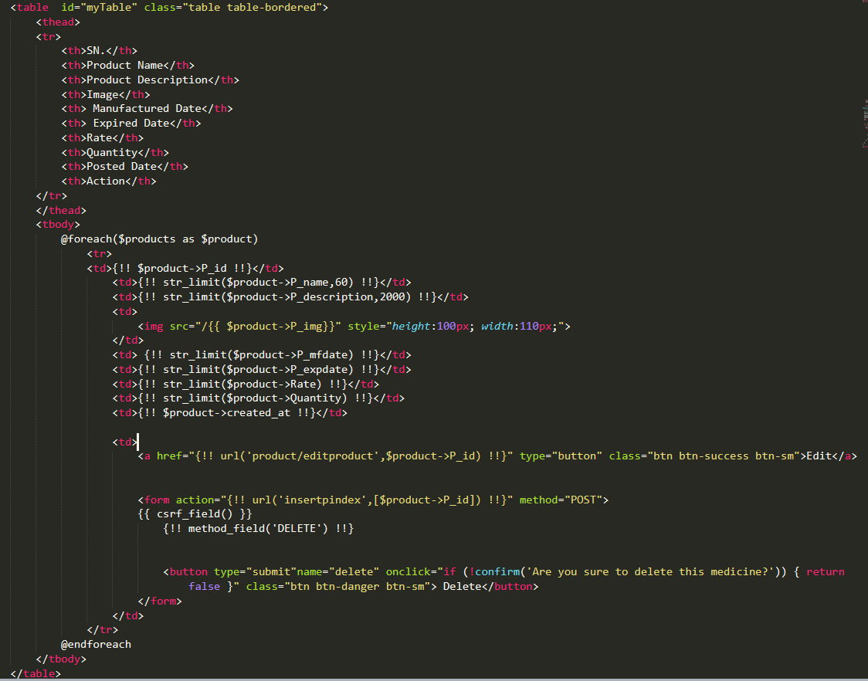

Slide 38
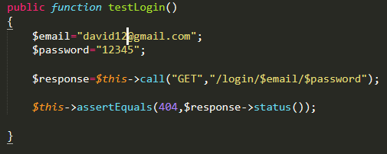
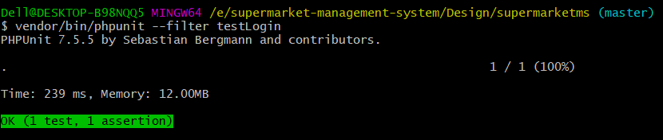
Test case
Test case | WB1
Purpose of test case | Email and password can be retrieved or not to login the system.
Test data | Email= david12@gmail.com Password= 12345
Class name | supermarketTest
Function name | testLogin
Expected result | To login into the system.
Actual result | Successfully login.
Outcome as expected | Yes

Slide 39
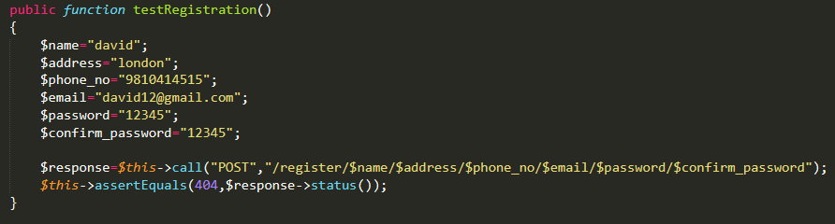
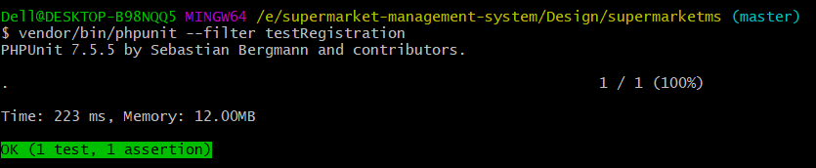
Test case | WB2
Purpose of test case | User can successfully register or not.
Test data | Name= david Address= London Phone_no= 9810414515 Email= david12@gmail.com Password= 12345 Confirm_password= 12345
Class name | supermarketTest
Function name | testRegistration
Expected result | To successfully register user.
Actual result | User registered successfully.
Outcome as expected | Yes

Slide 40
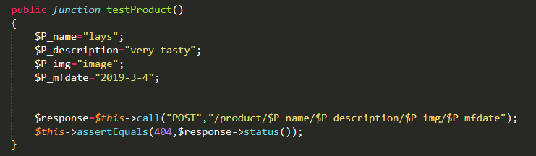
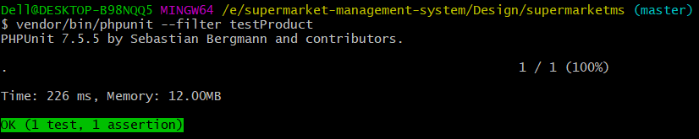
Test case | WB3
Purpose of test case | Product can insert successfully or not.
Test data | P_name= lays P_description= very tasty P_img= image P_mfdate= 2019-03-04
Class name | supermarketTest
Function name | testRegistration
Expected result | To insert product successfully.
Actual result | Successfully inserted in the database.
Outcome as expected | Yes

Slide 41
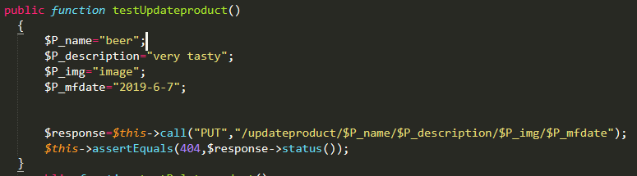
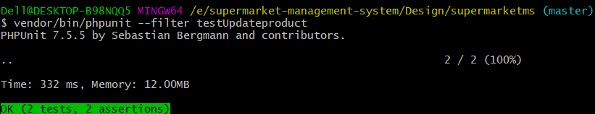
Test case | WB4
Purpose of test case | Product can update successfully or not.
Test data | P_name= beer P_description= very tasty P_img= image P_mfdate= 2019-06-07
Class name | supermarketTest
Function name | testRegistration
Expected result | To update product successfully.
Actual result | Successfully updated in the database.
Outcome as expected | Yes

Slide 42
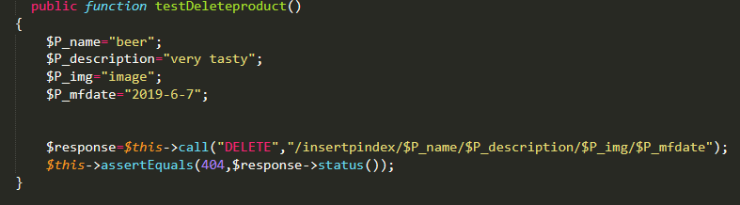
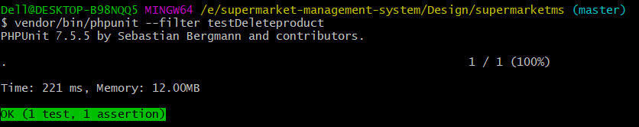
Test case | WB5
Purpose of test case | To check product can delete successfully or not from the database.
Test data | P_name= beer P_description= very tasty P_img= image P_mfdate= 2019-06-07
Class name | supermarketTest
Function name | testRegistration
Expected result | To delete product successfully.
Actual result | Successfully deleted from the database.
Outcome as expected | Yes

Slide 43
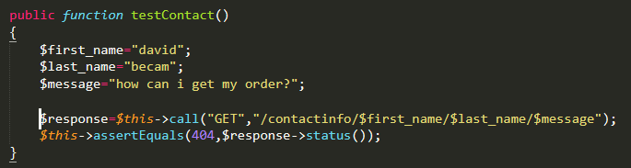
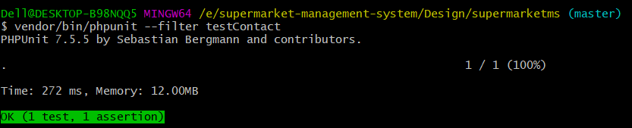
Test case | WB6
Purpose of test case | To check user can directly contact to the seller or not.
Test data | First_name=david Last_name=becam Message= how can I get my order?
Class name | supermarketTest
Function name | testRegistration
Expected result | To insert information in the database.
Actual result | Successfully inserted in the database.
Outcome as expected | Yes

Slide 44
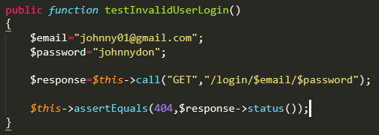
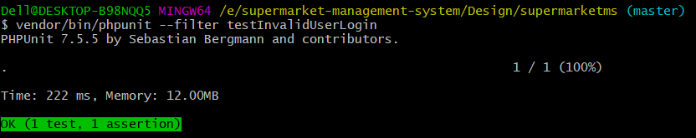
Test case | WB7
Purpose of test case | To check invalid user can login into the system or not.
Test data | Email= johnny01@gmail.com Password=johnnydon
Class name | supermarketTest
Function name | testInvalidUserLogin
Expected result | Show error message and return back to the login page.
Actual result | Invalid user return back to the login page with error message.
Outcome as expected | Yes

Slide 45
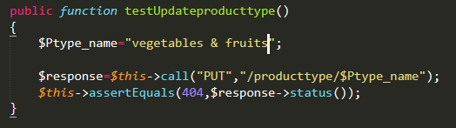

Test case | WB8
Purpose of test case | Product type can update successfully or not.
Test data | Ptype_name=bakery
Class name | supermarketTest
Function name | testAddproducttype
Expected result | To update product type successfully.
Actual result | Successfully updated in the database.
Outcome as expected | Yes

Slide 46
Future Work
In terms of future scope, data mining techniques can be used by researchers.
Use of payment system through credit card for purchasing the products.
Online chat system while purchasing the items.
High secure site for the transaction while using cards.
Provide notification after adding the products in the cart.
Providing the discount system on the various product.

Slide 47
Limitation
Online transaction is not available.
User cannot chat online to the sellers.
User cannot see their notification after their product is added in their cart until and unless they see their carts.
Now, the user cannot get the discount on any products.

Slide 48
Conclusion
Finally, the web-site is developed by using the different tools, techniques, methodology and approaches for this project which gives you the self-automation and self-service while purchasing the products.

Slide 49
References
https://www.slideshare.net/pujithaboggarapu/grocery-management-system [Accessed on: 1st April 2019]
http://shodhganga.inflibnet.ac.in/bitstream/10603/11075/10/10_conclusion.pdf [Accessed on: 1st April 2019]
https://www.agilebusiness.org/content/moscow-prioritisation [Accessed on: 23rd march 2019]

