Slide 1
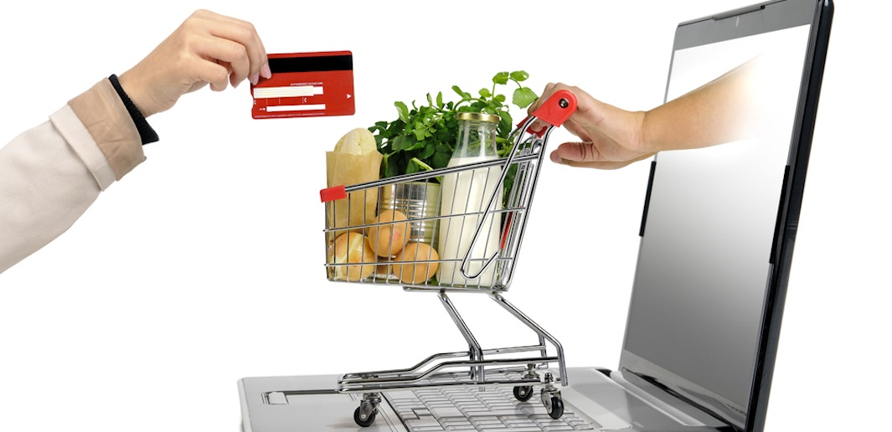
Supermarket management system
Presented By: Sadina Jarga Magar
NCC ID: 00170190
Batch : 21’A’
Subject: Computing Project

Slide 2
Introduction
This project is a self automation supermarket.
A supermarket is a self service store which provides a wide variety of products related to food, beverages and household.
Designed to make the existing system more informative, reliable, fast and easy for all the stake-holders.

Slide 3
Problems with the existing system
Lack of security of data.
Takes too much time.
Increase paper work.
Inefficiencies in manual system.
Needs manual calculations which are prone to errors.
Although manpower but it is less efficiency.

Slide 4
Project Description
first of all, adding the product along with their names and rates of the products which will be up for sale in the super-market. This authority is given only to admin.
Any modification to be done in the product name or product rate can be only done by admin.
Right to delete any product details rest with the admin too.
Admin provides a unique email and password for each employee which they can login.
All the products will be displayed by the system which customer wants to purchase.

Slide 5
Objective
To always be the first choice of customers.
To manage the supermarket activities.
To maintain the records of the sales done.
To maintain the stock details.
To reduce paper work; so that users can spend more time on monitoring their requirements.
To reduce time in calculation of sales activities.
To store huge amount of data in the database which will reduce clumsiness.

Slide 6
Architecture
I have used MVC architectural pattern which contains three folders i.e. model, view and controller that is used to separate application’s regard.
M(Model) – It shows the functionality of the application.
V(View) - Deals with the interface. User can view the interface of the system.
C(Controller) – It handles the user interaction.

Slide 7
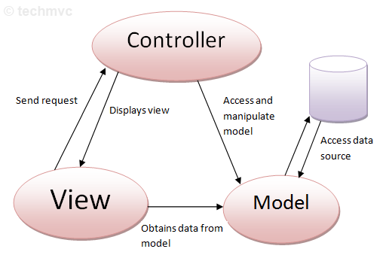
MVC Architecture

Slide 8
Features of the Project
Login by admin and User.
There is login feature which will allow admin to access the system and provides a unique email and password for each users which they can login.
Add product category
We can add different types of product category to our stock on the basis of customers requirements.
Display product
Admin can display all the products for the customers.
Modify product category
Update the product category in case wrong input is done.

Slide 9
Features of the Project
Delete product
Product can be deleted if incase product is expired or something gone wrong.
Navigation
Navigation allows admin and customers to navigate around the interface.
Create and print bill
Automatic bill is created once customer buys the product and check out from the supermarket. Created bill can be printed.
Search engine
It allows searchers to find a products, with search results featuring product information, Rate and description.

Slide 10
Features of the Project
Add product
We can add different types of product to our stock on the basis of customers requirements and trend as well.
Modify product
Update the product in case wrong input is done or if we have to upgrade the certain price of product .
View order
Admin can view customers order along with their specific details.
Contact page
It is a standard web page on a website to allow the visitor to contact the website owner or people who are responsible for the maintenance of the site.

Slide 11
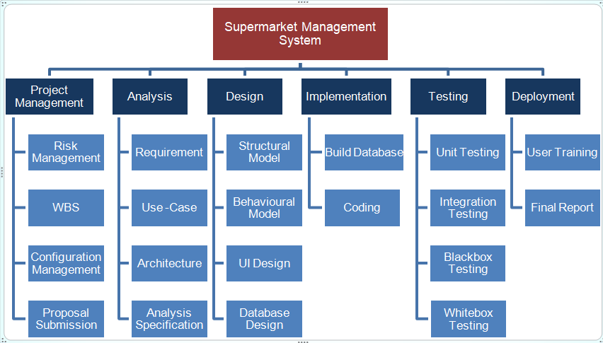
Work Breakdown Structure

Slide 12
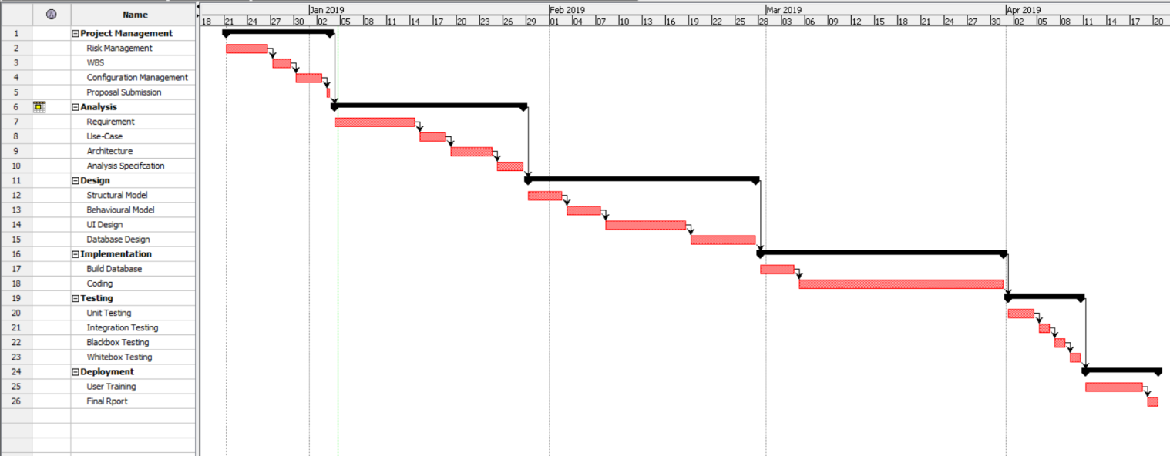
Gantt Chart

Slide 13
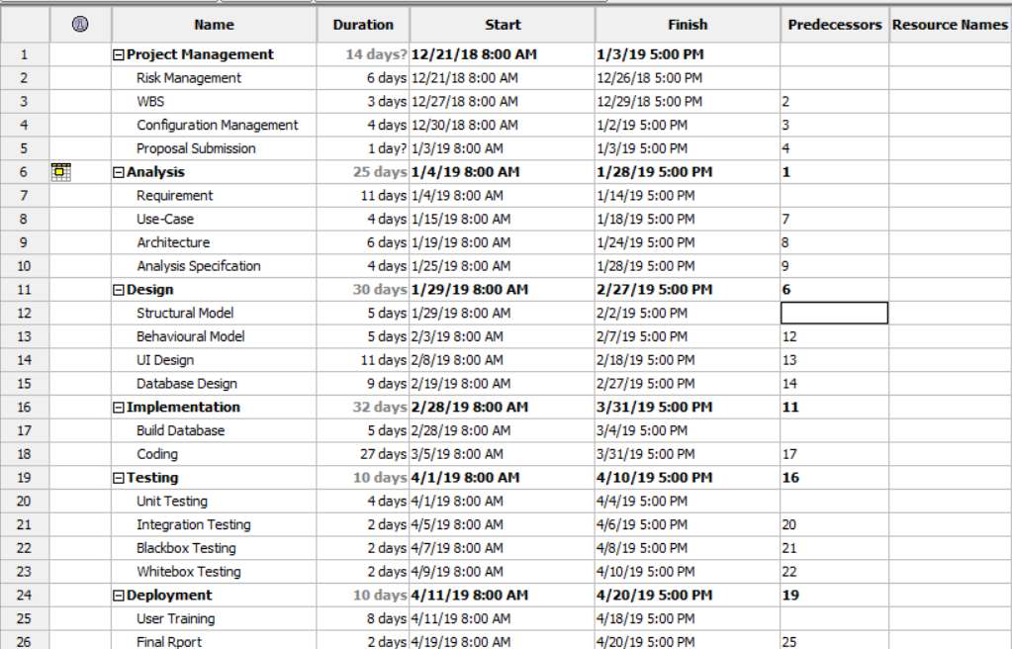
Scheduling

Slide 14
MoSCoW prioritization
MoSCoW prioritization is a technique for helping to understand and manage priorities.
The letter stand for:
Must Have
Should Have
Could Have
Won’t Have

Slide 15
Waterfall Methodology
I have used waterfall methodology in my supermarket management system project which helps to manage my project on a sequential design process; it finishes on stage before another stage can begin.
I have used this methodology for the following reasons:
It is simple and easy to understand.
It enables to find error early in the requirement analysis stage.
It is easier to keep on budget.
Due to the rigidity of the model each stage has certain deliverables and a review process which make easier to manage.
In this model, stages do not overlap. There stages are processed and completed one at a time.
Developers and customers agree on what will be delivered early in the development lifecycle. This makes planning and designing more straightforward.

Slide 16
Risk Management
Risk management should always be pro-active.
Risk management is the process to avoid or minimize the adverse effects of unforeseen events.
Should applied to all projects.

Slide 17
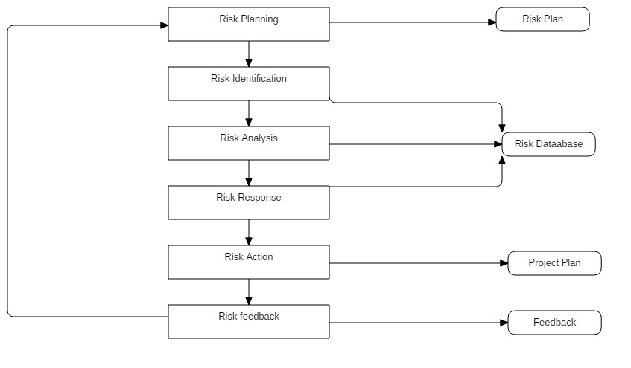
Risk Management Process

Slide 18
Configuration Management
Configuration management is the preserver of the quality of the emerging solution, controlling the elements of the solution as it is developed.
It is a version controller.
Why configuration management?
It manage the code.
It is used for rollback.
It is used for change implementation.

Slide 19
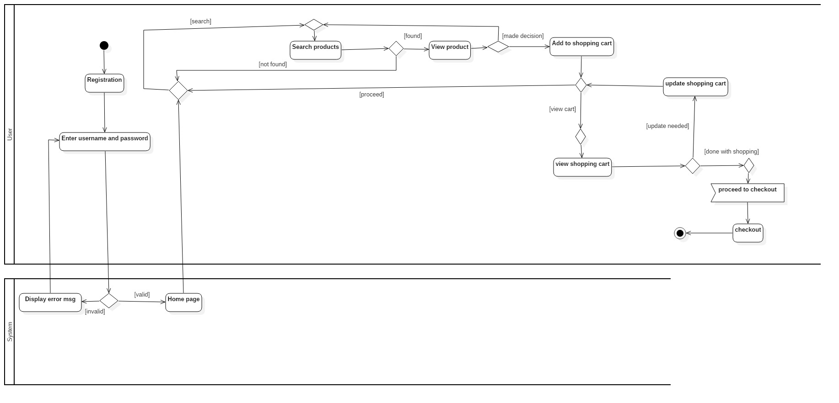
Diagram
1) Behavioral Diagram
1) Activity Diagram

Slide 20
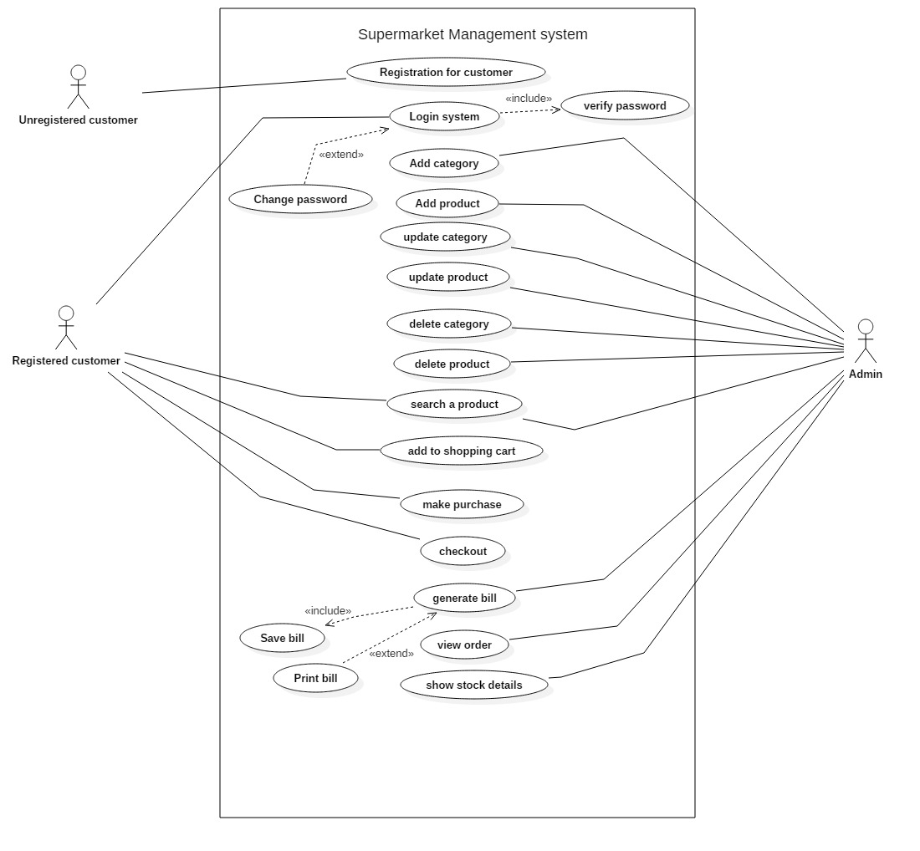
2) Use Case Diagram

Slide 21
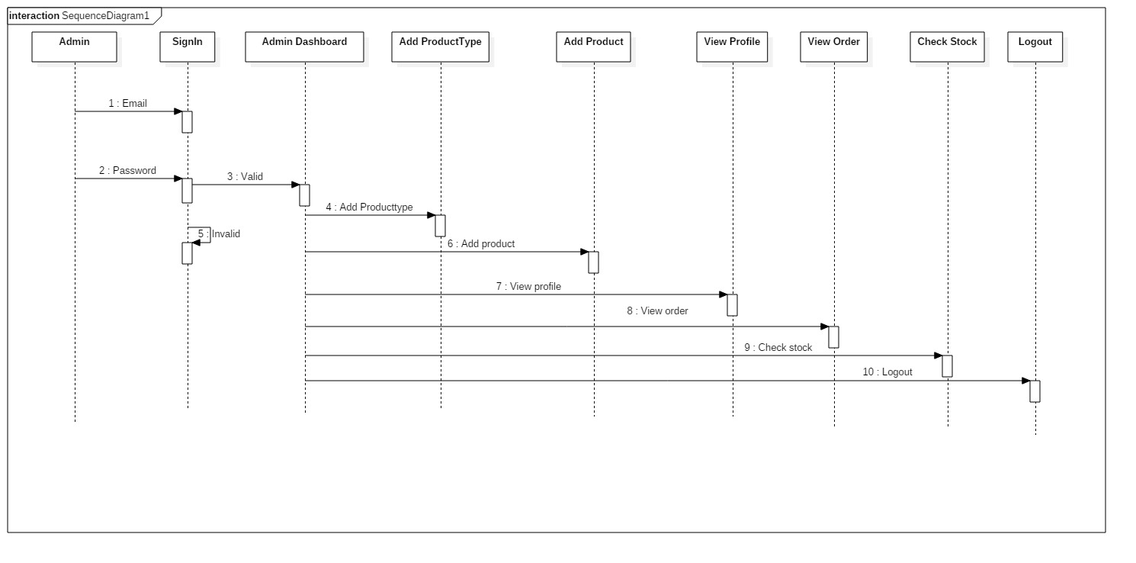
3) Sequence Diagram

Slide 22
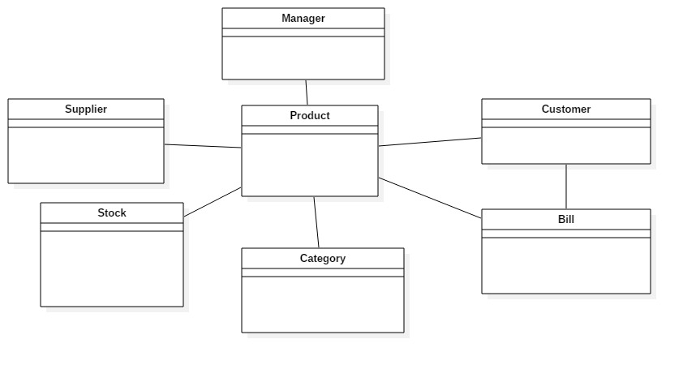
2) Structural Diagram
4) Initial Class Diagram

Slide 23
5) Final Class Diagram

