Slide 1
STUDENT PERFORMANCE
- BY GROUP IRONMAN

Slide 2
TOPICS
WHAT IS EDA?
UNDERSTANDING THE DATA
DESCRIBING THE DATA
HANDLING MISSING VALUES & HANDLING OUTLIERS
ANALYSIS ON COLUMNS
MODEL BUIDING USING LOGISTIC REGRESSION
CONCLUSION
REFERENCES

Slide 3

WHAT IS EDA?

Slide 4
UNDERSTANDING THE DATA
GENDER | RACE/ETHNICITY | PARENTAL LEVEL OF EDUCATION | LUNCH | TEST PREPARATION COURSE | MATHS SCORE | READING SCORE | WRITING SCORE
Female | Group B | Bachelor’s degree | Standard | None | 72 | 72 | 74
Female | Group B | Some college | Standard | Completed | 69 | 90 | 89
Female | Group C | Master’s degree | Standard | None | 90 | 95 | 93
: : | : : | : : | : : | : : | : : | : : | : :
Female | Group D | Some college | Free/reduced | None | 77 | 86 | 86

Slide 5
DESCRIBING THE DATA
 | MATHS SCORE | READING SCORE | WRITING SCORE
COUNT | 1000 | 1000 | 1000
MEAN | 66.08 | 69.16 | 68.05
STANDARD DEVIATION | 15.16 | 14.60 | 15.19
MIN | 0.00 | 17.00 | 10.00
FIRST QUARTILE | 57.00 | 59.0 | 57.75
SECOND QUARTILE | 66.00 | 70.00 | 69.00
THIRD QUARTILE | 77.00 | 79.00 | 79.00
MAX | 100.00 | 100.00 | 100.00

Slide 6
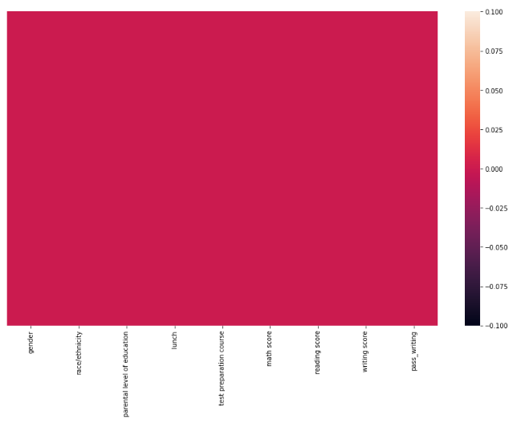
CHECKING FOR NULL VALUES

Slide 7
HANDLING MISSING VALUES & OUTLIERS
Missing values can be handled by:
Drop NULL or missing values
Fill Missing Values
Predict Missing values

Slide 8
COLUMNAL ANALYSIS

Slide 9
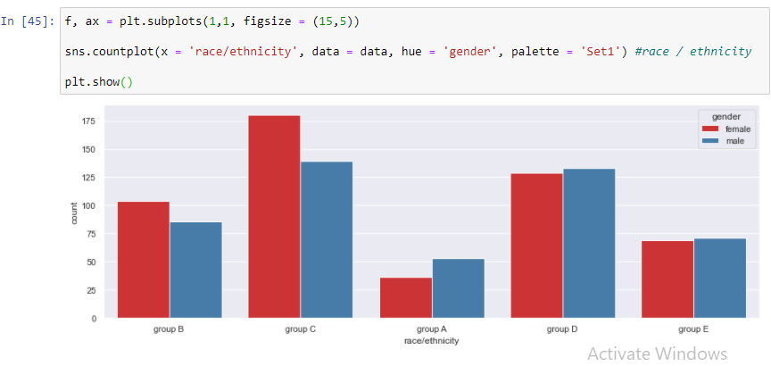
DISTRIBUTION OF GENDER IN GROUPS

Slide 10
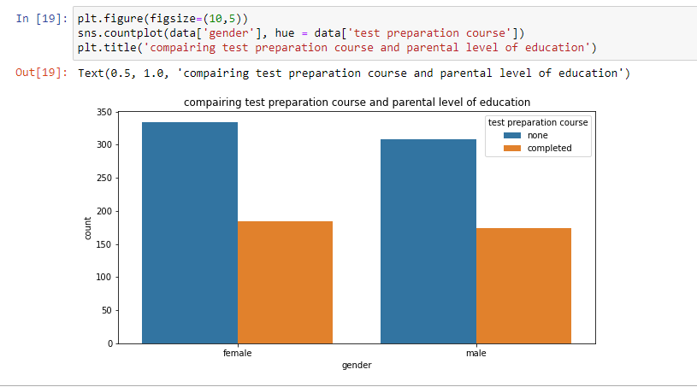
GENDER COMPLETED THE TEST COURSE

Slide 11
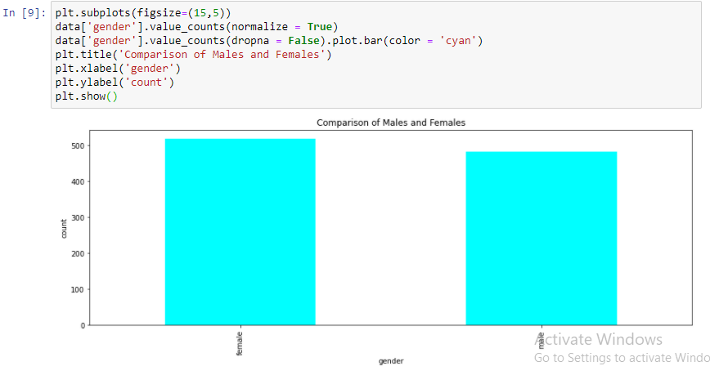
GETTING COUNT OF FEMALES AND MALES

Slide 12
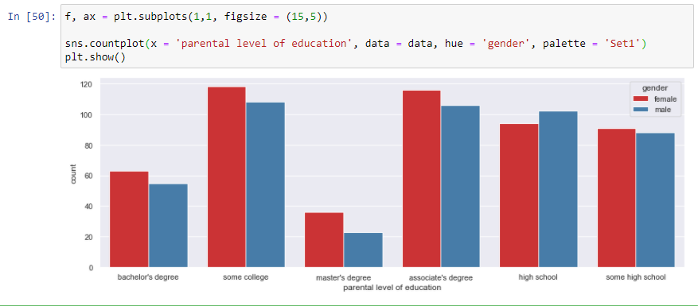
GENDER & PARENTAL LEVEL OF EDUCATION

Slide 13
MATHS SCORE WITH RESPECET TO GENDER
MATHS SCORE
TEST PREPARATION COURSE | GENDER | SCORES
COMPLETED | FEMALE | 67.19
 | MALE | 72.33
NONE | FEMALE | 61.67
 | MALE | 66.68

Slide 14
READING SCORE WITH RESPECET TO GENDER
READING SCORE
TEST PREPARATION COURSE | GENDER | SCORES
COMPLETED | FEMALE | 77.37
 | MALE | 70.21
NONE | FEMALE | 69.98
 | MALE | 62.79

Slide 15
WRITING SCORE WITH RESPECET TO GENDER
WRITING SCORE
TEST PREPARATION COURSE | GENDER | SCORES
COMPLETED | FEMALE | 78.79
 | MALE | 69.79
NONE | FEMALE | 68.98
 | MALE | 56.64

Slide 16
RACE/ETHNICITY

Slide 17
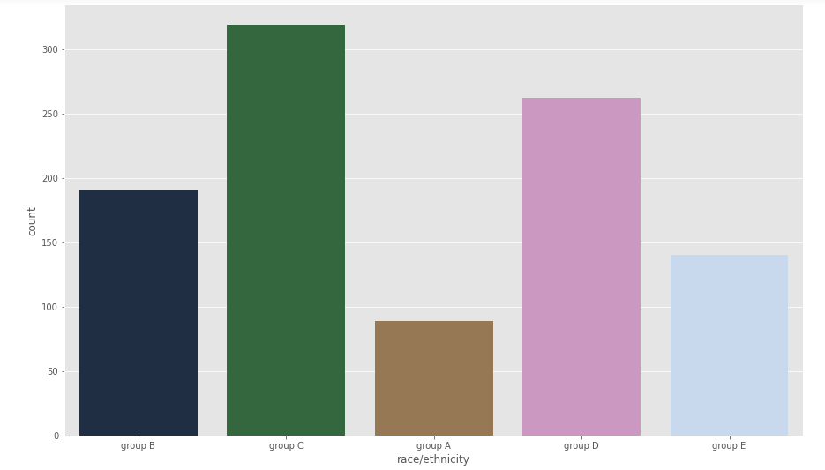
HOW MANY STUDENT BELONGS TO EACH GROUP

Slide 18
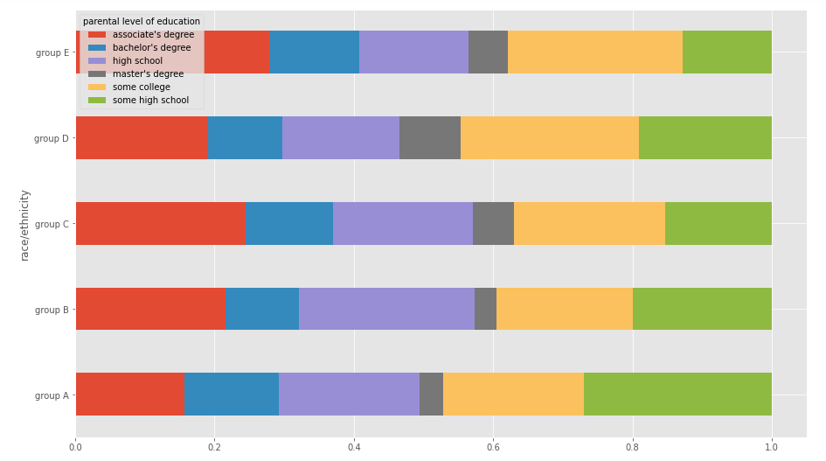
COMPARISON OF RACE WITH PARENTAL LEVEL OF EDUCATION

Slide 19
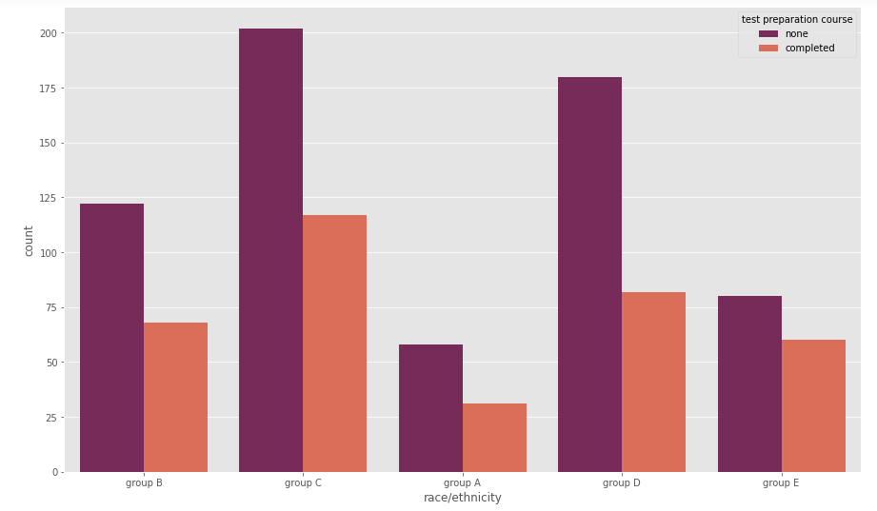
COMPARISON OF RACE WITH TEST PREPARATION COURSE

Slide 20
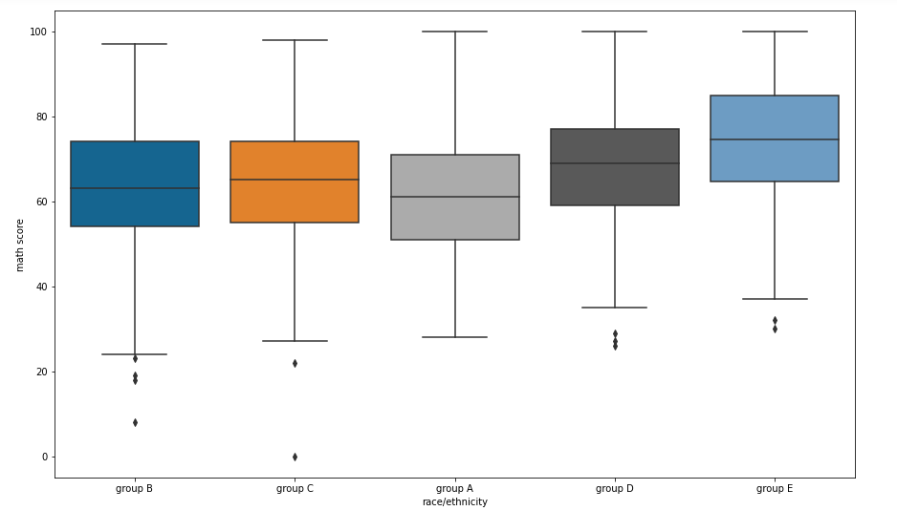
COMPARISON OF RACE WITH MATHS SCORE

Slide 21
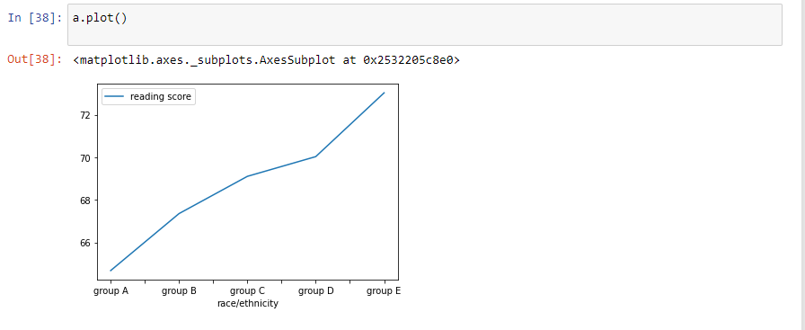
COMPARISON OF RACE WITH READING SCORES

Slide 22
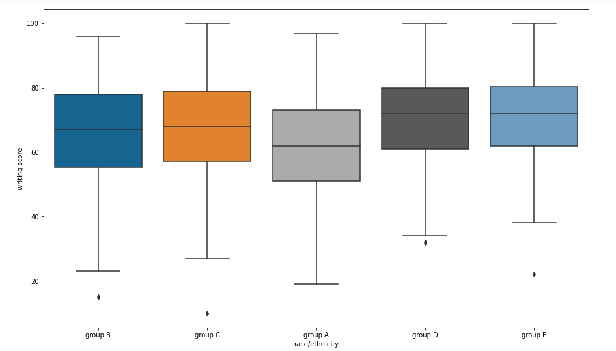
COMPARISON OF RACE WITH WRITING SCORES

Slide 23
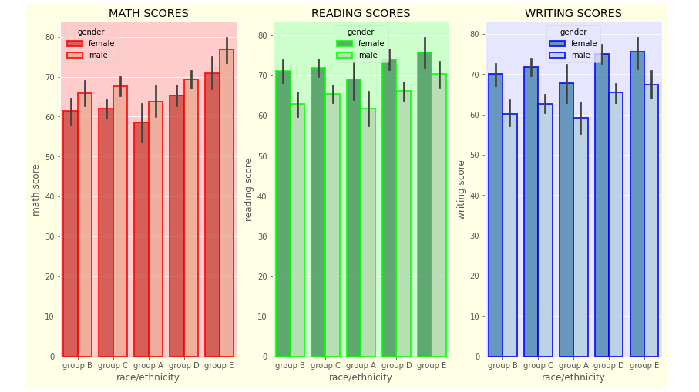
COMPARISON OF RACE WITH GENDER WITH ALL SCORES

Slide 24
PARENTAL LEVEL OF EDUCATION

Slide 25
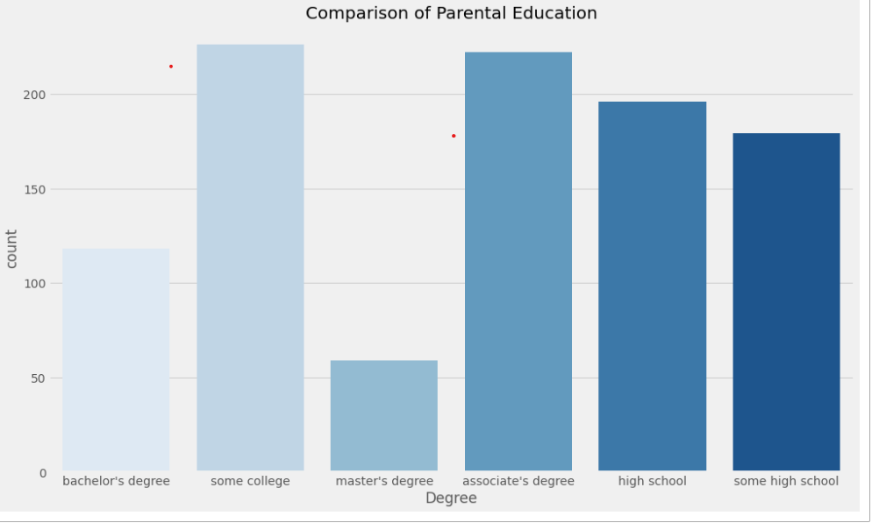
COUNT OF PARENTS EDUCATION

Slide 26
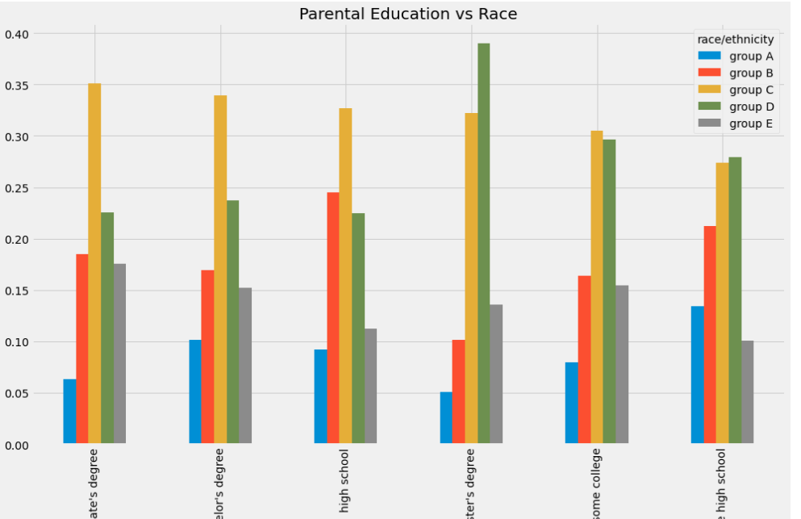
PARENTAL LEVEL OF EDU OF RESPECTIVE GROUPS

Slide 27
PARENTAL LEVEL OF EDU AND ENROLLMENT OF THE COURSE

Slide 28
PARENTAL LEVEL OF EDU & MATHS SCORES

Slide 29
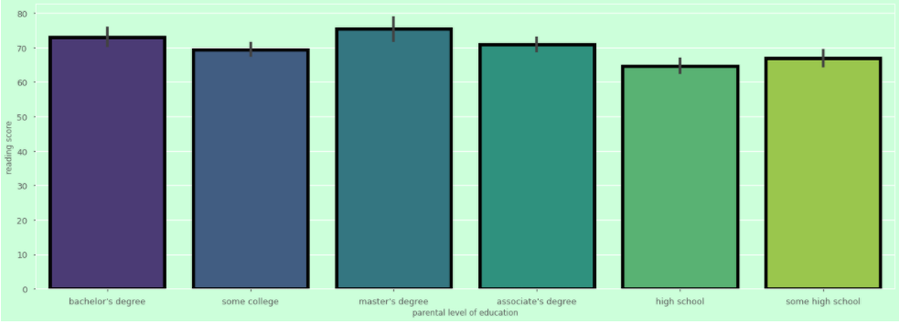
PARENTAL LEVEL OF EDU & READING SCORES

Slide 30
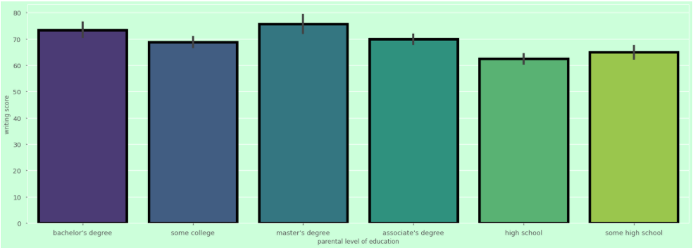
PARENTAL LEVEL OF EDU & WRITING SCORES

Slide 31
LUNCH

Slide 32
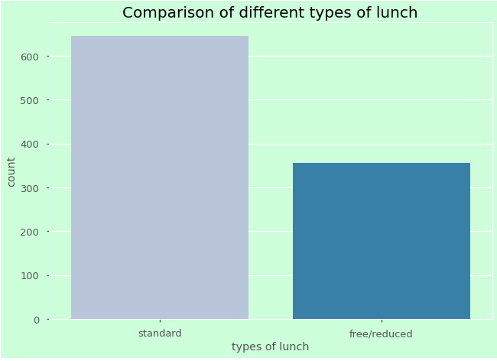
GETTING THE COUNT ON QUALITY OF GENDER

Slide 33
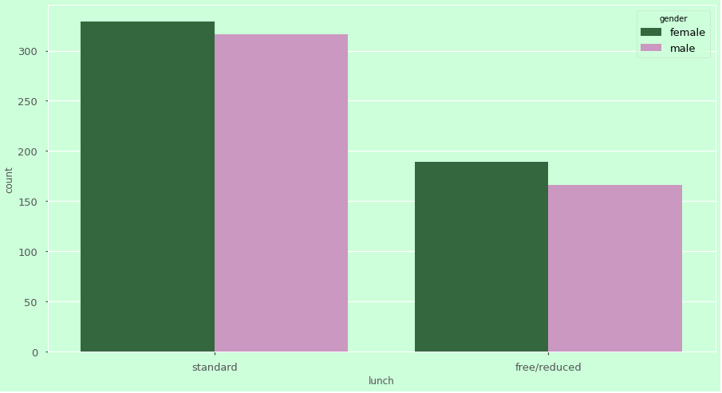
QUALITY OF LUNCH PERCIEVED BY GENDER

Slide 34
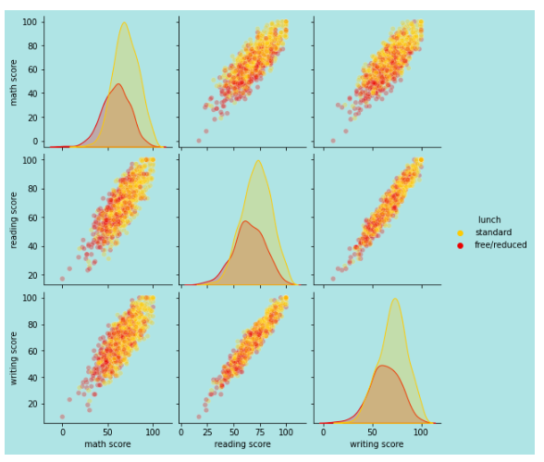
SCORES BASED ON QUALITY OF LUNCH

Slide 35
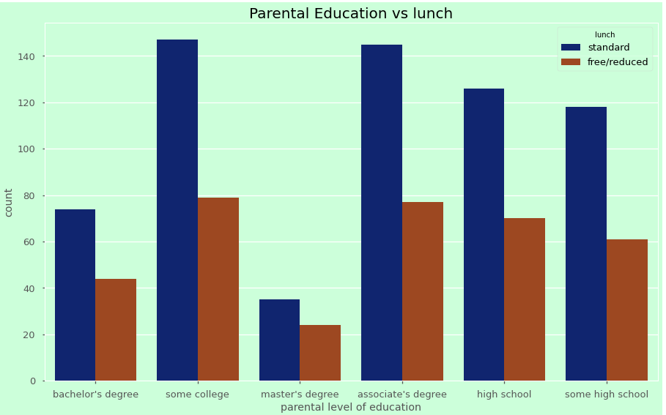
LUNCH & PARENTAL LEVEL OF EDU

Slide 36
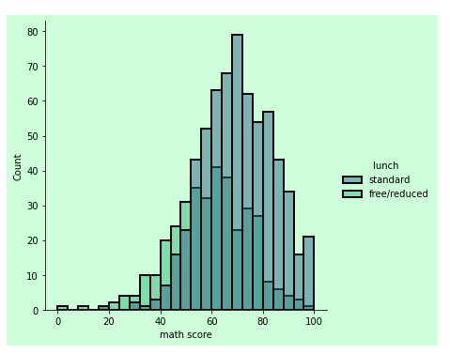
MATHS SCORES BASED QUALITY OF LUNCH

Slide 37
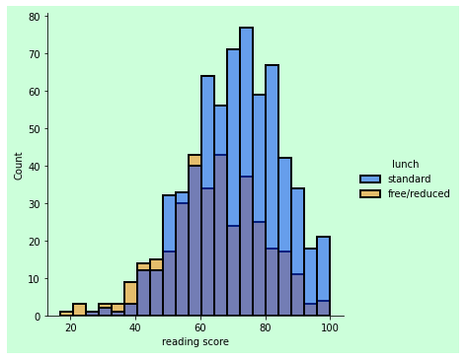
READING SCORES BASED QUALITY OF LUNCH

Slide 38
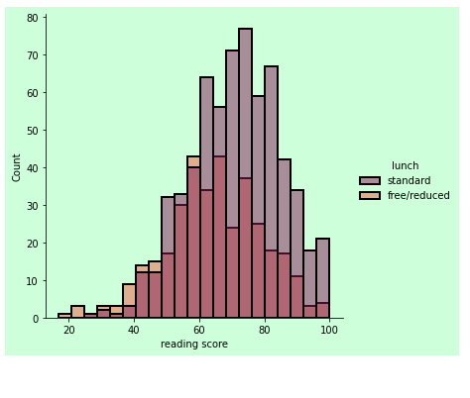
MATHS SCORES BASED QUALITY OF LUNCH

Slide 39
TEST PREPARATION COURSE

Slide 40
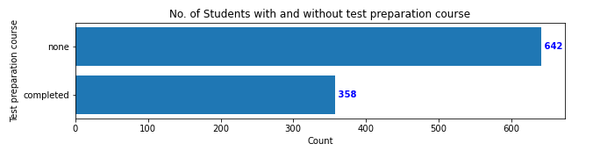
COUNT OF TEST PREPARATION COURSE

Slide 41
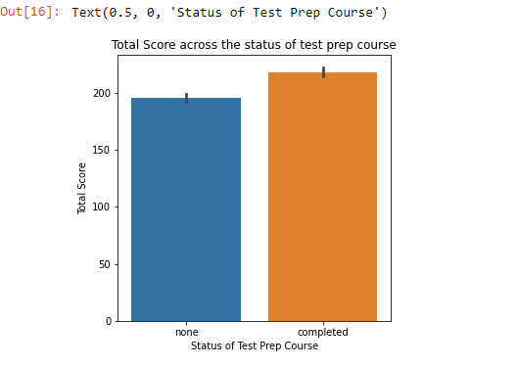
AVERAGE OF TOTAL SCORES BASED ON COURSE

Slide 42
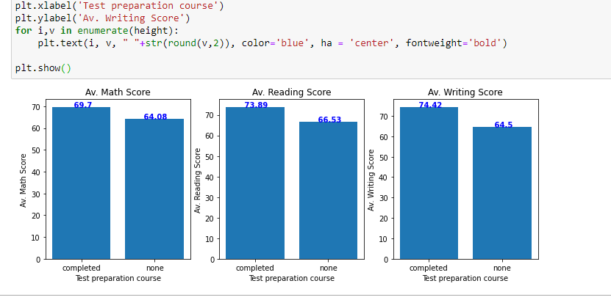
AVERAGE OF ALL SCORES BASED ON COURE

Slide 43
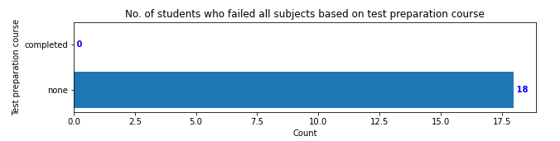
FAILURE BASED ON TEST COURSE

Slide 44
MATHS SCORES

Slide 45
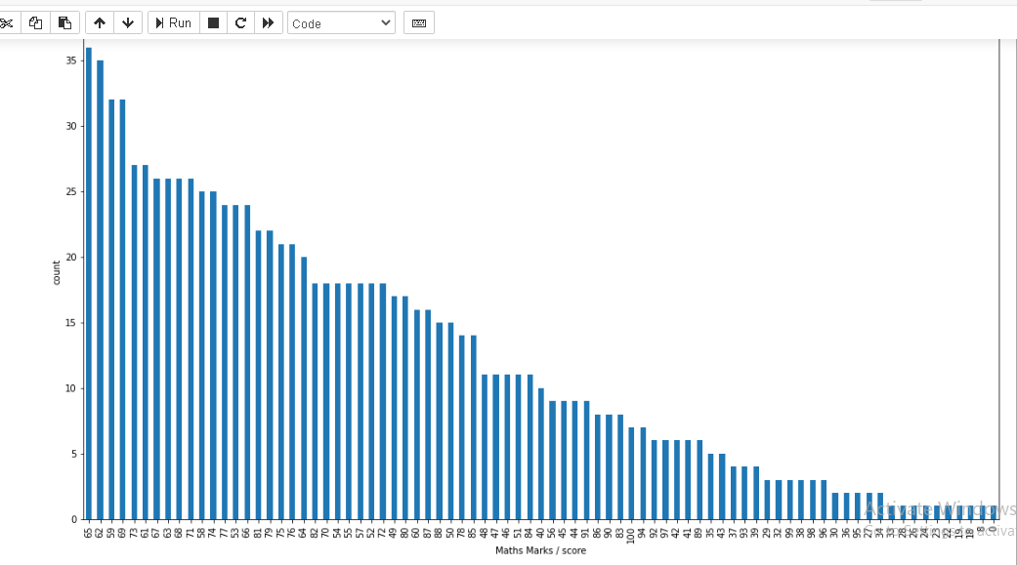
OVERVIEW OF MATHS SCORE

Slide 46
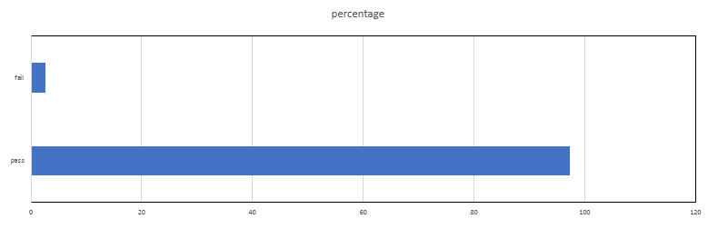
COUNT OF PASS & FAIL

Slide 47
SCORES OF MATHS BASED ON LUNCH
LUNCH | GENDER | MATHS SCORE
FREE/REDUCED | FEMALE | 57
 | MALE | 62
STANDARD | FEMLAE | 67
 | MALE | 72

Slide 48
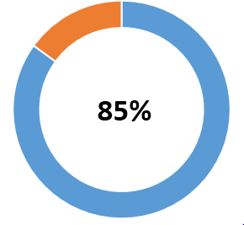
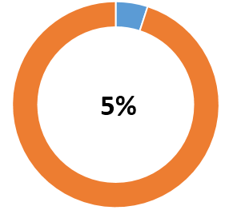
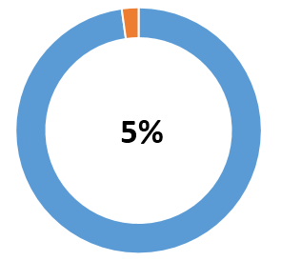
PERCENTAGE OF MATHS SCORE
SCORING MORE THAN 50 MARKS
SCORING MORE THAN 90 MARKS
SCORING MORE THAN 35

Slide 49
SCORED OUTSTANDING IN MATHS (100 MARKS)
FEMALES
MALES
3
4
7

Slide 50
FEMALES SCORING MORE THAN 90
COUNT
21
LUNCH
STANDARD = 2
FREE/REDUCED = 19
GROUP A = 1
GROUP B = 2
GROUP C = 5
GROUP D = 4
GROUP E = 9
PARENTAL LEVEL OF EDU
TEST PREPARATION
COMPLETED = 9
NONE = 9
RACE
HIGH SCHOOL = 1
SOME HIGH SCHL = 2
BACHELOR’S DEG = 7
ASSOCIATE DEG = 7
MASTER’S DEG = 2
SOME COLLEGE = 2

Slide 51
MALES SCORING MORE THAN 90
COUNT
29
LUNCH
STANDARD = 19
FREE/REDUCED = 10
GROUP A = 1
GROUP B = 2
GROUP C = 5
GROUP D = 4
GROUP E = 9
PARENTAL LEVEL OF EDU
TEST PREPARATION
COMPLETED = 9
NONE = 9
RACE
HIGH SCHOOL = 1
SOME HIGH SCHOOL = 3
BACHELOR’S DEG = 5
ASSOCIATE DEG = 9
MASTER’S DEG = 2
SOME COLLEGE = 9

Slide 52
FAILURE ANALYSIS OF MALES
COUNT
8
LUNCH
STANDARD = 3
FREE/REDUCED = 5
GROUP A = 2
GROUP B = 2
GROUP C = 2
GROUP D = 1
GROUP E = 1
PARENTAL LEVEL OF EDU
TEST PREPARATION
COMPLETED = 0
NONE = 8
RACE
HIGH SCHOOL = 4
SOME HIGH SCHL = 2
BACHELOR’S DEG =12
ASSOCIATE DEG = 13
MASTER’S DEG = 10
SOME COLLEGE = 2

Slide 53
FAILURE ANALYSIS OF FEMALES
COUNT
7
LUNCH
STANDARD = 1
FREE/REDUCED = 6
GROUP A = 0
GROUP B = 2
GROUP C = 2
GROUP D = 2
GROUP E = 1
PARENTAL LEVEL OF EDU
TEST PREPARATION
COMPLETED = 0
NONE = 7
RACE
HIGH SCHOOL = 2
SOME HIGH SCHL = 4
BACHELOR’S DEG =0
ASSOCIATE DEG = 1
MASTER’S DEG = 0
SOME COLLEGE = 0

Slide 54
READING SCORES

Slide 55
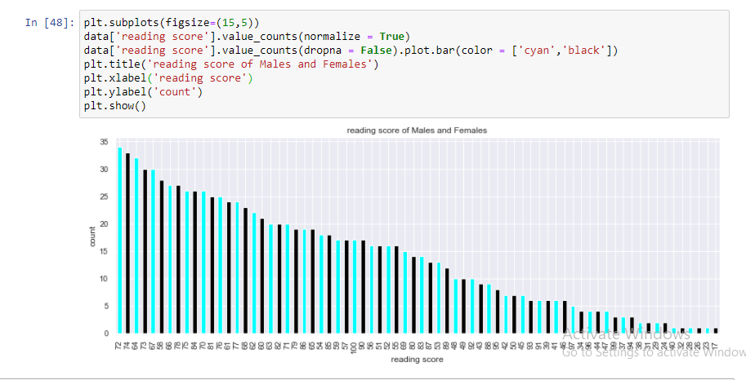
OVERVIEW OF READING SCORE

Slide 56
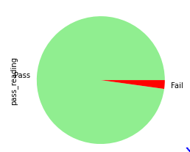
COUNT OF PASS/FAIL

Slide 57
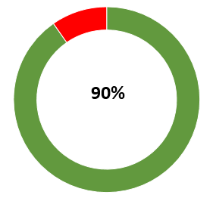
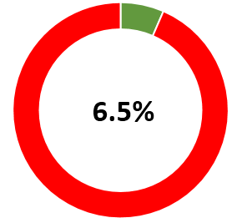
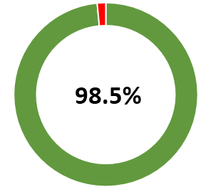
PERCENTAGE OF READING SCORE
SCORING MORE THAN 50 MARKS
SCORING MORE THAN 90 MARKS
SCORING MORE THAN 35

Slide 58
SCORED OUTSTANDING IN READING (100 MARKS)
FEMALES
MALES
14
3
17

Slide 59
FEMALES SCORING MORE THAN 90
COUNT
52
LUNCH
STANDARD = 45
FREE/REDUCED = 7
GROUP A = 2
GROUP B = 7
GROUP C = 14
GROUP D = 16
GROUP E = 13
PARENTAL LEVEL OF EDU
TEST PREPARATION
COMPLETED = 26
NONE = 26
RACE
HIGH SCHOOL = 5
SOME HIGH SCHL = 6
BACHELOR’S DEG =12
ASSOCIATE DEG = 13
MASTER’S DEG = 10
SOME COLLEGE = 6

Slide 60
MALES SCORING MORE THAN 90
COUNT
10
LUNCH
STANDARD = 9
FREE/REDUCED = 1
GROUP A = 3
GROUP B = 1
GROUP C = 2
GROUP D = 1
GROUP E = 3
PARENTAL LEVEL OF EDUCATION
TEST PREPARATION
COMPLETED = 8
NONE = 2
RACE
HIGH SCHOOL = 1
SOME HIGH SCL = 0
BACHELOR’S DEG = 2
ASSOCIATE DEG = 4
MASTER’S DEG = 0
SOME COLLEGE = 3

Slide 61
FAILURE ANALYSIS OF MALES
COUNT
8
LUNCH
STANDARD = 3
FREE/REDUCED = 5
GROUP A = 2
GROUP B = 2
GROUP C = 2
GROUP D = 1
GROUP E = 1
PARENTAL LEVEL OF EDU
TEST PREPARATION
COMPLETED = 0
NONE = 8
RACE
HIGH SCHOOL = 4
SOME HIGH SCHL = 2
BACHELOR’S DEG =12
ASSOCIATE DEG = 13
MASTER’S DEG = 10
SOME COLLEGE = 2

Slide 62
FAILURE ANALYSIS OF FEMALES
COUNT
7
LUNCH
STANDARD = 1
FREE/REDUCED = 6
GROUP A = 0
GROUP B = 2
GROUP C = 2
GROUP D = 2
GROUP E = 1
PARENTAL LEVEL OF EDU
TEST PREPARATION
COMPLETED = 0
NONE = 7
RACE
HIGH SCHOOL = 2
SOME HIGH SCHL = 4
BACHELOR’S DEG =0
ASSOCIATE DEG = 1
MASTER’S DEG = 0
SOME COLLEGE = 0

Slide 63
WRITING SCORES

Slide 64
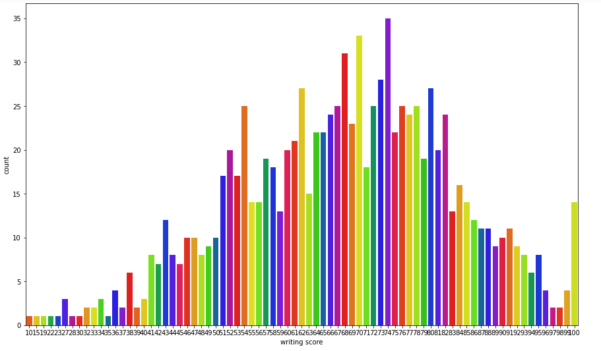
OVERVIEW OF WRITING SCORE

Slide 65
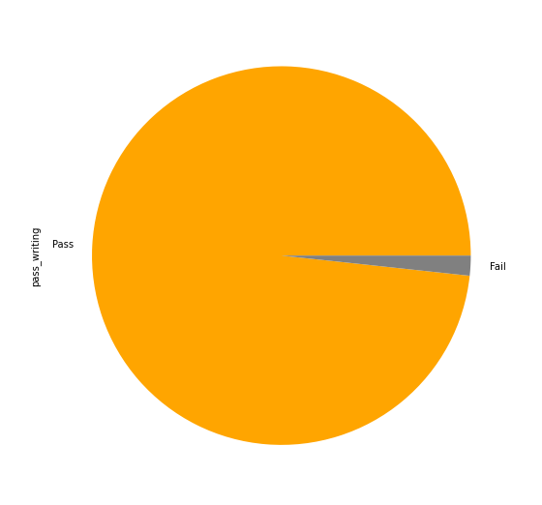
COUNT OF PASS/FAIL

Slide 66
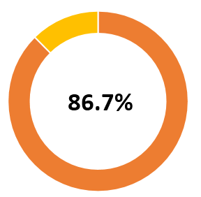
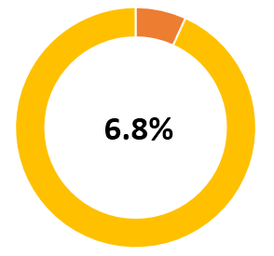
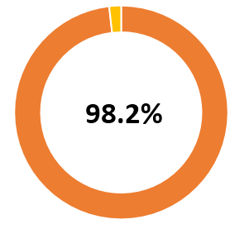
PERCENTAGE OF READING SCORE
SCORING MORE THAN 50 MARKS
SCORING MORE THAN 90 MARKS
SCORING MORE THAN 35

Slide 67
SCORED OUTSTANDING IN WRITING (100 MARKS)
FEMALES
MALES
10
1
11

Slide 68
FEMALES SCORING MORE THAN 90
COUNT
58
LUNCH
STANDARD = 50
FREE/REDUCED = 8
GROUP A = 4
GROUP B = 7
GROUP C = 15
GROUP D = 17
GROUP E = 15
PARENTAL LEVEL OF EDU
TEST PREPARATION
COMPLETED = 34
NONE = 24
RACE
HIGH SCHOOL = 1
SOME HIGH SCHL = 5
BACHELOR’S DEG =11
ASSOCIATE DEG = 15
MASTER’S DEG = 10
SOME COLLEGE = 16

Slide 69
MALES SCORING MORE THAN 90
COUNT
10
LUNCH
STANDARD = 9
FREE/REDUCED = 1
GROUP A = 1
GROUP B = 2
GROUP C = 4
GROUP D = 1
GROUP E = 2
PARENTAL LEVEL OF EDUCATION
TEST PREPARATION
COMPLETED = 8
NONE = 2
RACE
HIGH SCHOOL = 0
SOME HIGH SCL = 0
BACHELOR’S DEG = 4
ASSOCIATE DEG = 4
MASTER’S DEG = 0
SOME COLLEGE = 2

Slide 70
FAILURE ANALYSIS OF MALES
COUNT
8
LUNCH
STANDARD = 1
FREE/REDUCED = 7
GROUP A = 2
GROUP B = 3
GROUP C = 1
GROUP D = 1
GROUP E = 1
PARENTAL LEVEL OF EDU
TEST PREPARATION
COMPLETED = 0
NONE = 8
RACE
HIGH SCHOOL = 3
SOME HIGH SCHL = 2
BACHELOR’S DEG =0
ASSOCIATE DEG = 0
MASTER’S DEG = 0
SOME COLLEGE = 3

Slide 71
FAILURE ANALYSIS OF FEMALES
COUNT
9
LUNCH
STANDARD = 2
FREE/REDUCED = 7
GROUP A = 0
GROUP B = 4
GROUP C = 4
GROUP D = 1
GROUP E = 0
PARENTAL LEVEL OF EDU
TEST PREPARATION
COMPLETED = 0
NONE = 9
RACE
HIGH SCHOOL = 2
SOME HIGH SCHL = 4
BACHELOR’S DEG =0
ASSOCIATE DEG = 0
MASTER’S DEG = 0
SOME COLLEGE = 3

Slide 72
THE EXCELLENT ONES – SCORED 100%
COUNT
MALE = 1
LUNCH
STANDARD = 3
FREE/REDUCED = 0
GROUP E = 3
PARENTAL LEVEL OF EDU
TEST PREPARATION
COMPLETED=1
NONE = 2
RACE
BACHELOR’S DEG =2
ASSOCIATE DEG = 1
GENDER
3
FEMALE = 2

Slide 73
MODEL BUILDING

Slide 74
WRANLGING THE DATA
Predicting the effectiveness of the TEST PREPARATON COURSE based on the SCORES of all the papers.
 | MATH SCORE | READING SCORE | WRITING SCORE | GENDER | LUNCH | TEST PREPARATION COURSE
0 | 72 | 72 | 74 | 0 | 1 | 1
1 | 69 | 90 | 88 | 0 | 1 | 0
2 | 90 | 95 | 93 | 0 | 1 | 1
3 | 47 | 57 | 44 | 1 | 0 | 1
4 | 76 | 78 | 75 | 1 | 1 | 1
5 | 71 | 83 | 78 | 0 | 1 | 1

Slide 75
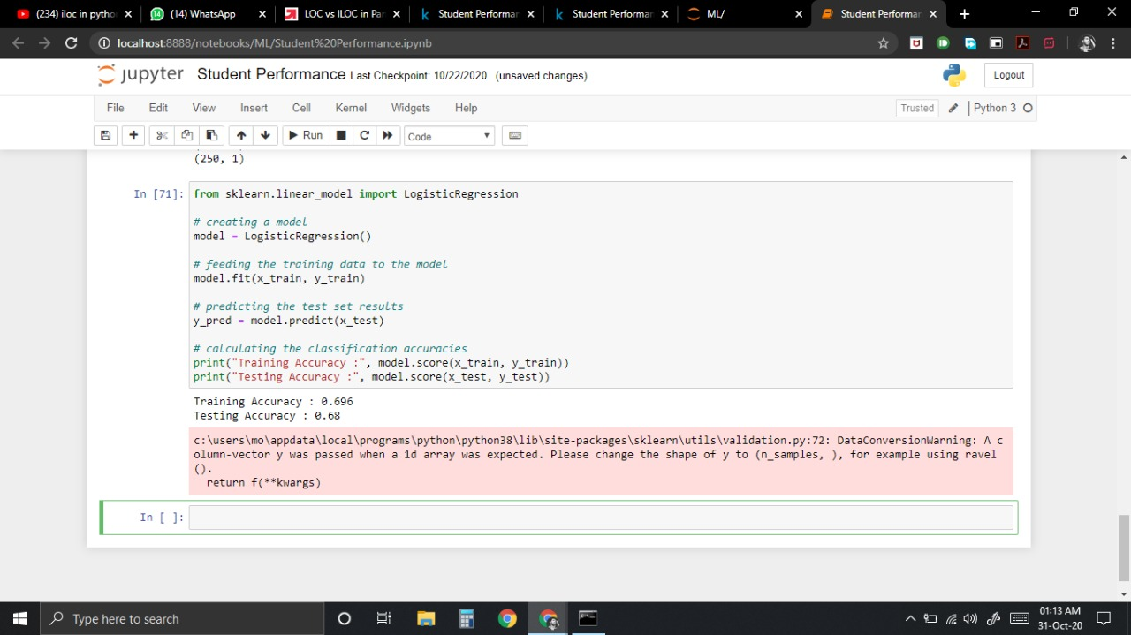
TRAINING THE DATA & IMPLEMENTING THE MODEL
x = data['math score'],['reading score'],['writing score']
y = data[test preparation score']
X_train.shape = (750, 3)
Y_train.shape = (750, 1)
Model = LogisticRegression()
Model.fit(X_train, Y_train)
Y_pred = model.predict(x_test)

Slide 76
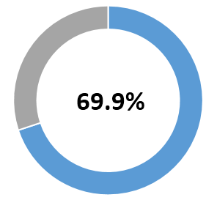
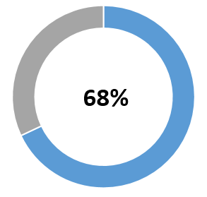
CHECKING ACCURACY
TESTING ACCURACY
TRAINING ACCURACY

Slide 77
CONCLUSION
Test Preparation Course gave positive result helping most them to score distinction among which a good count scored 90+ and one of them outstanding!
None of student who completed the course have failed.
Students having Reduced Lunch have mostly negative effects on their scores.
The best of the scores subject wise are Reading > Writing > Maths
With respect to overall performance Females have scored much better than Males.
INTERESTING FACT - Two students who didn’t completed the course scored excellent.

Slide 78
CONCLUSION
Major factors contributing in test outcomes
The best way to improve scores are as follows:
Parental level of education
Quality of Lunch
Preparation course
Improve the quality of lunch
Enroll for test preparation courses

Slide 79
REFERENCES
www.kaggle.com
www.edureka.com
www.stackoverflow.com
www.upgrad.com
www.analyticsvidya.com
pandas.pydata.org
seaborn.pydata.com
sklearn.pydata.com

