Slide 1

Python for Data Science
Yt: @sadiqpashag
http://linkedin.com/in/achieversadiq
Email: psadiqg@gmail.com

Slide 2
Agenda
What is Python? What Can Python do? Why python?
Variable Definitions in Python
Data Types and Built-in Data Structures in Python
Strings
Arrays & Lists
Tuples
Dictionary
Sets & Operations
Python Keywords
Python Operators
Conditionals in Python
Loops & nested Loops in Python
Comprehensions in Python
Collections Module
Functions, arguments & Variable Scopes
Closures
Decorators
generators
Classes & __init__()
OOPS – Inheritance, multiple inheritance and multi-level inheritance
OOPS - Data encapsulation
OOPS – Polymorphism
Exception Handling in Python
Working with Files
Regex in Python
Map, reduce & filter in python
itertools modules
OS module
Random modules
Handling datetime
Dis module
Sqlite3 module
Python project

Slide 3
Python
What is Python?
Python is a popular programming language. It was created by Guido van Rossum and released in 1991.
It is used for:
web development (server-side),
software development,
mathematics,
system scripting,
Data Analysis & Machine Learning
What can Python do?
Python can be used on a server to create web applications.
Python can be used alongside software to create workflows.
Python can connect to database systems. It can also read and modify files.
Python can be used to handle big data and perform complex mathematics.
Python can be used for rapid prototyping, or for production-ready software development.
Why Python?
Python works on different platforms (Windows, Mac, Linux, Raspberry Pi, etc).
Python has a simple syntax similar to the English language.
Python has syntax that allows developers to write programs with fewer lines than some other programming languages.
Python runs on an interpreter system, meaning that code can be executed as soon as it is written. This means that prototyping can be very quick.
Python can be treated in a procedural way, an object-oriented way or a functional way.

Slide 4
Variables
Variable is a name and place in memory that we reserve for a value
In Python, we use this syntax to create a variable and assign a value to this variable:
<var_name> = <value>
For example:
age = 56
name = "Nora"
color = "Blue"
grades = [67, 100, 87, 56]
If the name of a variable has more than one word, then the Style Guide for Python Code recommends separating words with an underscore "as necessary to improve readability."

Slide 5
Data Types in Python
Text Type: | Str -> ' ', " " , """ """
Numeric Types: | int, float, complex
Sequence Types: | List [], tuple (), range [startvalue, end value ,batch size], generators
Mapping Type: | Dict {key : value}
Set Types: | Set {}, frozenset
Boolean Type: | Bool -> True / False
Binary Types: | bytes, bytearray, memoryview
None Type: | NoneType -> Null
In Programming, data type is an attribute associated with a piece of data that tells a computer system how to interpret its value.
Python has the following data types built-in by default, in these categories:

Slide 6
Strings
String is a sequence of characters
We can use both single quotes '' or double quotes "" to define a string.
Strings can contain any character that we can type in our keyboard, including numbers, symbols, and other special characters.
For example:
"45678"
"my_email@email.com"
'#IlovePython'
"I'm 10 years old"
'My favorite book is "Sense and Sensibility"'
Input: r'Python\nis\easy\to\learn' Output: Python\nis\easy\to\learn
Explanation: As we can see that the string is printed as raw, and it neglected all newline sign(\n) or tab space (\t).

Slide 7
Method | Description
capitalize() | Converts the first character to upper case
casefold() | Converts string into lower case
center() | Returns a centered string
count() | Returns the number of times a specified value occurs in a string
encode() | Returns an encoded version of the string
endswith() | Returns true if the string ends with the specified value
expandtabs() | Sets the tab size of the string
find() | Searches the string for a specified value and returns the position of where it was found
format() | Formats specified values in a string
format_map() | Formats specified values in a string
index() | Searches the string for a specified value and returns the position of where it was found
isalnum() | Returns True if all characters in the string are alphanumeric
isalpha() | Returns True if all characters in the string are in the alphabet
isascii() | Returns True if all characters in the string are ascii characters
isdecimal() | Returns True if all characters in the string are decimals
isdigit() | Returns True if all characters in the string are digits

Slide 8
Method | Description
isidentifier() | Returns True if the string is an identifier
islower() | Returns True if all characters in the string are lower case
isnumeric() | Returns True if all characters in the string are numeric
isprintable() | Returns True if all characters in the string are printable
isspace() | Returns True if all characters in the string are whitespaces
istitle() | Returns True if the string follows the rules of a title
isupper() | Returns True if all characters in the string are upper case
join() | Converts the elements of an iterable into a string
ljust() | Returns a left justified version of the string
lower() | Converts a string into lower case
lstrip() | Returns a left trim version of the string
maketrans() | Returns a translation table to be used in translations
partition() | Returns a tuple where the string is parted into three parts
replace() | Returns a string where a specified value is replaced with a specified value
rfind() | Searches the string for a specified value and returns the last position of where it was found
rindex() | Searches the string for a specified value and returns the last position of where it was found

Slide 9
Method | Description
rjust() | Returns a right justified version of the string
rpartition() | Returns a tuple where the string is parted into three parts
rsplit() | Splits the string at the specified separator, and returns a list
rstrip() | Returns a right trim version of the string
split() | Splits the string at the specified separator, and returns a list
splitlines() | Splits the string at line breaks and returns a list
startswith() | Returns true if the string starts with the specified value
strip() | Returns a trimmed version of the string
swapcase() | Swaps cases, lower case becomes upper case and vice versa
title() | Converts the first character of each word to upper case
translate() | Returns a translated string
upper() | Converts a string into upper case
zfill() | Fills the string with a specified number of 0 values at the beginning

Slide 10
Arrays
Method | Description
append() | append a new item to the end of the array
buffer_info() | return information giving the current memory info
byteswap() | byteswap all the items of the array
count() | Returns the number of elements with the specified value
extend() | Add the elements of a list (or any iterable), to the end of the current list
fromfile() | read items from a file object
fromlist() | append items from the list
frombytes() | append items from the string
index() | Returns the index of the first element with the specified value
insert() | Adds an element at the specified position
pop() | Removes the element at the specified position
remove() | Removes the first item with the specified value
reverse() | Reverses the order of the list
tofile() | write all items to a file object
tolist() | return the array converted to an ordinary list
tobytes() | return the array converted to a string
Arrays are collection datatype that are used to store homogenous values
To use arrays we import from "array" module
To create an array we pass the typecode and then the list of items
array(typecode [, initializer]) -> array
>> from array import * >> my_array = array('i',[1,2,3,4,5]) >> print(my_array)
Output:
>> [1, 2, 3, 4, 5]
Here I, indicates that the list we are passing is going to hold only integers.
Type code C Type Minimum size in bytes
'b' signed integer 1 'B' unsigned integer 1 'u' Unicode character 2 (see note) 'h' signed integer 2 'H' unsigned integer 2 'i' signed integer 2 'I' unsigned integer 2 'l' signed integer 4 'L' unsigned integer 4 'q' signed integer 8 (see note) 'Q' unsigned integer 8 (see note) 'f' floating point 4 'd' floating point 8

Slide 11
Lists
Method | Description
append() | Adds an element at the end of the list
clear() | Removes all the elements from the list
copy() | Returns a copy of the list
count() | Returns the number of elements with the specified value
extend() | Add the elements of a list (or any iterable), to the end of the current list
index() | Returns the index of the first element with the specified value
insert() | Adds an element at the specified position
pop() | Removes the element at the specified position
remove() | Removes the first item with the specified value
reverse() | Reverses the order of the list
sort() | Sorts the list
Lists are a collection datatype used to store mutable, heterogenous elements.
List items are ordered, changeable, and allow duplicate values.
Syntax:
>> L = []
>> X='abcd’
>>L1 = list(X)
Output: [‘a’, ‘b’, ‘c’, ‘d’]

Slide 12
Tuples
Tuples are a collection datatype used to store immutable, heterogenous elements.
To create a tuple, just initialize with ()
# Creating an empty Tuple >> t = ()
# with the use of string >> tuple1 = ('Data', 'Science’)
Output:
>> (‘Data’, ‘Science’)
# Creating a Tuple with the use of list >> list1 = [1, 2, 4, 5, 6]
>> tuple(list1)
Output:
>> (1, 2, 3, 4, 5)
Method | Description
count() | Returns the number of elements with the specified value
index() | Returns the index of the first element with the specified value

Slide 13
Dictionary
A Python dictionary is a mapping type data structure that stores the value in key:value pairs.
It allows you to store and retrieve elements by referencing a key.
To create a dictionary, follow the below Syntax:
>> d = {}
>> d = {'key':'value’}
>> d = dict()
>> d = dict(key='value’)
>> d = dict([('key', 'value')])
Method | Description
clear() | Removes all the elements from the dictionary
copy() | Returns a copy of the dictionary
fromkeys() | Returns a dictionary with the specified keys and value
get() | Returns the value of the specified key
items() | Returns a list containing a tuple for each key value pair
keys() | Returns a list containing the dictionary's keys
pop() | Removes the element with the specified key
popitem() | Removes the last inserted key-value pair
setdefault() | Returns the value of the specified key. If the key does not exist: insert the key, with the specified value
update() | Updates the dictionary with the specified key-value pairs
values() | Returns a list of all the values in the dictionary

Slide 14
Sets in Python
A Set is an unordered collection data type that is iterable, mutable and has no duplicate elements.
Set are represented by { } (values enclosed in curly braces)
The major advantage of using a set, as opposed to a list, is that it has a highly optimized method for checking whether a specific element is contained in the set.
Since sets are unordered, we cannot access items using indexes as we do in lists.
Method | Description
clear() | Removes all the elements from the set
pop() | Removes the last element from the set
add() | Adds a given element to a set
discard() | Removes the element from the set
remove() | Removes the element from the set
update() | Add multiple elements into a set

Slide 15
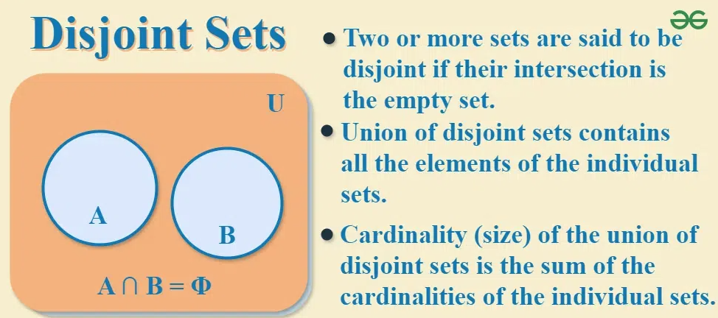
Set Operations
Definitions:
The symmetric difference between both sets A and B is the set that contains the elements that are present in both sets except the common elements.
The symmetric difference between two sets is also called as disjunctive union. Symmetric difference between two sets is a set of elements that are in both sets but not in their intersection. The symmetric difference between two sets A and B is represented by A Δ B or A ? B
In Python, below quick operands can be used for different operations:
>> | for union. >> & for intersection. >> – for difference >> ^ for symmetric difference
>> >= for Issuperset
>> <= for Issubset
>> Isdisjoint
>> In for existance
Set Theory | Definition, Types, Symbols, Examples & Operation on Sets (geeksforgeeks.org)

Slide 16
Python Keywords
Keywords are the reserved words that cannot be used as variable names, function or class names.
Keyword | Description | Keyword | Description | Keyword | Description
and | It is a Logical Operator | False | Represents an expression that will result in not being true. | nonlocal | It is a non-local variable
as | It is used to create an alias name | finally | It is used with exceptions | not | It is a Logical Operator
assert | It is used for debugging | for | It is used to create Loop | or | It is a Logical Operator
break | Break out a Loop | from | To import specific parts of a module | pass | pass is used when the user doesn’t want any code to execute
class | It is used to define a class | global | It is used to declare a global variable | raise | raise is used to raise exceptions or errors.
continue | Skip the next iteration of a loop | if | To create a Conditional Statement | return | return is used to end the execution

Slide 17
Python Keywords
Keywords are the reserved words that cannot be used as variable names, function or class names.
Keyword | Description | Keyword | Description | Keyword | Description
def | It is used to define the Function | import | It is used to import a module | True | Represents an expression that will result in true.
del | It is used to delete an object | is | It is used to test if two variables are equal | try | Try is used to handle errors
elif | Conditional statements, same as else-if | in | To check if a value is present in a Tuple, List, etc. | while | While Loop is used to execute a block of statements
else | It is used in a conditional statement | lambda | Used to create an anonymous function | with | with statement is used in exception handling
except | try-except is used to handle these errors | None | It represents a null value | yield | yield keyword is used to create a generator function

Slide 18
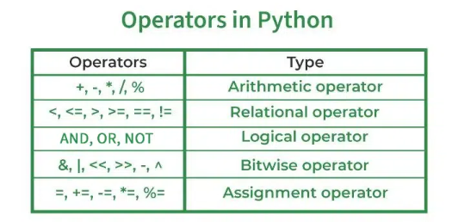
Python Operators
Arithmetic Operators
Comparison Operators
Logical Operators
Bitwise Operators
Assignment Operators
Identity Operators and Membership Operators

Slide 19
Arithmetic Operators Comparison Operators
Operator | Description | Syntax
+ | Addition: adds two operands | x + y
– | Subtraction: subtracts two operands | x – y
* | Multiplication: multiplies two operands | x * y
/ | Division (float): divides the first operand by the second | x / y
// | Division (floor): divides the first operand by the second | x // y
% | Modulus: returns the remainder when the first operand is divided by the second | x % y
** | Power: Returns first raised to power second | x ** y
Operator | Description | Syntax
> | Greater than: True if the left operand is greater than the right | x > y
< | Less than: True if the left operand is less than the right | x < y
== | Equal to: True if both operands are equal | x == y
!= | Not equal to – True if operands are not equal | x != y
>= | Greater than or equal to True if the left operand is greater than or equal to the right | x >= y
<= | Less than or equal to True if the left operand is less than or equal to the right | x <= y

Slide 20
Logical Operators Bitwise Operators
Operator | Description | Syntax
& | Bitwise AND | x & y
| | Bitwise OR | x | y
~ | Bitwise NOT | ~x
^ | Bitwise XOR | x ^ y
>> | Bitwise right shift | x>>
<< | Bitwise left shift | x<<
Operator | Description | Syntax
and | Logical AND: True if both the operands are true | x and y
or | Logical OR: True if either of the operands is true | x or y
not | Logical NOT: True if the operand is false | not x
The precedence of Bitwise Operators in Python is as follows:
Bitwise NOT
Bitwise Shift
Bitwise AND
Bitwise XOR
Bitwise OR

Slide 21
Assignment Operators
Operator | Description | Syntax
= | Assign the value of the right side of the expression to the left side operand | x = y + z
+= | Add AND: Add right-side operand with left-side operand and then assign to left operand | a+=b a=a+b
-= | Subtract AND: Subtract right operand from left operand and then assign to left operand | a-=b a=a-b
*= | Multiply AND: Multiply right operand with left operand and then assign to left operand | a*=b a=a*b
/= | Divide AND: Divide left operand with right operand and then assign to left operand | a/=b a=a/b
%= | Modulus AND: Takes modulus using left and right operands and assign the result to left operand | a%=b a=a%b
//= | Divide(floor) AND: Divide left operand with right operand and then assign the value(floor) to left operand | a//=b a=a//b
**= | Exponent AND: Calculate exponent(raise power) value using operands and assign value to left operand | a**=b a=a**b
&= | Performs Bitwise AND on operands and assign value to left operand | a&=b a=a&b
|= | Performs Bitwise OR on operands and assign value to left operand | a|=b a=a|b
^= | Performs Bitwise xOR on operands and assign value to left operand | a^=b a=a^b
>>= | Performs Bitwise right shift on operands and assign value to left operand | a>>=b a=a>>b
<<= | Performs Bitwise left shift on operands and assign value to left operand | a <<= b a= a << b

Slide 22
Identity Operators
is True if the operands are identical is not True if the operands are not identical
Membership Operators
in True if value is found in the sequence not in True if value is not found in the sequence
Ternery Operators
Syntax : [on_true] if [expression] else [on_false]

Slide 23
Operator precedence
Operators | Meaning
() | Parentheses
** | Exponent
+x, -x, ~x | Unary plus, Unary minus, Bitwise NOT
*, /, //, % | Multiplication, Division, Floor division, Modulus
+, - | Addition, Subtraction
<<, >> | Bitwise shift operators
& | Bitwise AND
^ | Bitwise XOR
| | Bitwise OR
==, !=, >, >=, <, <=, is, is not, in, not in | Comparisons, Identity, Membership operators
not | Logical NOT
and | Logical AND
or | Logical OR

Slide 24
Associativity of Python Operators
Associativity is the order in which an expression is evaluated that has multiple operators of the same precedence. Almost all the operators have left-to-right associativity.
For example, multiplication and floor division have the same precedence. Hence, if both of them are present in an expression, the left one is evaluated first.
# Left-right associativity >> print(5 * 2 // 3) output: 3 # Shows left-right associativity >> print(5 * (2 // 3))
Output: 0
Note: Exponent operator ** has right-to-left associativity in Python.
# Shows the right-left associativity of ** # Output: 512, Since 2**(3**2) = 2**9 >> print(2 ** 3 ** 2) # If 2 needs to be exponated fisrt, need to use () # Output: 64 >> print((2 ** 3) ** 2)
We can see that 2 ** 3 ** 2 is equivalent to 2 ** (3 ** 2).

Slide 25
Non Associative operators
Some operators like assignment operators and comparison operators do not have associativity in Python. There are separate rules for sequences of this kind of operator and cannot be expressed as associativity.
For example,
x < y < z neither means (x < y) < z nor x < (y < z). x < y < z
is equivalent to
x < y and y < z and is evaluated from left-to-right.
Furthermore, while chaining of assignments like
x = y = z = 1 is perfectly valid,
x = y = z+= 2 will result in error.
# Initialize x, y, z x = y = z = 1 # Expression is invalid # (Non-associative operators) # SyntaxError: invalid syntax x = y = z+= 2

Slide 26
Python Operator Overloading
In Python, we can change the way operators work for user-defined types.
For example, the + operator will perform arithmetic addition on two numbers, merge two lists, or concatenate two strings.
This feature in Python that allows the same operator to have different meaning according to the context is called operator overloading.

Slide 27
Conditionals in Python
Conditional Statements are statements in Python that provide a choice for the control flow based on a condition. It means that the control flow of the Python program will be decided based on the outcome of the condition.
1. If Conditional Statement in Python
if condition: # Statements to execute if # condition is true
2. If else Conditional Statements in Python
if (condition): # Executes this block if # condition is true else: # Executes this block if # condition is false
3. If-elif-else Conditional Statements in Python
# if-elif statement example
>> letter = "A"
>> if letter == "B":
print("letter is B")
>> elif letter == "C":
print("letter is C")
>> elif letter == "A":
print("letter is A")
>> else:
print("letter isn't A, B or C")

Slide 28
Conditionals in Python
4. Ternary Expression Conditional Statements in Python
Syntax: [on_true] if [expression] else [on_false] expression: conditional_expression | lambda_expr
# Python program to demonstrate nested ternary operator
>> a, b = 10, 20
>> print ("Both a and b are equal" if a == b else "a is greater than b“ if a > b else "b is greater than a")
Best Practices for Using Conditional Statements
Keep conditions simple and expressive for better readability.
Avoid deeply nested conditional blocks; refactor complex logic into smaller, more manageable functions.
Comment on complex conditions to clarify their purpose.
Prefer the ternary operator for simple conditional assignments.
Advanced Techniques:
Using short-circuit evaluation for efficiency in complex conditions.
Leveraging the any() and all() functions with conditions applied to iterables.
Employing conditional expressions within list comprehensions and generator expressions.

Slide 29
Loops in Python
While Loop in Python
In Python, a while loop is used to execute a block of statements repeatedly until a given condition is satisfied. When the condition becomes false, the line immediately after the loop in the program is executed.
Python While Loop Syntax:
>> while expression: #condition statement(s)
Syntax of While Loop with else statement:
>> while condition: # execute these statements >> else: # execute these statements
For Loop in Python
For loops are used for sequential traversal. For example: traversing a list or string or array etc. In Python, there is “for in” loop which is similar to foreach loop in other languages.
For Loop Syntax:
>> for iterator_var in sequence: statements(s)
Using else Statement with for Loop in Python
>> for iterator_var in sequence: statements(s)
>> else: # execute these statements

Slide 30
Loops in Python
Loop Control Statements
Loop control statements change execution from their normal sequence. When execution leaves a scope, all automatic objects that were created in that scope are destroyed. Python supports the following control statements.
Continue Statement
The continue statement in Python returns the control to the beginning of the loop.
>> for letter in 'geeksforgeeks': if letter == 'e' or letter == 's': continue print('Current Letter :', letter)
Break Statement
The break statement in Python brings control out of the loop.
>> for letter in 'geeksforgeeks': if letter == 'e' or letter == 's': break >> print('Current Letter :', letter)
Pass Statement
We use pass statement in Python to write empty loops. Pass is also used for empty control statements, functions and classes.
>> for letter in 'geeksforgeeks': pass >> print('Last Letter :', letter)

Slide 31
Comprehensions
List Comprehensions
Syntax: output_list = [output_exp for var in input_list if (var satisfies this condition)]
Dictionary Comprehensions
output_dict = {key:value for (key, value) in iterable if (key, value satisfy this condition)}
Set Comprehensions
Syntax: output_list = {output_exp for var in input_list if (var satisfies this condition)}
Generator Comprehensions
Syntax: output_list = (output_exp for var in input_list if (var satisfies this condition))
Comprehensions in Python provide us with a short and concise way to construct new sequences (such as lists, sets, dictionaries, etc.) using previously defined sequences.
Python supports the following 4 types of comprehension:
List Comprehensions -> []
Dictionary Comprehensions {k:v}
Set Comprehensions -> {}
Generator Comprehensions -> ()

Slide 32
Python Built-in Functions
Function | Description
abs() | Returns the absolute value of a number
all() | Returns True if all items in an iterable object are true
any() | Returns True if any item in an iterable object is true
ascii() | Returns a readable version of an object. Replaces none-ascii characters with escape character
bin() | Returns the binary version of a number
bool() | Returns the boolean value of the specified object
bytearray() | Returns an array of bytes
bytes() | Returns a bytes object
callable() | Returns True if the specified object is callable, otherwise False
chr() | Returns a character from the specified Unicode code.
classmethod() | Converts a method into a class method
compile() | Returns the specified source as an object, ready to be executed
complex() | Returns a complex number
delattr() | Deletes the specified attribute (property or method) from the specified object

Slide 33
Python Built-in Functions
Function | Description
dict() | Returns a dictionary (Array)
dir() | Returns a list of the specified object's properties and methods
divmod() | Returns the quotient and the remainder when argument1 is divided by argument2
enumerate() | Takes a collection (e.g. a tuple) and returns it as an enumerate object
eval() | Evaluates and executes an expression
exec() | Executes the specified code (or object)
filter() | Use a filter function to exclude items in an iterable object
float() | Returns a floating point number
format() | Formats a specified value
frozenset() | Returns a frozenset object
getattr() | Returns the value of the specified attribute (property or method)
globals() | Returns the current global symbol table as a dictionary
hasattr() | Returns True if the specified object has the specified attribute (property/method)
hash() | Returns the hash value of a specified object
help() | Executes the built-in help system

Slide 34
Python Built-in Functions
Function | Description
hex() | Converts a number into a hexadecimal value
id() | Returns the id of an object
input() | Allowing user input
int() | Returns an integer number
isinstance() | Returns True if a specified object is an instance of a specified object
issubclass() | Returns True if a specified class is a subclass of a specified object
iter() | Returns an iterator object
len() | Returns the length of an object
list() | Returns a list
locals() | Returns an updated dictionary of the current local symbol table
map() | Returns the specified iterator with the specified function applied to each item
max() | Returns the largest item in an iterable
memoryview() | Returns a memory view object
min() | Returns the smallest item in an iterable

Slide 35
Python Built-in Functions
Function | Description
next() | Returns the next item in an iterable
object() | Returns a new object
oct() | Converts a number into an octal
open() | Opens a file and returns a file object
ord() | Convert an integer representing the Unicode of the specified character
pow() | Returns the value of x to the power of y
print() | Prints to the standard output device
property() | Gets, sets, deletes a property
range() | Returns a sequence of numbers, starting from 0 and increments by 1 (by default)
repr() | Returns a readable version of an object
reversed() | Returns a reversed iterator
round() | Rounds a numbers
set() | Returns a new set object
setattr() | Sets an attribute (property/method) of an object

Slide 36
Python Built-in Functions
Function | Description
slice() | Returns a slice object
sorted() | Returns a sorted list
staticmethod() | Converts a method into a static method
str() | Returns a string object
sum() | Sums the items of an iterator
super() | Returns an object that represents the parent class
tuple() | Returns a tuple
type() | Returns the type of an object
vars() | Returns the __dict__ property of an object
zip() | Returns an iterator, from two or more iterators

Slide 37
Collections Module
The collection Module in Python provides different types of containers. A Container is an object that is used to store different objects and provide a way to access the contained objects and iterate over them. Some of the built-in containers are Tuple, List, Dictionary,
Data type | Description
deque | A sequence-like collection that supports efficient addition and removal of items from either end of the sequence
defaultdict | A dictionary subclass for constructing default values for missing keys and automatically adding them to the dictionary
namedtuple() | A factory function for creating subclasses of tuple that provides named fields that allow accessing items by name while keeping the ability to access items by index
OrderedDict | A dictionary subclass that keeps the key-value pairs ordered according to when the keys are inserted
Counter | A dictionary subclass that supports convenient counting of unique items in a sequence or iterable
ChainMap | A dictionary-like class that allows treating a number of mappings as a single dictionary object

Slide 38
Counters
>> collections.Counter('Happy Birthday’)
Output:
Counter({'H': 1,
'a': 2,
'p': 2,
'y': 2,
' ': 1,
'B': 1,
'i': 1,
'r': 1,
't': 1,
'h': 1,
'd': 1})
A counter is a sub-class of the dictionary. It is used to keep the count of the elements in an iterable in the form of an unordered dictionary where the key represents the element in the iterable and value represents the count of that element in the iterable.
Syntax:
>> class collections.Counter([iterable-or-mapping])
Initializing Counter Objects
The counter object can be initialized using the counter() function and this function can be called in one of the following ways:
With a sequence of items
With a dictionary containing keys and counts
With keyword arguments mapping string names to counts

Slide 39
OrderedDict DefaultDict
The order of keys in python dictionaries is arbitrary. They are not governed by the order in which you add them.
The collections.OrderedDict class provides dictionary objects that retain the order of keys.
Iterating through an OrderedDict allows key access in the order they were added.
Syntax:
>> from collections import OrderedDict
>> d = OrderedDict()
>> d['baz'] = 7
>> d['foobar’]=4
>> print(d)
>> d['foo’]=3
>> print(d)
Output:
OrderedDict([('baz', 7), ('foobar', 4)])
OrderedDict([('baz', 7), ('foobar', 4), ('foo', 3)])
collections.defaultdict returns a subclass of default value for missing keys. Argument should be a function that returns the default value when called with no arguments. If there is nothing passed, it defaults to None
>> state_capitals = collections.defaultdict(str)
>> state_capitals
Output:
defaultdict(str, {})
>> state_capitals['Alaska’]
Output:
defaultdict(str, {'Alaska': ''})

Slide 40
ChainMap
Returns a new ChainMap object given several maps. This object groups multiple dicts or other mappings together to create a single, updateable view.
ChainMaps are useful managing nested contexts and overlays. An example in the python world is found in the implementation of the Context class in Django's template engine.
It is useful for quickly linking a number of mappings so that the result can be treated as a single unit. It is often much faster than creating a new dictionary and running multiple update() calls.
Syntax:
>> class collections.ChainMap(dict1, dict2)
Accessing Keys and Values from ChainMap
Values from ChainMap can be accessed using the key name. They can also be accessed by using the keys() and values() method.
>> from collections import ChainMap
>> dict1 = {'apple':1, 'banana’:2}
>> dict2 = {'coconut':1, 'date':1, 'apple’:3}
>> combined_dict = collections.ChainMap(dict1, dict2)
>> combined_dict
Output:
ChainMap({'apple': 1, 'banana': 2}, {'coconut': 1, 'date': 1, 'apple': 3})

Slide 41
NamedTuple
A NamedTuple returns a tuple object with names for each position which the ordinary tuples lack. For example, consider a tuple names student where the first element represents fname, second represents lname and the third element represents the DOB.
Suppose for calling fname instead of remembering the index position you can call the element by using the fname argument, then it will be easy for accessing tuples element. This functionality is provided by the NamedTuple.
Syntax:
>> class collections.namedtuple(typename, field_names)
Conversion Operations
1. _make(): This function is used to return a namedtuple() from the iterable passed as argument.
2. _asdict(): This function returns the OrdereDict() as constructed from the mapped values of namedtuple().
Example:
>> Person = collections.namedtuple('Person’, ['age’, 'height’, 'name’])
>> #second argument is list of attributes that tuple will have.
>> dave = Person(30, 178, 'Dave’)
>> jack = Person(45, 189, 'Jack')

Slide 42
Deque
Inserting Elements
Elements in deque can be inserted from both ends. To insert the elements from right append() method is used and to insert the elements from the left appendleft() method is used.
>> from collections import deque
>> d = deque("ghi")
>> d.append('j’)
>> d.appendleft('f’)
Removing Elements
Elements can also be removed from the deque from both the ends. To remove elements from right use pop() method and to remove elements from the left use popleft() method.
>> d.pop()
>> d.popleft()
Returns a new deque object initialized left-to-right (using append()) with data from iterable.
If iterable is not specified, the new deque is empty.
Deques are a generalization of stacks and queues (the name is pronounced “deck” and is short for “double-ended queue”).
Deques support thread-safe, memory efficient appends and pops from either side of the deque with approximately the same O(1) performance in either direction.
Though list objects support similar operations, they are optimized for fast fixed-length operations and incur O(n)memory movement costs for pop(0) and insert(0, v) operations which change both the size and position of the underlying data representation.
If maxlen is not specified or is None, deques may grow to an arbitrary length. Otherwise, the deque is bounded to the specified maximum length.
Once a bounded length deque is full, when new items are added, a corresponding number of items are discarded from the opposite end.

Slide 43
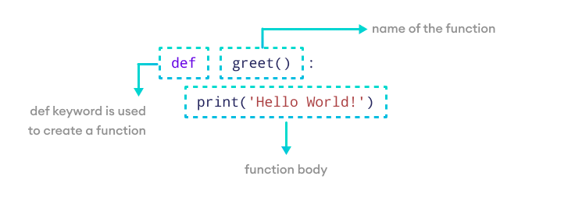
Functions
Functions in Python provide organized, reusable and modular code to perform a set of specific actions. Functions simplify the coding process, prevent redundant logic, and make the code easier to follow
Syntax:
>> def greet(): print('Hello World!')
If we run the above code, we won't get an output.
It's because creating a function doesn't mean we are executing the code inside it. It means the code is there for us to use if we want to.
To use this function, we need to call the function.
>> greet()
Output
Hello World! Outside function

Slide 44
Functions – Arguments & Parameters
Parameters
Parameters are the variables listed inside the parentheses in the function definition. They act like placeholders for the data the function can accept when we call them.
Think of parameters as the blueprint that outlines what kind of information the function expects to receive.
>> def print_age(age): # age is a parameter print(age)
In this example, the print_age() function takes age as its input. However, at this stage, the actual value is not specified.
The age parameter is just a placeholder waiting for a specific value to be provided when the function is called.
Arguments
Arguments are the actual values that we pass to the function when we call it.
Arguments replace the parameters when the function executes.
>> print_age(25) # 25 is an argument
Here, during the function call, the argument 25 is passed to the function.

Slide 45
Functions – args & kwargs
Python passes variable length non keyword argument to function using *args but we cannot use this to pass keyword argument. For this problem Python has got a solution called **kwargs, it allows us to pass the variable length of keyword arguments to the function.
In the function, we use the double asterisk ** before the parameter name to denote this type of argument. The arguments are passed as a dictionary and these arguments make a dictionary inside function with name same as the parameter excluding double asterisk
>> def intro(**data): print("\nData type of argument:", type(data)) for key, value in data.items(): print("{} is {}".format(key, value)) >> intro(Firstname = "Sita", Lastname = "Sharma", Age=22, Phone=1234567890) >> intro(Firstname="John", Lastname="Wood", Email="johnwood@nomail.com", Country="Wakanda", Age=25, Phone=9876543210)
In Python, we can pass a variable number of arguments to a function using special symbols. There are two special symbols:
*args (Non Keyword Arguments)
**kwargs (Keyword Arguments)
We use *args and **kwargs as an argument when we are unsure about the number of arguments to pass in the functions.
Using *args to pass the variable length arguments to the function
>> def adder(*num): sum = 0 for n in num: sum = sum + n print("Sum :", sum) >> adder(3,5) >> adder(1,2,3,5,6)

Slide 46
Functions – global & non-local
Python Local Variables
When we declare variables inside a function, these variables will have a local scope (within the function). We cannot access them outside the function.
These types of variables are called local variables. For example,
>> def greet(): # local variable message = 'Hello' print('Local', message) >> greet() # try to access message variable # outside greet() function >> print(message)
Output
Local Hello NameError: name 'message' is not defined
In Python, we can declare variables in three different scopes: local scope, global, and nonlocal scope.
A variable scope specifies the region where we can access a variable. For example,
>> def add_numbers(): sum = 5 + 4
Here, the sum variable is created inside the function, so it can only be accessed within it (local scope). This type of variable is called a local variable.
Based on the scope, we can classify Python variables into three types:
Local Variables
Global Variables
Nonlocal Variables

Slide 47
Functions – global & non-local
In Python, nonlocal variables are used in nested functions whose local scope is not defined. This means that the variable can be neither in the local nor the global scope.
We use the nonlocal keyword to create nonlocal variables. For example,
# outside function def outer(): message = 'local' def inner(): # declare nonlocal variable nonlocal message message = 'nonlocal' print("inner:", message) inner() print("outer:", message) outer()
Output
inner: nonlocal outer: nonlocal
In the above example, there is a nested inner() function. We have used the nonlocal keywords to create a nonlocal variable.
The inner() function is defined in the scope of another function outer()
In Python, a variable declared outside of the function or in global scope is known as a global variable. This means that a global variable can be accessed inside or outside of the function.
Let's see an example of how a global variable is created in Python.
# declare global variable >> message = 'Hello’ >> def greet(): # declare local variable print('Local', message) >> greet() >> print('Global', message)
Output
Local Hello Global Hello
This time we can access the message variable from outside of the greet() function. This is because we have created the message variable as the global variable.

Slide 48
Functions – Closures
>> def make_multiplier_of(n): def multiplier(x): return x * n return multiplier # Multiplier of 3 times3 = make_multiplier_of(3) # Multiplier of 5 times5 = make_multiplier_of(5) # Output: 27 print(times3(9)) # Output: 15 print(times5(3)) # Output: 30 print(times5(times3(2)))
Python closure is a nested function that allows us to access variables of the outer function even after the outer function is closed.
When to use closures?
Closures can be used to avoid global values and provide data hiding and can be an elegant solution for simple cases with one or few methods.
However, for larger cases with multiple attributes and methods, a class implementation may be more appropriate.

Slide 49
Functions – Decorators
>> def smart_divide(func): def inner(a, b): print("I am going to divide", a, "and", b) if b == 0: print("Whoops! cannot divide") return func(a, b) return inner >> @smart_divide >> def divide(a, b): print(a/b) >> divide(2,5) >> divide(2,0)
Output
I am going to divide 2 and 5 0.4 I am going to divide 2 and 0 Whoops! cannot divide
In Python, a decorator is a design pattern that allows you to modify the functionality of a function by wrapping it in another function.
The outer function is called the decorator, which takes the original function as an argument and returns a modified version of it.
In fact, any object which implements the special __call__() method is termed callable. So, in the most basic sense, a decorator is a callable that returns a callable.
Basically, a decorator takes in a function, adds some functionality and returns it.

Slide 50
Generators
Example: Python Generator
Here's an example of a generator function that produces a sequence of numbers,
>> def my_generator(n): # initialize counter value = 0 # loop until counter is less than n while value < n: # produce the current value of the counter yield value # increment the counter value += 1 # iterate over the generator object produced by my_generator >> for value in my_generator(3): print(value)
Output:
0
1
2
In Python, a generator is a function that returns an iterator that produces a sequence of values when iterated over.
Generators are useful when we want to produce a large sequence of values, but we don't want to store all of them in memory at once.
Create Python Generator
In Python, similar to defining a normal function, we can define a generator function using the def keyword, but instead of the return statement we use the yield statement.
>> def generator_name(arg): # statements yield something
Here, the yield keyword is used to produce a value from the generator.
When the generator function is called, it does not execute the function body immediately. Instead, it returns a generator object that can be iterated over to produce the values.

Slide 51
Lambda Functions
Lambda is an anonymous, inlined function
The parameters of the lambda are defined to the left of the colon.
The function body is defined to the right of the colon. The result of running the function body is (implicitly) returned.
We use the lambda keyword instead of def to create a lambda function. Here's the syntax to declare the lambda function:
lambda argument(s) : expression
Here,
argument(s) - any value passed to the lambda function
expression - expression is executed and returned
Syntax:
>> s = lambda x: x*x
>> s(8)
Output:
64

Slide 52
Classes
Example:
class Dog:
def __init__(self, breed):
self.breed = breed
Sam = Dog(breed = 'Lab')
frank = Dog(breed = 'Huskie')
Here __init__() is automatically called after object is created.
def __init__(self, breed):
Each attribute in a class definition brings with a reference to the instance object.
It is by convention named self. The breed is its argument.
Value is passed during the class instantiation.
>> self.breed = breed
Now we have created two instances of Dog class.
With two breed types, we can access these attributes like this:
>> Sam.breed, frank.breed
The class is a blueprint that defines nature of the future object.
By convention we give classes a name that starts with capital letter.
#create an object type called sample
>> class Sample:
pass
#instance of sample
>> x= Sample()
print(type(x))
x is a reference to our new instance of a sample class.
Inside class we can define attributes and methods.
An attribute is a characteristic of an object.
A method is an operation we can perform with the object.

Slide 53
Classes – __init__()
Classes describe data and provide methods to manipulate that data, all encompassed under a single
object. Furthermore, classes allow for abstraction by separating concrete implementation details from abstract representations of data.
class Person(object):
species = "Homo Sapiens"
def __init__(self, name):
self.name = name
def __str__(self):
return self.name
def rename(self, renamed):
self.name = renamed
print("Now my name is {}".format(self.name))
1. The class is made up of attributes (data) and methods (functions).
2. Attributes and methods are simply defined as normal variables and functions.
3. As noted in the corresponding docstring, the __init__() method is called the initializer. It's equivalent to the constructor in other object-oriented languages and is the method that is first run when you create a new object, or new instance of the class.
4. Attributes that apply to the whole class are defined first and are called class attributes.
5. Attributes that apply to a specific instance of a class (an object) are called instance attributes. They are generally defined inside __init__(); this is not necessary, but it is recommended
6. Every method, included in the class definition passes the object in question as its first parameter. The word self is used for this parameter

Slide 54
Classes – Inheritance
>> class Animal:
# attribute and method of the parent class
name = ""
def eat(self):
print("I can eat“)
# inherit from Animal
>> class Dog(Animal):
# new method in subclass
def display(self):
# access name attribute of superclass using self
print("My name is ", self.name)
# create an object of the subclass
>> labrador = Dog()
>> labrador.name = "Rohu"
>> labrador.eat()
# call subclass method
>> labrador.display()
Output:
I can eat
My name is Rohu
allows us to create a new class from an existing one.
The newly created class is known as the subclass (child or derived class).
The existing class from which the child class inherits is known as the superclass (parent or base class).
Syntax:
>> # define a superclass
class super_class:
# attributes and method definition
# inheritance
class sub_class(super_class):
# attributes and method of super_class
# attributes and method of sub_class
Here, we are inheriting the sub_class from the super_class

Slide 55
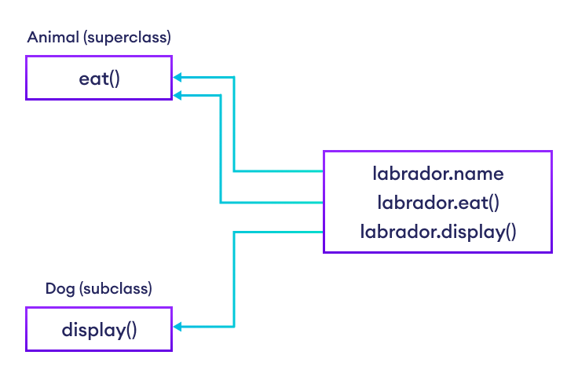
Classes – Inheritance
is-a relationship
Inheritance is an is-a relationship. That is, we use inheritance only if there exists an is-a relationship between two classes. For example,
Car is a Vehicle
Apple is a Fruit
Cat is an Animal
Inheritance Types
There are 5 different types of inheritance in Python. They are:
Single Inheritance: a child class inherits from only one parent class.
Multiple Inheritance: a child class inherits from multiple parent classes.
Multilevel Inheritance: a child class inherits from its parent class, which is inheriting from its parent class.
Hierarchical Inheritance: more than one child class are created from a single parent class.
Hybrid Inheritance: combines more than one form of inheritance.

Slide 56
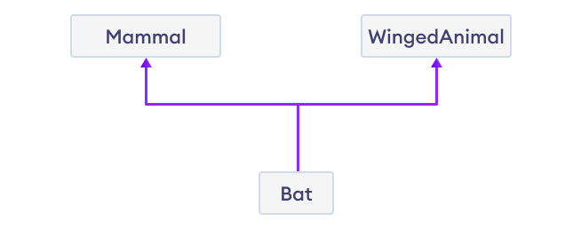
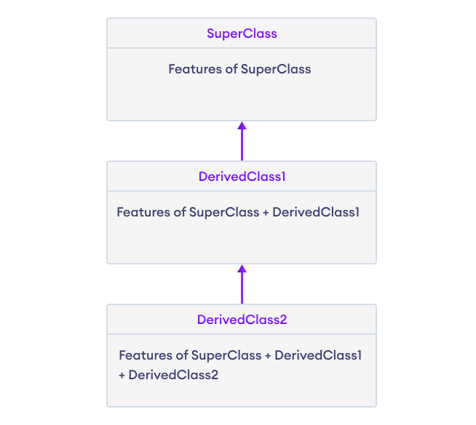
Classes – Multiple Inheritance vs Multi-Level Inheritance
class SuperClass:
# Super class code here
class DerivedClass1(SuperClass):
# Derived class 1 code here
class DerivedClass2(DerivedClass1):
# Derived class 2 code here
Python Multiple Inheritance Syntax
class SuperClass1:
# features of SuperClass1
class SuperClass2:
# features of SuperClass2
class MultiDerived(SuperClass1, SuperClass2):
# features of SuperClass1 + SuperClass2 + MultiDerived class

Slide 57
Classes – Polymorphism
class Dog:
def __init__(self, name, age):
self.name = name
self.age = age
def info(self):
print(f"I am a dog. My name is {self.name}. I am {self.age} years old.")
def make_sound(self):
print("Bark")
>> cat1 = Cat("Kitty", 2.5)
>> dog1 = Dog("Fluffy", 4)
for animal in (cat1, dog1):
animal.make_sound()
animal.make_sound()
Output:
Meow
Bark
It refers to the use of a single type entity (method, operator or object) to represent different types in different scenarios
We can use the concept of polymorphism while creating class methods as Python allows different classes to have methods with the same name.
We can then later generalize calling these methods by disregarding the object we are working with
>> class Cat:
def __init__(self, name, age):
self.name = name
self.age = age
def info(self):
print(f"I am a cat. My name is {self.name}. I am {self.age} years old.")
def make_sound(self):
print("Meow")

Slide 58
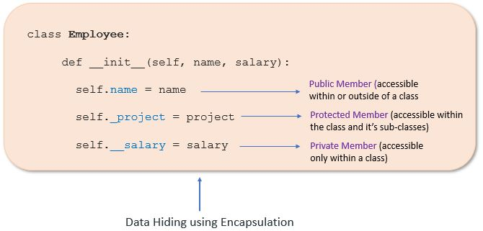
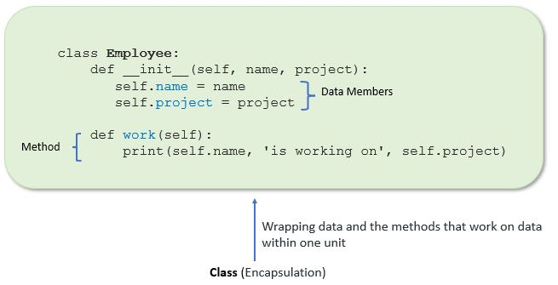
Classes – Encapsulation
Encapsulation in Python describes the concept of bundling data and methods within a single unit. So, for example, when you create a class, it means you are implementing encapsulation. A class is an example of encapsulation as it binds all the data members (instance variables) and methods into a single unit.
Using encapsulation, we can hide an object’s internal representation from the outside. This is called information hiding.
Also, encapsulation allows us to restrict accessing variables and methods directly and prevent accidental data modification by creating private data members and methods within a class.
Access Modifiers in Python
Encapsulation can be achieved by declaring the data members and methods of a class either as private or protected. But In Python, we don’t have direct access modifiers like public, private, and protected. We can achieve this by using single underscore and double underscores

Slide 59
File handling
File Mode | Description
‘r’ | reading mode. The default. It allows you only to read the file, not to modify it. When using this mode the file must exist
‘w’ | writing mode. It will create a new file if it does not exist, otherwise will erase the file and allow you to write to it
‘a’ | append mode. It will write data to the end of the file. It does not erase the file, and the file must exist for this mode.
‘r+’ | reading mode plus writing mode at the same time. This allows you to read and write into files at the same time without having to use r and w
‘w+’ | writing and reading mode. The exact same as r+ but if the file does not exist, a new one is made. Otherwise, the file is overwritten
‘a+’ | appending and reading mode. Similar to w+ as it will create a new file if the file does not exist
‘rb’ | reading mode in binary. This is similar to r except that the reading is forced in binary mode. This is also a default choice
‘wb’ | writing mode in binary. The same as w except the data is in binary
‘ab’ | appending in binary mode. Similar to a except that the data is in binary
'rb+' | reading and writing mode in binary. The same as r+ except the data is in binary
'wb+' | writing and reading mode in binary mode. The same as w+ but the data is in binary
'ab+' | appending and reading mode in binary. The same as a+ except that the data is in binary
'x' | open for exclusive creation, will raise FileExistsError if the file already exists
'xb' | open for exclusive creation writing mode in binary. The same as x except the data is in binary
'x+' | reading and writing mode. Similar to w+ as it will create a new file if the file does not exist. Otherwise,will raise FileExistsError
'xb+' | writing and reading mode. The exact same as x+ but the data is binary
A file is a named location used for storing data.
we need to open a file first to perform any operations on it—we use the open() function to do so
Syntax:
>> with open(filename, <mode>) as f:
f.read()
>> with open(filename, 'w') as f:
f.write(filedata)
>> with open(filename, 'a') as f:
f.write('\\n' + newdata)

Slide 60
File handling
Method | Description
close() | Closes the file
detach() | Returns the separated raw stream from the buffer
fileno() | Returns a number that represents the stream, from the operating system's perspective
flush() | Flushes the internal buffer
isatty() | Returns whether the file stream is interactive or not
read() | Returns the file content
readable() | Returns whether the file stream can be read or not
readline() | Returns one line from the file
readlines() | Returns a list of lines from the file
seek() | Change the file position
seekable() | Returns whether the file allows us to change the file position
tell() | Returns the current file position
truncate() | Resizes the file to a specified size
writable() | Returns whether the file can be written to or not
write() | Writes the specified string to the file
writelines() | Writes a list of strings to the file

Slide 61
Regex
Character sets
Pattern | Meaning
\w | Match a single word character a-z, A-Z, 0-9, and underscore (_)
\d | Match a single digit 0-9
\s | Match whitespace including \t, \n, and \r and space character
. | Match any character except the newline
\W | Match a character except for a word character
\D | Match a character except for a digit
\S | Match a single character except for a whitespace character
Anchors
Pattern | Meaning
^ | Match at the beginning of a string
$ | Match at the end of a string
\b | Match a position defined as a word boundary
\B | Match a position that is not a word boundary
Quantifiers
Quantifiers (Greedy) | Non-greedy Quantifiers (Lazy) | Meaning
* | *? | Match its preceding element zero or more times.
+ | +? | Match its preceding element one or more times.
? | ?? | Match its preceding element zero or one time.
{n} | {n}? | Match its preceding element exactly n times.
{n , } | {n,}? | Match its preceding element at least n times.
{n , m} | {n , m}? | Match its preceding element from n to m times

Slide 62
Regex
Sets and ranges
Capturing groups
Pattern | Meaning
[XYZ] | Match any of three elements X, Y, and Z
[X-Y] | Match a range from X to Y
^[XYZ] | Match any single element except X, Y, and Z
^[X-Y] | Match any single element
{n , } | Match its preceding element at least n times.
{n , m} | Match its preceding element from n to m times
Pattern | Meaning
(X) | Capture the X in the group
(?P<name>X) | Capture the X and assign it the name
\N | Reference the capturing group #N
\g<N> | Reference the capturing group #N (alternative syntax)
Regex methods
Function | Description
findall() | Return a list of matches or None
finditer() | Return an iterator yielding all non-overlapping matches
search() | Return the first match
fullmatch() | Return a Match object if the whole string matches a pattern
match() | Return the match at the beginning of a string or None
sub() | Return a string with matched replaced with a replacement
split() | Split a string at the occurrences of matches
Look Around
Pattern | Meaning
X(?=Y) | Match X but only if it is followed by Y
X(?!Y) | Match X but only if it is NOT followed by Y
(?<=Y)X | Match X if there is Y before it
(?<!Y)X | Match X if there is NO Y before it

Slide 63
Exception handling
An exception is an unexpected event that occurs during program execution. For example,
>> divide_by_zero = 7 / 0
The above code causes an exception as it is not possible to divide a number by 0.
For instance, Exceptions occur when we
try to open a file(for reading) that does not exist (FileNotFoundError)
try to divide a number by zero (ZeroDivisionError)
try to import a module that does not exist (ImportError) and so on.
Whenever these types of runtime errors occur, Python creates an exception object.
If not handled properly, it prints a traceback to that error along with some details about why that error occurred.
>> Output
Traceback (most recent call last):
File "<string>", line 1, in <module>
ZeroDivisionError: division by zero
Illegal operations can raise exceptions. There are plenty of built-in exceptions in Python that are raised when corresponding errors occur.
We can view all the built-in exceptions using the built-in local() function as follows
>> print(dir(locals()['__builtins__']))

Slide 64
Exception handling
In Python, an exception is an object derives from the BaseException class that contains information about an error event that occurred within a method. Exception object contains:
Error type (exception name)
The state of the program when the error occurred
An error message describes the error event.
Why use Exception
Standardized error handling: Using built-in exceptions or creating a custom exception with a more precise name and description, you can adequately define the error event, which helps you debug the error event.
Cleaner code: Exceptions separate the error-handling code from regular code, which helps us to maintain large code easily.
Robust application: With the help of exceptions, we can develop a solid application, which can handle error event efficiently
Exceptions propagation: By default, the exception propagates the call stack if you don’t catch it. For example, if any error event occurred in a nested function, you do not have to explicitly catch-and-forward it; automatically, it gets forwarded to the calling function where you can handle it.
Different error types: Either you can use built-in exception or create your custom exception and group them by their generalized parent class, or Differentiate errors by their actual class

Slide 65
Exception handling – built-in Exceptions
Exception | Description
AssertionError | Raised when an assert statement fails.
AttributeError | Raised when attribute assignment or reference fails.
EOFError | Raised when the input() function hits the end-of-file condition.
FloatingPointError | Raised when a floating-point operation fails.
GeneratorExit | Raise when a generator’s close() method is called.
ImportError | Raised when the imported module is not found.
IndexError | Raised when the index of a sequence is out of range.
KeyError | Raised when a key is not found in a dictionary.
KeyboardInterrupt | Raised when the user hits the interrupt key (Ctrl+C or Delete)
MemoryError | Raised when an operation runs out of memory.
NameError | Raised when a variable is not found in the local or global scope.
OSError | Raised when system operation causes system related error.
ReferenceError | Raised when a weak reference proxy is used to access a garbage collected referent.

Slide 66
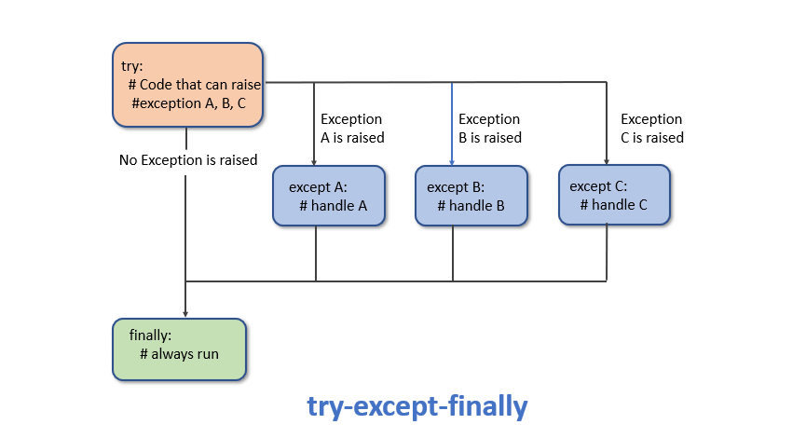
Exception handling – built-in Exceptions
try :
# statements in try block
except :
# executed when exception occured in try block
else:
# statements in else block when there is no exception
finally:
# always run this code
Example:
>> try:
a = int(input("Enter value of a:"))
b = int(input("Enter value of b:"))
c = a / b
print("The answer of a divide by b:", c)
>> except ZeroDivisionError:
print("Can't divide with zero")
>> finally:
print("Inside a finally block")
The raise statement allows us to throw an exception
assert keyword allows us to ensure the value of variable does not change

Slide 67
Itertools
Python’s Itertool is a module that provides various functions that work on iterators to produce complex iterators. This module works as a fast, memory-efficient tool
Infinite iterators:
Iterator | Arguments | Results | Example
count() | [start[, step]] | start, start+step, start+2*step, … | count(10) → 10 11 12 13 14 ...
cycle() | p | p0, p1, … plast, p0, p1, … | cycle('ABCD') → A B C D A B C D ...
repeat() | elem [,n] | elem, elem, elem, … endlessly or up to n times | repeat(10, 3) → 10 10 10
Combinatoric iterators:
Iterator | Arguments | Results
product() | p, q, … [repeat=1] | cartesian product, equivalent to a nested for-loop
permutations() | p[, r] | r-length tuples, all possible orderings, no repeated elements
combinations() | p, r | r-length tuples, in sorted order, no repeated elements
combinations_with_replacement() | p, r | r-length tuples, in sorted order, with repeated elements

Slide 68
Itertools
Iterators terminating on the shortest input sequence:
Iterator | Arguments | Results | Example
accumulate() | p [,func] | p0, p0+p1, p0+p1+p2, … | accumulate([1,2,3,4,5]) → 1 3 6 10 15
batched() | p, n | (p0, p1, …, p_n-1), … | batched('ABCDEFG', n=3) → ABC DEF G
chain() | p, q, … | p0, p1, … plast, q0, q1, … | chain('ABC', 'DEF') → A B C D E F
chain.from_iterable() | iterable | p0, p1, … plast, q0, q1, … | chain.from_iterable(['ABC', 'DEF']) → A B C D E F
compress() | data, selectors | (d[0] if s[0]), (d[1] if s[1]), … | compress('ABCDEF', [1,0,1,0,1,1]) → A C E F
dropwhile() | predicate, seq | seq[n], seq[n+1], starting when predicate fails | dropwhile(lambda x: x<5, [1,4,6,3,8]) → 6 3 8
filterfalse() | predicate, seq | elements of seq where predicate(elem) fails | filterfalse(lambda x: x<5, [1,4,6,3,8]) → 6 8
groupby() | iterable[, key] | sub-iterators grouped by value of key(v)
islice() | seq, [start,] stop [, step] | elements from seq[start:stop:step] | islice('ABCDEFG', 2, None) → C D E F G
pairwise() | iterable | (p[0], p[1]), (p[1], p[2]) | pairwise('ABCDEFG') → AB BC CD DE EF FG
starmap() | func, seq | func(*seq[0]), func(*seq[1]), … | starmap(pow, [(2,5), (3,2), (10,3)]) → 32 9 1000
takewhile() | predicate, seq | seq[0], seq[1], until predicate fails | takewhile(lambda x: x<5, [1,4,6,3,8]) → 1 4
tee() | it, n | it1, it2, … itn splits one iterator into n
zip_longest() | p, q, … | (p[0], q[0]), (p[1], q[1]), … | zip_longest('ABCD', 'xy', fillvalue='-') → Ax By C- D-
More Info: itertools — Functions creating iterators for efficient looping — Python 3.12.5 documentation

Slide 69
Functools – Higher order functions
The functools module is for higher-order functions: functions that act on or return other functions.
Benefits of Using functools
Function Composition: functools provides tools like compose and reduce that allow you to compose functions together. Function composition is the process of combining two or more functions to produce a new function. This makes it easier to create complex functions from simpler ones. It promotes code reuse and modularity by breaking down functionality into smaller, composable pieces.
Memoization: Memoization is a technique of caching function results to avoid redundant computations. The functools module provides the lru_cache decorator, which can be applied to functions. It caches the results of function calls based on their arguments. This is particularly useful for functions with expensive computations or recursive functions, as it can significantly improve performance by storing and reusing previously calculated results.
Decorator Simplification: Decorators are a powerful tool in Python for modifying the behavior of functions or methods. However, writing decorators can sometimes lead to boilerplate code for preserving metadata and docstrings. functools addresses this issue with functions like wraps and update_wrapper. These functions help simplify the creation of decorators by preserving the identity, name, and docstring of the decorated function, making the code more maintainable and readable.
Partial Function Application: The partial function in functools allows you to create new functions by fixing a specific set of arguments and keywords of an existing function. This is useful when you want to create variations of a function with some arguments pre-set. It reduces code duplication and makes your code more concise and readable.
Error Handling and Default Values: The functools module also provides functions like partialmethod and singledispatch that can be useful for managing error handling, providing default values, or customizing methods in classes.
Functional Programming Patterns: If you are a fan of functional programming, functools provides you with tools that enable you to implement functional programming patterns more easily in Python. This can lead to code that is more declarative and easier to reason about.

Slide 70
Functools – Higher order functions
partial
The partial function allows you to create a new function by fixing a certain number of arguments and keyword arguments of an existing function. It's a way to "pre-set" some parameters of a function, creating a new function with those parameters already set.
Here's an example:
from functools import partial
>> def multiply(x, y):
>> return x * y
# Create a new function that multiplies by 2
>> double = partial(multiply, y=2)
>> result = double(5)
>> print(result) # Output: 10
lru_cache
The lru_cache decorator is used for memoization, which is a technique to cache the results of a function so that if the same inputs are provided again, the function can return the cached result instead of recomputing it.
>> from functools import lru_cache
>> @lru_cache(maxsize=None) # None means no limit on cache size
>> def add(a, b):
print(f'Adding {a}, {b}')
return a + b
>> result = add(10, 5)
print(result)
# Output:
# Adding 10, 5
# 15

Slide 71
Functools – Higher order functions
reduce
reduce function is used to apply a binary function cumulatively to the items of an iterable, reducing it to a single accumulated result.
Here's an example:
>> from functools import reduce
>> data = [1, 2, 3, 4, 5] # Calculate the product of all elements
>> product = reduce(lambda x, y: x * y, data) print(product)
# Output: 120
map
map() function returns a map object(which is an iterator) of the results after applying the given function to each item of a given iterable (list, tuple etc.)
>> numbers = (1, 2, 3, 4)
>>result = map(lambda x: x + x, numbers)
>> print(list(result))
# output: [2, 4, 6, 8]

Slide 72
Functools – Higher order functions
filter
The filter() method filters the given sequence with the help of a function that tests each element in the sequence to be true or not
Here's an example:
>> def fun(variable):
letters = ['a', 'e', 'i', 'o', 'u']
if (variable in letters):
return True
else:
return False
>> sequence = ['g', 'e', 'e', 'j', 'k', 's', 'p', 'r’]
>> filtered = filter(fun, sequence)
>> print('The filtered letters are:’)
>> for s in filtered:
print(s)

